Slide 1
CSCI E-11
Class 12
April 22, 2025
Introduction to IoT

Slide 2
Outline for today’s class
News story
April 9 — World IoT Day!
Labs:
Lab 6 — Due April 28
Lab 7 — Due May 12
IoT 1
This week’s reading:
Internet of Things (IoT): Opportunities, issues and challenges towards a smart and sustainable future
IoT 2

Slide 3
News Stories

Slide 4
April 9 was World IOT Day

Slide 6
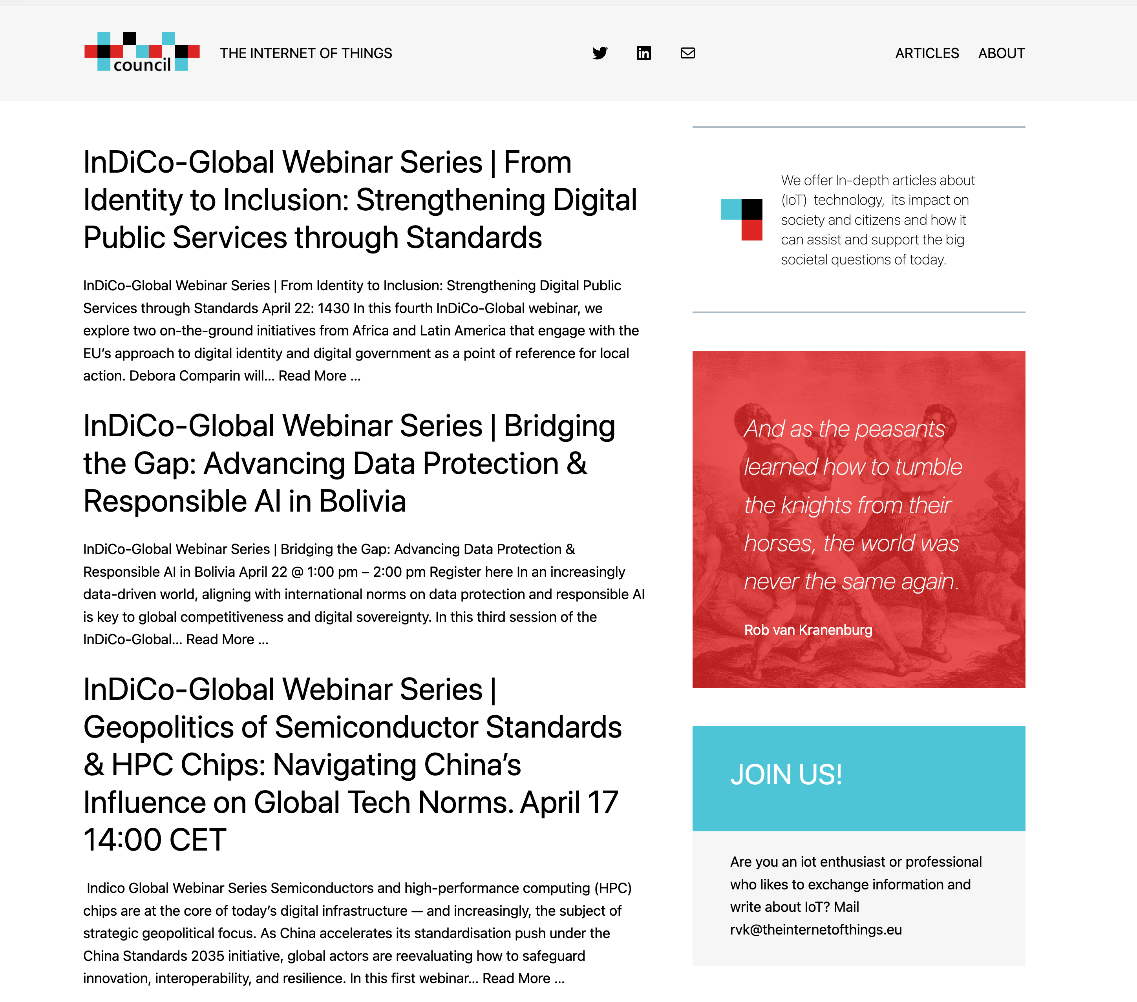

Slide 7
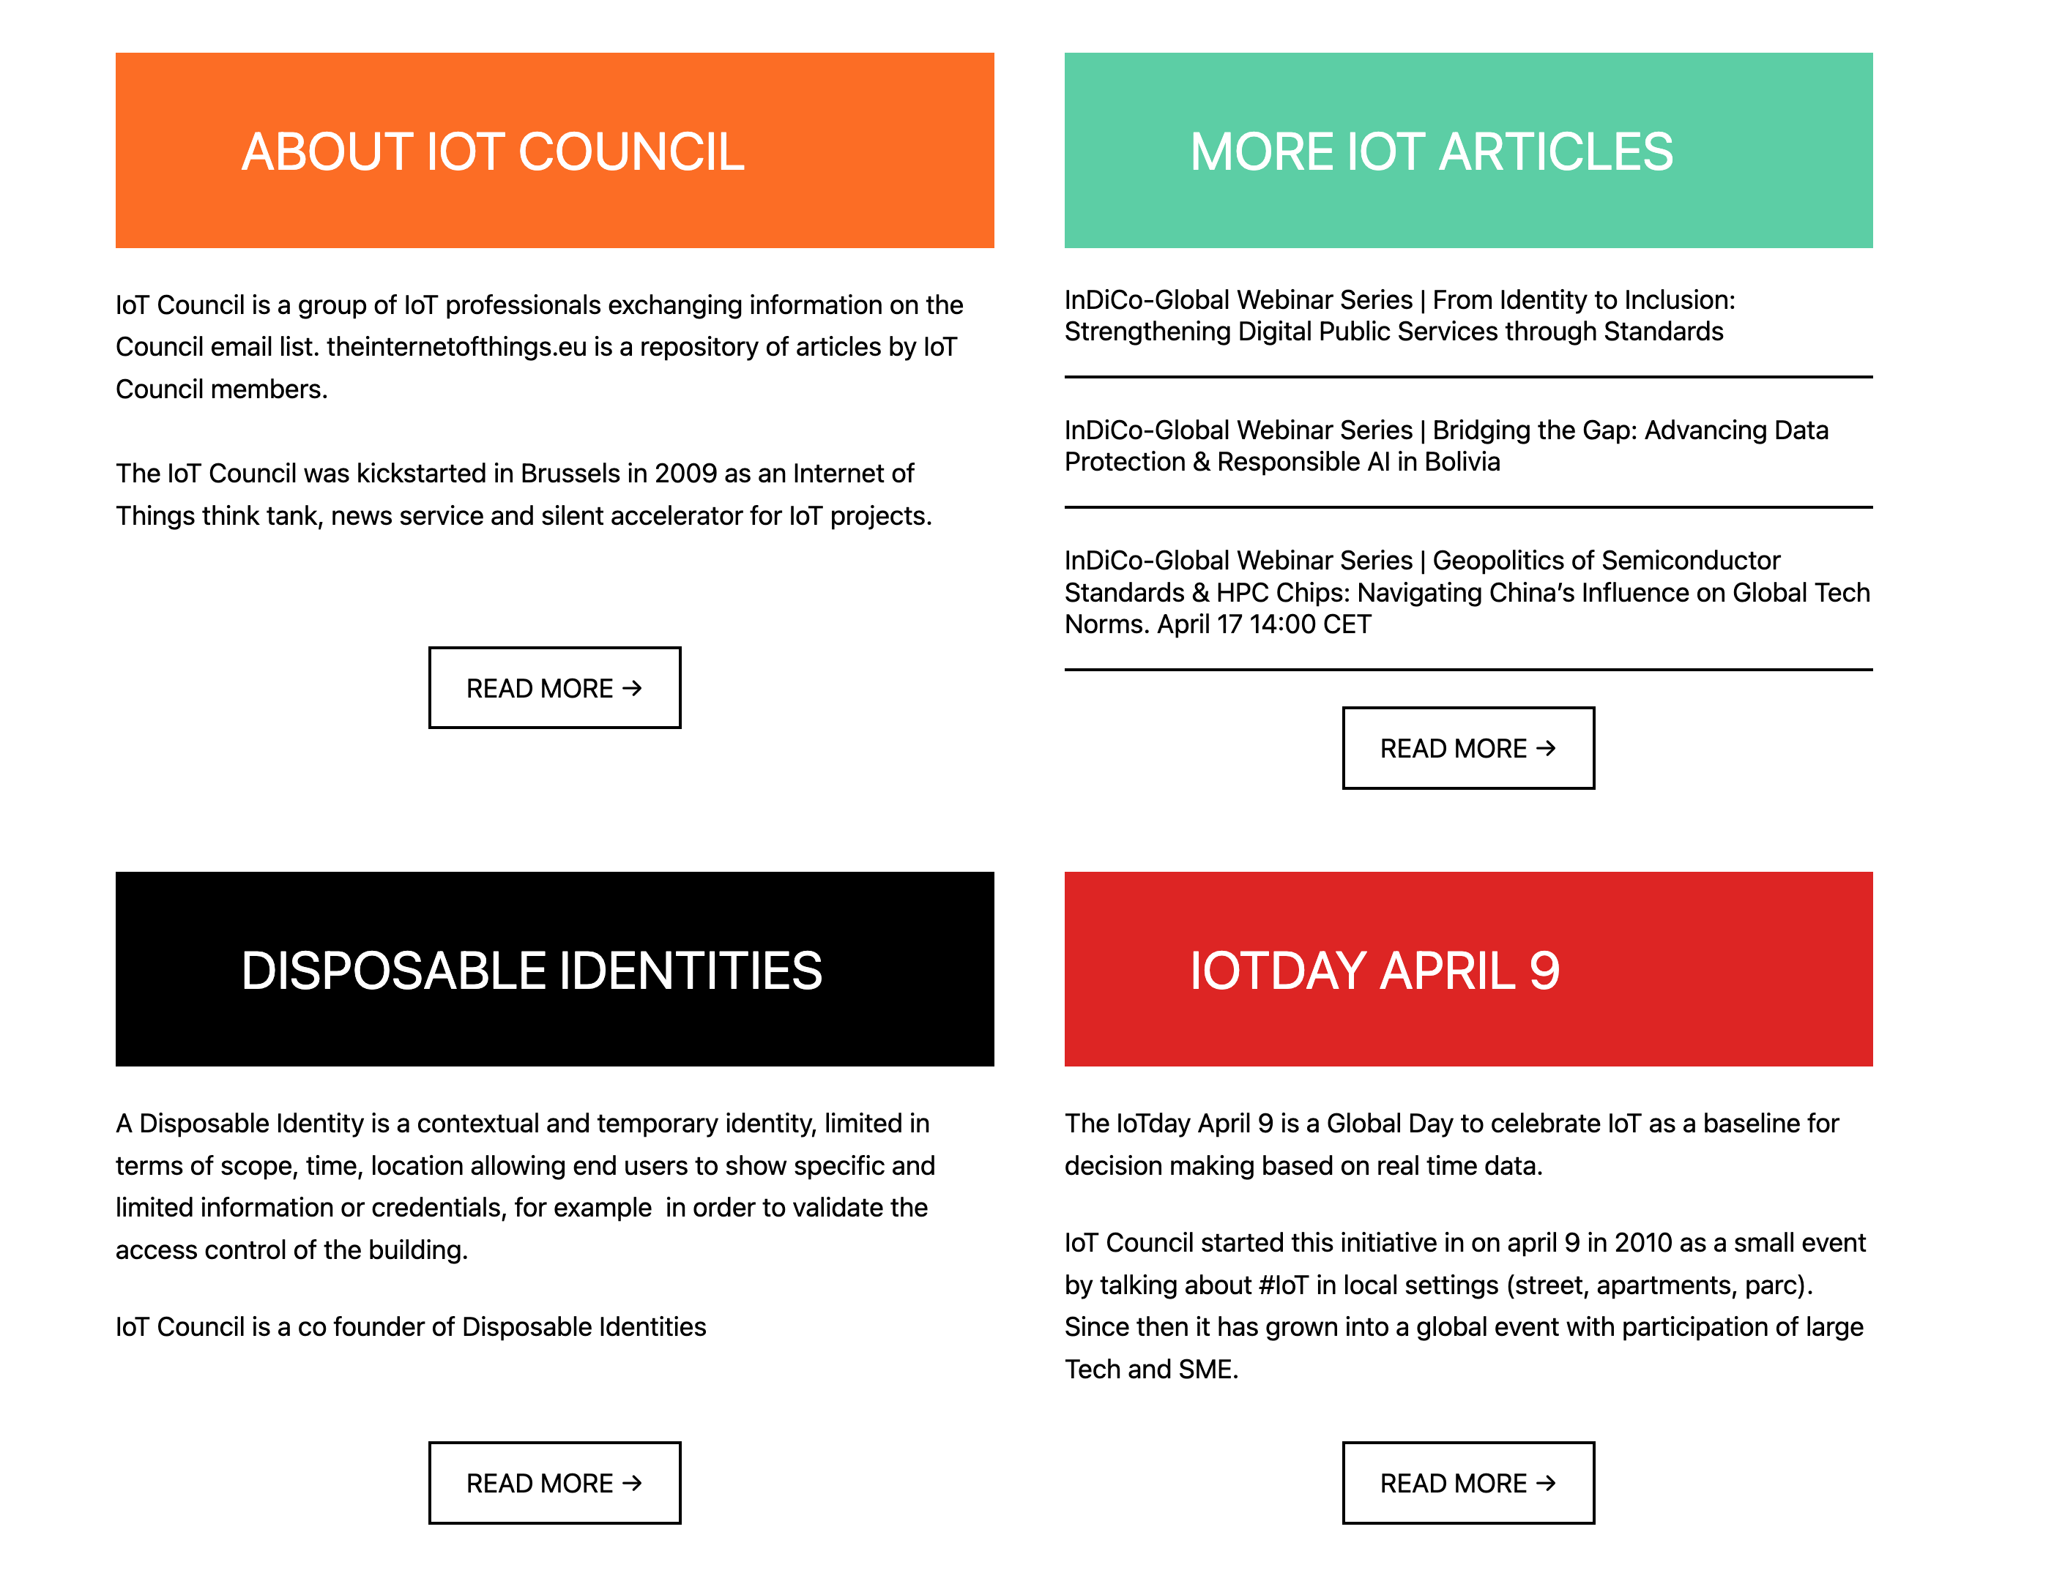

Slide 9
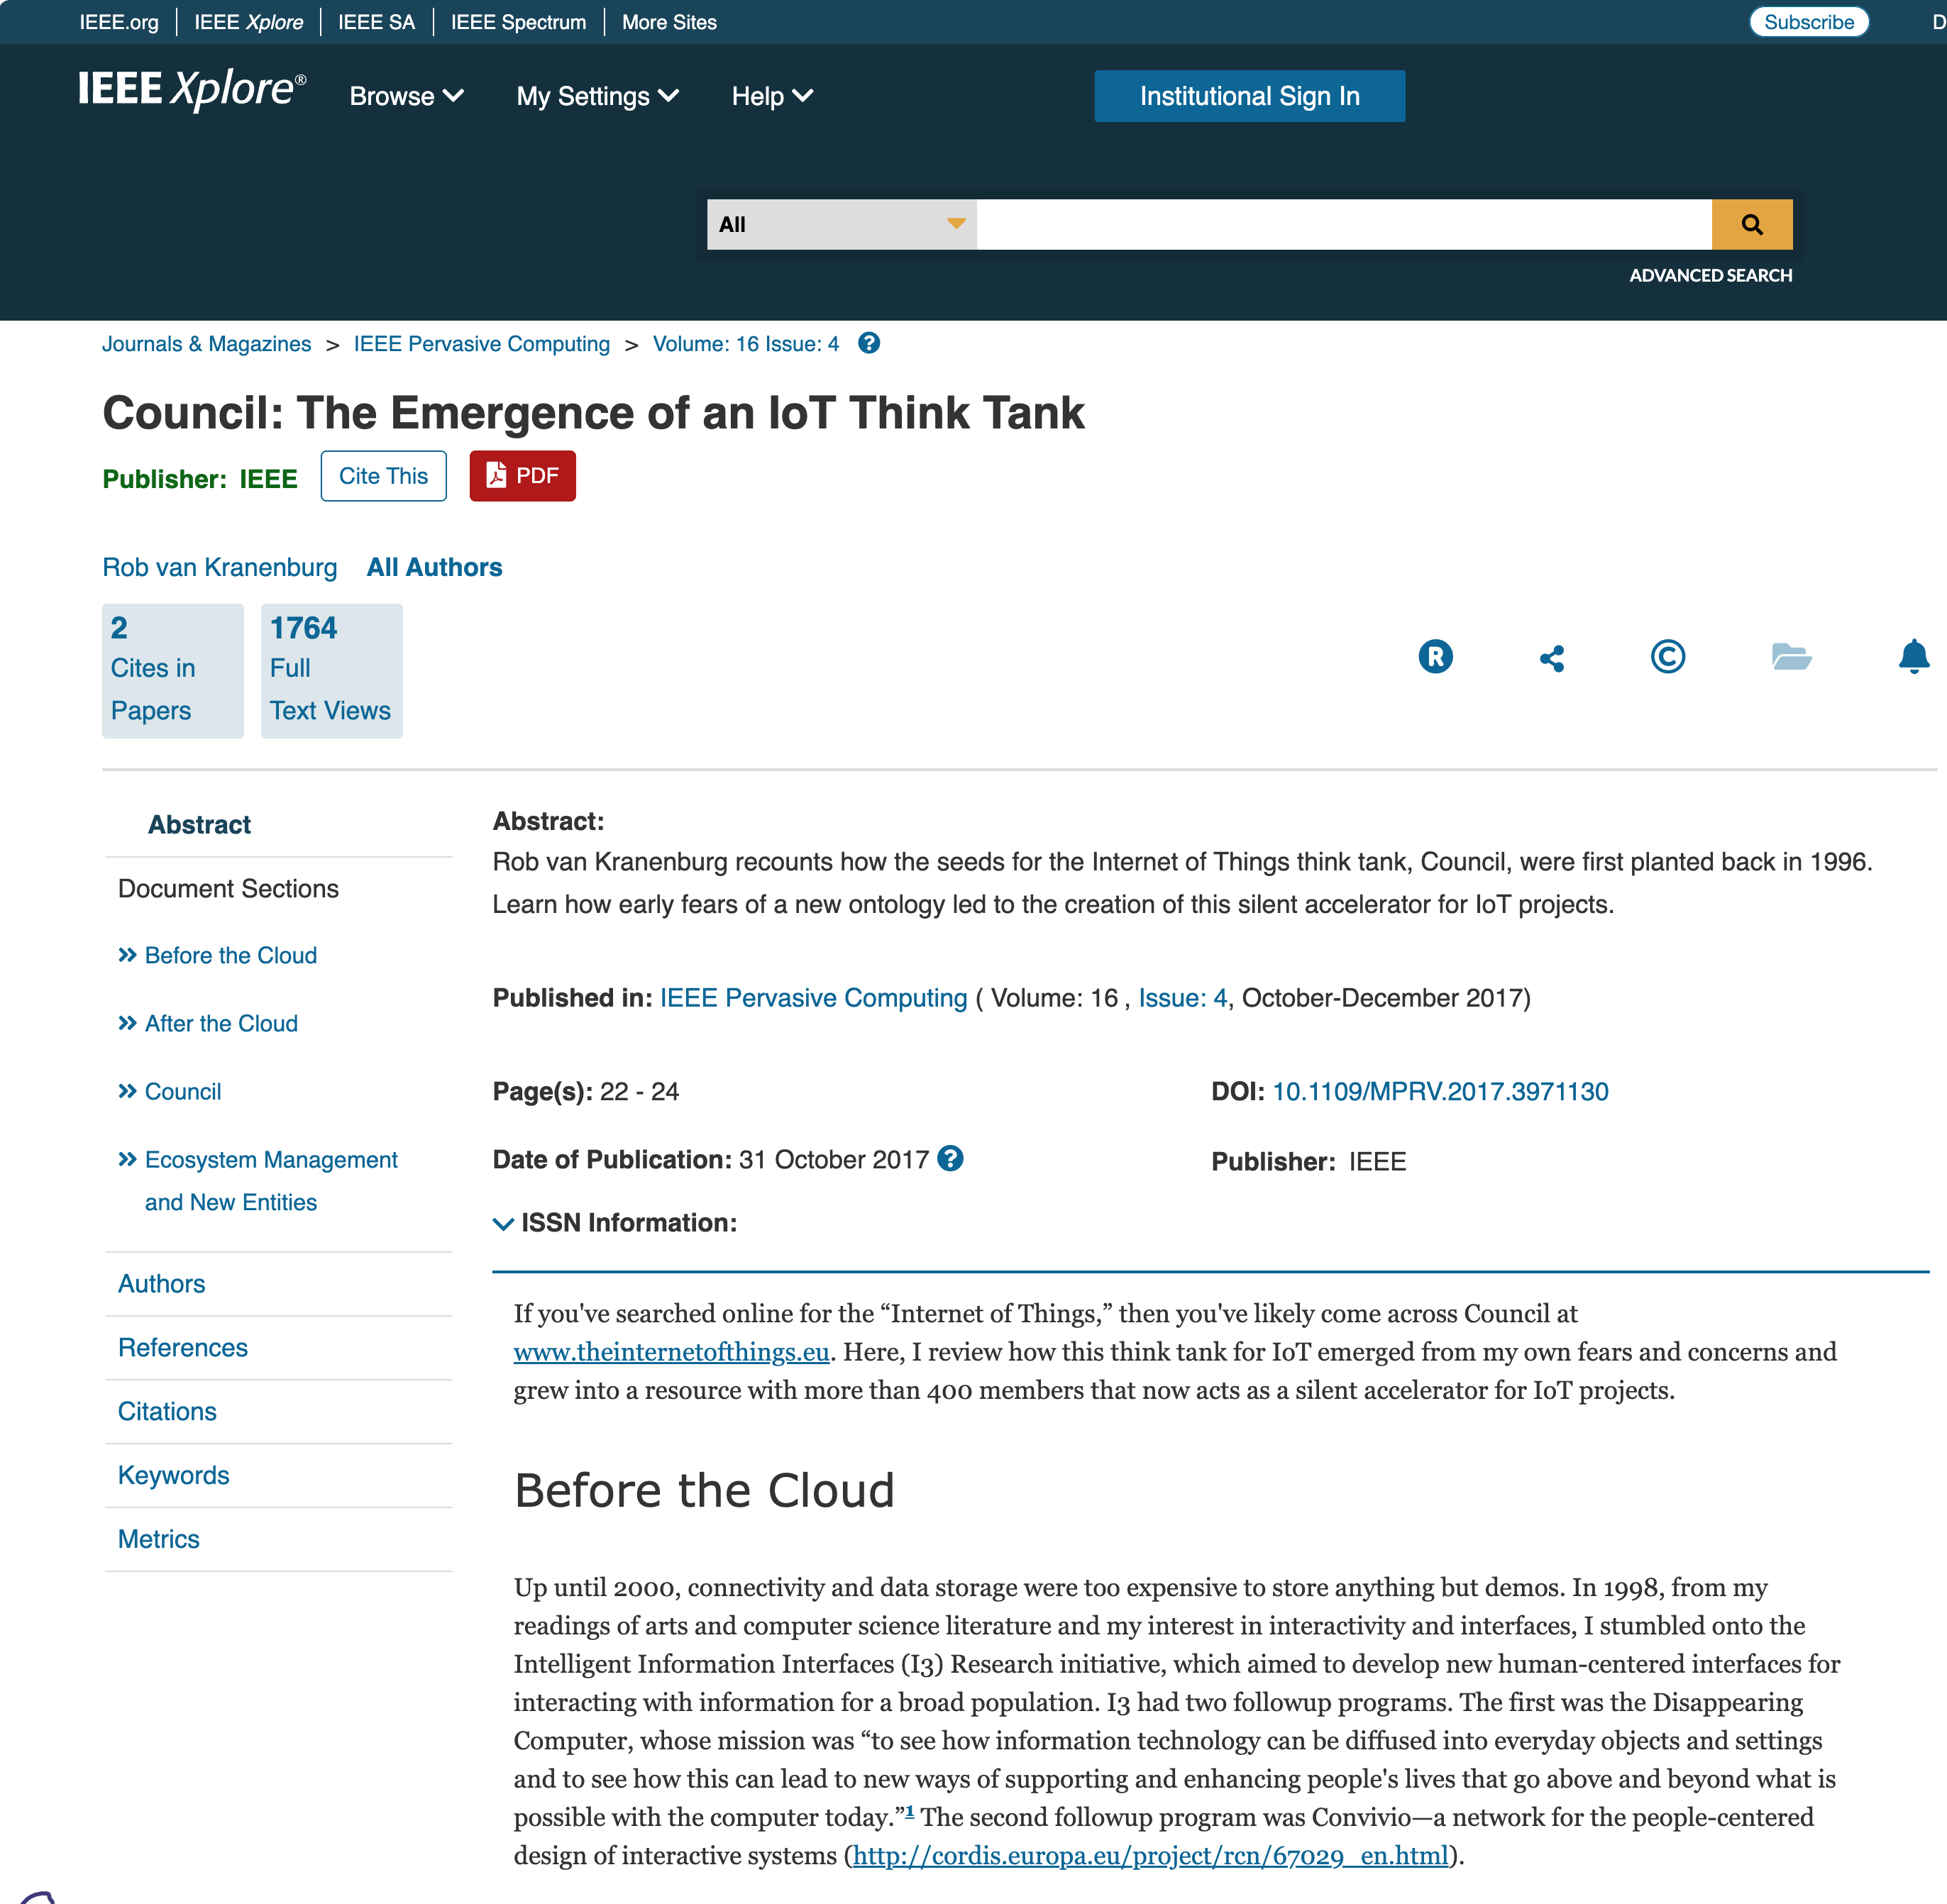

Slide 10
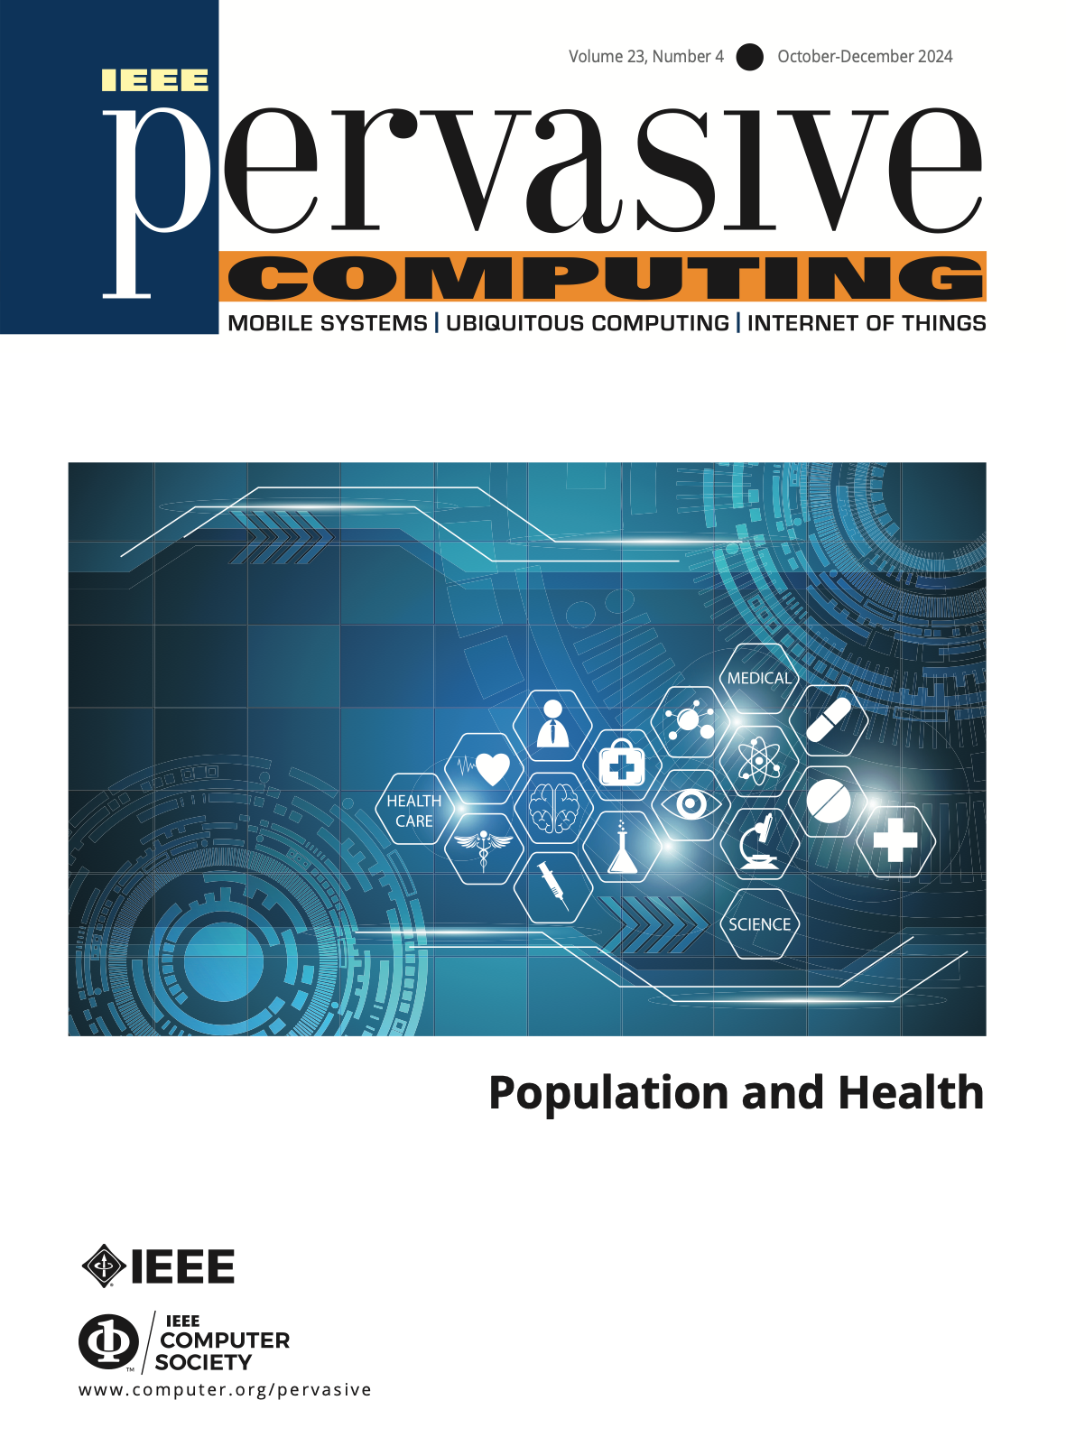
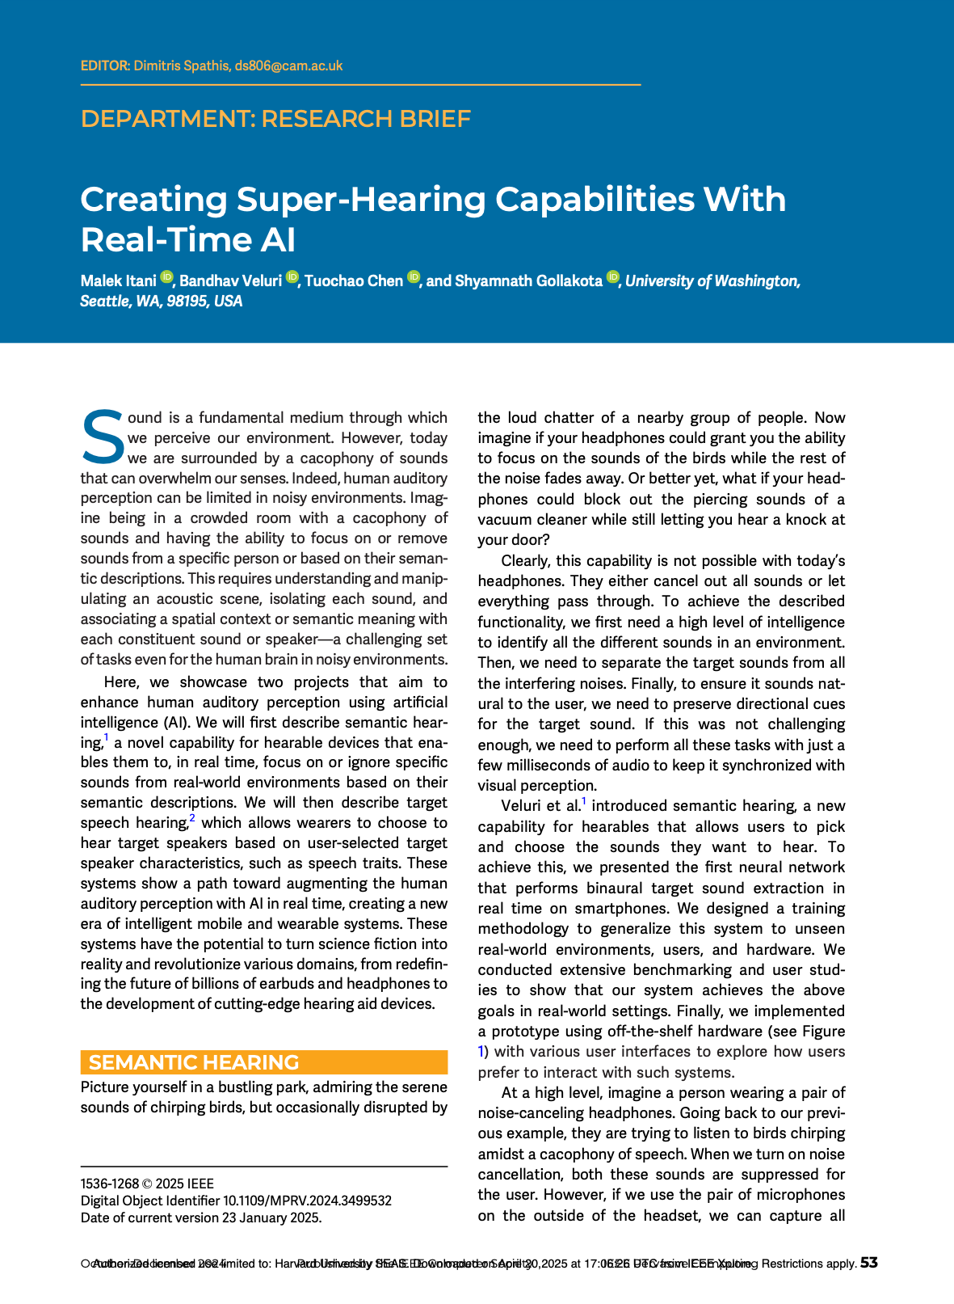
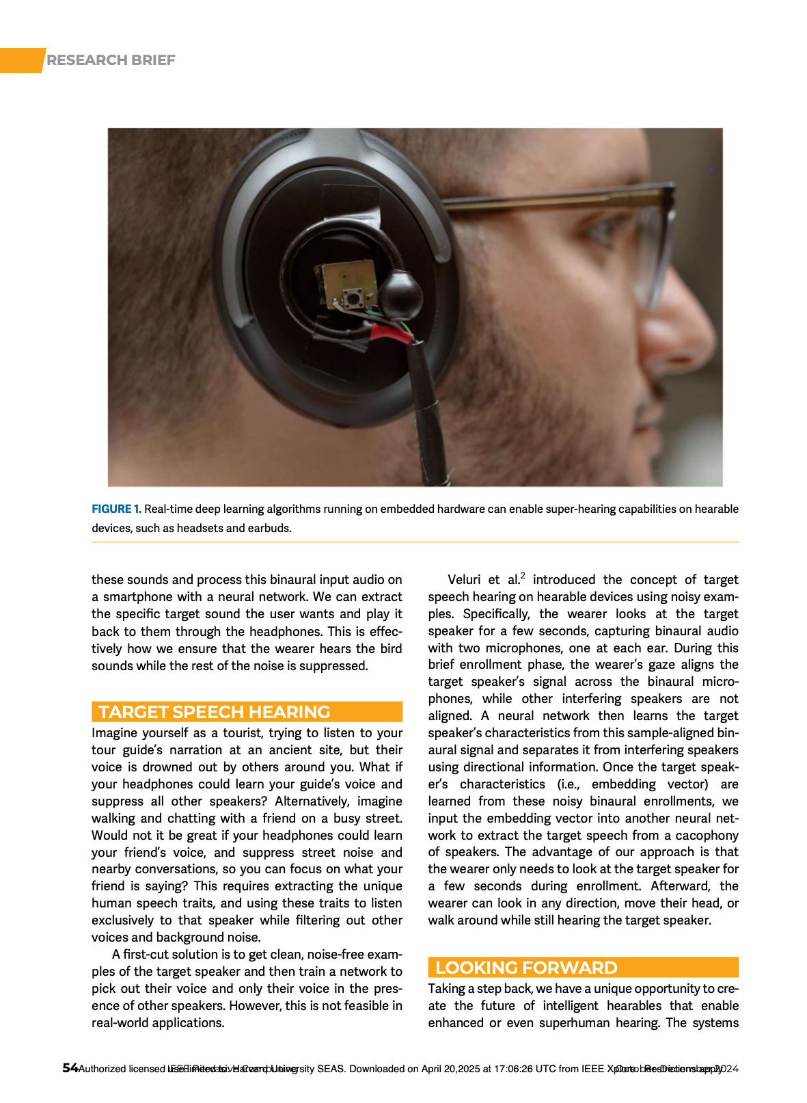

Slide 11
Labs
Lab #6: Due April 21 (Yesterday)
Lab #7: Due May 12 (3 weeks from now! Don’t wait)
Lab #8: Also due May 12 (5 points of extra credit)

Slide 12
Lab 6 — Leaderboard sorted by IP Address, as of April 20
Q: What features would you like to see added to the leaderboard display?

Slide 13
Lab 7

Slide 14
IoT 1

Slide 15
Internet of Things (IoT)
Q: What do we mean by “Internet?”

Slide 16
Internet: a network of networks

Slide 17
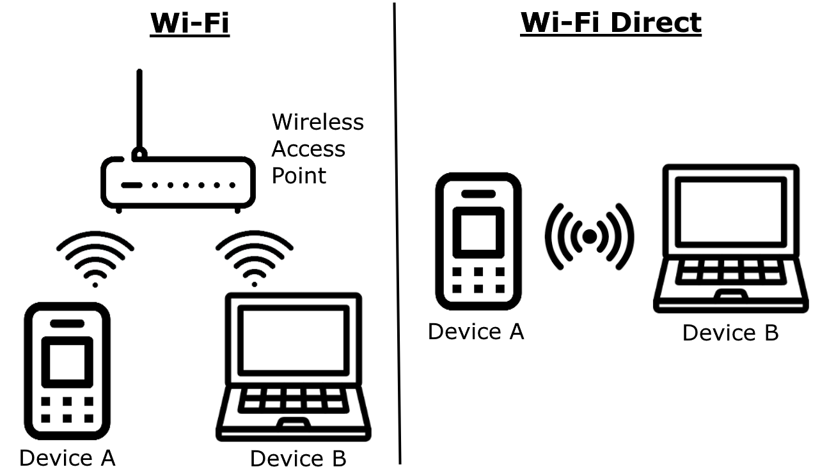
“Network” — Like your wi-fi network
Host ⇄ Host
“Layer 1” — the physical connection
IEEE 802.3 — Ethernet & Twisted Pair
IEEE 802.11 — Wi-Fi
“Layer 2” — the network data connection
MAC — Media Access Control
48-bit address — 44:a9:2c:51:41:90

Slide 18
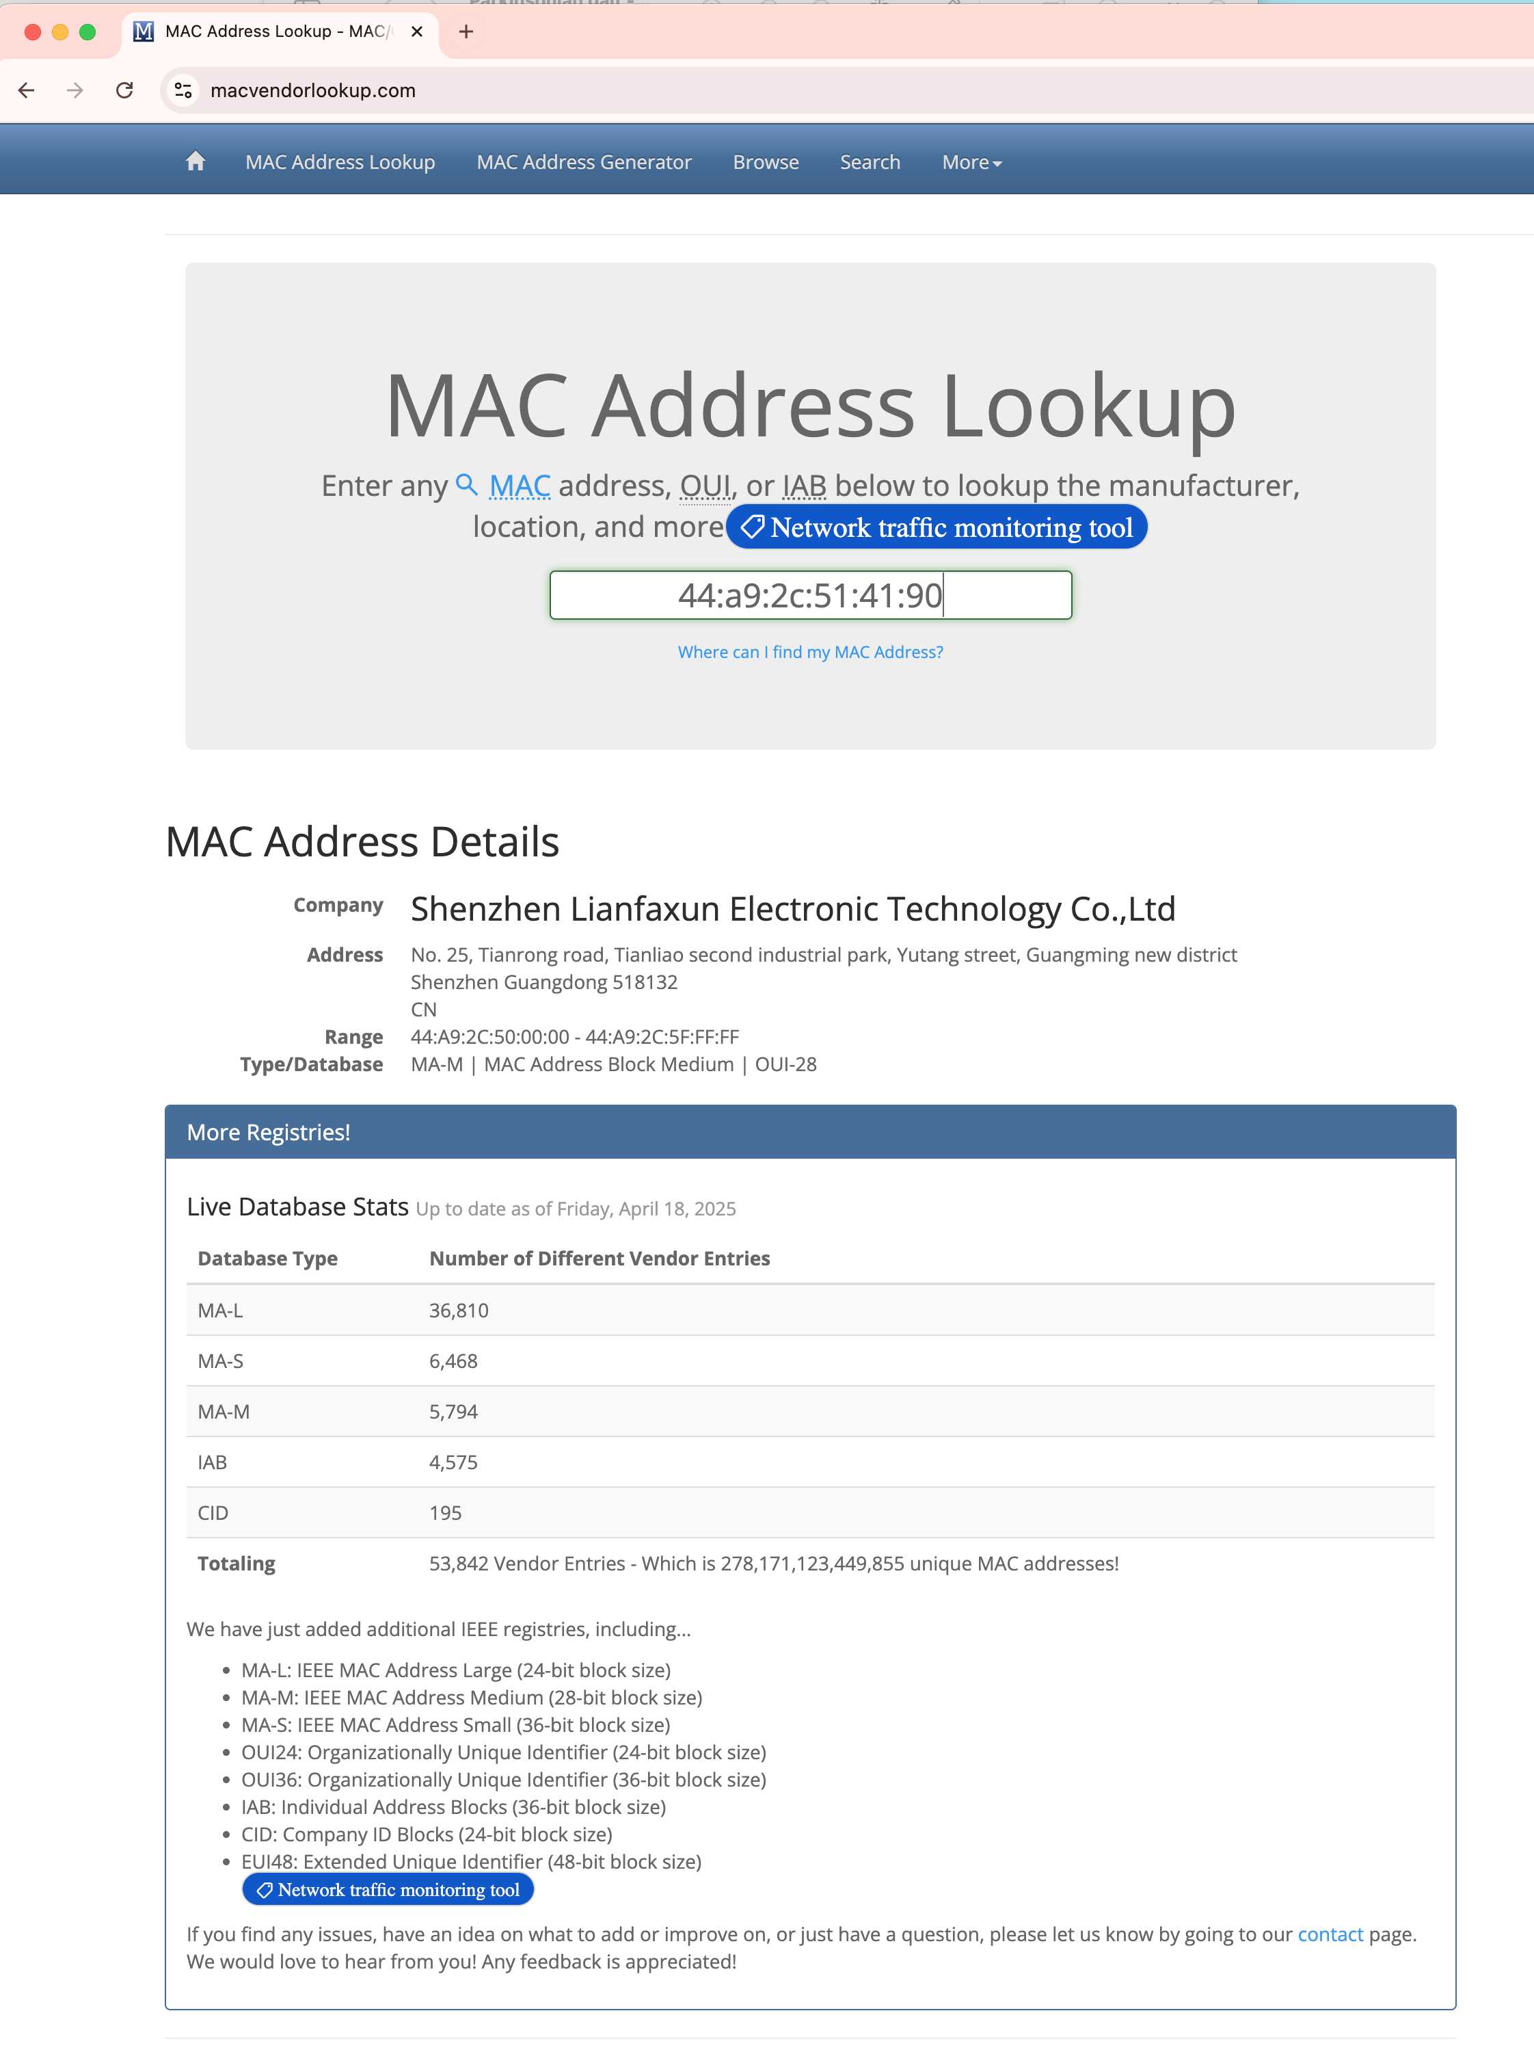
$ ifconfig
shows MAC addresses
simsong@Seasons ~ % ifconfig
lo0: flags=8049<UP,LOOPBACK,RUNNING,MULTICAST> mtu 16384
options=1203<RXCSUM,TXCSUM,TXSTATUS,SW_TIMESTAMP>
inet 127.0.0.1 netmask 0xff000000
inet6 ::1 prefixlen 128
inet6 fe80::1%lo0 prefixlen 64 scopeid 0x1
nd6 options=201<PERFORMNUD,DAD>
. . .
en7: flags=8863<UP,BROADCAST,SMART,RUNNING,SIMPLEX,MULTICAST> mtu 1500
options=404<VLAN_MTU,CHANNEL_IO>
ether 44:a9:2c:51:41:90
inet6 fe80::182f:551:f527:befe%en7 prefixlen 64 secured scopeid 0x1b
inet6 fd11:6ed0:5d25:a56b:1077:1fd9:ddb0:6fda prefixlen 64 autoconf secured
inet 10.14.8.90 netmask 0xfffff000 broadcast 10.14.15.255
nd6 options=201<PERFORMNUD,DAD>
media: autoselect (1000baseT <full-duplex>)
status: active

Slide 19
The Internet Protocol connects the networks together
“network gateway”
“network gateway”

Slide 20
IPv4 Internet January 1983 →

Slide 21
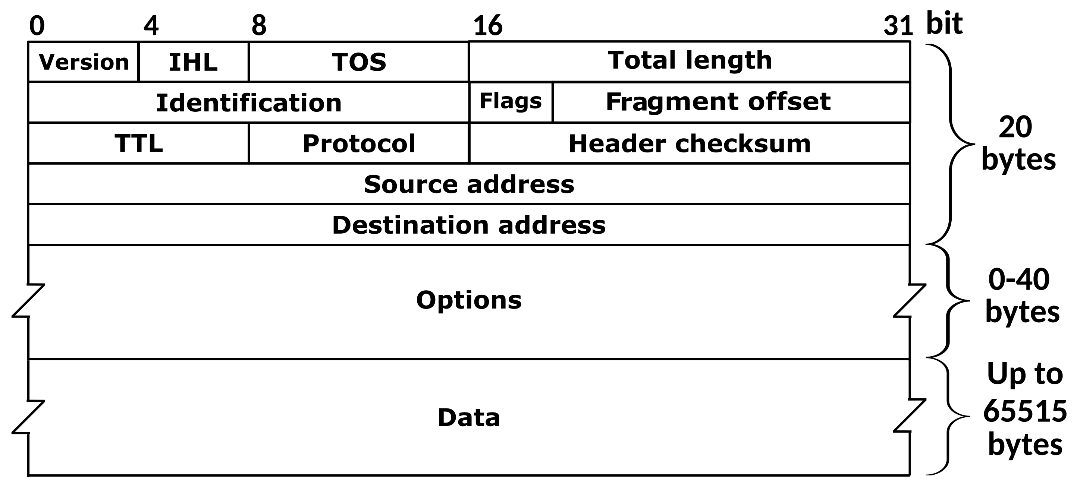
Facts about IPv4
Data moves by packets.
Packets can be fragmented.
Variable number of IP “options”
Most traffic is “TCP” (streams) or “UDP” (datagrams)
Each layer has its own “checksum.”
Source & destination addresses: 32 bits each = 2³² = 4,294,967,296 possible addresses
TCP & UDP source & destination Ports: 16 bits each = 2¹⁶ = 65,536 possible ports
Sample addresses:
127.0.0.1 loopback address
10.0.0.1 local network gateway
8.8.8.8 A popular nameserver
23.185.0.1 dce.harvard.edu

Slide 22
IPv4 — 2³² is not enough!
IP Address “exhaustion.”

Slide 23
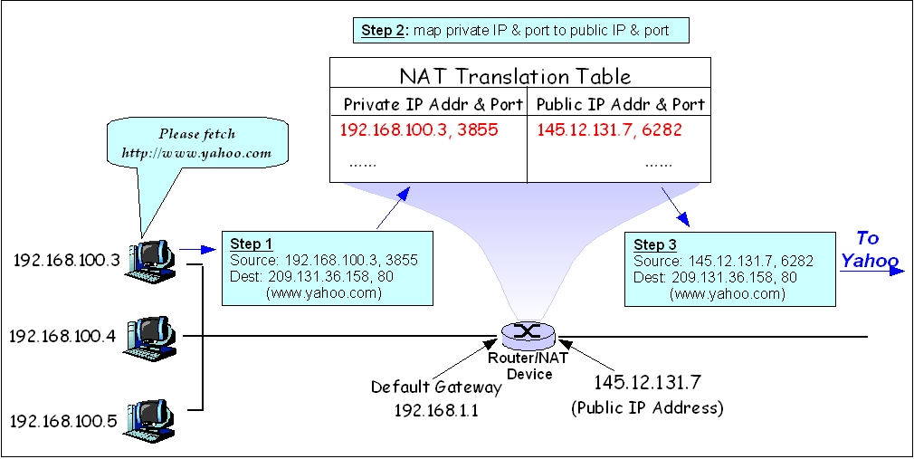
Private networks and network address translation help conserve IPv4 address space.
RFC 1918 name | IP address range | Number of addresses | Largest CIDR block (subnet mask) | Host ID size | Mask bits
24-bit block | 10.0.0.0 – 10.255.255.255 | 16777216 | 10.0.0.0/8 (255.0.0.0) | 24 bits | 8 bits
20-bit block | 172.16.0.0 – 172.31.255.255 | 1048576 | 172.16.0.0/12 (255.240.0.0) | 20 bits | 12 bits
16-bit block | 192.168.0.0 – 192.168.255.255 | 65536 | 192.168.0.0/16 (255.255.0.0) | 16 bits | 16 bits
https://en.wikipedia.org/wiki/Network_address_translation https://en.wikipedia.org/wiki/Private_network

Slide 24
IPv6 Internet June 6, 2012 →

Slide 25
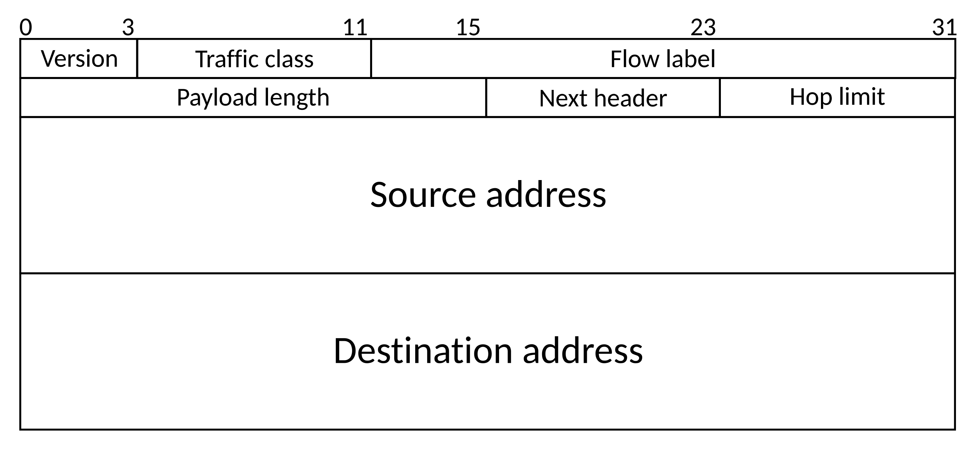
Facts about IPv6
Data moves by packets.
Packets cannot be fragmented.
No IP “options”
Most traffic is “TCP” (streams) or “UDP” (datagrams)
Only the top layer has a checksum.
Source & Destination Addresses: 128 bits each = 2¹²⁸ = 3.4 x 10³⁸ possible addresses
TCP source & destination ports: 16 bits each = 2¹⁶ = 65,536 possible ports
Sample addresses:
fe80::1 loopback address
fe80::434:97ff:feef:3a1d local IP address
2620:12a:8000::1 dce.harvard.edu
“::” means “fill with 0s.”

Slide 26
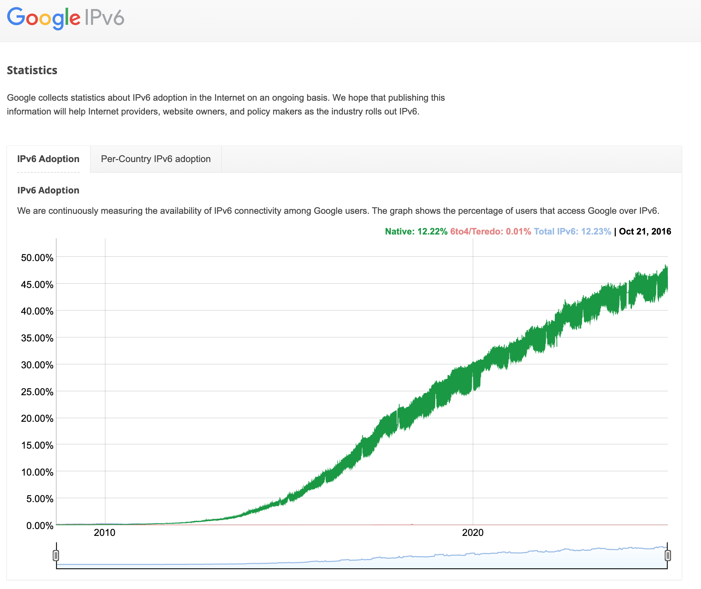
IPv6 adoption
https://www.google.com/intl/en/ipv6/statistics.html

Slide 27
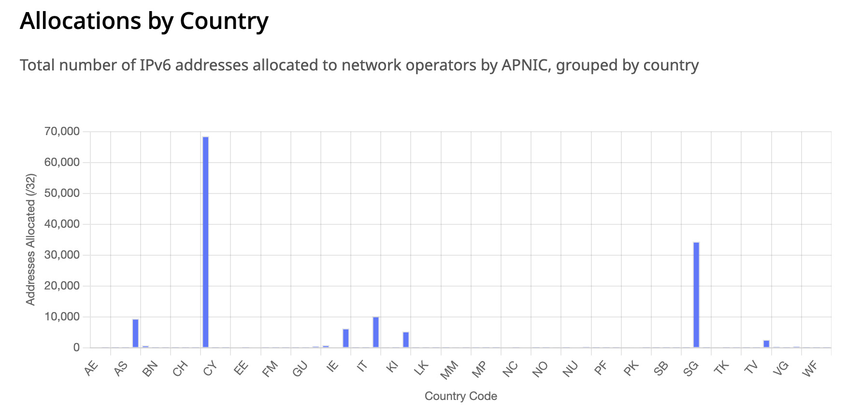
Q: Name three things wrong with this graph.
https://www.iana.org/numbers/allocations/apnic/ipv6/
Notes:
1 - the China graph (CN) is on Cyprus (CY)
2 - Ireland and TV and VG all have two bars.
3 - The location of each bar relative to the country changes.
Looks like the number of bars is more than the number of legends.

Slide 28
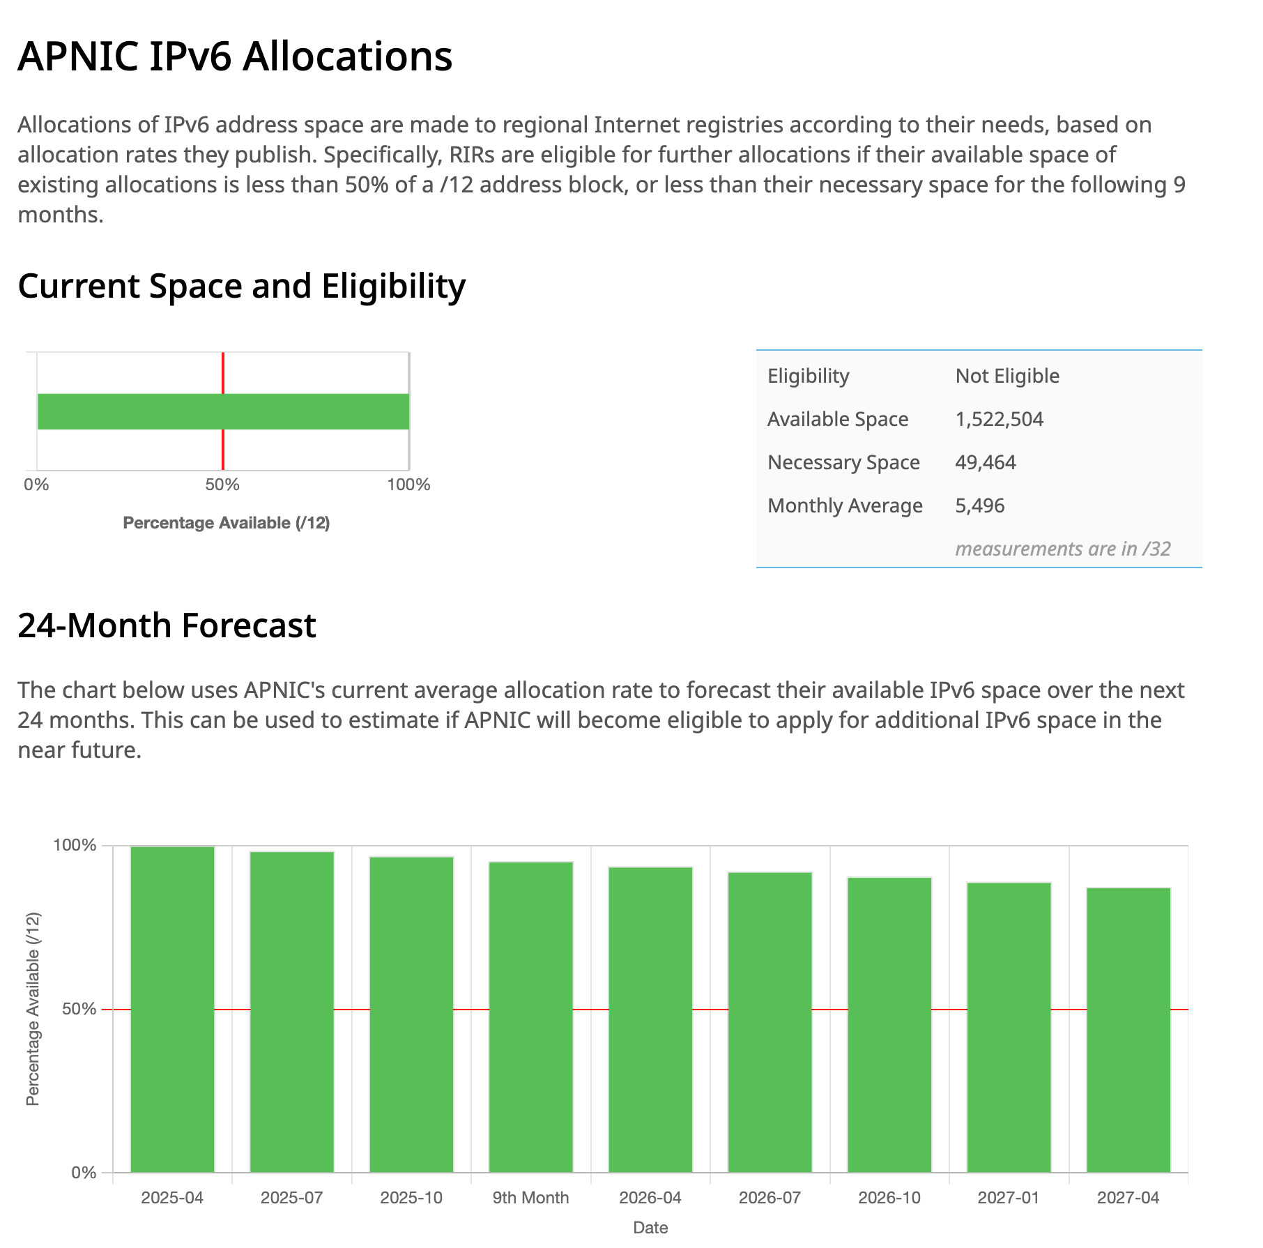
IPv6 exhaustion???
Even with 2¹²⁸ addresses, allocation matters.
https://www.iana.org/numbers/allocations/apnic/ipv6/

Slide 29
Internet of Things (IoT)

Slide 30
If IoT is something new, then…
Q: What are “not” things?

Slide 31
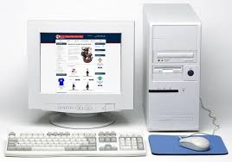
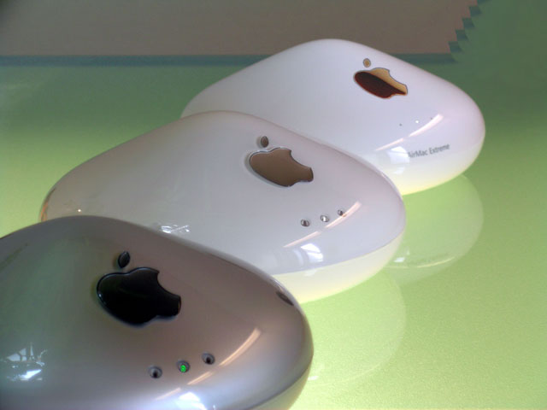
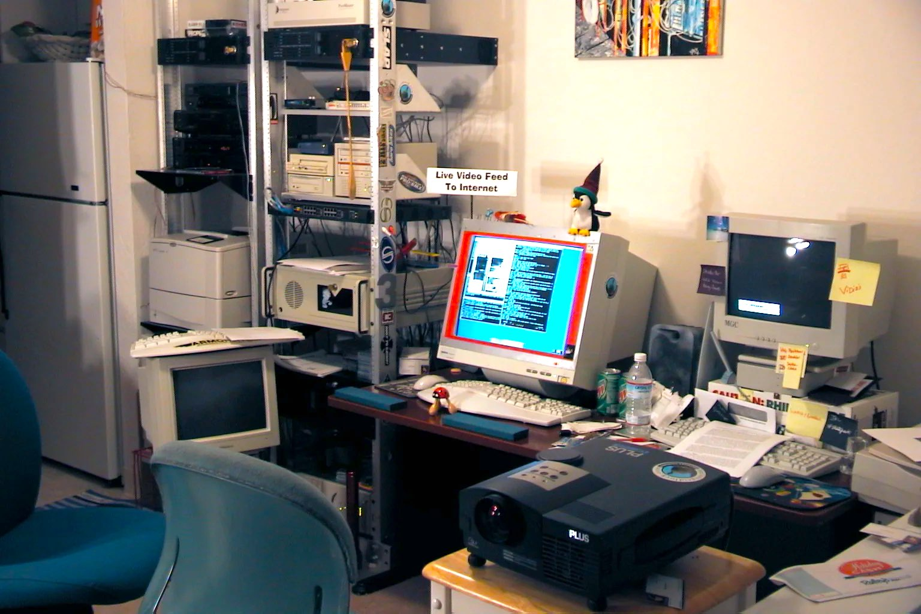
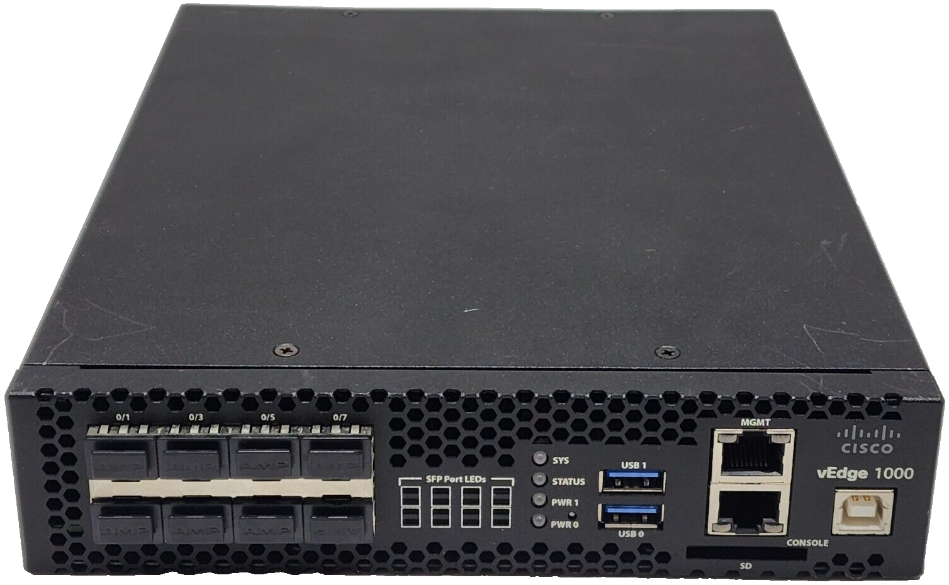
The Internet of “not things” (circa 1999) —
https://www.reddit.com/r/retrobattlestations/comments/agv6c6/home_battle_station_1999/

Slide 32
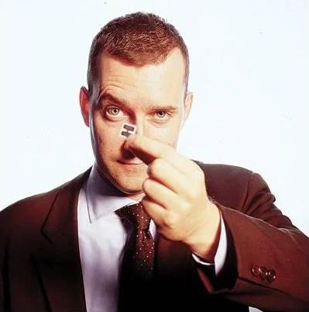
1999: Kevin Ashton, MIT Auto-ID Center, coins “Internet of Things”
“Auto-ID” — Things identify themselves.
RFID — Radio Frequency Identification.
https://alchetron.com/Kevin-Ashton

Slide 33
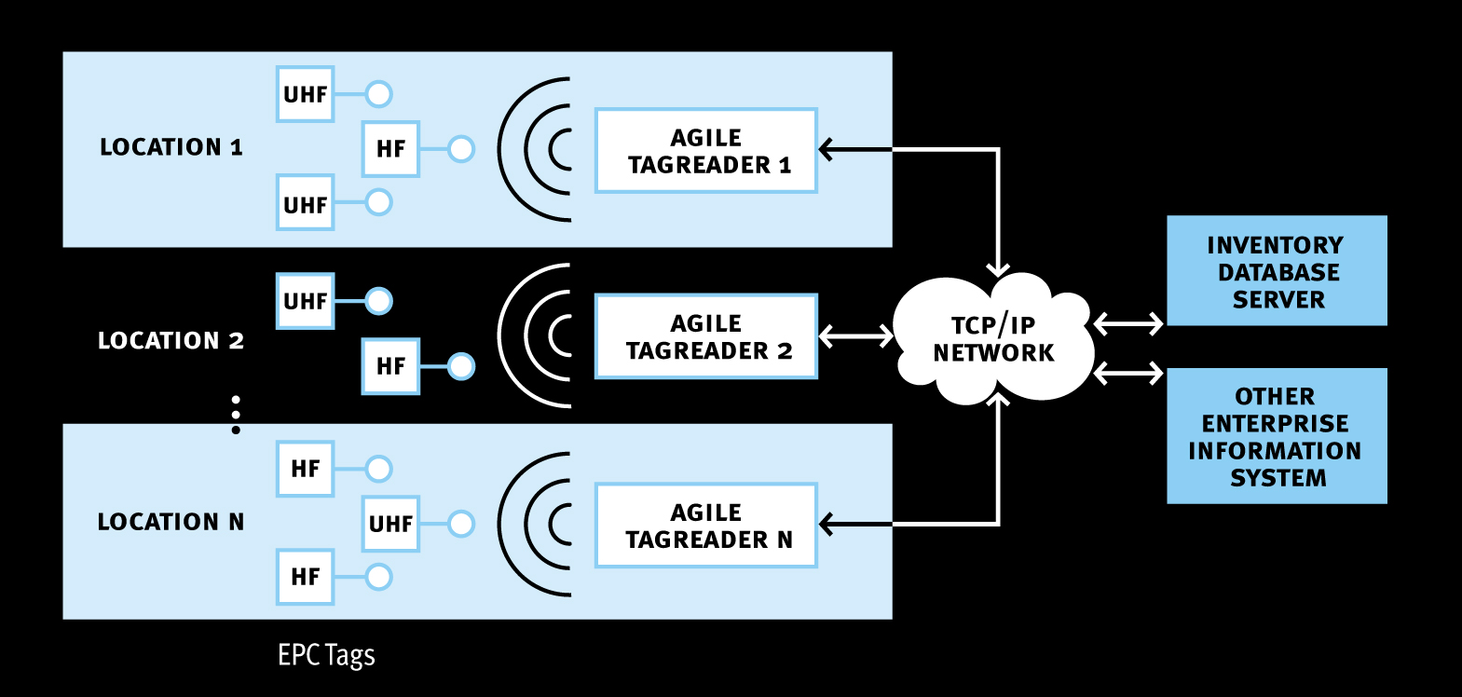
What is an RFID Reader?
Elements of an RFID system
(eg Savant)
Four main elements: Tags, Readers, Antennas, and Network Systems

Slide 34
RF system variables
Choice of operating frequency
Tag IC, tag antenna design
Reader, reader antenna design
Proximate materials
Sources of external interference

Slide 35
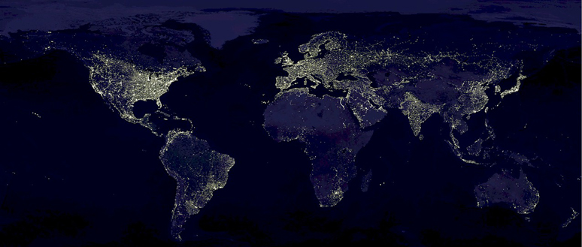
Major RFID markets by frequency
US, Canada
125KHz
13.56MHz
902-928MHz
EU Countries
125KHz
13.56MHz
868-870MHz
Japan
125KHz
13.56MHz
950-956MHz

Slide 36
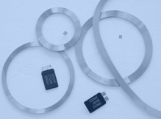
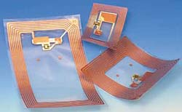
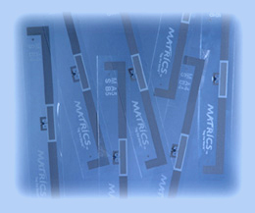
RFID tags at different frequencies
125 KHz
TI
Philips
Others
13.56 MHz
Tagsys
Philips
TI
Microchip
Others
915 MHz
Intermec
SCS
Matrics
Alien
Philips
TI
2.4 GHz
Intermec
SCS
Hitachi

Slide 37
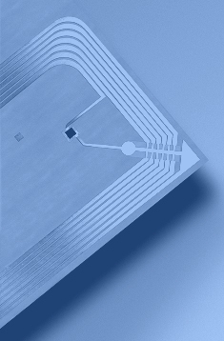
Tag anatomy
Substrate
Die attach
Tag IC
Antenna
Notes:
The tag is made up of three r major components: substrate, antenna and IC.
Its design, manuffacture and assembly are a complex set of steps with the following economics......

Slide 38
Tag block diagram
Antenna
Power Supply
Memory
Cells
Control Logic
(Finite State machine)
Tx Modulator
Rx Demodulator
Tag Integrated Circuit (IC)

Slide 39
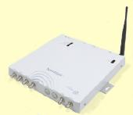
What does a reader do?
Primary functions:
Remotely power tags
Establish a bidirectional data link
Inventory tags, filter results
Communicate with networked server(s)

Slide 40
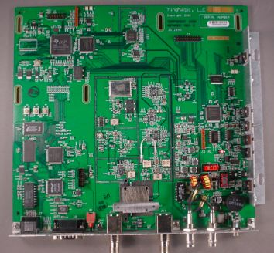
Reader anatomy
Digital Signal
Processor
(DSP)
Network
Processor
Power
Supply
915MHz
Radio
13.56MHz
Radio

Slide 41
A passive RFID communication model
Reader
Antenna
Power from RF field
Reader->Tag Commands
Reader
Tag->Reader Responses
Tags
RFID Communication Channel

Slide 42
Limiting factors for passive RFID
Reader transmitter power Pr (Gov’t. limited)
Reader receiver sensitivity Sr
Reader antenna gain Gr (Gov’t. limited)
Tag antenna gain Gt (Size limited)
Power required at tag Pt (Silicon process limited)
Tag modulator efficiency Et

Slide 43
Reader->Tag power transfer
Reader
Antenna
Tag
Reader
Separation
distance d
Q: If a reader transmits Pr watts, how much power Pt does the tag receive at a separation distance d?
A: It depends-
UHF (915MHz) : Far field propagation : Pt ∝ 1/d²
HF (13.56MHz) : Inductive coupling : Pt ∝1/d⁶

Slide 44
Typical UHF system parameters
Reader Transmit Power Pr = 30dBm (1 Watt)
Reader Receiver Sensitivity Sr = -80dBm (10 ⁻¹¹ Watts)
Reader Antenna Gain Gr = 6dBi
Tag Power Requirement Pt = -10dBm (100 microwatts)
Tag Antenna Gain Gt = 1dBi
Tag Backscatter Efficiency Et = -20dB
System operating wavelength λ = 33cm (915MHz)

Slide 45
Blah blah blah

Slide 46
Conclusions
There are serious practical limitations to passive RFID read range.
It is not practical to read a passive UHF RFID tag from Earth orbit.
Improvements to tag IC design will yield commercially helpful, but probably privacy-insignificant increase in read range.
UHF RFID signals are easily shielded by common materials (aluminum foil, antistatic bags, or your hands).

Slide 47
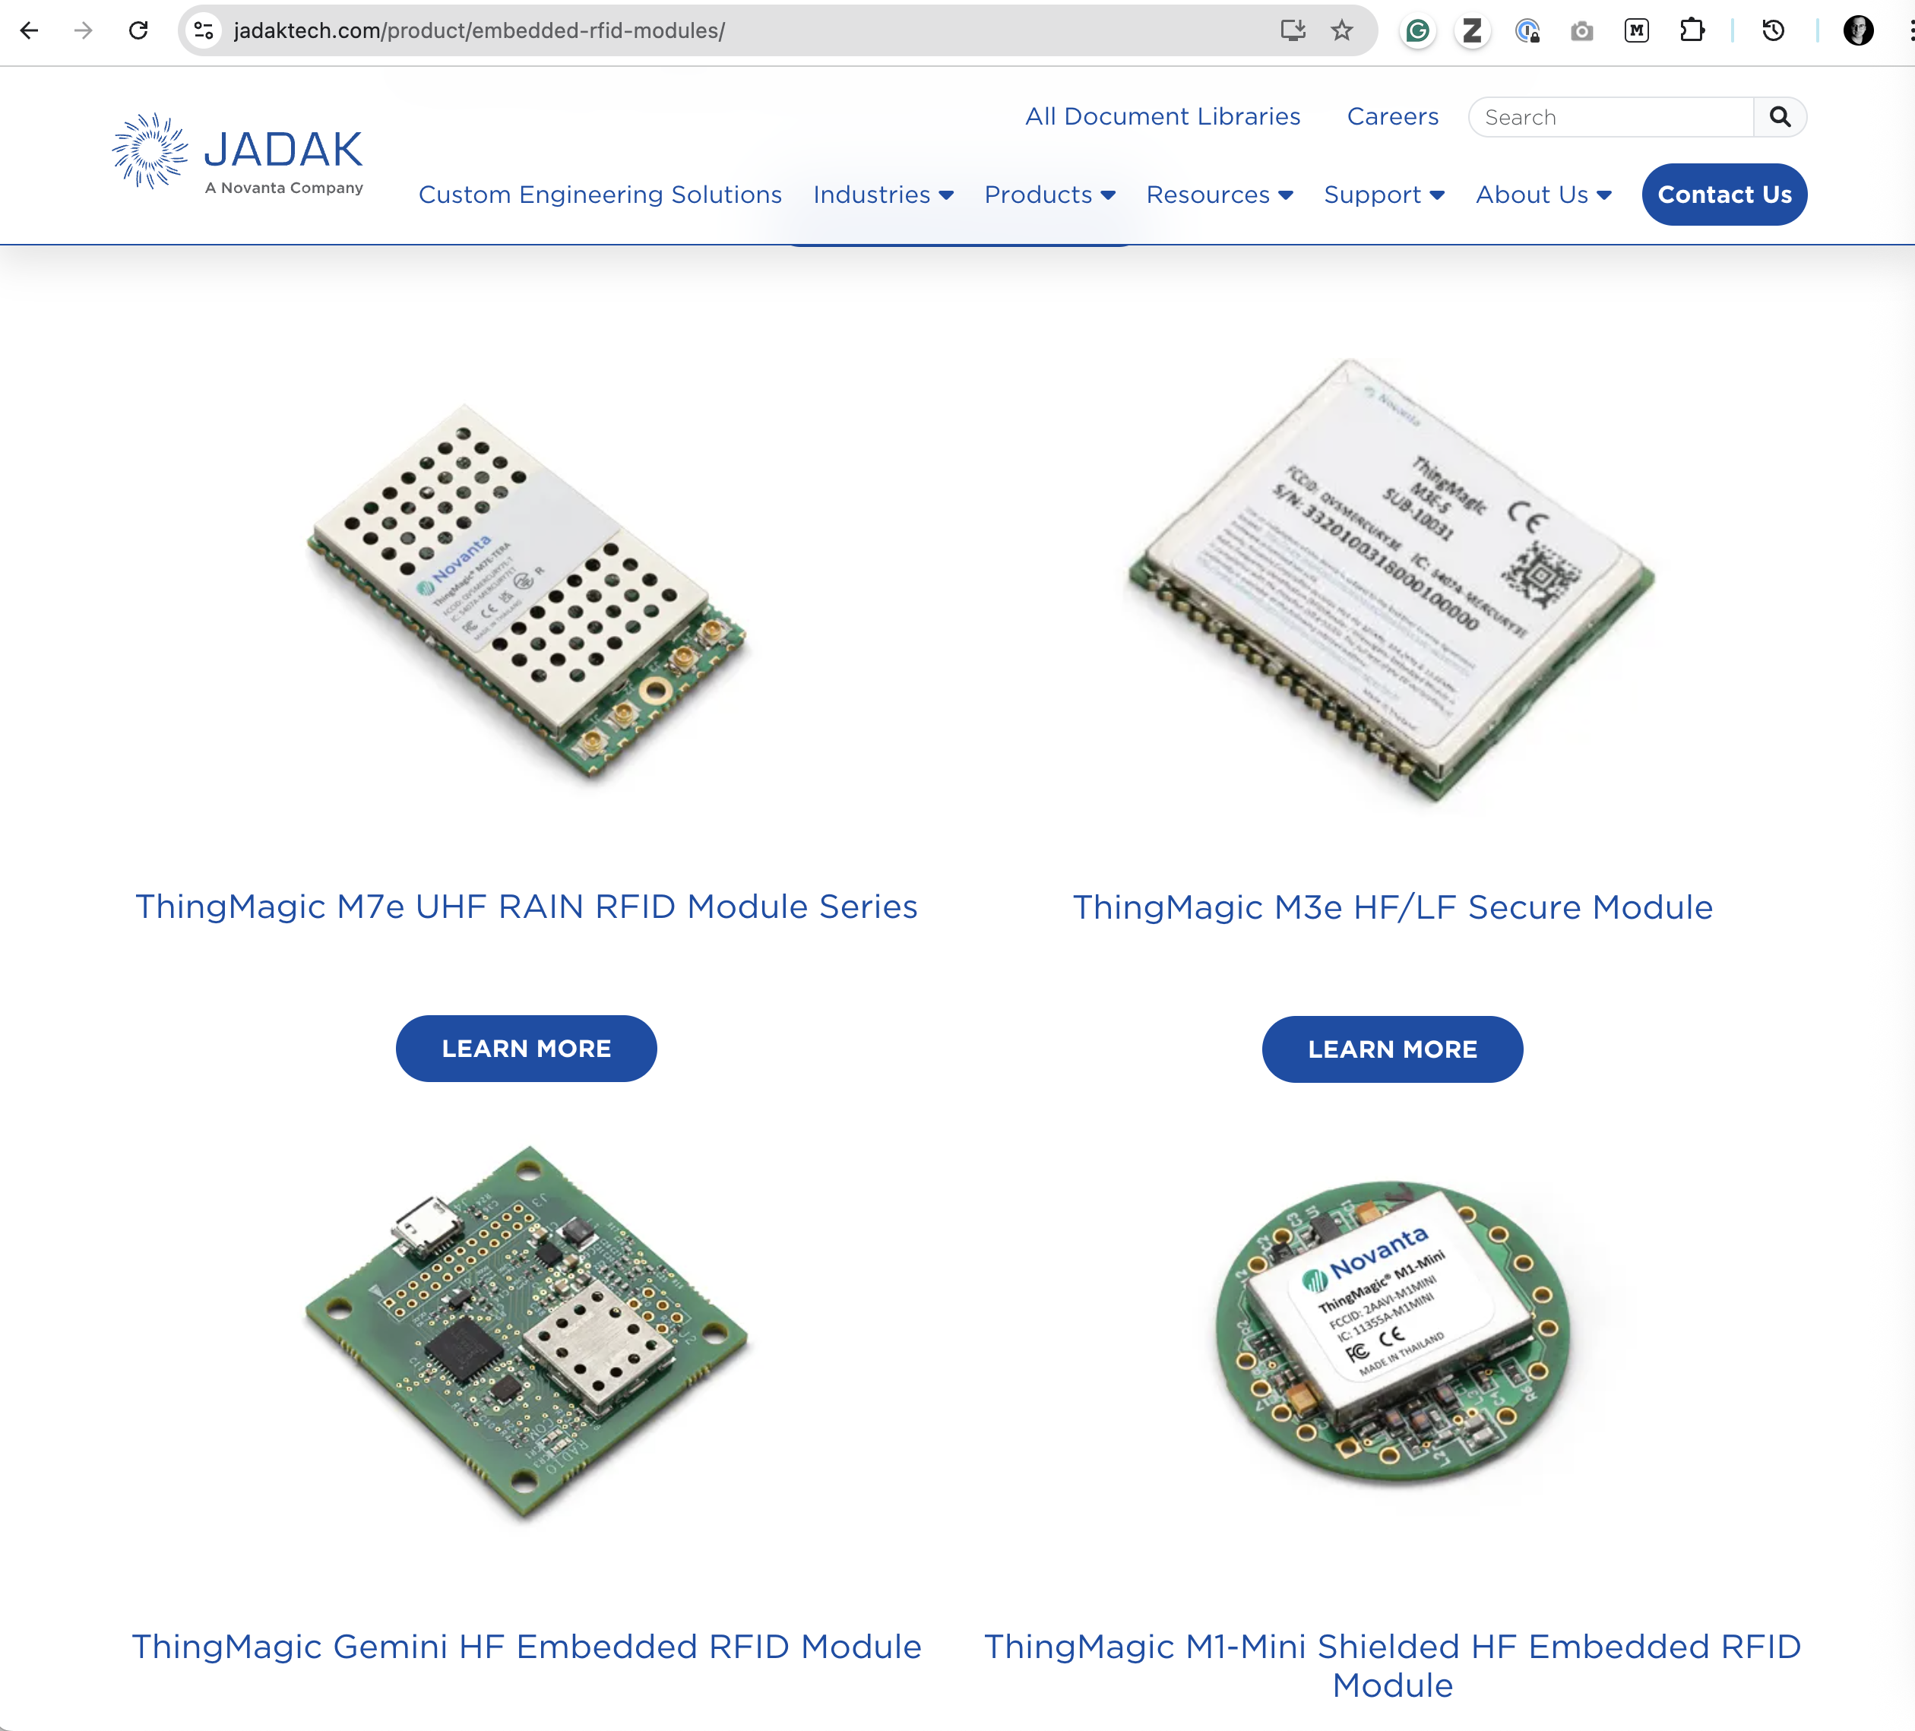
And what happend to “ThingMagic” ?
2000 — Founded by MIT Media Lab grads
2010 — Sold to Trimble
2017 — Sold to Novanta for $20M

Slide 48
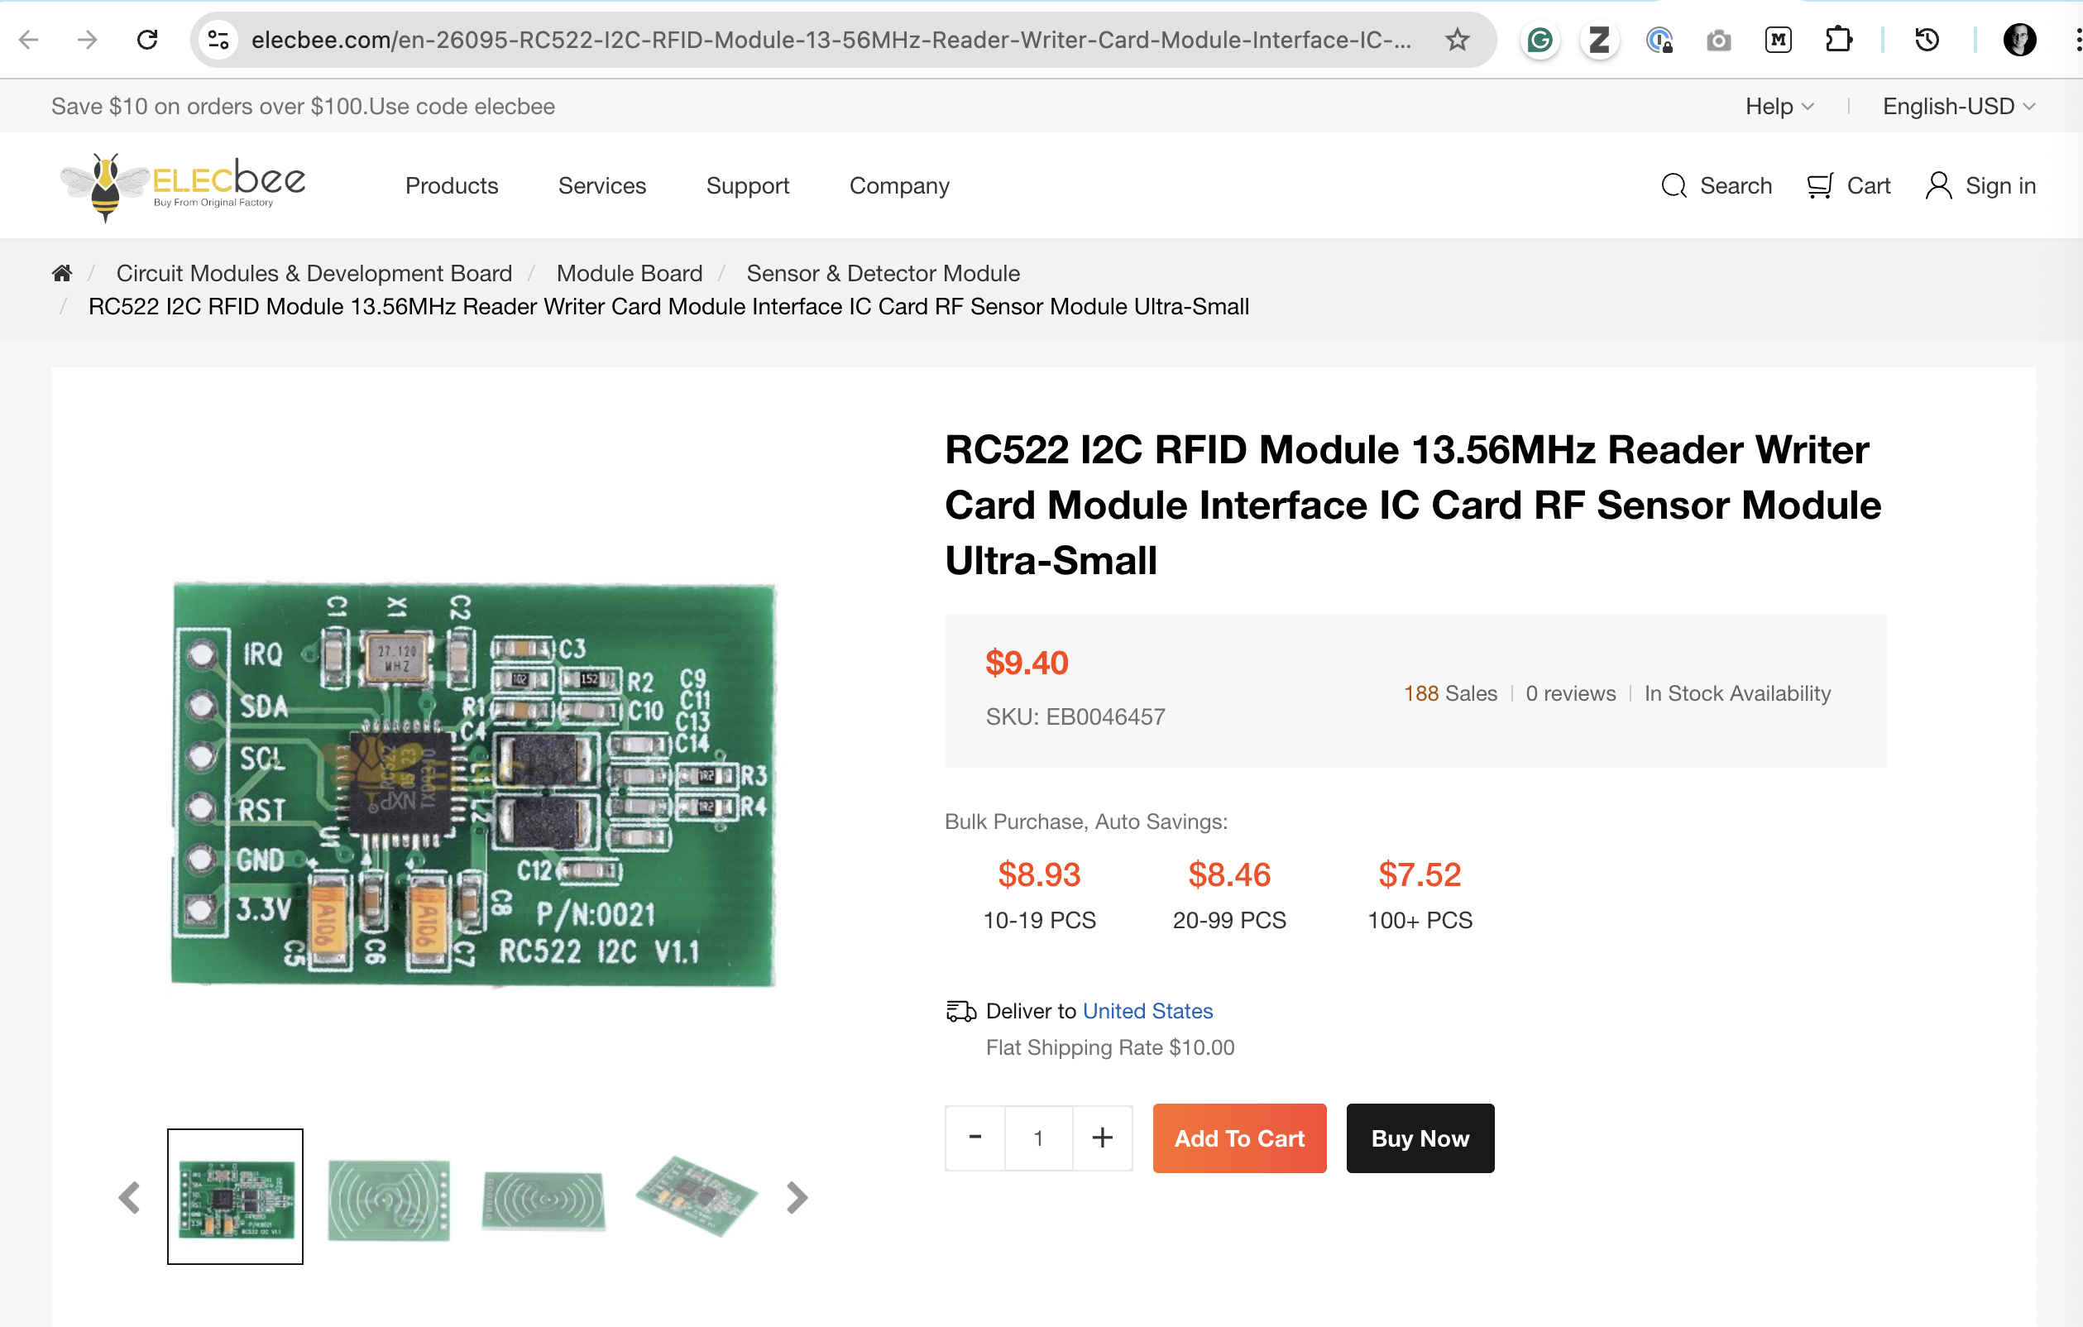
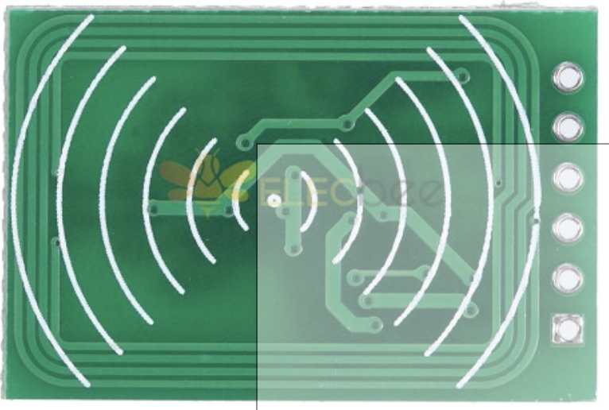

Slide 49
1970s - 1990s — an early thing on the internet — CMU coke machine
Originally connected to the time sharing machine in the 1970s
EMPTY EMPTY 1h 3m
COLD COLD 1h 4m
> In 1992, a second year graduate student and a full time staff member
> of the CMU CS department decided to re-connect the coke machine to the
> internet. The new Coke Machine Interface passively senses the
> presence of bottles in the machine by the state of the "empty" light
> for each column. The status of the nearby M&M machine is also
> monitored. The new Coke Machine Interface is based on home-brew
> optical isolators designed by John Zsarnay before he left CMU in 1991.
> The new Coke Machine Interface resides on a PC-XT class machine whose
> host name is COKE.ELAB.CS.CMU.EDU at IP address 128.2.209.43.
The "Only" Coke Machine on the Internet
Hi, I'm the CMU CS Department Coke Machine. A lot of folks have
written a quite a bit about me in the last couple of years, and most
of them can tell you more about the history of me and my family than I
can. Before I worked here, my Mom, and I think her Pop (heh heh :-)
used to sell sodas to the folks in the Computer Science Department.
In fact, my family has been here longer than most of the students, and
even a lot of the faculty. We moved to the third floor of the
computer science building (Wean Hall) in the 70's. I still sell Coke
in bottles, but they're big 20 oz plastic things these days. They go
for 50 cents each, which I guess isn't too bad considering inflation.
And at least they don't break inside me any more like the glass ones
used to. What a mess...
Tom Lane had the following to say about us:
> Since time immemorial (well, maybe 1970) the Carnegie-Mellon CS
> department has maintained a departmental Coke machine which sells
> bottles of Coke for a dime or so less than other vending machines
> around campus. As no Real Programmer can function without caffeine,
> the machine is very popular. (I recall hearing that it had the highest
> sales volume of any Coke machine in the Pittsburgh area.) The machine
> is loaded on a rather erratic schedule by grad student volunteers.
>
> In the mid-seventies expansion of the department caused people's
> offices to be located ever further away from the main terminal room
> where the Coke machine stood. It got rather annoying to traipse down
> to the third floor only to find the machine empty - or worse, to shell
> out hard-earned cash to receive a recently loaded, still-warm Coke.
> One day a couple of people got together to devise a solution.
>
> They installed micro-switches in the Coke machine to sense how many
> bottles were present in each of its six columns of bottles. The
> switches were hooked up to CMUA, the PDP-10 that was then the main
> departmental computer. A server program was written to keep tabs on
> the Coke machine's state, including how long each bottle had been in
> the machine. When you ran the companion status inquiry program, you'd
> get a display that might look like this:
>
> EMPTY EMPTY 1h 3m
> COLD COLD 1h 4m
>
> This let you know that cold Coke could be had by pressing the
> lower-left or lower-center button, while the bottom bottles in the two
> right-hand columns had been loaded an hour or so beforehand, so were
> still warm. (I think the display changed to just "COLD" after the
> bottle had been there 3 hours.)
>
https://www.cs.cmu.edu/~coke/history_long.txt

Slide 50
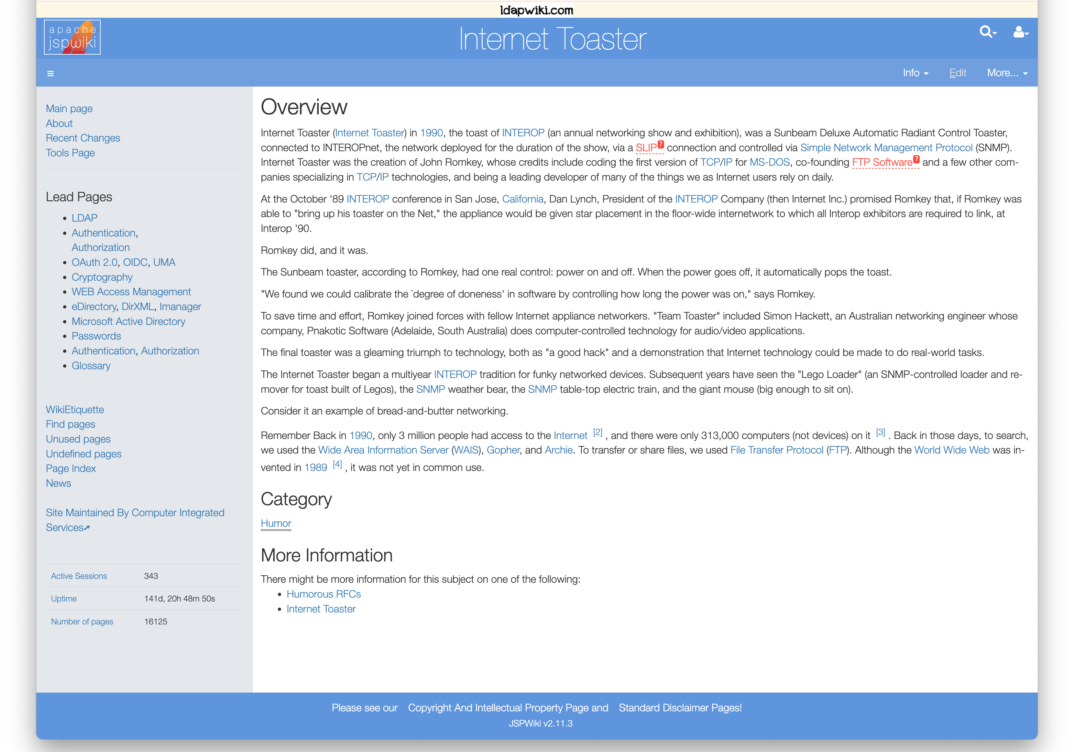
1989 / 1990 — Another early thing on the Internet
— Toaster (FTP Software/ John Romkey)
Implemented SNMP
To show you could actually control things

Slide 51
Q: What are things today?

Slide 52
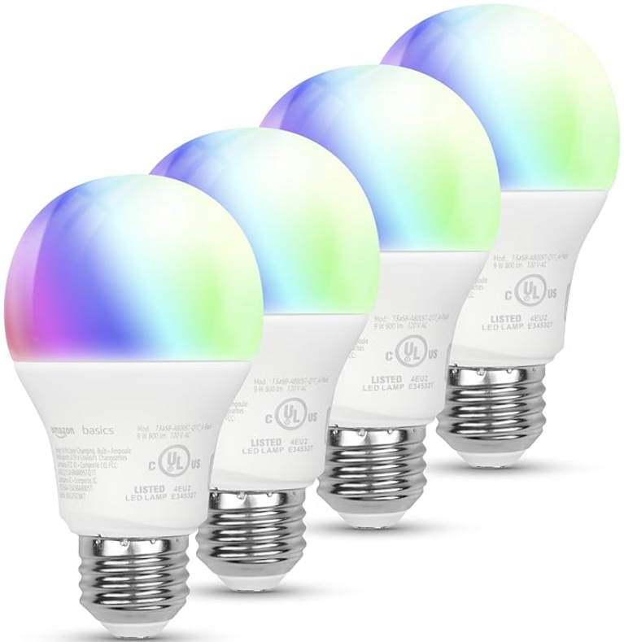
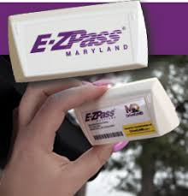
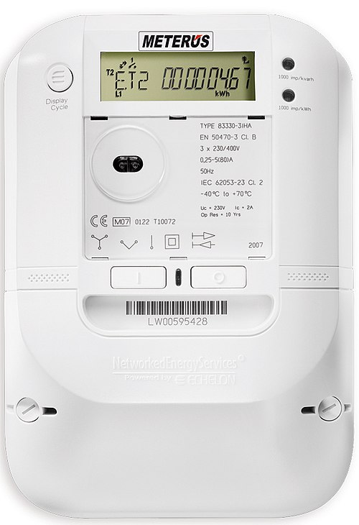
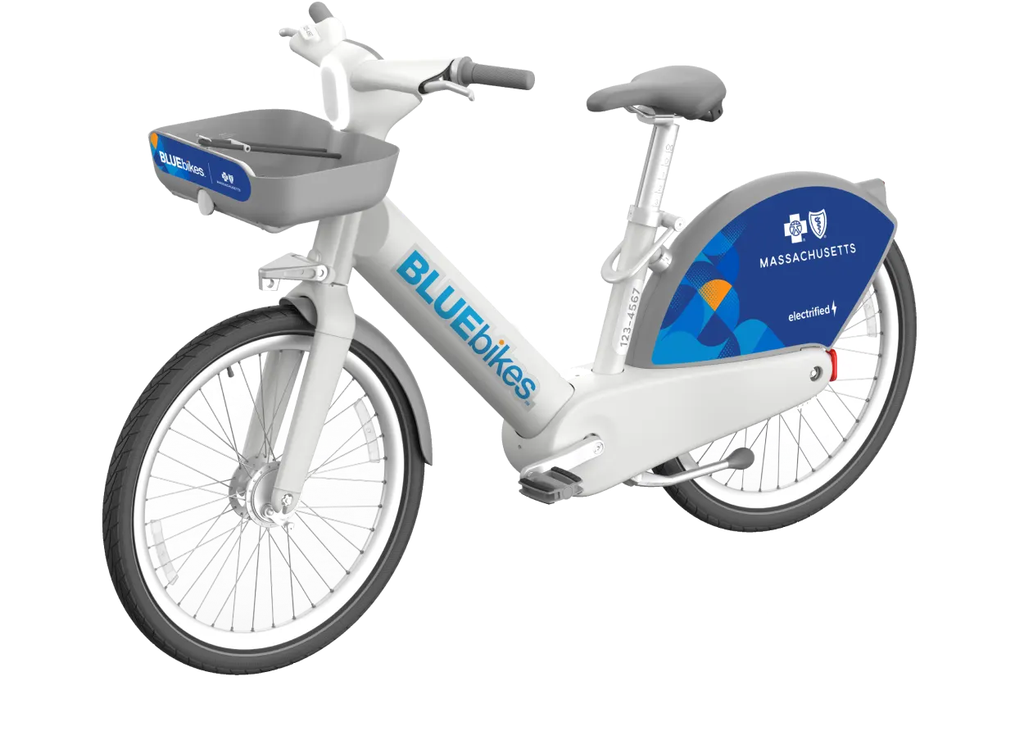
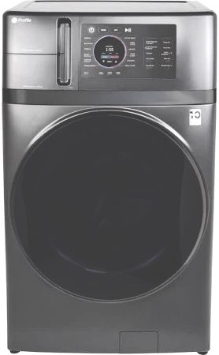
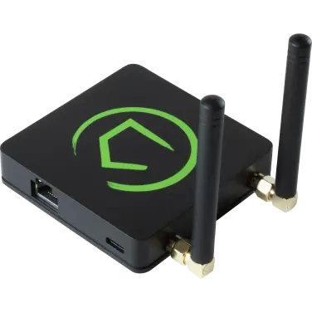
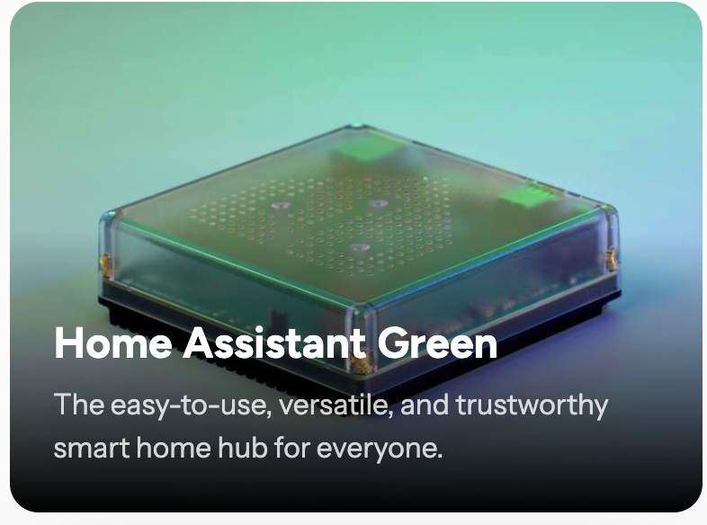
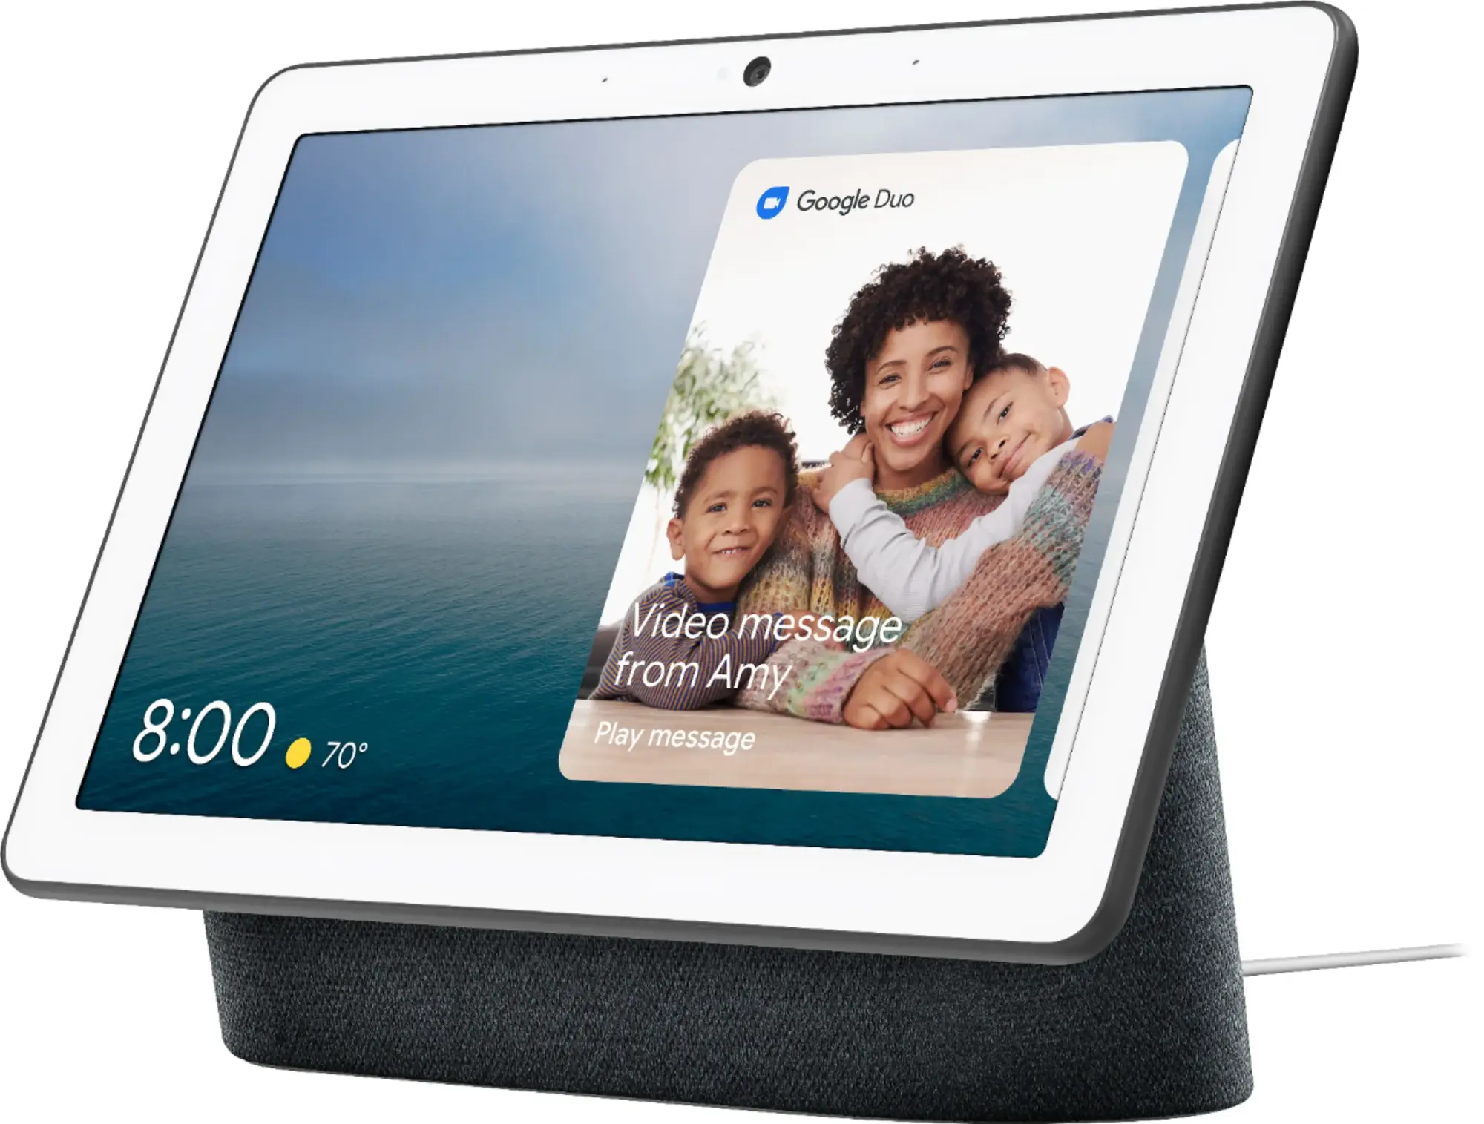
Today’s things
https://www.amazon.com/Amazon-Basics-Equivalent-4-Pack-Multicolor/dp/B0CG5VZ8KT
https://en.wikipedia.org/wiki/E-ZPass
https://en.wikipedia.org/wiki/Smart_meter
Google Nest Thermostat
Google Nest Hub
GE Washer/Dryer
Hubitat

Slide 53
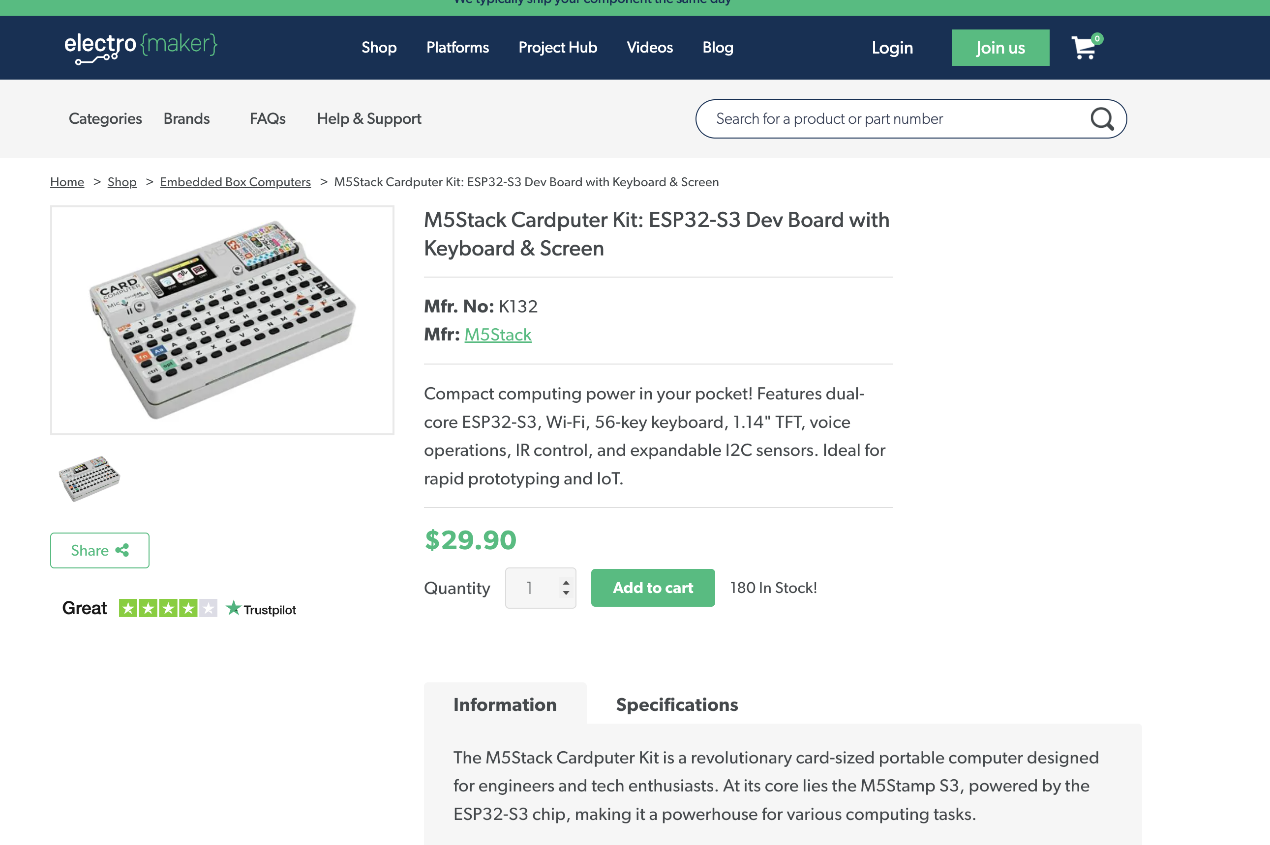
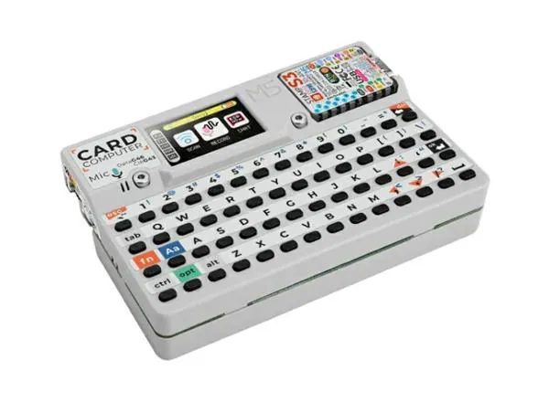

Slide 54
Q: How do things communicate?

Slide 55
IoT devices communicate using every available technology.
Ethernet & Internet protocols — IPv4 & IPv6
Ethernet
Ethernet over power
Wi-Fi
Bluetooth
Mesh networking
Z-Wave
Zigbee
Bluetooth mesh networking

Slide 56
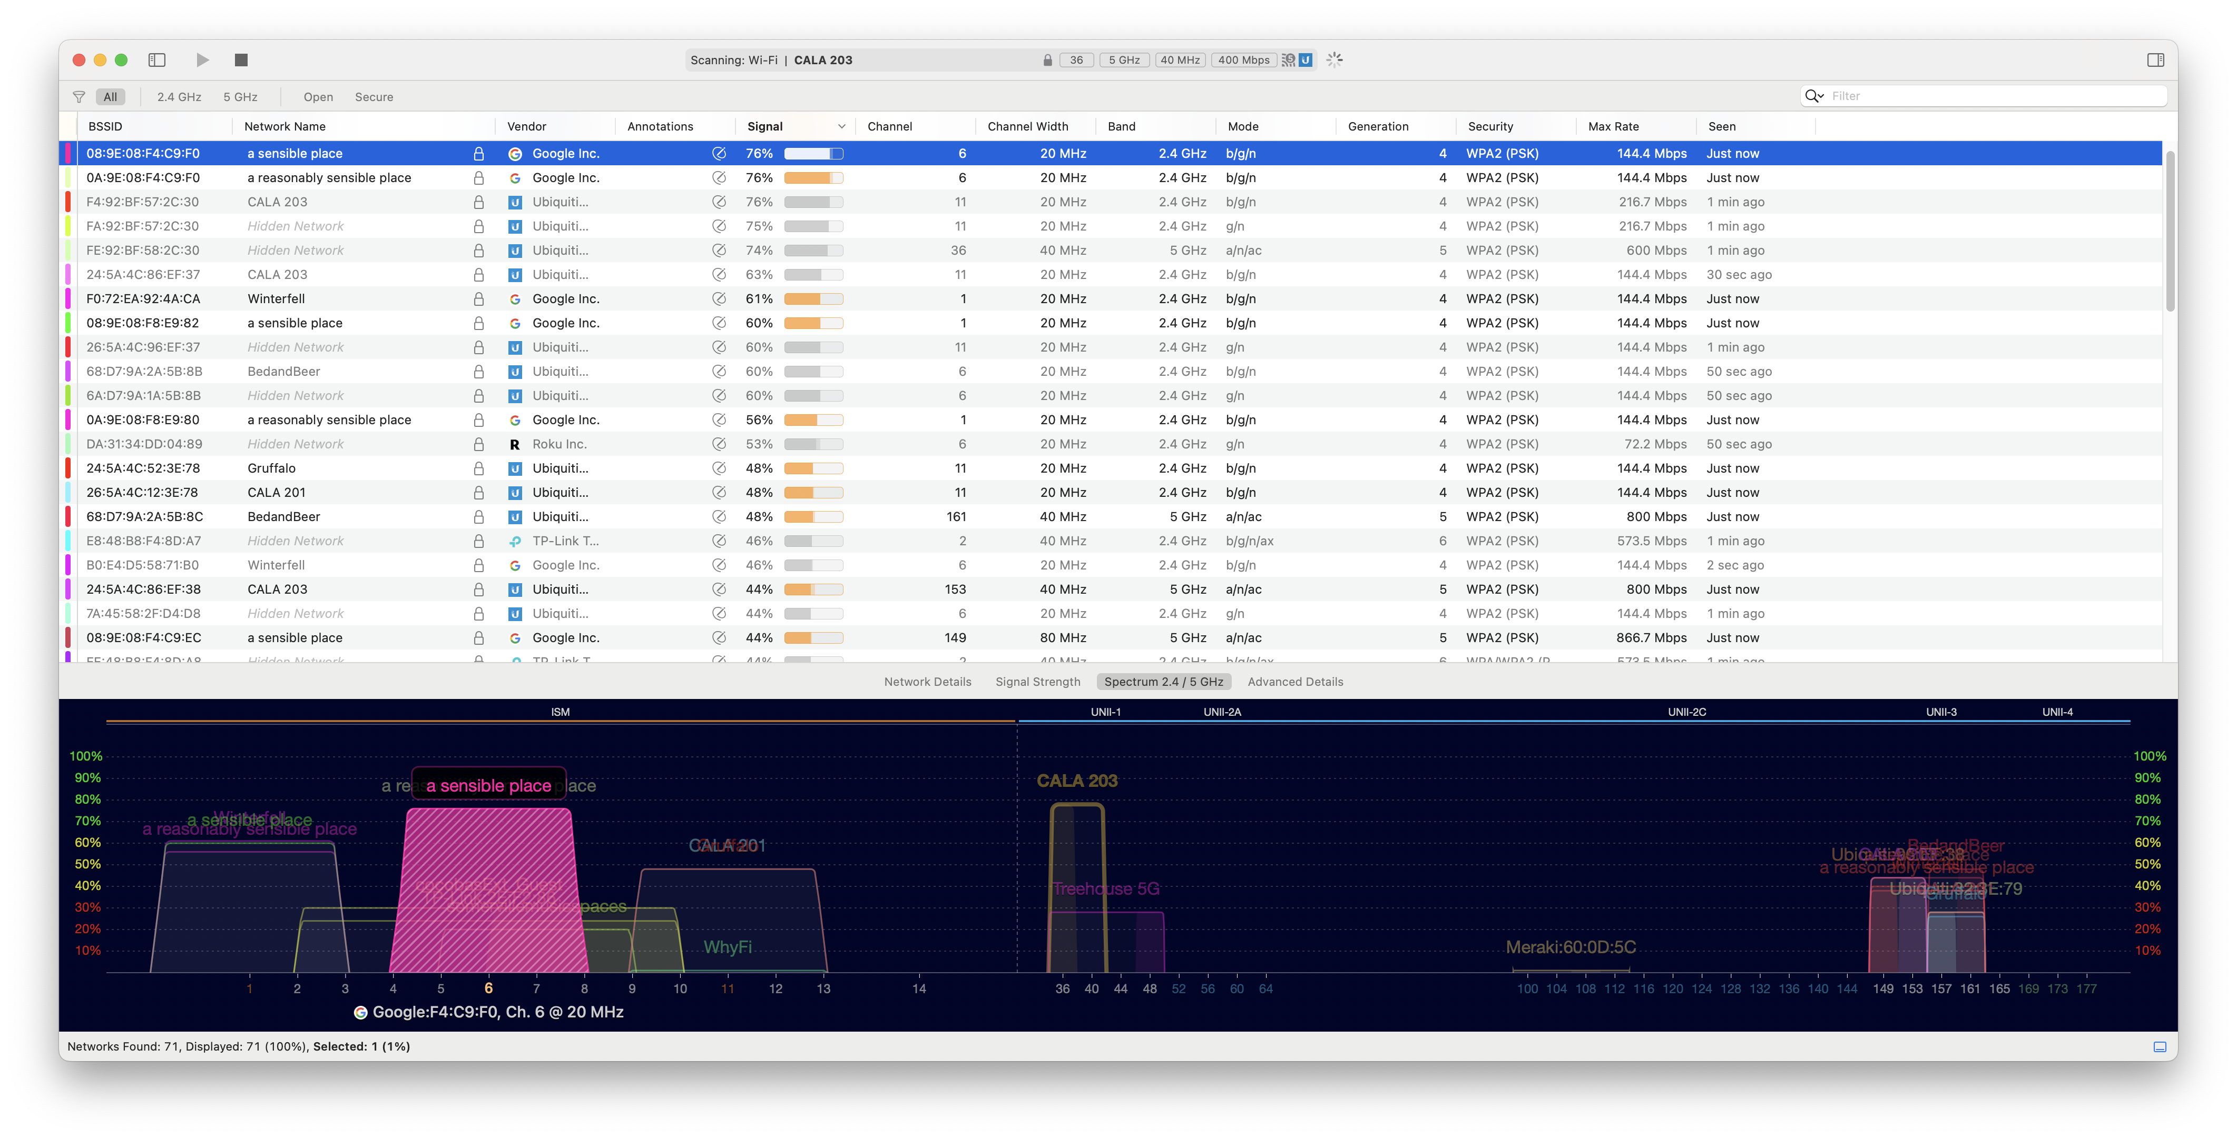
Wi-Fi

Slide 57
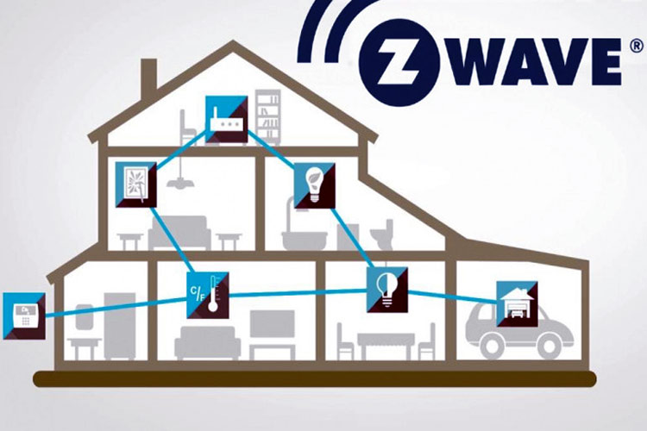
https://circuitdigest.com/article/understanding-z-wave-protocol-and-its-role-in-home-automation

Slide 58
Mesh Networking systems compared (ChatGPT)
Feature | Zigbee | Z-Wave | Bluetooth Mesh
Frequency | 2.4 GHz (global); 868/915 MHz regionally | Sub-GHz: 868.42 MHz (EU) 908.42 MHz (US) | 2.4 GHz (global)
Range (per hop) | ~10–20 m indoors | ~30–100 m indoors | ~10–30 m indoors
Max Nodes | >65,000 devices | ~232 devices per network | ~32,000 (theoretical limit; practical deployments are smaller)
Topology | Mesh (star/tree supported) | Mesh (up to 4 hops) | Managed mesh (many-to-many, flooding approach)
Power Usage | Very low | Very low | Low (optimized for short bursts; beaconing can drain more)
Data Rate | Up to 250 kbps | Up to 100 kbps | 1 Mbps (but effective throughput is lower due to mesh overhead)
Interoperability | Open standard (Zigbee 3.0 improves compatibility) | Proprietary but standardized | Open standard via Bluetooth SIG
Vendor Alliance | Zigbee Alliance (CSA) | Z-Wave Alliance (Silicon Labs) | Bluetooth SIG
Security | AES-128 encryption | AES-128 encryption | AES-128 encryption, device and message authentication
Device Certification | Required for branding | Required for branding | Optional but recommended for compliance
Interference Potential | Moderate–High (2.4 GHz overlaps with Wi-Fi/Bluetooth) | Low (sub-GHz less crowded) | High (shares band with Wi-Fi and other Bluetooth devices)
Market Penetration | Broad in commercial & residential IoT | Strong in consumer smart homes | Growing, especially in lighting, industrial, and wearables
Open/Proprietary | Open standard (IEEE 802.15.4) | Proprietary protocol (owned by Silicon Labs) | Open standard (Bluetooth Core Spec + Mesh Profile Spec)
Matter Support | Supported natively or via bridge | Supported via bridge only | Future support planned, some bridges available

Slide 59
IoT devices communicate using every availabile technology.
Ethernet & Internet protocols — IPv4 & IPv6
Ethernet
Ethernet over power
Wi-Fi
Bluetooth
Mesh networking
Z-Wave
Zigbee
Bluetooth mesh networking
RS232
USB
1-Wire
JTAG
I²C
SPI (Serial Peripheral Interface)
CAN (Controller Area Network — vehicles)

Slide 60
Protocol | Year Introduced | Max Speed | Power Delivery | Bus Type | Max Devices | Typical Distance | Security | Still Used? | Estimated Devices Deployed
RS-232 | 1962 | ~1 Mbps (typically 115.2 kbps) | No | Point-to-point | 2 (1:1) | ~15 m | None | ⚠️ Legacy only | Billions (esp. 80s–2000s)
USB 2.0 | 2000 | 480 Mbps | Yes (up to 2.5W per port) | Host-device | 127 per host | ~5 m | Optional (application-layer) | ✅ Yes | Billions (ubiquitous on PCs and MCUs)
USB 3.0 | 2008 | 5 Gbps | Yes (up to 4.5W or more) | Host-device | 127 per host | ~3 m | Optional (application-layer) | ✅ Yes | Billions (esp. for storage devices)
USB-C | 2014 | 10–40 Gbps (with USB 3.1/3.2/4) | Yes (up to 100W via PD) | Connector spec (not a protocol itself) | N/A | ~3 m | Optional (application-layer) | ✅ Yes | Billions (rapidly replacing earlier USBs)
1-Wire | 1990 | ~16 kbps (std), 142 kbps (overdrive) | Yes (parasitic or powered) | Master-slave | 100 | ~100 m | None | ⚠️ Niche use | Millions (sensors, iButtons)
JTAG | 1990 | ~20 MHz (device-dependent) | No | Daisy-chained | ~5 | PCB-local | None | ✅ Yes | Billions (debug/program every MCU/FPGA)
I²C | 1982 | 3.4 Mbps (HS mode) | No (can be added) | Multi-master shared bus | 128 (7-bit) or 1024 (10-bit) | ~1 m | None | ✅ Yes | Billions (MCUs, sensors, EEPROM)
SPI | ~1980 | 10–100+ Mbps (device-limited) | No | Master-slave | Typically 1–4 (more with mux) | <1 m | None | ✅ Yes | Billions (displays, ADCs, memory)
CAN | 1986 | 1 Mbps (Classic), 5 Mbps+ (CAN FD) | No | Multi-master broadcast bus | 112 (practical) | ~40 m (up to 1 km at low speed) | MAC filtering, app-layer auth | ✅ Yes | Billions (vehicles, industrial)

Slide 61
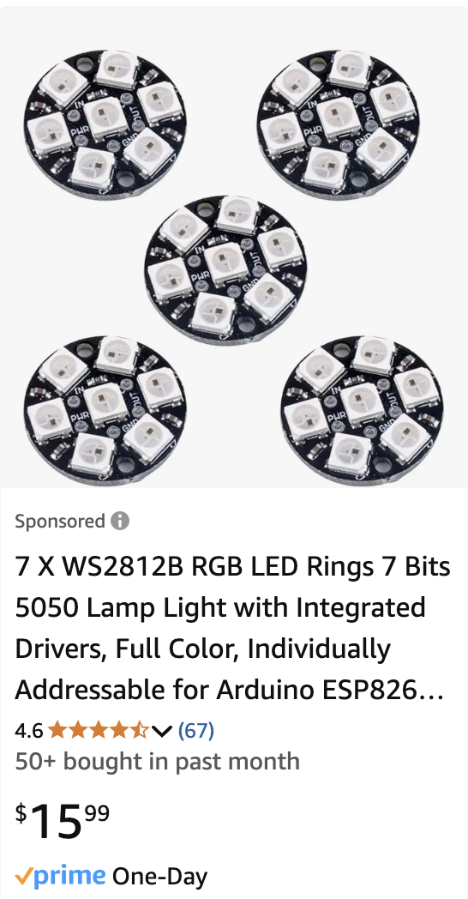
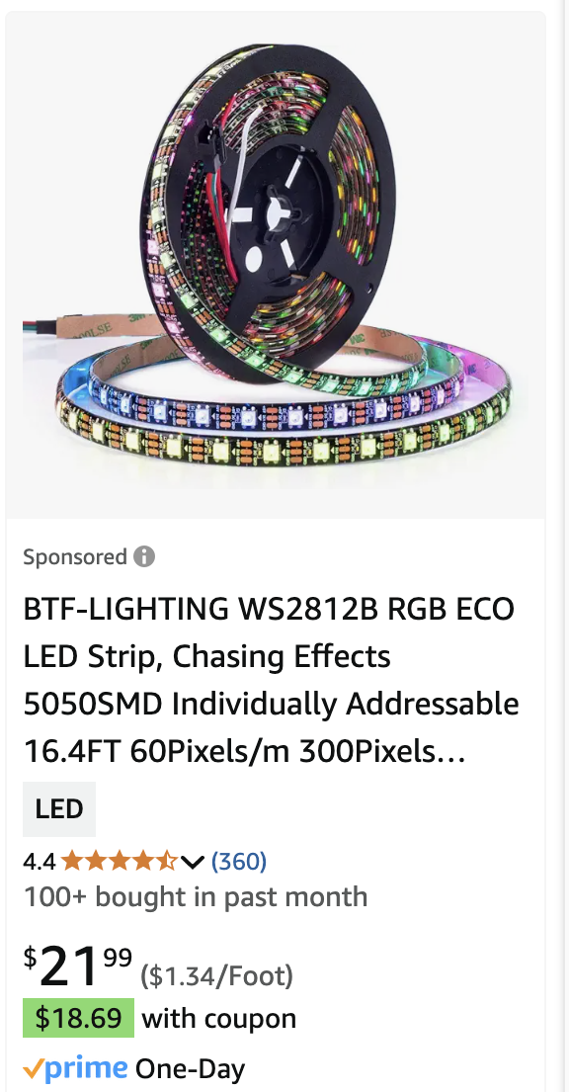
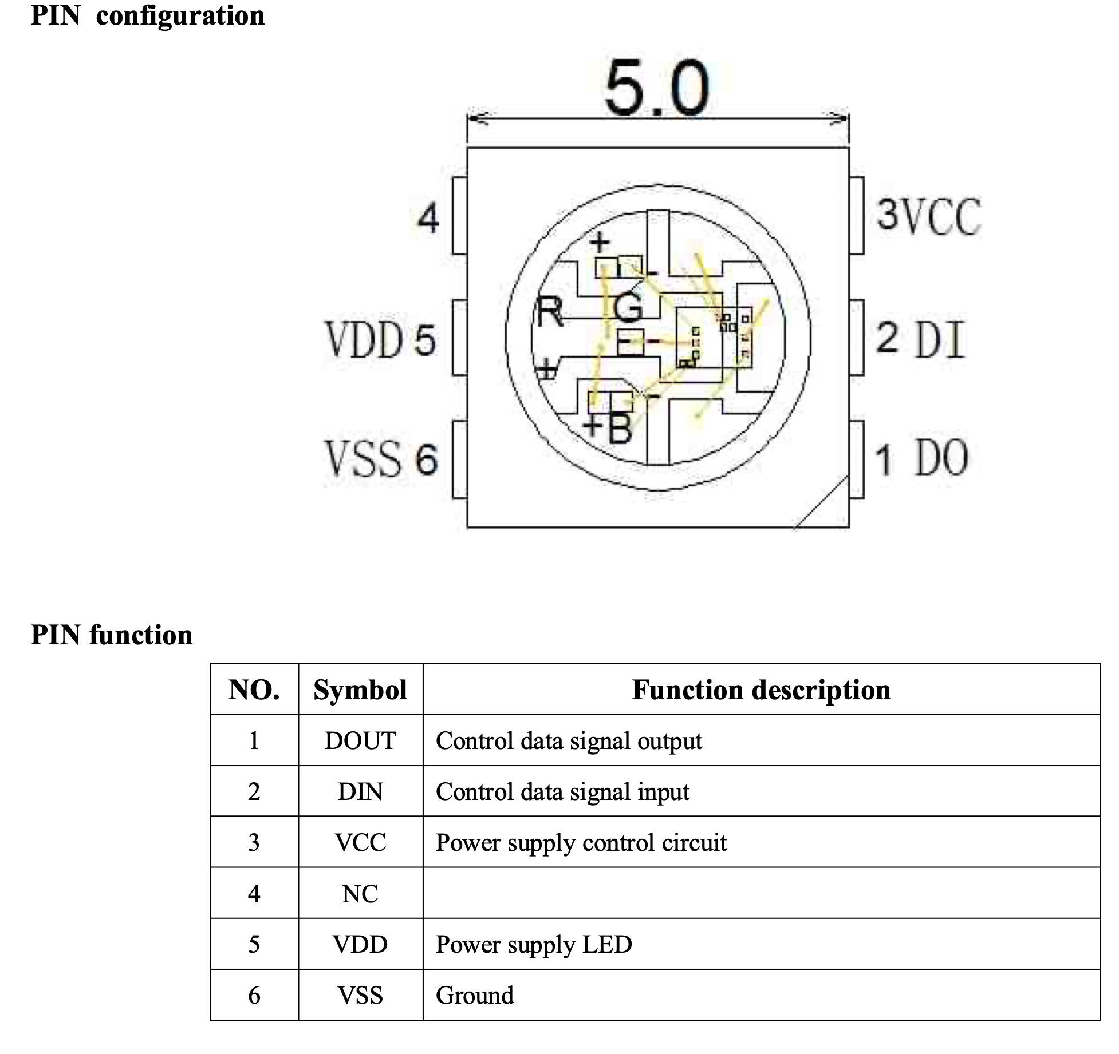
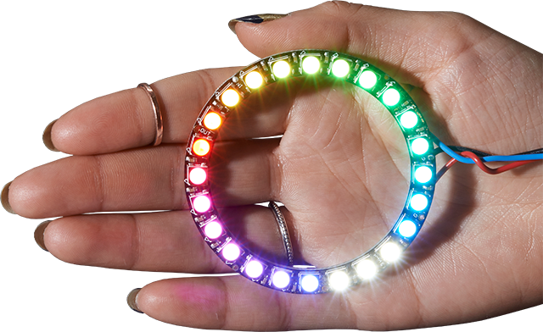
Neopixels… aka WS2812

Slide 62
Electronics Test!

Slide 63
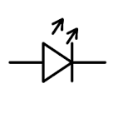
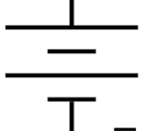
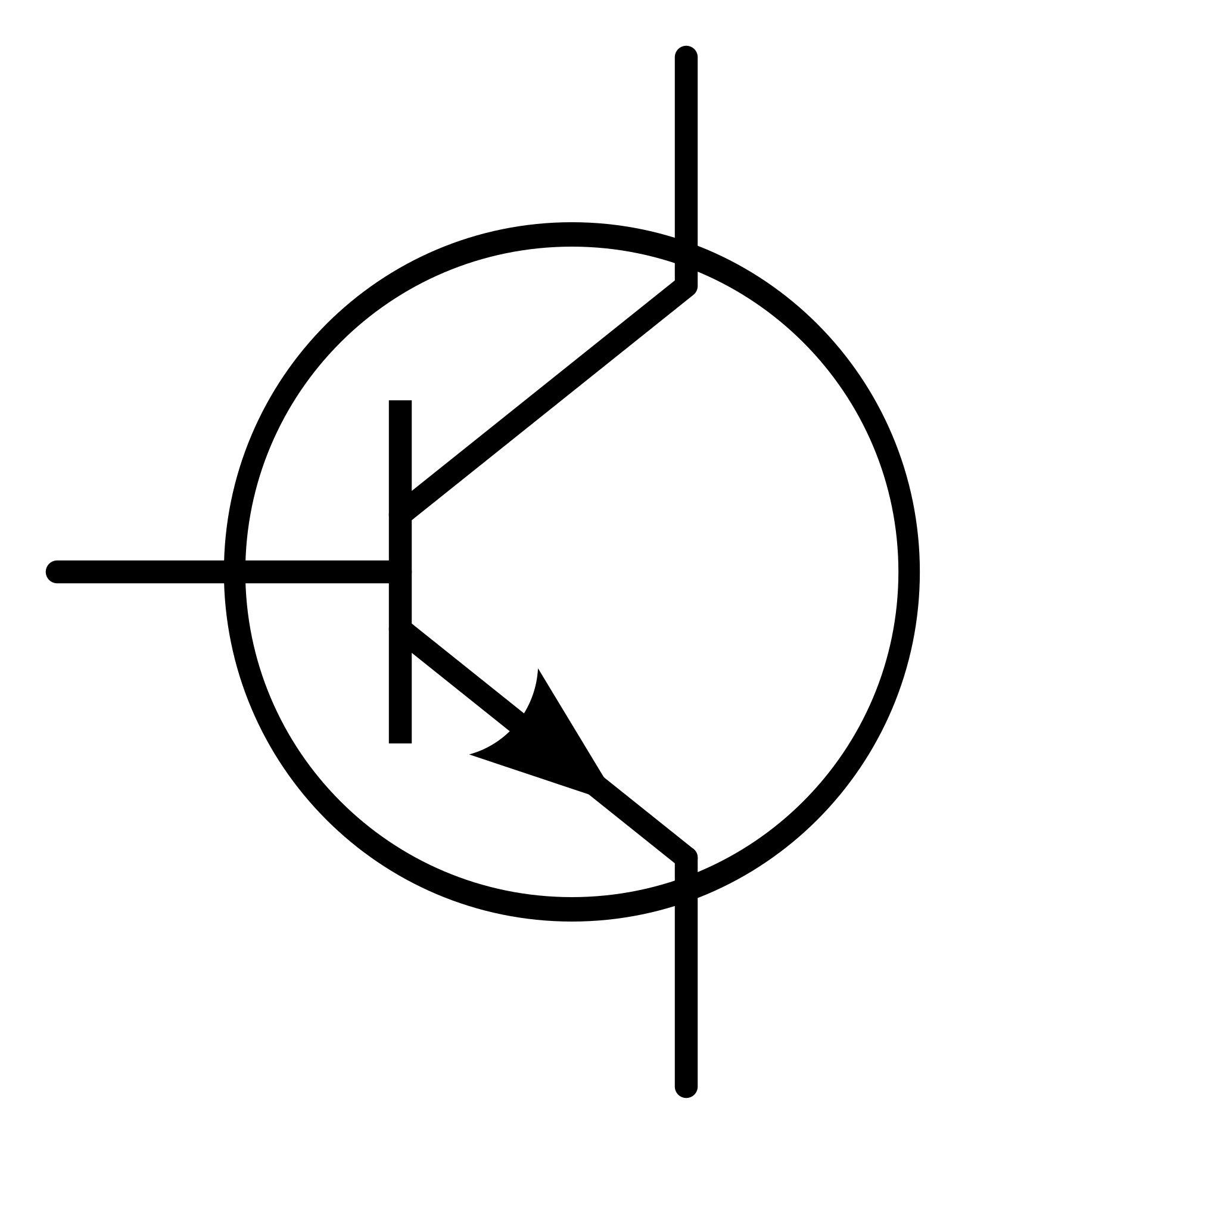
Q: Can you identify these symbols?
a
b
c
d
e
f

Slide 64
Q: How about these vocab words?
Cathode
Anode
Battery
Diode
Transistor
Q: Bonus points — What’s a 555?

Slide 65
Internet of Things (IoT): Opportunities, issues and challenges towards a smart and sustainable future

Slide 66
This article is really a textbook
Skim the article for what you find interesting.
Key points:
IoT has the possibility to revolutionize
transportation
energy management
power networks
agriculture
Industrial applications are the most well developed.
Home automation is …
Q: How many people think that they have a smart home?

Slide 67
General market structure of IoT technologies

Slide 68
(2 slide aside) This illustration shows a good reason to avoid pie charts

Slide 69
(2 slide aside) If you want more…
https://www.perceptualedge.com/articles/visual_business_intelligence/save_the_pies_for_dessert.pdf

Slide 70
IoT devices need to be aware of available Internet connectivity— but it’s becoming less of an issue.
Choices influenced by available bandwidth:
Compute: on-device or off-device
Storage: on-device or off-device
Battery size and life — faster bandwidth is typically more energy efficient.

Slide 71
Q: Smart power grid and energy meter — what are they?

Slide 72
Examples of the smart power grid today

Slide 73
There is tremendous emphasis on power consumption
What is the power consumption when running a program?
What is the absolute minimum power draw in “power down” mode?
How does the system wake up?
Real Time Clock (RTC)
Watchdog timer (WDT)
Interrupt
How does the system power-down and power-up components?
What are the sources of power?
“Ambient power sources” — Solar, body, RF in the air
Battery.
Line voltage
Fuel cell
If the computer turns off…
How does it turn back on?
Where does it store data (EEPROM?)

Slide 74
Ambient RF harvesting
https://www.onio.com/article/how-do-rf-harvesting-work.html

Slide 75
IoT 2
Data — Input, Output, Storage, and Compute

Slide 76
Sensors

Slide 85
Three AS7265x spectral sensors are combined alongside a visible, UV, and IR LEDs to illuminate and test various surfaces for light spectroscopy.
The Triad is made up of three sensors; the AS72651, the AS72652, and the AS72653 and can detect the light from 410nm (UV) to 940nm (IR).
In addition, 18 individual light frequencies can be measured with precision down to 28.6 nW/cm2 and accuracy of +/-12%.

Slide 91
Storage

Slide 92
MESH LOCAL CLOUD
Raspberry PI4

Slide 93
Compute

Slide 94
On-Device LOCAL CLOUD
Raspberry PI4
Functions as a service
Servers (possibly elastic)

Slide 95
We’ve been working with the ESP32-S3
What about the ESP32-C6?
Feature | ESP32-C6 | ESP32-S3
Core Architecture | Single-core RISC-V @ 160 MHz | Dual-core Xtensa LX7 @ 240 MHz
Wi-Fi | Wi-Fi 6 (802.11ax) 2.4 GHz | Wi-Fi 4 (802.11b/g/n) 2.4 GHz
Bluetooth | Bluetooth 5.0 LE | Bluetooth 5.0 LE
IEEE 802.15.4 (Thread/Zigbee) | ✅ Supported | ❌ Not supported
PSRAM Support | ❌ No external PSRAM support | ✅ Supports external PSRAM
AI Acceleration | ❌ Not available | ✅ Vector instructions for AI (ML, DSP, etc.)
USB OTG | ✅ Full-speed USB 2.0 Device | ✅ Full-speed USB 1.1 OTG
Security | Secure boot, Flash encryption, AES, SHA | Secure boot, Flash encryption, AES, SHA
GPIO Count | Up to 22 | Up to 45
Ultra Low Power (ULP) | ULP coprocessor (new RISC-V based) | ULP coprocessor (FSM based)
Temperature Range | –40°C to +125°C (industrial) | –40°C to +105°C (typical)
Target Use Cases | Thread/Zigbee IoT, BLE, Wi-Fi 6 IoT | AIoT, voice, image recognition, more I/O
Release Year | 2023 | 2021
USD$13.99

Slide 96
Here’s another dev board…
(LilyGO is another Shenzhen-based company)

Slide 97
Any questions?
Live meetup?

