Slide 1
Differential Privacy:
Some Basic Concepts
Simson L. Garfinkel
Senior Scientist, Confidentiality and Data Access
U.S. Census Bureau
May 2, 2019
National Advisory Committee on Racial, Ethnic and Other Populations Spring 2019 Meeting
The views in this presentation are those of the author, and not those of the U.S. Census Bureau.

Slide 2
Acknowledgments
This presentation is based on numerous discussions with
  John Abowd (Chief Scientist)
  Dan Kifer (Scientific Lead)
  Salil Vadhan (Harvard University)
  Robert Ashmead, Philip Leclerc, William Sexton, Pavel Zhuravlev (US Census Bureau)

Slide 3
Statistical agencies collect data under a pledge of confidentiality.
We pledge:
  Collected data will be used only for statistical purposes.
  Collected data will be kept confidential.
  Data from individuals or establishments
  won’t be identifiable in any publication.
Fines and prison await any Census Bureau employee who violates this pledge.

Slide 4
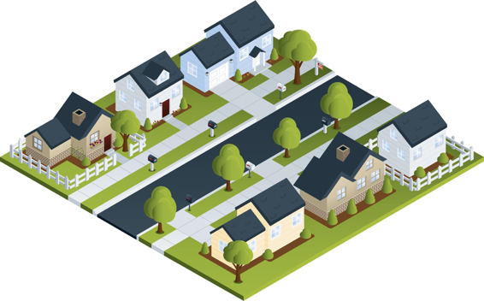
Statistical agencies are trusted curators.
Confidential
Database
Published Statistics
Respondents
 | # | Median Age | Mean Age
Total | 7 | 30 | 38
Women | 4 | 30 | 33.5
Male | 3 | 30 | 44
Black | 4 | 51 | 48.5
White | 3 | 24 | 24
Married | 4 | 51 | 54
Black F | 3 | 36 | 36.7
Age Sex Race/MS
8 FBS
18 MWS
24 FWS
30 MWM
36 FBM
66 FBM
84 MBM

Slide 5
We now know “trusted curator” model is more complex.
Every data publication results in some privacy loss.
Publishing too many statistics results in the compromise of the entire confidential database.
Respondents
Confidential Database
Published Statistics

Slide 6
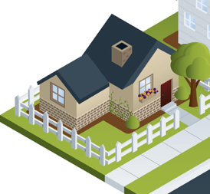
Consider the statistics from a single household
 | Count | Median | Mean
Total | 1 | 24 | 24
# Female | 1 | 24 | 24
# white | 1 | 24 | 24
Single | 1 | 24 | 24
White F | 1 | 24 | 24
24 yrs Female White Single (24 FWS)

Slide 7
Publishing statistics for this household alone would result in an improper disclosure.
 | Count | Median | Mean
Total | (D) | (D) | (D)
# Female | (D) | (D) | (D)
# white | (D) | (D) | (D)
Single | (D) | (D) | (D)
White F | (D) | (D) | (D)
(D) Means suppressed to prevent an improper disclosure.
24 yrs Female White Single (24 FWS)

Slide 8

In the past, statistical agencies aggregated data from many households together into a single publication.
 | Count | Median Age | Mean Age
Total | 7 | 30 | 38
# Female | 4 | 30 | 33.5
# male | 3 | 30 | 44
# black | 4 | 51 | 48.5
# white | 3 | 24 | 24
Married | 4 | 51 | 54
Black F | 3 | 36 | 36.7

Slide 9
We now know that this publication can be reverse-engineered to reveal the confidential database.
 | Count | Median | Mean
Total | 7 | 30 | 38
# Female | 4 | 30 | 33.5
# male | 3 | 30 | 44
# black | 4 | 51 | 48.5
# white | 3 | 24 | 24
Married | 4 | 51 | 54
Black F | 3 | 36 | 36.7
66 FBM & 84 MBM
30 MWM & 36 FBM
8 FBS
18 MWS
24 FWS
This table can be expressed by 164 equations.
Solving those equations takes
0.2 seconds on a 2013 MacBook Pro.

Slide 10
Faced with “database reconstruction,” statistical agencies have just two choices.
Option #1: Publish fewer statistics.
Option #2: Publish statistics with less accuracy.

Slide 11
The problem with publishing fewer statistics: it’s hard to know how many statistics is “too many.”
Solution #1
8 FBS
18 MWS
24 FWS
30 MWM
36 FBM
66 FBM
84 MBM
Solution #2
2 FBS
12 MWS
24 FWS
30 MBM
36 FWM
72 FBM
90 MBM
 | Count | Median | Mean
Total | 7 | 30 | 38
# Female | 4 | 30 | 33.5
# male | 3 | 30 | 44
# black | 4 | 51 | 48.5
# white | 3 | 24 | 24
Married | 4 | 51 | 54
Black F | 3 | 36 | 36.7

Slide 12
Faced with “database reconstruction,” statistical agencies have just two one choice.
Option #1: Publish fewer statistics.
Option #2: Publish statistics with less accuracy.

Slide 13
Differential privacy gives us a mathematical approach for balancing accuracy and privacy loss.
No privacy
No accuracy

Slide 14
“Differential privacy” is really two things
1 – A mathematical definition of privacy loss.
2 – Specific mechanisms that allow us to:
    Add the smallest amount of noise necessary for a given privacy outcome
    Structure the noise to have minimal impact on the more important statistics

Slide 15
Differential privacy — the big idea:
Use “noise” to create uncertainty about private data.
NOISE BARRIER
35 yrs Female Black Single (35 FBS)
Impact of the noise ≈ impact of a single person
Impact of noise on aggregate statistics
decreases with larger population.
24 yrs Female White Single (24 FWS)

Slide 16
Understanding the impact of “noise:”
Statistics based on 10,000 experiments, epsilon=1.0
 | 5,000 (50%) runs | 9,500 (95%) runs
 | Median(age): 9 → 73 | Median(age): 0→ 104
 | Median(age): 17 → 61 | Median(age): 0→ 103
 | Median(age): 21 → 22 | Median(age): 21→ 22
1 person age 22
NOISE BARRIER
10 people, all age 22
100 people, all age 22

Slide 17
The noise also impacts the person counts.
 | 5,000 (50%) runs | 9,500 (95%) runs
 | Median(age): 9 → 73 # people: -9 → 11 | Median(age): 0→ 104 # people: -29 → 30
 | Median(age): 17 → 61 # people: 0 → 20 | Median(age): 0→ 103 # people: -19 → 38
 | Median(age): 21 → 22 # people: 90 → 110 | Median(age): 21→ 22 # people: 71 → 129
1 person age 22
NOISE BARRIER
10 people, all age 22
100 people, all age 22

Slide 18

Disclosure Avoidance for the 2010 Census

Slide 19
“This is the official form for all the people at this address.”
“It is quick and easy, and your answers are protected by law.”

Slide 20
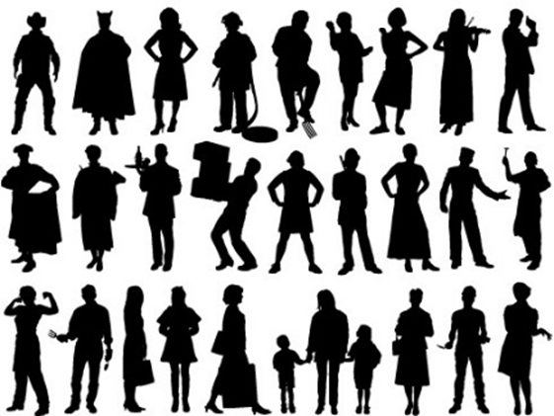
The 2010 Census collected data on 308,745,538 people.
Pre-specified tabular summaries:
PL94-171, SF1, SF2 (SF3, SF4, … in 2000)
DRF
HDF
Raw data from respondents: Decennial Response File
Statistical
Processes
Hundred-percent Detail File
Special tabulations and post-census research
Confidential data
Public data

Slide 21
For each person, we collected 6 variables
(44 bits of data)
Variable | Range | Bits
Block | 6,207,027 inhabited blocks | 23
Sex | 2 (Female/Male) | 1
Age | 103 (0-99 single age year categories, 100-104, 105-109, 110+) | 7
Race | 63 allowable race combinations | 7
Ethnicity | 2 (Hispanic/Not) | 1
Relationship | 17 values | 5
Total |  | 44
308,745,538 people x 6 variables = 1,852,473,228 measurements
308,745,538 people x 44 bits = 13,584,803,672 bits ≈ 1.7 GB

Slide 22
2010 Census: Summary of Publications
(approximate counts)
Publication | Released counts
PL94-171 Redistricting | 2,771,998,263
Balance of Summary File 1 | 2,806,899,669
Summary File 2 | 2,093,683,376
Public-use micro data sample | 30,874,554
Lower bound on published statistics | 7,703,455,862
Published Statistics/person | 25
Recall: Collected variables/person: | 6
Published Statistics/collected variable | 25 ÷ 6 ≈ 4.2
Notes:
The 2010 Census publication schedule resulted in roughly 2.8 billion counts (including zeros) published in PL94-171, another 2.8 billion in the rest of SF1, 2 billion in SF2, and another 30 million in a public-use microdata sample. This is roughly 7.7 billion statistics, or 25 per person. That’s a lot more than 6 per person.

Slide 23
The 2010 Census collected data on 308,745,538 people.
7,703,455,862 published statistics
(lower bound)
Pre-specified tabular summaries:
PL94-171, SF1, SF2 (SF3, SF4, … in 2000)
DRF
HDF
Raw data from respondents: Decennial Response File
Statistical
Processes
Hundred-percent Detail File
Special tabulations and post-census research
1,852,473,228 collected values
(308,745,538 people x 6 variables/person)
Public data

Slide 24
We performed a database reconstruction and re-identification attack for all 308,745,538 people in 2010 Census
Reconstructed 308,745,538 microdata records.
Used 4 commercial databases of the 2010 US population
acquired 2009-2011 in support of the 2010 Census
  Commercial database had: NAME, ADDRESS, AGE, SEX
Linked reconstructed records to the commercial database records
  Linked database has: NAME, ADDRESS, AGE, SEX , ETHNICITY & RACE
  Link rate: 45%
Compared linked database to Census Bureau confidential data
  Question: How often did the attack get the all variables including race and ethnicity right?
  Answer: 38% (17% of US population)

Slide 25
Our attack is good, but not perfect.
An outside attacker would have a harder time.
  We confirmed re-identification of 38% (17% of US population)
  We did not reconstruct families.
  We did not recover detailed self-identified race codes
An outside attacker:
  Would not know which re-identifications are correct.
    An outside attacker would need to confirm with another external data source.

Slide 26
The protection system used in 2000 and 2010 relied on swapping households.
Some households were swapped with other households
  Swapped households had the same size.
  Swapping limited to within each state.
Disadvantages:
  Swap rate and details of swapping not disclosed.
  Privacy protection was not quantified.
  Impact on data quality not quantified.
Swapping is called a “Disclosure Avoidance” technique.
It’s job is to prevent improper disclosures.
Town 1
Town 2
Any State

Slide 27
We now know that the disclosure avoidance techniques we used in the 2010 Census were flawed.
  We released exact population counts for blocks, tracts and counties.
  We did not swap 100% of the households
  We released ≈25 statistics per person,
  but only collected six pieces of data per person:
    Block • Age • Sex • Race • Ethnicity • Relationship to Householder
The Census Bureau did the best possible in 2010.
The math for protecting a decennial census did not [yet] exist.

Slide 28
Options for protecting the confidentiality of the collected data in a decennial census
Publish less data.
Publish less accurate data.

Slide 29

The 2020 census and differential privacy

Slide 30
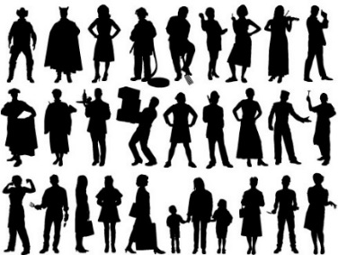
The Disclosure Avoidance System allows the Census Bureau to enforce global confidentiality protections.
Pre-specified tabular summaries:
PL94-171, DHC, detailed DHC
DRF
CUF
CEF
DAS
MDF
Decennial Response File
Census Unedited File
Census Edited File
Global Confidentiality Protection Process
Disclosure Avoidance System
Microdata Detail File
Special tabulations and post-census research
Confidential data
Privacy-loss Budget,
Accuracy Decisions
Public data

Slide 31
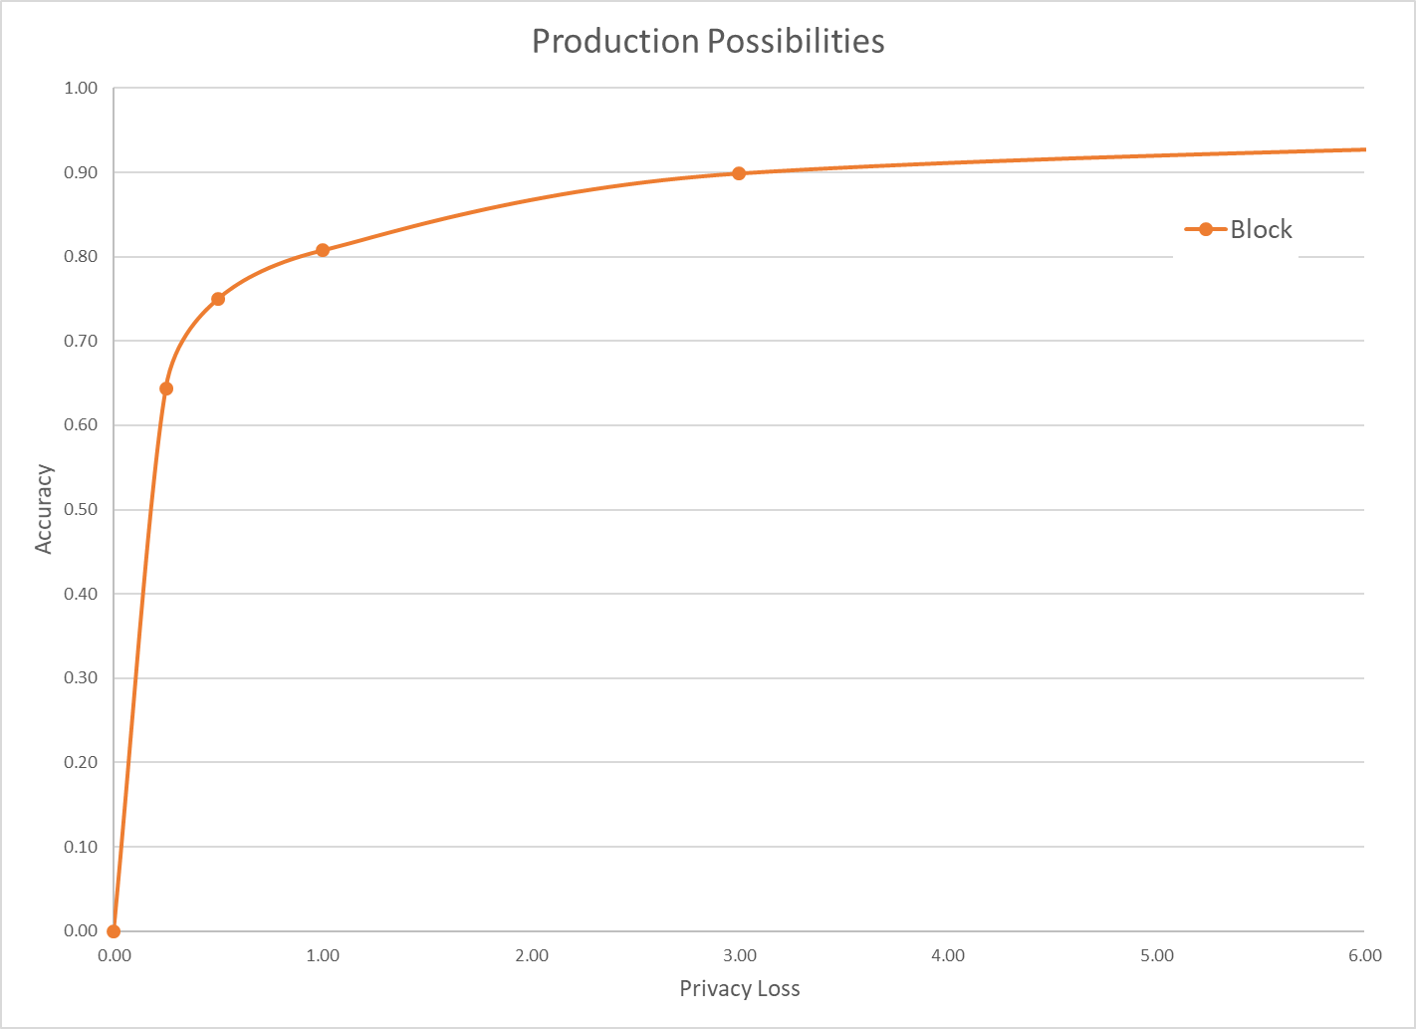
The Census disclosure avoidance system uses differential privacy to defend against an accurate reconstruction attack.
Differential privacy provides:
  Provable bounds on the accuracy of the best possible database reconstruction given the released tabulations.
  Algorithms that allow policy makers to decide the trade-off between accuracy and privacy.
Data accuracy
Privacy loss budget (ε)
Final privacy-loss budget determined by Data Stewardship Executive Policy Committee (DSEP)
with recommendation from Disclosure Review Board (DRB)
Pre-Decisional

Slide 32
The Disclosure Avoidance System relies on injects formally private noise.
Advantages of noise injection with formal privacy:
  Transparency: the details can be explained to the public
  Tunable privacy guarantees
  Privacy guarantees do not depend on external data
  Protects against accurate database reconstruction
  Protects every member of the population
Challenges:
  Entire country must be processed at once for best accuracy
  Every use of confidential data must be tallied in the privacy-loss budget
Global Confidentiality Protection Process
Disclosure Avoidance System
ε

Slide 33
There was no off-the-shelf system for applying differential privacy to a national census
We had to create a new system that:
  Produced higher-quality statistics at more densely populated geographies
  Produced consistent tables
  We created new differential privacy algorithms and processing systems that:
  Produce highly accurate statistics for large populations (e.g. states, counties)
  Create privatized microdata that can be used for any tabulation without additional privacy loss
  Fit into the decennial census production system

Slide 34
How the 2020 System Works:
High-level Overview
  Every record in the population may be modified
    But modifications are bounded by the global privacy budget.
  Records in the tabulation data have no exact counterpart in the confidential data
    There is no one-to-one mapping between CEF and MDF records.
  Explicitly protected tabulations (PL-94 and SF-1) have provable, public accuracy levels

Slide 35
Two algorithmic choices
Block-by-block algorithm:
Top-down algorithm:
330M records
ε
National Histogram
8 million blocks
Disclosure Avoidance System
8 million protected blocks
State-level measurements
ε
51 state histograms
County-level measurements
ε
3,142 county histograms
Tract-level measurements
ε
75,000 census tract histograms
Block-level measurements
ε
8 million block histograms

Slide 36
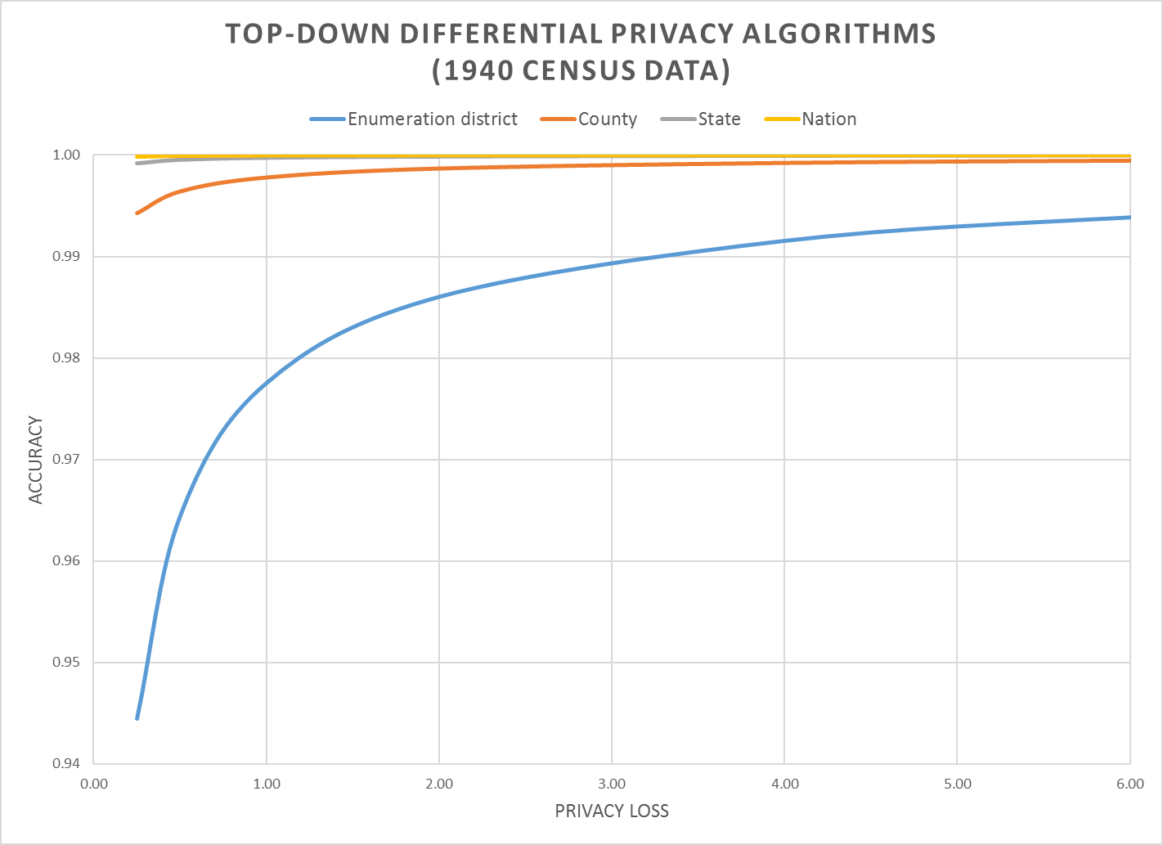
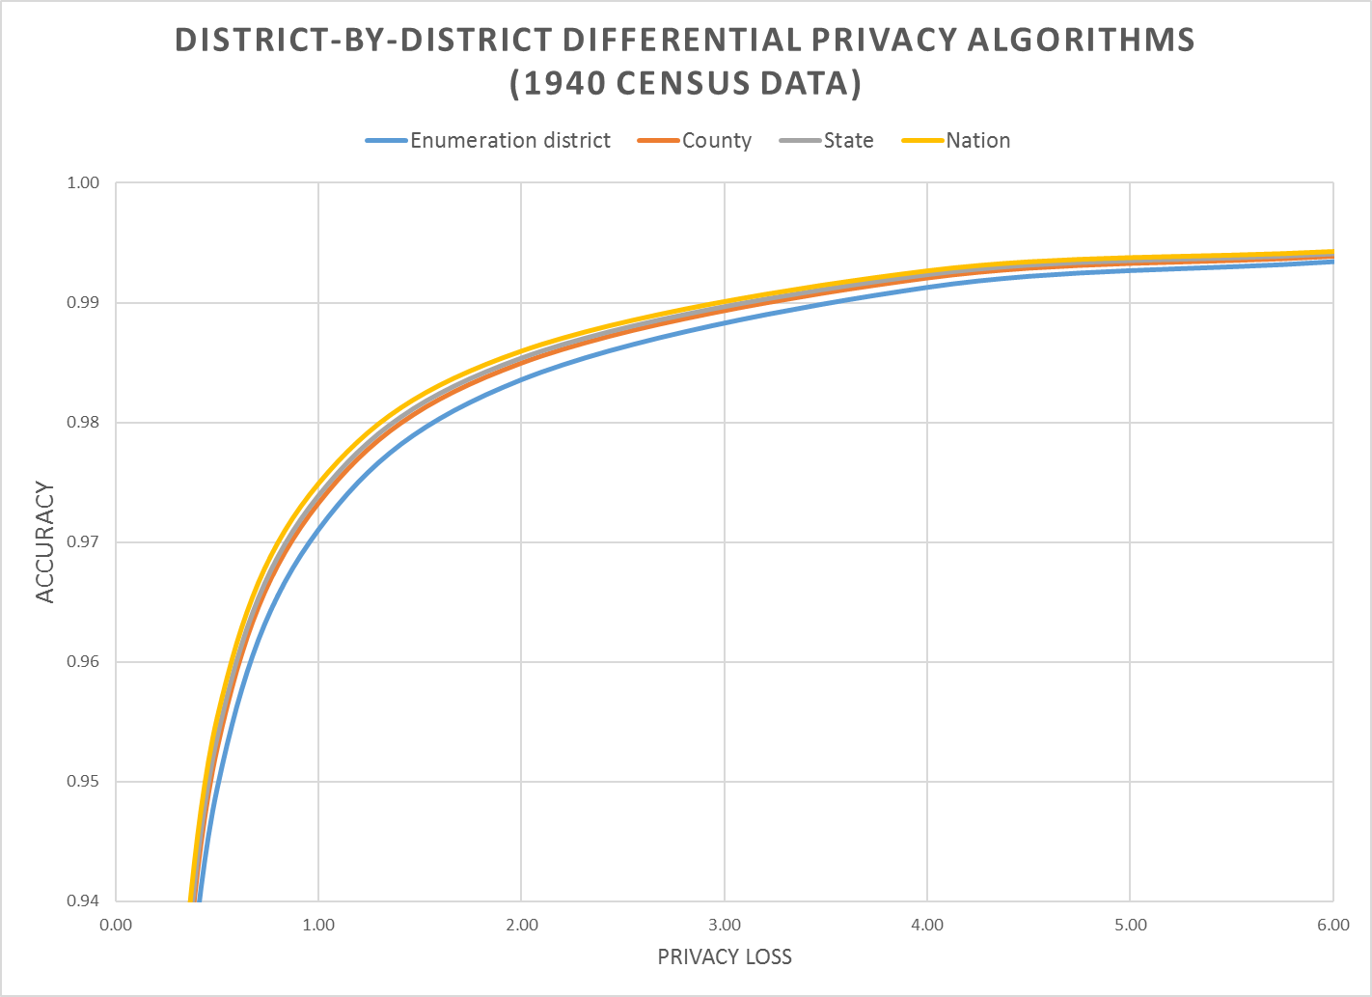
Notes:
Accuracy (in all slides) is (1 – AveTVD/N), where AveTVD = Average Total Variation Distance = Sum( 0.5L_1) over all query sets in the PL94 workload over all geographies in the workload divided by the number of query sets (14), L_1 is the absolute error in all the table, and N is the population count in the complete person table (1940 population). AveTVD is averaged over all the tables in the workload for the relevant geography.
In the 1940 Census data, the geography is nation, state, county, enumeration district (approximately, a modern block group, in 1940 a voting precinct in most areas).
Left panel is the performance of the top-down algorithm at each level of geography for privacy-loss budgets from 0.25 to 6.00. Right panel is the performance of the district-by-district algorithm for the same geographies and workload.
Workload in the experiments is the detailed histogram GQ/HH type (9) x voting age (2) x Hispanic (5) x Race (6) x Citizenship (5) measured sharing the global privacy loss budget across all levels of geography.

Slide 37
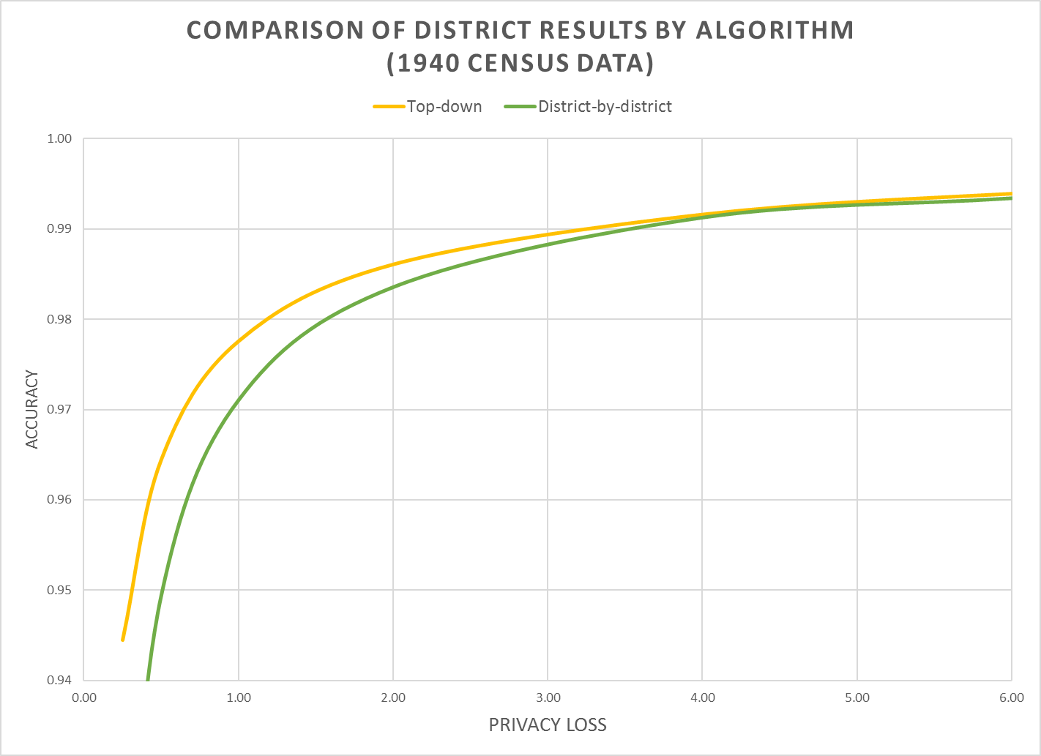
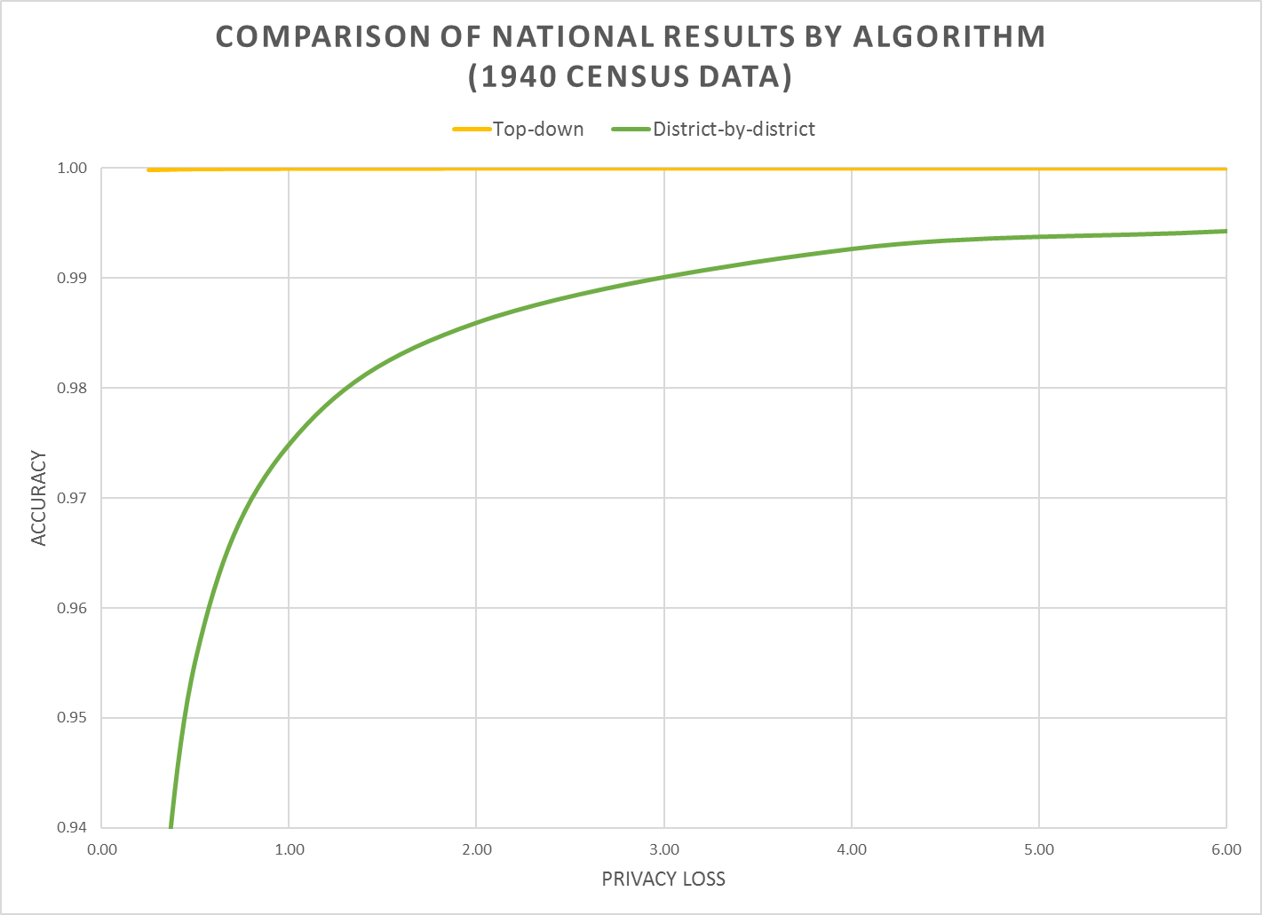
Notes:
Left panel is enumeration-district level data showing both algorithms.
Right panel is national data showing both algorithms. Notice how the national data are still noisy with district-by-district DP.

Slide 38
The 2020 DAS produces highly accurate data when blocks are aggregated into tracts
99% accuracy
95% accuracy
“epsilon” — the privacy loss parameter
Notes:
Accuracy (in all slides) is (1 – AveTVD/N), where AveTVD = Average Total Variation Distance = Sum( 0.5L_1) over all query sets in the PL94 workload over all geographies in the workload divided by the number of query sets (14), L_1 is the absolute error in all the table, and N is the population count in the complete person table (1940 population). AveTVD is averaged over all the tables in the workload for the relevant geography.
In the 1940 Census data, the geography is nation, state, county, enumeration district (approximately, a modern block group, in 1940 a voting precinct in most areas).
Left panel is the performance of the top-down algorithm at each level of geography for privacy-loss budgets from 0.25 to 6.00. Right panel is the performance of the district-by-district algorithm for the same geographies and workload.
Workload in the experiments is the detailed histogram GQ/HH type (9) x voting age (2) x Hispanic (5) x Race (6) x Citizenship (5) measured sharing the global privacy loss budget across all levels of geography.

Slide 39
Two public policy choices:
What is the correct value of epsilon?
Where should the accuracy be allocated?

Slide 40

Managing the Tradeoff

Slide 41
Basic Principles
Based on recent economics (2019, American Economic Review)
https://digitalcommons.ilr.cornell.edu/ldi/48/ or https://arxiv.org/abs/1808.06303
The marginal social benefit is the sum of all persons’ willingness-to-pay for data accuracy with increased privacy loss
The marginal rate of transformation is the slope of the privacy-loss v. accuracy graphs we have been examining
This is exactly the same problem being addressed by Google in RAPPOR or PROCHLO, Apple in iOS 11, and Microsoft in Windows 10 telemetry

Slide 42
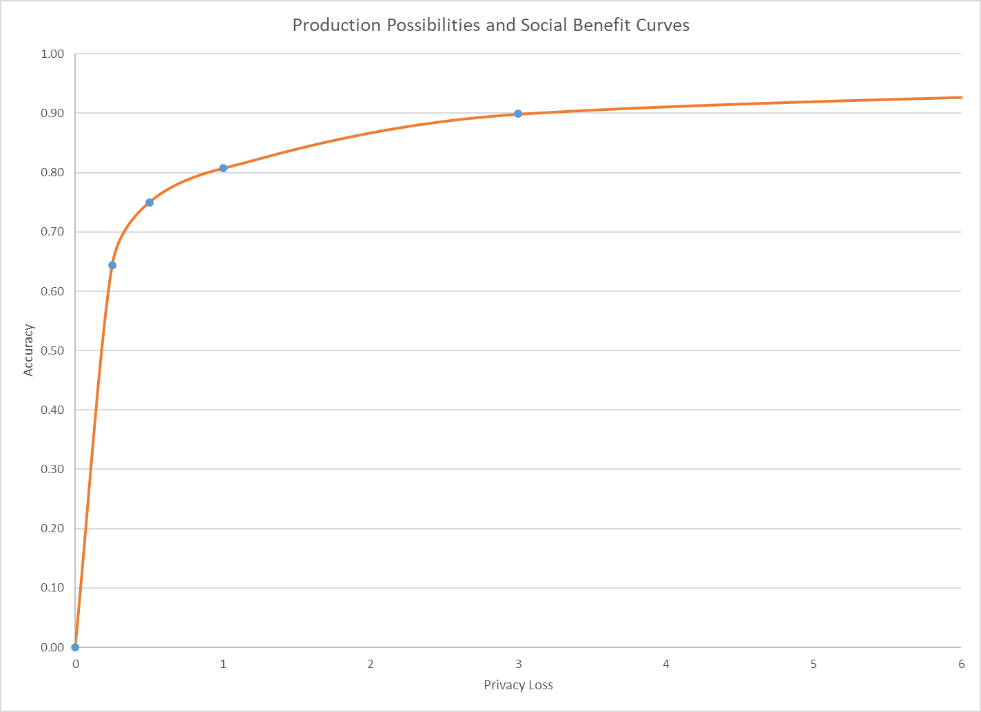
Marginal Social Benefit Curve
Social Optimum: MSB = MSC
(0.25, 0.64)
Production Technology
Notes:
The marginal social benefit is the slope of the illustrated iso-social welfare line (gray). These lines must slope upwards because data accuracy is a “good” and privacy-loss is a “bad.” Iso-social welfare lines above the one illustrated are infeasible because no point on the PPF reaches them. Iso-social welfare lines below the one illustrated are feasible but suboptimal because social welfare can be increase by either increasing accuracy at no privacy-loss cost or decreasing privacy-loss without loss of accuracy.
Slope of the Iso-social welfare curve is 1.5, this means surrendering one unit of privacy loss (say, epsilon goes from 0.25 to 0.26) is worth 1.5 units of accuracy (then accuracy goes from 0.64 to 0.655)
The social optimum is the point of tangency between an iso-social welfare line (gray) and the PPF (red). At this point, the only social welfare improving combinations of data accuracy and privacy-loss are infeasible.
The illustrated iso-social welfare line is the best one attainable, and social welfare is maximized at the indicated point. This point gives the optimal privacy-loss budget and the optimal data accuracy as determined by the preferences of the data users constrained by the SDL technology.
At the indicated level of ε = 0.25, accuracy for tract-level tables averages 96%, and for county and state-level tables averages 100%.
It is impossible to assess the block-level error in a vacuum. You have to consider the use case. The other slides in that presentation show that as the blocks are assembled into geographic areas with larger populations--tracts (244), counties (5), and state (1)--the accuracy improves rapidly. Accuracy is about 96% at the tract level, and essentially 100% at the state and county level. The vast majority of legislative districts in the country have populations far in excess of the average census tract population (about 4,300 for RI in 2010). We have decided to release a large batch of statistical tables, in 2010 PL94-171 redistricting format, from the experiments summarized in my CSAC presentation in advance of releasing the production code for the 2018 End-to-End Census Test disclosure avoidance system. Users of all stripes will be able to use those simulation results to assess average error for their own use cases at all levels of geography.

Slide 43
But the Choice Problem for Redistricting Tabulations Is More Challenging
In the redistricting application, the fitness-for-use is based on :
  Supreme Court one-person one-vote decision (All legislative districts must have approximately equal populations; there is judicially approved variation)
  Is statistical disclosure limitation a “statistical method” (permitted by Utah v. Evans) or “sampling” (prohibited by the Census Act, confirmed in Commerce v. House of Representatives)?
  Voting Rights Act, Section 2: requires majority-minority districts at all levels, when certain criteria are met
The privacy interest is based on:
  Title 13 requirement not to publish exact identifying information
  The public policy implications of uses of detailed race, ethnicity and citizenship
Notes:
All statistical disclosure limitation methods used by the Census Bureau, including differential privacy as implemented for the 2020 Census, conform to both the Census Act--there is no sampling at any level, all the records in the official, confidential decennial census data are used, and no others--and to our understanding of Utah v. Evans--statistical disclosure limitation is an accepted statistical method and has been used since at least 1970 by the Census Bureau.

Slide 44
For more information…
Can a set of equations keep U.S. census data private?
By Jeffrey Mervis
Science
Jan. 4, 2019 , 2:50 PM
Communications of ACM March 2019
Garfinkel & Abowd
http://bit.ly/Science2019C1

Slide 45
More Background on the 2020 Disclosure Avoidance System
September 14, 2017 CSAC (overall design)
https://www2.census.gov/cac/sac/meetings/2017-09/garfinkel-modernizing-disclosure-avoidance.pdf
August, 2018 KDD’18 (top-down v. block-by-block)
https://digitalcommons.ilr.cornell.edu/ldi/49/
October, 2018 WPES (implementation issues)
https://arxiv.org/abs/1809.02201
October, 2018 ACMQueue (understanding database reconstruction)
https://digitalcommons.ilr.cornell.edu/ldi/50/ or
https://queue.acm.org/detail.cfm?id=3295691

