Slide 1
Differential Privacy Deployment at the US Census Bureau
Simson L. Garfinkel
Senior Scientist, Confidentiality and Data Access
U.S. Census Bureau
DARPA Brandeis PI Meeting
Wednesday, May 15, 2019
The views in this presentation are those of the author and do not represent those of the U.S. Census Bureau.

Slide 2
Abstract
When differential privacy was created more than a decade ago, the motivating example was statistics published by an official statistics agency. In attempting to transition differential privacy from the academy to practice, an in particular for the 2020 Census of Population and Housing, the U.S. Census Bureau has encountered many challenges unanticipated by differential privacy's creators. These challenges include obtaining qualified personnel and a suitable computing environment, the difficulty accounting for all uses of the confidential data, the lack of release mechanisms that align with the needs of data users, the expectation on the part of data users that they will have access to micro-data, and the difficulty in setting the value of the privacy-loss parameter, ε (epsilon), and the lack of tools and trained individuals to verify the correctness of differential privacy implementations.

Slide 3
Acknowledgments
This presentation incorporates work by:
  Dan Kifer (Scientific Lead)
  John Abowd (Chief Scientist)
  Tammy Adams, Robert Ashmead, Aref Dajani, Jason Devine, Michael Hay, Cynthia Hollingsworth, Meriton Ibrahimi, Michael Ikeda, Philip Leclerc, Ashwin Machanavajjhala, Christian Martindale, Gerome Miklau, Brett Moran, Ned Porter, Anne Ross, and William Sexton

Slide 4
Outline
Motivation
The flow of census response data
Disclosure Avoidance for the 2020 census: Report on the 2018 end-to-end test.
Specific technical problems we have encountered
Non-technical problems we have encountered
Resistance in our data user community
Other technologies we are considering, such as secure multiparty computation and IntelSGX

Slide 5

Motivation

Slide 6
The Decennial Census
Required by the US Constitution.
  First performed in 1790 under the supervision of Thomas Jefferson
  Longest running statistical program on the planet
Data uses:
  Reapportion the US House of Representatives
  Redistricting of every legislature in the country, including the Congress
  Compliance with Voting Rights Act
  Distribution $670B in US funding

Slide 7
Statistical agencies collect data under a pledge of confidentiality.
We pledge:
  Collected data will be used only for statistical purposes.
  Collected data will be kept confidential.
  Data from individuals or establishments
  won’t be identifiable in any publication.
Fines and prison await any Census Bureau employee
who violates this pledge.
https://www.census.gov/privacy/

Slide 8
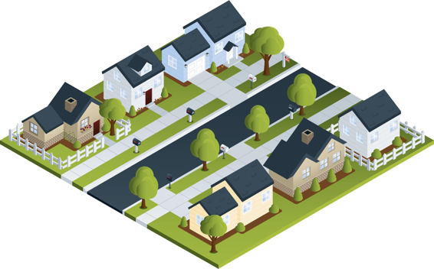
Statistical agencies are trusted curators.
Confidential
Database
Published Statistics
Respondents
 | # | Median Age | Mean Age
Total | 7 | 30 | 38
Women | 4 | 30 | 33.5
Male | 3 | 30 | 44
Black | 4 | 51 | 48.5
White | 3 | 24 | 24
Married | 4 | 51 | 54
Black F | 3 | 36 | 36.7
Age Sex Race/MS
8 FBS
18 MWS
24 FWS
30 MWM
36 FBM
66 FBM
84 MBM

Slide 9
“Disclosure Avoidance”
The Census Bureau uses the term disclosure avoidance:
  Avoiding an illegal disclosure of information that can be attributed to a person or an establishment.
  A higher standard than avoiding “re-identification.”
We have traditionally published Census data as:
  Statistical tables (many!)
  Public Use Microdata Samples --- Household & Person microdata with coarse geography
Confidentiality of respondent data is guaranteed under 13 USC §9

Slide 10

Disclosure Avoidance for the 2010 Census

Slide 11
“This is the official form for all the people at this address.”
“It is quick and easy, and your answers are protected by law.”

Slide 12
2010 Census of Population and Housing
Basic results from the 2010 Census:
Total population | 308,745,538
Household population | 300,758,215
Group quarters population | 7,987,323
Households | 116,716,292

Slide 13
2010 Census Person-Level Database Schema
Variables | Distinct values
Habitable blocks | 10,620,683
Habitable tracts | 73,768
Sex | 2
Age | 115
Race/Ethnicity (OMB Categories) | 126
Race/Ethnicity (SF2 Categories) | 600
Relationship to person 1 | 17
National histogram cells (OMB Categories) | 492,660
Notes:
Note: relationship to person 1 also includes two group quarters types (institutional, non-institutional) that are used for person-level tabulations

Slide 14
2010 Census: Summary of Publications
(approximate counts)
Publication | Released counts (including zeros)
PL94-171 Redistricting | 2,771,998,263
Balance of Summary File 1 | 2,806,899,669
Summary File 2 | 2,093,683,376
Public-use micro data sample | 30,874,554
Lower bound on published person statistics | 7,703,455,862
Statistics/person | 25
Notes:
The 2010 Census publication schedule resulted in roughly 2.8 billion counts (including zeros) published in PL94-171, another 2.8 billion in the rest of SF1, 2 billion in SF2, and another 30 million in a public-use microdata sample. This is roughly 7.7 billion statistics, or 25 per person. That’s a lot more than 6 per person.

Slide 15
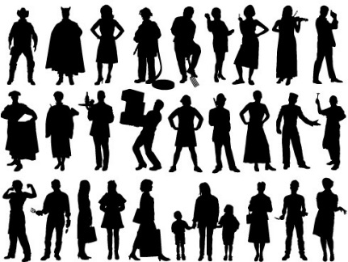
The 2000 and 2010 Disclosure Avoidance System operated as a privacy filter:
Blue = Public Data
Pre-specified tabular summaries:
PL94-171, SF1, SF2 (SF3, SF4, … in 2000)
Red = Confidential Data
Raw data from respondents: Decennial Response File
Selection & unduplication: Census Unedited File
Edits, imputations: Census Edited File
Confidentiality edits (household swapping), Tabulation recodes: Hundred-percent Detail File
Special tabulations and post-census research

Slide 16

The protection system relied on swapping households:
Advantages of swapping:
  Easy to understand
  Does not affect state counts if swaps are within a state
  Can be run state-by-state
  Operation is “invisible” to rest of Census processing
Disadvantages:
  Does not consider or protect against
  database reconstruction attacks
  Does not provide formal privacy guarantees
  Swap rate and details of swapping must remain secret
  Privacy guarantee based on the lack of external data
Town 1
Town 2
State XV

Slide 17
Statistical agencies are trusted curators.
Confidential
Database
Published Statistics
Respondents
 | # | Median Age | Mean Age
Total | 7 | 30 | 38
Women | 4 | 30 | 33.5
Male | 3 | 30 | 44
Black | 4 | 51 | 48.5
White | 3 | 24 | 24
Married | 4 | 51 | 54
Black F | 3 | 36 | 36.7
Age Sex Race/MS
8 FBS
18 MWS
24 FWS
30 MWM
36 FBM
66 FBM
84 MBM

Slide 18
We now know “trusted curator” model is more complex.
Every data publication results in some privacy loss.
Publishing too many statistics results in the compromise of the entire confidential database.
Respondents
Confidential Database
Published Statistics

Slide 19
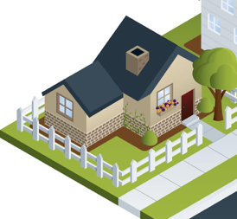
Consider the statistics from a single household
 | Count | Median | Mean
Total | 1 | 24 | 24
# Female | 1 | 24 | 24
# white | 1 | 24 | 24
Single | 1 | 24 | 24
White F | 1 | 24 | 24
24 year-old Female White Single (24 FWS)

Slide 20
Publishing statistics for this household alone would result in an improper disclosure.
 | Count | Median | Mean
Total | (D) | (D) | (D)
# Female | (D) | (D) | (D)
# white | (D) | (D) | (D)
Single | (D) | (D) | (D)
White F | (D) | (D) | (D)
(D) Means suppressed to prevent an improper disclosure.
24 year-old Female White Single (24 FWS)

Slide 21

In the past, statistical agencies aggregated data from many households together into a single publication.
 | Count | Median Age | Mean Age
Total | 7 | 30 | 38
# Female | 4 | 30 | 33.5
# male | 3 | 30 | 44
# black | 4 | 51 | 48.5
# white | 3 | 24 | 24
Married | 4 | 51 | 54
Black F | 3 | 36 | 36.7

Slide 22
We now know that this publication can be reverse-engineered to reveal the confidential database.
 | Count | Median | Mean
Total | 7 | 30 | 38
# Female | 4 | 30 | 33.5
# male | 3 | 30 | 44
# black | 4 | 51 | 48.5
# white | 3 | 24 | 24
Married | 4 | 51 | 54
Black F | 3 | 36 | 36.7
66 FBM & 84 MBM
30 MWM & 36 FBM
8 FBS
18 MWS
24 FWS
This table can be expressed by 164 equations.
Solving those equations takes
0.2 seconds on a 2013 MacBook Pro.

Slide 23
Faced with “database reconstruction,” statistical agencies have just two choices.
Option #1: Publish fewer statistics.
Option #2: Publish statistics with less accuracy.

Slide 24
The problem with publishing fewer statistics: it’s hard to know how many statistics is “too many.”
 | Count | Median | Mean
Total | 7 | 30 | 38
# Female | 4 | 30 | 33.5
# male | 3 | 30 | 44
# black | 4 | 51 | 48.5
# white | 3 | 24 | 24
Single | XXXX | XXXX | XXXX
Married | 4 | 51 | 54
Black F | 3 | 36 | 36.7
Black M | XXXX | XXXX | XXXX
White M | XXXX | XXXX | XXXX
White F | XXXX | XXXX | XXXX
Solution #1
8 FBS
18 MWS
24 FWS
30 MWM
36 FBM
66 FBM
84 MBM
Solution #2
2 FBS
12 MWS
24 FWS
30 MBM
36 FWM
72 FBM
90 MBM

Slide 25
Faced with “database reconstruction,” statistical agencies have just two one choice.
Option #1: Publish fewer statistics.
Option #2: Publish statistics with less accuracy.

Slide 26
Differential privacy gives us a mathematical approach for balancing accuracy and privacy loss.
No privacy
No accuracy

Slide 27
“Differential privacy” is really two things
1 – A mathematical definition of privacy loss.
2 – Specific mechanisms that allow us to:
    Add the smallest amount of noise necessary for a given privacy outcome
    Structure the noise to have minimal impact on the more important statistics

Slide 28
Differential privacy — the big idea:
Use “noise” to create uncertainty about private data.
NOISE BARRIER
35 year-old Female Black Single (35 FBS)
Impact of the noise ≈ impact of a single person
Impact of noise on aggregate statistics
decreases with larger population.
24 year-old Female White Single (24 FWS)

Slide 29
In 2017, the Census Bureau announced that it would use differential privacy for the 2020 Census.
There is no off-the-shelf mechanism for applying differential privacy to a national census.
Randomized response (RAPPOR) would introduce far too much noise for any sensible value of ε to be a much statistical value.
  Google found this out.
We cannot simply apply the Laplace Mechanism to tables.
  Our data users expect consistent tables.

Slide 30
Understanding the impact of “noise:”
(Statistics based on 10,000 experiments, epsilon=1.0)
 | 50% runs | 95% runs
 | Median(age): 9 → 73 | Median(age): 0→ 104
 | Median(age): 17 → 61 | Median(age): 0→ 103
 | Median(age): 21 → 22 | Median(age): 21→ 22
1 person age 22
NOISE BARRIER
10 people, all age 22
100 people, all age 22

Slide 31
The noise also impacts the person counts.
 | 50% runs | 95% runs
 | Median(age): 9 → 73 # people: -9 → 11 | Median(age): 0→ 104 # people: -29 → 30
 | Median(age): 17 → 61 # people: 0 → 20 | Median(age): 0→ 103 # people: -19 → 38
 | Median(age): 21 → 22 # people: 90 → 110 | Median(age): 21→ 22 # people: 71 → 129
1 person age 22
NOISE BARRIER
10 people, all age 22
100 people, all age 22

Slide 32

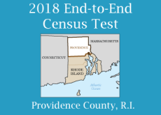
The US Census Bureau embraces formal privacy:
Results of the 2018 End-to-End Test

Slide 33
We created a “Disclosure Avoidance System” (DAS) for the 2020 Census
Features of the DAS:
  Operates on the edited Census records
  Makes records that are “safe to tabulate.”
Census Edited File
Disclosure Avoidance System
Microdata Detail File (2020)
NOISE BARRIER

Slide 34


DAS allows the Census Bureau to enforce global confidentiality protections.
Pre-specified tabular summaries:
PL94-171, DHC, DDHC, AIANNH
Decennial Response File
Census Unedited File
Census Edited File
Global Confidentiality Protection Process
Disclosure Avoidance System
Microdata Detail File
NOISE BARRIER
Special tabulations and post-census research
Privacy Budget,
Accuracy Decisions
Notes:
SF1 is replaced by Demographic and Household Characteristics
SF2 is replaced by Detailed Demographic and Household Characteristics
AIANNH is American Indian, Alaska Native and Native Hawaiian
DDHC and AIANNH will not pass through the MDF, nor will the join tables once they have been named

Slide 35
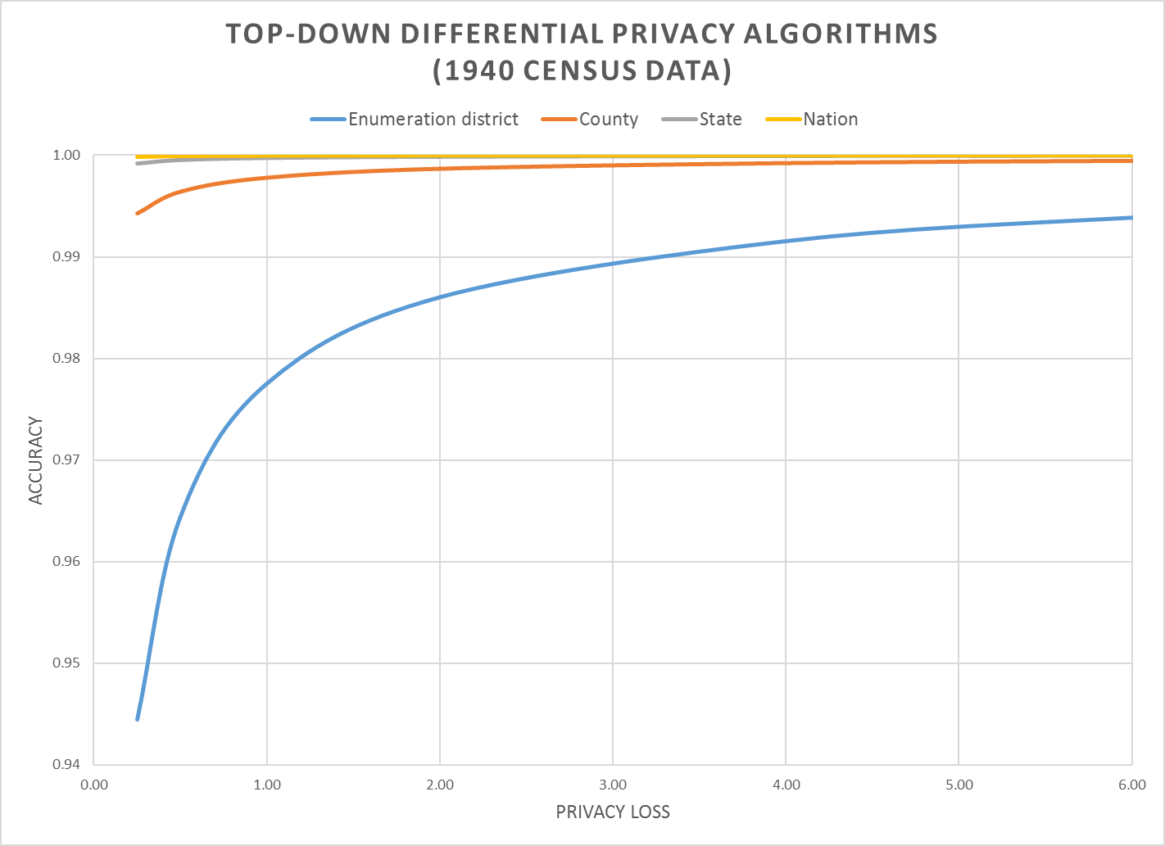
The Census disclosure avoidance system will use differential privacy to defend against a reconstruction attack,
Differential privacy provides:
  Provable bounds on the accuracy of the best possible database reconstruction given the released tabulations.
  Algorithms that allow policy makers to decide the trade-off between accuracy and privacy.
Final privacy-loss budget determined by Data Stewardship Executive Policy Committee (DSEP)
with recommendation from Disclosure Review Board (DRB)
Pre-Decisional

Slide 36

Why generate a differentially private MDF?
  Familiar to internal and external stakeholders
  Operates with legacy tabulation systems to produce PL-94 and DHC tabulations
  Consistency among query answers
Pre-specified tabular summaries:
PL94-171, DHC,DDHC,
AIANNH
Decennial Response File
Census Unedited File
Census Edited File
Global Confidentiality Protection Process
Disclosure Avoidance System
Microdata Detail File
NOISE BARRIER
Special tabulations and post-census research
Privacy Budget,
Accuracy Decisions

Slide 37
Scientific Issues for the 2020 Census:
Hierarchical Mechanisms
We needed a novel mechanism that:
  Assured consistent statistics from US->States->Counties->Tracts
  Provided lower error for larger geographies
We have successfully created a “top-down” mechanism that accomplishes this goal.

Slide 38
Scientific Issues for the 2020 Census:
Invariants
For the 2018 End-to-End test, policy makers wanted exact counts:
  Number of people on each block
  Number of people on each block of voting age
  Number of residences & group quarters on each block
We implemented invariants before we understood their mathematical impact on differential privacy semantics.
For the End-to-End test, we only had four invariants
The five items set as invariant were
  C1: Total population (invariant at the county level for the 2018 E2E)
  C2: Voting-age population (population age 18 and older) (eliminated for the 2018 E2E)
  C3: Number of housing units (invariant at the block level)
  C4: Number of occupied housing units (invariant at the block level)
  C5: Number of group quarters facilities by group quarters type (invariant at the block level)

Slide 39
Scientific Issues for the 2020 Census:
Person-Household Joins
The Census creates two kinds of tables:
  Person tables
  Household tables
We can create P & H today. We are working on P x H and Detailed P, H
Q(P): # of men living on a block.
Q(H): # of occupied houses on a block.
Q(P x H): # of children in houses headed by a single man.

Slide 40
Scientific Issue for any use of DP:
Quality Metrics
What is the measure of “quality” or “utility” in a complex data product?
Options:
  L1 error between “true” data set and “privatized” data set
  Impact on an algorithm that uses the data (e.g., redistricting and Voting Rights Act enforcement)

Slide 41
Organizational Challenges
Process documentation
  All uses of confidential data need to be tracked and accounted.
Workload identification
  All desired queries on MDF should be known in advance.
  Required accuracy for various queries should be understood.
  Queries outside of MDF must also be pre-specified
Correctness and Quality control
  Verifying implementation correctness.
  Data quality checks on tables cannot be done by looking at raw data.

Slide 42
Data User Challenges
Differential privacy is not widely known or understood.
Many data users want highly accurate data reports on small areas.
  Some are anxious about the intentional addition of noise.
  Some are concerned that previous studies done with swapped data might not be replicated if they used DP data.
Many data users believe they require access to Public Use Microdata.
Users in 2000 and 2010 didn’t know the error introduced by swapping and other protections applied to the tables and PUMS.

Slide 43
Scientific issues for the
American Community Survey
The American Community Survey replaced the “Long Form” in 2005.
Data from the ACS is widely used by academics and industry.
ACS is a complex multi-stage weighted sample.
Uses a stratified probability sample of the entire US with ex post weight adjustment.
Differential privacy currently does not handle (well):
Weights on survey microdata when they are processed after the design phase.
Skip-logic/conditional responses, and other edit criteria.
Our current plan is use hierarchical spatio-temporal models and rework the ACS production system to incorporate data from multiple sources.
Formal privacy will be introduced once the science has caught up to the data products.

Slide 44
Policy issue: Accuracy Allocation
Differential privacy allows us to make some statistics more accurate and others less accurate.
Who decides which is more important? (M/F ? Minor/adult?)
 | Males | Females
Age < 18 | 100 | 150
Age >= 18 | 150 | 100

Slide 45
Policy Issue: Setting Epsilon
Notes:
We want the most efficient technology, which is the one in red.

Slide 46
Where social scientists act like MSC = MSB
Where computer scientists act like MSC = MSB
Notes:
Selecting an optimal point on the PPF requires a social choice model. In economics, such a model equates the marginal social benefit to the marginal social cost. In the data privacy analysis, the marginal social cost of increased data accuracy is the incremental privacy loss given by the slope of the PPF at any point.
A social choice model posits a social welfare function linking data quality and privacy loss for individuals in the target/protected population. The points of equal social welfare would be upward sloping lines in the graph above (not necessarily straight lines).

Slide 47
Operational Issues
Obtaining Qualified Personnel and Tools
Recasting high-sensitivity queries
Identifying Structural Zeros
Obtaining a Suitable Computing Environment
Accounting for All Uses of Confidential Data

Slide 48
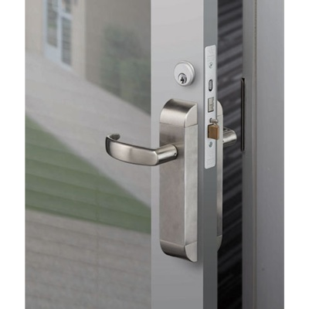
Other
Access Options

Slide 49
The goal of a statistics agency is to produce data that is useful for decision making.
The historical model is to publish statistics:
To be useful, data must be:
  Timely, Complete, Integrated, and Privatized
None of these goals are accomplished by just publishing statistics.
Respondents
Confidential Database
Published Statistics

Slide 50
Can we shift away from sample surveys?
Real time data capture / Flow-based processing /
Customer-focused analytics / Built-in privacy controls
New data analysis approaches:
  Realistic privacy-protected microdata data distributed to researchers.
  Remote data analysis with computation & validation servers.
New data collection approaches:
  Secure Multiparty Computation
  Trusted Computing (e.g. SGX) for data collection

Slide 51
Example: Pilot project to simulate collection for the Commodity Flow Survey
Pilot project is to:
  Simulate the daily load of daily UPS processing (20 million shipments)
  Transfer and tabulate data to Census (suggesting most of the entire university of daily shipments in the US could be tabulated nighty in 30 minutes or less)
We are working with Galois, Microsoft Research, and Azure to set up multiple a VM test of real data on a commercial FEDRAMP-certified cloud.

Slide 52
In Summary
The Census Bureau will use differential privacy for the 2020 Census
  There is no plan B.
  We have a working system today that can produce Person and Household tables
Differential privacy will impact:
  Data collection
  Data processing
  Data dissemination
  Data users
This is the most significant change to the decennial census dissemination since the decision to publish microdata in 1960.

