Slide 1
Attacking and Protecting Public Data with Differential Privacy
Simson L. Garfinkel Senior Scientist, Confidentiality and Data Access U.S. Census Bureau Seminar Series
10:00 – 11:30 Tuesday, March 26
The views in this presentation are those of the author, and not those of the U.S. Census Bureau.
UNCLASSIFIED

Slide 2
Abstract
Publishing exact statistical data creates mathematical risks and vulnerabilities that have only recently been appreciated. In 2010, the U.S. Census Bureau collected information on more than 308 million residents and published more than 8 billion statistics. Last year a Census Bureau red team performed a simulated attack against this public dataset and was able to reconstruct all of confidential microdata used in these tabulations with very limited error. They matched 45% of these reconstructed records to commercial datasets acquired between 2009 and 2011. 38% of these matches were confirmed in the original 2010 confidential microdata. These rates represent vulnerability levels more than a thousand times higher than had been previously considered acceptable. As a result of this internal test, the Census Bureau has adopted a new privacy protection methodology called differential privacy to protect the data publications of the 2020 Census. Differential privacy is based on systematically adding statistical "noise" to data products prior to publication. By carefully controlling the method by which the noise is added, and through the use of advanced post-processing, the Census Bureau is able to ensure the analytical validity of its statistical publications while protecting the underlying confidential data on which those publications are based. It is hypothesized that similar approaches could be used to protect other kinds of data products that must be shared outside of a trusted community, such as statistical models and cyber threat intelligence.

Slide 3
Acknowledgments
This presentation incorporates work by:
Dan Kifer (Scientific Lead)
John Abowd (Chief Scientist)
Tammy Adams, Robert Ashmead, Aref Dajani, Jason Devine, Nathan Goldschlag, Michael Hay, Cynthia Hollingsworth, Meriton Ibrahimi, Michael Ikeda, Philip Leclerc, Ashwin Machanavajjhala, Christian Martindale, Gerome Miklau, Brett Moran, Ned Porter, Anne Ross, William Sexton, Lars Vilhuber, and Pavel Zhuravlev

Slide 4
The threat of database reconstruction

Slide 5
Imagine a typical block in the US
The job of an official statistics agency is to collect data and publish useful statistics.

Slide 6
Step #1: Collect data from the public
66 yrs Female Black Married (66 FBM)
84 yrs Male Black Married (84 MBM)
30 yrs Male White Married (30 MWM)
36 yrs Female Black Married (36 FBM)
8 yrs Female Black Single (8 FBS)
12 yrs Male White Single (12 MWS)
24 yrs Female White Single (24 FWS)
18 MWS
24 FWS

Slide 7
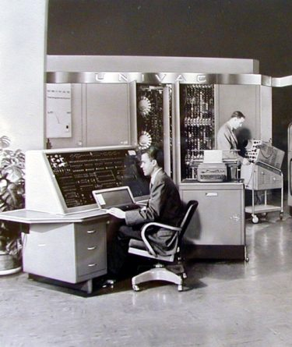
Step #2: Analyze the data
66 FBM & 84 MBM
30 MWM & 36 FBM
UNIVAC I
8 FBS
18 MWS
24 FWS

Slide 8
Step #3: Publish the data
 | Count | Median | Mean
Total | 7 | 30 | 38
# Female | 4 | 30 | 33.5
# male | 3 | 30 | 44
# black | 4 | 51 | 48.5
# white | 3 | 24 | 24
Single | (D) | (D) | (D)
Married | 4 | 51 | 54
Black F | 3 | 36 | 36.7
Black M | (D) | (D) | (D)
White M | (D) | (D) | (D)
White F | (D) | (D) | (D)
66 FBM & 84 MBM
30 MWM & 36 FBM
UNIVAC I
8 FBS
18 MWS
24 FWS

Slide 9
(D) is a statistic suppressed for privacy
 | Count | Median | Mean
Total | 7 | 30 | 38
# Female | 4 | 30 | 33.5
# male | 3 | 30 | 44
# black | 4 | 51 | 48.5
# white | 3 | 24 | 24
Single | (D) | (D) | (D)
Married | 4 | 51 | 54
Black F | 3 | 36 | 36.7
Black M | (D) | (D) | (D)
White M | (D) | (D) | (D)
White F | (D) | (D) | (D)
(D) means publishing this statistic would result in an unauthorized disclosure of confidential information.
Spoiler:
Despite the (D)s, nothing in this table is actually suppressed because a reconstruction attack succeeds, allowing recovery of all suppressed data.

Slide 10
Our motivation: The US Constitution
Article 1, Section 2
“The actual Enumeration shall be made within three Years after the first Meeting of the Congress of the United States, and within every subsequent Term of ten Years, in such Manner as they shall by Law direct.

Slide 11
We also must protect respondent confidentiality!
13 U.S. Code § 9 - Information as confidential
(a) Neither the Secretary, nor any other officer or employee of the Department of Commerce or bureau or agency thereof, or local government census liaison may….
(2) Make any publication whereby the data furnished by any particular establishment or individual under this title can be identified; or
…
Copies of census reports, which have been so retained, shall be immune from legal process, and shall not, without the consent of the individual or establishment concerned, be admitted as evidence or used for any purpose in any action, suit, or other judicial or administrative proceeding.

Slide 12
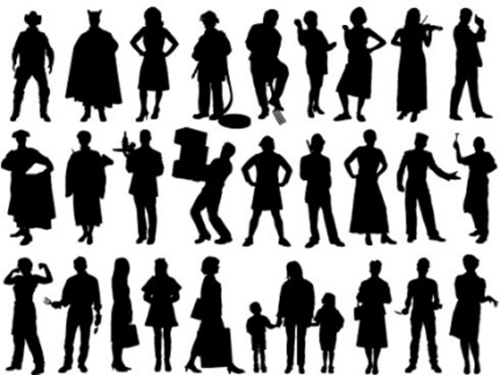
The 2010 Census collected data on 308,745,539 people.
Pre-specified tabular summaries: PL94-171, SF1, SF2 (SF3, SF4, … in 2000)
DRF
HDF
Raw data from respondents: Decennial Response File
Statistical
Processes
Hundred-percent Detail File
Special tabulations and post-census research
Confidential data
Public data

Slide 13
For each person, we collected 6 variables (44 bits of data)
Variable | Range | Bits
Block | 6,207,027 inhabited blocks | 23
Sex | 2 (Female/Male) | 1
Age | 103 (0-99 single age year categories, 100-104, 105-109, 110+) | 7
Race | 63 allowable race combinations | 7
Ethnicity | 2 (Hispanic/Not) | 1
Relationship | 17 values | 5
Total |  | 44
308,745,538 people x 6 variables = 1,852,473,228 measurements
308,745,538 people x 44 bits = 13,584,803,672 bits ≈ 1.7 GB

Slide 14
And now, a quick detour back to basic algebra.
http://archive.defense.gov/news/newsarticle.aspx?id=66200

Slide 15
Some systems of linear equations have exact solutions.
X = 10 | 1 equation 1 unknown | X = 10
X + Y = 10 | 1 equation 2 unknowns | -∞ < X < +∞ -∞ < Y < +∞
X + Y = 10 X = 3 | 2 equations 2 unknowns | X = 3 Y = 7

Slide 16
2010 Census: Summary of Publications (approximate counts)
Publication | Released counts
PL94-171 Redistricting | 2,771,998,263
Balance of Summary File 1 | 2,806,899,669
Summary File 2 | 2,093,683,376
Public-use micro data sample | 30,874,554
Lower bound on published statistics | 7,703,455,862
Published Statistics/person | 25
Published Statistics/collected variable | ~ 4.2
Notes:
The 2010 Census publication schedule resulted in roughly 2.8 billion counts (including zeros) published in PL94-171, another 2.8 billion in the rest of SF1, 2 billion in SF2, and another 30 million in a public-use microdata sample. This is roughly 7.7 billion statistics, or 25 per person. That’s a lot more than 6 per person.

Slide 17
The 2010 Census collected data on 308,745,538 people.
7,703,455,862 published statistics
(lower bound)
Pre-specified tabular summaries: PL94-171, SF1, SF2 (SF3, SF4, … in 2000)
DRF
HDF
Raw data from respondents: Decennial Response File
Statistical
Processes
Hundred-percent Detail File
Special tabulations and post-census research
1,852,473,228 collected values
(308,745,538 people x 6 variables/person)
Public data

Slide 18
We performed a database reconstruction and re-identification attack for all 308,745,538 people in 2010 Census
Reconstructed 308,745,538 microdata records.
Used 4 commercial databases of the 2010 US population acquired 2009-2011 in support of the 2010 Census
Commercial database had: NAME, ADDRESS, AGE, SEX
Linked reconstructed records to the commercial database records
Linked database has: NAME, ADDRESS, AGE, SEX , ETHNICITY & RACE
Link rate: 45%
Compared linked database to Census Bureau confidential data
Question: How often did the attack get the all variables including race and ethnicity right?
Answer: 38% (17% of US population)

Slide 19
Our attack is good, but not perfect. An outside attacker would have a harder time.
We confirmed re-identification of 38% (17% of US population)
We did not reconstruct families.
We did not recover detailed self-identified race codes
An outside attacker:
Would not know which re-identifications are correct.
An outside attacker would need to confirm with another external data source.

Slide 20
The protection system used in 2000 and 2010 relied on swapping households.
Some households were swapped with other households
Swapped households had the same size.
Swapping limited to within each state.
Disadvantages:
Swap rate and details of swapping not disclosed.
Privacy protection was not quantified.
Impact on data quality not quantified.
Swapping is called a “Disclosure Avoidance” technique. It’s job is to prevent improper disclosures.
Town 1
Town 2
Any State

Slide 21
We now know that the disclosure avoidance techniques we used in the 2010 Census were flawed.
We released exact population counts for blocks, tracts and counties.
We did not swap 100% of the households
We released ≈25 statistics per person, but only collected six pieces of data per person:
Block • Age • Sex • Race • Ethnicity • Relationship to Householder
The Census Bureau did the best possible in 2010. The math for protecting a decennial census did not [yet] exist.

Slide 22
Options for protecting the confidentiality of the collected data in a decennial census
Publish less data.
Publish less accurate data.

Slide 23
Can we publish less data?
Publishing less data requires tracking every data publication.
This was called “Query Auditing” or “Query Tracking”
Many research papers, 1970s — 2001.

Slide 24
Query auditing is hard.
 | Count | Median | Mean
Total | 7 | 30 | 38
# Female | 4 | 30 | 33.5
# male | 3 | 30 | 44
# black | 4 | 51 | 48.5
# white | 3 | 24 | 24
Single
Married | 4 | 51 | 54
Black F | 3 | 36 | 36.7
Black M
White M
White F
66 FBM & 84 MBM
30 MWM & 36 FBM
8 FBS
18 MWS
24 FWS
Notes:
Remember the data that we published for this block?

Slide 25
Query auditing is hard.
 | Count | Median | Mean
Total | 7 | 30 | 38
# Female | 4 | 30 | 33.5
# male | 3 | 30 | 44
# black | 4 | 51 | 48.5
# white | 3 | 24 | 24
Single
Married | 4 | 51 | 54
Black F | 3 | 36 | 36.7
Black M
White M
White F
Solution #1
8 FBS
18 MWS
24 FWS
30 MWM
36 FBM
66 FBM
84 MBM
SAT Solver
Notes:
It turns out that if we publish those statistics, there is only a single solution.

Slide 26
Query auditing is hard.
 | Count | Median | Mean
Total | 7 | 30 | 38
# Female | 4 | 30 | 33.5
# male | 3 | 30 | 44
# black | 4 | 51 | 48.5
# white | 3 | 24 | 24
Single
Married | 4 | 51 | 54
Black F | 3 | 36 | 36.7
Black M
White M
White F
Notes:
What if we remove this statistic?

Slide 27
Query auditing is NP-hard!
 | Count | Median | Mean
Total | 7 | 30 | 38
# Female | 4 | 30 | 33.5
# male | 3 | 30 | 44
# black | 4 | 51 | 48.5
# white | 3 | 24 | 24
Single
Married | 4 | 51 | 54
Black F | 3 | 36 | 36.7
Black M
White M
White F
Solution #1
8 FBS
18 MWS
24 FWS
30 MWM
36 FBM
66 FBM
84 MBM
Solution #2
2 FBS
12 MWS
24 FWS
30 MBM
36 FWM
72 FBM
90 MBM
SAT Solver
Notes:
It turns out that query auditing is NP-hard

Slide 28
Query auditing is NP-hard. Attacking query auditing systems is easy.
In 2003, Irit Dinur and Kobbi Nissim published a simple attack on query-auditing systems:
Make random queries.
Find a database consistent with all queries.
Protecting a database of $n$ bits requires randomizing bits
Smaller perturbation always results in a stronger violation of privacy.

Slide 29
We can’t publish less data. We won’t know when we have crossed the threshold.
Publish less data.
Publish less accurate data.
We must publish less accurate data
Fundamental theorem of information recovery:
Too many statistics published too accurately from a confidential database compromises the entire confidential database.
But how much less accurate should it be?

Slide 30
Another problem: external information.
 | Count | Median | Mean
Total | 7 | 30 | 38
# Female | 4 | 30 | 33.5
# male | 3 | 30 | 44
# black | 4 | 51 | 48.5
# white | 3 | 24 | 24
Single
Married | 4 | 51 | 54
Black F | 3 | 36 | 36.7
Black M
White M
White F
If we know there is an 8 FBS, we know Solution #1 is correct.
Solution #1
8 FBS
18 MWS
24 FWS
30 MWM
36 FBM
66 FBM
84 MBM
Solution #2
2 FBS
12 MWS
24 FWS
30 MBM
36 FWM
72 FBM
90 MBM
SAT Solver

Slide 31
Differential Privacy provides us with a solution.
Differential Privacy gives us:
Mathematical definition for privacy loss caused by a data release.
No dependence on attacker’s external information.
No dependence on attacker’s computer power.
Composable privacy-protection mechanisms.

Slide 32
No privacy
No accuracy

Slide 33
“Differential Privacy” is a formal privacy system
Differential privacy provides:
Provable bounds on the maximum privacy loss
Algorithms that allow policy makers to manage the trade-off between accuracy and privacy
It’s called “differential privacy” because it mathematically models the privacy “differential” that each person experiences from having their data included in the Census Bureau’s data products compared to having their record deleted or replaced with an arbitrary record.
Pre-Decisional

Slide 34
Differential privacy: the basic idea. Take the statistics you want to publish and add noise
 | Count | Median | Mean
Total | 7 | 30 | 38
# Female | 4 | 30 | 33.5
# male | 3 | 30 | 44
# black | 4 | 51 | 48.5
# white | 3 | 24 | 24
Single Adults | 2 | 21 | 21
Married | 4 | 51 | 54
Black F | 3 | 36 | 36.7
Black M | 1 | 84 | 84
White M | 2 | 24 | 24
White F | 1 | 24 | 24
 | Count | Median | Mean
Total | 5.9 | 26.9 | 38.6
# Female | 2.7 | 30.4 | 29.1
# male | 3.5 | 25.6 | 39.1
# black | 3.2 | 51.0 | 44.0
# white | 2.2 | 19.7 | 19.2
Single Adults | 0.9 | 19.7 | 20.9
Married | 3.4 | 47.5 | 56.3
Black F | 1.7 | 31.7 | 34.4
Black M | -0.4 | 80.8 | 80.1
White M | 2.2 | 27.9 | 21.6
White F | -0.1 | 23.8 | 19.4
NOISE BARRIER

Slide 35
There’s no way to undo the addition of noise.
SAT solver will give us a solution
But it probably won’t be the correct solution!
Use post-processing to:
Round the numbers
Make the numbers consistent
Post-processing cannot consider data to the left of the noise barrier
 | Count | Median | Mean
Total | 5.9 | 26.9 | 38.6
# Female | 2.7 | 30.4 | 29.1
# male | 3.5 | 25.6 | 39.1
# black | 3.2 | 51.0 | 44.0
# white | 2.2 | 19.7 | 19.2
Single Adults | 0.9 | 19.7 | 20.9
Married | 3.4 | 47.5 | 56.3
Black F | 1.7 | 31.7 | 34.4
Black M | -0.4 | 80.8 | 80.1
White M | 2.2 | 27.9 | 21.6
White F | -0.1 | 23.8 | 19.4
?

Slide 36
The 2020 census needs differential privacy

Slide 37
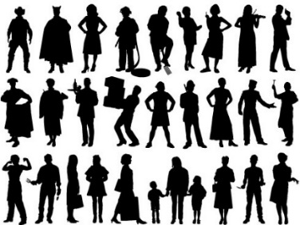
The Disclosure Avoidance System allows the Census Bureau to enforce global confidentiality protections.
Pre-specified tabular summaries: PL94-171, SF1, SF2
DRF
CUF
CEF
DAS
MDF
Decennial Response File
Census Unedited File
Census Edited File
Global Confidentiality Protection Process
Disclosure Avoidance System
Microdata Detail File
Special tabulations and post-census research
Confidential data
Privacy-loss Budget,
Accuracy Decisions
Public data

Slide 38
The Disclosure Avoidance System relies on injects formally private noise.
Advantages of noise injection with formal privacy:
Transparency: the details can be explained to the public
Tunable privacy guarantees
Privacy guarantees do not depend on external data
Protects against accurate database reconstruction
Protects every member of the population
Challenges:
Entire country must be processed at once for best accuracy
Every use of confidential data must be tallied in the privacy-loss budget
Global Confidentiality Protection Process
Disclosure Avoidance System
ε

Slide 39
There was no off-the-shelf system for applying differential privacy to a national census
We had to create a new system that:
Produced higher-quality statistics at more densely populated geographies
Produced consistent tables
We created new differential privacy algorithms and processing systems that:
Produce highly accurate statistics for large populations (e.g. states, counties)
Create privatized microdata that can be used for any tabulation without additional privacy loss
Fit into the decennial census production system

Slide 40
We have implemented two algorithms
Block-by-block algorithm:
Top-down algorithm:
330M records
ε
National Histogram
8 million blocks
Disclosure Avoidance System
8 million protected blocks
State-level measurements
ε
51 state histograms
County-level measurements
ε
3,142 county histograms
Tract-level measurements
ε
75,000 census tract histograms
Block-level measurements
ε
8 million block histograms

Slide 41
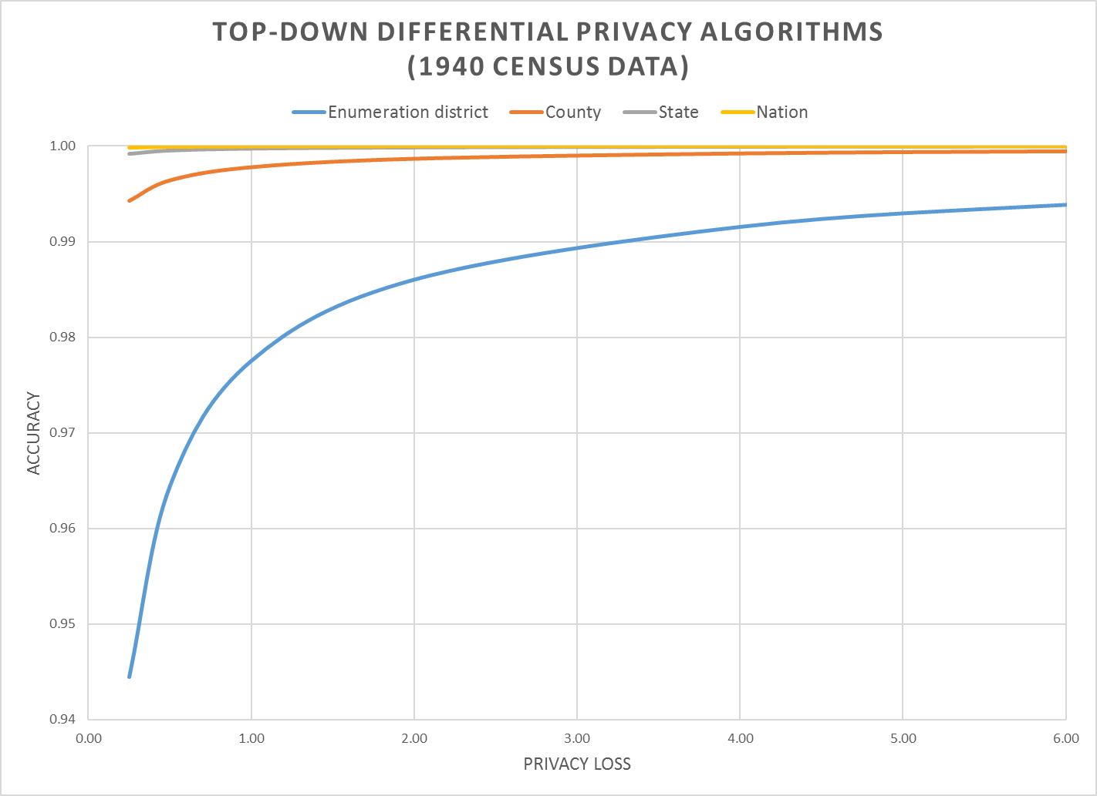
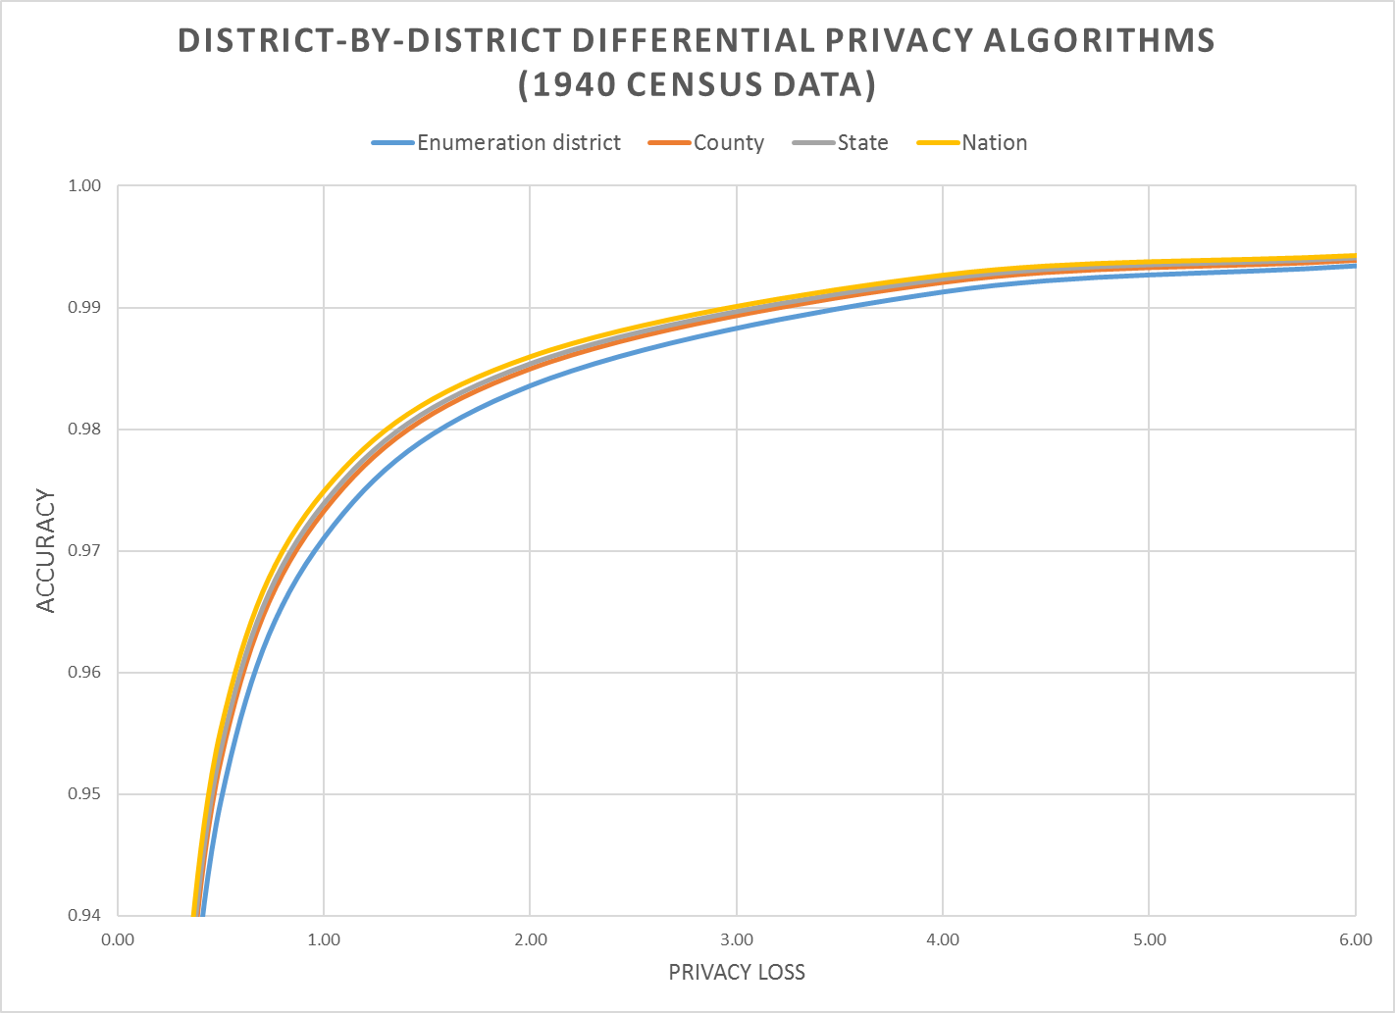
The top-down algorithm beats block-by-block at every level of geography
Notes:
Accuracy (in all slides) is (1 – AveTVD/N), where AveTVD = Average Total Variation Distance = Sum( 0.5L_1) over all query sets in the PL94 workload over all geographies in the workload divided by the number of query sets (14), L_1 is the absolute error in all the table, and N is the population count in the complete person table (1940 population). AveTVD is averaged over all the tables in the workload for the relevant geography.
In the 1940 Census data, the geography is nation, state, county, enumeration district (approximately, a modern block group, in 1940 a voting precinct in most areas).
Left panel is the performance of the top-down algorithm at each level of geography for privacy-loss budgets from 0.25 to 6.00. Right panel is the performance of the district-by-district algorithm for the same geographies and workload.
Workload in the experiments is the detailed histogram GQ/HH type (9) x voting age (2) x Hispanic (5) x Race (6) x Citizenship (5) measured sharing the global privacy loss budget across all levels of geography.

Slide 42
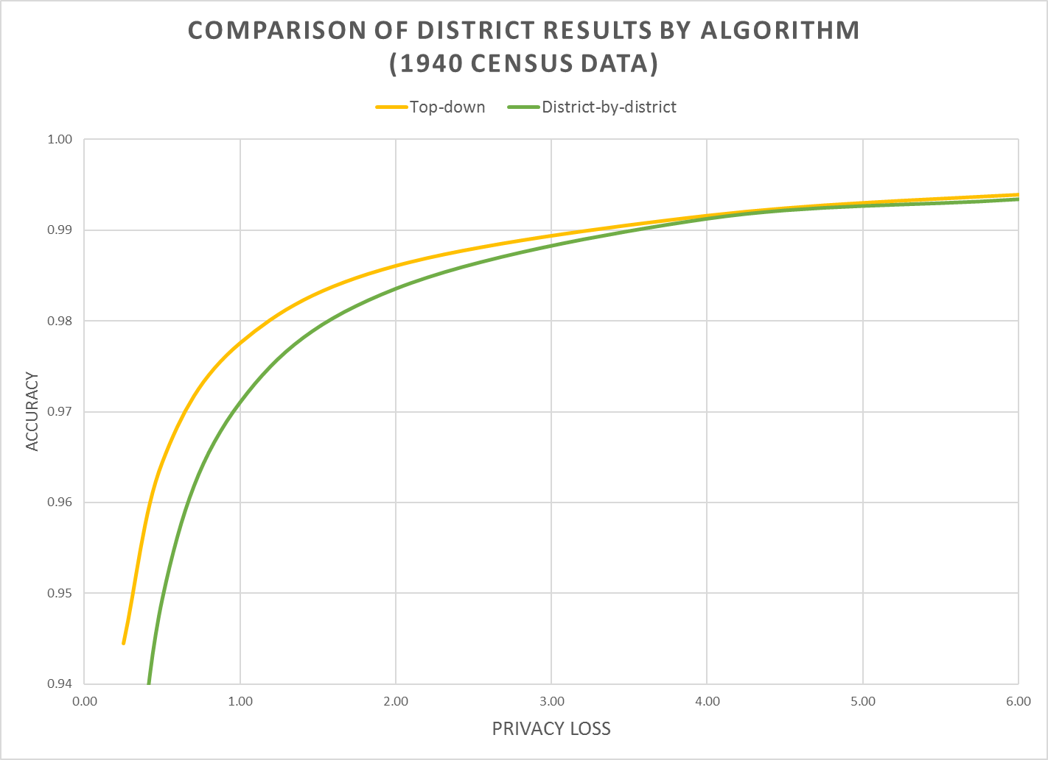
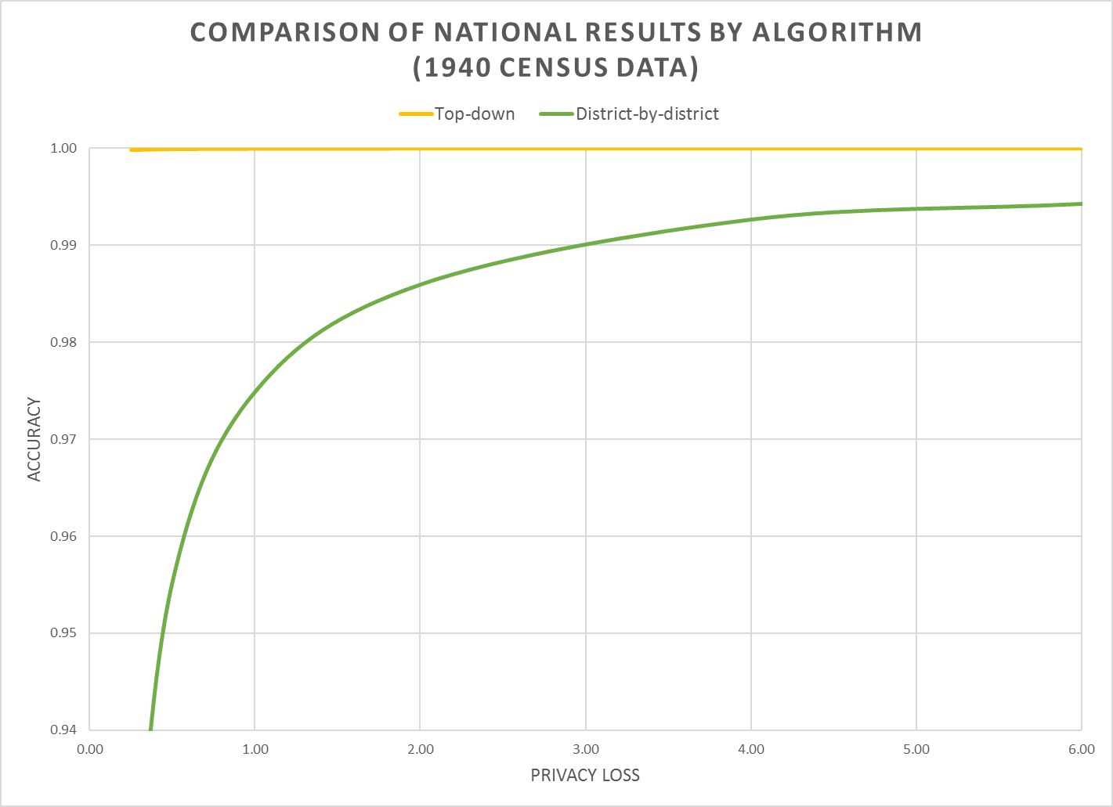
Notes:
Left panel is enumeration-district level data showing both algorithms.
Right panel is national data showing both algorithms. Notice how the national data are still noisy with district-by-district DP.

Slide 43
Two public policy choices:
What is the correct value of epsilon?
Where should the accuracy be allocated?

Slide 44
Public policy question: Setting epsilon
We want the most efficient technology, which is the one in red.
Notes:
We want the most efficient technology, which is the one in red.

Slide 45
Where social scientists act like MSC = MSB
Where computer scientists act like MSC = MSB
Notes:
Selecting an optimal point on the PPF requires a social choice model. In economics, such a model equates the marginal social benefit to the marginal social cost. In the data privacy analysis, the marginal social cost of increased data accuracy is the incremental privacy loss given by the slope of the PPF at any point.
A social choice model posits a social welfare function linking data quality and privacy loss for individuals in the target/protected population. The points of equal social welfare would be upward sloping lines in the graph above (not necessarily straight lines).

Slide 46
Public policy question: What should be accurate?
Reporting Option #1
Sex split more important
As enumerated
 | Males | Females
Age < 18 | 75 | 125
Age >= 18 | 200 | 125
 | Males | Females
Age < 18 | 100 | 150
Age >= 18 | 150 | 100
Reporting Option #1
Age split more important
 | Males | Females
Age < 18 | 120 | 130
Age >= 18 | 130 | 120

Slide 47
For more information…
Can a set of equations keep U.S. census data private?
By Jeffrey Mervis Science
Jan. 4, 2019 , 2:50 PM
Communications of ACM March 2019 Garfinkel & Abowd
http://bit.ly/Science2019C1

Slide 48
More Background on the 2020 Disclosure Avoidance System
September 14, 2017 CSAC (overall design) https://www2.census.gov/cac/sac/meetings/2017-09/garfinkel-modernizing-disclosure-avoidance.pdf
August, 2018 KDD’18 (top-down v. block-by-block) https://digitalcommons.ilr.cornell.edu/ldi/49/
October, 2018 WPES (implementation issues) https://arxiv.org/abs/1809.02201
October, 2018 ACMQueue (understanding database reconstruction) https://digitalcommons.ilr.cornell.edu/ldi/50/ or https://queue.acm.org/detail.cfm?id=3295691

