Slide 1
Privacy and the 2020 Census
Simson L. Garfinkel
Senior Scientist, Confidentiality and Data Access
U.S. Census Bureau
Rice University Symposium on Data Privacy
Monday, January 28, 2019.
1:00pm – 5:15pm (CST)
Houston, TX
This presentation is made with the hope that their content may be of interest to the general statistical community. The views in this presentation are those of the author(s), and do not necessarily represent those of the U.S. Census Bureau.

Slide 2
Acknowledgments
This presentation incorporates work by:
  Dan Kifer (Scientific Lead)
  John Abowd (Chief Scientist)
  Tammy Adams, Robert Ashmead, Aref Dajani, Jason Devine, Michael Hay, Cynthia Hollingsworth, Meriton Ibrahimi, Michael Ikeda, Philip Leclerc, Ashwin Machanavajjhala, Christian Martindale, Gerome Miklau, Brett Moran, Ned Porter, Anne Ross and William Sexton

Slide 3
Outline
Motivation
Privacy protection for the 2010 census
The threat of database reconstruction
Privacy protection for the 2020 census
The public policy questions

Slide 4

Motivation

Slide 5
Article 1, Section 2
The House of Representatives shall be composed of Members chosen every second Year by the People of the several States, and the Electors in each State shall have the Qualifications requisite for Electors of the most numerous Branch of the State Legislature.
No Person shall be a Representative who shall not have attained to the Age of twenty five Years, and been seven Years a Citizen of the United States, and who shall not, when elected, be an Inhabitant of that State in which he shall be chosen.
Representatives and direct Taxes shall be apportioned among the several States which may be included within this Union, according to their respective Numbers, which shall be determined by adding to the whole Number of free Persons, including those bound to Service for a Term of Years, and excluding Indians not taxed, three fifths of all other Persons. The actual Enumeration shall be made within three Years after the first Meeting of the Congress of the United States, and within every subsequent Term of ten Years, in such Manner as they shall by Law direct.
The Number of Representatives shall not exceed one for every thirty Thousand, but each State shall have at Least one Representative; and until such enumeration shall be made, the State of New Hampshire shall be entitled to chuse three, Massachusetts eight, Rhode-Island and Providence Plantations one, Connecticut five, New-York six, New Jersey four, Pennsylvania eight, Delaware one, Maryland six, Virginia ten, North Carolina five, South Carolina five, and Georgia three.
When vacancies happen in the Representation from any State, the Executive Authority thereof shall issue Writs of Election to fill such Vacancies.
The House of Representatives shall chuse their Speaker and other Officers; and shall have the sole Power of Impeachment.

Slide 6
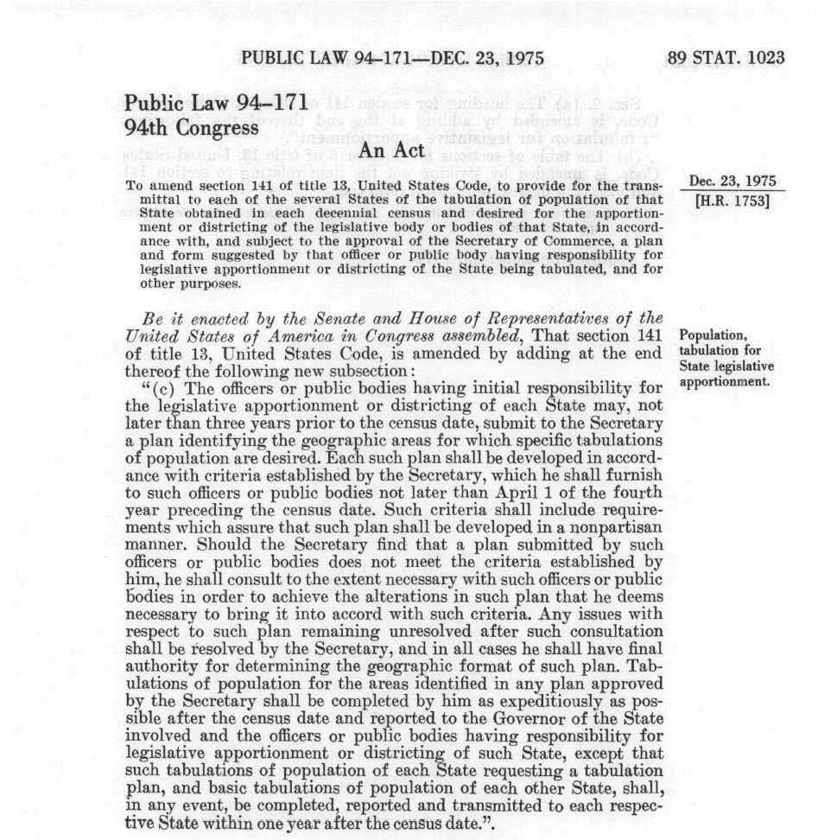
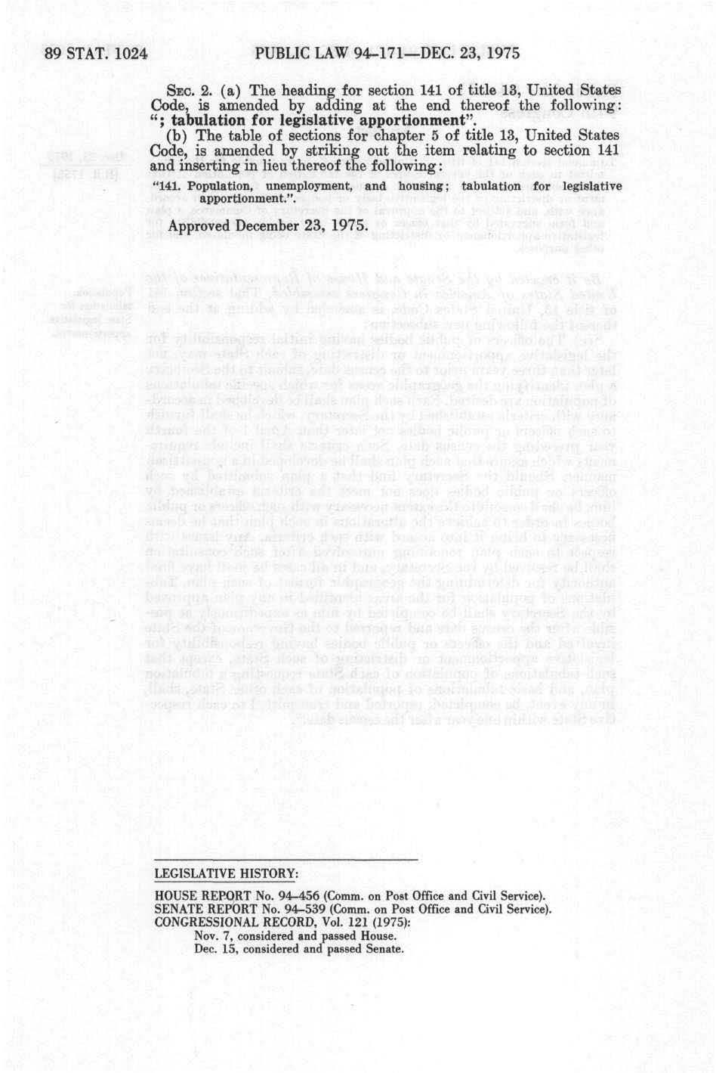
“in such Manner as they shall by Law direct.”
Public Law 94-171
http://uscode.house.gov/statutes/pl/94/171.pdf

Slide 7
Federal Register / Vol. 82, No. 215 / Nov 8, 2017 / Notices
Dec. 31, 2018
We will report (per block):
  P1. RACE/ETHNICITY
    Universe: Total population
    Group by: BLOCK
  P2. RACE/ETHNICITY
    Universe: Total population age 18 and over
  H1. OCCUPANCY STATUS
  P42. GROUP QUARTERS POPULATION
    Universe: Population in Group Quarters

Slide 8
But, we need to protect privacy!
13 U.S. Code § 9 - Information as confidential; exception
(a) Neither the Secretary, nor any other officer or employee of the Department of Commerce or bureau or agency thereof, or local government census liaison may, except as provided in section 8 or 16 or chapter 10 of this title or section 210 of the Departments of Commerce, Justice, and State, the Judiciary, and Related Agencies Appropriations Act, 1998.
  (1) Use the information furnished under the provisions of this title for any purpose other than the statistical purposes for which it is supplied; or
  (2) Make any publication whereby the data furnished by any particular establishment or individual under this title can be identified; or
  (3) Permit anyone other than the sworn officers and employees of the Department or bureau or agency thereof to examine the individual reports. No department, bureau, agency, officer, or employee of the Government, except the Secretary in carrying out the purposes of this title, shall require, for any reason, copies of census reports which have been retained by any such establishment or individual. Copies of census reports, which have been so retained, shall be immune from legal process, and shall not, without the consent of the individual or establishment concerned, be admitted as evidence or used for any purpose in any action, suit, or other judicial or administrative proceeding.
(b) The provisions of subsection (a) of this section relating to the confidential treatment of data for particular individuals and establishments, shall not apply to the censuses of governments provided for by subchapter III of chapter 5 of this title, nor to interim current data provided for by subchapter IV of chapter 5 of this title as to the subjects covered by censuses of governments, with respect to any information obtained therefore that is compiled from, or customarily provided in, public records.

Slide 9

Disclosure Avoidance for the 2010 Census

Slide 10
“This is the official form for all the people at this address.”
“It is quick and easy, and your answers are protected by law.”

Slide 11
2010 Census of Population and Housing
Basic results from the 2010 Census:
Total population | 308,745,538
Household population | 300,758,215
Group quarters population | 7,987,323
Households | 116,716,292

Slide 12
2010 Census Person-Level Database Schema
Variables | Distinct values
Habitable blocks | 10,620,683
Habitable tracts | 73,768
Sex | 2
Age | 115
Race/Ethnicity (OMB Categories) | 126
Race/Ethnicity (SF2 Categories) | 600
Relationship to person 1 | 17
National histogram cells (OMB Categories) | 492,660
Notes:
Note: relationship to person 1 also includes two group quarters types (institutional, non-institutional) that are used for person-level tabulations

Slide 13
2010 Census: Summary of Publications
(approximate counts)
Publication | Released counts (including zeros)
PL94-171 Redistricting | 2,771,998,263
Balance of Summary File 1 | 2,806,899,669
Summary File 2 | 2,093,683,376
Public-use micro data sample | 30,874,554
Lower bound on published statistics | 7,703,455,862
Statistics/person | 25
Notes:
The 2010 Census publication schedule resulted in roughly 2.8 billion counts (including zeros) published in PL94-171, another 2.8 billion in the rest of SF1, 2 billion in SF2, and another 30 million in a public-use microdata sample. This is roughly 7.7 billion statistics, or 25 per person. That’s a lot more than 6 per person.

Slide 14
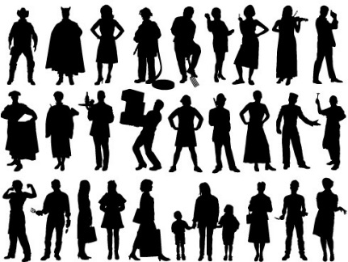
The 2000 and 2010 Disclosure Avoidance System operated as a filter, on the Census Edited File:
Pre-specified tabular summaries:
PL94-171, SF1, SF2 (SF3, SF4, … in 2000)
Raw data from respondents: Decennial Response File
Selection & unduplication: Census Unedited File
Edits, imputations: Census Edited File
Confidentiality edits (household swapping), tabulation recodes: Hundred-percent Detail File
Special tabulations and post-census research

Slide 15
The protection system used in 2000 and 2010 relied on swapping households:
Advantages of swapping:
  Easy to understand
  Does not affect state counts if swaps are within a state
  Can be run state-by-state
  Operation is “invisible” to rest of Census processing
Disadvantages:
  Does not consider or protect against
  database reconstruction attacks
  Privacy protection is not quantified
  Swap rate and details of swapping must remain secret
  Privacy guarantee based on the lack of external data
Town 1
Town 2
State “X”

Slide 16
We now know that the Disclosure Avoidance Techniques we used in the 2010 Census were flawed.
These were the best available techniques at the time! But
  Assumes that disclosure avoidance modifications made for two products from the same confidential data are compatible
  Released exact counts at the block, tract and county level.
  Released exact counts for age in years, OMB race/ethnicity, sex, relationship to householder, in Summary File 2: detailed race data
Between 2017 and 2018, we used the 2010 tabular summaries to produce a 100% micro-data file!
  Geographic detail: block, tract, county
  Other detail: exactly as in the tabular data

Slide 17
Experiments Using the 2010 Census
We confirm that the micro-data from the confidential 2010 Hundred-percent Detail File (HDF) can be accurately reconstructed from PL94 + balance of SF1
  The block geocode is always correct, as is voting age
  50% of reconstructed records match both the HDF (swapped) and Census Edited File (CEF, unswapped) exactly
  More than 70% match exactly if age +/- one year is used
  More than 90% match if one match error in age, sex, race or ethnicity is allowed
  More than 50% of the confidential records (CEF) are population uniques on block, age (in years), sex, race (OMB) and ethnicity
  More than 35% of the reconstructed records are population uniques on the same variables
We linked these reconstructed data with commercially purchased external data, and performed a re-identification attack.
  A much larger percentage were successfully re-identified than in any previous experiments
  The major impediment to re-identification was poor quality geocodes and other information on the commercial databases the Census Bureau purchased in 2010 and 2011 in support of the 2010 Census evaluations
Notes:
  Experiments are at the person level, not household
  Census Bureau declared reconstruction of Title 13-sensitive data an issue, no longer a risk
  This is the justification for adopting differential privacy for the 2018 End-to-End Census Test and 2020 Census
  Quantitative details are being withheld to permit external peer-review before they are released
Notes:
A reconstruction attack recreates record-level images of all variables used in published tabulations, not all variables in the confidential database. If “name” is never tabulated, then “name” cannot be reconstructed.
A reconstruction-abetted re-identification attack links external data to the reconstructed micro-data. These external data contain identifying information like names and addresses. Such an attack leads to “putative re-identifications”: records that the attacker believes are the data for identifiable information. In a successful re-identification attack, putative re-identifications are confirmed at a high rate. The putative re-identifications from the 2010 Census experiments are not confirmed at a high rate. We are still researching this issue.
An issue is a risk that has occurred (probability = 1), and an active mitigation plan is required.

Slide 18

Formal Privacy and the 2020 Census

Slide 19


(Dinur Nissim 2003)
Database Reconstruction
A statistical database can be reconstructed with a small number of random queries.
Previous work showed that query privacy could only be assured:
  By tracking every query.
  Even then, it was exponentially hard.
Dinur & Nissim proposed a generalized solution by adding noise.

Slide 20
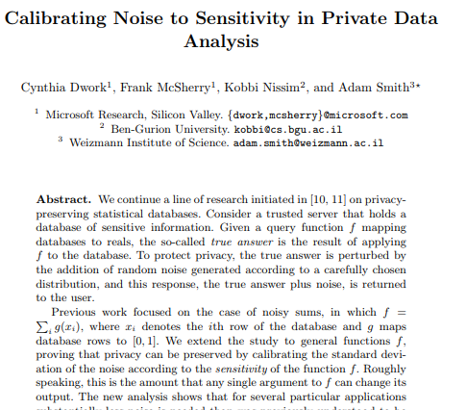
(Dwork, McSherry, Nissim & Smith 2006)
Differential Privacy
Differential Privacy tells us how much noise to add!
A generic approach for protecting privacy by adding noise
Key features:
  lower bound for the amount of noise that needs to be added
  upper bound for privacy loss
  Mechanisms are composable

Slide 21
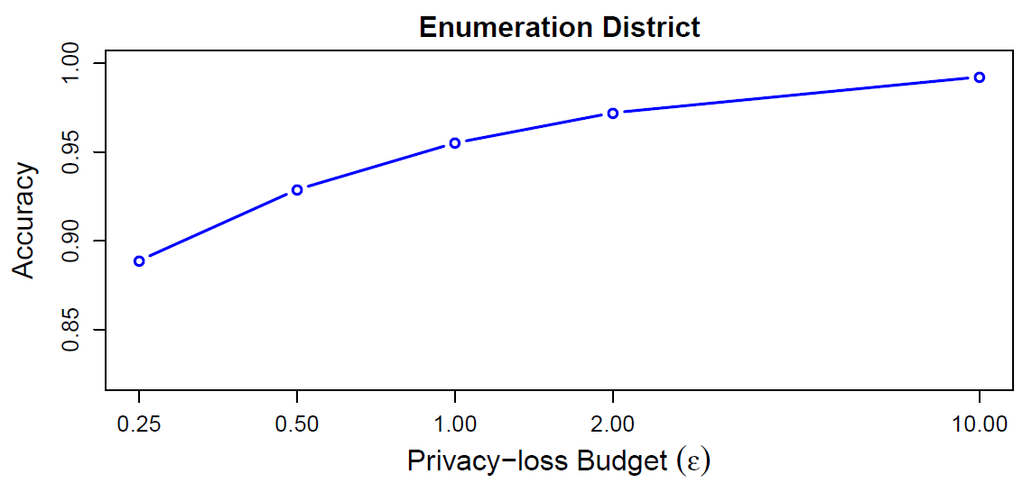
In 2017, the Census Bureau announced that it would use differential privacy for the 2020 Census.
Differential privacy provides:
  Provable bounds on the maximum privacy loss
  Algorithms that allow policy makers to manage the trade-off between accuracy and privacy
Pre-Decisional

Slide 22
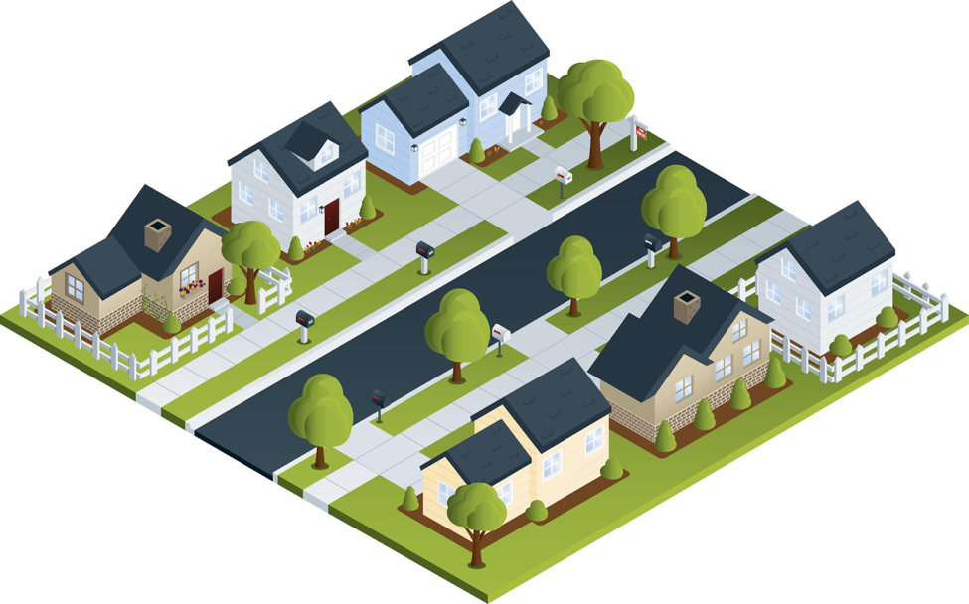
Consider a census block:
As collected:
As Reported
 | Male | Female
Age < 18 | 10 | 20
Age >= 18 | 40 | 30

Slide 23

Consider a census block:
As reported
 | Male | Female
Age < 18 | 4 | 4
Age >= 18 | 4 | 4
High privacy loss
As collected:
 | Male | Female
Age < 18 | 3 | 2
Age >= 18 | 5 | 6
More accurate sex distribution
 | Male | Female
Age < 18 | 6 | 2
Age >= 18 | 3 | 5
More accurate age distribution

Slide 24
There was no off-the-shelf system for applying differential privacy to a national census
We had to create a new system that:
  Produced higher-quality statistics at more densely populated geographies
  Produced consistent tables
  We created a new differential privacy algorithm and system that:
  Produces statistics from the top-down
    E.g. National Level -> State Level -> County Level -> Tract Level -> Block Level
    Creates privatized microdata that can be used for any tabulation without additional privacy loss
  Fits into the decennial census production system

Slide 25
Our plan is to create a “Disclosure Avoidance System” that drops into the Census production system.
Features of the DAS:
  Operates on the edited Census records
  Designed to make records that are “safe to tabulate.”
Census Edited File
Disclosure Avoidance System
Microdata Detail File (2020)

Slide 26

The Disclosure Avoidance System allows the Census Bureau to enforce global confidentiality protections.
Pre-specified tabular summaries:
PL94-171, SF1, SF2
Decennial Response File
Census Unedited File
Census Edited File
Global Confidentiality Protection Process
Disclosure Avoidance System
Microdata Detail File
Special tabulations and post-census research
Privacy Budget,
Accuracy Decisions

Slide 27
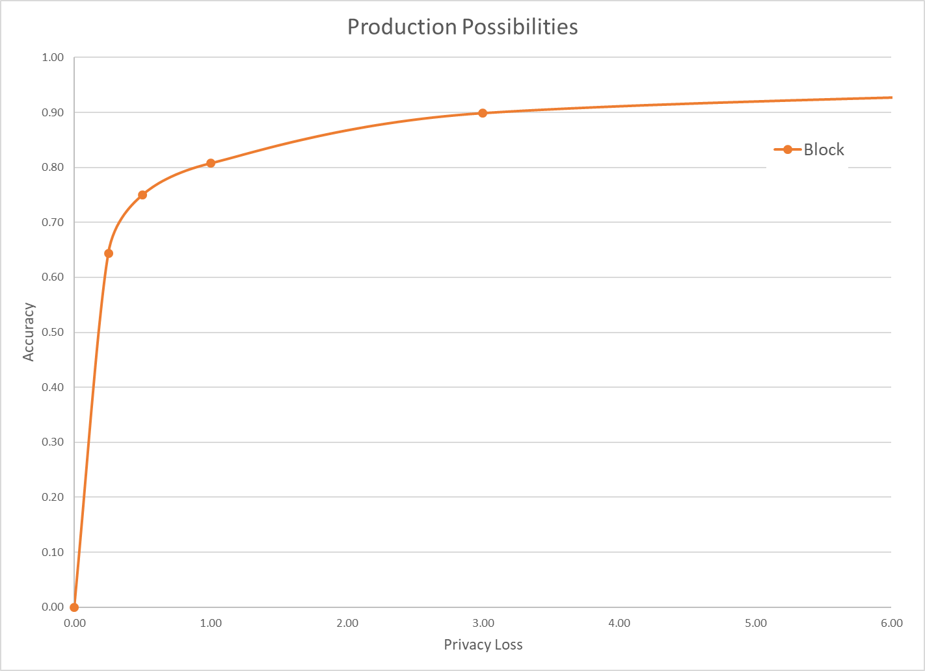
The Census disclosure avoidance system uses differential privacy to defend against an accurate reconstruction attack.
Differential privacy provides:
  Provable bounds on the accuracy of the best possible database reconstruction given the released tabulations.
  Algorithms that allow policy makers to decide the trade-off between accuracy and privacy.
Data accuracy
Privacy loss budget (ε)
Final privacy-loss budget determined by Data Stewardship Executive Policy Committee (DSEP)
with recommendation from Disclosure Review Board (DRB)
Pre-Decisional

Slide 28
The Disclosure Avoidance System relies on injects formally private noise.
Advantages of noise injection with formal privacy:
  Transparency: the details can be explained to the public.
  Tunable privacy guarantees
  Privacy guarantees do not depend on external data
  Protects against accurate database reconstruction
  Protects every member of the population
Challenges:
  Entire country must be processed at once for best accuracy
  Every use of private data must be tallied in the privacy-loss budget
Global Confidentiality Protection Process
Disclosure Avoidance System
ε

Slide 29
How the 2020 System Works:
High-level Overview
  Every record in the population may be modified
    But modifications are bounded by the global privacy budget.
  Records in the tabulation data have no exact counterpart in the confidential data
    There is no one-to-one mapping between CEF and MDF records.
  Explicitly protected tabulations (PL-94 and SF-1) have provable, public accuracy levels

Slide 30
Two algorithmic choices
Block-by-block algorithm:
Top-down algorithm:
330M records
ε
National Histogram
8 million blocks
Disclosure Avoidance System
8 million protected blocks
State-level measurements
ε
51 state histograms
County-level measurements
ε
3,142 county histograms
Tract-level measurements
ε
75,000 census tract histograms
Block-level measurements
ε
8 million block histograms

Slide 31
Two public policy choices:
What is the correct value of epsilon?
Where should the accuracy be allocated?

Slide 32
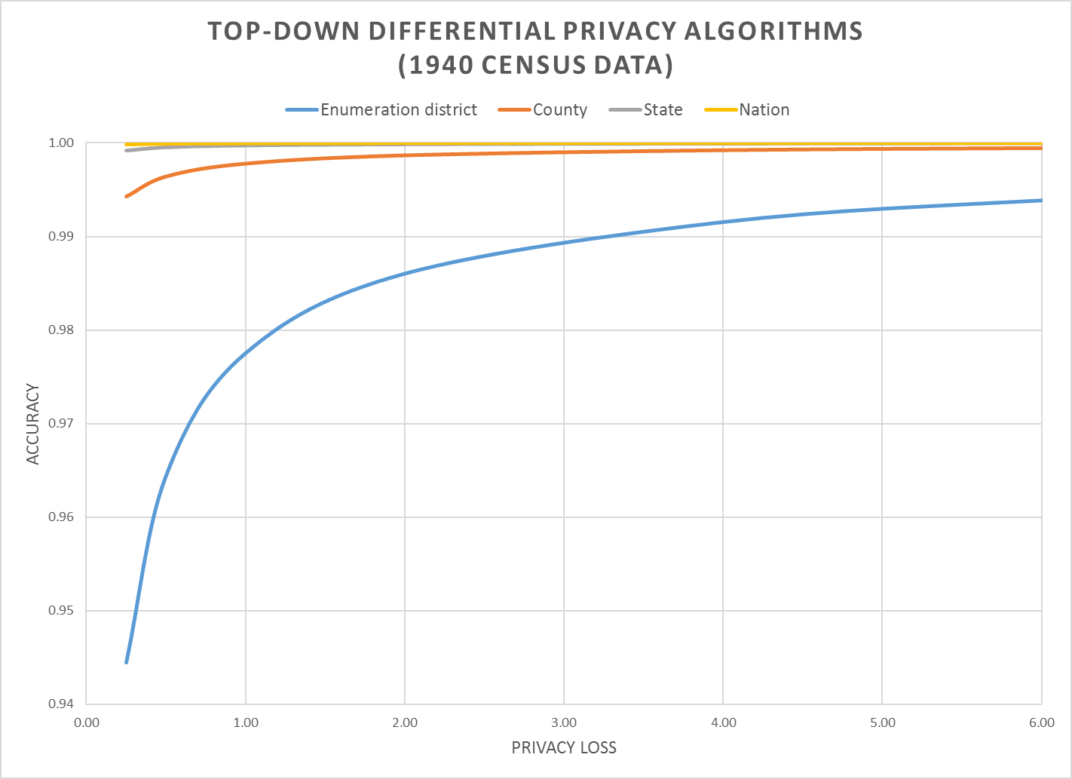
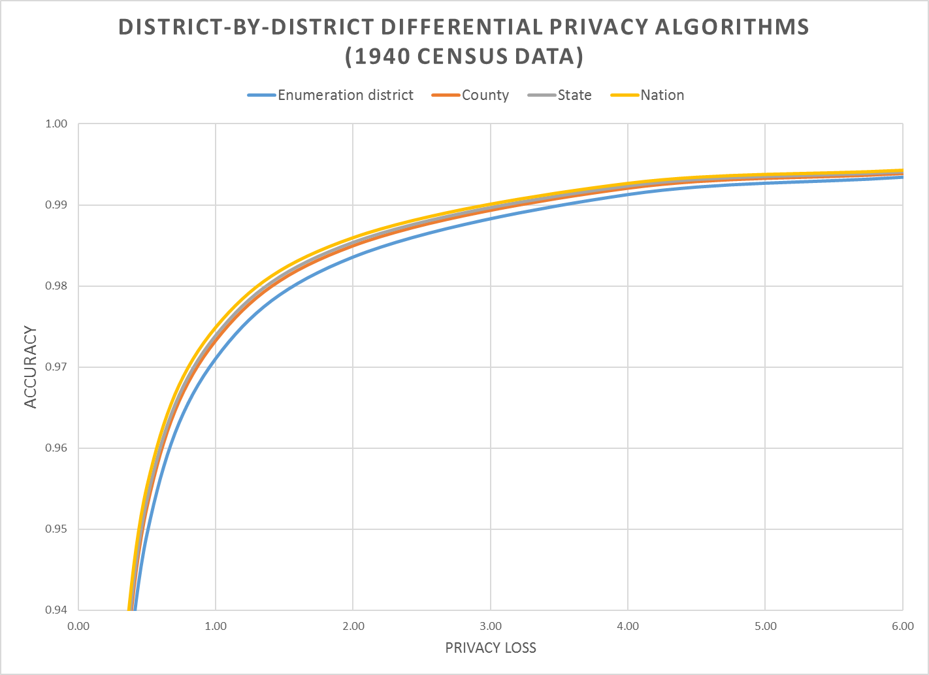
Notes:
Accuracy (in all slides) is (1 – AveTVD/N), where AveTVD = Average Total Variation Distance = Sum( 0.5L_1) over all query sets in the PL94 workload over all geographies in the workload divided by the number of query sets (14), L_1 is the absolute error in all the table, and N is the population count in the complete person table (1940 population). AveTVD is averaged over all the tables in the workload for the relevant geography.
In the 1940 Census data, the geography is nation, state, county, enumeration district (approximately, a modern block group, in 1940 a voting precinct in most areas).
Left panel is the performance of the top-down algorithm at each level of geography for privacy-loss budgets from 0.25 to 6.00. Right panel is the performance of the district-by-district algorithm for the same geographies and workload.
Workload in the experiments is the detailed histogram GQ/HH type (9) x voting age (2) x Hispanic (5) x Race (6) x Citizenship (5) measured sharing the global privacy loss budget across all levels of geography.

Slide 33
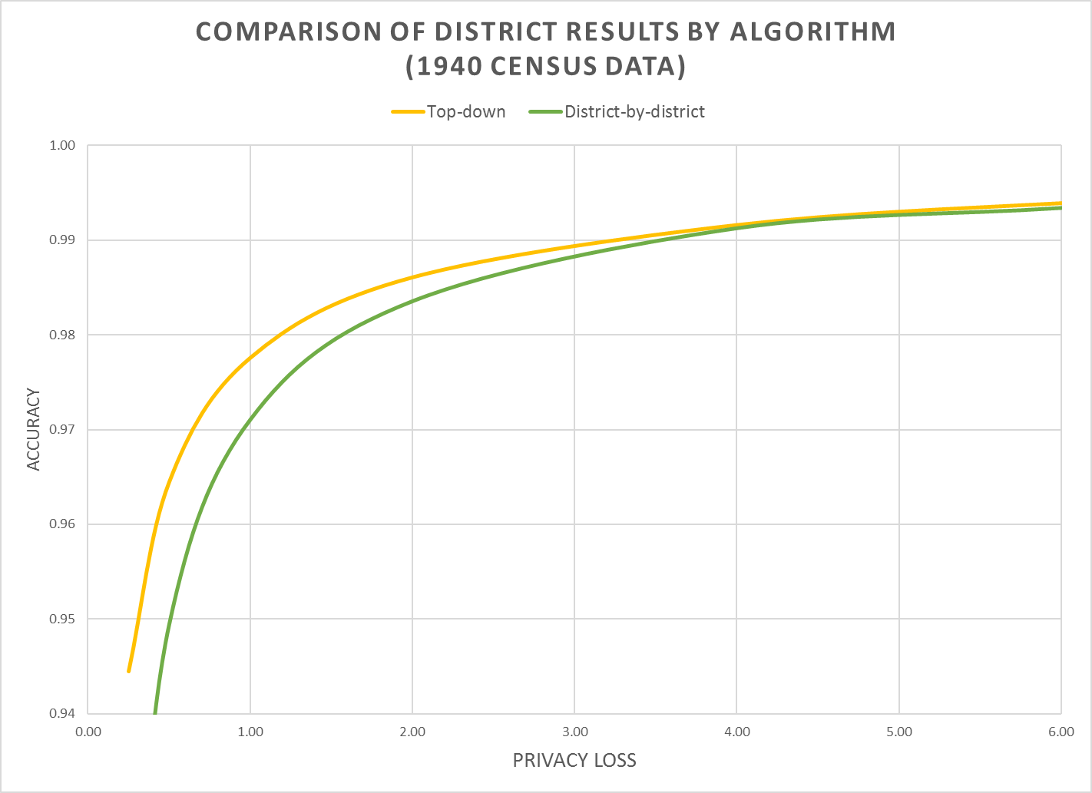
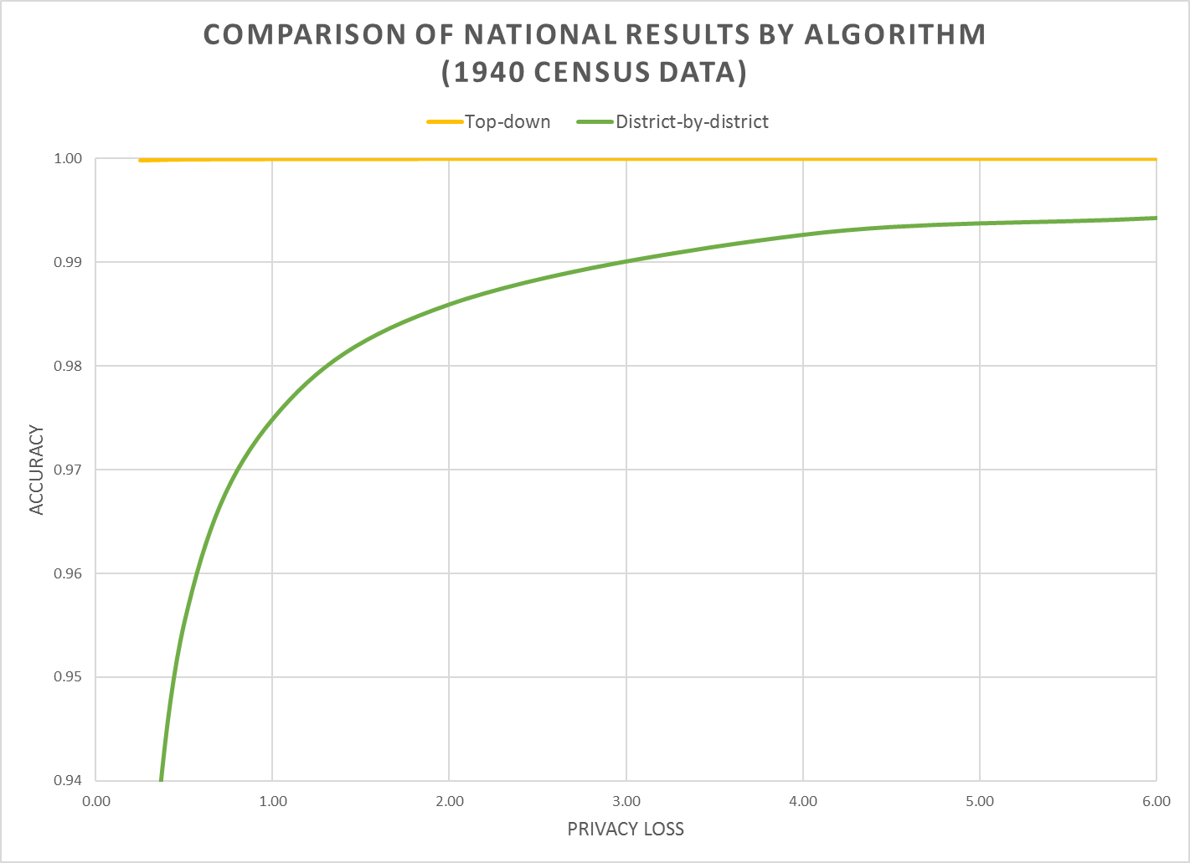
Notes:
Left panel is enumeration-district level data showing both algorithms.
Right panel is national data showing both algorithms. Notice how the national data are still noisy with district-by-district DP.

Slide 34

Managing the Tradeoff

Slide 35
Basic Principles
Based on recent economics (2019, American Economic Review)
https://digitalcommons.ilr.cornell.edu/ldi/48/ or https://arxiv.org/abs/1808.06303
The marginal social benefit is the sum of all persons’ willingness-to-pay for data accuracy with increased privacy loss
The marginal rate of transformation is the slope of the privacy-loss v. accuracy graphs we have been examining
This is exactly the same problem being addressed by Google in RAPPOR or PROCHLO, Apple in iOS 11, and Microsoft in Windows 10 telemetry

Slide 36
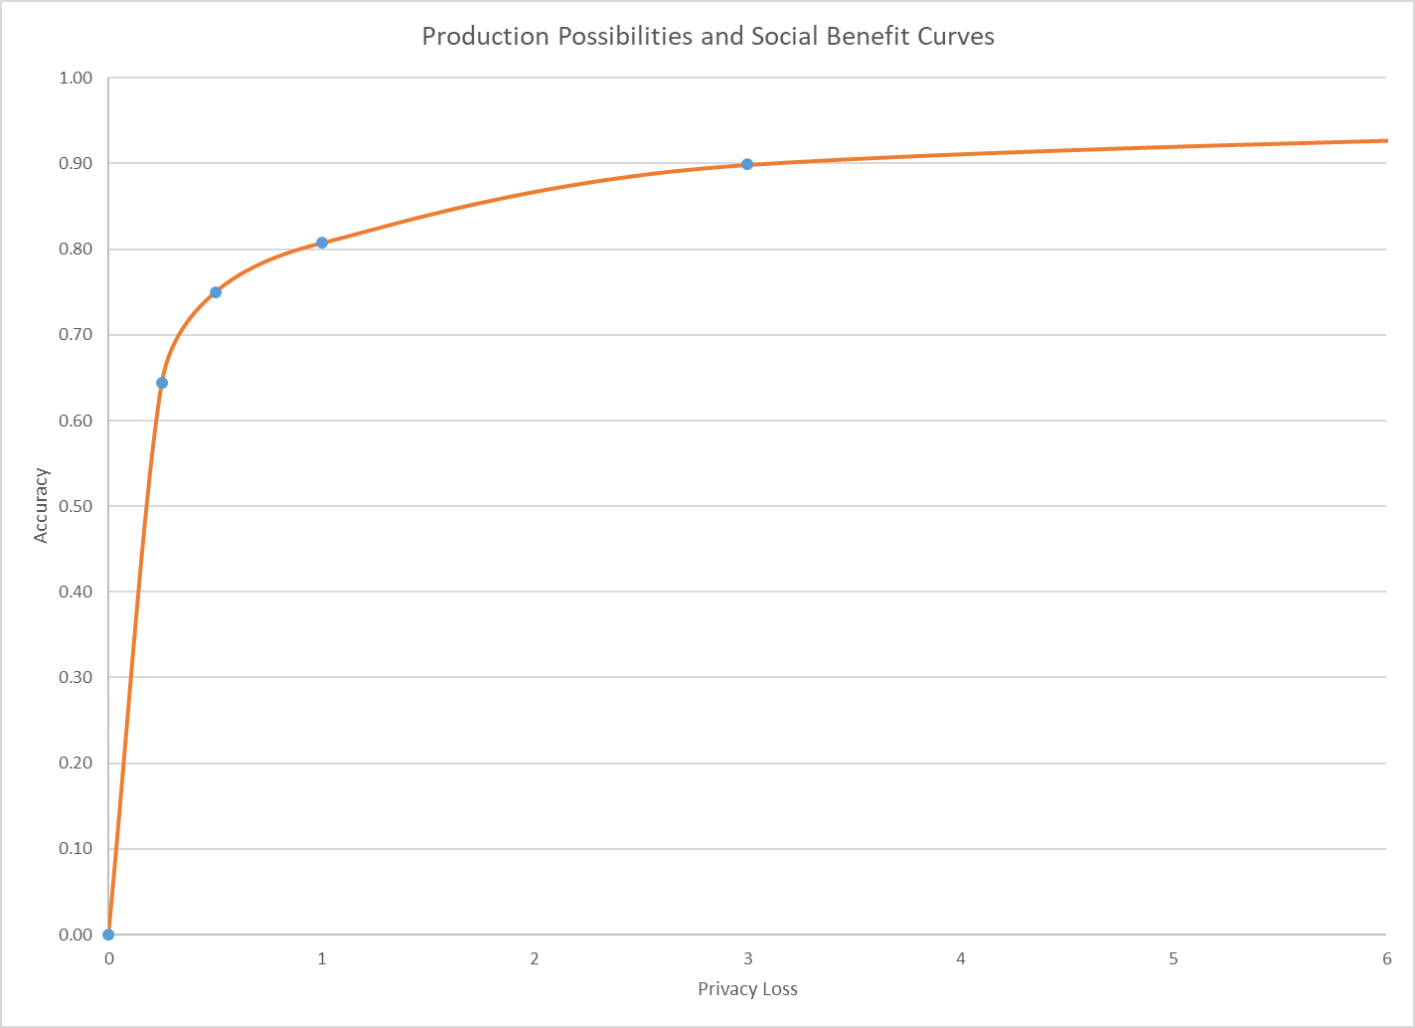
Marginal Social Benefit Curve
Social Optimum: MSB = MSC
(0.25, 0.64)
Production Technology
Notes:
The marginal social benefit is the slope of the illustrated iso-social welfare line (gray). These lines must slope upwards because data accuracy is a “good” and privacy-loss is a “bad.” Iso-social welfare lines above the one illustrated are infeasible because no point on the PPF reaches them. Iso-social welfare lines below the one illustrated are feasible but suboptimal because social welfare can be increase by either increasing accuracy at no privacy-loss cost or decreasing privacy-loss without loss of accuracy.
Slope of the Iso-social welfare curve is 1.5, this means surrendering one unit of privacy loss (say, epsilon goes from 0.25 to 0.26) is worth 1.5 units of accuracy (then accuracy goes from 0.64 to 0.655)
The social optimum is the point of tangency between an iso-social welfare line (gray) and the PPF (red). At this point, the only social welfare improving combinations of data accuracy and privacy-loss are infeasible.
The illustrated iso-social welfare line is the best one attainable, and social welfare is maximized at the indicated point. This point gives the optimal privacy-loss budget and the optimal data accuracy as determined by the preferences of the data users constrained by the SDL technology.
At the indicated level of ε = 0.25, accuracy for tract-level tables averages 96%, and for county and state-level tables averages 100%.
It is impossible to assess the block-level error in a vacuum. You have to consider the use case. The other slides in that presentation show that as the blocks are assembled into geographic areas with larger populations--tracts (244), counties (5), and state (1)--the accuracy improves rapidly. Accuracy is about 96% at the tract level, and essentially 100% at the state and county level. The vast majority of legislative districts in the country have populations far in excess of the average census tract population (about 4,300 for RI in 2010). We have decided to release a large batch of statistical tables, in 2010 PL94-171 redistricting format, from the experiments summarized in my CSAC presentation in advance of releasing the production code for the 2018 End-to-End Census Test disclosure avoidance system. Users of all stripes will be able to use those simulation results to assess average error for their own use cases at all levels of geography.

Slide 37
But the Choice Problem for Redistricting Tabulations Is More Challenging
In the redistricting application, the fitness-for-use is based on :
  Supreme Court one-person one-vote decision (All legislative districts must have approximately equal populations; there is judicially approved variation)
  Is statistical disclosure limitation a “statistical method” (permitted by Utah v. Evans) or “sampling” (prohibited by the Census Act, confirmed in Commerce v. House of Representatives)?
  Voting Rights Act, Section 2: requires majority-minority districts at all levels, when certain criteria are met
The privacy interest is based on:
  Title 13 requirement not to publish exact identifying information
  The public policy implications of uses of detailed race, ethnicity and citizenship
Notes:
All statistical disclosure limitation methods used by the Census Bureau, including differential privacy as implemented for the 2020 Census, conform to both the Census Act--there is no sampling at any level, all the records in the official, confidential decennial census data are used, and no others--and to our understanding of Utah v. Evans--statistical disclosure limitation is an accepted statistical method and has been used since at least 1970 by the Census Bureau.

Slide 38
More Background on the 2020 Disclosure Avoidance System
September 14, 2017 CSAC (overall design)
https://www2.census.gov/cac/sac/meetings/2017-09/garfinkel-modernizing-disclosure-avoidance.pdf
August, 2018 KDD’18 (top-down v. block-by-block)
https://digitalcommons.ilr.cornell.edu/ldi/49/
October, 2018 WPES (implementation issues)
https://arxiv.org/abs/1809.02201
October, 2018 ACMQueue (understanding database reconstruction)
https://digitalcommons.ilr.cornell.edu/ldi/50/ or
https://queue.acm.org/detail.cfm?id=3295691

