Slide 1
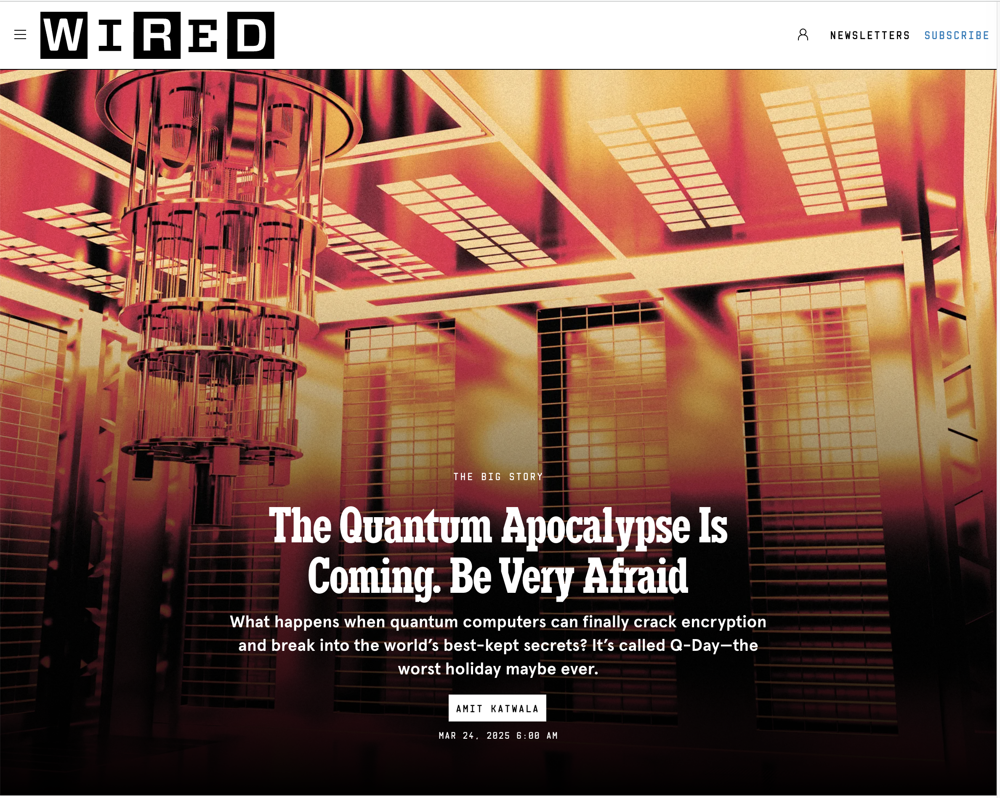

Slide 2
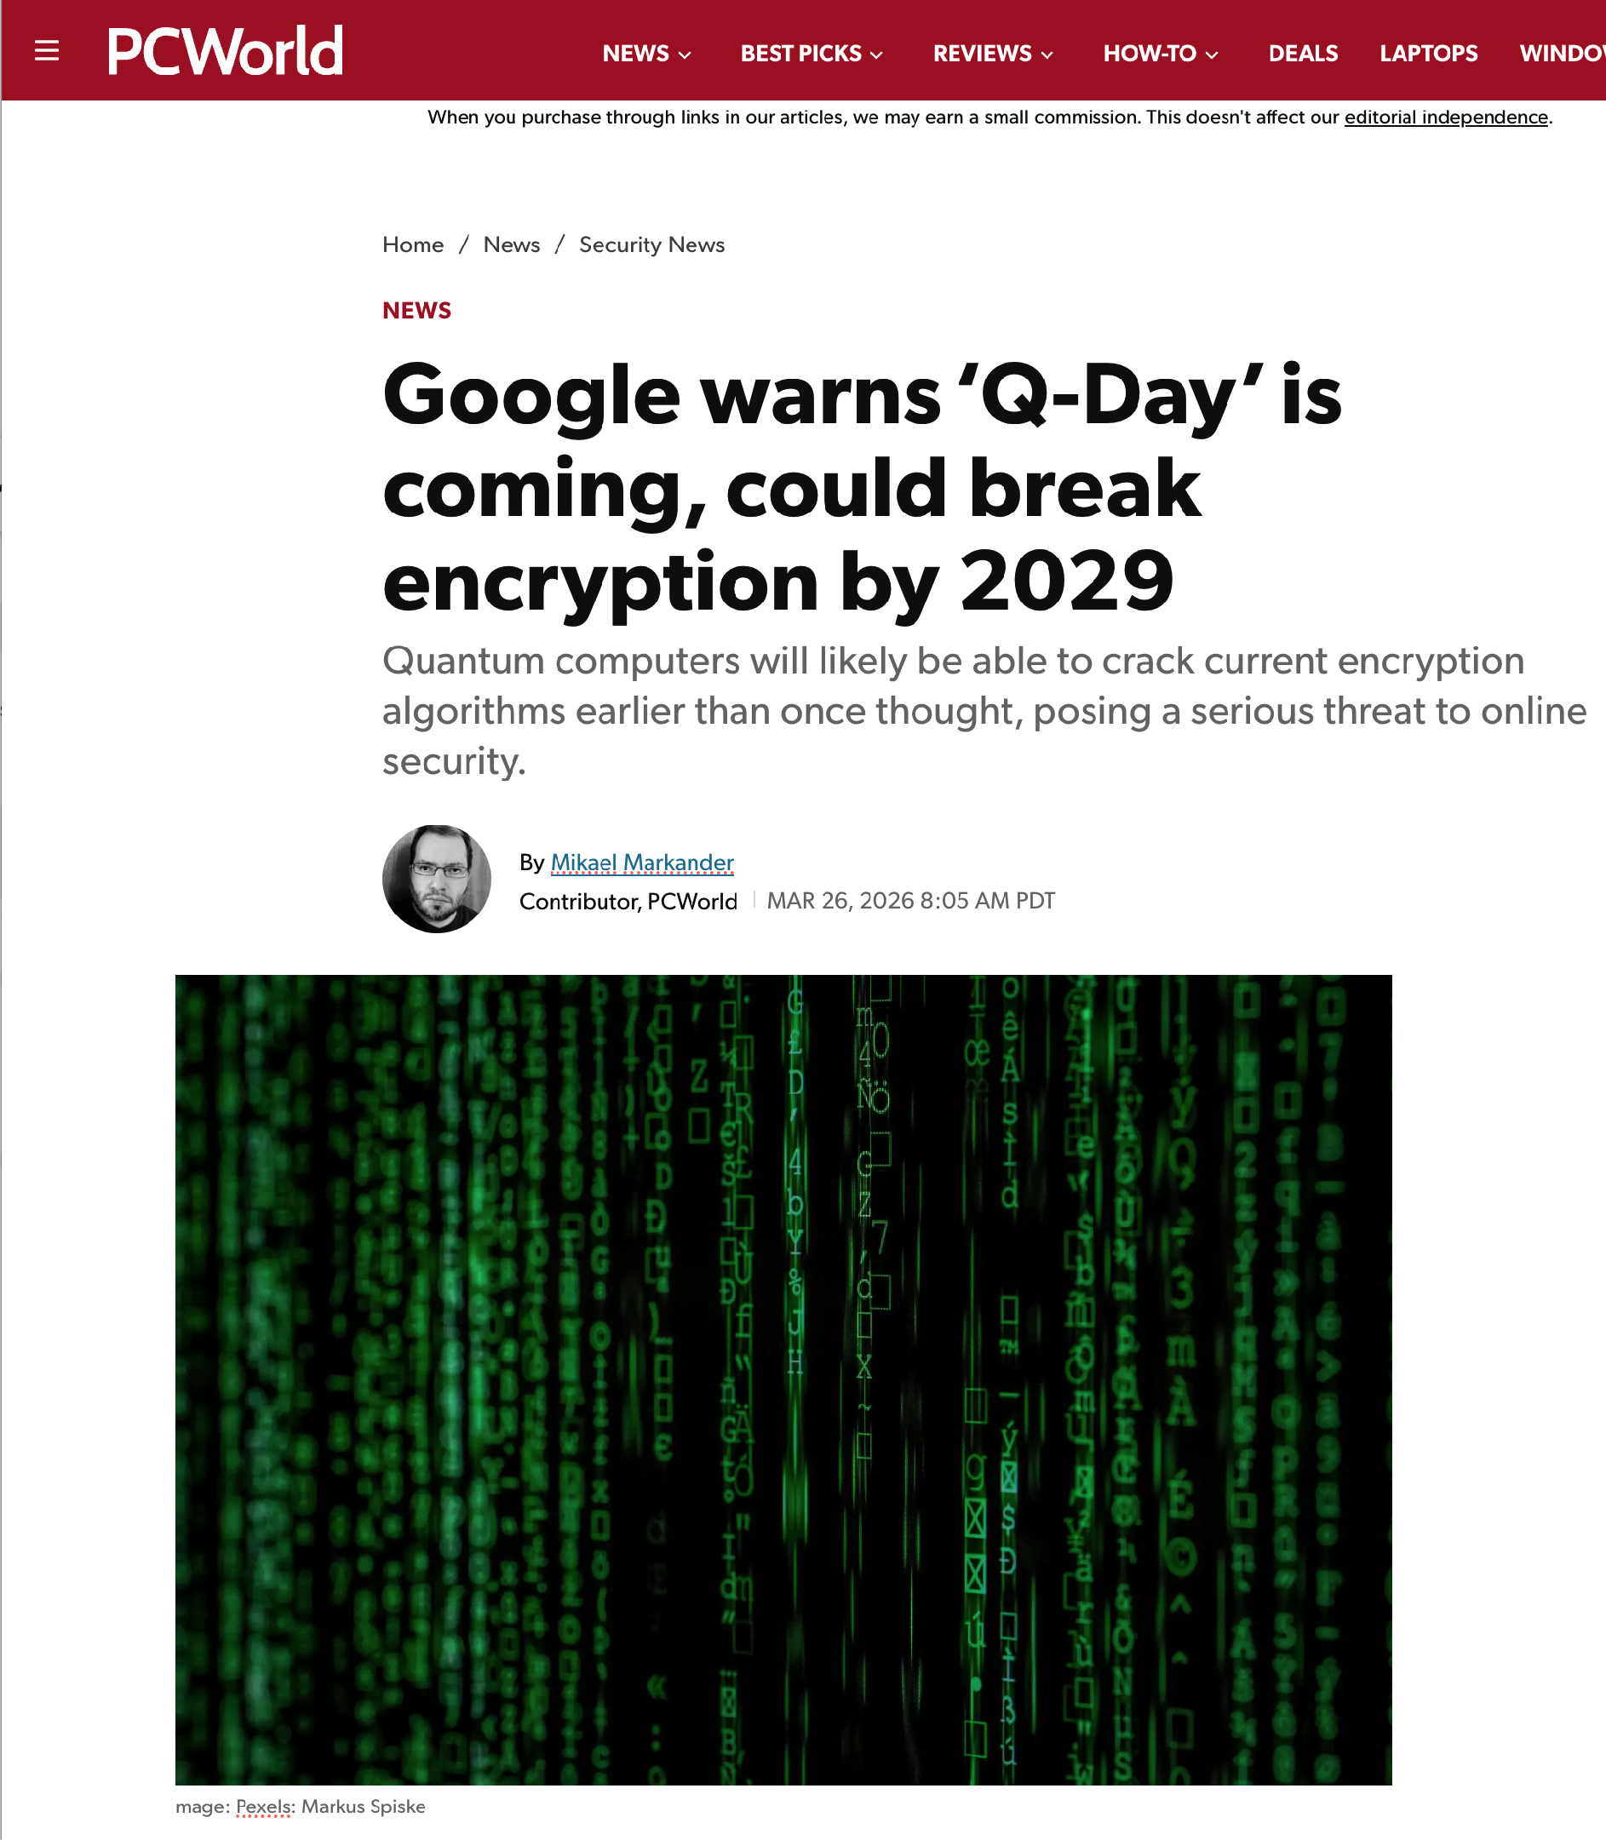
Q-Day in 2029?

Slide 3
Goals and Outline of this briefing
Goals:
  Introduce Quantum Information Science (QIS) terminology
  Explain important quantum issues as they pertain to NDOC
  Dispel myths about quantum computers
Outline:
  The 22 JUN Quantum Executive Orders
  What is with this “quantum” word, anyway?
  Quantum Computing - Where are we on the hype cycle?
  Quantum Key Distribution - (China satellites)
  Quantum Sensing
  Post Quantum Cryptography - The transition mandated by the EOs

Slide 4
The 22 JUN Quantum Executive Orders

Slide 5
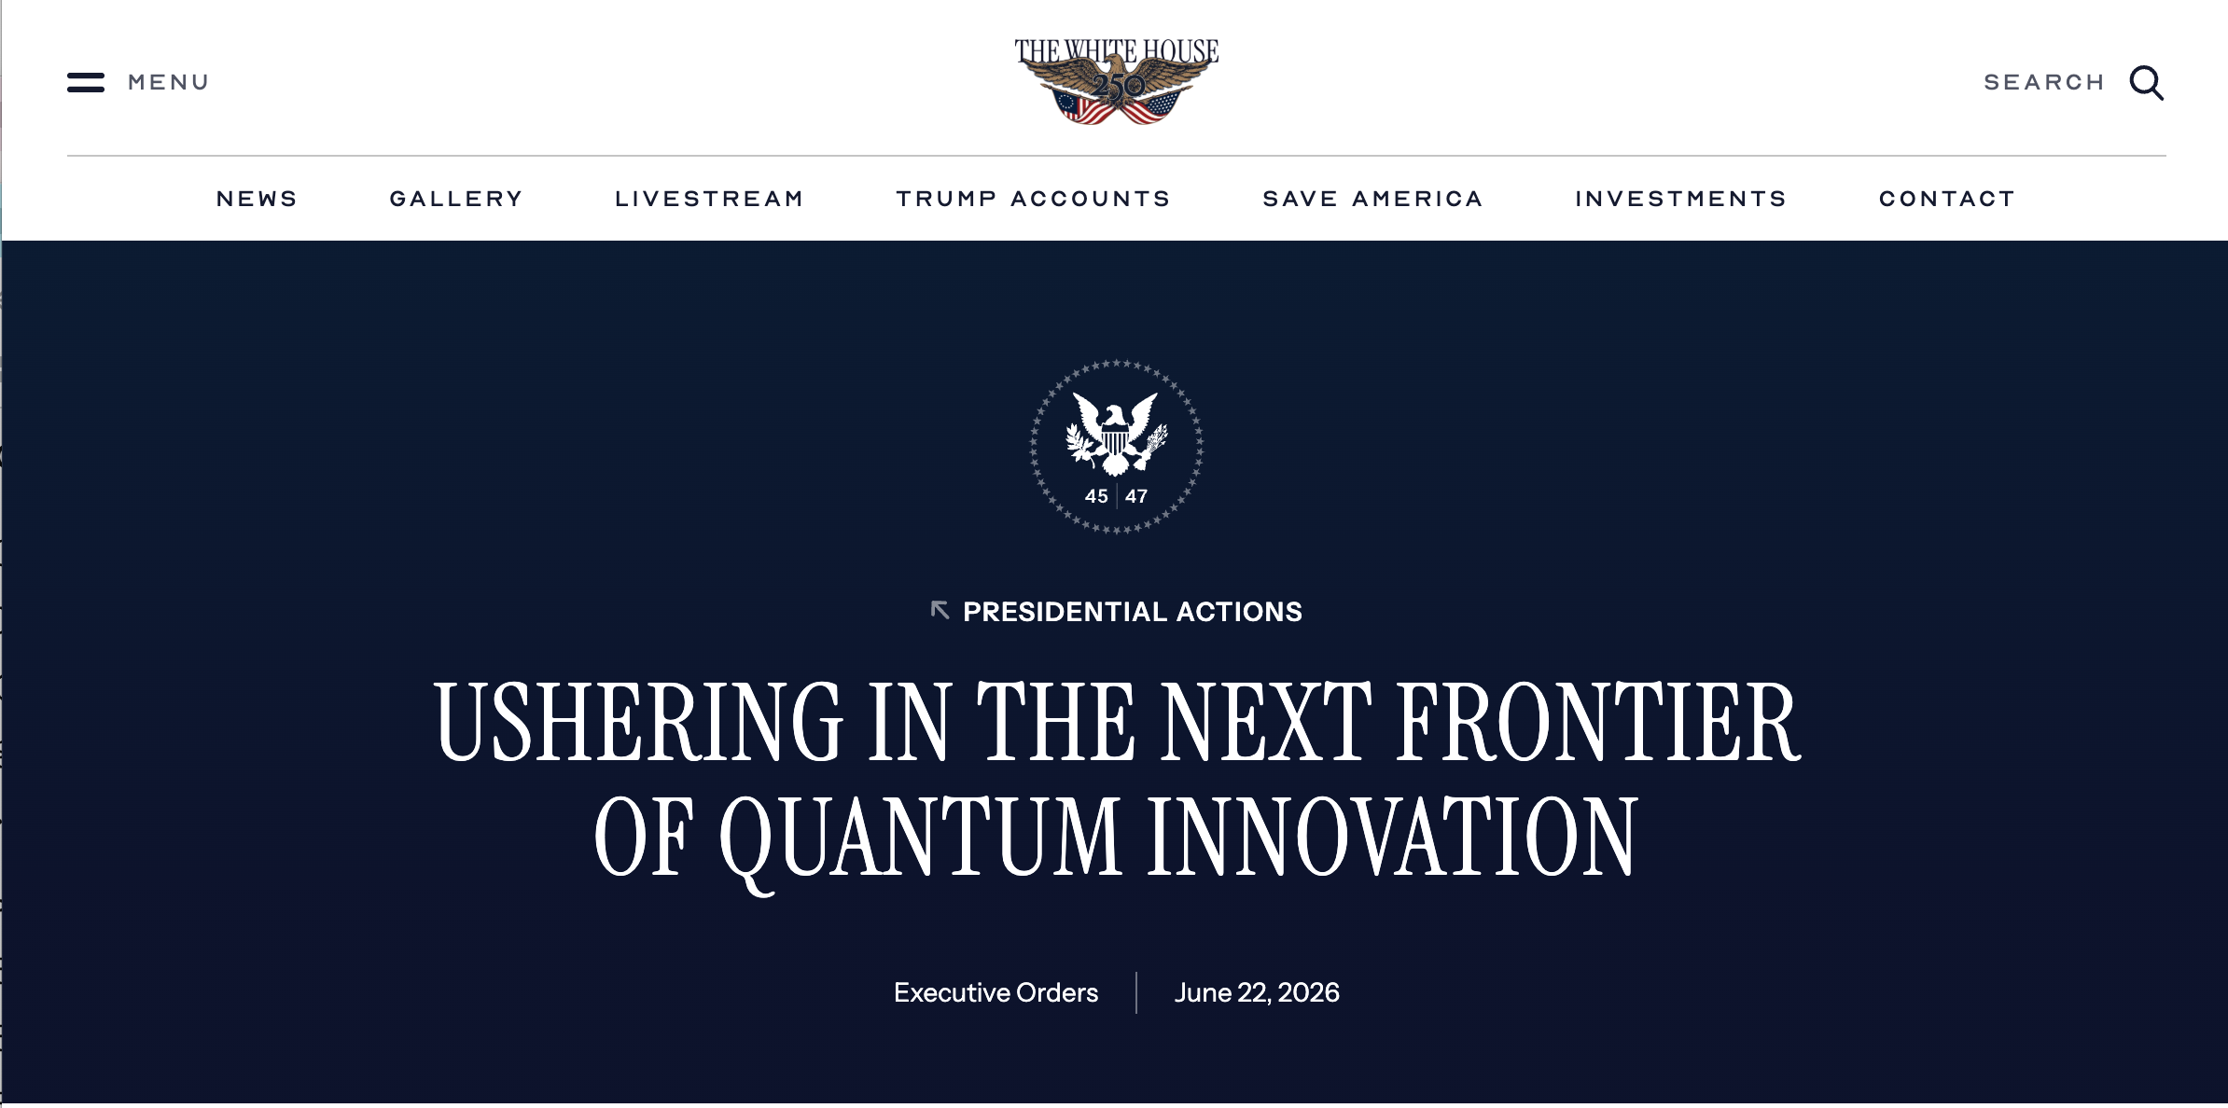
EO 14413 • 22 JUN 2026
https://www.whitehouse.gov/presidential-actions/2026/06/ushering-in-the-next-frontier-of-quantum-innovation/

Slide 6
EO 14413 — Key things to know
Creates QC-ADDS initiative

Slide 7
EO14413 — Key things to know
Section 3 - Updating the National Quantum Strategy
  180 days (19 DEC) - Updating National Quantum Strategy
  SECDOW, SECDOC, SECDOE; DNI; DIRNSF; in consultation with:
    Co-Chairs of the National Science and Technology Council Subcommittees on Quantum Information Science (SCQIS)
    Economic and Security Implications of Quantum Information Science (ESIX)
Section 4 - Harnessing Quantum Computing for Scientific Applications
  Quantum Computer for Application Development and Discovery Science Effort (QC-ADDS)
  90 days (20 SEP) - Identify technical specifications for a QC-ADDS
  180 days (19 DEC) - Explore private-sector partnership models
    Robust assessment of QC-ADDS’ “and other quantum computing systems’ capabilities”
    Establish a national center to develop tools and capabilities required to assess performance (DOE & DOW)
    Identify the national security implications of the increasing scale and performance of commercial quantum computers (DNI & SECWAR)

Slide 8
EO14413 — More things you need to know.
Section 5 — Deploying Quantum-Enabled Sensors and Networks
  60 days (21 AUG) - Identify three next-generation quantum sensor projects
    to field by Sep 30, 2028
  Develop 5-year plan for advancing quantum sensing and networking
  Prioritize RDTE of applications and hardware for quantum sensing and quantum networking
Section 6 - Bolstering the Domestic Ecosystem for Quantum Supply Chains
  Analyze QIST supply changes, encourage adoption of QIST-related standards
  120 days (20 OCT) - Develop a plan to develop quantum-enabling component technologies
    SECWAR, SECCOM, SECDOE, DIRNSF
    possibly using prize challenges or advance market commitments
  Share information; participate in DARPA QBI
  180 days (19 DEC) - Increase access to foundry resources, issue grants
  210 days (18 JAN 2027) - Reconstitute the National Quantum Initiative Advisory Committee (NQIAC)
    NQIAC was originally established under the National Quantum Initiative Act (NQIA) of 2018; NQIA expired Sept. 30, 2023
    NQIA was oriented towards basic research; EO 14413 represents a shift to aggressive commercialization, hardware deployment, and national security readiness.

Slide 9
EO14413 — Even more things you need to know.
Section 7 - Protecting Quantum Technology
  DIRFBI, SECSTATE, SECWAR, SECCOM, SECDOE, SECDHS, DNI, DIRNSA propose to APST (advisor to President on S&T) and DIROMB staffing to expand the Quantum Information Science and Technology Counterintelligence Protection Team (QCPT)
Section 8 - Expanding and Retaining the Quantum Workforce
  90 days (20 SEP) - GOV-wide recruitment and retention strategy
  120 days (20 OCT) - SECLABOR prioritize QIST-relevant industry needs
Section 9 - Engaging with International Partners
Section 10 - Reports

Slide 10
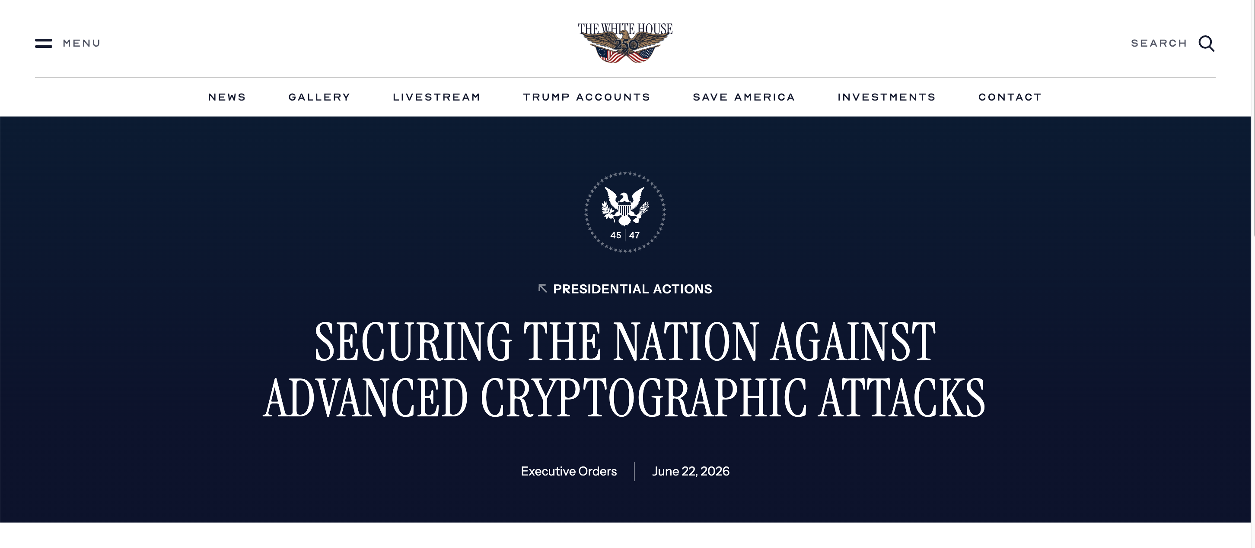
EO 14412 • also 22 JUN 2026
https://www.whitehouse.gov/presidential-actions/2026/06/securing-the-nation-against-advanced-cryptographic-attacks/

Slide 11
EO 14412 — Key things you need to know
Section 2 - Definitions
  “agency,” “critical infrastructure,” “high impact system,” “high value asset,”
  “information system,” “National Security System,” “post-quantum cryptography,”
  “PQC migration lead,” “Cryptographic Module Validation Program,” “digital signature,”
  “key establishment”
Section 3 - Coordinating the PQC Transition
  Director of OMB & National Cyber Director, in consultation with the Assistant to the President for National Security Affairs and the Administrator of the Office of Electronic Government
  SECCOM, DIRNIST, DIRNSA, SECDHS through DIRCISA

Slide 12
EO 14412 — More things you need to know
Section 4 - Accelerating the PQD Transition
  90 days (20 SEP) - issue guidance requiring each agency to:
    Review inventory of HVA and high impact systems, excluding National Security Systems
    Transition all HVAs and high impact systems to use PQC for key establishment by 31 DEC 2030
    Transition all HVAs and high impact systems to use PQC for digital signatures by 31 DEC 2031
  180 days (19 DEC), DIRNIST initiate a pilot project for PQC migration, to be completed no later than 31 DEC 2027
Section 5 - Leading the PQC Transition
  DIRNIST, National Cyber Director, SECWAR, DNI - Identify and engage foreign governments and industry groups
  180 days (19 DEC), DIRNSA as National Manager for National Security Systems shall submit a report to the President, through CNSS, on status of PQC migration for NSS
  270 days (19 MAR), DIRCISA and DIRNIST release public guidance describing minimum elements for a “cryptographic bill of materials”

Slide 13
EO 14412 — Even mey things you need to know
Section 6 - Procurement
  180 days (19 DEC) DIRNIST shall revise cryptographic module validation program
  180 days (19 DEC), FAR Council shall publish a proposed rule to require contractors to comply with NIST PQC FIPS by 31 DEC 2030
  270 days (19 MAR) propose rule for FAR amendment requiring contractors to implement vulnerability disclosure policies (VDPs) that report cryptographic vulnerabilities (including use of non-FIPS approved algorithms)

Slide 14
EO14412 and EO14413 — Key Dates
21 AUG 2026 - Identify three next-generation quantum sensor projects
20 SEP 2026 - Identify technical specifications for a QC-ADDS
20 OCT 2026 - Develop a plan to develop quantum enableling component technologies
19 DEC 2026 - Updating National Quantum Strategy
19 DEC 2026 - NSA submits report on status of PQC migration for NSS
19 DEC 2026 - Exploring private-sector partnership models for QC-ADDS
19 DEC 2026 - Increase access to foundry resources
18 JAN 2027 - Reconstitute the National Quantum Initiative Advisory Committee
19 MAR 2027 - CISA and NIST rerelease guidance for CBOM
31 DEC 2027 - Dept. of Commerce initiates pilot project for PQC migration
31 DEC 2030 - Covered contractors must meet “certain cybersecurity standards”

Slide 15
What is with this “quantum” word?

Slide 16
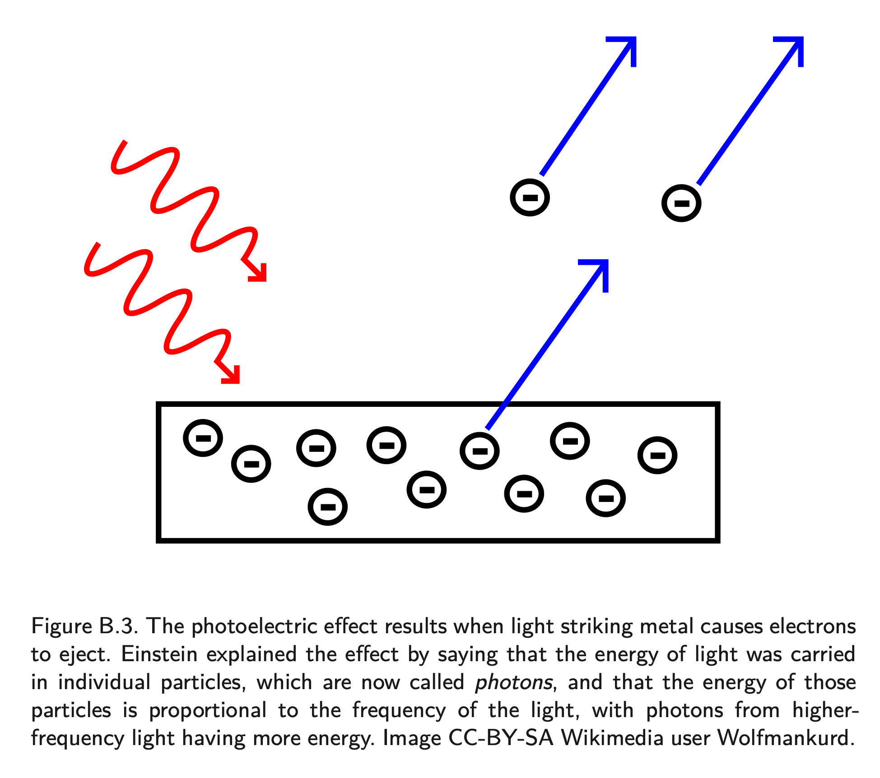
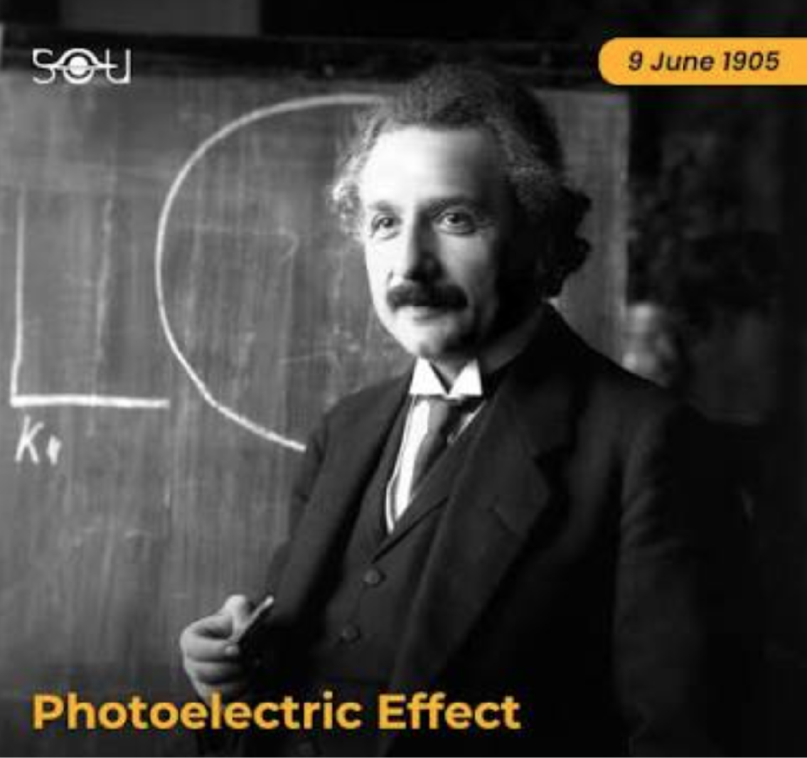
The “quantum” in quantum physics refers to the quantization of light.
Light acts like a wave, but in 1905 Einstein showed that light is a particle.
This is the photoelectric effect
It’s what earned Einstein his Nobel prize.

Slide 17
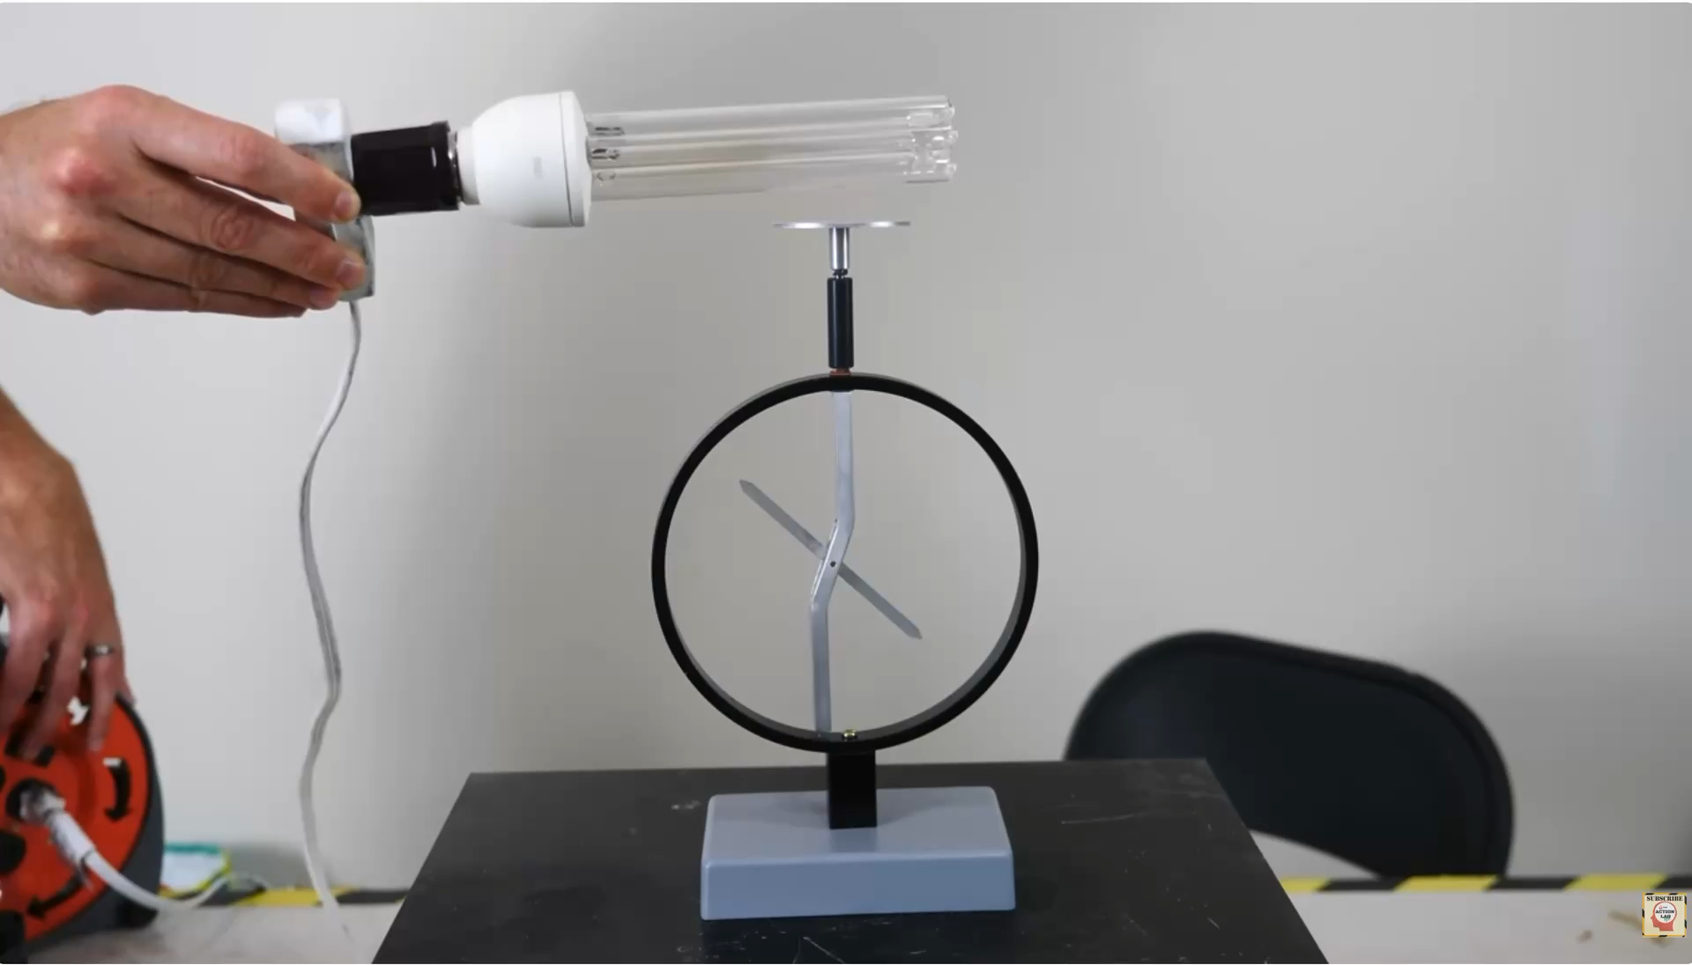
https://www.youtube.com/watch?v=oYnp0WZDhYQ

Slide 18




Quantum Information Science relies on two quantum effects: superposition and entanglement
Superposition — quantum objects can exist in a union of two states
1
0

Slide 19
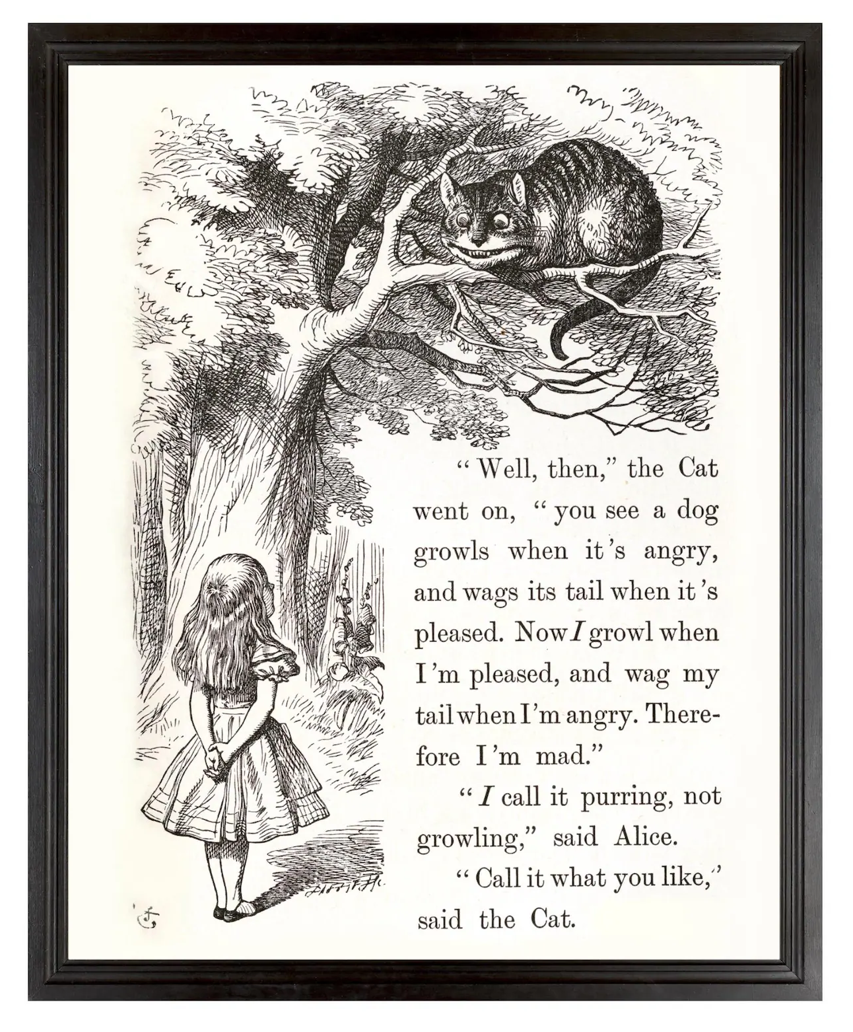
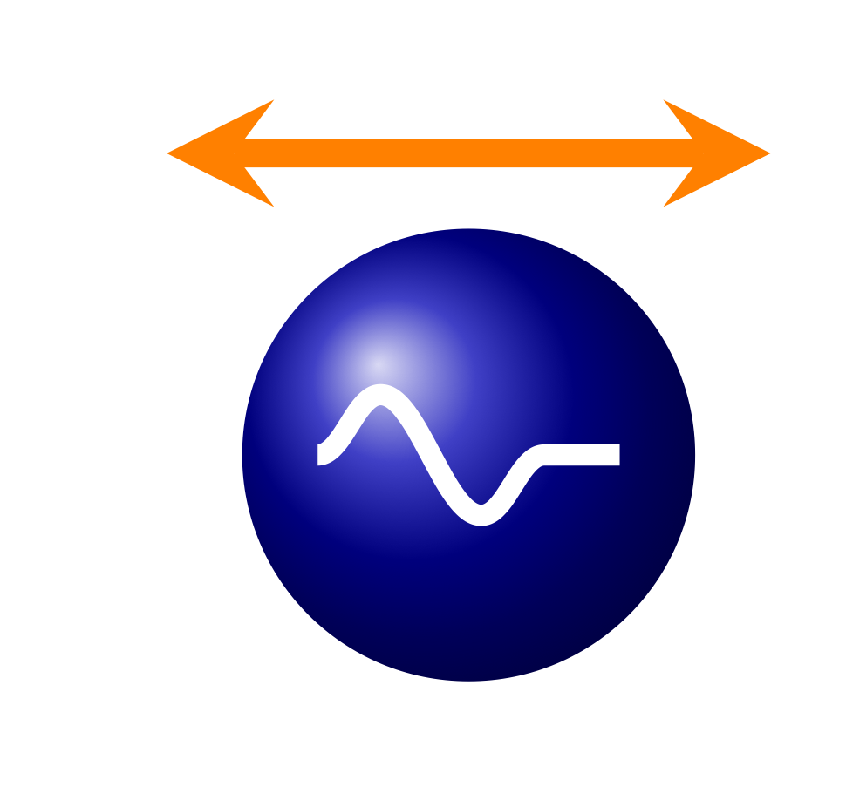
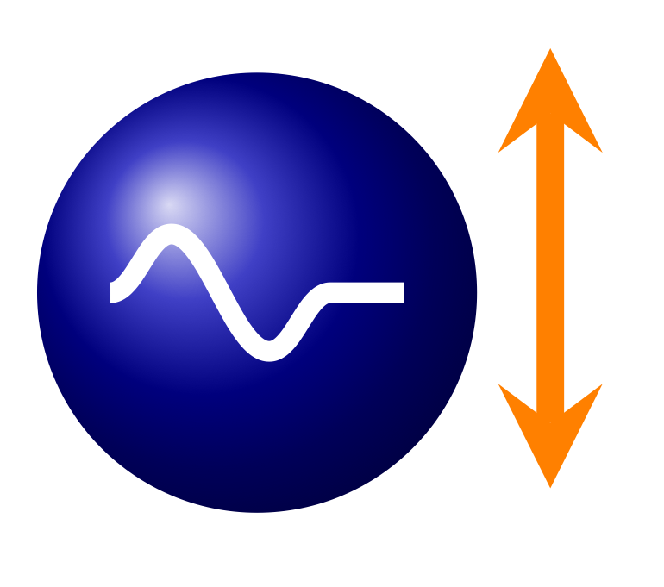
Quantum Information Science relies on two quantum effects: superposition and entanglement
Superposition — quantum objects can exist in a union of two states
Entanglement — The superposition of two (or more) particles can be linked

Slide 20

You can buy a polarizing filter.

Slide 21
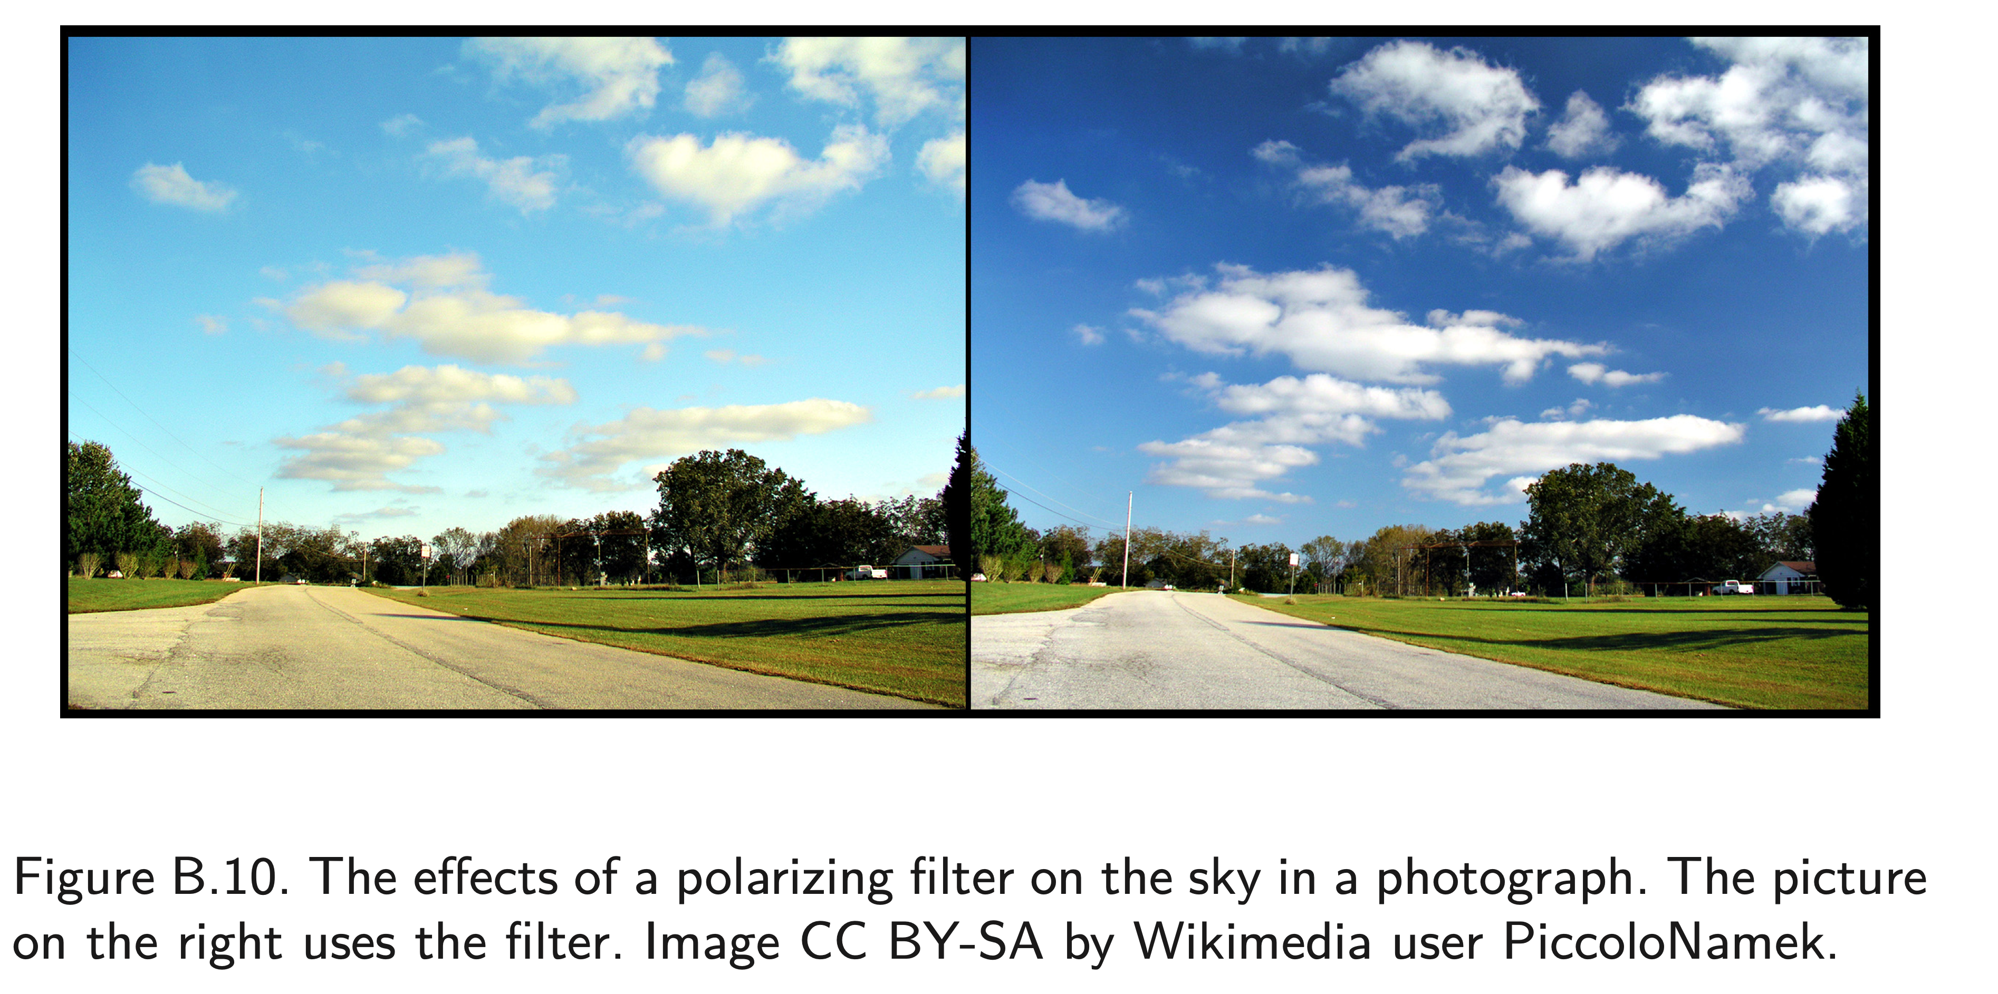

Slide 22
Light can be polarized

Slide 23
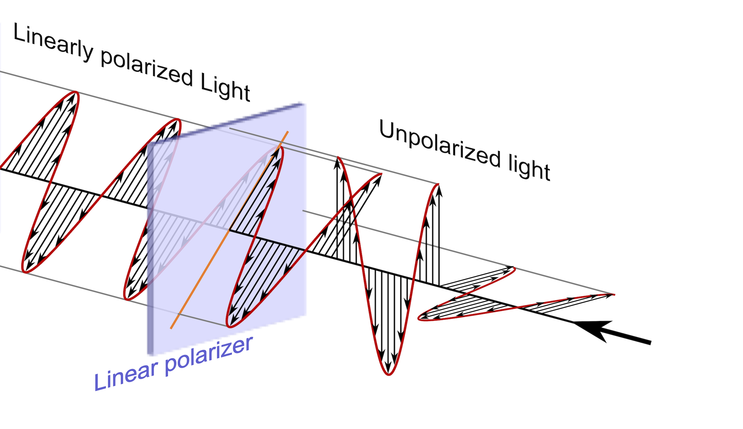
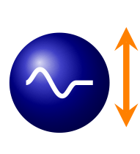

A polarizing filter only allows light through in 1-direction

Slide 25
Quantum Computing:
Where Are We On the Hype Cycle?

Slide 26
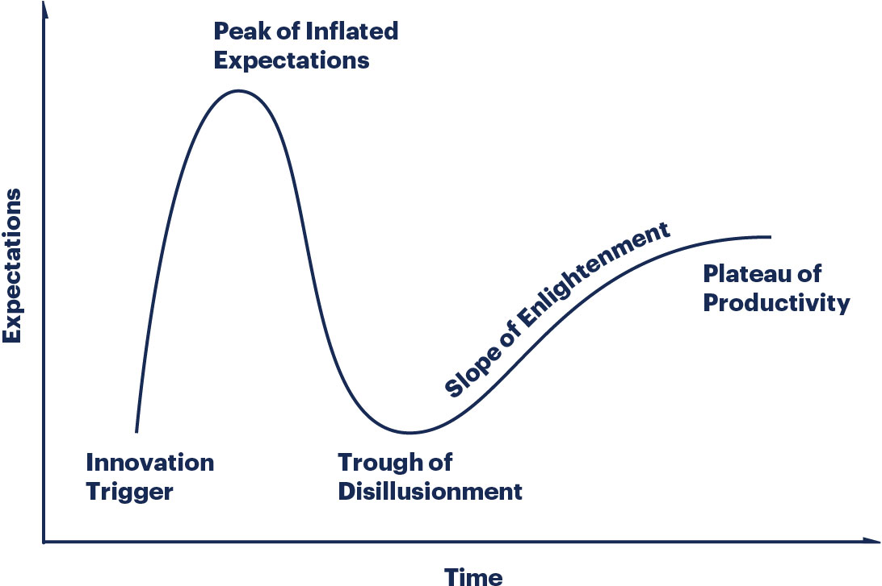
Gartner Hype Cycle

Slide 27
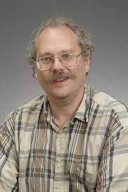


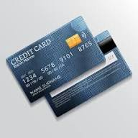
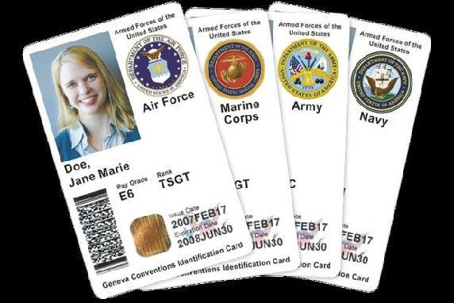
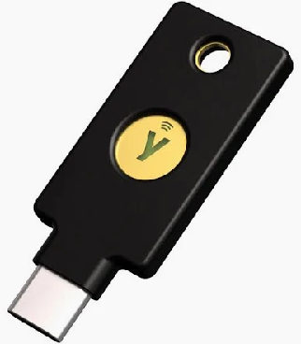
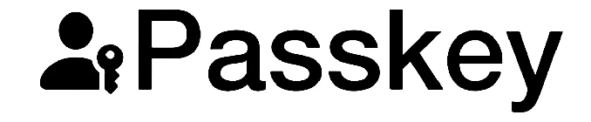
Quantum computing’s Innovation Trigger: Shor’s algorithm (1994)
1994 Peter Shor shows that a quantum computer could quickly factor numbers and compute discrete logarithms.
    Shor was a researcher at AT&T Bell Labs in NJ
    Today Shor is a professor at MIT
Paper: “Algorithms for quantum computation: discrete logarithms and factoring.”"
    Factoring is the “hard problem” on which RSA encryption is based.
    Discrete logarithms is the “hard problem” on which Diffie-Hellman key exchange is based.
These algorithms are at the heart of today’s cryptographic systems:
… but quantum computers did not exist in 1994!

Slide 28
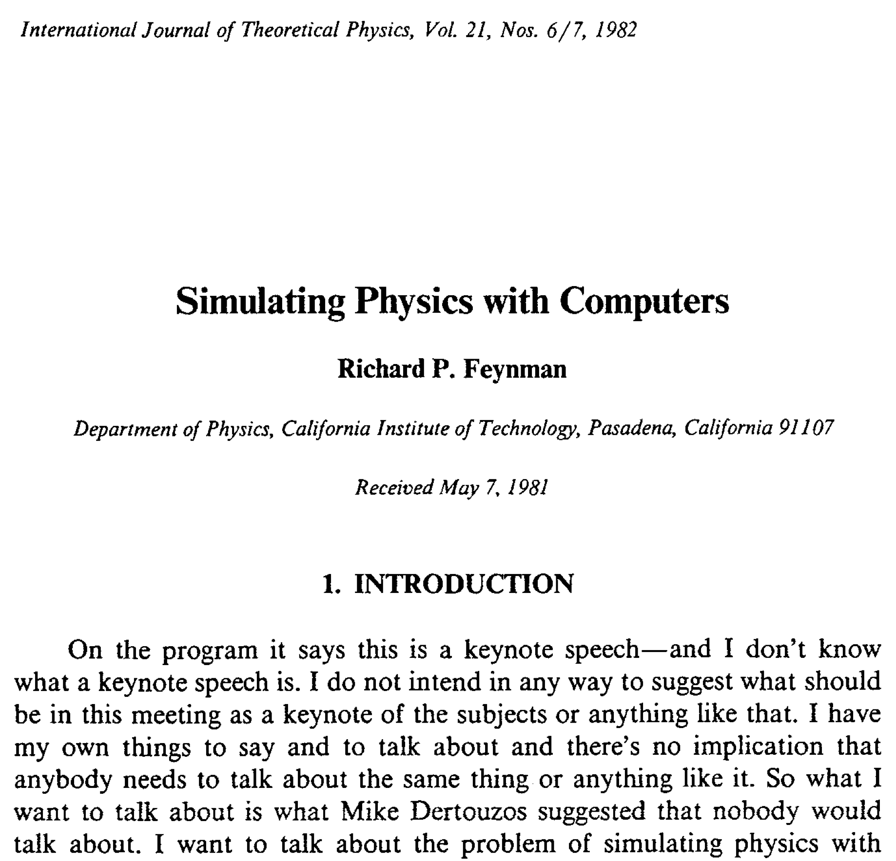
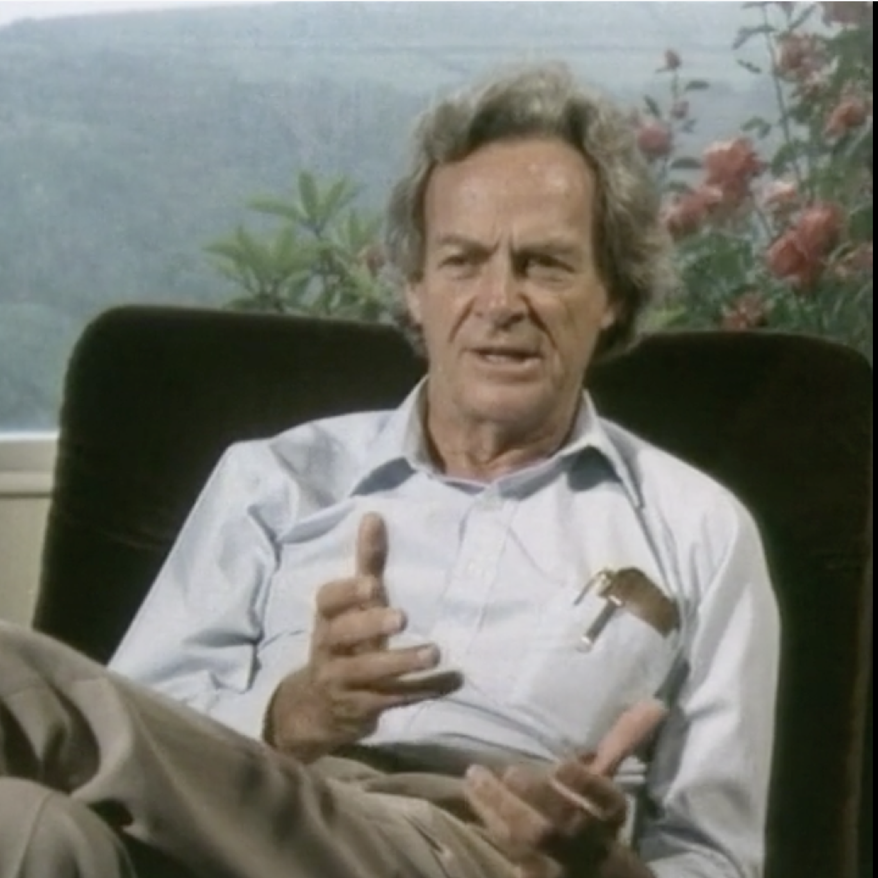
In 1981 Nobel prize winner Richard Feynman proposed building a “quantum computer” to quantum mechanics.
FEYNMAN: THE PLEASURE OF FINDING THINGS OUT (1981) https://vimeo.com/340695809

Slide 29
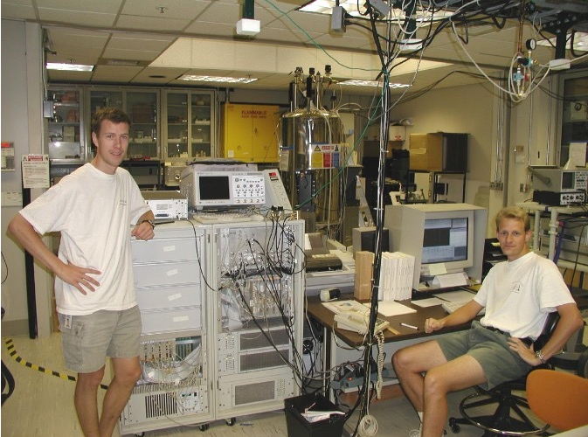
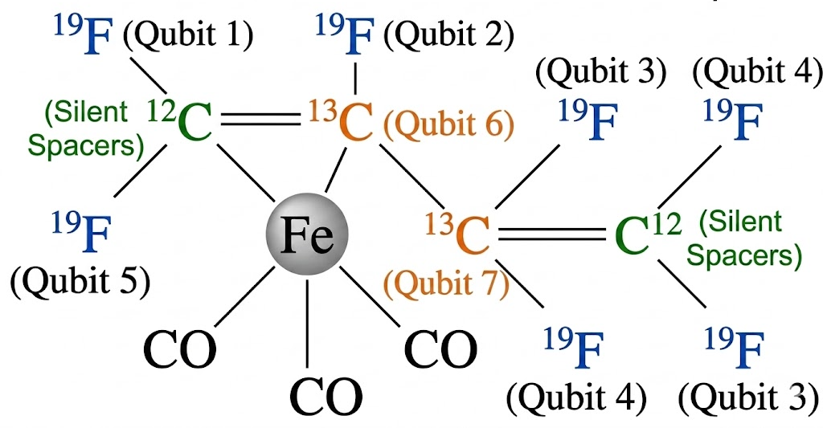
In December 2001, a quantum computer at IBM factored the number “15”
Lieven Vandersypen (left) and Matthias Steffen (right).

Slide 30
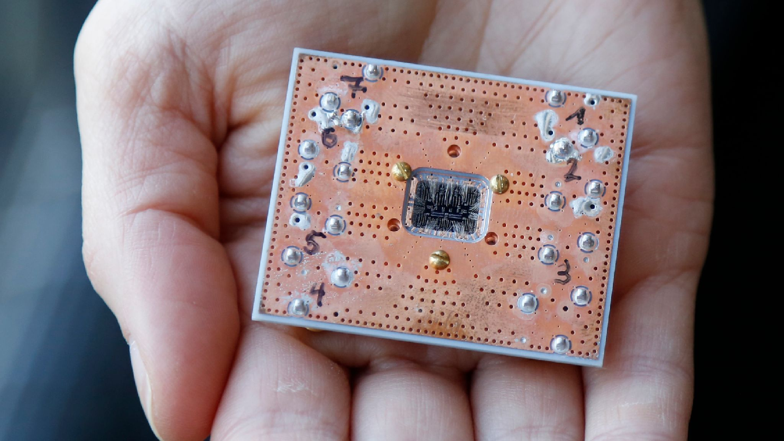
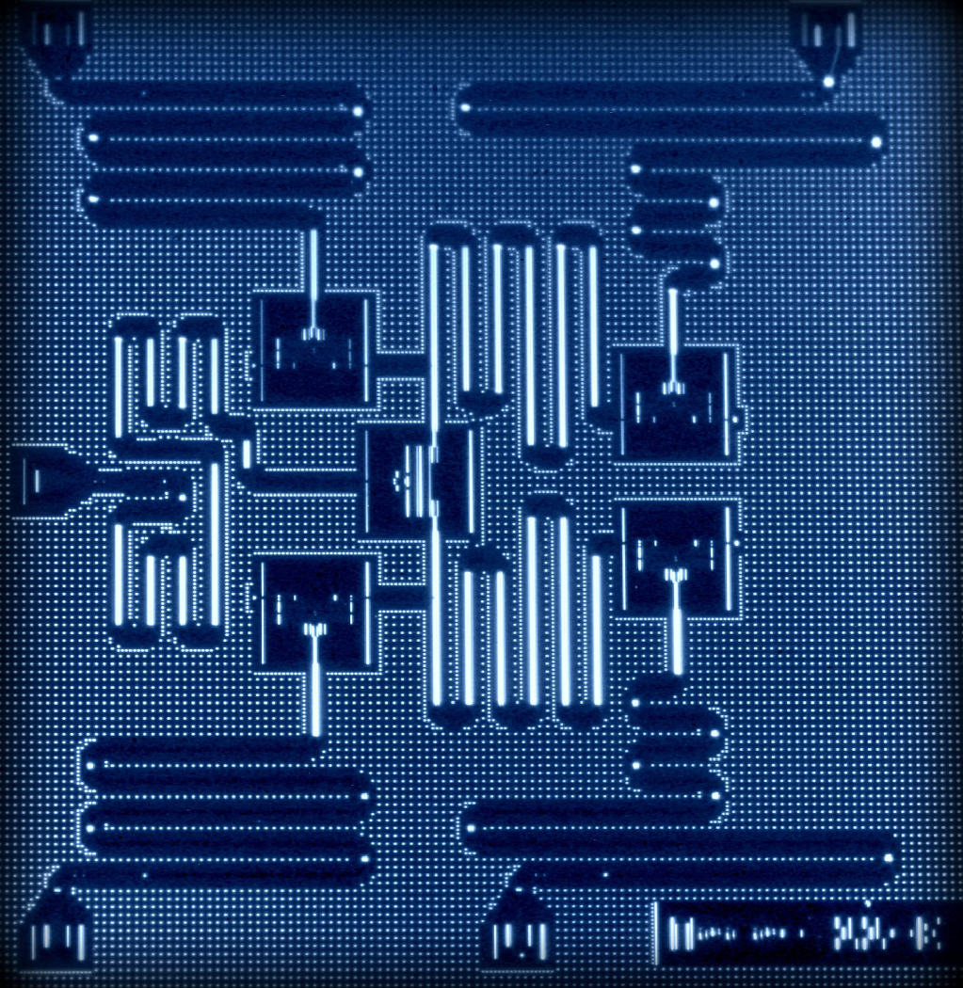
IBM’s 5-qubit device (2016)
qubits implemented with superconductors.
“artificial atoms”
gates implemented with microwave pulses.
  Each qubit requires its own control line.

Slide 31
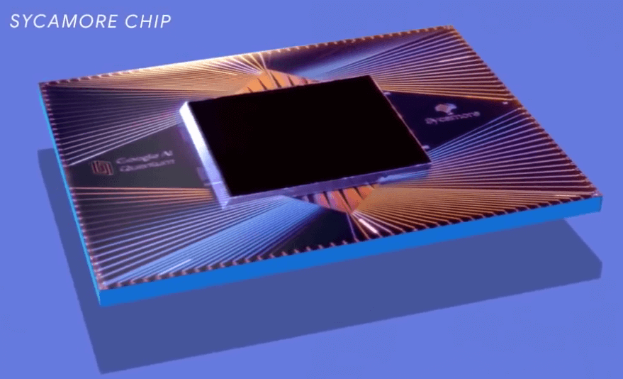
Google’s 53-qubit Sycamore quantum processor (2019)
\

Slide 32
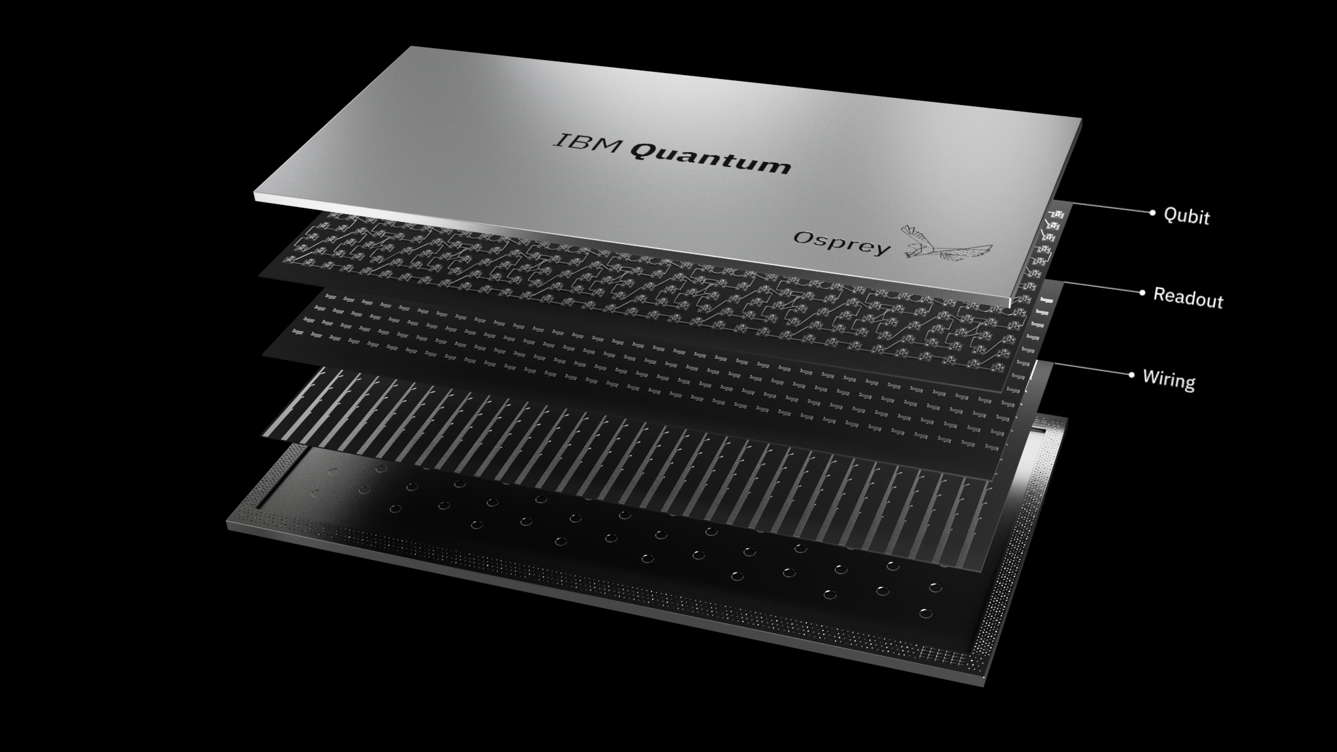
IBM 400 qubit device (2022)

Slide 33
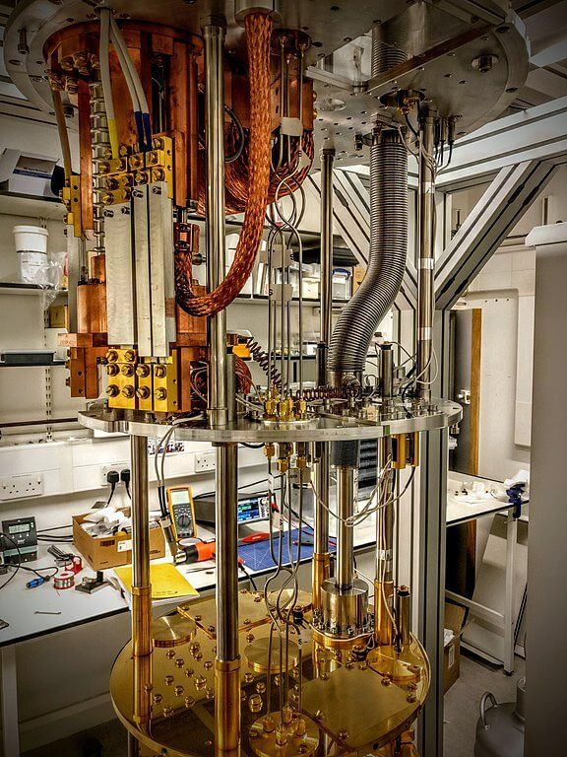
Dilution Refrigerator
Cooling to 0.035Kº

Slide 34
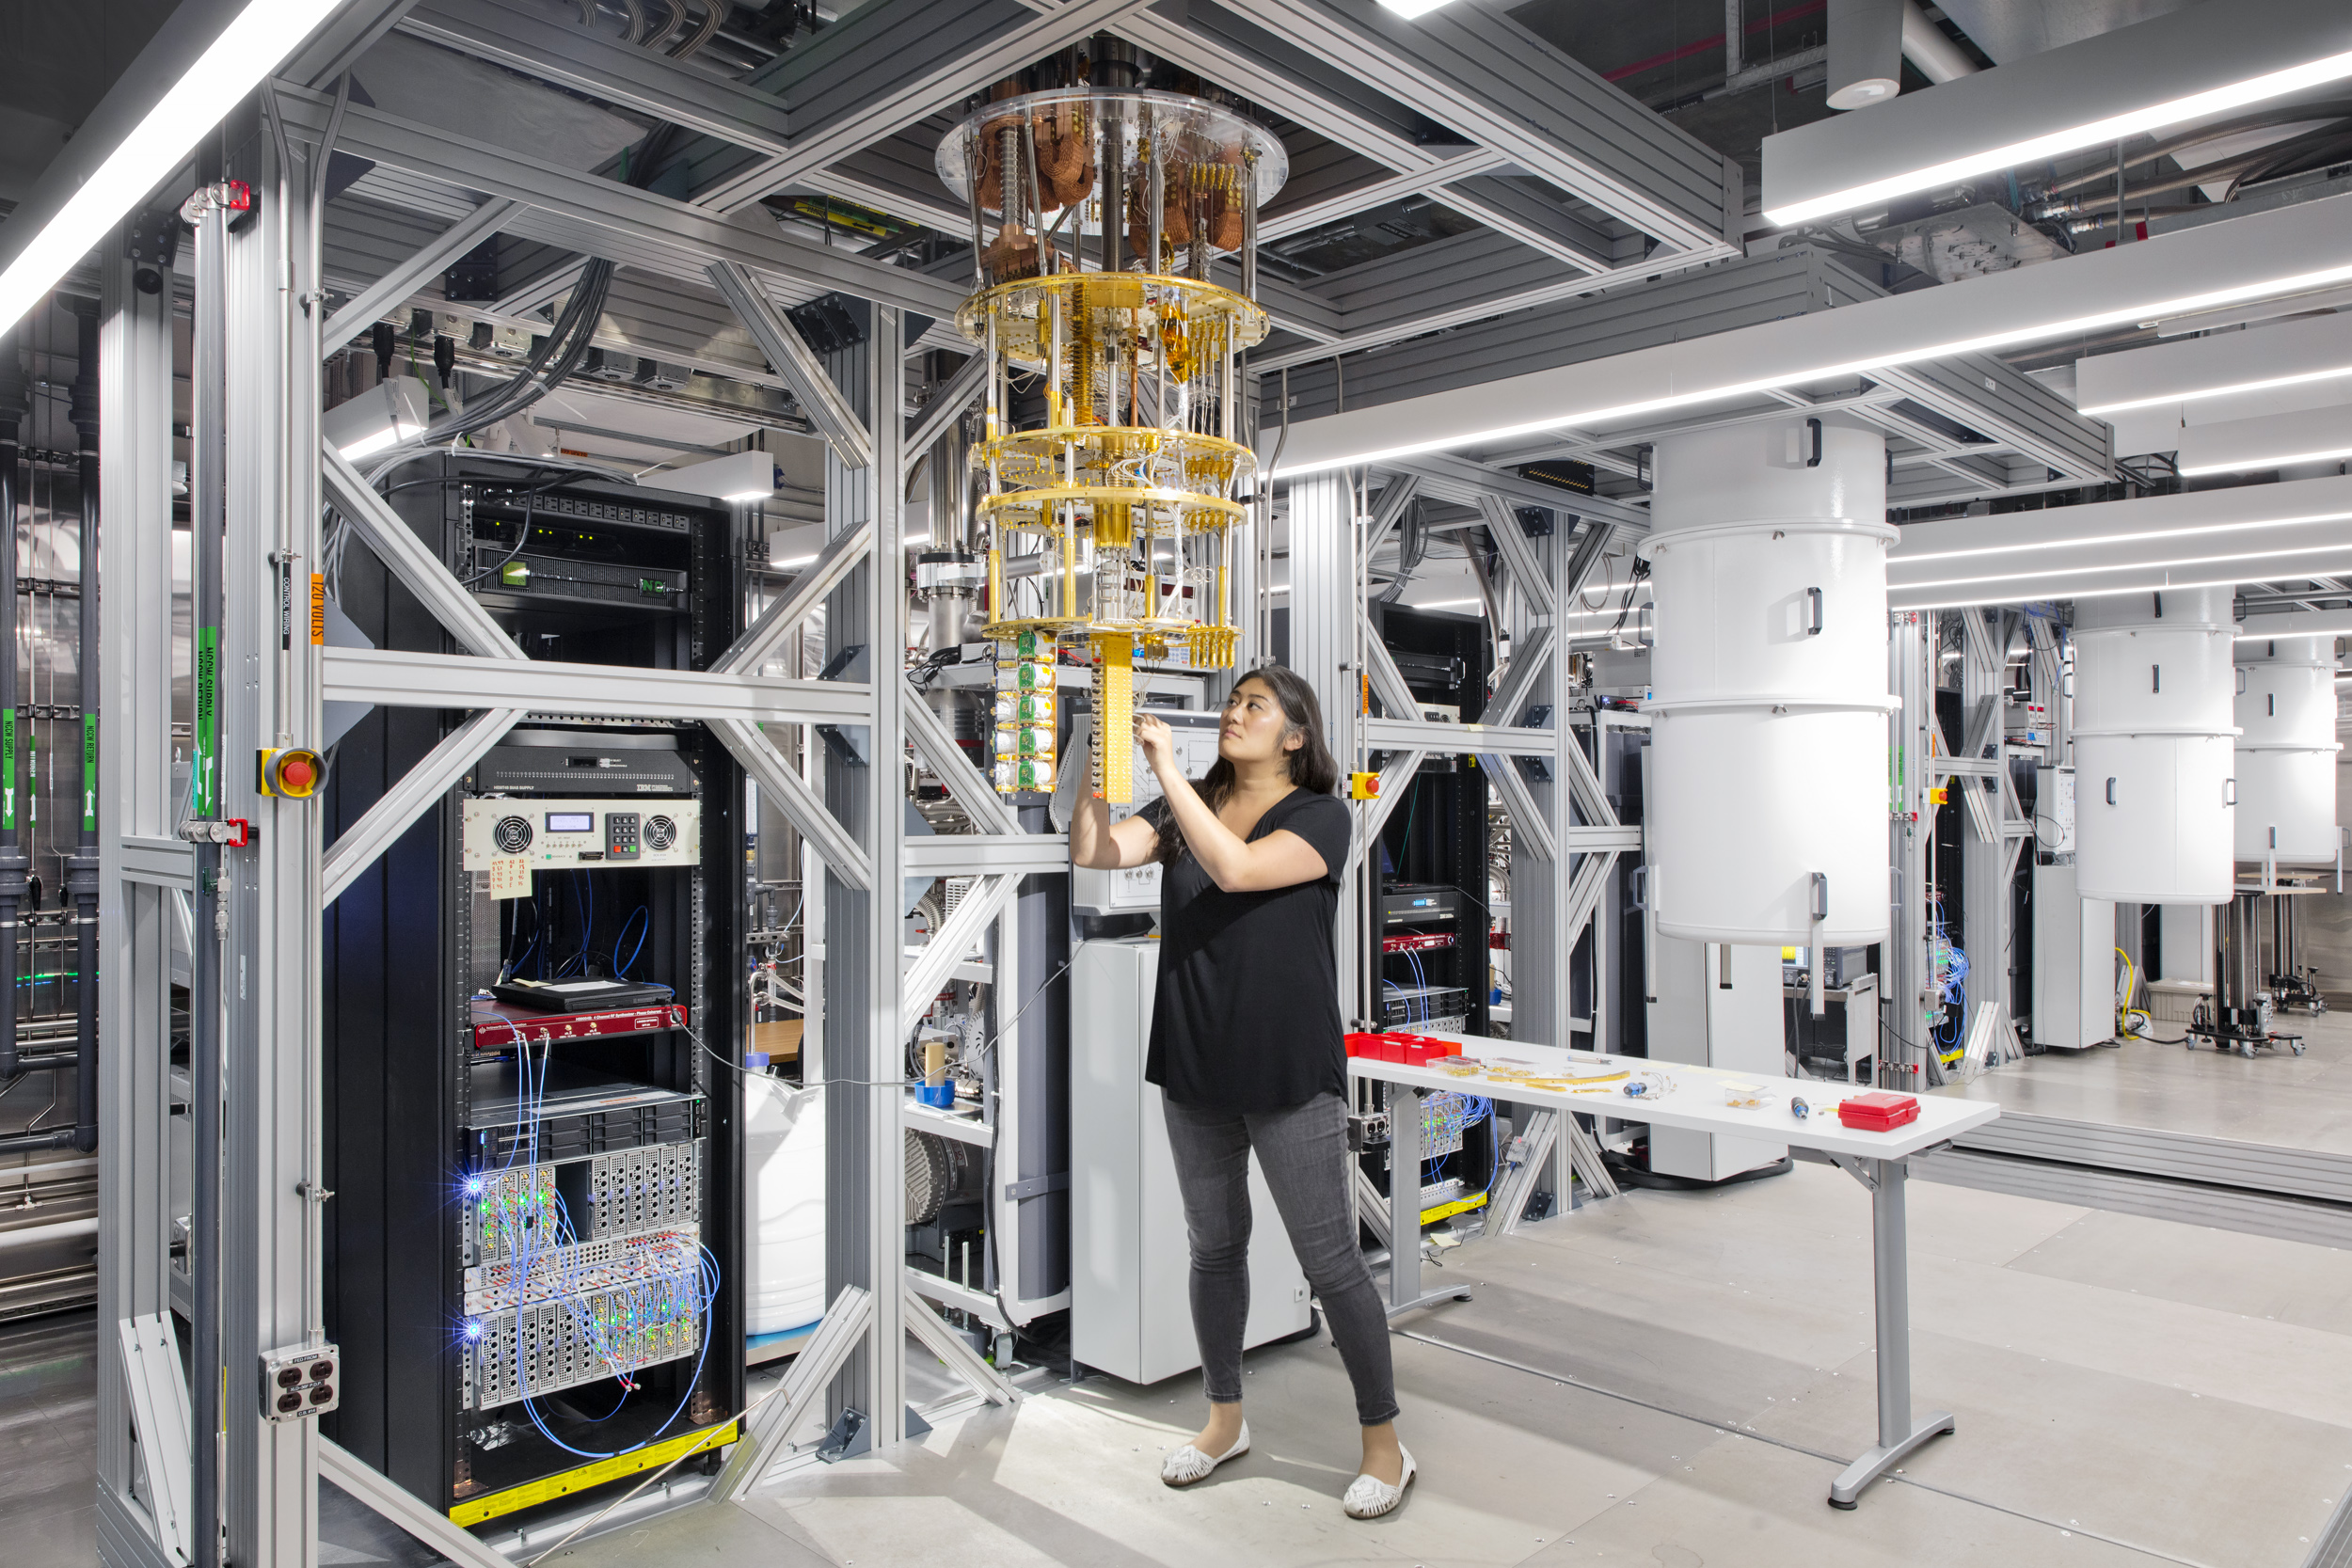
2023 — IBM “Condor” quantum computer — 1023 qubits

Slide 35
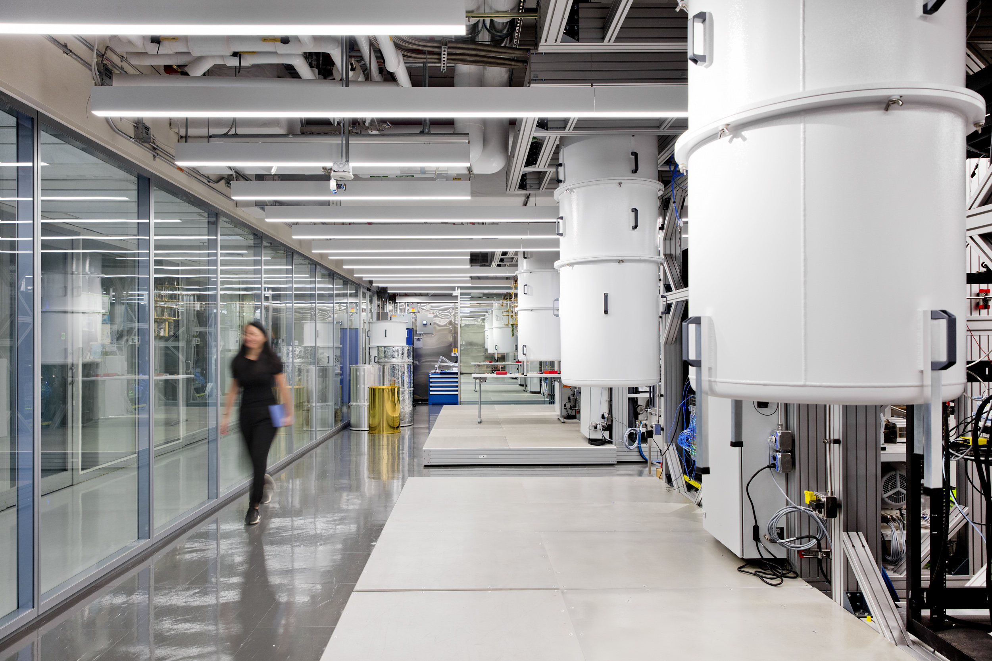
https://newsroom.ibm.com/media-quantum-innovation?keywords=quantum&l=100#gallery_gallery_0:22084

Slide 36

2029 rendering of multiple quantum computers connected

Slide 37
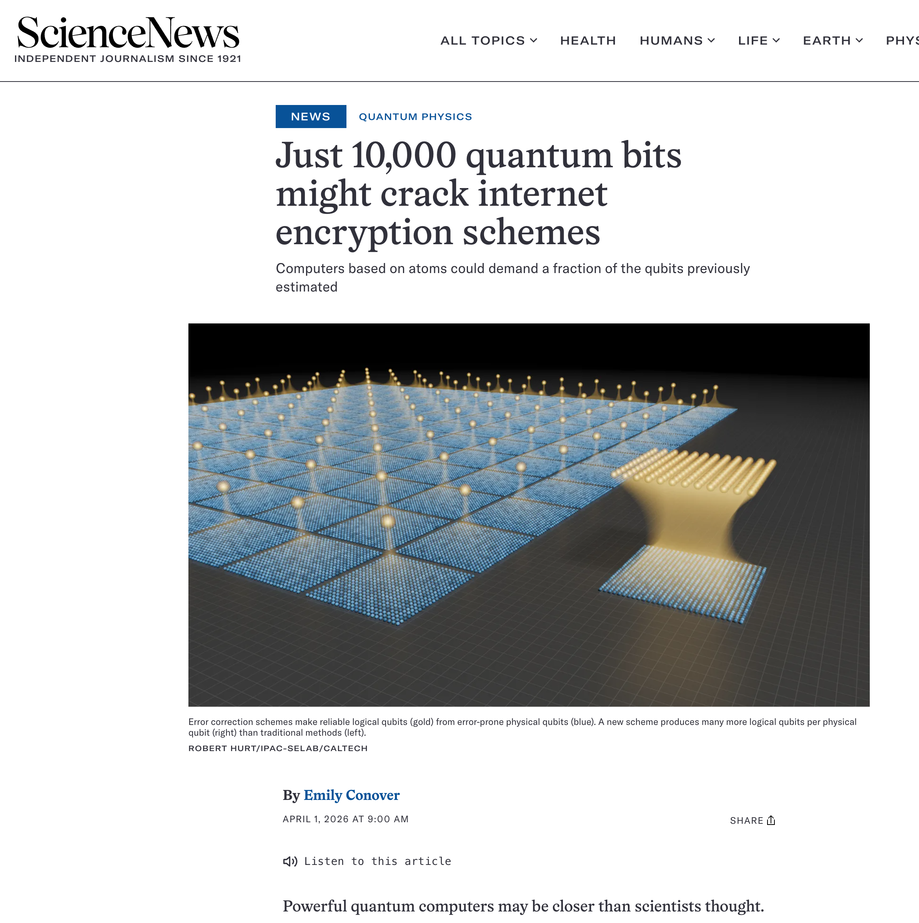
https://www.sciencenews.org/article/quantum-bits-crack-internet-encryption

Slide 38
April 1, 2026 — no joke
qubit
6,100 physical qubits
10,000 need to break ECC
(but many more needed to crack keys in a reasonable amount of time.)

Slide 39
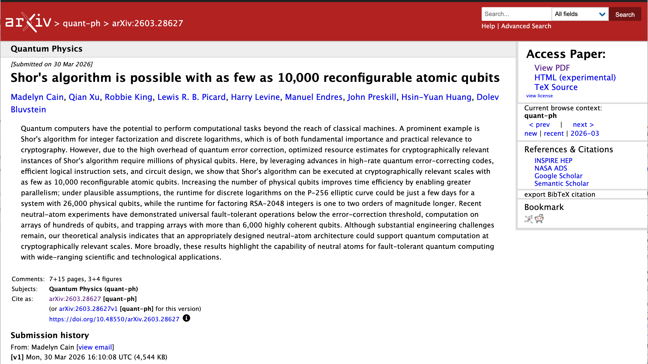
https://arxiv.org/abs/2603.28627

Slide 40
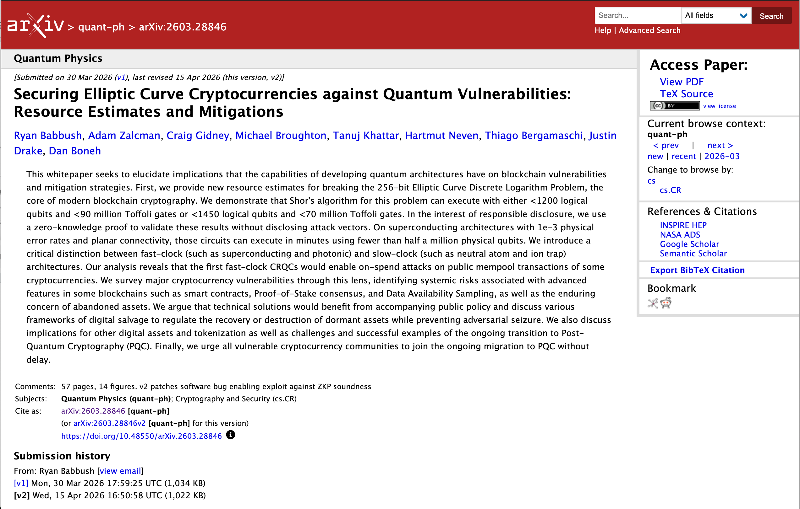
https://arxiv.org/abs/2603.28846

Slide 41

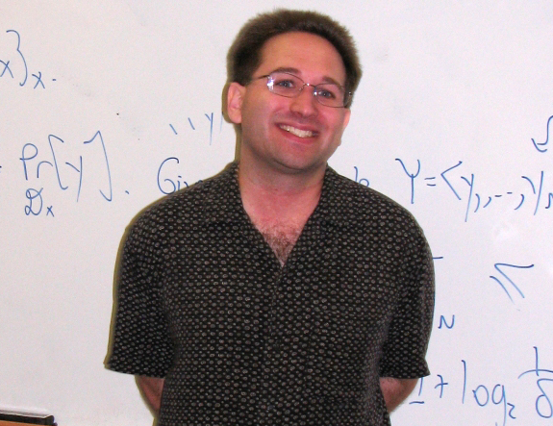
Scott Aaronson, Schlumberger Centennial Chair of Computer Science at
The University of Texas at Austin, and director of its Quantum Information Center.

Slide 42
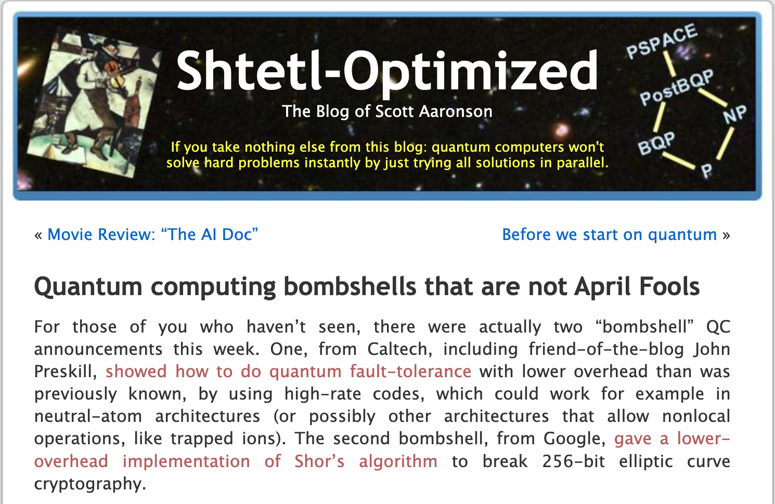
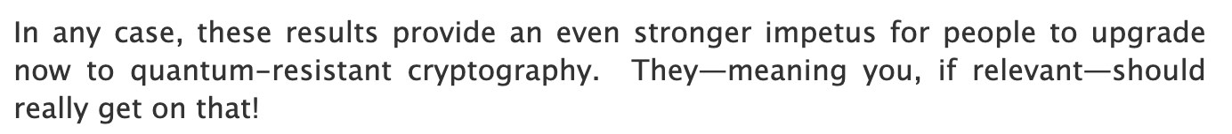
https://scottaaronson.blog/?p=9665

Slide 43
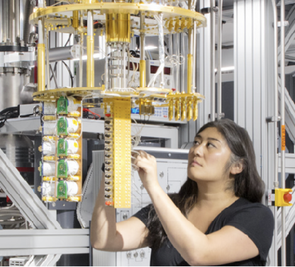
Gartner Hype Cycle

Slide 44
“Quantum advantage” — problems that can be run on a quantum computer that could never be done on a convention (“classical”) computer
Today four applications that we know product quantum advantage
  Quantum cryptanalysis — Cracking RSA and ECC public keys.
  Quantum chemistry — Simulating electrons in molecular systems.
  Quantum physics — Simulating the behavior of quantum particle systems
  Quantum publications — Getting papers published about quantum computers in Science and Nature.
We do not know about other quantum applications:
  Quantum machine learning
  Quantum optimization
  Quantum solving of partial differential equations
https://www.nist.gov/quantum-information-science/quantum-computing-explained

Slide 45
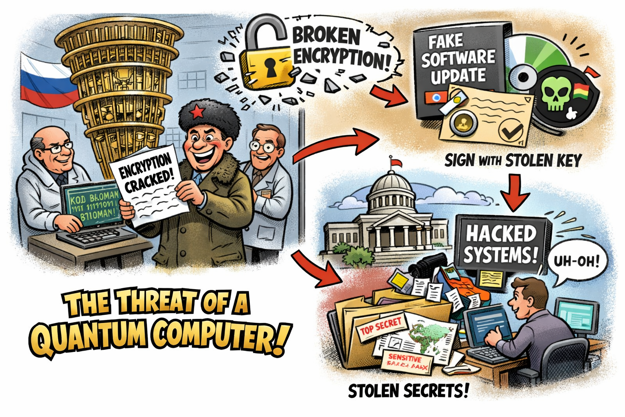
Faking signatures

Slide 46
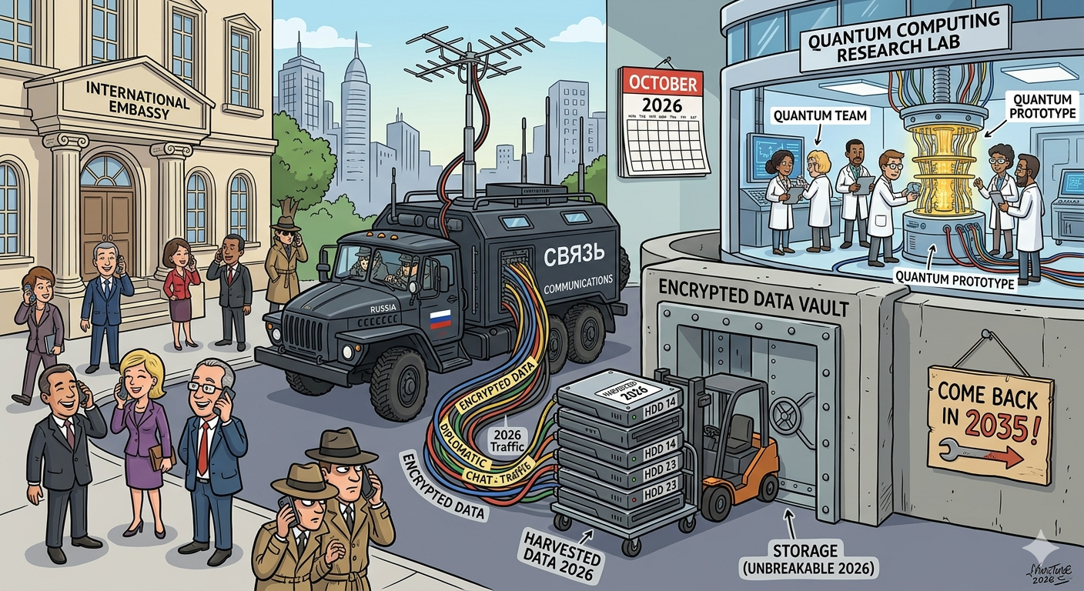
Quantum Cryptanalysis — “Harvest Now, Decrypt Later”

Slide 47
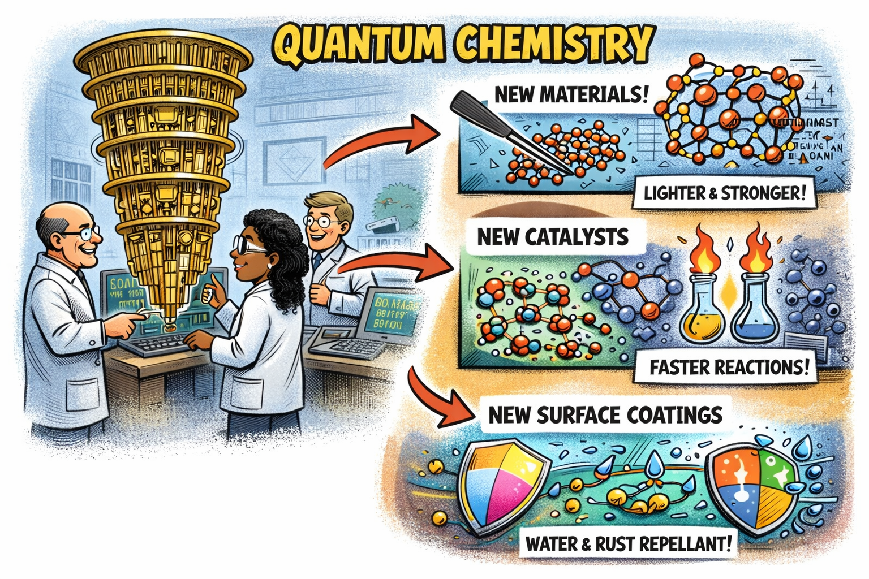
Quantum Chemistry

Slide 48
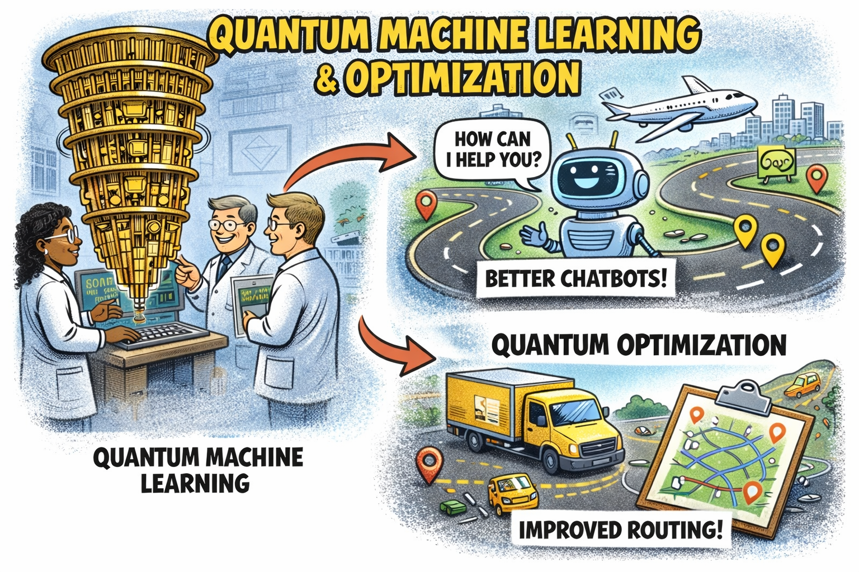
Quantum Optimization & Quantum Machine Learning

Slide 49
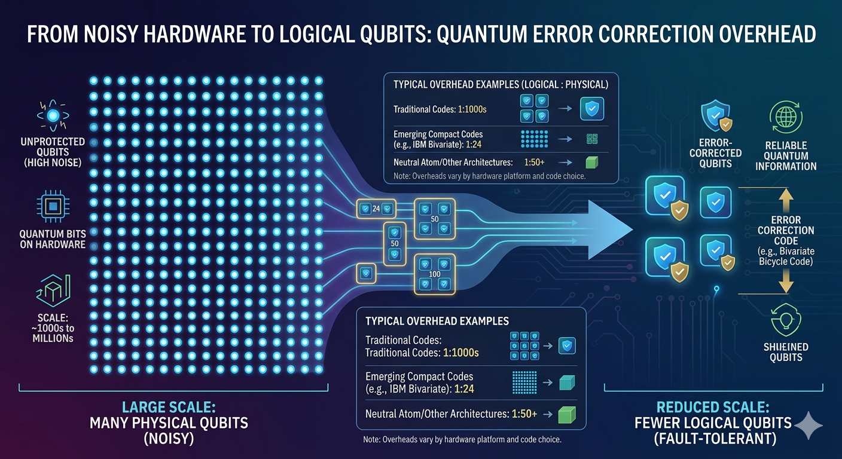

Slide 50
Challenges in building a quantum computer
Quantity of qubits — today’s system have hundreds of physical qubits.
  We need systems with hundreds to thousands of logical qubits.
Quality of qubits — Today’s qubits are noisy, increasing need for error correction.
  We need systems with qubits that are less susceptible to the outside universe.
Connectivity between qubits — Today’s systems are limited in their topology.
  Better connectivity allows for more efficient error correction and algorithms.
The Wiring problem — each qubit requires its own coaxial cable for pulses
  We cannot physically fit millions of cables in a dilution refrigerator
State Preparation and Measurement (SPAM) Errors
  Each microwave pulse generates heat (noise) which impacts the computation

Slide 51
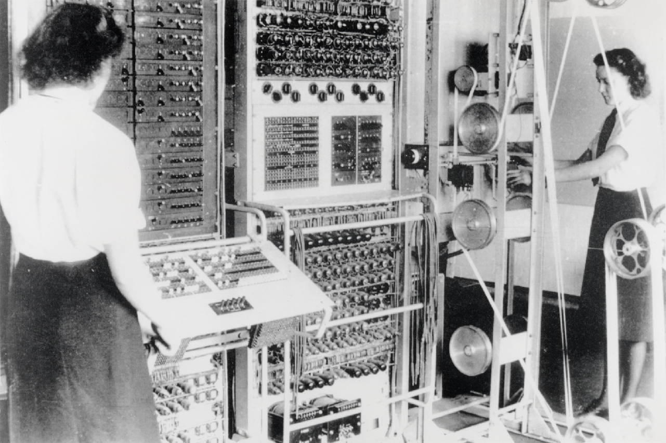
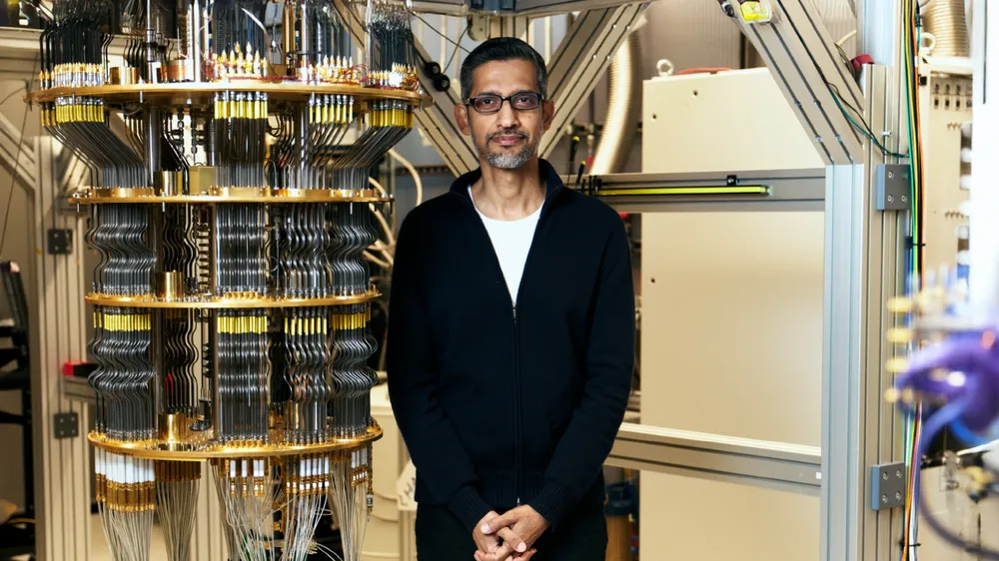
Today’s quantum computers are like vacuum tube computers of the 1940s
Today’s quantum computers:
  Hundreds of qubits of storage
  Between 1000 and 5000 operations (“gates”) can run
Needed for practical applications:
  100 - 10,000 logical qubits
  100,000 - 1,000,000 physical qubits
  10,000 - 100,000,000 gates
A Colossus Mark 2 codebreaking computer being operated by Dorothy Du Boisson (left) and Elsie Booker (right), 1943
Sundar Pichai (Alphabet’s CEO) next to Google’s Willow quantum processor

Slide 52
Department of Energy “Quantum Genesis” Initiative
Launch: 24 JUN 2026
Mission: Develop and deploy “the world’s first fault-tolerant, scientifically relevant quantum computing capability” by 2028.
Priorities:
  The DOE Q Competition — demonstrate fault-tolerant quantum systems in 2028 with “low hundreds” number of logical qubits.
  The National Quantum Supercomputing User Facility - Provide scientists and engineers access to advanced quantum computing systems.
  Focused R&D for Quantum Computing Applications - “conduct targeted research and development to identify and implement breakthrough quantum scientific applications”

Slide 53
Quantum computer myths
Myth: Quantum computers can solve any hard problem instantly by simultaneously trying all possible solutions.
  Fact: We know of only two problems that can be solved dramatically faster on a quantum computer than on a classical computer — quantum physics solutions and factoring. Even these problems will not be solved instantly.
  A fully-realized cryptographically relevant quantum computer Quantum computers can solve only a very small number of problems at all.
Myth: On “Q Day,” all encryption systems will be instantly broken
  Fact: A CRQC will only be able to crack an encyrption key in hours or days.
  Targeting and deconfliction will become of critical importance.

Slide 54
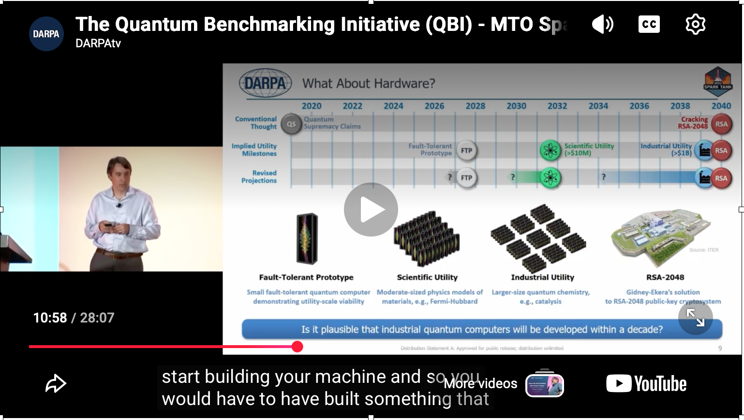
DARPA MTD SPARK TANK • July 25, 2025
Quantum Benchmarking Initiative
https://www.youtube.com/watch?v=AiB2zNPJXN4
https://www.darpa.mil/sites/default/files/attachment/2025-09/darpa-mto-spark-tank-qbi.pdf
https://www.darpa.mil/events/rewinds/spark-tank/presentations

Slide 55
Quantum Key Distribution

Slide 56
Remember that light can be polarized

Slide 57
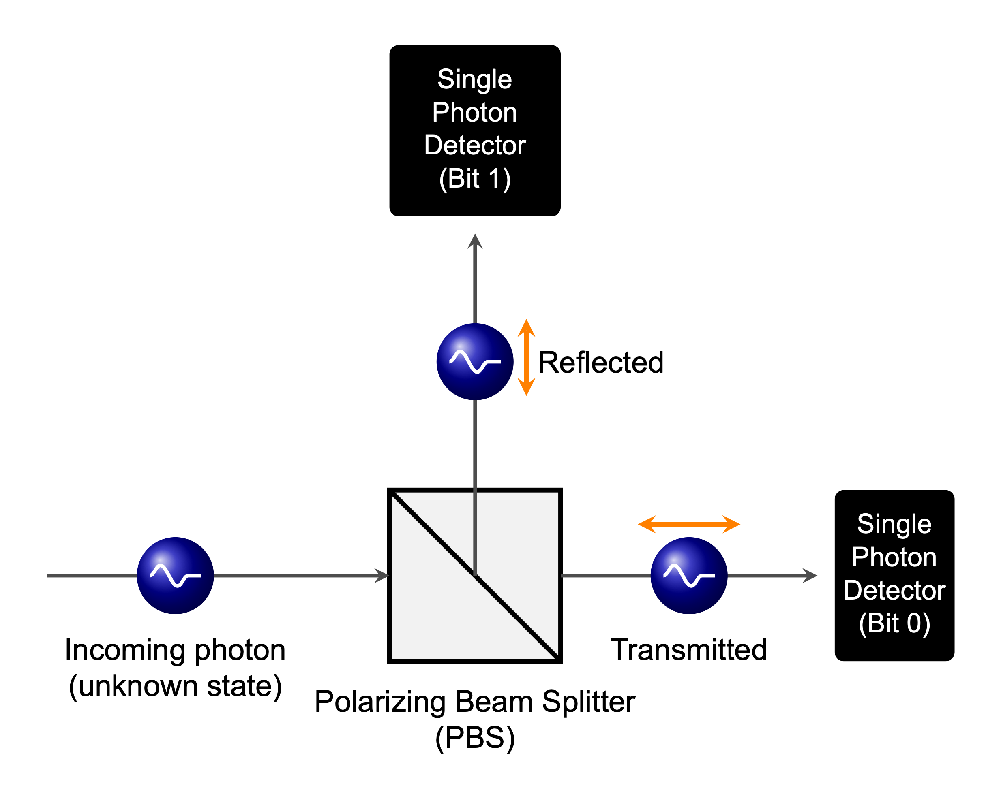
For quantum cryptography, we need to measure the polarization of a single photon!

Slide 58
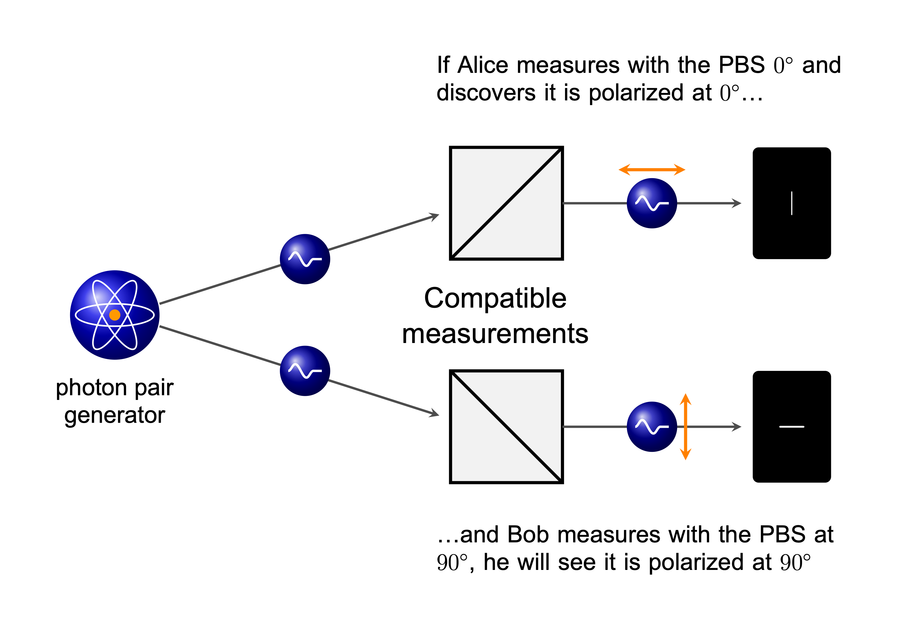
BBM92 quantum key distribution protocol uses orthogonalized, entangled photon pairs

Slide 59
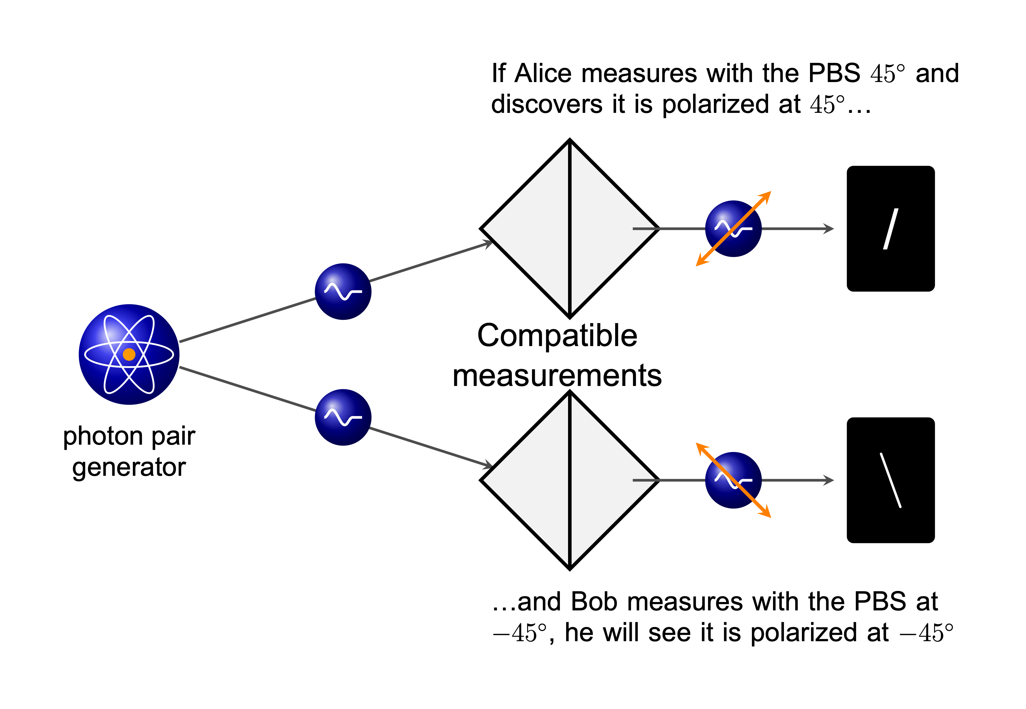
BBM92 quantum key distribution protocol uses orthogonalized, entangled photon pairs

Slide 60
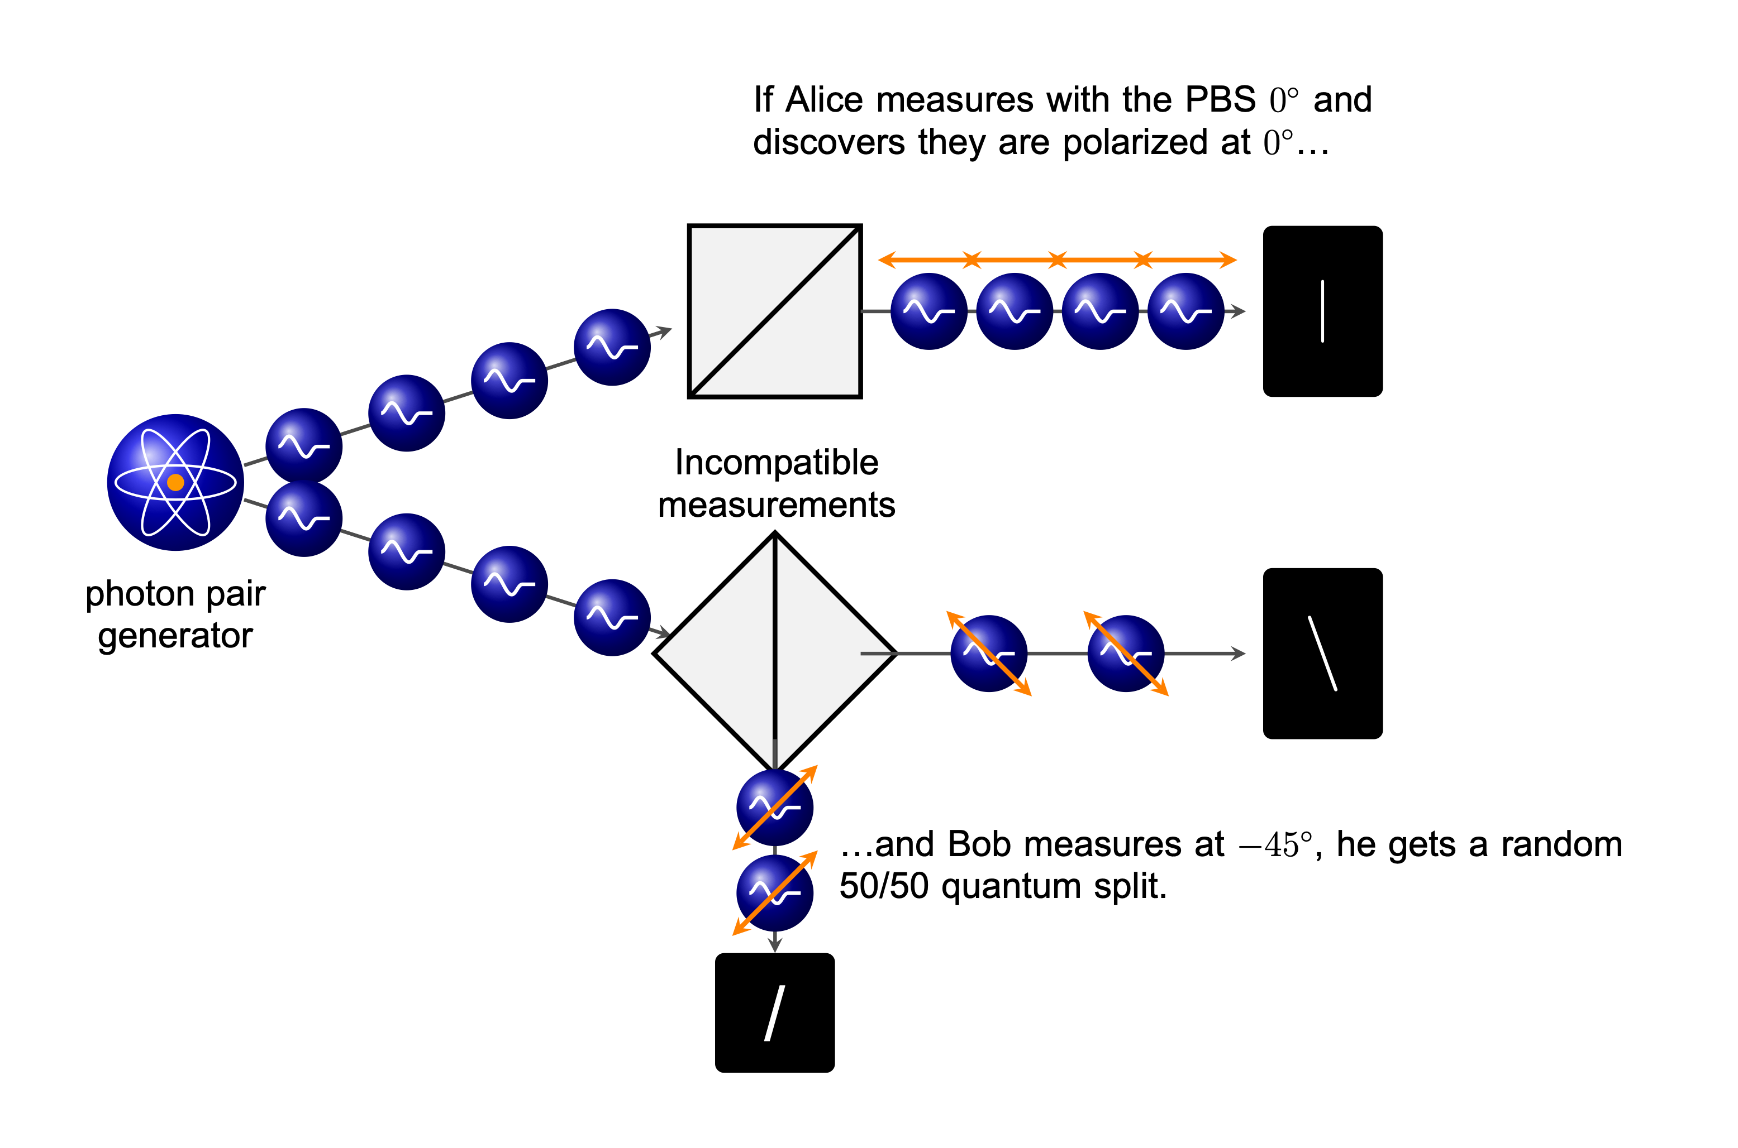
BBM92 quantum key distribution protocol uses orthogonalized, entangled photon pairs

Slide 61
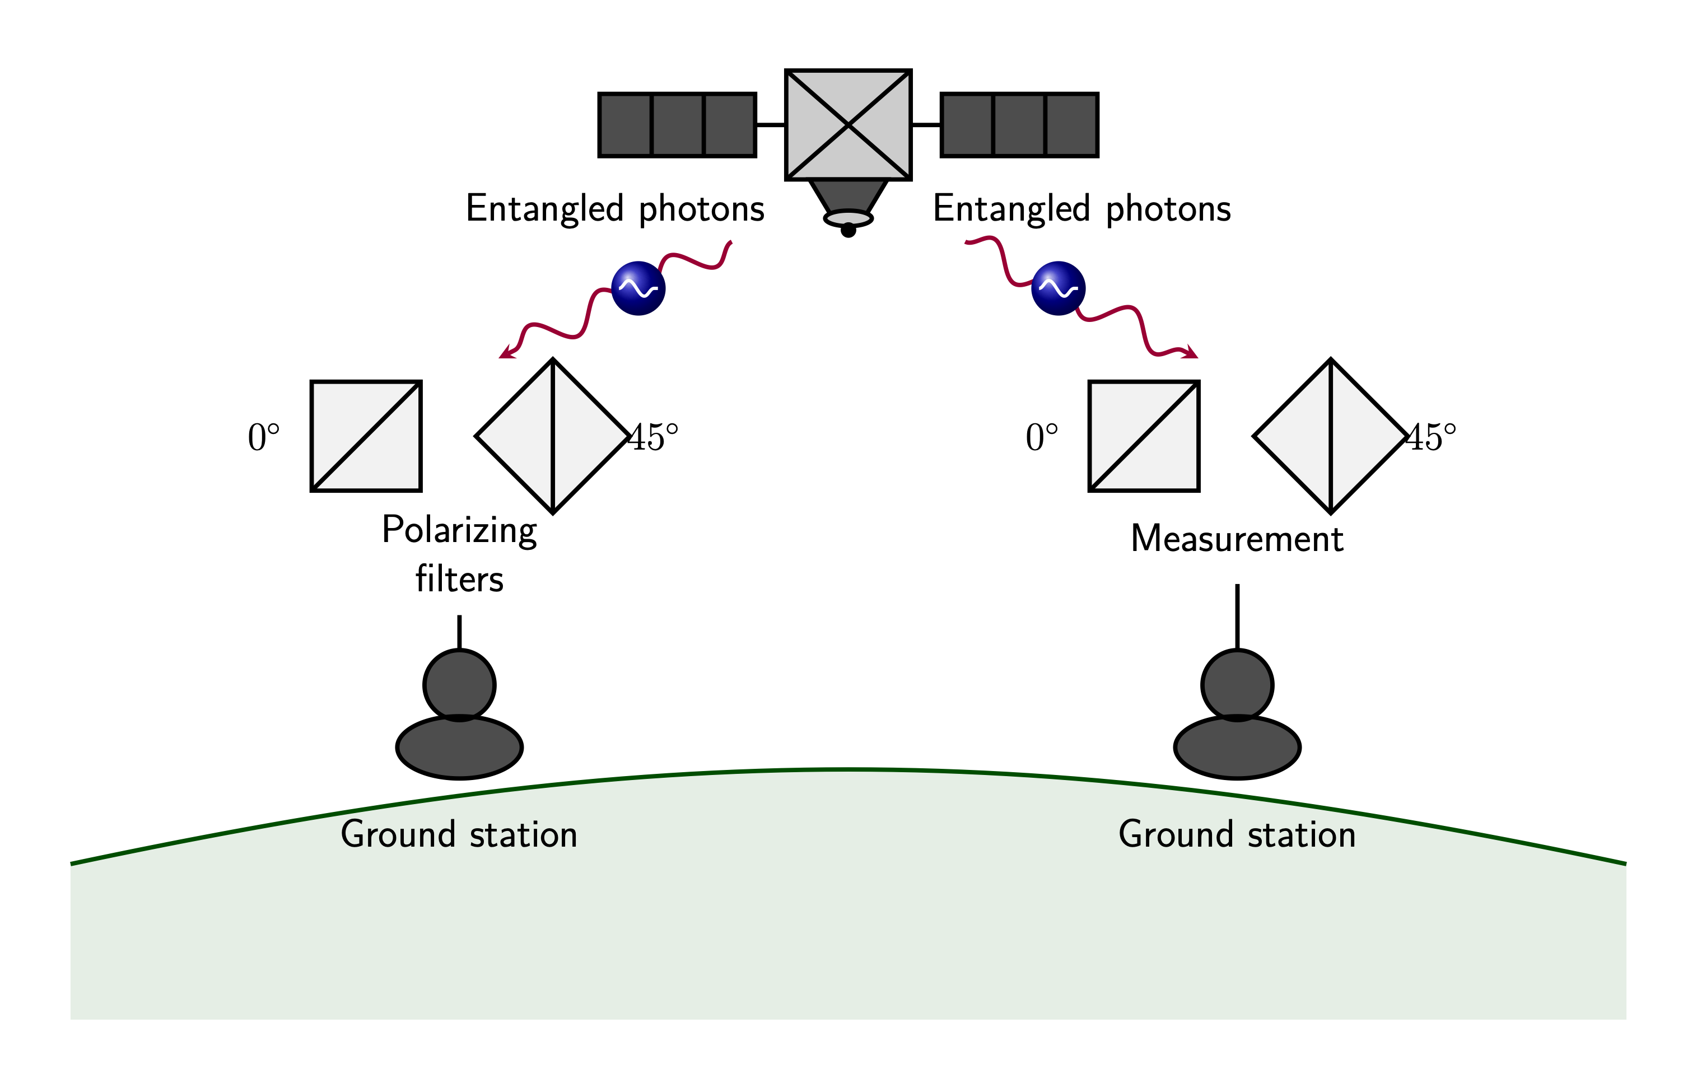
This was the basis of the Chinese Micius (Mozi / QUESS—Quantum Experiments at Space Scale) and Jinan-1 satellites

Slide 62


https://www.optica-opn.org/home/articles/volume_29/february_2018/features/satellite-based_qkd/

Slide 63
Quantum Sensing

Slide 64

Quantum sensing is here today

Slide 65



GPS Atomic Clocks
GPS III Satellite
https://www.gps.gov/images/
Cesium Frequency Standard (Clock)
Source: National Air and Space Museum, Smithsonian Institution.

Slide 66
Three key quantum sensing areas: magnetism, gravity and RF
Magnetism —
  Optically Pumped Magnetometers • Nitrogen-vacancy (NV) Diamonds Centers • SQUIDs (Superconducting Quantum Interference Devices)
    exquisitely sensitive to absolute magnetic field vector and minor changes
  applications: PNT in GPS-denied regions; reverse-engineering microelectronics
Gravity
  Atomic interferometry
Radio Frequency (RF)
  Rydberg Atom Receivers
  Trapped Ions

Slide 67

Quantum sensing - more information
https://www.nist.gov/quantum-information-science/quantum-sensing-explained

Slide 68

DARPA Quantum Sensing
https://www.youtube.com/watch?v=FYy1TSNtGYM
https://www.darpa.mil/sites/default/files/attachment/2025-09/darpa-mto-spark-tank-quantum-sensing.pdf

Slide 69

DARPA Quantum Sensing
https://www.youtube.com/watch?v=yka78a00Ia8
https://www.darpa.mil/sites/default/files/attachment/2025-09/darpa-mto-spark-tank-quantum-photonic-microsystems.pdf

Slide 70

Quantum networking…

Slide 71


Slide 72
Post-Quantum Cryptography
Implementing the 22 JUN Executive Orders

Slide 73
What is the timeline for a cryptographically relevant quantum computer (CRQC)?
Nobody knows!
2019 Google —
  20M state-of-the-art (e.g. “noisy”) qubits
  2.6 billion gates for a 2048-bit RSA key. (Google estimated 8 hours.)
  It is “highly unexpected” that a quantum computer that can break a 2048-bit RSA key will be built before 2030.
2026 Google —
  10,000 logical qubits to crack ECC-256 (in 3 years)
  We are deploying post-quantum now. Everybody should be using it by 2029.

Slide 74
Post-Quantum Cryptography (PQC) Standardization effort:
We need a public key algorithm for signing and sealing.
Grover’s algorithm poses threat to AES
  Square-root speed up on search operations.
  Simple solution: Move from AES-256 to AES-128
Shor’s algorithm poses a threat to RSA & Elliptic Curve
  Quantum Fourier transform factor large numbers and compute discrete logarithms.
  Moving to larger keys is not a solution: still only polynomial security (not exponential)
  Hard solution: identifier better public key encryption algorithms.
Today’s quantum computers pose no threat to today’s hash algorithms.
  There is no quantum implementation of SHA-256 (or any other hash).
  Hashing reduces the number of bits: it’s not a reversible algorithm.

Slide 75
Moving public key cryptography to quantum resistant algorithms (NIST IR 8547ipd)
Between 2016 - 2020, NIST evaluated 23 signature and 59 KEM schemes.
2024 — NIST publishes three FIPS (Federal Information Processing Standards):
  FIPS 203, Module-Lattice-Based Key-Encapsulation Mechanism Standard
  FIPS 204, Module-Lattice-Based Digital Signature Standard
  FIPS 205, Stateless Hash-Based Digital Signature Standard
2025 — NIST selects HQC as a fifth PQ algorithm
2026 — National Quantum Initiative Reauthorization Act Introduced
  Passed Senate Commerce Committee unanimously on April 16.
2030 — RSA-2048 is no longer approved for encryption (“stop selling”)
2035 — RSA-2048 is no longer approved for decryption (“stop using”)

Slide 76
The size of a quantum computer necessary to break codes is unknown.
Speed of code code-breaking depends on:
  The number of qubits — the size of the numbers that can be cracked
  The logical error rate — the length of the quantum computation that they can perform.
  The encryption code being cracked (RSA vs. Elliptic Curve Cryptography)
2019 — Google estimated 20M qubits | 8 hours — RSA-2048
2025 — Google estimated 1M qubits | 1 week — RSA-2048
2026 — Caltech estimated 10,000 qubits | 3 years — ECC-256
(used by Bitcoin and most mobile apps)
(2026 — Pinnacle estimated 100,000 qubits | 30 days — RSA-2048)
Operationally, the number of keys that can be cracked depends on:
  The number of quantum computers
  The speed of the quantum gates

Slide 77

NIST defines “Security Categories”
https://csrc.nist.gov/pubs/ir/8547/ipd - p.12

Slide 78
Timeline to deploying post-quantum crypto
2016 — US NIST announces effort.
2028 — UK NCSC says to:
  “Define your migration goals”
  “Carry out a full discovery exercise…”
  “Build an initial plan for migration.”
2030 — NIST deprecates ECDSA and RSA
2031 — UK NCSC target date for initial migration
2035 — UK NCSC target date for complete migration; NIST disallows ECDSA and RSA
Sources:
  https://www.ncsc.gov.uk/guidance/pqc-migration-timelines
  https://csrc.nist.gov/pubs/ir/8547/ipd

Slide 79

Am I safe today? https://radar.cloudflare.com/post-quantum

Slide 80


Slide 81



Slide 82


Slide 83


Slide 84
Q&A

Slide 85

Find out more
2021 “mostly accurate.”

