Slide 2
Using Spark and Differential Privacy to Protecting the Privacy of the 2020 Census Respondents
Simson L. Garfinkel
U.S. Census Bureau

Slide 3
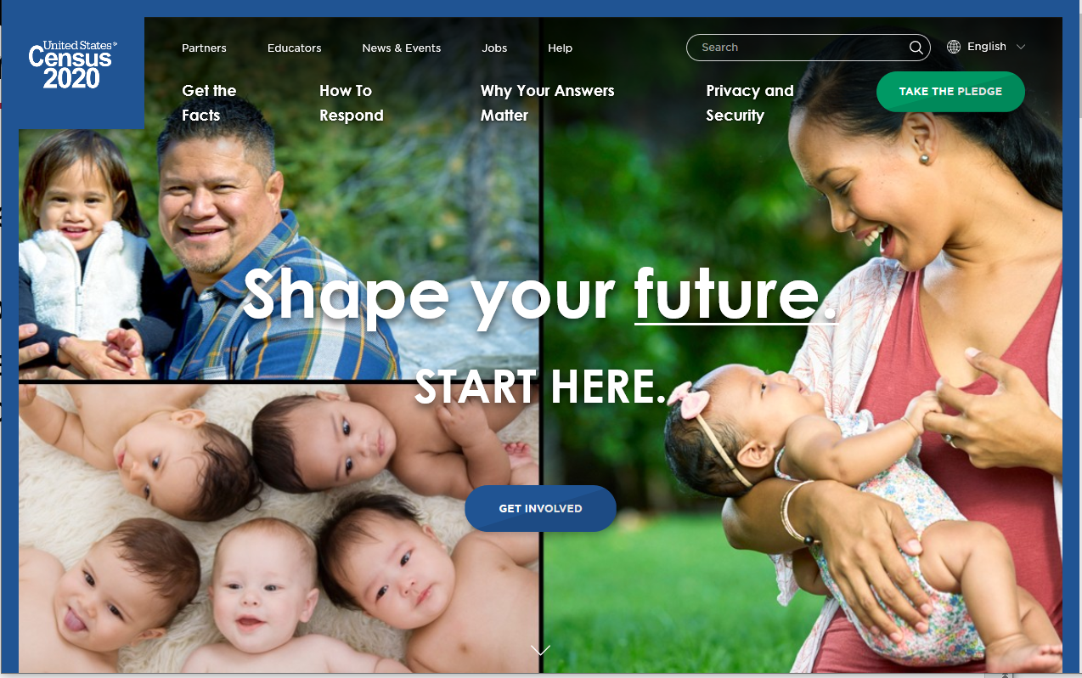
Using Spark and Differential Privacy to Protect the Privacy of the 2020 Census Respondents
Simson L. Garfinkel
U.S. Census Bureau
June 25, 2020
Spark + AI Virtual Summit
The views in this presentation are those of the author, and not those of the U.S. Census Bureau.

Slide 4
Abstract
The goal of the 2020 Census is to count every person in the US, once, and in the correct place. The data created by the census will be used to apportion the US House of Representatives, to draw legislative districts, and distribute more than $675 billion in federal funds. One of the data challenges of the 2020 Census is to making high-quality data available for these purposes while protecting respondent confidentiality.
We are doing this with differential privacy, a mathematical approach that allows us to balance the requirements for data accuracy and privacy protection.
In this talk, we will present the design of our differential privacy application and the process that we are working with Census Bureau.

Slide 5
Acknowledgments
This presentation incorporates work by:
  John Abowd (Chief Scientist)
  Dan Kifer (Scientific Lead)
  Simson Garfinkel (Senior Computer Scientist for Confidentiality and Data Access)
  Rob Sienkiewicz (Chief, Center for Enterprise Dissemination)
  Tamara Adams, Robert Ashmead, Stephen Clark, Craig Corl, Aref Dajani, Jason Devine, Nathan Goldschlag, Michael Hay, Cynthia Hollingsworth, Michael Ikeda, Philip Leclerc, Ashwin Machanavajjhala, Christian Martindale, Gerome Miklau, Brett Moran, Edward Porter, Sarah Powazek, Anne Ross, Ian Schmutte, William Sexton, Lars Vilhuber, and Pavel Zhuralev.

Slide 6
Outline
Motivation
Differential Privacy and the 2020 Census
Protecting the 2020 Census with the TopDown Algorithm
Monitoring Spark

Slide 7

Motivation
Article 1, Section 2
“The actual Enumeration shall be made within three Years after the first Meeting of the Congress of the United States, and within every subsequent Term of ten Years, in such Manner as they shall by Law direct.”

Slide 8
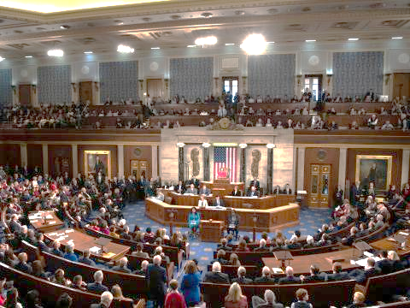
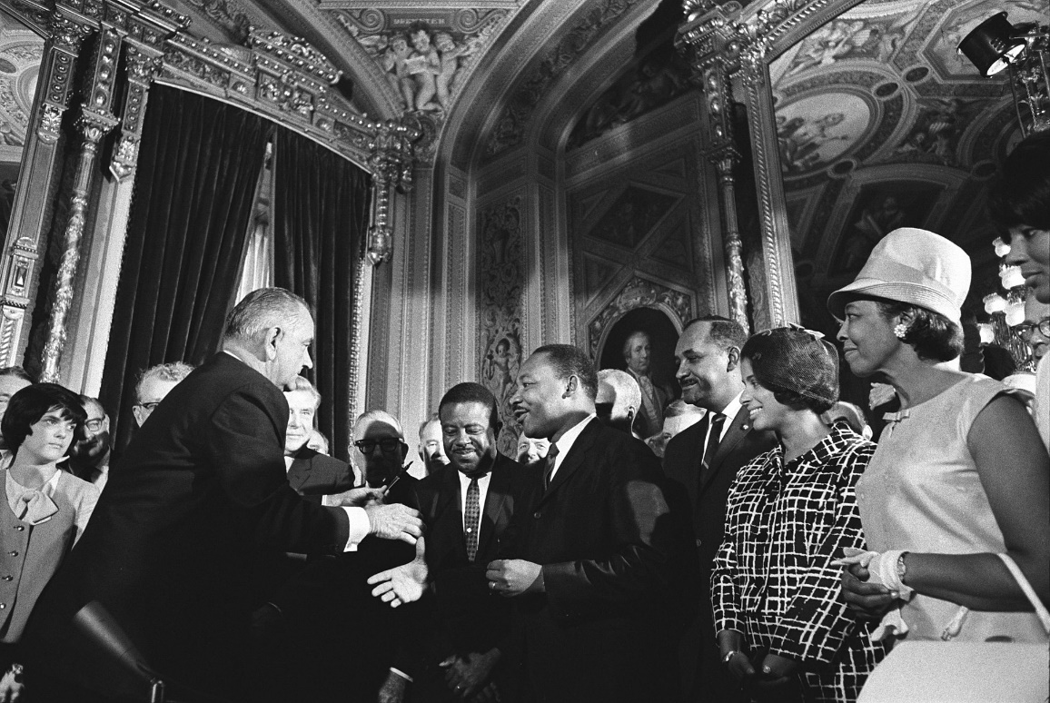
Uses of the Decennial Census Data
Apportioning the House of Representatives (U.S. Constitution)
  50 numbers of total state population as of April 1
Enforcing Voting Rights Act of 1965 Section 2
  Prohibits every state and local government from imposing any voting law that results in discrimination against racial or language minorities.
Distributing Federal Funds
  $675 billion in FY2015

Slide 9
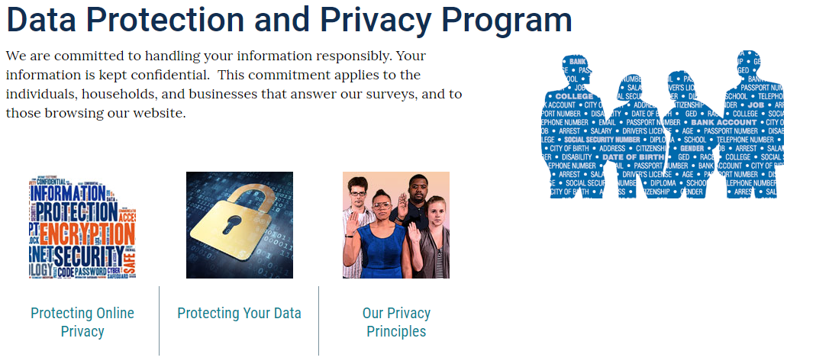
Privacy and the Decennial Census
Title 13 Section 9 of the US Code Prohibits the US Census Bureau from making any publication that reveals data provided by a person or an establishment.
Respondent data cannot be used for non-statistical purposes.
Census Bureau employees are sworn for life to protect respondent data.
https://www.census.gov/about/policies/privacy.html

Slide 10
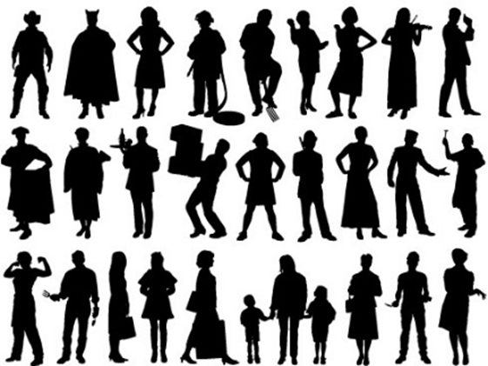
Data that we collected in 2010:
Variable | Range | Bits
Block | 6,207,027 inhabited blocks | 23
Sex | 2 (Female/Male) | 1
Age | 103 (0-99 single age year categories, 100-104, 105-109, 110+) | 7
Race | 63 allowable race combinations | 7
Ethnicity | 2 (Hispanic/Not) | 1
Relationship | 17 values | 5
Total |  | 44
2010 values:
308,745,538 people x 6 variables = 1,852,473,228 measurements
308,745,538 people x 44 bits = 13,584,803,672 bits ≈ 1.7 GB

Slide 11
2010 Census: Summary of Publications
(approximate counts)
Publication | Released counts
PL94-171 Redistricting | 2,771,998,263
Balance of Summary File 1 | 2,806,899,669
Total Statistics in PL94-171 and Balance of SF1: | 5,578,897,932
Published Statistics/person | 18
Recall: Collected variables/person: | 6
Published Statistics/collected variable | 18 ÷ 6 ≈ 3
You can create a system 5.5 billion simultaneous equations and solve for 1.8 billion unknown integers!
Notes:
The 2010 Census publication schedule resulted in roughly 2.8 billion counts (including zeros) published in PL94-171, another 2.8 billion in the rest of SF1, 2 billion in SF2, and another 30 million in a public-use microdata sample. This is roughly 7.7 billion statistics, or 25 per person. That’s a lot more than 6 per person.

Slide 12
We performed a database reconstruct and re-identification attack for all 308,745,538 people in the 2010 Census
Reconstructed all 308,745,538 microdata records
Used four commercial databases of the 2010 US population
acquired 2009-2011 in support of the 2010 Census.
Link rate: 45%
Validated Re-identification Rate: 38% (17% of the US population)
Address
Age
Sex
Ethnicity
Race
Name
Commercial Data
Reconstructed Data
Notes:
A reconstruction attack recreates record-level images of all variables used in published tabulations, not all variables in the confidential database. If “name” is never tabulated, then “name” cannot be reconstructed.
A reconstruction-abetted re-identification attack links external data to the reconstructed micro-data. These external data contain identifying information like names and addresses. Such an attack leads to “putative re-identifications”: records that the attacker believes are the data for identifiable information. In a successful re-identification attack, putative re-identifications are confirmed at a high rate. The putative re-identifications from the 2010 Census experiments are not confirmed at a high rate. We are still researching this issue.
An issue is a risk that has occurred (probability = 1), and an active mitigation plan is required.

Slide 13
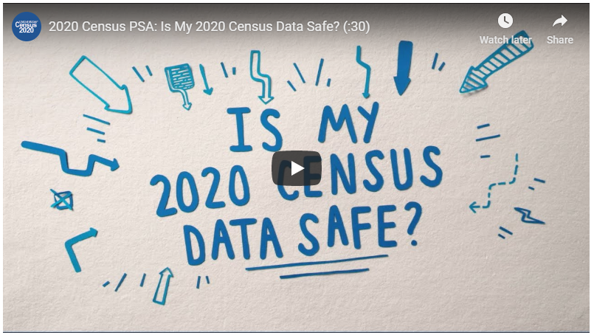
Differential Privacy and the 2020 Census

Slide 14
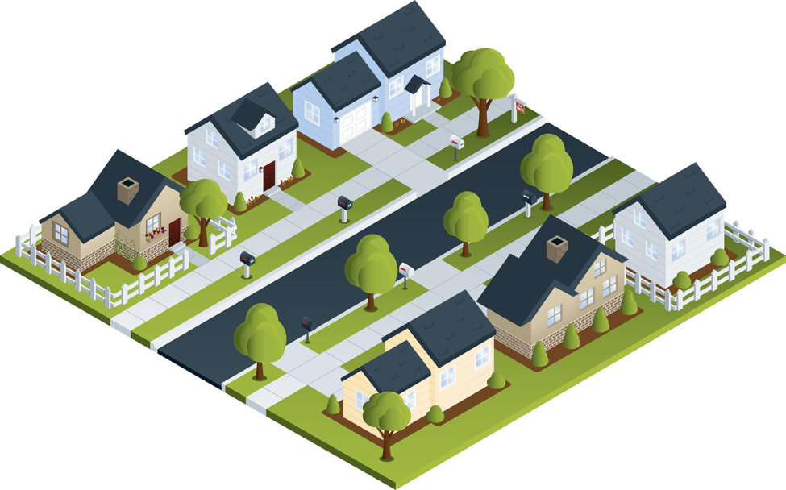
Statistical agencies aggregate data from many households together into a single publication.
 | Count | Median | Mean
Total | 7 | 30 | 38
# female | 4 | 30 | 33.5
# male | 3 | 30 | 44
# black | 4 | 51 | 48.5
# white | 3 | 24 | 24
# married | 4 | 51 | 54
# black F | 3 | 36 | 36.7

Slide 15
We now know how to take many aggregate publications and “solve” for the original microdata.
 | Count | Median | Mean
Total | 7 | 30 | 38
# female | 4 | 30 | 33.5
# male | 3 | 30 | 44
# black | 4 | 51 | 48.5
# white | 3 | 24 | 24
# married | 4 | 51 | 54
# black F | 3 | 36 | 36.7
66 FBM & 84 MBM
30 MWM & 36 FBM
This table can be expressed by 164 equations.
Solving those equations takes 0.2 seconds
on a 2013 MacBook Pro.
8 FBS
18 MWS
24 FWS
https://cacm.acm.org/magazines/2019/3/234925-understanding-database-reconstruction-attacks-on-public-data/

Slide 16
The basic idea of differential privacy:
Uncertainty (noise) protects privacy
Collected
Published
Fictional Respondents
Count Fictional Respondent Data (ages)
9 25 35 22 45 28 28 45 55 49
(Median: 35)
9 63 88 32 18 16 23 42 48 49
(Median: 42)
11 17 29 34 45 24 3 34 5 48 39 42
(Median: 34)
Count Median Age
8 45
11 40
6 18
Noise protects the confidentiality of the respondent data.

Slide 17
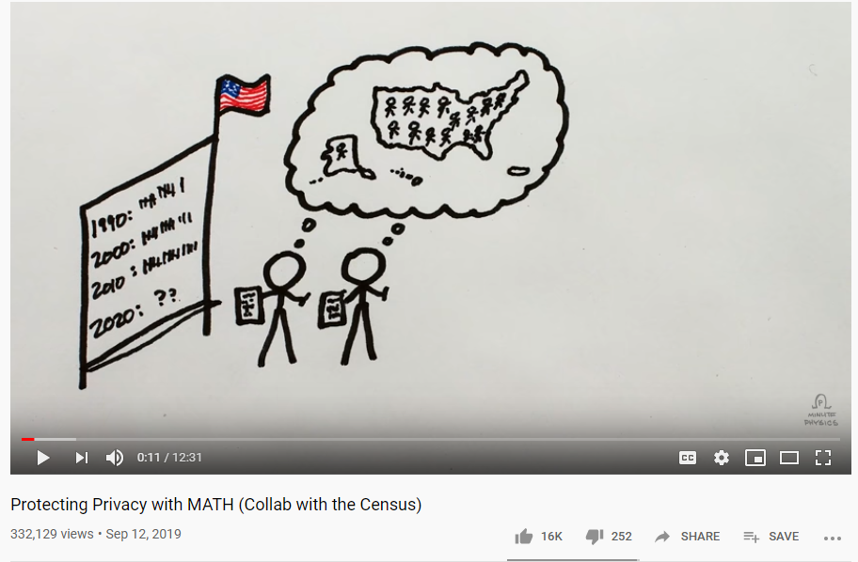
The Census Bureau is using differential privacy for the 2020 Census.
Watch the Minute Physics Video!
DP is a tool for controlling privacy-loss/accuracy trade-off
DP lets us put the accuracy where it is needed.
DP privacy is “future-proof”
Records in the tabulation data will have no exact counterpart in the confidential data
Explicitly protected tabulations have provable, public accuracy levels
  PL 94-171
  Demographic and Housing Characteristics (DHC)
Pre-Decisional

Slide 18
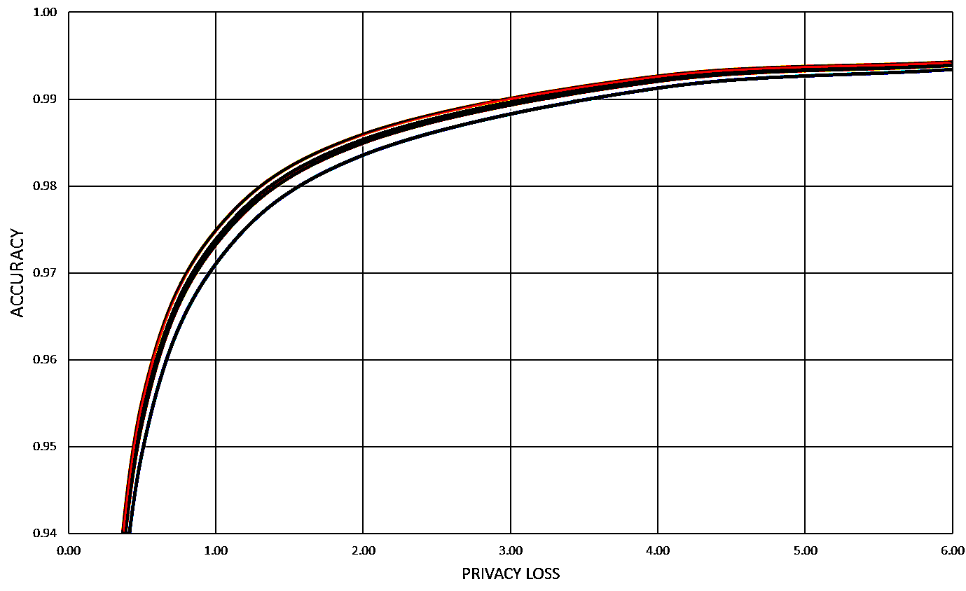
How much noise do we add?
That’s a policy decision.
Highly accurate.
High privacy loss
Less accurate.
Little privacy loss

Slide 19
Protecting the 2020 Census with the TopDown Algorithm
330M records
ε
National Histogram
State-level measurements
ε
51 state histograms
County-level measurements
ε
3,143 county histograms
Tract-level measurements
ε
73,057 census tract histograms
Block-level measurements
ε
~8 M block histograms

Slide 20
There was no off-the-shelf system for applying differential privacy to a national census
We had to create a new system that:
  Produced higher-quality statistics at more densely populated geographies
  Produced consistent tables
We created a new differential privacy algorithm and system that:
  Produces statistics from the top-down
    e.g. National Level -> State Level -> County Level -> Tract Level -> Block Group Level -> Block Level
    Creates protected microdata that can be used for any tabulation without additional privacy loss
  Fits into the decennial census production system

Slide 21
We planned to create a “Disclosure Avoidance System” that dropped into the Census production system.
Features of the DAS:
  Operates on the edited Census records
  Create microdata that would be “safe to tabulate.”
  Capture all necessary statistics in the microdata.
Census Edited File
Disclosure Avoidance System
Microdata Detail File (2020)

Slide 22
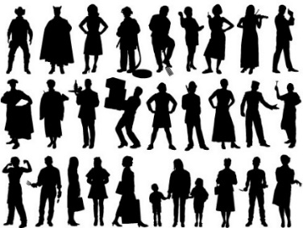
The Disclosure Avoidance System allows the Census Bureau to enforce global confidentiality protections*
Pre-specified tabular summaries:
PL94-171, DHC, Other Scheduled Tabulations
Decennial Response File
Census Unedited File
Census Edited File
Global Confidentiality Protection Process
Disclosure Avoidance System
Microdata Detail File
Special tabulations and post-census research
Privacy-Loss Budget,
Accuracy Decisions
*Note: See later in this presentation for the design that includes “Group II” data products

Slide 23
Our DP mechanism protects histograms of person types.
Census “block”
Census “block” histogram
Count | Age | Sex | Race | Ethnicity | REL
1 | 8 | F | B | - | Child
1 | 18 | M | W | H | Single
1 | 24 | F | W | H | Single
1 | 30 | M | W | - | HH
1 | 36 | F | B | - | Spouse
1 | 66 | F | B | - | HH
1 | 84 | M | B | - | Spouse

Slide 24



Our first system applied DP to every block.
This was the “block-by-block” system.
ε

Slide 25
There are roughly 8 million inhabitable blocks
8 million blocks
Disclosure Avoidance System
8 million protected blocks
Computes statistics on confidential data
Adds noise to statistics
Constructs new microdata consistent with noisy statistics

Slide 26
Each block histogram has:
2 sexes * 31 races * 2 ethnicities * 103 age bins * 17 relationships = 217,124 cells
8 million blocks
Disclosure Avoidance System
8 million protected blocks
1,347,694,530,348
Integers counts
mostly zero
5.3 PB with zeros
(1.7 GB sparse!)
Computes statistics on confidential data
Adds noise to statistics
Constructs new microdata consistent with noisy statistics
Still
1.7 GB sparse
(microdata)
Notes:
This slide looks at the amount of data.

Slide 27
Running the block-by-block algorithm with spark
Illustrated for the current specification of the Demographic and Housing Characteristics Person tables with proposed, approximate 2020 tabulation geography
8 million blocks
Disclosure Avoidance System
8 million protected blocks
16 GB CSV file
RDD of
8 M
scikit sparse
histograms
map()
to apply
noise
map() to create
Mixed Integer
Linear Program
and solve with
Gurobi
map() to
create output
microdata
save
As
Text
File()
16 GB CSV file
Confidential Data
DP
“Post Processing”

Slide 28
In 2018 we invented the
TopDown Algorithm (TDA)
330M records
ε
National Histogram
State-level measurements
ε
51 state histograms
NOISE BARRIER
County-level measurements
ε
3,142 county histograms
Tract-level measurements
ε
75,000 census tract histograms
*v1 geographies
Block-level measurements
ε
8 million block histograms

Slide 29
TDA part 1: protecting the data
records
Histogram
ε
Noisy Histogram
NOISE BARRIER

Slide 30
TDA part 2: post-processing
Total Histogram storage (bytes) | Minimum RDD Size (2 histograms)
869 KB
44 MB
2.7 GB
63 GB
5 TB
330M records
ε
National Histogram
State-level measurements
ε
51 state histograms
NOISE BARRIER
Optimization happens here.
County-level measurements
ε
3,143 county histograms
Tract-level measurements
ε
73,057 census tract histograms
Block-level measurements
ε
~8M block histograms

Slide 31
In 2018 we invented the
TopDown Algorithm (TDA)
Computes and protects a histogram for various geographical units at various geographical levels
Level | Count | Integers per histogram | Total Histogram storage (bytes)
National | 1 | 217,124 | 869 KB
State | 51 | 217,124 | 44 MB
Counties & Equivalents | 3143 | 217,124 | 2.7 GB
Census Tracts | 73,057 | 217,124 | 63 GB
Inhabitable Blocks | 6.2* M | 217,124 | 5 TB
We actually need two histograms per node! (input & output)
Source: https://www.census.gov/geographies/reference-files/time-series/geo/tallies.html
2010 inhabited block count: 6.2 M; 2020 block count: 8 M (estimated)
Notes:
Other geographies such as tract groups and block groups are delted.

Slide 32
Monitoring Spark

Slide 33
Key challenges in monitoring spark
TopDown Algorithm is not balanced
Most of our computation is done with Gurobi
  We perform ~ 800,000 separate optimizations in a typical run
  Gurobi is installed as a multi-threaded shared library
  Looks like a big user-defined function
We run in AWS GovCloud
  AWS monitoring tools (e.g. CloudWatch) are too coarse
  CloudWatch throws out old data (we need it for retrospective analysis)
Developing and tuning the algorithm has required thousands of test-runs

Slide 34
We created our own monitoring framework
Agent on each node
REST server
Agent on each node
Agent on each node
web-based display
Agent on each node
Agent on each node
Agent on each node
Agent on each node
MySQL DB

Slide 35
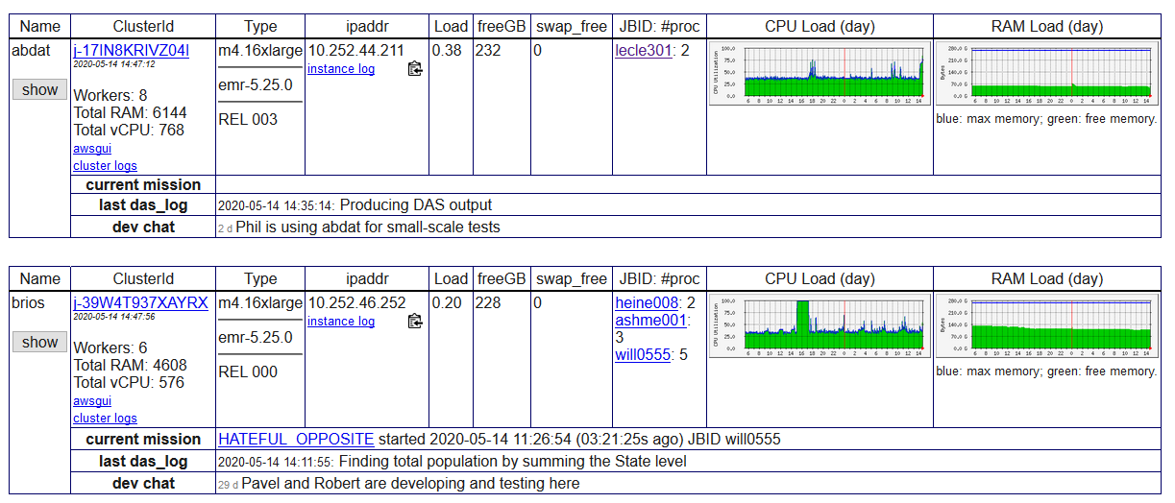
Cluster List

Slide 36
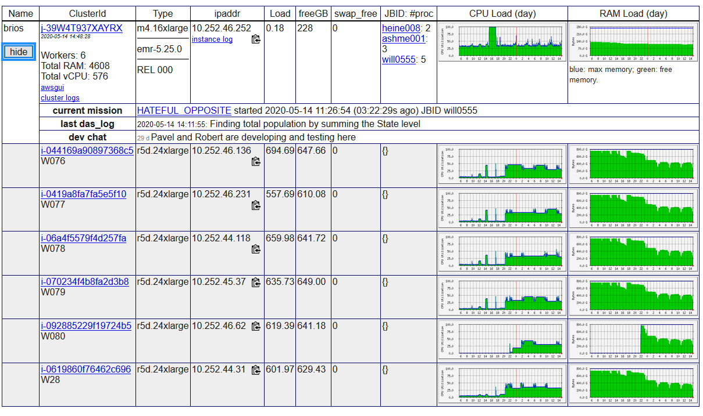
Each cluster can be expanded

Slide 37
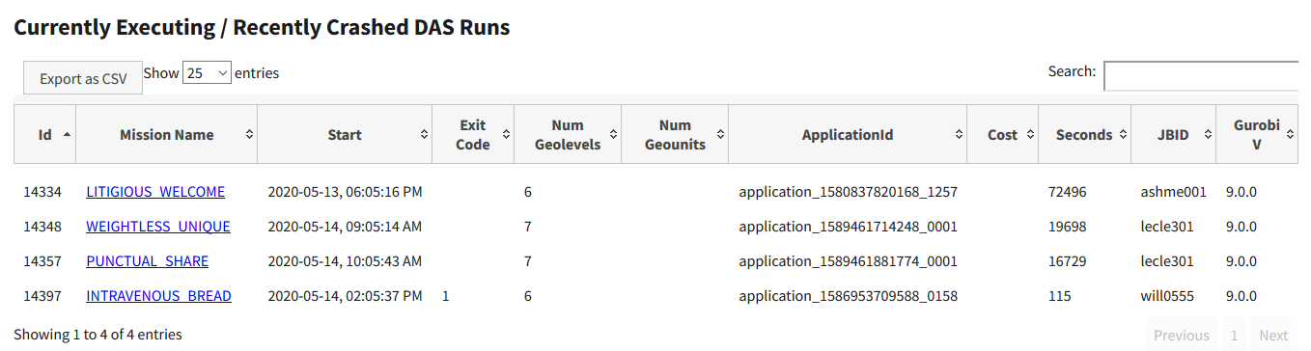
Each DAS run is a “mission”

Slide 38
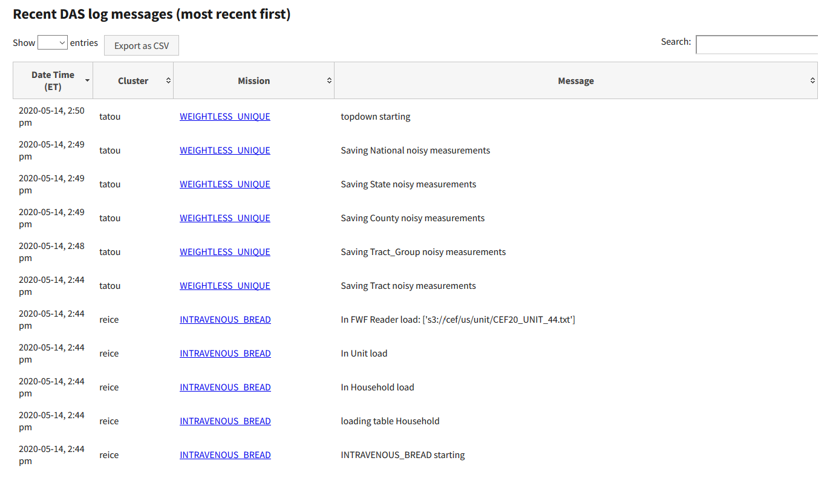
Log display shows activity in all active missions

Slide 39
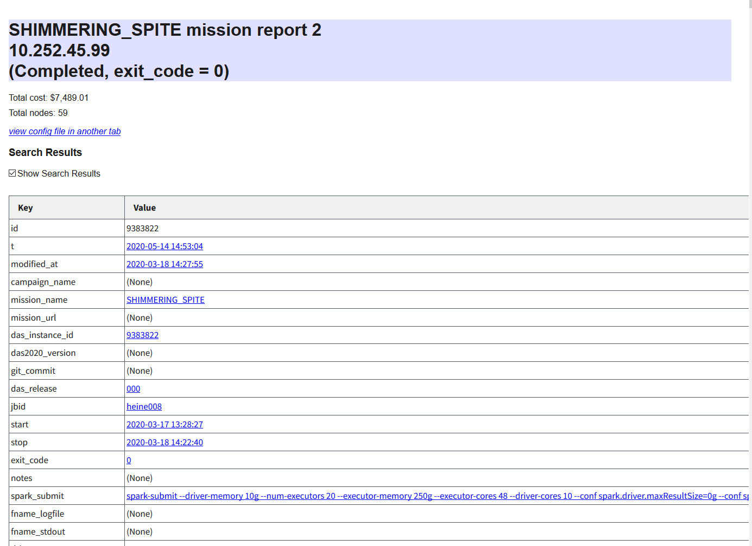
Mission Report

Slide 40
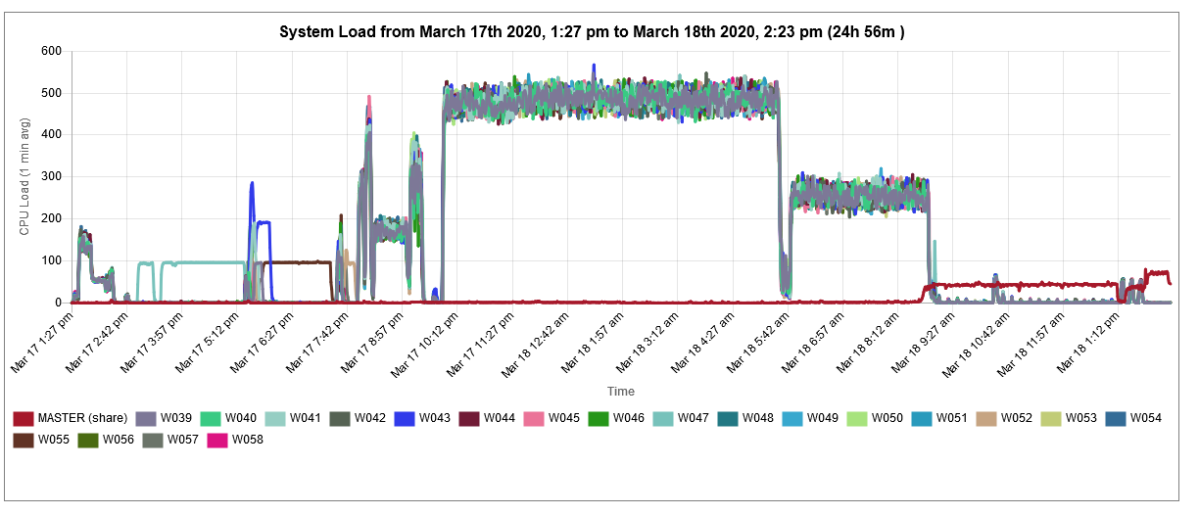
System Load

Slide 41
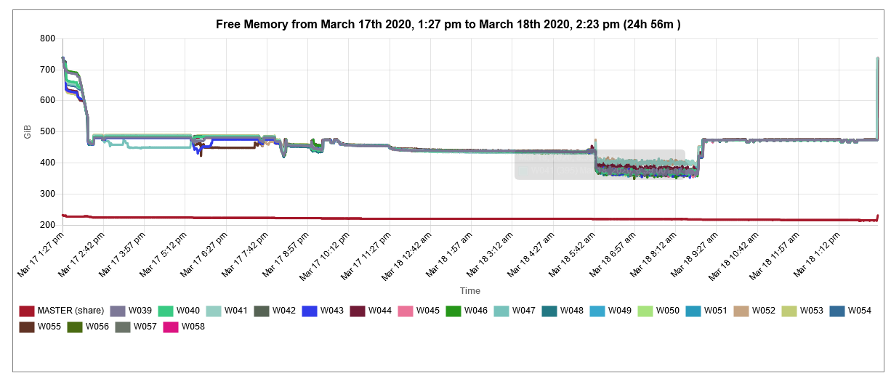
Free Memory

Slide 42
In Summary
The 2020 Census will use “differential privacy” as its privacy protection mechanism.
Differential privacy adds carefully controlled noise to the statistical “queries.”
Most of the work is “post-processing” to make microdata for legacy uses.
We use Spark to distribute the load to a commercial optimizer (Gurobi) to solve 800,000 MILPs

Slide 43

For more information…
Can a set of equations keep U.S. census data private?
By Jeffrey Mervis
Science
Jan. 4, 2019 , 2:50 PM
Census Overhaul Seeks to Avoid Outing Individual Respondent Data
Most Census 2020 results will be adjusted; measures would prevent targeting based on citizenship
By Paul Overberg
Nov. 10, 2019 7:00 am ET
http://bit.ly/Science2019C1
Communications of ACM March 2019
Garfinkel & Abowd

Slide 44
The Most Technical 2020 Publications
Most recent public source code:
  https://github.com/uscensusbureau/census2020-das-2010ddp
System Design Specification
  https://github.com/uscensusbureau/census2020-das-2010ddp/blob/master/doc/2010-Demonstration-Data-Products-Disclosure-Avoidance-System-Design-Specification%20FINAL.pdf
Scientific paper describing mechanism:
  https://github.com/uscensusbureau/census2020-das-2010ddp/blob/master/doc/20191020_1843_Consistency_for_Large_Scale_Differentially_Private_Histograms.pdf

Slide 45
More Background on the 2020 Census Disclosure Avoidance System
September 14, 2017 CSAC (overall design) https://www2.census.gov/cac/sac/meetings/2017-09/garfinkel-modernizing-disclosure-avoidance.pdf?#
August, 2018 KDD’18 (top-down v. block-by-block) https://digitalcommons.ilr.cornell.edu/ldi/49/
October, 2018 WPES (implementation issues) https://arxiv.org/abs/1809.02201
October, 2018 ACMQueue (understanding database reconstruction)
https://digitalcommons.ilr.cornell.edu/ldi/50/ or https://queue.acm.org/detail.cfm?id=3295691
December 6, 2018 CSAC (detailed discussion of algorithms and choices) https://www2.census.gov/cac/sac/meetings/2018-12/abowd-disclosure-avoidance.pdf?#
April 15, 2019 Code base and documentation for the 2018 End-to-End Census Test (E2E) version of the 2020 Disclosure Avoidance System https://github.com/uscensusbureau/census2020-das-e2e
June 6, 2019 Blog explaining how to use the code base with the 1940 Census public data from IPUMS https://www.census.gov/newsroom/blogs/research-matters/2019/06/disclosure_avoidance.html
June 11, 2019 Keynote address “The U.S. Census Bureau Tries to Be a Good Data Steward for the 21st Century” ICML 2019 abstract, video
June 29-31, 2019 Joint Statistical Meetings Census Bureau electronic press kit
(See talks by Abowd, Ashmead, Garfinkel, Leclerc, Sexton, and others)

