Slide 1
De-Identification and Differential Privacy
Special Topics on Privacy and Public Auditability
National Institute of Standards and Technology
January 27, 2020
Simson L. Garfinkel
Senior Computer Scientist for Confidentiality and Data Access
Associate Directorate for Research and Methodology
U.S. Census Bureau
Disclaimer: The views expressed in this talk are those of the author, and not necessarily those of the U.S. Census Bureau.

Slide 2
Outline for today’s talk
  Privacy risks of Open Data
  Addressing privacy risks with de-identification
  De-identification techniques
  De-identification failings
  Database reconstruction
  Differential Privacy

Slide 3
Lesson 1: People want our data

Slide 4
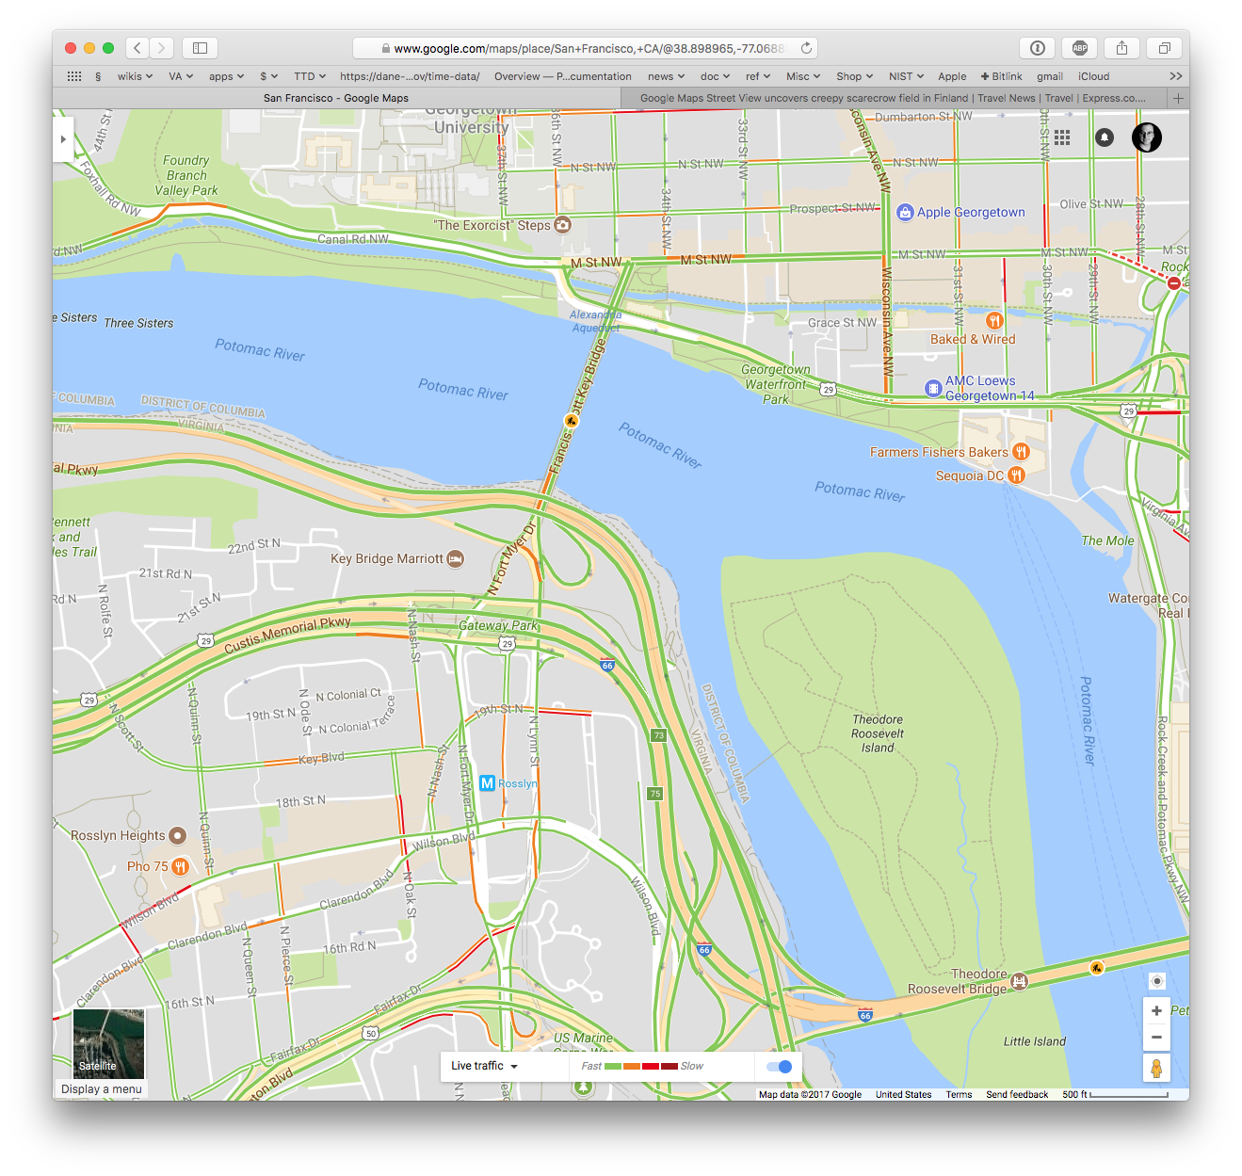
Open Data and data products using information from individuals holds great promise…

Slide 5
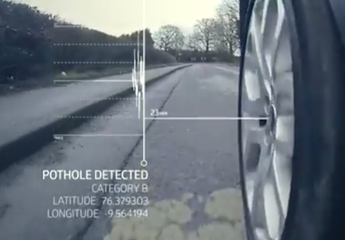
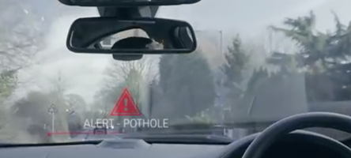
Land Rover plans to use real-time data to help you avoid the next big thing!
“Using cellular communication, we can take anonymized data, so that the location and the severity of the pothole.
“And we can share that in the cloud
“As other users come along, we can provide that back to them to warn other drivers. “
-Dr. Mike Bell, Global Connected Car Director, Jaguar Land Rover
http://www.cheatsheet.com/automobiles/pothole-detection-is-this-the-next-big-car-technology.html/

Slide 6
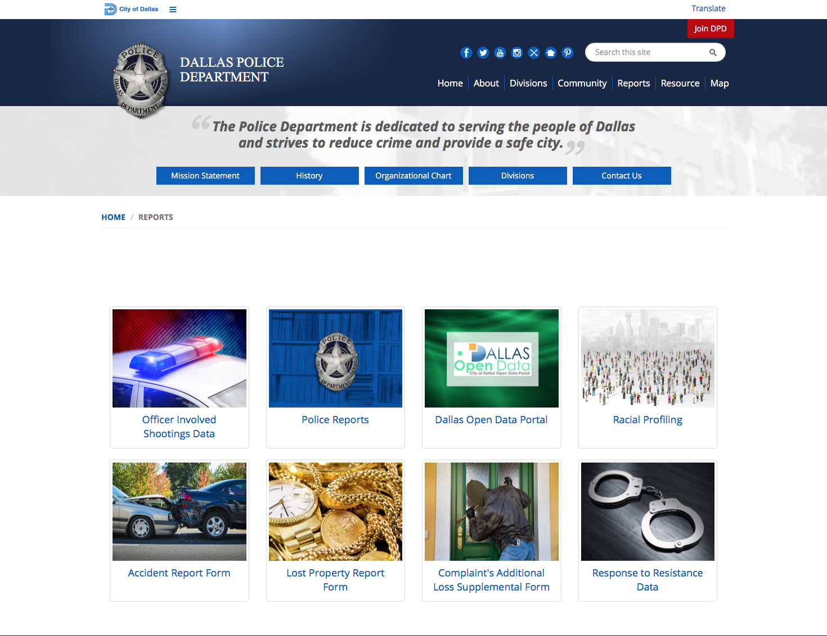
Open Data concerns are shared by
Federal, State, Local Governments & Organizations.

Slide 7
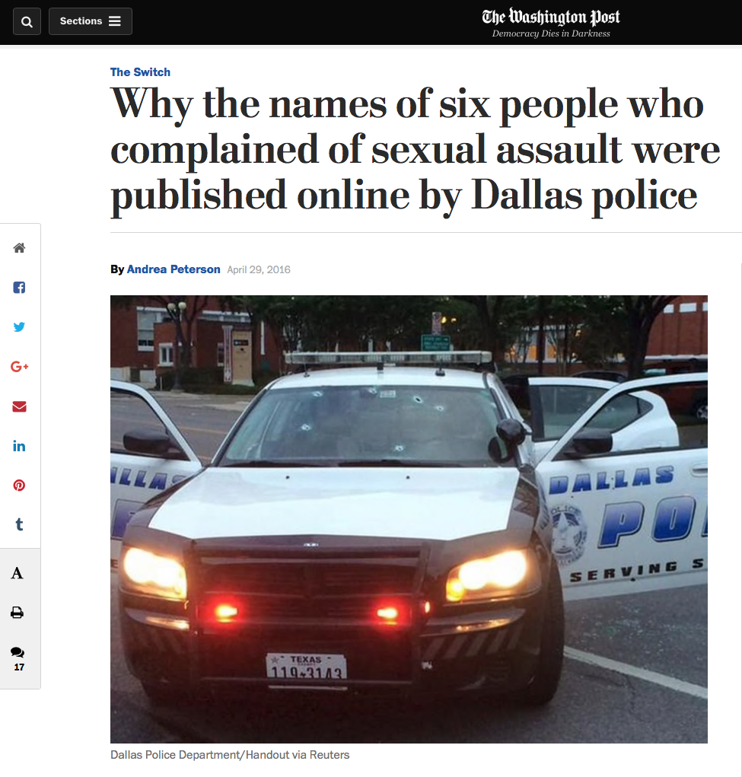

Slide 8
Dallas Open Records: What went wrong?
“The Dallas Police Department made public the names, ages, and home addresses of some alleged sexual assault victims on an official website, an incident that highlights how the push to put more police records online may also be inadvertently leaving victims exposed.
…
“The Dallas Police Department’s online incident database does not appear to have included reports categorized as sexual assaults. In at least six other cases, though, the victim complained of a sexual assault or an attempted sexual assault and the incidents were labelled as “Class C Assault offenses” or simply “Injured Person.” In these cases, the name and age of that victim is listed online. A few times, the home address was included as well.
“In one instance, a note says a “suspect sexually and physically assaulted” the alleged victim. Another says an “unknown suspect had unwanted sexual contact with the complainant.” In some cases, the records seem to indicate that the alleged victims received follow-up sexual assault care from the department’s Victim Services unit.

Slide 9
Open Data Lessons
  People want our data — but the data can cause harms.

Slide 10
Outline for today’s talk
  Privacy risks of Open Data ☺
  Addressing privacy risks with de-identification
  De-identification techniques
  De-identification failings
  Database reconstruction
  Differential Privacy

Slide 11
Lesson 2:
We can de-identify data by removing names.

Slide 12
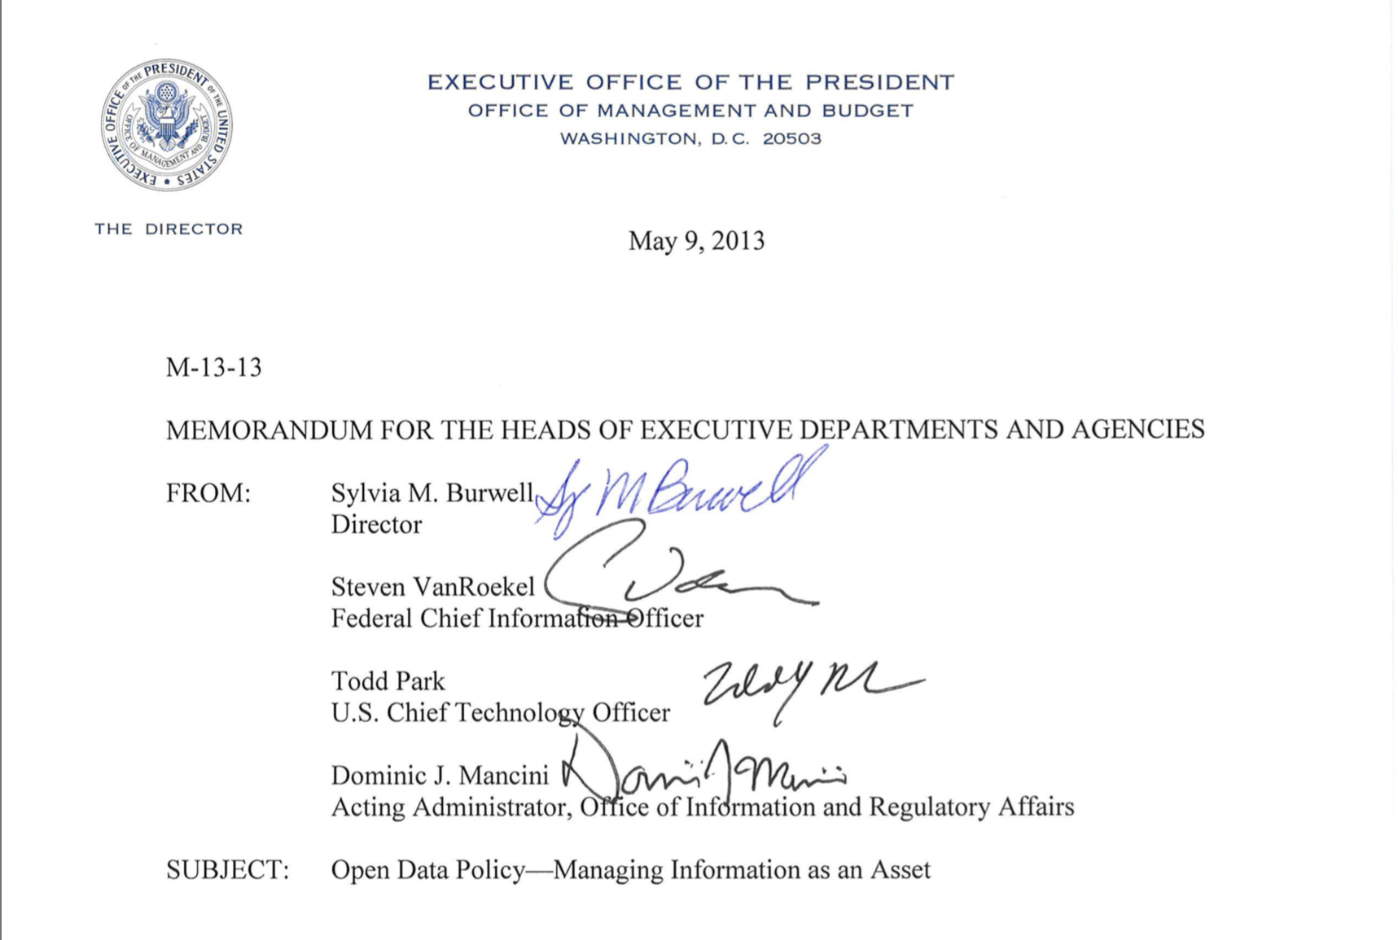
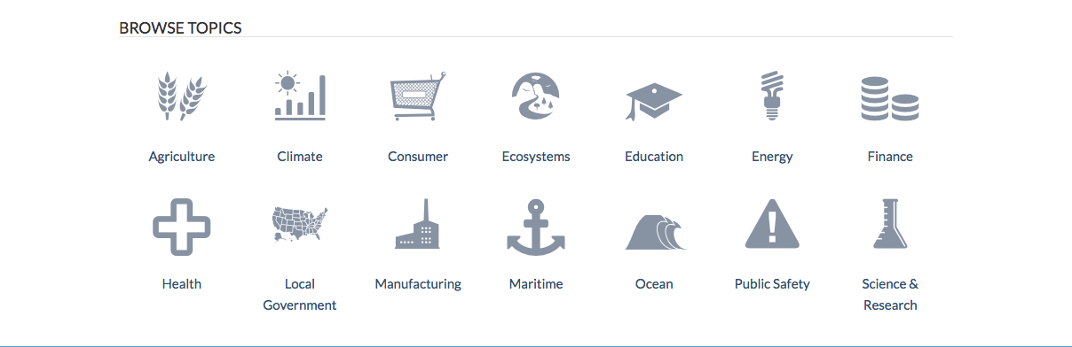
Open Data is US Policy.
M-13-13 Open Data Policy

Slide 13
M-13-13: Open Data must be consistent with privacy
“Consistent with OMB's Open Government Directive, agencies must adopt a presumption in favor of openness to the extent permitted by law and subject to privacy, confidentiality, security, or other valid restrictions.”
In practice, do not release:
Data that would be exempt from FOIA.
Data that could harm an individual
Especially an issue for proactive data releases.

Slide 14
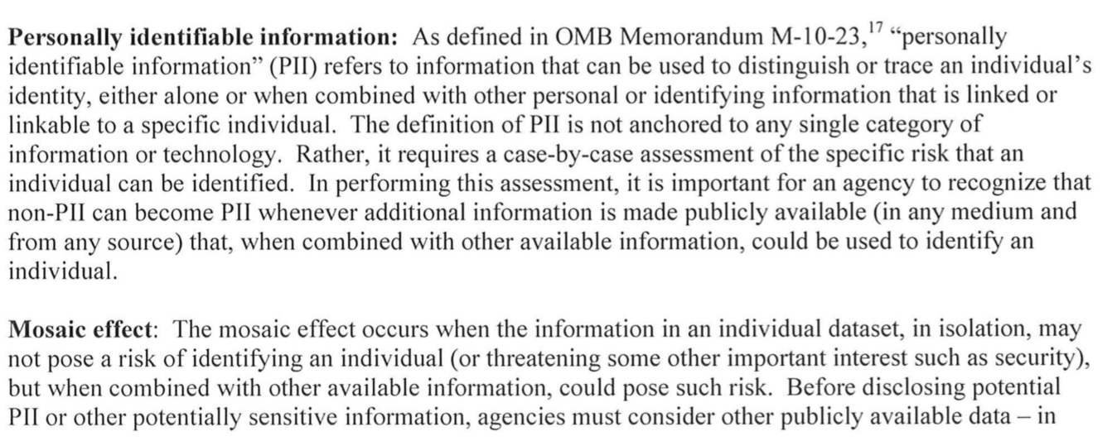
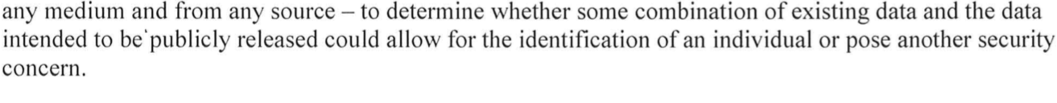
M-13-13 warns that data may be identifiable

Slide 15
Corporations have taken a similar approach.
It sometimes doesn’t work.
In 2006 America Online (AOL) published “search logs” to help the research community.
500k User Session Collection
----------------------------------------------
This collection is distributed for NON-COMMERCIAL RESEARCH USE ONLY.
Any application of this collection for commercial purposes is STRICTLY PROHIBITED.
Brief description:
This collection consists of ~20M web queries collected from ~650k users over three months. The data is sorted by anonymous user ID and sequentially arranged.
The goal of this collection is to provide real query log data that is based on real users.
It could be used for personalization, query reformulation or other types of search research.
The data set includes {AnonID, Query, QueryTime, ItemRank, ClickURL}.
AnonID - an anonymous user ID number.
Query - the query issued by the user, case shifted with
most punctuation removed.
QueryTime - the time at which the query was submitted for search.
ItemRank - if the user clicked on a search result, the rank of the
item on which they clicked is listed.
ClickURL - if the user clicked on a search result, the domain portion of
the URL in the clicked result is listed.
Each line in the data represents one of two types of events:
1. A query that was NOT followed by the user clicking on a result item.
2. A click through on an item in the result list returned from a query/

Slide 16
AOL’s logs were de-identified…
Anon ID | Query
2178 | Foods to avoid when breast feeding
4417749 | clothes for age 60
4417749 | dog who urinates on everything
3505202 | Depression and medical leave
4417749 | Hand tremors
47122 | Child porno
4417749 | landscapers in lilburn ga
4417749 | pine straw in lilburn ga

Slide 17
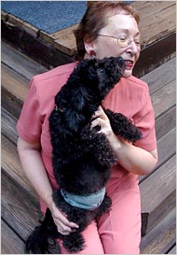
A face exposed for AOL searcher no. 4417749.
New York Times. Aug 9, 2006. (Barbaro & Zeller)
Thelma Arnold
& Dudley

Slide 18
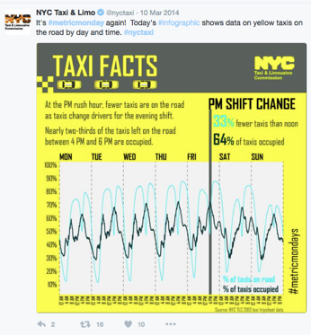
Government agencies have also inadvertently revealed personal information.
In March 2014, the New York City Taxi & License Commission tweeted a “TAXI FACTS” infographic:
Chris Whong files a “Freedom of Information Law” request for all the data used to create the graphic.

Slide 19
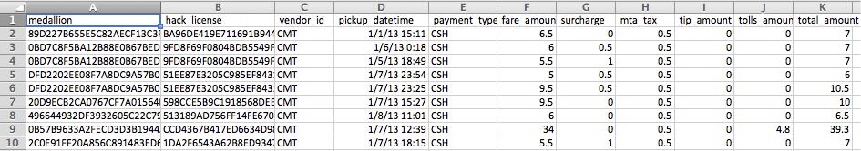
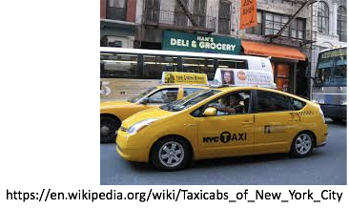
NYC TLC provided Chris Whong with all of the data
175 million trips:
Every trip:
  Pickup date, time & GPS
  Drop-off date, time & GPS
  Fare & tip
  Encoded medallion number
  Chris Whong published it on the Internet…

Slide 20
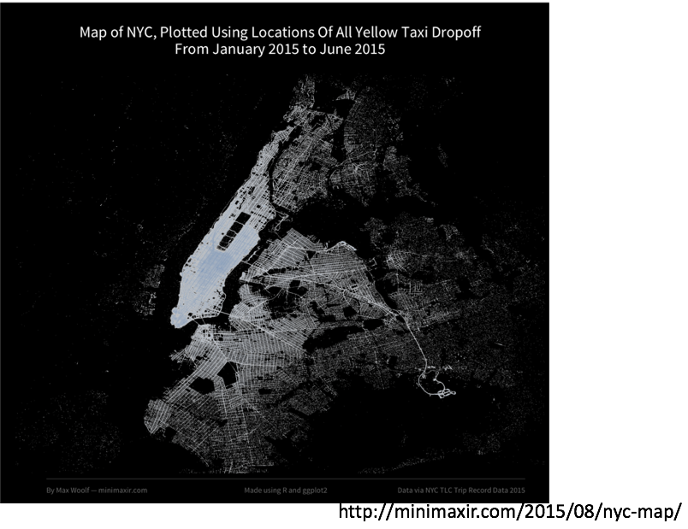
With this data, you can make a map of NYC Taxi Service

Slide 21
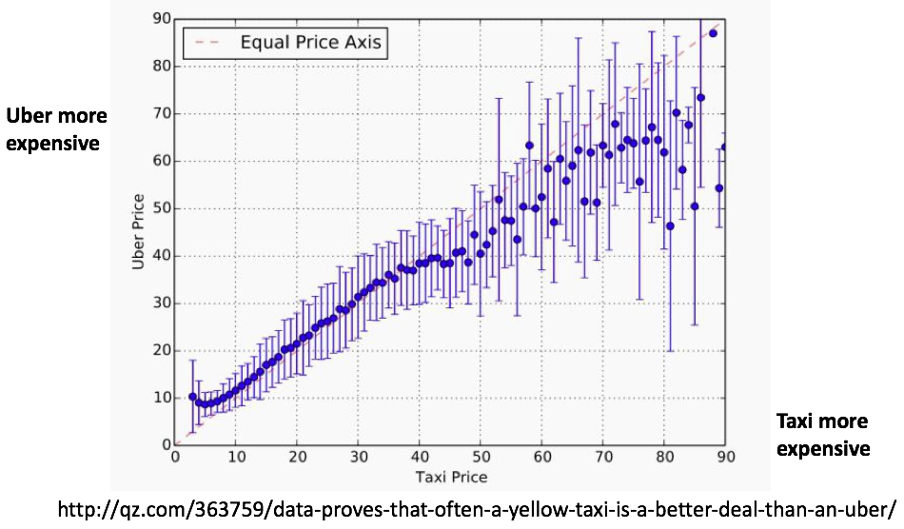
Compare taxi prices and Uber prices:

Slide 22
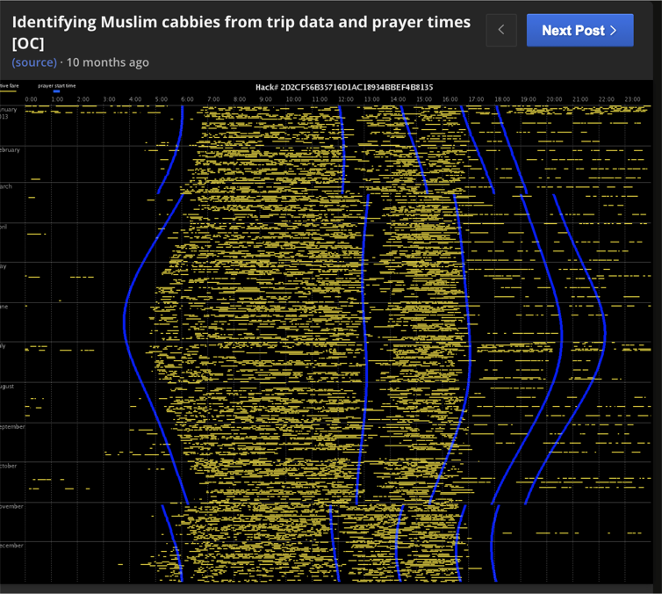
Each taxi has a pseudonym, which allows taxi rides to be linked.

Slide 23
The taxi medallion numbers were not properly de-identified.
Pseudonym | Taxi Medallion
0f76c35d4a069e0fe76b21d28f009639 | 5C27
be9f314926dd314b36496d926e42f4db | 5C28
9ee993809f648d39d24f5ba8f862d7f1 | 5C29
23f7e8636fb9099822aa381054d215d4 | 5C30
The pseudonyms looked suspicious to Anthony Tockar, an intern at Neustar Research.
Tockar realized that the pseudonyms were MD5 hashes
MD5(“5C27”) = be9f314926dd314b36496d926e42f4db

Slide 24

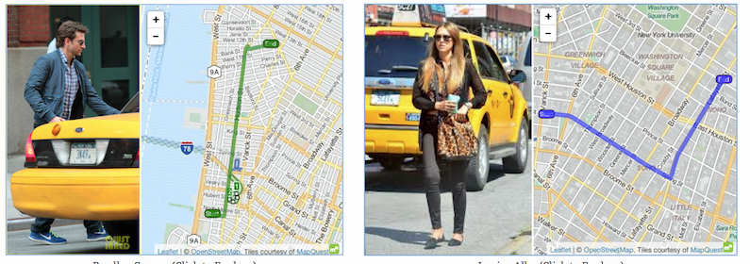
Tockar performed a “brute force” attack on the hashes.
Anthony Tockar identified the medallion number the records.
He searched for photos in flickr that showed movie stars at taxis where he could read the medallion number.
“5C27”
A journalist at Gawker identified 9 other cab rides.

Slide 25
Open Data Lessons
  People want our data
  — but the data can cause harms.
  We can de-identify data by removing names
  — but people can still be identified.

Slide 26
Outline for today’s talk
  Privacy risks of Open Data ☺
  Addressing privacy risks with de-identification ☺
  De-identification techniques
  De-identification failings
  Database reconstruction
  Differential Privacy

Slide 27
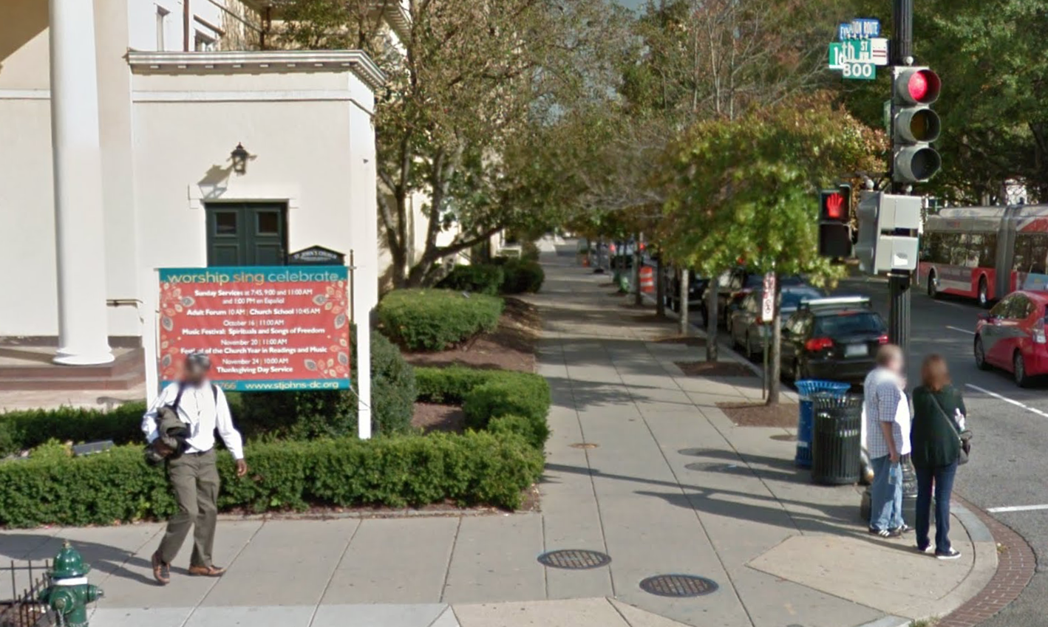
Lesson 3:
Beyond names, all direct identifiers must be removed.
Google Street View

Slide 28

Agencies want to release data to researchers
Identifying Data
Names & Address
Sensitive Data
Medical Records

Slide 29
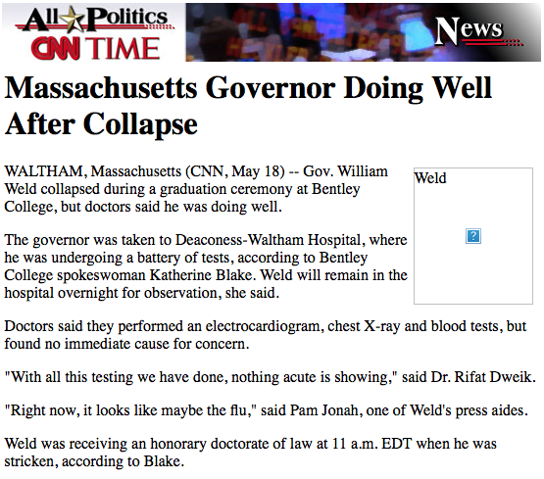

May 18, 1996: Massachusetts Governor William Weld Collapses at Bentley College Commencement

Slide 30
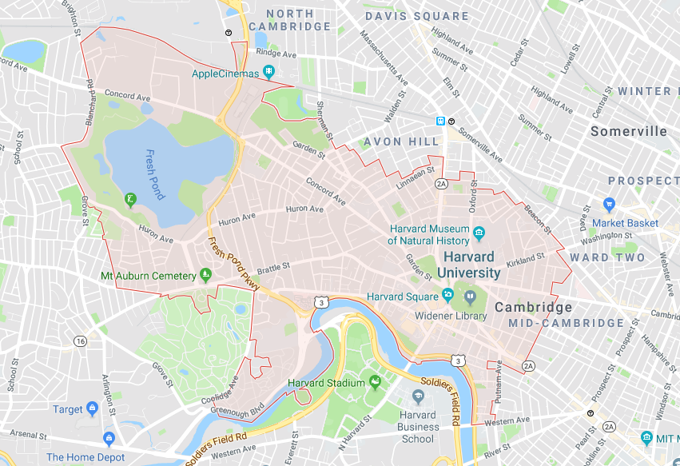
In 1997, MIT Graduate Student Latanya Sweeney decided to search for William Weld’s medical records in the GIC data.
Sweeney obtains GIC dataset and looks for Weld's data.
  She knew that Weld lived in Cambridge, MA.
  Sweeney purchased Cambridge voter rolls for $20.
  Six people had the same birthday (July 31, 1945)
  Three were men
  One person had the same ZIP code.
02138

Slide 31
“Linkage Attack”
Matching records using quasi-identifiers
  Weld’s records were uniquely identified.
  Sweeney estimated 87%of US population
  were uniquely identified by birthday, sex & ZIP
“Quasi-Identifiers”
or
“Indirect-Identifiers”
Hospital
admission
info
Birthday
Sex
ZIP Code
Name
Address
Phone
SSN
“Direct”
or
“Explicit”
identifiers
“Sensitive Data”

Slide 32
Sweeney invented K-Anonymity
A model for de-identifying structured data.
A dataset that you would like to release:
Name | Race | Birthdate | Sex | Zip | Medication | Diagnosis
Alice | Black | 9/20/65 | M | 37203 | M1 | Gastric Ulcer
Bob | Black | 2/14/65 | M | 37203 | M1 | Gastric Ulcer
Candice | Black | 10/23/65 | F | 37215 | M1 | Gastritis
Dan | Black | 8/24/65 | F | 37215 | M2 | Gastritis
Eliza | Black | 11/7/64 | F | 37215 | M2 | Gastritis
Felix | Black | 12/1/64 | F | 37215 | M2 | Stomach Cancer
Gazelle | White | 10/23/64 | M | 37215 | M3 | Flu
Harry | White | 3/15/64 | F | 37217 | M3 | Flu
Irene | White | 8/13/64 | M | 37217 | M3 | Flu
Jack | White | 5/5/64 | M | 37217 | M4 | Pneumonia
Kelly | White | 2/13/67 | M | 37215 | M4 | Pneumonia
Lenny | White | 3/21/67 | M | 37215 | M4 | Flu
First you remove the identifiers...

Slide 33
Sweeney invented K-Anonymity
A model for de-identifying structured data.
A dataset that you would like to release:
Identifiers
Quasi Identifiers
Name | Race | Birthdate | Sex | Zip | Medication | Diagnosis
Alice | Black | 9/20/65 | M | 37203 | M1 | Gastric Ulcer
Bob | Black | 2/14/65 | M | 37203 | M1 | Gastric Ulcer
Candice | Black | 10/23/65 | F | 37215 | M1 | Gastritis
Dan | Black | 8/24/65 | F | 37215 | M2 | Gastritis
Eliza | Black | 11/7/64 | F | 37215 | M2 | Gastritis
Felix | Black | 12/1/64 | F | 37215 | M2 | Stomach Cancer
Gazelle | White | 10/23/64 | M | 37215 | M3 | Flu
Harry | White | 3/15/64 | F | 37217 | M3 | Flu
Irene | White | 8/13/64 | M | 37217 | M3 | Flu
Jack | White | 5/5/64 | M | 37217 | M4 | Pneumonia
Kelly | White | 2/13/67 | M | 37215 | M4 | Pneumonia
Lenny | White | 3/21/67 | M | 37215 | M4 | Flu
Next, you manipulate the quasi-identifiers to remove unicity.

Slide 34
A dataset is “k-anonymous” if every record is in a set of at least k indistinguishable individuals
Example: k=2
The higher “k”, the more privacy.
Race | Birthdate | Sex | Zip | Medication | Diagnosis
Black | 65 | M | 37203 | M1 | Gastric Ulcer
Black | 65 | M | 37203 | M1 | Gastric Ulcer
Black | 65 | F | 37215 | M1 | Gastritis
Black | 65 | F | 37215 | M2 | Gastritis
Black | 64 | F | 37215 | M2 | Gastritis
Black | 64 | F | 37215 | M2 | Stomach Cancer
White | 64 | M | 3721- | M3 | Flu
White | 64 | - | 37217 | M3 | Flu
White | 64 | M | 3721- | M3 | Flu
White | 64 | - | 37217 | M4 | Pneumonia
White | 67 | M | 37215 | M4 | Pneumonia
White | 67 | M | 37215 | M4 | Flu

Slide 35
K- anonyminity does not prevent attribute disclosure:
We know all [Black / 65 / M] had a Gastric Ulcer.
l-diversity solves this problem by assuring “diverseness” of the sensitive values. This table is not l-diverse.
Race | Birthdate | Sex | Zip | Medication | Diagnosis
Black | 65 | M | 37203 | M1 | Gastric Ulcer
Black | 65 | M | 37203 | M1 | Gastric Ulcer
Black | 65 | F | 37215 | M1 | Gastritis
Black | 65 | F | 37215 | M2 | Gastritis
Black | 64 | F | 37215 | M2 | Gastritis
Black | 64 | F | 37215 | M2 | Stomach Cancer
White | 64 | M | 3721- | M3 | Flu
White | 64 | - | 37217 | M3 | Flu
White | 64 | M | 3721- | M3 | Flu
White | 64 | - | 37217 | M4 | Pneumonia
White | 67 | M | 37215 | M4 | Pneumonia
White | 67 | M | 37215 | M4 | Flu

Slide 36
Removing or transforming direct identifiers
Removal and replacement with NULL value
Masking with a repeating character, e.g. XXXXXXXXX
Encryption
Hashing with a keyed hash
Replacing with keywords,
  "George Washington" → "PATIENT"
Replacement with realistic surrogates
  "George Washington" → "Lenny Wilkins"

Slide 37
Transforming quasi-identifiers
Top and bottom coding
Micro aggregation
Generalization categories with small values
Data suppression
Blanking and imputing
Attribute or record swapping
Noise infusion

Slide 38
De-identification Caveats — what can go wrong
Mistakes happen:
  Metadata may contain identifiers.
  Direct identifiers can be missed.
  Hard to determine what's a quasi-identifier.

Slide 39
Open Data Lessons
  People want our data
  — but the data can cause harms.
  We can de-identify data by removing names
  — but people can still be identified.
  Beyond names, all direct identifiers must be removed.
  Quasi-identifiers (indirect identifiers) must be manipulated.

Slide 40
Outline for today’s talk
  Privacy risks of Open Data ☺
  Addressing privacy risks with de-identification ☺
  De-identification techniques ☺
  De-identification failings
  Database reconstruction
  Differential Privacy

Slide 41
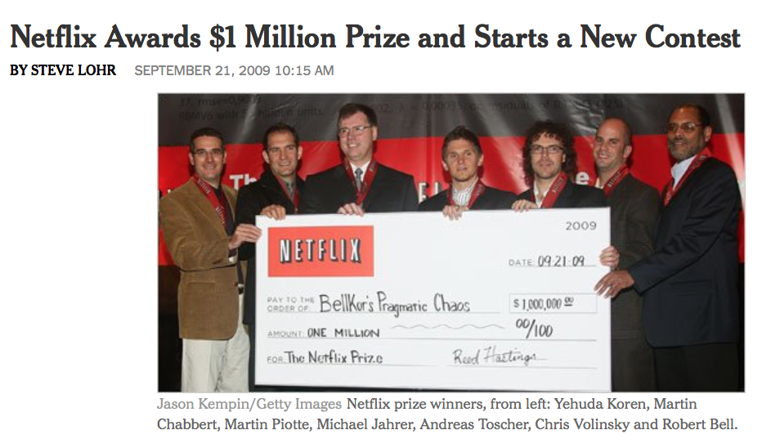
All data are potentially identifying.

Slide 42
The Netflix Challenge (2008-2009)
Netflix published movie data for ~450,000 subscribers:
  Pseudonymized username
  Information on movies watched:
    Movie Title
    Date watched
    Rating
  Challenge: Improve Netflix recommendation algorithm
  Unintentional Challenge: Identify Netflix subscribers!

Slide 43
Re-identifying the Netflix Challenge Victims
Other
Movies
Watched
&
Movie
Rankings
Movies
Watched
&
Movie
Rankings
“Direct”
or
“Explicit”
identifiers
“Sensitive Data”
IMDB
username
Netflix
Provided
Data

Slide 44
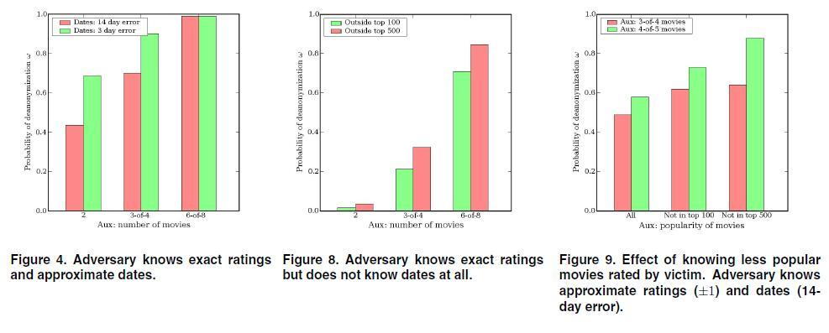

Slide 45
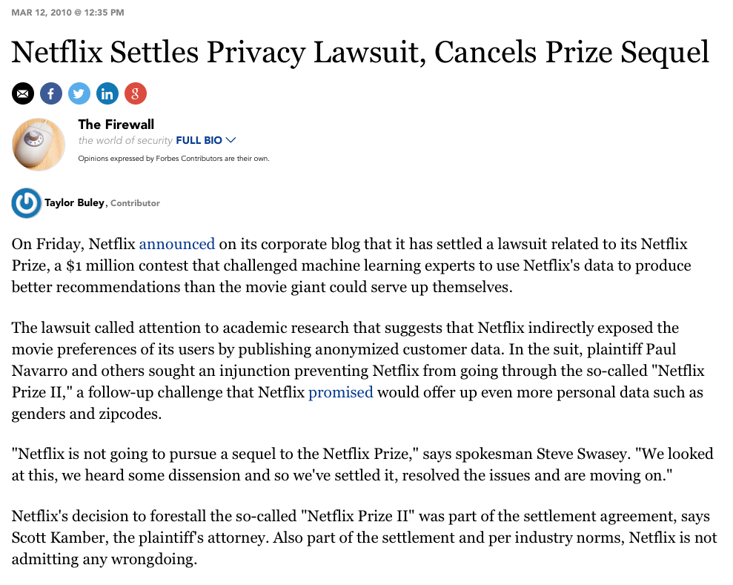
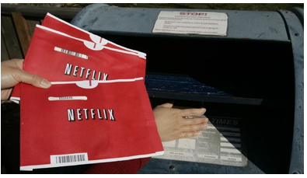

Slide 46
Open Data Lessons
  People want our data
  — but the data can cause harms.
  We can de-identify data by removing names
  — but people can still be identified.
  Beyond names, all direct identifiers must be removed.
  Quasi-identifiers (indirect identifiers) must be manipulated.
  All data are potentially identifying.

Slide 47
Outline for today’s talk
  Privacy risks of Open Data ☺
  Addressing privacy risks with de-identification ☺
  De-identification techniques ☺
  De-identification failings ☺
  Database reconstruction
  Differential Privacy

Slide 48
Lesson 5: Database Reconstruction is a real threat.
Reconstruction is real.

Slide 49
Every time an agency publishes statistics based on confidential data, a little bit of information is revealed.
Publication
#1
Publication
#2
Publication
#3
Confidential data
At some point, enough statistics are released that the confidential database can be “reconstructed.”

Slide 50
Even when values are suppressed, confidential data can be reconstructed.

Slide 51
One way to reconstruct: create simultaneous equations consistent with published data.
“Average age is 40:”

Slide 52
In 2003, Dinur & Nissim showed that statistical databases can be reconstructed with far less data than was previously thought.

Slide 53
Perturbation (noise infusion) is the only way to protect against database reconstruction.
Publication
#1
Publication
#2
Publication
#3
Confidential data
Possibility #1
Confidential data
Possibility #2
Confidential data
Possibility #3
With random perturbation, there is no way to know which is the real confidential database.

Slide 54
Open Data Lessons
  People want our data
  — but the data can cause harms.
  We can de-identify data by removing names
  — but people can still be identified.
  Beyond names, all direct identifiers must be removed.
  Quasi-identifiers (indirect identifiers) must be manipulated.
  All data are potentially identifying.
  Database reconstruction is a real threat — but it can be addressed using perturbation.

Slide 55
Outline for today’s talk
  Privacy risks of Open Data ☺
  Addressing privacy risks with de-identification ☺
  De-identification techniques ☺
  De-identification failings ☺
  Database reconstruction☺
  Differential Privacy

Slide 56
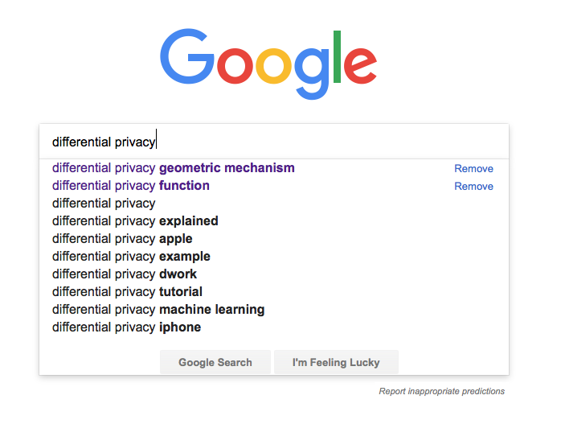
Differential Privacy: The Big Idea

Slide 57
Differential privacy is a new approach for assuring privacy in the release of statistical data.
Privacy Parameters
Privacy-Preserving
Data Release
Methods that implement the privacy definition
Formal Privacy
Definition
Sensitive dataset
Ad hoc Rules
Based on hope and assumptions.
Based on math.
Data are identify, quasi-identifying, or not-identifying
Future data sets will not be released that can be linked with previously released data
Adversaries have limited resources to pursue re-identification attacks
Sensitive dataset

Slide 58
In traditional data publications, there are many ways that the contributions of an individual can leak out
It’s pretty easy to determine that the new kid is sad and has a 90.
Name | Affect | Grade
Alex | Sad | 30
Bobbie | Sad | 50
Casey | Happy | 80
Harper | Happy | 100
Students: 4
Percent Happy: 50%
Average Grade: 65
January
Statistical Tabulation
Name | Affect | Grade
Alex | Sad | 30
Bobbie | Sad | 50
Casey | Happy | 80
Emerson | Sad | 90
Harper | Happy | 100
Students: 5
Percent Happy: 40%
Average Grade: 70
February
Statistical Tabulation

Slide 59
Differential privacy’s core idea:
Create uncertainty regarding the presence any person in the dataset.
Noise is added to mask an individual’s contribution
Name | Affect | Grade
Alex | Sad | 30
Bobbie | Sad | 50
Casey | Happy | 80
Harper | Happy | 100
Students: 4
Percent Happy: 45%
Average Grade: 50
Statistical Tabulation + noise
January
Name | Affect | Grade
Alex | Sad | 30
Bobbie | Sad | 50
Casey | Happy | 80
Emerson | Sad | 90
Harper | Happy | 100
Students: 5
Percent Happy: 60%
Average Grade: 75
February
Statistical Tabulation
+ noise

Slide 60
If we ran the statistics different times, we would get different results
In this example, a policy decision requires that the number of students be accurately reported.
Name | Affect | Grade
Alex | Sad | 30
Bobbie | Sad | 50
Casey | Happy | 80
Harper | Happy | 100
Students: 4
Percent Happy: 45%
Average Grade: 50
Statistical Tabulation + noise
January
Name | Affect | Grade
Alex | Sad | 30
Bobbie | Sad | 50
Casey | Happy | 80
Harper | Happy | 100
Students: 4
Percent Happy: 55%
Average Grade: 75
Statistical Tabulation + noise
January
Name | Affect | Grade
Alex | Sad | 30
Bobbie | Sad | 50
Casey | Happy | 80
Harper | Happy | 100
Students: 4
Percent Happy: 51%
Average Grade: 60
Statistical Tabulation + noise
January

Slide 61
Data users understand that noise has been added.
In this example, a policy decision requires that the exact number of students in the class be confidential.
Name | Affect | Grade
Alex | Sad | 30
Bobbie | Sad | 50
Casey | Happy | 80
Harper | Happy | 100
Students: 3
Percent Happy: 40%
Average Grade: 50
Statistical Tabulation + noise
January
Name | Affect | Grade
Alex | Sad | 30
Bobbie | Sad | 50
Casey | Happy | 80
Harper | Happy | 100
Students: 6
Percent Happy: 45%
Average Grade: 45
Statistical Tabulation + noise
January
Name | Affect | Grade
Alex | Sad | 30
Bobbie | Sad | 50
Casey | Happy | 80
Harper | Happy | 100
Students: 5
Percent Happy: 51%
Average Grade: 60
Statistical Tabulation + noise
January

Slide 62
How much noise do we add?
That is a policy decision
Differential privacy uses the parameter ε (epsilon) to describe the privacy/accuracy tradeoff.
      ε = 0 — No accuracy, full privacy
      ε = ∞ — No privacy, full accuracy

Slide 63
Noise can be added in two places:
1) When data are collected. 2) When statistics are produced.
Input noise infusion:
      Advantages:
        Tabulator need not be trusted.
        More statistics do not pose additional privacy threats.
Output noise infusion:
      Advantages:
        More accurate for the same level of privacy
        Allows uses of confidential data that do not involve publication.
Name | Affect | Grade
Alex | Sad + NOISE | 30 + NOISE
Bobbie | Sad + NOISE | 50 + NOISE
Casey | Happy + NOISE | 80 + NOISE
Harper | Happy + NOISE | 100 + NOISE
Students: 4
Percent Happy: 30..70
Average Grade: 50..80
Statistical Tabulation
Name | Affect | Grade
Alex | Sad | 30
Bobbie | Sad | 50
Casey | Happy | 80
Harper | Happy | 100
Students: 4
Percent Happy: 40..60
Average Grade: 60..70
Statistical Tabulation

Slide 64
Other choices for policy makers
Where should the accuracy be spent?
What values should be reported exactly (with no privacy)
What are the possible bounds (sensitivity) of a person’s data?
  e.g. If reporting average student age, can students be 5..18 or 5..115?
How do we convey privacy guarantees to public?

Slide 65
Final problem: what do we do about microdata?
Let’s say we want to publish this microdata:
Now say Emerson’s report card is lost on the way home:
Name | Affect | Grade
Alex | Sad | 30
Bobbie | Sad | 50
Casey | Happy | 80
Emerson | Sad | 90
Harper | Happy | 100
NOT DIFFERENTIALLY
PRIVATE
ID# | Affect | Grade
1 | Sad | 30
2 | Sad | 50
3 | Happy | 80
4 | Sad | 90
5 | Happy | 100
EMERSON
As a result of the data release, Emerson’s affect can be determined from the microdata.
The only solution is to add noise to microdata or produce synthetic microdata.
90

Slide 66
Differential privacy was invented in 2006 by
Dwork, McSherry, Nissim and Smith
Differential privacy is just 11 years old.
Today’s public key cryptography was invented in 1976-1978
Remember public key cryptography in 1989?
  No standardized implementations. No SSL/TLS. No S/MIME or PGP.
  Very few people knew how to build systems that used crypto.

Slide 67
Open Data Lessons
  People want our data
  — but the data can cause harms.
  We can de-identify data by removing names
  — but people can still be identified.
  Beyond names, all direct identifiers must be removed.
  Quasi-identifiers (indirect identifiers) must be manipulated.
  All data are potentially identifying.
  Database reconstruction is a real threat — but it can be addressed using perturbation.
  Differential privacy provides mathematical guarantees for privacy:
    Requires that we accept privacy/accuracy trade-off.
    Requires determining the amount of privacy (or accuracy)
    Makes releasing microdata really hard.
    We are just beginning to learn how to use it.
Simson.L.Garfinkel@census.gov

