Slide 1
Deploying Differential Privacy for the 2020 Census of Population and Housing
Simson L. Garfinkel
Senior Scientist, Confidentiality and Data Access
U.S. Census Bureau
July 23, 2019
Cambridge University
The views in this presentation are those of the author, and not those of the U.S. Census Bureau.

Slide 2
The views in this presentation are those of the author, and not those of the U.S. Census Bureau.

Slide 3
Abstract
When differential privacy was created more than a decade ago, the motivating example was statistics published by an official statistics agency. In theory there is no difference between theory and practice, but in practice there is.
In attempting to transition differential privacy from the theory to practice, and in particular for the 2020 Census of Population and Housing, the U.S. Census Bureau has encountered many challenges unanticipated by differential privacy's creators. Many of these challenges had less to do with the mathematics of differential privacy and more to do with operational requirements that differential privacy’s creators had not discussed in their writings. These challenges included obtaining qualified personnel and a suitable computing environment, the difficulty of accounting for all uses of the confidential data, the lack of release mechanisms that align with the needs of data users, the expectation on the part of data users that they will have access to micro-data, the difficulty in setting the value of the privacy-loss parameter, ε (epsilon), and the lack of tools and trained individuals to verify the correctness of differential privacy, and push-back from same members of the data user community.
Addressing these concerns required developing a novel hierarchical algorithm that makes extensive use of a high-performance commercial optimizer; transitioning the computing environment to the cloud; educating insiders about differential privacy; engaging with academics, data users, and the general public; and redesigning both data flows inside the Census Bureau and some of the final data publications to be in line with the demands of formal privacy.

Slide 4
Acknowledgments
This presentation incorporates work by:
  Dan Kifer (Scientific Lead)
  John Abowd (Chief Scientist)
  Tammy Adams, Robert Ashmead, Aref Dajani, Jason Devine, Nathan Goldschlag, Michael Hay, Cynthia Hollingsworth, Meriton Ibrahimi, Michael Ikeda, Philip Leclerc, Ashwin Machanavajjhala, Christian Martindale, Gerome Miklau, Brett Moran, Ned Porter, Anne Ross, William Sexton, Lars Vilhuber, and Pavel Zhuravlev

Slide 5
Outline
Motivation
The flow of census response data
Disclosure Avoidance for the 2010 census
Disclosure Avoidance for the 2018 census End-to-End test
Disclosure Avoidance for the 2020 census
Conclusion

Slide 6
Gauging the Audience
Raise your hand if you are familiar with differential privacy.
Keep your hand in the air if…
You could give a 15-minute introduction to differential privacy.
You could give a 90-minute tutorial on differential privacy, with programming examples.

Slide 7
Motivation
The 2020 Census of Population and Housing

Slide 8

Motivation
Article 1, Section 2
“…The actual Enumeration shall be made within three Years after the first Meeting of the Congress of the United States, and within every subsequent Term of ten Years, in such Manner as they shall by Law direct…”

Slide 9
Article 1, Section 2
The House of Representatives shall be composed of Members chosen every second Year by the People of the several States, and the Electors in each State shall have the Qualifications requisite for Electors of the most numerous Branch of the State Legislature.
No Person shall be a Representative who shall not have attained to the Age of twenty five Years, and been seven Years a Citizen of the United States, and who shall not, when elected, be an Inhabitant of that State in which he shall be chosen.
Representatives and direct Taxes shall be apportioned among the several States which may be included within this Union, according to their respective Numbers, which shall be determined by adding to the whole Number of free Persons, including those bound to Service for a Term of Years, and excluding Indians not taxed, three fifths of all other Persons. The actual Enumeration shall be made within three Years after the first Meeting of the Congress of the United States, and within every subsequent Term of ten Years, in such Manner as they shall by Law direct.
The Number of Representatives shall not exceed one for every thirty Thousand, but each State shall have at Least one Representative; and until such enumeration shall be made, the State of New Hampshire shall be entitled to chuse three, Massachusetts eight, Rhode-Island and Providence Plantations one, Connecticut five, New-York six, New Jersey four, Pennsylvania eight, Delaware one, Maryland six, Virginia ten, North Carolina five, South Carolina five, and Georgia three.
When vacancies happen in the Representation from any State, the Executive Authority thereof shall issue Writs of Election to fill such Vacancies.
The House of Representatives shall chuse their Speaker and other Officers; and shall have the sole Power of Impeachment.

Slide 10
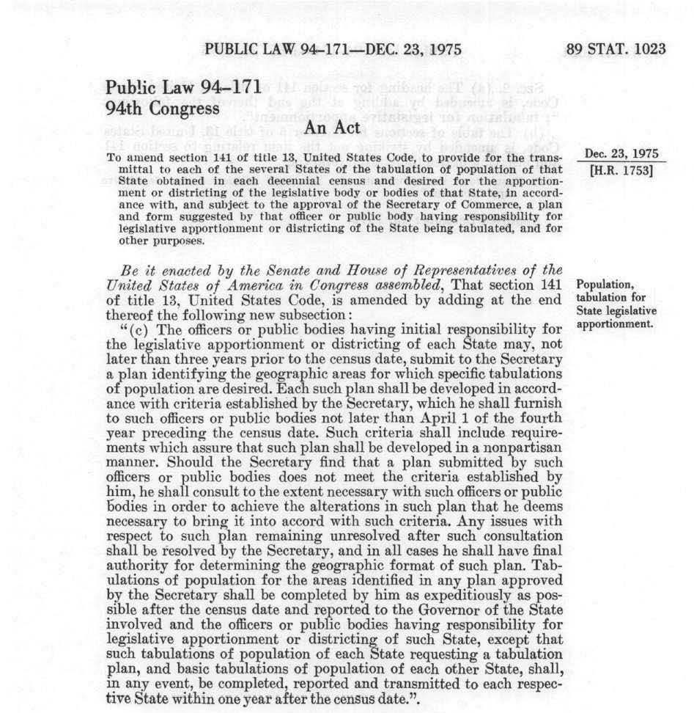
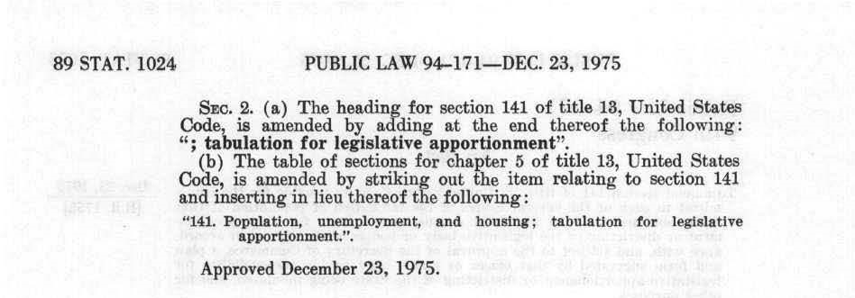

“in such Manner as they shall by Law direct.”
Public Law 94-171
http://uscode.house.gov/statutes/pl/94/171.pdf

Slide 11
Federal Register / Vol. 82, No. 215 / Nov 8, 2017 / Notices
(for the 2018 End-to-End test)
Dec. 31, 2018
We will report (per block):
  P1. RACE/ETHNICITY
    Universe: Total population
    Group by: BLOCK
  P2. RACE/ETHNICITY
    Universe: Total population age 18 and over
  H1. OCCUPANCY STATUS
  P42. GROUP QUARTERS POPULATION
    Universe: Population in Group Quarters

Slide 12
We need to protect privacy!
13 U.S. Code § 9 - Information as confidential; exception
(a) Neither the Secretary, nor any other officer or employee of the Department of Commerce or bureau or agency thereof, or local government census liaison may, except as provided in section 8 or 16 or chapter 10 of this title or section 210 of the Departments of Commerce, Justice, and State, the Judiciary, and Related Agencies Appropriations Act, 1998.
  (1) Use the information furnished under the provisions of this title for any purpose other than the statistical purposes for which it is supplied; or
  (2) Make any publication whereby the data furnished by any particular establishment or individual under this title can be identified; or
  (3) Permit anyone other than the sworn officers and employees of the Department or bureau or agency thereof to examine the individual reports. No department, bureau, agency, officer, or employee of the Government, except the Secretary in carrying out the purposes of this title, shall require, for any reason, copies of census reports which have been retained by any such establishment or individual. Copies of census reports, which have been so retained, shall be immune from legal process, and shall not, without the consent of the individual or establishment concerned, be admitted as evidence or used for any purpose in any action, suit, or other judicial or administrative proceeding.
(b) The provisions of subsection (a) of this section relating to the confidential treatment of data for particular individuals and establishments, shall not apply to the censuses of governments provided for by subchapter III of chapter 5 of this title, nor to interim current data provided for by subchapter IV of chapter 5 of this title as to the subjects covered by censuses of governments, with respect to any information obtained therefore that is compiled from, or customarily provided in, public records.

Slide 13
Statistical agencies collect data under a pledge of confidentiality.
We pledge:
  Collected data will be used only for statistical purposes.
  Collected data will be kept confidential.
  Data from individuals or establishments
  won’t be identifiable in any publication.

Slide 14


Slide 15
Disclosure Avoidance for the 2010 Census

Slide 16
“Disclosure Avoidance” means preventing improper disclosures.

Slide 17
“This is the official form for all the people at this address.”
“It is quick and easy, and your answers are protected by law.”

Slide 18
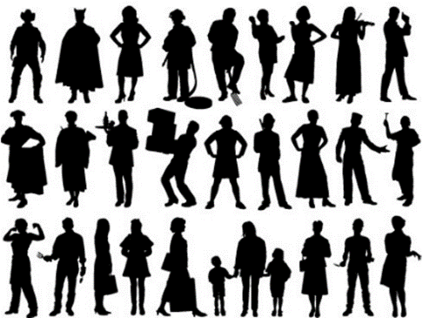
The 2010 Census collected data on 308,745,538 people.
Pre-specified tabular summaries:
PL94-171, SF1, SF2 (SF3, SF4, … in 2000)
DRF
HDF
Raw data from respondents: Decennial Response File
Statistical
Processes
Hundred-percent Detail File
Special tabulations and post-census research
Confidential data
Public data

Slide 19
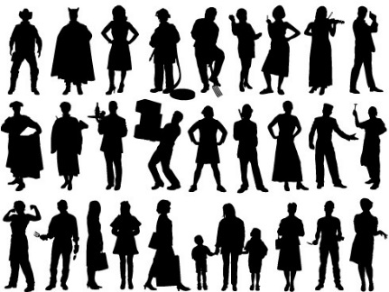
The 2000 and 2010 Confidentiality Mechanism operated as a filter on the Census Edited File:
Pre-specified tabular summaries:
PL94-171, SF1, SF2 (SF3, SF4, … in 2000)
DRF
HDF
Raw data from respondents: Decennial Response File
Selection & unduplication: Census Unedited File
Edits, imputations: Census Edited File
Hundred-percent Detail File
Confidentiality Mechanism
Special tabulations and post-census research
Public data

Slide 20

For each person, we collected 6 variables
(44 bits of data)
Variable | Range | Bits
Block | 6,207,027 inhabited blocks | 23
Sex | 2 (Female/Male) | 1
Age | 103 (0-99 single age year categories, 100-104, 105-109, 110+) | 7
Race | 63 allowable race combinations | 7
Ethnicity | 2 (Hispanic/Not) | 1
Relationship | 17 values | 5
Total |  | 44
308,745,538 people x 6 variables = 1,852,473,228 measurements
308,745,538 people x 44 bits = 13,584,803,672 bits ≈ 1.7 GB

Slide 21
2010 Census: Summary of Publications
(approximate counts)
Publication | Released counts
PL94-171 Redistricting | 2,771,998,263
Balance of Summary File 1 | 2,806,899,669
Summary File 2 | 2,093,683,376
Public-use micro data sample | 30,874,554
Lower bound on published statistics | 7,703,455,862
Published Statistics/person | 25
Recall: Collected variables/person: | 6
Published Statistics/collected variable | 25 ÷ 6 ≈ 4.2
Notes:
The 2010 Census publication schedule resulted in roughly 2.8 billion counts (including zeros) published in PL94-171, another 2.8 billion in the rest of SF1, 2 billion in SF2, and another 30 million in a public-use microdata sample. This is roughly 7.7 billion statistics, or 25 per person. That’s a lot more than 6 per person.

Slide 22
Question:
Is it possible to run the statistical process in reverse?
Pre-specified tabular summaries:
PL94-171,
SF1, SF2
DRF
Raw data from respondents: Decennial Response File
Reconstruction
Processes
Special tabulations and post-census research
1,852,473,228 collected values
(308,745,538 people x 6 variables/person)
Public data

Slide 23


2003:
Database Reconstruction

Slide 24
Attacking statistical databases

Slide 25
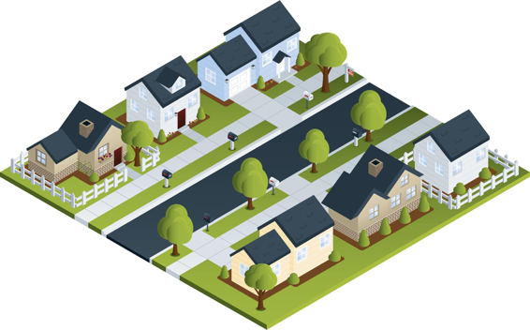
Statistical agencies are trusted curators.
Confidential
Database
Published Statistics
Respondents
 | # | Median Age | Mean Age
Total | 7 | 30 | 38
Women | 4 | 30 | 33.5
Male | 3 | 30 | 44
Black | 4 | 51 | 48.5
White | 3 | 24 | 24
Married | 4 | 51 | 54
Black F | 3 | 36 | 36.7
Age Sex Race/MS
8 FBS
18 MWS
24 FWS
30 MWM
36 FBM
66 FBM
84 MBM

Slide 26
This is the trusted curator model
Respondents
Confidential Database
Published Statistics

Slide 27
We now know “trusted curator” model is more complex.
Every data publication results in some privacy loss.
Publishing too many statistics results in the compromise of the entire confidential database.
Respondents
Confidential Database
Published Statistics

Slide 28
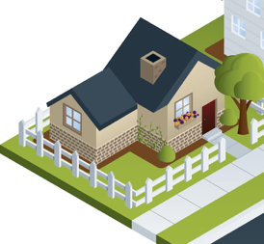
Consider the statistics from a single household
 | Count | Median | Mean
Total | 1 | 24 | 24
# Female | 1 | 24 | 24
# white | 1 | 24 | 24
Single | 1 | 24 | 24
White F | 1 | 24 | 24
24 yrs Female White Single (24 FWS)

Slide 29
Publishing statistics for this household alone would result in an improper disclosure.
 | Count | Median | Mean
Total | (D) | (D) | (D)
# Female | (D) | (D) | (D)
# white | (D) | (D) | (D)
Single | (D) | (D) | (D)
White F | (D) | (D) | (D)
(D) Means suppressed to prevent an improper disclosure.
24 yrs Female White Single (24 FWS)

Slide 30

In the past, statistical agencies aggregated data from many households together into a single publication.
 | Count | Median Age | Mean Age
Total | 7 | 30 | 38
# Female | 4 | 30 | 33.5
# male | 3 | 30 | 44
# black | 4 | 51 | 48.5
# white | 3 | 24 | 24
Married | 4 | 51 | 54
Black F | 3 | 36 | 36.7

Slide 31
We now know that this publication can be reverse-engineered to reveal the confidential database.
 | Count | Median | Mean
Total | 7 | 30 | 38
# Female | 4 | 30 | 33.5
# male | 3 | 30 | 44
# black | 4 | 51 | 48.5
# white | 3 | 24 | 24
Married | 4 | 51 | 54
Black F | 3 | 36 | 36.7
66 FBM & 84 MBM
30 MWM & 36 FBM
8 FBS
18 MWS
24 FWS
This table can be expressed by 164 equations.
Solving those equations takes
0.2 seconds on a 2013 MacBook Pro.

Slide 32
The problem with publishing fewer statistics: it’s hard to know how many statistics is “too many.”
Solution #1
8 FBS
18 MWS
24 FWS
30 MWM
36 FBM
66 FBM
84 MBM
Solution #2
2 FBS
12 MWS
24 FWS
30 MBM
36 FWM
72 FBM
90 MBM
 | Count | Median | Mean
Total | 7 | 30 | 38
# Female | 4 | 30 | 33.5
# male | 3 | 30 | 44
# black | 4 | 51 | 48.5
# white | 3 | 24 | 24
Married | 4 | 51 | 54
Black F | 3 | 36 | 36.7

Slide 33
Here’s what the system looks like:
Variables:
Constraints:
#define FEMALE 0
#define MALE 1
(int S1 FEMALE MALE)
(int S2 FEMALE MALE)
(int S3 FEMALE MALE)
(int S4 FEMALE MALE)
(int S5 FEMALE MALE)
(int S6 FEMALE MALE)
(int S7 FEMALE MALE)
;; there are three males
(= (+ (if (= S1 MALE) 1 0)
(if (= S2 MALE) 1 0)
(if (= S3 MALE) 1 0)
(if (= S4 MALE) 1 0)
(if (= S5 MALE) 1 0)
(if (= S6 MALE) 1 0)
(if (= S7 MALE) 1 0)
)
3)
Notes:
S1 is the sex of person #1, S2 is the sex of person #2, etc.
There is also A1 for person #1’s age, R1 for their race, M1 for their marital status, etc.

Slide 34
2010 Census: Summary of Publications
(approximate counts)
Publication | Released counts
PL94-171 Redistricting | 2,771,998,263
Balance of Summary File 1 | 2,806,899,669
Summary File 2 | 2,093,683,376
Public-use micro data sample | 30,874,554
Lower bound on published statistics | 7,703,455,862
Published Statistics/person | 25
Recall: Collected variables/person: | 6
Published Statistics/collected variable | 25 ÷ 6 ≈ 4.2
Notes:
The 2010 Census publication schedule resulted in roughly 2.8 billion counts (including zeros) published in PL94-171, another 2.8 billion in the rest of SF1, 2 billion in SF2, and another 30 million in a public-use microdata sample. This is roughly 7.7 billion statistics, or 25 per person. That’s a lot more than 6 per person.

Slide 35
We performed a database reconstruction and re-identification attack for all 308,745,538 people in 2010 Census
Reconstructed 308,745,538 microdata records.
Used 4 commercial databases of the 2010 US population
acquired 2009-2011 in support of the 2010 Census
  Commercial database had: NAME, ADDRESS, AGE, SEX
Linked reconstructed records to the commercial database records
  Linked database has: NAME, ADDRESS, AGE, SEX , ETHNICITY & RACE
  Link rate: 45%
Compared linked database to Census Bureau confidential data
  Question: How often did the attack get the all variables including race and ethnicity right?
  Answer: 38% (17% of US population)

Slide 36
Our attack is good, but not perfect.
An outside attacker would have a harder time.
  We confirmed re-identification of 38% (17% of US population)
  We did not reconstruct families.
  We did not recover detailed self-identified race codes
An outside attacker:
  Would not know which re-identifications are correct.
    An outside attacker would need to confirm with another external data source.

Slide 37
The protection system used in 2000 and 2010 relied on swapping households.
Some households were swapped with other households
  Swapped households had the same size.
  Swapping limited to within each state.
Disadvantages:
  Swap rate and details of swapping not disclosed.
  Privacy protection was not quantified.
  Impact on data quality not quantified.
Swapping is called a “Disclosure Avoidance” technique.
It’s job is to prevent improper disclosures.
Confidentiality Mechanism
Town 1
Town 2
Any State

Slide 38
We now know that the disclosure avoidance techniques we used in the 2010 Census were flawed
  We released exact population counts for blocks, tracts and counties.
  We did not swap 100% of the households
  We released ≈25 statistics per person,
  but only collected six pieces of data per person:
    Block • Age • Sex • Race • Ethnicity • Relationship to Householder
The Census Bureau did the best possible in 2010.
The math for protecting a decennial census using formal privacy did not [yet] exist.

Slide 39
Faced with “database reconstruction,” statistical agencies have just two choices
Option #1: Publish fewer statistics.
Option #2: Publish statistics with less accuracy.

Slide 40
Faced with “database reconstruction,” statistical agencies have just two one choice
Option #1: Publish fewer statistics.
Option #2: Publish statistics with less accuracy.
Notes:
The problem with publishing fewer statistics is that we don’t know when we have reached a threshold of having published too many statistics. This is because the information that is published can be combined with external information, or information in the future.

Slide 41
Notes:
These are the authors of the original 2006 paper on differential privacy, with photos created at the time.
Cynthia Dwork, Frank McSherry, Kobbi Nissim and John Smith.

Slide 42
2006:
Differential Privacy

Slide 43
Differential privacy gives us a mathematical approach for balancing accuracy and privacy loss
No privacy
No accuracy

Slide 44
“Differential privacy” is really two things
1 – A mathematical definition of privacy loss.
2 – Specific mechanisms that allow us to:
    Add the smallest amount of noise necessary for a given privacy outcome
    Structure the noise to have minimal impact on the more important statistics

Slide 45
Differential privacy — the big idea:
Use “noise” to create uncertainty about private data
NOISE BARRIER
35 yrs Female Black Single (35 FBS)
Impact of the noise ≈ impact of a single person
Impact of noise on aggregate statistics
decreases with larger population.
24 yrs Female White Single (24 FWS)

Slide 46
Each time we go through the noise barrier, we get a different number
 | Age
 | 25
Count
3
1 person age 22
NOISE BARRIER
17
1
1 person age 22
27
-1
1 person age 22

Slide 47
Epsilon controls the amount of noise
 | Epsilon | Age
 | 100 | 22
 | 1.0 | 24
 | 0.1 | -115
1 person age 22
NOISE BARRIER
1 person age 22
1 person age 22

Slide 48
Understanding the impact of “noise:”
Statistics based on 10,000 experiments, epsilon=1.0
 | 5,000 (50%) runs | 9,500 (95%) runs
 | Median(age): 9 → 73 | Median(age): 0→ 104
 | Median(age): 17 → 61 | Median(age): 0→ 103
 | Median(age): 21 → 22 | Median(age): 21→ 22
1 person age 22
NOISE BARRIER
10 people, all age 22
100 people, all age 22

Slide 49
The noise also impacts the person counts
 | 5,000 (50%) runs | 9,500 (95%) runs
 | Median(age): 9 → 73 # people: -9 → 11 | Median(age): 0→ 104 # people: -29 → 30
 | Median(age): 17 → 61 # people: 0 → 20 | Median(age): 0→ 103 # people: -19 → 38
 | Median(age): 21 → 22 # people: 90 → 110 | Median(age): 21→ 22 # people: 71 → 129
1 person age 22
NOISE BARRIER
10 people, all age 22
100 people, all age 22

Slide 50

The 2020 census and differential privacy

Slide 51


DAS allows the Census Bureau to enforce global confidentiality protections
Pre-specified tabular summaries:
PL94-171, DHC, DDHC, AIANNH
Decennial Response File
Census Unedited File
Census Edited File
Global Confidentiality Protection Process
Disclosure Avoidance System
Microdata Detail File
NOISE BARRIER
Special tabulations and post-census research
Privacy-loss Budget,
Accuracy Decisions
Notes:
In the 2020 Census of Publishing and Housing,
SF1 is replaced by Demographic and Household Characteristics
SF2 is replaced by Detailed Demographic and Household Characteristics
AIANNH is American Indian, Alaska Native and Native Hawaiian
DDHC and AIANNH will be generated directly from the DAS and not pass through the MDF, nor will the join tables once they have been named

Slide 52
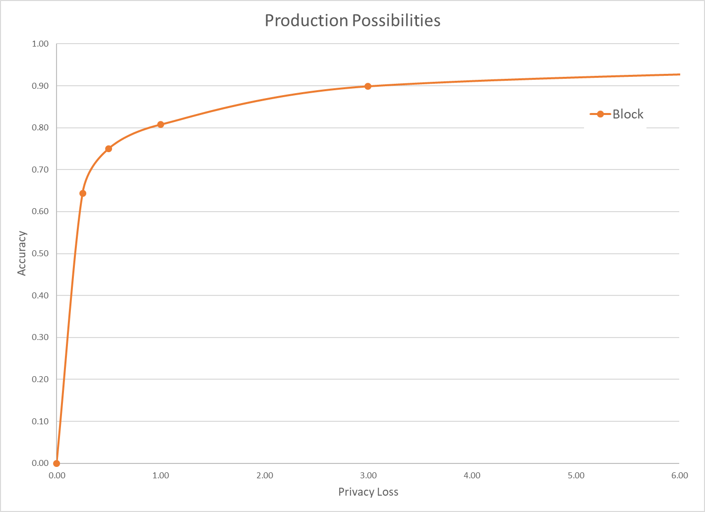
The Census disclosure avoidance system uses differential privacy to defend against an accurate reconstruction attack
Differential privacy provides:
  Provable bounds on the accuracy of the best possible database reconstruction given the released tabulations.
  Algorithms that allow policy makers to decide the trade-off between accuracy and privacy.
Data accuracy
Privacy loss budget (ε)
Final privacy-loss budget determined by Data Stewardship Executive Policy Committee (DSEP)
with recommendation from Disclosure Review Board (DRB)
Pre-Decisional

Slide 53
The Disclosure Avoidance System relies on injects formally private noise
Advantages of noise injection with formal privacy:
  Transparency: the details can be explained to the public
  Tunable privacy guarantees
  Privacy guarantees do not depend on external data
  Protects against accurate database reconstruction
  Protects every member of the population
Challenges:
  Entire country must be processed at once for best accuracy
  Every use of confidential data must be tallied in the privacy-loss budget
Global Confidentiality Protection Process
Disclosure Avoidance System
ε

Slide 54
There was no off-the-shelf system for applying differential privacy to a national census
We had to create a new system that:
  Produced higher-quality statistics at more densely populated geographies
  Produced consistent tables
  We created new differential privacy algorithms and processing systems that:
  Produce highly accurate statistics for large populations (e.g. states, counties)
  Create protected microdata that can be used for any tabulation without additional privacy loss
  Fit into the decennial census production system

Slide 55
How the 2020 System Works:
High-level Overview
  Every record in the population may be modified
    But modifications are bounded by the global privacy budget.
  Records in the tabulation data have no exact counterpart in the confidential data
    There is no one-to-one mapping between CEF and MDF records.
  Explicitly protected tabulations (PL-94 and SF-1) have provable, public accuracy levels

Slide 56
Basic approach for a DP Census
Treat the entire census as a set of queries on histograms.
Select the specific queries to measure
  Six geolevels (nation, state, county, tract, block group, block)
  Thousands of queries per geounit
  Billions of queries overall
  Histogram has billions of cells

Slide 57
Protecting the data
Confidential records
Measurements
ε
Noisy Measurements
Microdata
NOISE BARRIER

Slide 58
First effort: The block-by-block algorithm
Independently protect each block (parallel composition)
8 million blocks
Disclosure Avoidance System
8 million protected blocks
NOISE BARRIER
Measure queries for each block; privatize queries; convert results back to microdata

Slide 59
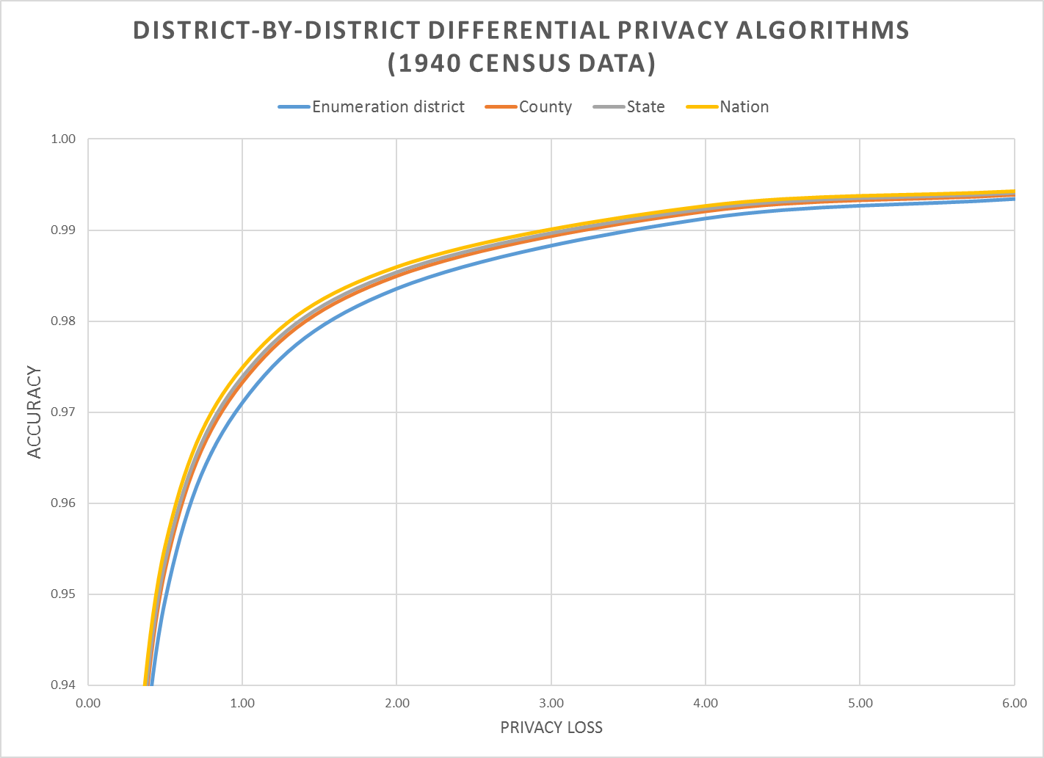
Tested with data from 1940
1940 hierarchy:
Nation
State
County
Enumeration District
Download from usa.ipums.org
Notes:
Accuracy (in all slides) is (1 – AveTVD/N), where AveTVD = Average Total Variation Distance = Sum( 0.5L_1) over all query sets in the PL94 workload over all geographies in the workload divided by the number of query sets (14), L_1 is the absolute error in all the table, and N is the population count in the complete person table (1940 population). AveTVD is averaged over all the tables in the workload for the relevant geography.
In the 1940 Census data, the geography is nation, state, county, enumeration district (approximately, a modern block group, in 1940 a voting precinct in most areas).
This panel shows the performance of the district-by-district algorithm for at each level of geography for privacy-loss budgets from 0.25 to 6.00.
Workload in the experiments is the detailed histogram GQ/HH type (9) x voting age (2) x Hispanic (5) x Race (6) x Citizenship (5) measured sharing the global privacy loss budget across all levels of geography.

Slide 60
Block-by-block algorithm (also called bottomUp)
Mechanism:
  Select, Measure, Reconstruct separately on each block
Advantages:
  Simple and easy to parallelize
  Privacy cost does not depend on # of blocks
  Releasing DP for one block has same cost as releasing for all
Disadvantages
  Significant error at higher level
  Error adds up
  Variance of each geounit is proportional to the number of blocks it contains

Slide 61
New algorithm: the top-down mechanism
Step 1: Generate national histogram without geographic identifiers.
Step 2: Allocate counts in histogram to each geography
“top down.”
  National-level measurements - ℇ_{nat}
  State-level histograms - ℇ_{state}
  County-level histograms - ℇ_{county}
  Tract-level histograms - ℇ_{tract}
  Block-group level histograms - ℇ_{blockgroup}
  Block-level histograms - ℇ_{block}
ℇ= ℇ_{nat} + ℇ_{state} + ℇ_{county} + ℇ_{tract} + ℇ_{blockgroup} + ℇ_{block}

Slide 62
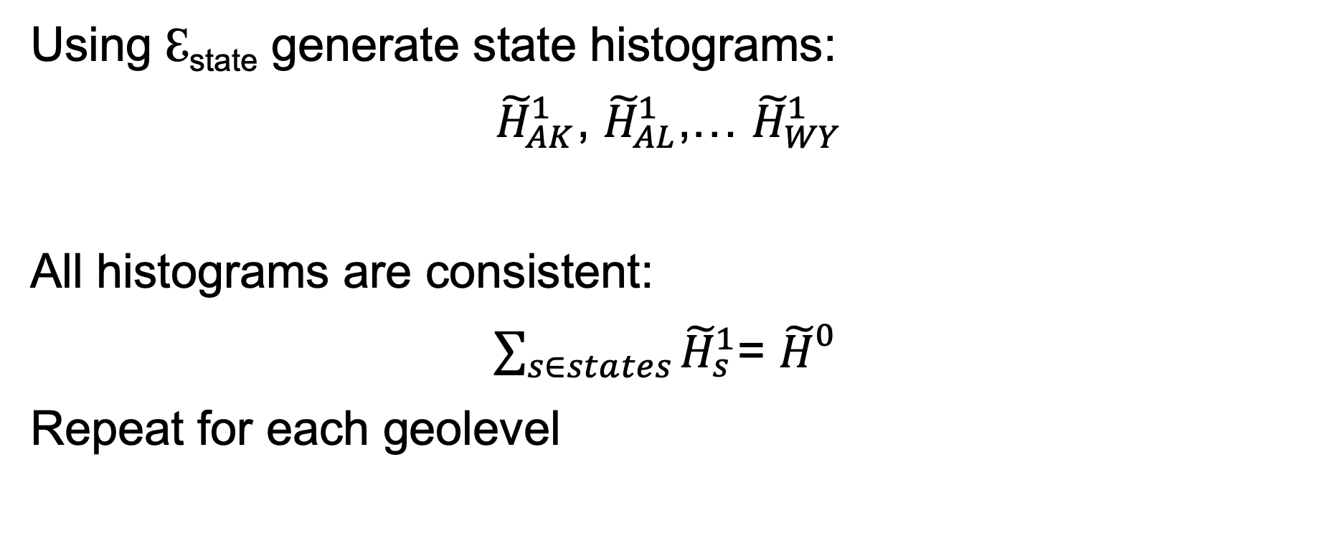
The top-down algorithm…
Using ℇ_{state} generate state histograms:
${\tilde{H}}_{AK}^{1}$, ${\tilde{H}}_{AL}^{1}$,… ${\tilde{H}}_{WY}^{1}$
All histograms are consistent:
$\sum_{s∈states}{{\tilde{H}}_{s}^{1}}$= ${\tilde{H}}_{}^{0}$
Repeat for each geolevel

Slide 63
New algorithm: the top-down mechanism
Edited
Confidential data
Tabulated
Confidential data
330M records
1 National histogram
ε
National Histogram
52 “state” Histograms
ε
52 state histograms
3142 “county” histograms
ε
3,142 county histograms
NOISE BARRIER
75,000 tract
histograms
ε
75,000 census tract histograms
8 M block group histograms
ε
1 M block group histograms
8 M block histograms
ε
8 M block histograms

Slide 64
Post-process for non-negativity and consistency
Edited
Confidential data
Tabulated
Confidential data
330M records
1 National histogram
ε
National Histogram
52 “state” Histograms
ε
52 state histograms
3142 “county” histograms
ε
3,142 county histograms
NOISE BARRIER
75,000 tract
histograms
ε
75,000 census tract histograms
8 M block group histograms
ε
1 M block group histograms
8 M block histograms
ε
8 M block histograms

Slide 65
Top-down framework: alternative view
National histogram equivalent to table of records:
Extend to state-level histograms:
Add county:
Then add tract, block group, block
Age | Race | Sex | Ethnicity | HHGQ
Age | Race | Sex | Ethnicity | HHGQ | State
Age | Race | Sex | Ethnicity | HHGQ | State | County

Slide 66
Top-Down Framework
Advantages:
  Easy to parallelize
  Each geo-unit can have its own strategy selection
  We use High Dimensional Matrix Mechanism [MMHM18]
  Parallel composition at each geo-level
  Reduced variance for many aggregate regions
  Sparsity discovery
    e.g. very few 100+ aged people who combine 5 races
    Once to—down decide a region has no such records in county A, no subregion will have them.

Slide 67
Post-processing
Each distribution involves (at least) two runs of an optimizer
L₂ solve:
  Generates nonnegative fractional demographics histogram
  State histograms must add up to National histogram (etc.)
L₁ solve:
  Converts fractional histogram to non-negative integer histogram
  Maintain consistency: child histograms must add up to parent
  Integer solutions are fast to find

Slide 68
Evaluating the algorithm
We released runs of the top-down algorithm on data from the 1940 Census.
  Epsilon values 0.25 .. 8.0
  Multiple runs at each value of epsilon.
Caveats:
  1940 data had 4 geography levels: Nation, State, County, Enumeration District.
  2020 data has 6 levels: Nation, State, County, Tract, Block Group and Block.
  1940 data has 6 races races / 2020 data has 63 race combinations
  1940 data has no citizenship (Citizen or non-Citizen)

Slide 69
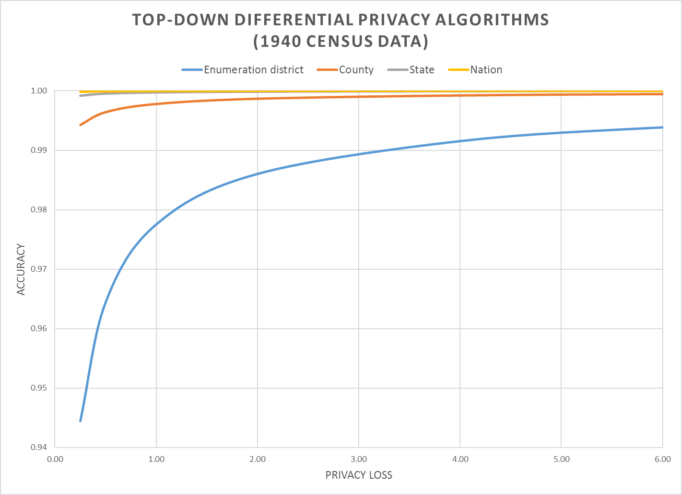
Top-Down: much more accurate!
Notes:
Accuracy (in all slides) is (1 – AveTVD/N), where AveTVD = Average Total Variation Distance = Sum( 0.5L_1) over all query sets in the PL94 workload over all geographies in the workload divided by the number of query sets (14), L_1 is the absolute error in all the table, and N is the population count in the complete person table (1940 population). AveTVD is averaged over all the tables in the workload for the relevant geography.
In the 1940 Census data, the geography is nation, state, county, enumeration district (approximately, a modern block group, in 1940 a voting precinct in most areas).
This panel shows the performance of the top-down algorithm at each level of geography for privacy-loss budgets from 0.25 to 6.00.
Workload in the experiments is the detailed histogram GQ/HH type (9) x voting age (2) x Hispanic (5) x Race (6) x Citizenship (5) measured sharing the global privacy loss budget across all levels of geography.

Slide 70
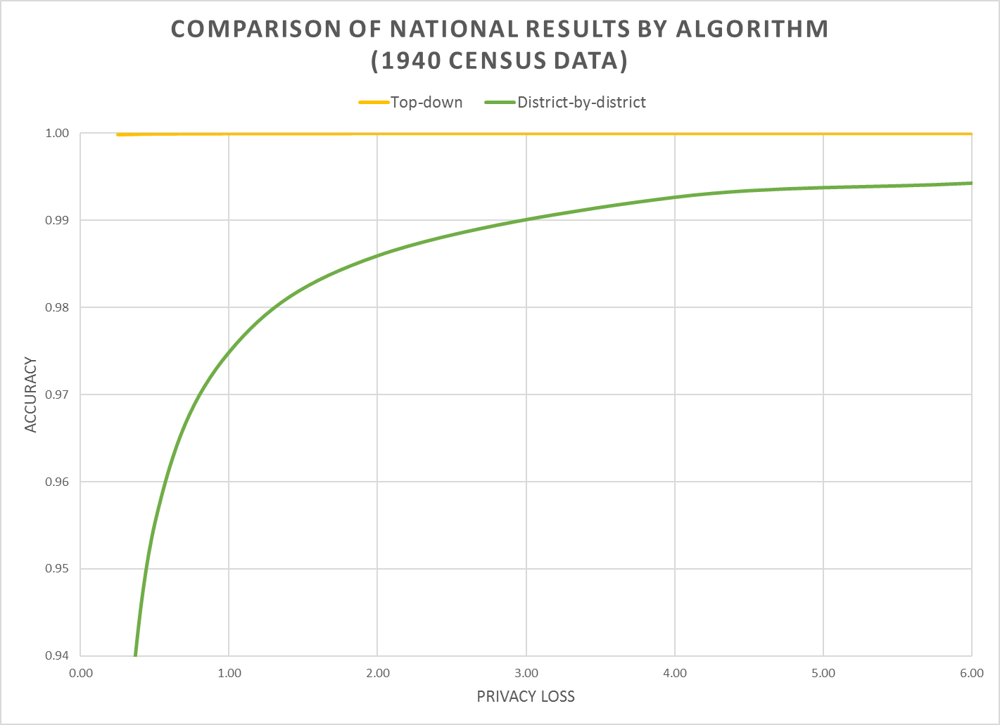
Notes:
This graph shows how the national results of the two algorithms compare..

Slide 71
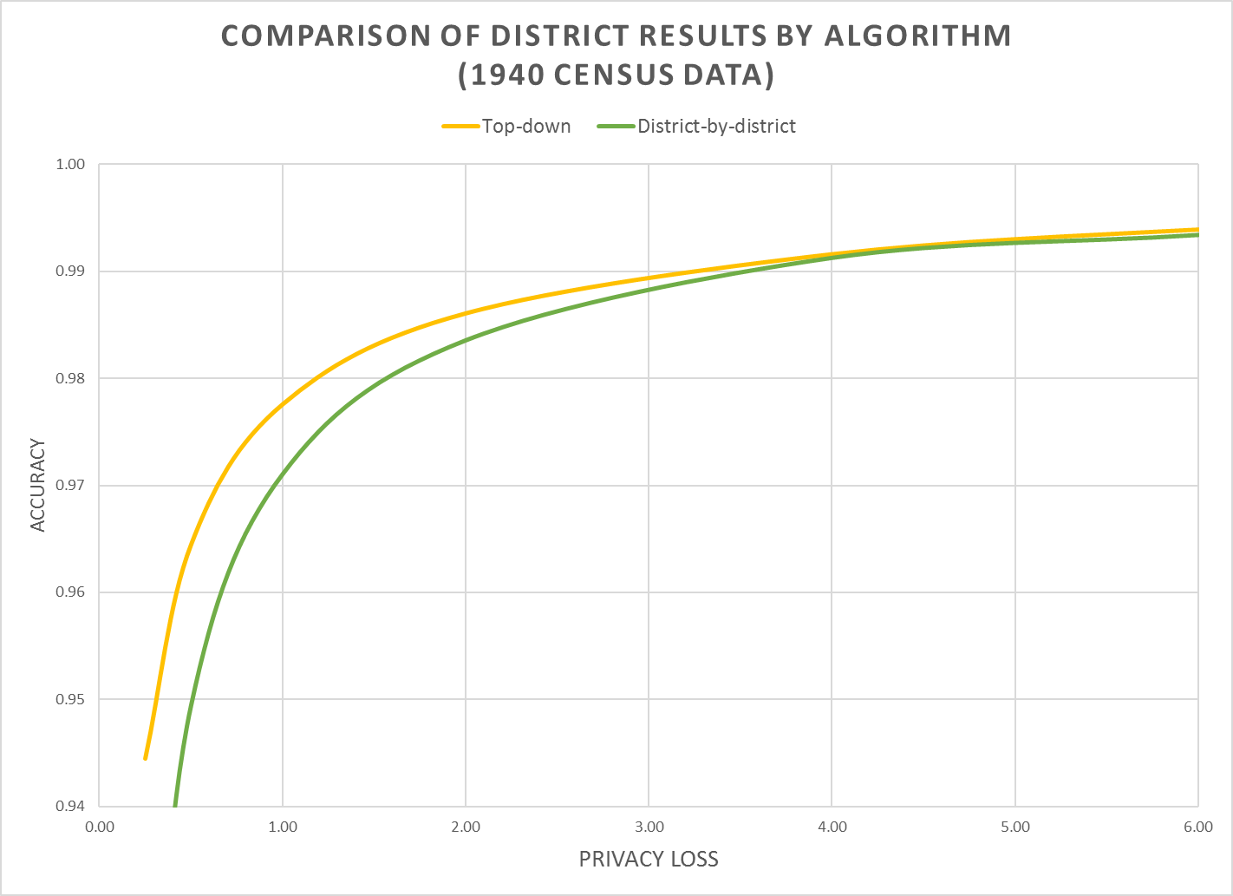
Notes:
This graph shows how the enumeration-district data for both algorithms compare.
We were surprised that the top-down algorithm is better than the district-by-district algorithm, but that makes sense, as they were gaining statistical power from the higher geographies.

Slide 72
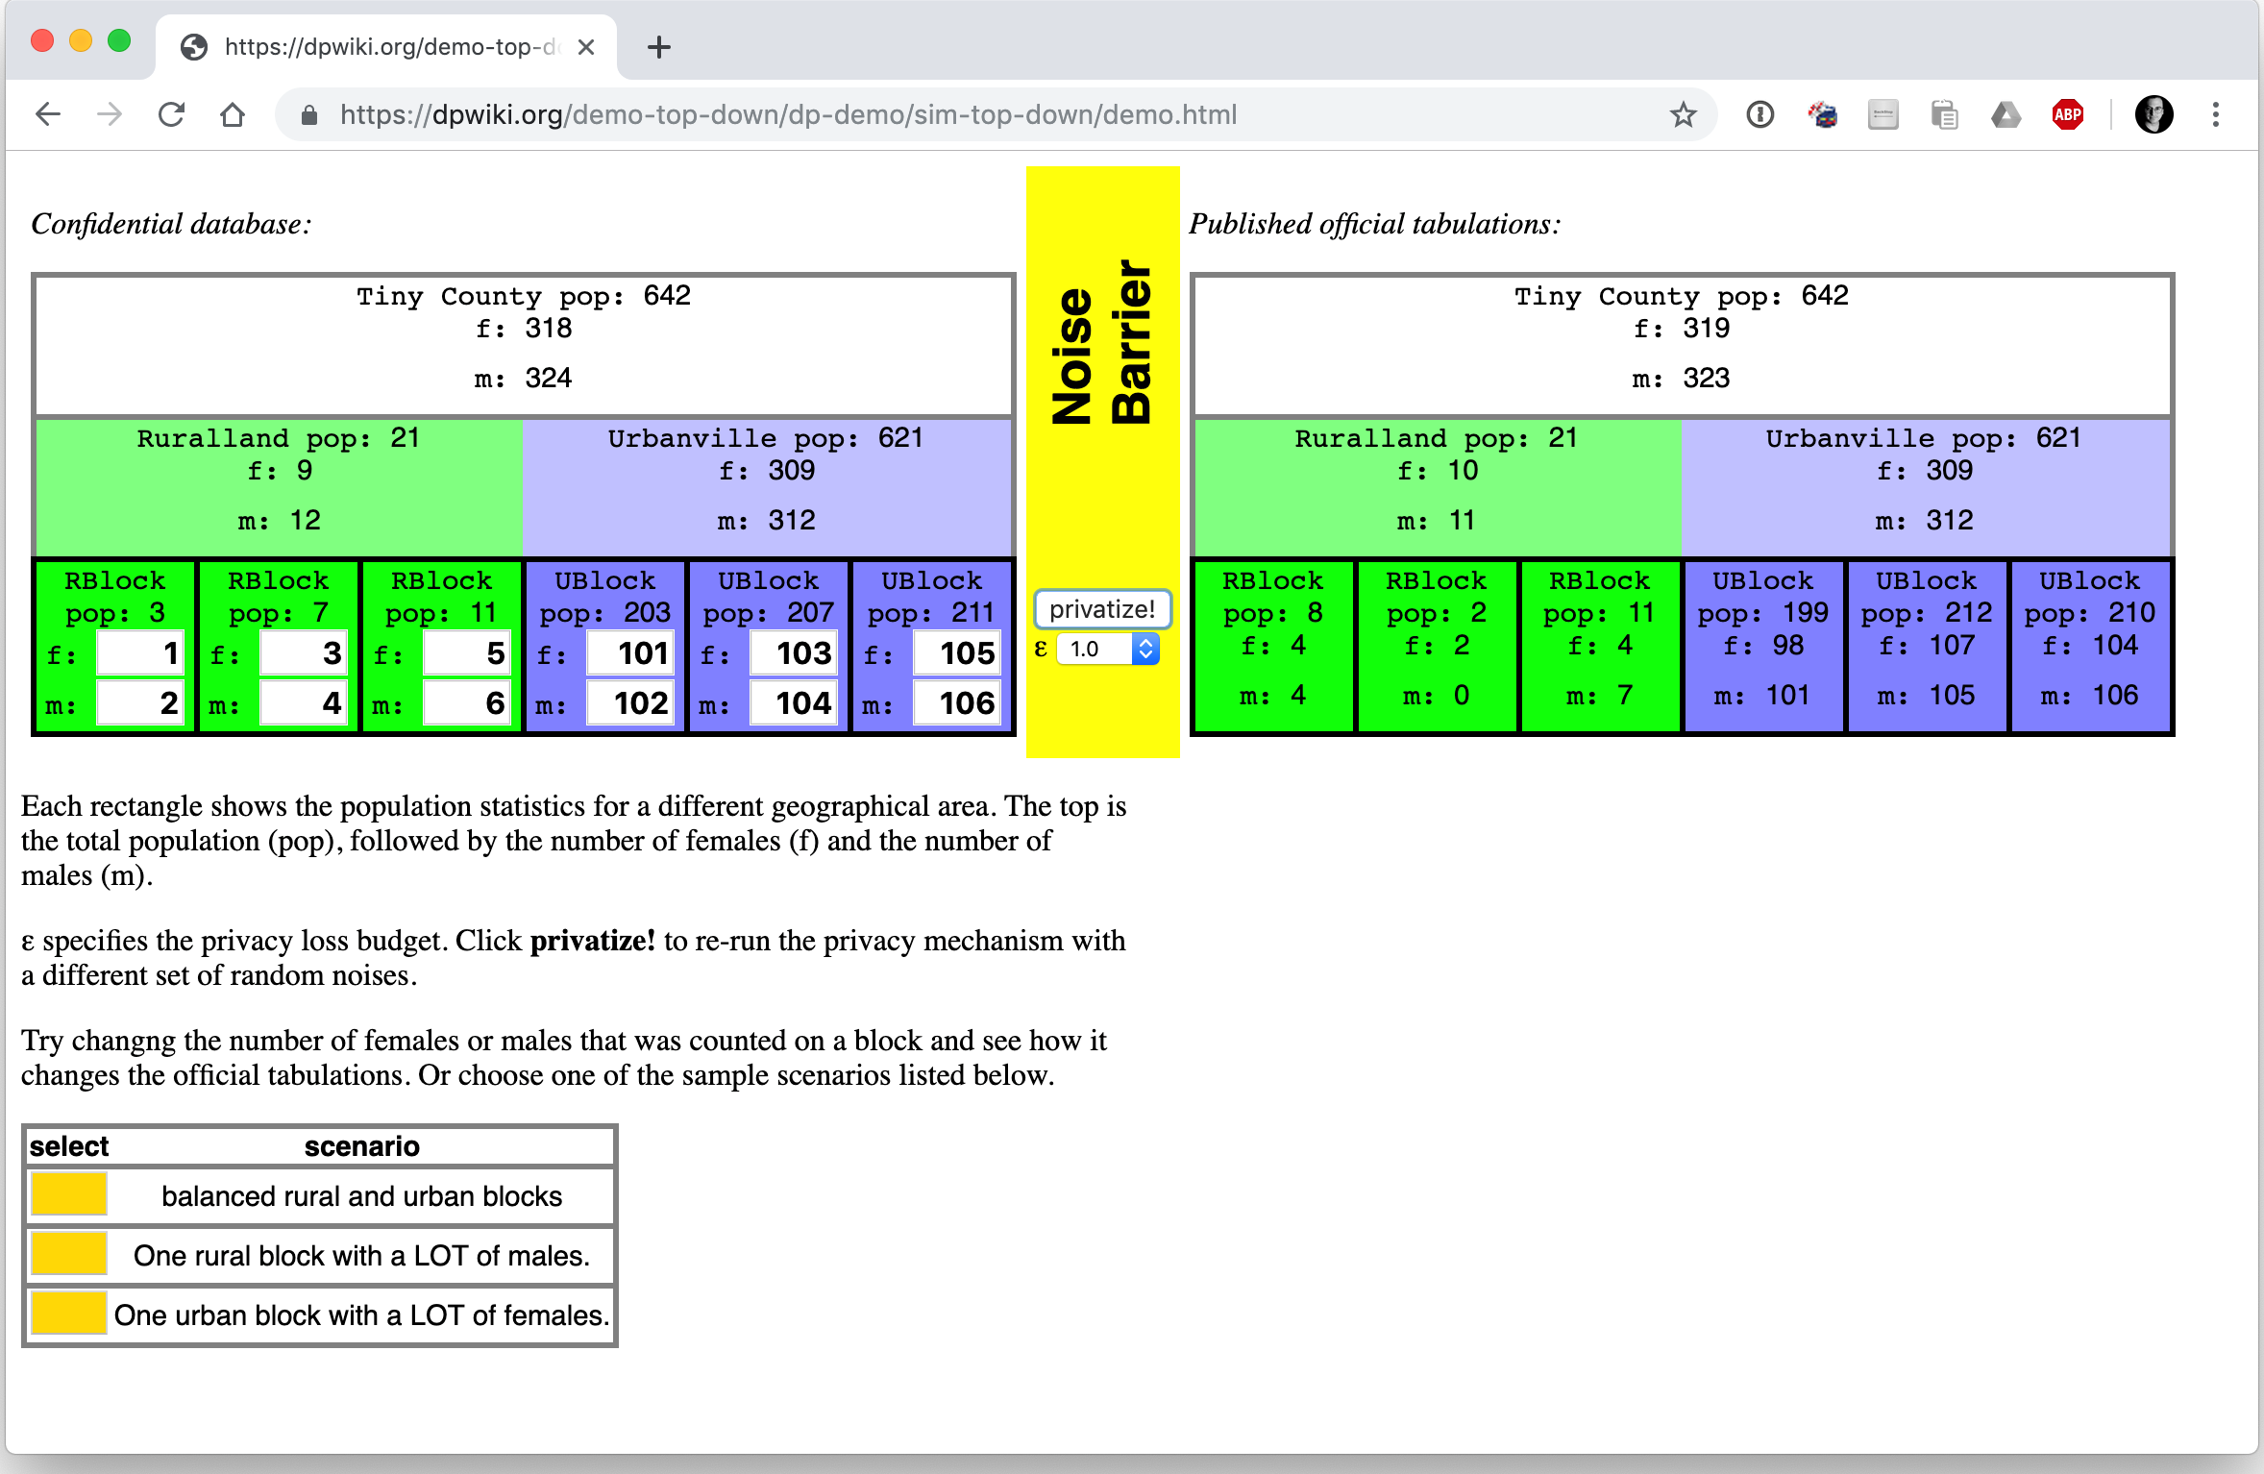
Note: The simulator uses hypothetical (fake) data provided by the user.

Slide 73
Two public policy choices:
What is the correct value of epsilon?
Where should the accuracy be allocated?

Slide 74

Managing the Tradeoff

Slide 75
Policy Issue: Setting Epsilon
Notes:
We want the most efficient technology, which is the one in red.

Slide 76
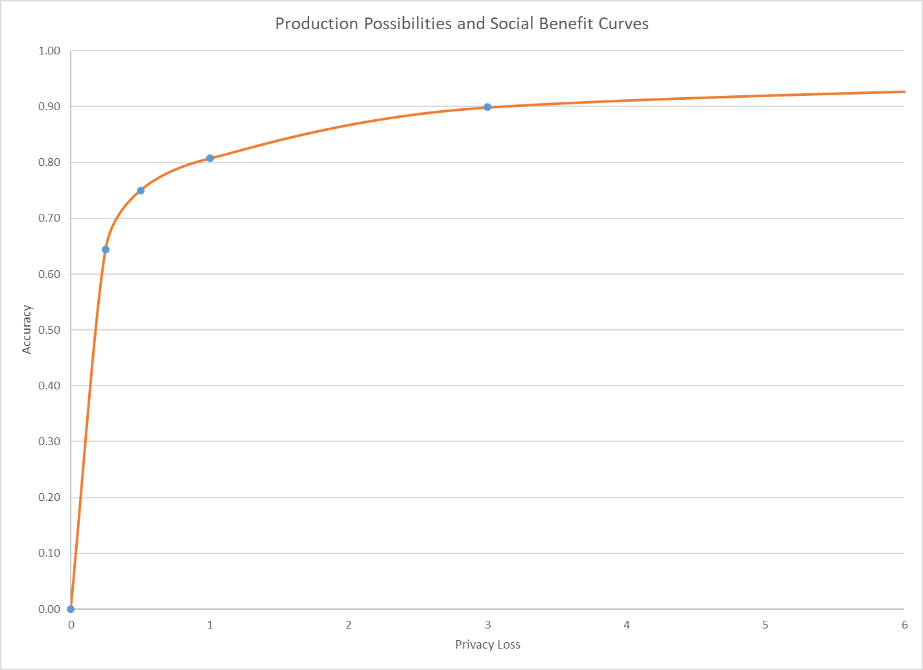
Marginal Social Benefit Curve
Social Optimum: MSB = MSC
(0.25, 0.64)
Production Technology
Notes:
The marginal social benefit is the slope of the illustrated iso-social welfare line (gray). These lines must slope upwards because data accuracy is a “good” and privacy-loss is a “bad.” Iso-social welfare lines above the one illustrated are infeasible because no point on the PPF reaches them. Iso-social welfare lines below the one illustrated are feasible but suboptimal because social welfare can be increase by either increasing accuracy at no privacy-loss cost or decreasing privacy-loss without loss of accuracy.
Slope of the Iso-social welfare curve is 1.5, this means surrendering one unit of privacy loss (say, epsilon goes from 0.25 to 0.26) is worth 1.5 units of accuracy (then accuracy goes from 0.64 to 0.655)
The social optimum is the point of tangency between an iso-social welfare line (gray) and the PPF (red). At this point, the only social welfare improving combinations of data accuracy and privacy-loss are infeasible.
The illustrated iso-social welfare line is the best one attainable, and social welfare is maximized at the indicated point. This point gives the optimal privacy-loss budget and the optimal data accuracy as determined by the preferences of the data users constrained by the SDL technology.
At the indicated level of ε = 0.25, accuracy for tract-level tables averages 96%, and for county and state-level tables averages 100%.
It is impossible to assess the block-level error in a vacuum. You have to consider the use case. The other slides in that presentation show that as the blocks are assembled into geographic areas with larger populations--tracts (244), counties (5), and state (1)--the accuracy improves rapidly. Accuracy is about 96% at the tract level, and essentially 100% at the state and county level. The vast majority of legislative districts in the country have populations far in excess of the average census tract population (about 4,300 for RI in 2010). We have decided to release a large batch of statistical tables, in 2010 PL94-171 redistricting format, from the experiments summarized in my CSAC presentation in advance of releasing the production code for the 2018 End-to-End Census Test disclosure avoidance system. Users of all stripes will be able to use those simulation results to assess average error for their own use cases at all levels of geography.

Slide 77
Notes on the previous slide
The marginal social benefit is the slope of the illustrated iso-social welfare line (gray). These lines must slope upwards because data accuracy is a “good” and privacy-loss is a “bad.” Iso-social welfare lines above the one illustrated are infeasible because no point on the PPF reaches them. Iso-social welfare lines below the one illustrated are feasible but suboptimal because social welfare can be increase by either increasing accuracy at no privacy-loss cost or decreasing privacy-loss without loss of accuracy.
Slope of the Iso-social welfare curve is 1.5, this means surrendering one unit of privacy loss (say, epsilon goes from 0.25 to 0.26) is worth 1.5 units of accuracy (then accuracy goes from 0.64 to 0.655)
The social optimum is the point of tangency between an iso-social welfare line (gray) and the PPF (red). At this point, the only social welfare improving combinations of data accuracy and privacy-loss are infeasible.
The illustrated iso-social welfare line is the best one attainable, and social welfare is maximized at the indicated point. This point gives the optimal privacy-loss budget and the optimal data accuracy as determined by the preferences of the data users constrained by the SDL technology.
At the indicated level of ε = 0.25, accuracy for tract-level tables averages 96%, and for county and state-level tables averages 100%.
It is impossible to assess the block-level error in a vacuum. You have to consider the use case. The other slides in that presentation show that as the blocks are assembled into geographic areas with larger populations--tracts (244), counties (5), and state (1)--the accuracy improves rapidly. Accuracy is about 96% at the tract level, and essentially 100% at the state and county level. The vast majority of legislative districts in the country have populations far in excess of the average census tract population (about 4,300 for RI in 2010). We have decided to release a large batch of statistical tables, in 2010 PL94-171 redistricting format, from the experiments summarized in my CSAC presentation in advance of releasing the production code for the 2018 End-to-End Census Test disclosure avoidance system. Users of all stripes will be able to use those simulation results to assess average error for their own use cases at all levels of geography.

Slide 78
Policy Decisions: Setting privacy loss budget (𝝴)
Global privacy loss budget
Geographic levels
  Fraction of 𝝴 allocated to each level
Tables
  Fraction of 𝝴 allocated to each table or relationship

Slide 79
Policy Issues for the 2020 Census:
Invariants
For the 2018 End-to-End test, policy makers wanted exact counts:
  Number of people on each block
  Number of people on each block of voting age
  Number of residences & group quarters on each block
We implemented invariants before we understood their mathematical impact on differential privacy semantics. We then scaled back to four invariants:
  C1: Total population (invariant at the county level for the 2018 E2E)
  C2: Voting-age population (population age 18 and older) (eliminated for the 2018 E2E)
  C3: Number of housing units (invariant at the block level)
  C4: Number of occupied housing units (invariant at the block level)
  C5: Number of group quarters facilities by group quarters type (invariant at the block level)

Slide 80
Scientific Issues for the 2020 Census:
Person-Household Joins
The Census creates two kinds of tables:
  Person tables
  Household tables
We can create P & H today.
We are working on P x H and Detailed P, H
Q(P): # of men living on a block.
Q(H): # of occupied houses on a block.
Q(P x H): # of children in houses headed by a single man.

Slide 81
Scientific Issue for any use of DP:
Quality Metrics
What is the measure of “quality” or “utility” in a complex data product?
Options:
  L1 error between “true” data set and “protected” data set
  Impact on an algorithm that uses the data (e.g., redistricting and Voting Rights Act enforcement)

Slide 82
The Choice Problem for Redistricting Tabulations
Is More Challenging
In the redistricting application, the fitness-for-use is based on :
  Supreme Court one-person one-vote decision (All legislative districts must have approximately equal populations; there is judicially approved variation)
  Is statistical disclosure limitation a “statistical method” (permitted by Utah v. Evans) or “sampling” (prohibited by the Census Act, confirmed in Commerce v. House of Representatives)?
  Voting Rights Act, Section 2: requires majority-minority districts at all levels, when certain criteria are met
The privacy interest is based on:
  Title 13 requirement not to publish exact identifying information
  The public policy implications of uses of detailed race, ethnicity and citizenship
Notes:
All statistical disclosure limitation methods used by the Census Bureau, including differential privacy as implemented for the 2020 Census, conform to both the Census Act--there is no sampling at any level, all the records in the official, confidential decennial census data are used, and no others--and to our understanding of Utah v. Evans--statistical disclosure limitation is an accepted statistical method and has been used since at least 1970 by the Census Bureau.

Slide 83
Notes on the previous slide
All statistical disclosure limitation methods used by the Census Bureau, including differential privacy as implemented for the 2020 Census, conform to both the Census Act--there is no sampling at any level, all the records in the official, confidential decennial census data are used, and no others--and to our understanding of Utah v. Evans--statistical disclosure limitation is an accepted statistical method and has been used since at least 1970 by the Census Bureau.

Slide 84
Organizational Challenges
Process documentation
  All uses of confidential data need to be tracked and accounted.
Workload identification
  All desired queries on MDF should be known in advance.
  Required accuracy for various queries should be understood.
  Queries outside of MDF must also be pre-specified
Correctness and Quality control
  Verifying implementation correctness.
  Data quality checks on tables cannot be done by looking at raw data.

Slide 85
Data User Challenges
Differential privacy is not widely known or understood.
Many data users want highly accurate data reports on small areas.
  Some are anxious about the intentional addition of noise.
  Some are concerned that previous studies done with swapped data might not be replicated if they used DP data.
Many data users believe they require access to Public Use Microdata.
Users in 2000 and 2010 didn’t know the error introduced by swapping and other protections applied to the tables and PUMS.

Slide 86
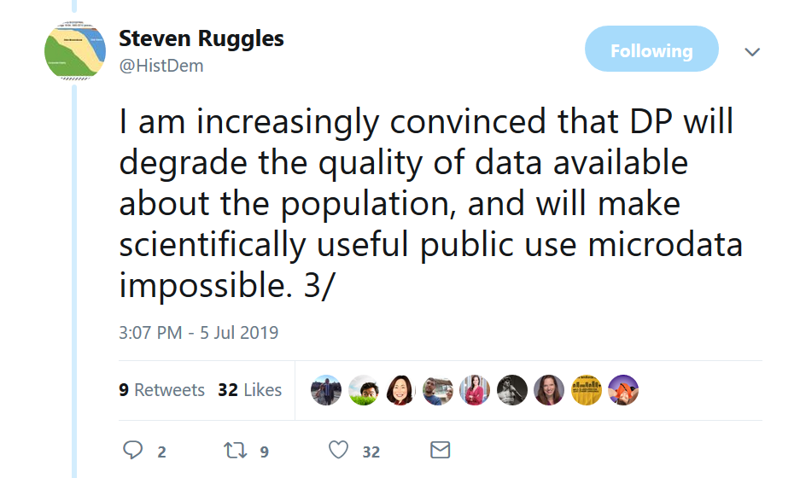
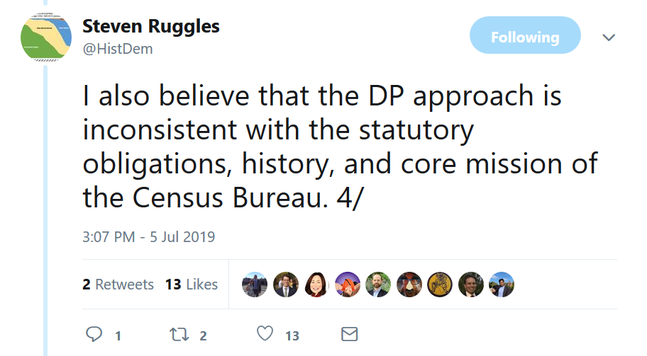
Concerns and Responses

Slide 87
Redistricting and Exact Counts
In the US, legislative districts must have equal size.
  Decennial Census counts of each block are the “official counts.”
Some data users are concerned that adding noise to the counts will make them unfit for use.
However:
  Evaluation of districts is based on official decennial counts; these data are used for 10 years.
  Noise added by DP is significantly less than noise added by other statistical methods currently in use
Notes:
The legal evaluations are made on the ”official statistics,” no matter what those official statistics happen to be, no matter how far they may have drifted from when they were created.
One of the advantages of the top-down algorithm is that errors at the block-level cancel out at higher geographies, assuming that the higher geographies have block groups and tracts.

Slide 88

Ruggles Concerns
Differential privacy is not a measure of identifiability
Differential privacy does not measure disclosure risk
“Differential Privacy is not concerned with re-identification of respondents
  “DP prohibits revealing characteristics of an individual even if the identity of that individual is effectively concealed
  “This is a radical departure from established census law and precedent
  “The Census Bureau has been disseminating individual-level characteristics routinely since the first microdata in 1962
Notes:
Steven Ruggles is a respected social scientist who is the director of Institute for Social Research and Data Innovation at the University of Minnesota. He is the driving force behind the IPUMS.
He has also organized a criticism of the Census Bureau’s decision to move to differential privacy.
Ruggles has repeatedly said that the law is concerned with re-identification. The Census Bureau disagrees, and says that the law is concerned with tracing data provided by an individual or an establishment back to the individual or establishment that provided it.

Slide 89
Organized attack on the move to differential privacy
Concerns:
  “Differential privacy will degrade the quality of data available about the population, and will probably make scientifically useful public use microdata impossible
  The differential privacy approach is inconsistent with the statutory obligations, history, and core mission of the Census Bureau”
Notes:
Ruggles is primarily concerned with the PUMS, and specifically the PUMS for the American Community Survey.
He is concerned that a synthetic PUMS will have limited use for discovering relationships that are not encoded into the PUMS when they are created. Although this is true, the high dimensionality of the decennial census, the fact that the top-down algorithm preserves a lot of spatial variance, and the fact that there is a lot of correlation between different variables means that the Decennial PUMS will probably be more useful than a naïve application of DP would imply.
There are more testable hypotheses in the proposed 2020 public use products than there were in 2010 public-use products. The query space is broader. And all the hypotheses are accompanied with correct measures of error.

Slide 90
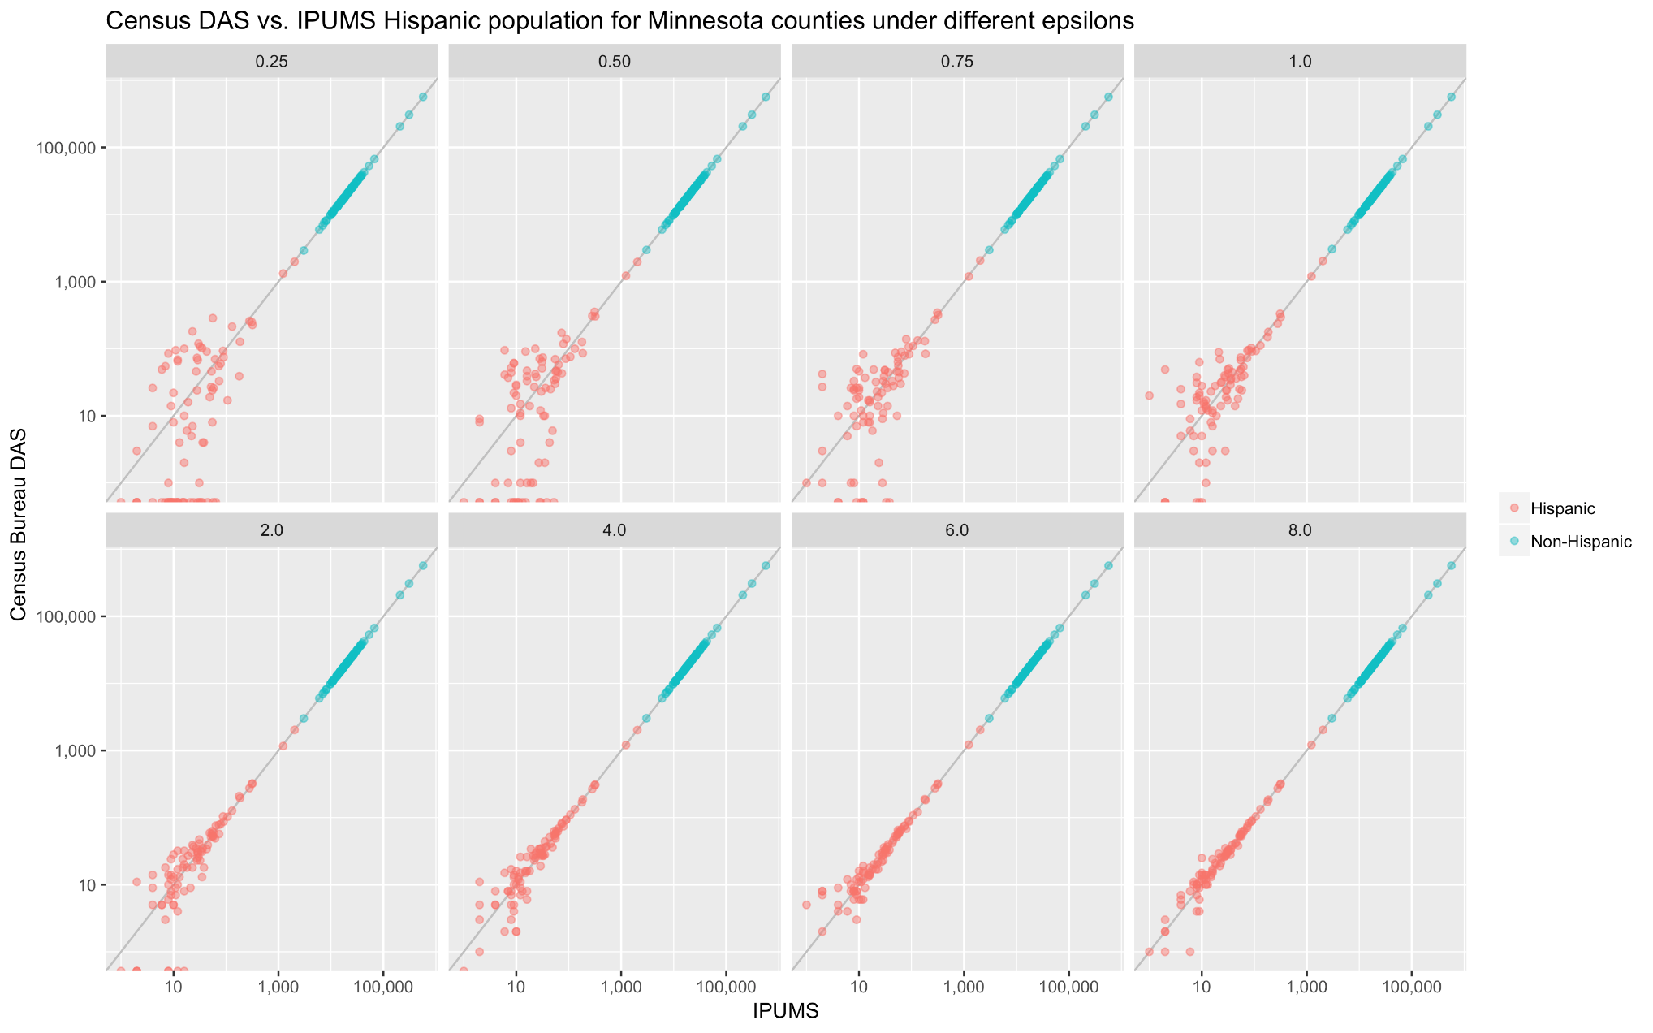
Analysis of population variances
David Van Riper & Tracy Kugler, IPUMS (APDU 2019)
Notes:
This graph shows an analysis done by David Riper and Tracy Kugler which was presented at the Association of Public Data Users a few weeks ago.
These graphs show that the algorithms are doing exactly what they are designed to do: as the number of people in a geographic area increases, the statistics about that area become more precise. Sparsely populated geographic areas are inherently risky, and DP always protects everyone in them, even when epsilon is as large at 8.
This is based on data from the 1940 Census that we released. As part of that release, we processed the 1940 data with the 2018 DAS at different values of epsilon.
Riper and Kugler took the 87 counties in Minnesota and compared the population in the original 1940 file with the population in the processed file. They did this for Hispanics and non-Hispanics. But there is nothing really special about those categories — it is simply a large population and a small population.
What these graphs show is that the change in population is more significant for counties with less than 100 Hispanics than those with more than 100. This makes sense, because differential privacy uses additive noise, not multiplicative noise.
This graph goes from an epsilon of 0.25 to 8.0.
(The details of the top-down algorithm are more complicated, of course, but it’s still basically the same thing.)
The analysis that this doesn’t show is how the error reduces when adjacent geographic areas are added together.
One of the issues with the data that we released is that the 1940 data only had four levels of geography: national, state, county, and enumeration district.
In contrast, the 2020 data will have 6 levels: National, state, county, tract, block group and block.
Another point of confusion is that the end-to-end test was run with an epsilon of 0.25. That value was specifically chosen because the purpose of the end-to-end test was to test data formats, not to use the data for a statistical product. Some people thought that the Census Bureau was signaling that it intended to use an epsilon of 0.25 for the 2020 release. That was not the intention of the Census Bureau.
To assist our data users, we will soon be re-releasing data from the 2010 Census, processing it with the DAS in its current form.

Slide 91
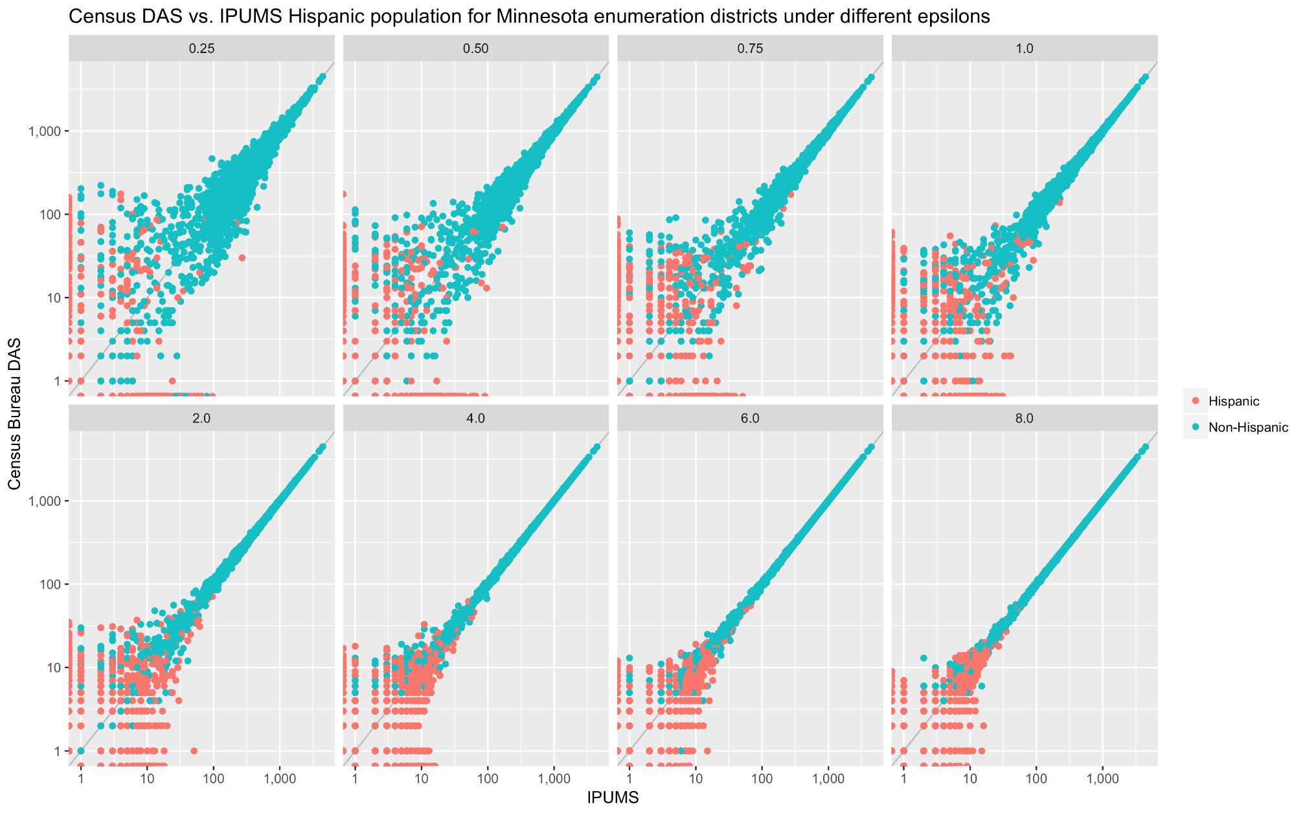
Analysis of population variances
David Van Riper & Tracy Kugler, IPUMS (APDU 2019)
Notes:
This is the same kind of graph, but for enumeration districts, not for counties.
Here again we see eight versions of the same graph, from epsilon 0.25 to 8.0.
As you can see, the lower values of epsilon have both more randomness, but also more bias—the graph is not symmetrical around the line x=y. That’s because 0s are getting only rounded up, so larger values are being pushed lower more often than they would otherwise be.

Slide 92
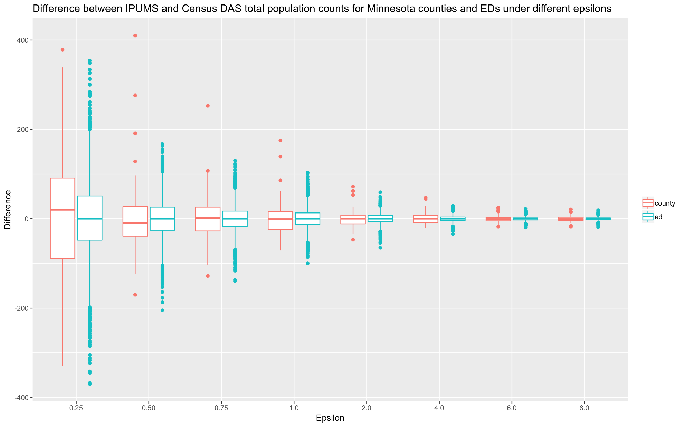
Analysis of population variances
David Van Riper & Tracy Kugler, IPUMS (APDU 2019)
Notes:
This graph by Riper and Kugler looks at the distribution of those differences for different values of epsilon, from 0.25 to 8.0. This time brown shows counties and green shows enumeration districts. Again, you can see that there is more bias at small values of epsilon.

Slide 93
For more information…
Can a set of equations keep U.S. census data private?
By Jeffrey Mervis
Science
Jan. 4, 2019 , 2:50 PM
Communications of ACM March 2019
Garfinkel & Abowd
http://bit.ly/Science2019C1

Slide 94
More Background on the 2020 Disclosure Avoidance System
September 14, 2017 CSAC (overall design)
https://www2.census.gov/cac/sac/meetings/2017-09/garfinkel-modernizing-disclosure-avoidance.pdf
August, 2018 KDD’18 (top-down v. block-by-block)
https://digitalcommons.ilr.cornell.edu/ldi/49/
October, 2018 WPES (implementation issues)
https://arxiv.org/abs/1809.02201
October, 2018 ACMQueue (understanding database reconstruction)
https://digitalcommons.ilr.cornell.edu/ldi/50/ or
https://queue.acm.org/detail.cfm?id=3295691
Memorandum 2019.13: Disclosure Avoidance System Design Parameters
https://www.census.gov/programs-surveys/decennial-census/2020-census/planning-management/memo-series/2020-memo-2019_13.html

