Slide 1
Differential Privacy:
Some Basic Concepts
Simson L. Garfinkel
Senior Scientist, Confidentiality and Data Access
U.S. Census Bureau
May 2, 2019
National Advisory Committee on Racial, Ethnic and Other Populations Spring 2019 Meeting
The views in this presentation are those of the author, and not those of the U.S. Census Bureau.

Slide 2
Acknowledgments
This presentation is based on numerous discussions with
  John Abowd (Chief Scientist)
  Dan Kifer (Scientific Lead)
  Salil Vadhan (Harvard University)
  Robert Ashmead, Philip Leclerc, William Sexton, Pavel Zhuravlev (US Census Bureau)

Slide 3
Statistical agencies collect data under a pledge of confidentiality.
We pledge:
  Collected data will be used only for statistical purposes.
  Collected data will be kept confidential.
  Data from individuals or establishments
  won’t be identifiable in any publication.
Fines and prison await any Census Bureau employee who violates this pledge.

Slide 4
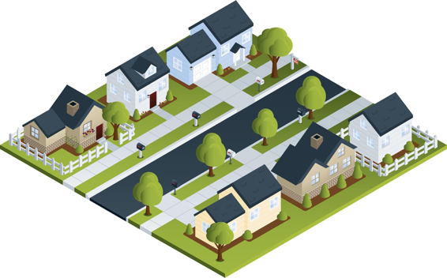
Statistical agencies are trusted curators.
Confidential
Database
Published Statistics
Respondents
 | # | Median Age | Mean Age
Total | 7 | 30 | 38
Women | 4 | 30 | 33.5
Male | 3 | 30 | 44
Black | 4 | 51 | 48.5
White | 3 | 24 | 24
Married | 4 | 51 | 54
Black F | 3 | 36 | 36.7
Age Sex Race/MS
8 FBS
18 MWS
24 FWS
30 MWM
36 FBM
66 FBM
84 MBM

Slide 5
We now know “trusted curator” model is more complex.
Every data publication results in some privacy loss.
Publishing too many statistics results in the compromise of the entire confidential database.
Respondents
Confidential Database
Published Statistics

Slide 6
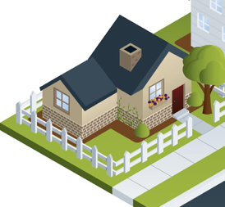
Consider the statistics from a single household
 | Count | Median | Mean
Total | 1 | 24 | 24
# Female | 1 | 24 | 24
# white | 1 | 24 | 24
Single | 1 | 24 | 24
White F | 1 | 24 | 24
24 yrs Female White Single (24 FWS)

Slide 7
Publishing statistics for this household alone would result in an improper disclosure.
 | Count | Median | Mean
Total | (D) | (D) | (D)
# Female | (D) | (D) | (D)
# white | (D) | (D) | (D)
Single | (D) | (D) | (D)
White F | (D) | (D) | (D)
(D) Means suppressed to prevent an improper disclosure.
24 yrs Female White Single (24 FWS)

Slide 8

In the past, statistical agencies aggregated data from many households together into a single publication.
 | Count | Median Age | Mean Age
Total | 7 | 30 | 38
# Female | 4 | 30 | 33.5
# male | 3 | 30 | 44
# black | 4 | 51 | 48.5
# white | 3 | 24 | 24
Married | 4 | 51 | 54
Black F | 3 | 36 | 36.7

Slide 9
We now know that this publication can be reverse-engineered to reveal the confidential database.
 | Count | Median | Mean
Total | 7 | 30 | 38
# Female | 4 | 30 | 33.5
# male | 3 | 30 | 44
# black | 4 | 51 | 48.5
# white | 3 | 24 | 24
Married | 4 | 51 | 54
Black F | 3 | 36 | 36.7
66 FBM & 84 MBM
30 MWM & 36 FBM
8 FBS
18 MWS
24 FWS
This table can be expressed by 164 equations.
Solving those equations takes
0.2 seconds on a 2013 MacBook Pro.

Slide 10
Faced with “database reconstruction,” statistical agencies have just two choices.
Option #1: Publish fewer statistics.
Option #2: Publish statistics with less accuracy.

Slide 11
The problem with publishing fewer statistics: it’s hard to know how many statistics is “too many.”
 | Count | Median | Mean
Total | 7 | 30 | 38
# Female | 4 | 30 | 33.5
# male | 3 | 30 | 44
# black | 4 | 51 | 48.5
# white | 3 | 24 | 24
Single | XXXX | XXXX | XXXX
Married | 4 | 51 | 54
Black F | 3 | 36 | 36.7
Black M | XXXX | XXXX | XXXX
White M | XXXX | XXXX | XXXX
White F | XXXX | XXXX | XXXX
Solution #1
8 FBS
18 MWS
24 FWS
30 MWM
36 FBM
66 FBM
84 MBM
Solution #2
2 FBS
12 MWS
24 FWS
30 MBM
36 FWM
72 FBM
90 MBM

Slide 12
Faced with “database reconstruction,” statistical agencies have just two one choice.
Option #1: Publish fewer statistics.
Option #2: Publish statistics with less accuracy.

Slide 13
Differential privacy gives us a mathematical approach for balancing accuracy and privacy loss.
No privacy
No accuracy

Slide 14
“Differential privacy” is really two things
1 – A mathematical definition of privacy loss.
2 – Specific mechanisms that allow us to:
    Add the smallest amount of noise necessary for a given privacy outcome
    Structure the noise to have minimal impact on the more important statistics

Slide 15
Differential privacy — the big idea:
Use “noise” to create uncertainty about private data.
NOISE BARRIER
35 yrs Female Black Single (35 FBS)
Impact of the noise ≈ impact of a single person
Impact of noise on aggregate statistics
decreases with larger population.
24 yrs Female White Single (24 FWS)

Slide 16
Understanding the impact of “noise:”
(Statistics based on 10,000 experiments, epsilon=1.0)
 | 50% runs | 95% runs
 | Median(age): 9 → 73 | Median(age): 0→ 104
 | Median(age): 17 → 61 | Median(age): 0→ 103
 | Median(age): 21 → 22 | Median(age): 21→ 22
1 person age 22
NOISE BARRIER
10 people, all age 22
100 people, all age 22

Slide 17
The noise also impacts the person counts.
 | 50% runs | 95% runs
 | Median(age): 9 → 73 # people: -9 → 11 | Median(age): 0→ 104 # people: -29 → 30
 | Median(age): 17 → 61 # people: 0 → 20 | Median(age): 0→ 103 # people: -19 → 38
 | Median(age): 21 → 22 # people: 90 → 110 | Median(age): 21→ 22 # people: 71 → 129
1 person age 22
NOISE BARRIER
10 people, all age 22
100 people, all age 22

Slide 18

The 2020 census and differential privacy

Slide 19
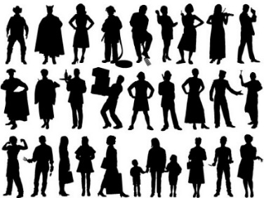
The Disclosure Avoidance System allows the Census Bureau to enforce global confidentiality protections.
Pre-specified tabular summaries:
PL94-171, DHC, detailed DHC
DRF
CUF
CEF
DAS
MDF
Decennial Response File
Census Unedited File
Census Edited File
Global Confidentiality Protection Process
Disclosure Avoidance System
Microdata Detail File
Special tabulations and post-census research
Confidential data
Privacy-loss Budget,
Accuracy Decisions
Public data

Slide 20
The Disclosure Avoidance System relies on injects formally private noise.
Advantages of noise injection with formal privacy:
  Transparency: the details can be explained to the public
  Tunable privacy guarantees
  Privacy guarantees do not depend on external data
  Protects against accurate database reconstruction
  Protects every member of the population
Challenges:
  Entire country must be processed at once for best accuracy
  Every use of confidential data must be tallied in the privacy-loss budget
Global Confidentiality Protection Process
Disclosure Avoidance System
ε

Slide 21
There was no off-the-shelf system for applying differential privacy to a national census
We had to create a new system that:
  Produced higher-quality statistics at more densely populated geographies
  Produced consistent tables
  We created new differential privacy algorithms and processing systems that:
  Produce highly accurate statistics for large populations (e.g. states, counties)
  Create privatized microdata that can be used for any tabulation without additional privacy loss
  Fit into the decennial census production system

Slide 22
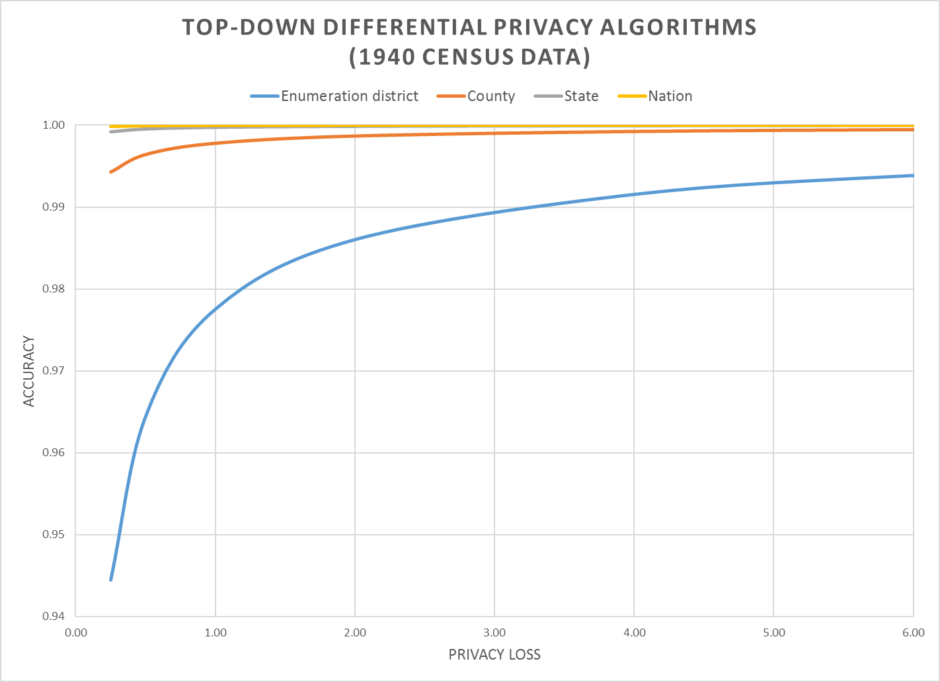
The 2020 DAS produces highly accurate data when blocks are aggregated into tracts
99% accuracy
95% accuracy
“epsilon” — the privacy loss parameter
Notes:
Accuracy (in all slides) is (1 – AveTVD/N), where AveTVD = Average Total Variation Distance = Sum( 0.5L_1) over all query sets in the PL94 workload over all geographies in the workload divided by the number of query sets (14), L_1 is the absolute error in all the table, and N is the population count in the complete person table (1940 population). AveTVD is averaged over all the tables in the workload for the relevant geography.
In the 1940 Census data, the geography is nation, state, county, enumeration district (approximately, a modern block group, in 1940 a voting precinct in most areas).
Left panel is the performance of the top-down algorithm at each level of geography for privacy-loss budgets from 0.25 to 6.00. Right panel is the performance of the district-by-district algorithm for the same geographies and workload.
Workload in the experiments is the detailed histogram GQ/HH type (9) x voting age (2) x Hispanic (5) x Race (6) x Citizenship (5) measured sharing the global privacy loss budget across all levels of geography.

Slide 23
Two public policy choices:
What is the correct value of epsilon?
Where should the accuracy be allocated?

Slide 24
For more information…
Can a set of equations keep U.S. census data private?
By Jeffrey Mervis
Science
Jan. 4, 2019 , 2:50 PM
Communications of ACM March 2019
Garfinkel & Abowd
http://bit.ly/Science2019C1

Slide 25
More Background on the 2020 Disclosure Avoidance System
September 14, 2017 CSAC (overall design)
https://www2.census.gov/cac/sac/meetings/2017-09/garfinkel-modernizing-disclosure-avoidance.pdf
August, 2018 KDD’18 (top-down v. block-by-block)
https://digitalcommons.ilr.cornell.edu/ldi/49/
October, 2018 WPES (implementation issues)
https://arxiv.org/abs/1809.02201
October, 2018 ACMQueue (understanding database reconstruction)
https://digitalcommons.ilr.cornell.edu/ldi/50/ or
https://queue.acm.org/detail.cfm?id=3295691

