Slide 1
Protecting the Confidentiality of the 2020 Census Statistics
Simson L. Garfinkel Senior Scientist, Confidentiality and Data Access U.S. Census Bureau Presented to the Trust and Confidentiality Working Group
California Complete Count—Census 2020
Friday, March 1, 9:30am Pacific Time
The views in this presentation are those of the author, and do not represent those of the U.S. Census Bureau.

Slide 2
Questions I’ve been asked to address
How is the U.S. Census Bureau's messaging concerning privacy and confidentiality different from 2010?
What is the U.S. Census Bureau's messaging to explain differential privacy to the public?
How does the U.S. Census Bureau's differential privacy safeguard both individual and block-level data?
Which industry professionals are conducting penetration tests and what are the results of those tests? How are the results of those tests being communicated to help build public trust in data confidentiality?
Who is hosting the U.S. Census Bureau's data? Which cloud service is being used?

Slide 3
Privacy and Confidentiality: 2010 vs. 2020

Slide 4
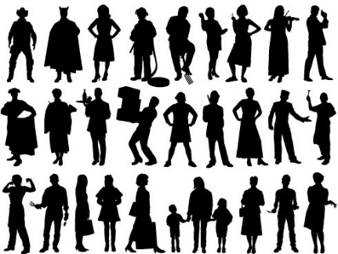
Data flow in the 2000 and 2010 census:
Pre-specified tabular summaries: PL94-171, SF1, SF2 (SF3, SF4, … in 2000)
DRF
CUF
CEF
HDF
Raw data from respondents: Decennial Response File
Selection & unduplication: Census Unedited File
Edits, imputations: Census Edited File
Confidentiality edits (household swapping), tabulation recodes: Hundred-percent Detail File
Special tabulations and post-census research
Confidential data
Public data

Slide 5
The protection system used in 2000 and 2010 relied on swapping households.
Some households were swapped with other households
Swapped households had the same size.
Swapping limited to within each state.
Disadvantages:
Swap rate and details of swapping not disclosed.
Privacy protection was not quantified.
Impact on data quality not quantified.
Town 1
Town 2
State “X”

Slide 6
After we swapped, we tabulated the 2010 Census of Population and Housing
Basic results from the 2010 Census:
Total population | 308,745,538
Household population | 300,758,215
Group quarters population | 7,987,323
Households | 116,716,292

Slide 7
2010 Census: Summary of Publications (approximate counts)
Publication | Released counts (including zeros)
PL94-171 Redistricting | 2,771,998,263
Balance of Summary File 1 | 2,806,899,669
Summary File 2 | 2,093,683,376
Public-use micro data sample | 30,874,554
Lower bound on published statistics | 7,703,455,862
Statistics/person | 25
Notes:
The 2010 Census publication schedule resulted in roughly 2.8 billion counts (including zeros) published in PL94-171, another 2.8 billion in the rest of SF1, 2 billion in SF2, and another 30 million in a public-use microdata sample. This is roughly 7.7 billion statistics, or 25 per person. That’s a lot more than 6 per person.

Slide 8
We now know that the Disclosure Avoidance Techniques we used in the 2010 Census were flawed.
These were the best available techniques at the time! But:
We released exact population counts at the block, tract and county level.
We released counts for age in years, OMB race/ethnicity, sex, relationship to householder, in Summary File 2: detailed race data based on the swapped data.
We released 25 statistics per person, but only collected six pieces of data per person:
Block • Age • Sex • Race • Ethnicity • Relationship to Householder

Slide 9
We performed a database reconstruction and re-identification attack for all 308,745,538 people in 2010 Census
We reconstructed 308,745,538 microdata records.
Linked the reconstructed records to commercial databases: acquire PII
Successfully linked to commercial data: putative re-identification
Compare putative re-identifications to confidential data
Successful linkage to confidential data: confirmed re-identification
Harm: attacker can learn self-response race and ethnicity

Slide 10
Results of our reconstruction and re-identification attack: legacy privacy protection methods are no longer acceptable.
Census block correctly reconstructed in all 6,207,027 inhabited blocks
Block, sex, age, race, ethnicity reconstructed
Exactly: 46% of population (142 million of 308,745,538)
Allowing age +/- one year: 71% of population (219 million of 308,745,538)
Block, sex, age linked to commercial data to acquire PII
Putative re-identifications: 45% of population (138 million of 308,745,538)
Name, block, sex, age, race, ethnicity compared to confidential data
Confirmed re-identifications: 38% of putative (52 million; 17% of population)
For the confirmed re-identifications, race and ethnicity are learned exactly, not statistically
Notes:
A reconstruction attack recreates record-level images of all variables used in published tabulations, not all variables in the confidential database. If “name” is never tabulated, then “name” cannot be reconstructed.
A reconstruction-abetted re-identification attack links external data to the reconstructed micro-data. These external data contain identifying information like names and addresses. Such an attack leads to “putative re-identifications”: records that the attacker believes are the data for identifiable information. In a successful re-identification attack, putative re-identifications are confirmed at a high rate. The putative re-identifications from the 2010 Census experiments are not confirmed at a high rate. We are still researching this issue.
An issue is a risk that has occurred (probability = 1), and an active mitigation plan is required.

Slide 11
1. “How is the U.S. Census Bureau's messaging concerning privacy and confidentiality different from 2010?”

Slide 12
“How is the U.S. Census Bureau's messaging concerning privacy and confidentiality different from 2010?”
In 2020, we are adopting Formal Privacy to protect privacy and confidentiality.
Formal Privacy gives us:
Techniques for protecting confidentiality that have been subjected to rigorous, mathematical proofs.
The ability to directly manage the accuracy/privacy-loss trade-off.

Slide 13
Formal Privacy and the 2020 Census

Slide 14
No privacy
No accuracy

Slide 15
“Differential Privacy” is the formal privacy system that we are using.
Differential privacy gives us:
Provable bounds on the maximum privacy loss
Algorithms that allow policy makers to manage the trade-off between accuracy and privacy
It’s called “differential privacy” because it mathematically models the privacy “differential” that each person experiences from having their data included in the Census Bureau’s data products compared to having their record deleted or replaced with an arbitrary record.
Pre-Decisional

Slide 16
The Disclosure Avoidance System relies on injects formally private noise.
Advantages of noise injection with formal privacy:
Transparency: the details can be explained to the public
Tunable privacy guarantees
Privacy guarantees do not depend on external data
Protects against accurate database reconstruction
Protects every member of the population
Challenges:
Entire country must be processed at once for best accuracy
Every use of confidential data must be tallied in the privacy-loss budget
Global Confidentiality Protection Process
Disclosure Avoidance System
ε

Slide 17
2. What is the U.S. Census Bureau's messaging to explain differential privacy to the public?

Slide 18
What is the U.S. Census Bureau's messaging to explain differential privacy to the public?
Differential privacy requires that statistical noise be added to every data product.
The amount of noise that we add is determined by the Census Bureau’s policy makers:
The noise will balance the requirements for accuracy and confidentiality.
Some data products will be more accurate with differential privacy than they were with swapping.
The system developed for the 2020 Census will not be the system used for the American Community Survey (ACS); that is still under development.

Slide 19
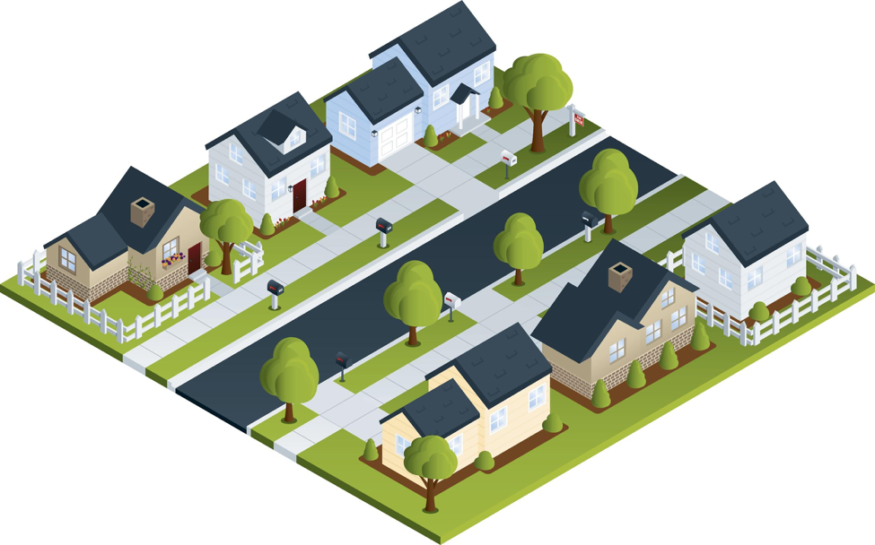
Consider a census block:
As collected:
As Reported
 | Male | Female
Age < 18 | 10 | 20
Age >= 18 | 40 | 30

Slide 20
Consider a census block:
 | Male | Female
Age < 18 | 5 | 0
Age >= 18 | 2 | 8
More accurate sex distribution
Pop=15
As collected:
 | Male | Female
Age < 18 | 6 | 2
Age >= 18 | 2 | 7
More accurate age distribution
Pop=17
 | Male | Female
Age < 18 | 4 | 4
Age >= 18 | 4 | 4
Pop=16

Slide 21
There was no off-the-shelf system for applying differential privacy to a national census
We had to create a new system that:
Produced higher-quality statistics at more densely populated geographies
Produced consistent tables
We created new differential privacy algorithms and processing systems that:
Produce highly accurate statistics for large populations (e.g. states, counties)
Create privatized microdata that can be used for any tabulation without additional privacy loss
Fit into the decennial census production system

Slide 22
The Disclosure Avoidance System allows the Census Bureau to enforce global confidentiality protections.
Pre-specified tabular summaries: PL94-171, SF1, SF2
DRF
CUF
CEF
DAS
MDF
Decennial Response File
Census Unedited File
Census Edited File
Global Confidentiality Protection Process
Disclosure Avoidance System
Microdata Detail File
Special tabulations and post-census research
Confidential data
Privacy-loss Budget,
Accuracy Decisions
Public data

Slide 23
3. How does the U.S. Census Bureau's differential privacy safeguard both individual and block-level data?

Slide 24
How does the U.S. Census Bureau's differential privacy safeguard both individual and block-level data?
Individual data is in the CEF but not in the MDF:
Block-level data has added noise:
The noise makes database reconstruction less accurate.
The noise frustrates using block-level data to find specific individuals.
CEF
DAS
MDF
Census Edited File
Global Confidentiality Protection Process
Disclosure Avoidance System
Microdata Detail File

Slide 25
4. Which industry professionals are conducting penetration tests and what are the results of those tests? How are the results of those tests being communicated to help build public trust in data confidentiality?

Slide 26
Which industry professionals are conducting penetration tests and what are the results of those tests?
There are two kinds of “penetration tests.”
1. Attacks on the published data
The statistical team that performed the reconstruction attack is the same team that is building the Disclosure Avoidance System (DAS).
We are testing the DAS with data from the 2010 Census to confirm that the DAS will protect against an accurate reconstruction.
2. Attacks on the computer systems
The Census Bureau maintains a comprehensive information security program under the Federal Information Security Management Act (FISMA).

Slide 27
How are the results of those tests being communicated to help build public trust in data confidentiality?
We are engaging stakeholders through:
Talks at academic conferences
Presentations to stakeholders
Presentations to advisory groups
Articles published in academic and popular press

Slide 28
5. Who is hosting the U.S. Census Bureau's data? Which cloud service is being used?

Slide 29
Who is hosting the U.S. Census Bureau's data? Which cloud service is being used?
Data are hosted on-site and in Amazon Web Services in the GovCloud with all Census Bureau security protocols in force (it’s as if the GovCloud were in our own computer facility)
The Disclosure Avoidance System runs in AWS
We need the computing power!

Slide 30
Backup slides

Slide 31
How the 2020 System Works: High-level Overview
Every record in the population may be modified
But modifications are bounded by the global privacy budget.
Records in the tabulation data have no exact counterpart in the confidential data
There is no one-to-one mapping between CEF and MDF records.
Explicitly protected tabulations (PL-94 and SF-1) have provable, public accuracy levels
The successor to SF2 and AIAN tabulations will also have provable, public accuracy levels

Slide 32
Two algorithmic choices
Block-by-block algorithm:
Top-down algorithm:
330M records
ε
National Histogram
8 million blocks
Disclosure Avoidance System
8 million protected blocks
State-level measurements
ε
51 state histograms
County-level measurements
ε
3,142 county histograms
Tract-level measurements
ε
75,000 census tract histograms
Block-level measurements
ε
8 million block histograms

Slide 33
Two public policy choices:
What is the correct value of epsilon?
Where should the accuracy be allocated?

Slide 34
But the Choice Problem for Redistricting Tabulations Is More Challenging
In the redistricting application, the fitness-for-use is based on :
Supreme Court one-person one-vote decision (All legislative districts must have approximately equal populations; there is judicially approved variation)
Is statistical disclosure limitation a “statistical method” (permitted by Utah v. Evans) or “sampling” (prohibited by the Census Act, confirmed in Commerce v. House of Representatives)? Answer: statistical method; there is no sampling.
Voting Rights Act, Section 2: requires majority-minority districts at all levels, when certain criteria are met
The privacy interest is based on:
Title 13 requirement not to publish exact identifying information
The public policy implications of uses of detailed race, ethnicity and citizenship
Notes:
All statistical disclosure limitation methods used by the Census Bureau, including differential privacy as implemented for the 2020 Census, conform to both the Census Act--there is no sampling at any level, all the records in the official, confidential decennial census data are used, and no others--and to our understanding of Utah v. Evans--statistical disclosure limitation is an accepted statistical method and has been used since at least 1970 by the Census Bureau.

Slide 35
More Background on the 2020 Disclosure Avoidance System
September 14, 2017 CSAC (overall design) https://www2.census.gov/cac/sac/meetings/2017-09/garfinkel-modernizing-disclosure-avoidance.pdf
August, 2018 KDD’18 (top-down v. block-by-block) https://digitalcommons.ilr.cornell.edu/ldi/49/
October, 2018 WPES (implementation issues) https://arxiv.org/abs/1809.02201
October, 2018 ACMQueue (understanding database reconstruction) https://digitalcommons.ilr.cornell.edu/ldi/50/ or https://queue.acm.org/detail.cfm?id=3295691

