Slide 1
The U.S. Census Bureau Adopts Differential Privacy
John M. Abowd
Chief Scientist and Associate Director for Research and Methodology
U.S. Census Bureau
2018 International Methodology Symposium
Ottawa, Ontario, Canada
November 9, 2018

Slide 2
Acknowledgments and Disclaimer
The opinions expressed in this talk are my own and not necessarily those of the U.S. Census Bureau
The application to the Census Bureau’s 2020 publication system incorporates work by Daniel Kifer (Scientific Lead), Simson Garfinkel (Senior Computer Scientist for Confidentiality and Data Access), Tamara Adams, Robert Ashmead, Michael Bentley, Stephen Clark, Aref Dajani, Jason Devine, Nathan Goldschlag, Michael Hay, Cynthia Hollingsworth, Meriton Ibrahami, Michael Ikeda, Philip Leclerc, Ashwin Machanavajjhala, Christian Martindale, Gerome Miklau, Brett Moran, Edward Porter, Sarah Powazek, Anne Ross, William Sexton, and Lars Vilhuber [link to the September 2018 Census Scientific Advisory Committee presentation]
Parts of this talk were supported by the National Science Foundation, the Sloan Foundation, and the Census Bureau (before and after my appointment started)

Slide 3

Disclosure Avoidance for the 2010 Census

Slide 4
“This is the official form for all the people at this address.”
“It is quick and easy, and your answers are protected by law.”
Notes:
The 2010 Census asked 10 questions and collected 6 pieces of information used in tabulation: address, sex, age, race, ethnicity, and relationship to person 1.

Slide 5
2010 Census of Population and Housing
Basic results from the 2010 Census:
Total population | 308,745,538
Household population | 300,758,215
Group quarters population | 7,987,323
Households | 116,716,292

Slide 6
2010 Census Person-Level Database Schema
Variables | Distinct values
Habitable blocks | 10,620,683
Habitable tracts | 73,768
Sex | 2
Age | 115
Race/Ethnicity (OMB Categories) | 126
Race/Ethnicity (SF2 Categories) | 600
Relationship to person 1 | 17
National histogram cells (OMB Categories) | 492,660
Notes:
Note: relationship to person 1 also includes two group quarters types (institutional, non-institutional) that are used for person-level tabulations

Slide 7
2010 Census: Summary of Publications
(approximate counts)
Publication | Released counts (including zeros)
PL94-171 Redistricting | 2,771,998,263
Balance of Summary File 1 | 2,806,899,669
Summary File 2 | 2,093,683,376
Public-use micro data sample | 30,874,554
Lower bound on published statistics | 7,703,455,862
Statistics/person | 25
Notes:
The 2010 Census publication schedule resulted in roughly 2.8 billion counts (including zeros) published in PL94-171, another 2.8 billion in the rest of SF1, 2 billion in SF2, and another 30 million in a public-use microdata sample. This is roughly 7.7 billion statistics, or 25 per person. That’s a lot more than 6 per person.

Slide 8
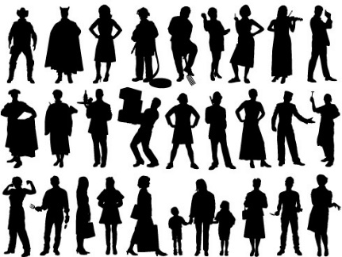
The 2000 and 2010 Disclosure Avoidance System operated as a privacy filter:
Blue = Public Data
Pre-specified tabular summaries:
PL94-171, SF1, SF2 (SF3, SF4, … in 2000)
Red = Confidential Data
Raw data from respondents: Decennial Response File
Selection & unduplication: Census Unedited File
Edits, imputations: Census Edited File
Confidentiality edits (household swapping), tabulation recodes: Hundred-percent Detail File
Special tabulations and post-census research

Slide 9
The protection system relied on swapping households:
Advantages of swapping:
  Easy to understand
  Does not affect state counts if swaps are within a state
  Can be run state-by-state
  Operation is “invisible” to rest of Census processing
Disadvantages:
  Does not consider or protect against
  database reconstruction attacks
  Does not provide formal privacy guarantees
  Swap rate and details of swapping must remain secret
  Privacy guarantee based on the lack of external data
Town 1
Town 2
State “X”

Slide 10
Database Reconstruction

Slide 11


(Dinur Nissim 2003):
Database Reconstruction
A statistical database can be reconstructed with a relatively small number of random queries
Previous work showed that query privacy could only be assured:
  By tracking every query
  Even then, it is exponentially hard
This work proposes a generalized solution by adding noise

Slide 12
The database reconstruction theorem is the death knell for traditional data publication systems from confidential sources, including those used by national statistical offices.

Slide 13
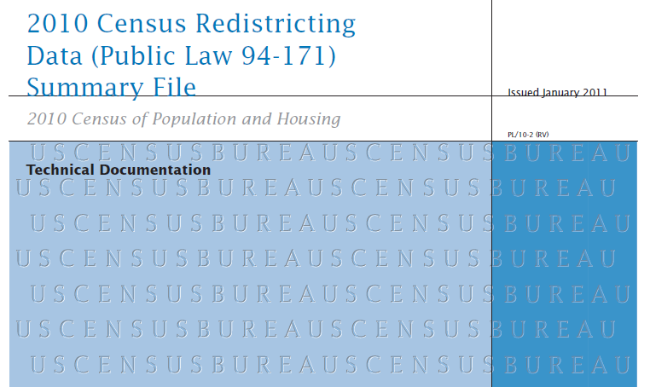
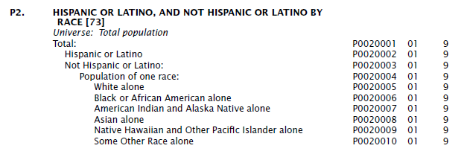
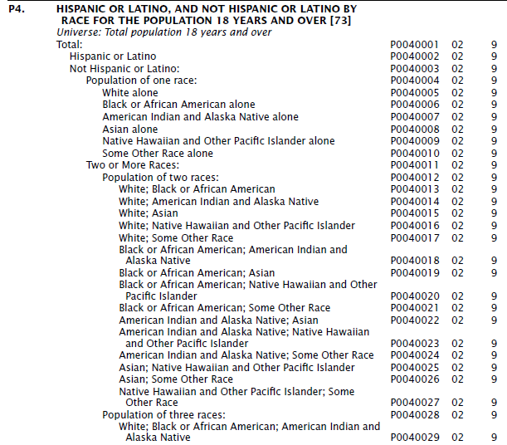
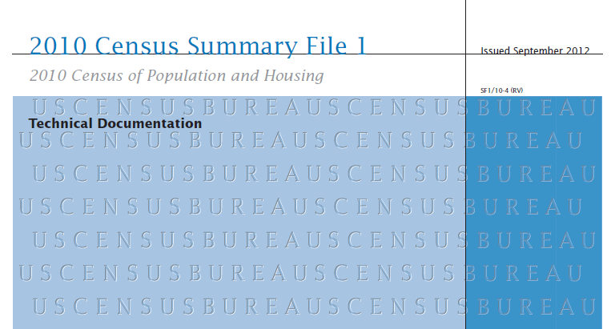
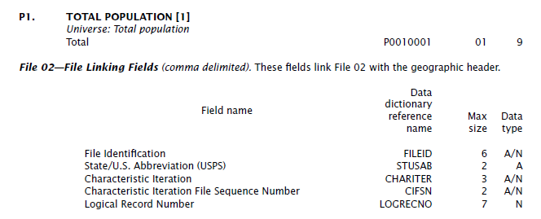
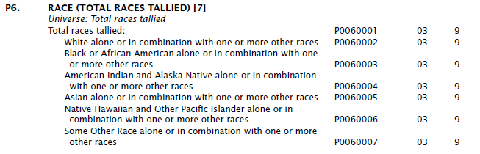
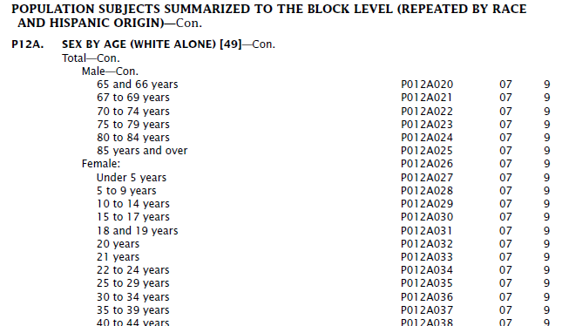
Reconstruction Equation System
Collect more than 5 billion statistics
from official 2010 Census tables.
From the sample space at the block
and tract level (2 x 115 x 2 x 63 = 28,980),
write the linear equations for each sample
statistic, including zeros.
Notes:
For each of 10,620,683 habitable blocks and 73,768 habitable tracts:
Record sample space 2 x 115 x 2 x 63 = 28,980 unique combinations
Counts in PL94 tables P1-P4 and SF1 tables P1, P6, P7, P9, P11, P12, P12A-I, P14, PCT12, PCT12A-O provide constraints
Margins of tables for total population and voting age population are exact (as per public documentation on PL94-171 and SF1)
Only household-level record swapping was used; implies that zeros are unprotected except as swapping relocates them by geography (again, from public documentation on PL94-171 and SF1)

Slide 14
Properties of the Reconstruction
We created equations to solve for the underlying population for every census tract and block
The solution:
  Can’t be overdetermined (known to come from a real person table)
  Usually underdetermined: most blocks have many solutions
All solutions share some exact images
  For example, block and voting-age variables are the same in every solution
Full details will be released soon
Notes:
Whether the problem is overdetermined (too many equations; no exact solution), exact (one unique solution), or underdetermined (too few equations; many exact solutions) depends upon the sparsity of the tables.
Because the tables originated from a single micro-data file (Hundred-percent Detail File, HDF), an overdetermined system implies an error in the problem set-up or the original tabulation programs; there can never be more numbers in the published tables than can be created from a single HDF
When the system is exact, only one configuration (multiset) from the sample space could have produced the published tables—the reconstruction is exact
When the system is underdetermined there are infinitely many ways the records in the sample space could be selected to get the same publication tables
Even when the system is underdetermined, all solutions could share some exact images
For example, every 2010 reconstruction has exactly the same block-level geocode and voting-age values

Slide 15
Results Using the Published 2010 Census
The tabulation variables from the confidential hundred-percent detail micro-data file can be reconstructed quite accurately from PL94 + balance of SF1
While there is a vulnerability, the risk of re-identification was small
Experiments are at the person level, not household
Experiments led to the declaration that reconstruction of Title 13-sensitive data is an issue, no longer a risk
This provides strong motivation for the adoption of differential privacy for the 2018 End-to-End Census Test and 2020 Census
Notes:
A reconstruction attack recreates record-level images of all variables used in published tabulations, not all variables in the confidential database. If “name” is never tabulated, then “name” cannot be reconstructed.
A reconstruction-abetted re-identification attack links external data to the reconstructed micro-data. These external data contain identifying information like names and addresses. Such an attack leads to “putative re-identifications”: records that the attacker believes are the data for identifiable information. In a successful re-identification attack, putative re-identifications are confirmed at a high rate. The putative re-identifications from the 2010 Census experiments are not confirmed at a high rate. We are still researching this issue.

Slide 16
Formal Privacy

Slide 17
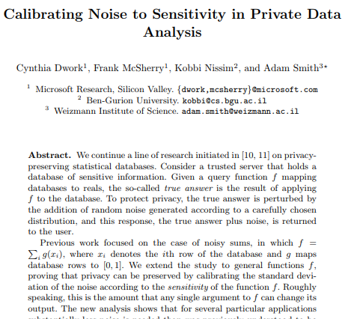
(Dwork, McSherry, Nissim & Smith 2006):
Differential Privacy
Definition of a criterion that constrains algorithms that process the confidential data
A generic approach for protecting privacy by adding random noise
Key features:
  lower bound for the amount of noise that needs to be added
  upper bound for privacy loss
  mechanisms are composable

Slide 18
The DP tradeoff: Accuracy vs. Privacy-loss
Estimated Marginal Social Benefit Curve
Social Optimum: Marginal Social Benefit = Marginal Social Cost
Marginal social cost: slope of the estimated production technology
Marginal social benefit: slope of the estimated social benefit curve
Estimated Production Technology
Source: Abowd and Schmutte (forthcoming, American Economic Review)
Notes:
The estimated marginal social benefit is the slope of the illustrated iso-social welfare line (gray). These lines must slope upwards because data accuracy is a “good” and privacy-loss is a “bad.” Iso-social welfare lines above the one illustrated are infeasible because no point on the PPF reaches them. Iso-social welfare lines below the one illustrated are feasible but suboptimal because social welfare can be increase by either increasing accuracy at no privacy-loss cost or decreasing privacy-loss without loss of accuracy.
The social optimum is the point of tangency between an iso-social welfare line (gray) and the PPF (red). At this point, the only social welfare improving combinations of data accuracy and privacy-loss are infeasible.
The illustrated iso-social welfare line is the best one attainable, and social welfare is maximized at the indicated point. This point gives the optimal privacy-loss budget and the optimal data accuracy as determined by the preferences of the data users constrained by the SDL technology.
The illustrated optimal point, based loosely on Abowd and Schmutte (forthcoming, AER) is a privacy-loss budget of about 2.5 and an optimal data accuracy that is about 85% of the best possible accuracy.

Slide 19
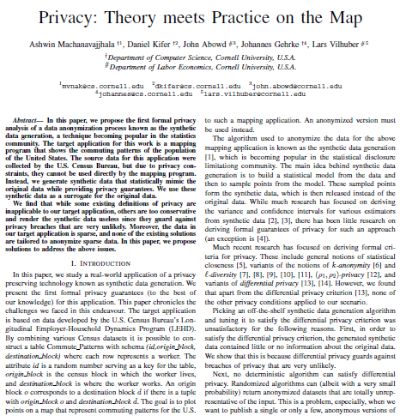
OnTheMap was the Census Bureau’s first product to use Differential Privacy
This work was done at Cornell University while Abowd and Vilhuber were on IPA assignments to the Census Bureau. Gehrke is now Technical Fellow at Microsoft. Kifer is now the scientific lead on the 2020 DAS. Machanavajjhala is now a contractual collaborator on the 2020 DAS. Vilhuber is now on IPA assignment to the Census Bureau.
2008

Slide 20
OnTheMap was much easier to make formally private than the decennial census
OnTheMap
  New data product designed from the ground-up to be formally private
  Users were willing to accept data with noise
  Added noise was quantified for users
  Developed by a relatively small, highly-trained team that became comfortable with formal privacy requirements
Decennial Census
  Data product started in 1790 with many legacy data users
  Most users were not aware that noise had been added with “swapping”
  Swap rate held confidential
  Huge team, with wide levels of experience and many with no prior experience with formal privacy methods

Slide 21

Formal Privacy and the 2020 Census

Slide 22
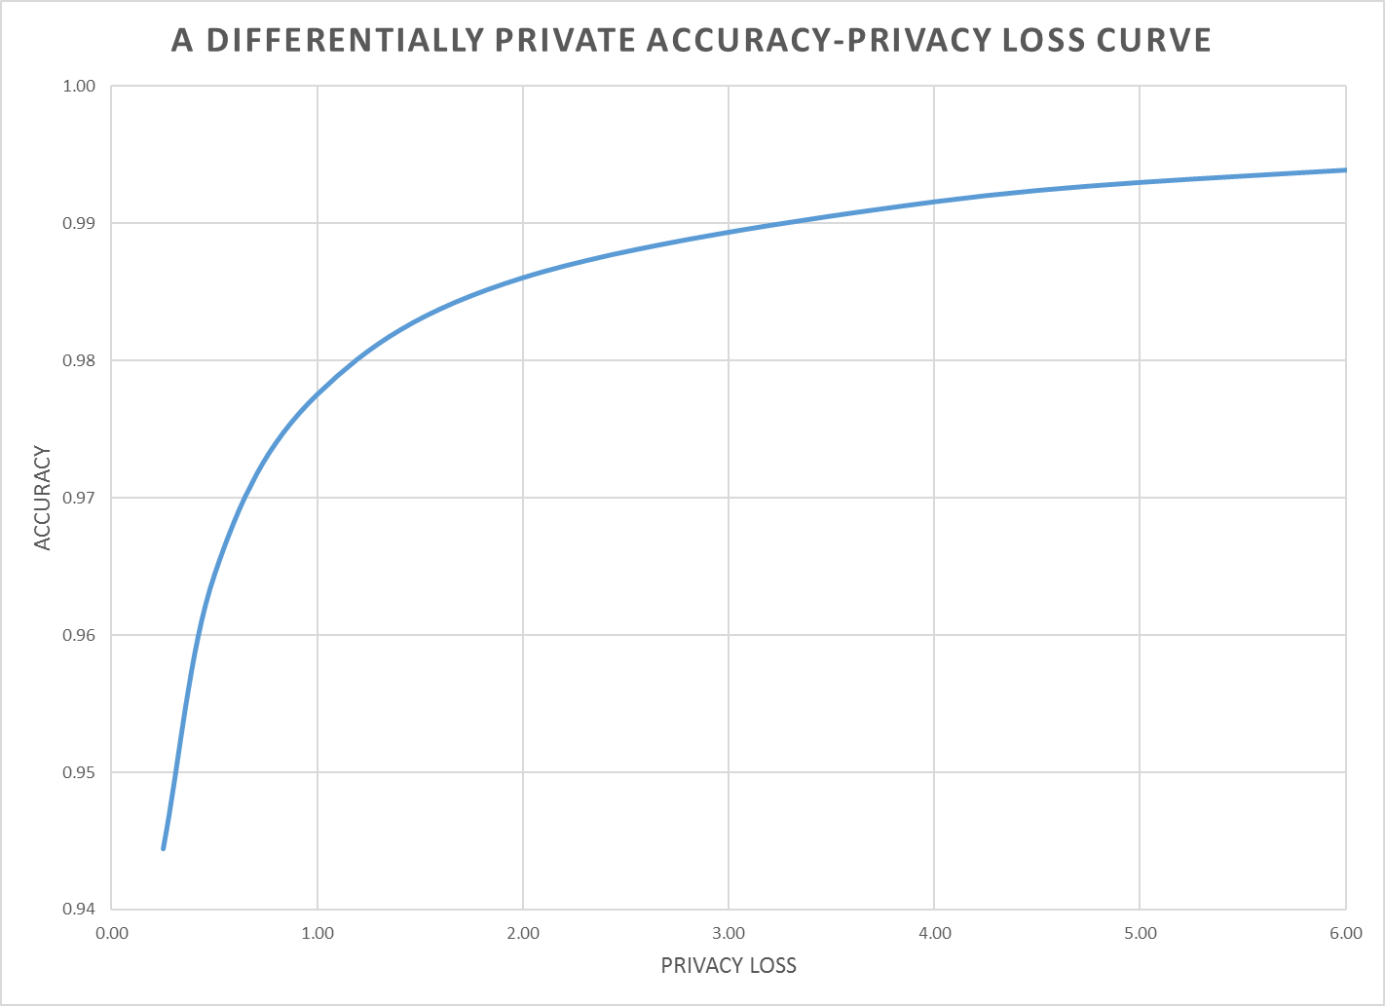
In 2017, the Census Bureau announced that it would use differential privacy for the 2020 Census.
Differential privacy provides:
  Provable bounds on the maximum privacy loss
  Algorithms that allow policy makers to manage the trade-off between accuracy and privacy
The graph on this slide is not hypothetical; it was computed from real population data from the 1940 Census using the table specifications for current redistricting data
Pre-Decisional

Slide 23

Consider a census block
As reported
 | Male | Female
Age < 18 | 4 | 4
Age >= 18 | 4 | 4
High privacy loss
As collected
 | Male | Female
Age < 18 | 3 | 2
Age >= 18 | 5 | 6
More accurate sex distribution
 | Male | Female
Age < 18 | 6 | 2
Age >= 18 | 3 | 5
More accurate age distribution

Slide 24
There was no off-the-shelf system for applying differential privacy to a national census
We had to create a new system that:
  Produced higher-quality statistics at more densely populated geographies
  Produced consistent tables
  We created a new differential privacy algorithm and system that:
  Produces statistics controlling accuracy from the top-down
    E.g., national Level -> state Level -> county Level -> tract Level -> block Level
    Creates privatized micro-data that can be used for any tabulation without additional privacy loss
  Fits into the decennial census production system

Slide 25
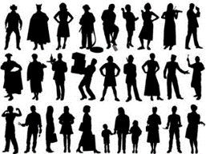
We have created a “Disclosure Avoidance System” that drops into the 2020 Census production system
Global Confidentiality Protection Process
Pre-specified tabular summaries:
PL94-171, SF1, SF2
Decennial Response File
Census Unedited File
Census Edited File
Disclosure Avoidance System
Microdata Detail File
Special tabulations and post-census research
ε
accuracy trade-offs
Privacy-loss Budget,
Accuracy Decisions
Notes:
This diagram shows the flow of data from respondents to create the Census Edited File.
The DAS transforms this file into the Microdata Detail File, which is used to create pre-specified tabular summaries.
We can also use the file to create special tabulations and to enable post-census research.

Slide 26
The disclosure avoidance system uses differential privacy to defend against a reconstruction attack
Differential privacy provides:
  Provable bounds on the accuracy of the best possible database reconstruction given the released tabulations
  Algorithms that allow policy makers to decide the trade-off between accuracy and privacy loss
Reconstruction is still possible, but the data intruder doesn’t get the confidential data! (gets the safe micro-data instead)
Final privacy-loss budget determined by
Data Stewardship Executive Policy Committee (DSEP)
with recommendation from Disclosure Review Board (DRB)
Pre-Decisional

Slide 27
The Disclosure Avoidance System Relies on Injecting Noise with Formal Privacy Rules
Advantages of noise injection with differential privacy:
  Privacy operations are closed under composition
  Privacy guarantees are robust to post-processing
  Privacy guarantees are future-proof
  Privacy guarantees are provable and tunable
  Privacy guarantees are public and explainable
  Protects against database reconstruction attacks
Disadvantages:
  Entire country must be processed at once for best accuracy
  Every use of the private data must be tallied in the privacy-loss budget
Global Confidentiality Protection Process
Disclosure Avoidance System
ε
Notes:
Closure under composition means that if two differentially private publishing mechanisms are applied sequentially to the same confidential data, then the cumulative privacy loss from those mechanisms is no greater than the sum of the privacy losses from each applied individually. This property is what makes possible the calculation of global disclosure risk when using differential privacy.
Provable privacy guarantees mean that the conformance of the differential privacy algorithm to the mathematical properties the mechanism is required to possess can be proven.

Slide 28
The Challenge of Creating the 2020 DAS
Business processes:
  All desired tabulations must be known in advance
  All uses of confidential data must be tracked and accounted for
  Data quality checks on tables cannot be done by looking at raw data
Communications strategy:
  Differential privacy is not widely known or understood outside academia
  Most data users expect the same accuracy regardless of the level of detail
  In 2000 and 2010 we used swapping with an undisclosed swap rate
    The Census Bureau did not quantify the error rate
Notes:
We’ve had lots of challenges in developing differential privacy for the Census Bureau.
They have created changes in Census Bureau business processes.
They are also posting communications challenges.
Read our WPES 2018 paper! https://arxiv.org/abs/1809.02201

Slide 29


And we can make the DAS public!
Open source system
  Source code published on GitHub
  All parameters public including global ε
  Testable with data from 1940 Census

Slide 30
Demonstration of the Actual 2020 Disclosure Avoidance System Using Public 1940 Census Data

Slide 31
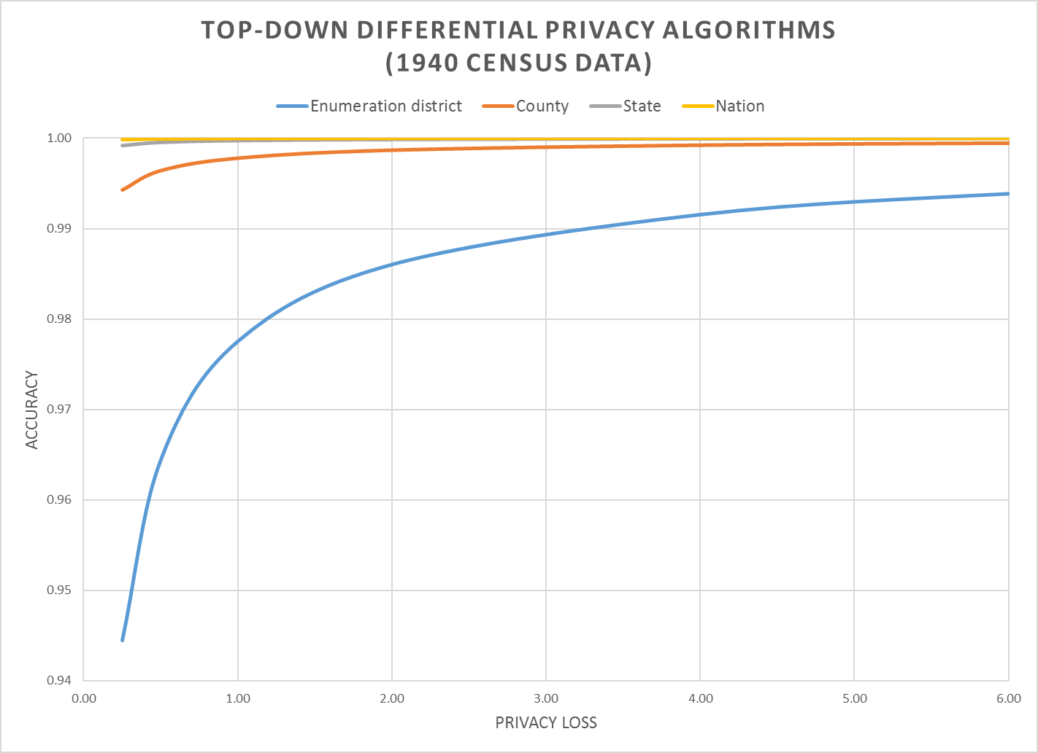
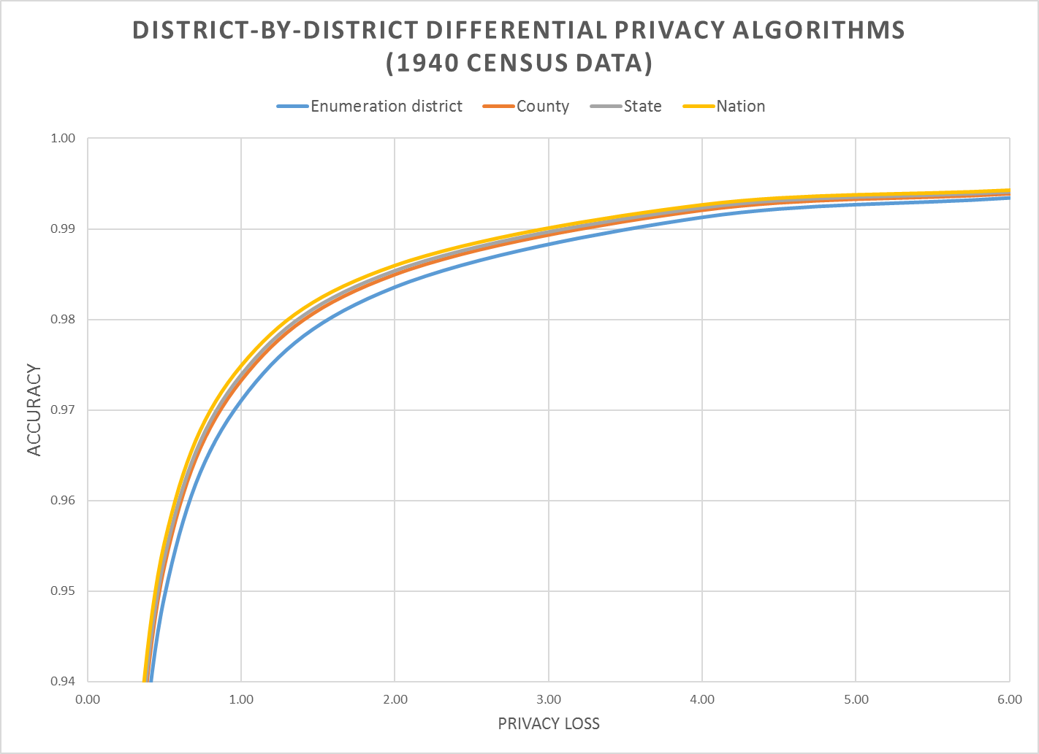

Slide 32
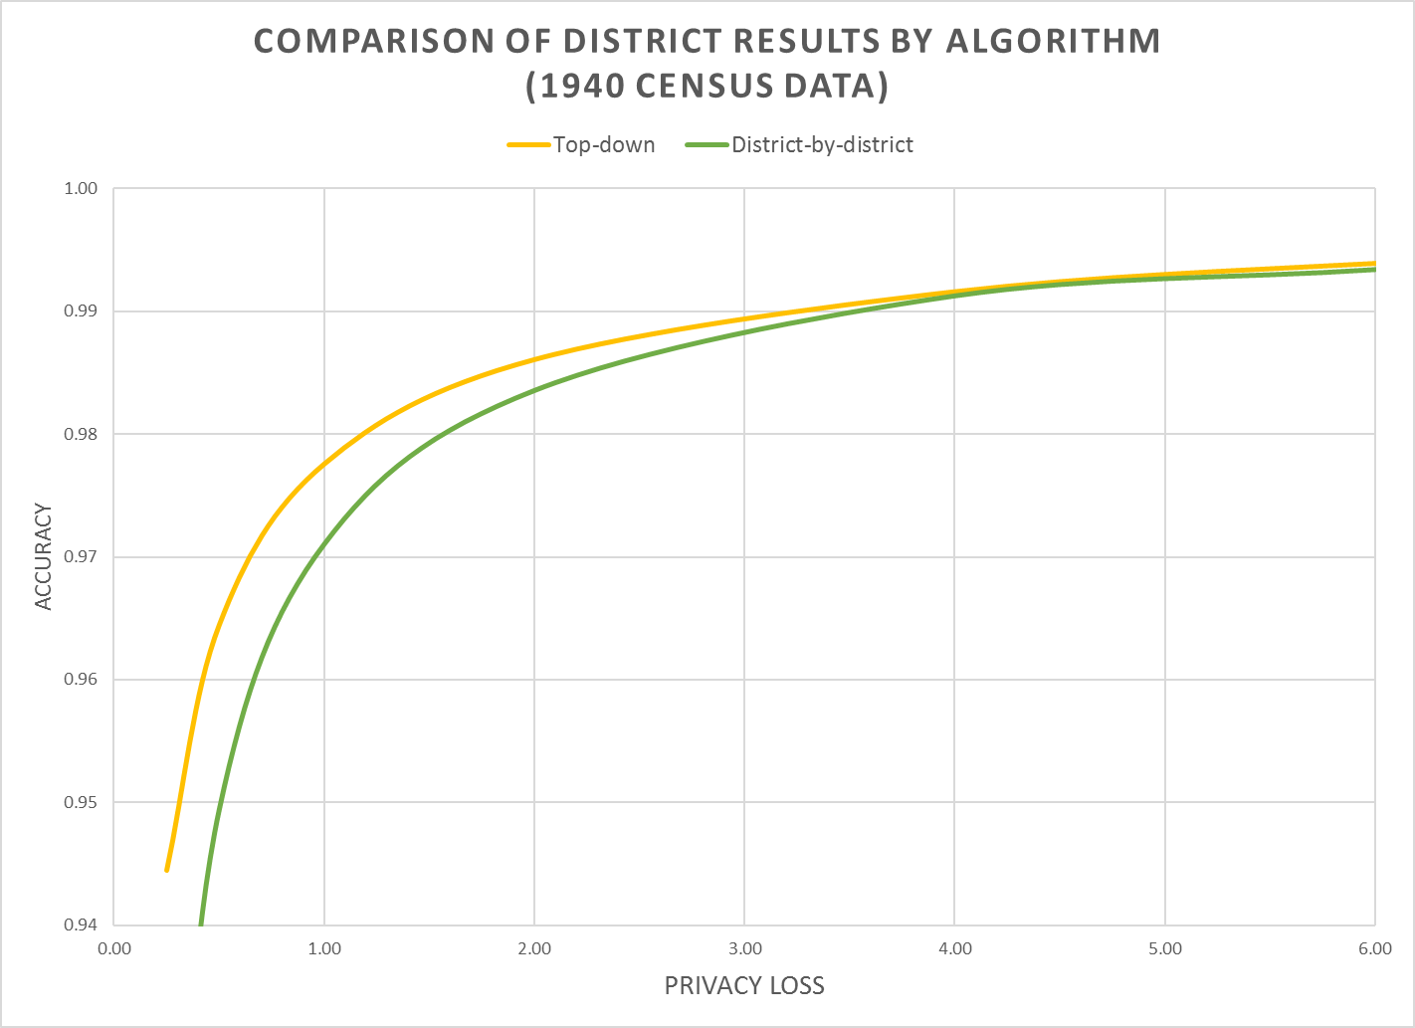
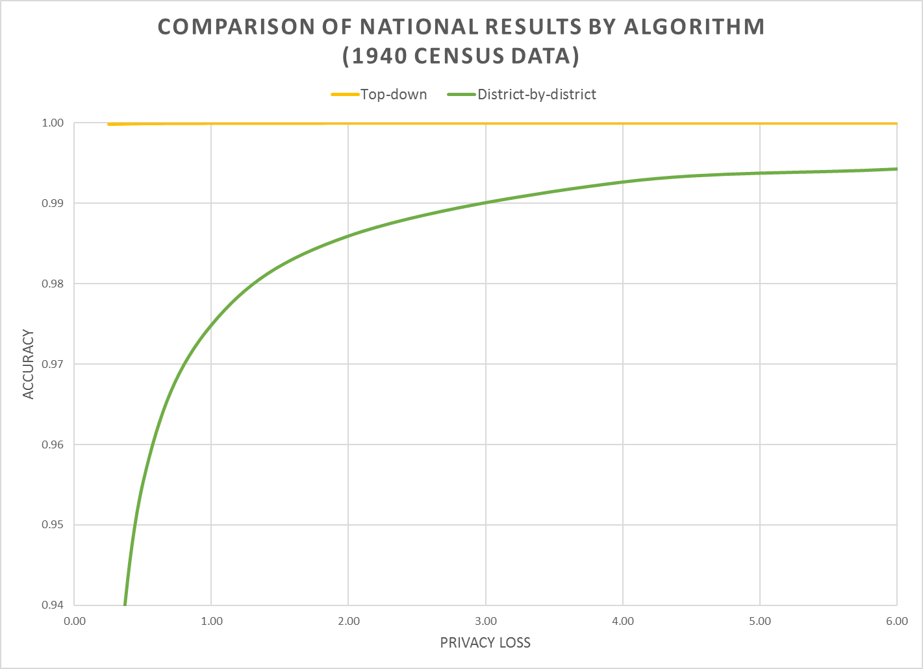

Slide 33
Managing the Tradeoff

Slide 34

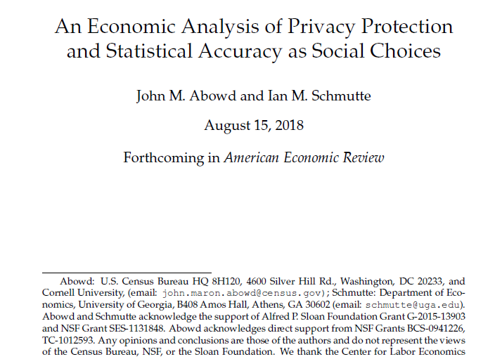
You know what I look like already

Slide 35
How to Think about the Social Choice Problem
The marginal social benefit is the sum of all persons’ willingness-to-pay for data accuracy with increased privacy loss
The marginal rate of transformation is the slope of the privacy-loss v. accuracy graphs we have been examining
This is exactly the same problem being addressed by Google in RAPPOR, Apple in iOS 11, and Microsoft in Windows 10 telemetry
Notes:
The marginal social benefit from increased data quality is the sum of all persons’ willingness-to-pay for data quality with increased privacy loss.
Can be estimated from survey data.
The next slide shows how to use the estimate from survey data to select an optimal (data quality, privacy loss) pair.

Slide 36
Estimated Marginal Social Benefit Curve
Social Optimum: MSB = MSC
Estimated Production Technology
Notes:
The estimated marginal social benefit is the slope of the illustrated iso-social welfare line (gray). These lines must slope upwards because data accuracy is a “good” and privacy-loss is a “bad.” Iso-social welfare lines above the one illustrated are infeasible because no point on the PPF reaches them. Iso-social welfare lines below the one illustrated are feasible but suboptimal because social welfare can be increase by either increasing accuracy at no privacy-loss cost or decreasing privacy-loss without loss of accuracy.
The social optimum is the point of tangency between an iso-social welfare line (gray) and the PPF (red). At this point, the only social welfare improving combinations of data accuracy and privacy-loss are infeasible.
The illustrated iso-social welfare line is the best one attainable, and social welfare is maximized at the indicated point. This point gives the optimal privacy-loss budget and the optimal data accuracy as determined by the preferences of the data users constrained by the SDL technology.
The illustrated optimal point, based loosely on Abowd and Schmutte (forthcoming, AER) is a privacy-loss budget of about 2.5 and an optimal data accuracy that is about 85% of the best possible accuracy.

Slide 37
But the Choice Problem for Redistricting Tabulations Is More Challenging
In the redistricting application, the fitness-for-use is based on
  Supreme Court one-person one-vote decision (All legislative districts must have approximately equal populations; there is judicially approved variation)
  Is statistical disclosure limitation a “statistical method” (permitted by Utah v. Evans) or “sampling” (prohibited by the Census Act, confirmed in Commerce v. House of Representatives)?
  Voting Rights Act, Section 2: requires majority-minority districts at all levels, when certain criteria are met
The privacy interest is based on
  Title 13 requirement not to publish exact identifying information
  The public policy implications of uses of detailed race and ethnicity

Slide 38
Notes:
We want the most efficient technology, which is the one in red.

Slide 39
Where social scientists act like MSC = MSB
Where computer scientists act like MSC = MSB
Notes:
Selecting an optimal point on the PPF requires a social choice model. In economics, such a model equates the marginal social benefit to the marginal social cost. In the data privacy analysis, the marginal social cost of increased data accuracy is the incremental privacy loss given by the slope of the PPF at any point.
A social choice model posits a social welfare function linking data quality and privacy loss for individuals in the target/protected population. The points of equal social welfare would be upward sloping lines in the graph above (not necessarily straight lines).

Slide 40
Estimated Marginal Social Benefit Curves
More accuracy favoring
Social Optima: MSB = MSC
Blue tangency (3.5, 94%)
Green tangency (1.0, 60%)
More privacy favoring
Notes:
Does the correct social welfare function favor accuracy (blue) or privacy (green)?

Slide 41
Thank you
John.Maron.Abowd@census.gov
johnabowd.com

Slide 42
References
Dinur, Irit and Kobbi Nissim. 2003. Revealing information while preserving privacy. In Proceedings of the twenty-second ACM SIGMOD-SIGACT-SIGART symposium on Principles of database systems(PODS '03). ACM, New York, NY, USA, 202-210. DOI: 10.1145/773153.773173.
Dwork, Cynthia, Frank McSherry, Kobbi Nissim, and Adam Smith. 2006. in Halevi, S. & Rabin, T. (Eds.) Calibrating Noise to Sensitivity in Private Data Analysis Theory of Cryptography: Third Theory of Cryptography Conference, TCC 2006, New York, NY, USA, March 4-7, 2006. Proceedings, Springer Berlin Heidelberg, 265-284, DOI: 10.1007/11681878_14.
Dwork, Cynthia. 2006. Differential Privacy, 33rd International Colloquium on Automata, Languages and Programming, part II (ICALP 2006), Springer Verlag, 4052, 1-12, ISBN: 3-540-35907-9.
Dwork, Cynthia and Aaron Roth. 2014. The Algorithmic Foundations of Differential Privacy. Foundations and Trends in Theoretical Computer Science. Vol. 9, Nos. 3–4. 211–407, DOI: 10.1561/0400000042.
Dwork, Cynthia, Frank McSherry and Kunal Talwar. 2007. The price of privacy and the limits of LP decoding. In Proceedings of the thirty-ninth annual ACM symposium on Theory of computing(STOC '07). ACM, New York, NY, USA, 85-94. DOI:10.1145/1250790.1250804.
Machanavajjhala, Ashwin, Daniel Kifer, John M. Abowd , Johannes Gehrke, and Lars Vilhuber. 2008. Privacy: Theory Meets Practice on the Map, International Conference on Data Engineering (ICDE) 2008: 277-286, doi:10.1109/ICDE.2008.4497436.
Dwork, Cynthia and Moni Naor. 2010. On the Difficulties of Disclosure Prevention in Statistical Databases or The Case for Differential Privacy, Journal of Privacy and Confidentiality: Vol. 2: Iss. 1, Article 8. Available at: http://repository.cmu.edu/jpc/vol2/iss1/8.
Kifer, Daniel and Ashwin Machanavajjhala. 2011. No free lunch in data privacy. In Proceedings of the 2011 ACM SIGMOD International Conference on Management of data (SIGMOD '11). ACM, New York, NY, USA, 193-204. DOI:10.1145/1989323.1989345.
Erlingsson, Úlfar, Vasyl Pihur and Aleksandra Korolova. 2014. RAPPOR: Randomized Aggregatable Privacy-Preserving Ordinal Response. In Proceedings of the 2014 ACM SIGSAC Conference on Computer and Communications Security (CCS '14). ACM, New York, NY, USA, 1054-1067. DOI:10.1145/2660267.2660348.
Garfinkel, Simson L., John M. Abowd and Sarah Powazek 2018 Issues Encountered Deploying Differential Privacy WPES 2018, https://arxiv.org/abs/1809.02201.
Abowd, John M. and Ian M. Schmutte. 2017 . Revisiting the economics of privacy: Population statistics and confidentiality protection as public goods. Labor Dynamics Institute, Cornell University, Labor Dynamics Institute, Cornell University, at https://digitalcommons.ilr.cornell.edu/ldi/37/
Abowd, John M. and Ian M. Schmutte. Forthcoming. An Economic Analysis of Privacy Protection and Statistical Accuracy as Social Choices. American Economic Review, at https://arxiv.org/abs/1808.06303
Apple, Inc. 2016. Apple previews iOS 10, the biggest iOS release ever. Press Release (June 13). URL=http://www.apple.com/newsroom/2016/06/apple-previews-ios-10-biggest-ios-release-ever.html.
Ding, Bolin, Janardhan Kulkarni, and Sergey Yekhanin 2017. Collecting Telemetry Data Privately, NIPS 2017.

