Slide 1
Differential Privacy for Growing Databases
Prof. Rachel Cummings, Georgia Tech ISyE
joint work with Sara Krehbiel, Kevin Lai, and Uthaipon (Tao) Tantitongpipat
U.S. Census Bureau – June 12, 2018

Slide 2
Original data science:
One-shot analysis of a static database

Slide 3
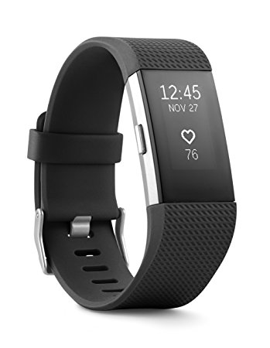
Modern data science:
Continuous analysis of a growing database
Need data analysis tools for growing databases

Slide 4
Modern data science:
Continuous analysis of a growing, highly sensitive database
Need data analysis tools for growing databases
Need formal privacy guarantees

Slide 5
Differential privacy [DMNS ‘06]
Bound the “maximum amount” that one person’s data can change the output of a computation
$S$ as set of “bad outcomes”
Worst-case guarantee
An algorithm $M:T^{n}→R$ is $ε$-differentially private if $∀$ neighboring $x,x′∈T^{n}$ and $∀ S⊆R$,
$$P\left[M\left(x\right)∈S\right]≤e^{ε} P\left[M\left(x^{′}\right)∈S\right]$$
Notes:
--This is exactly what we get with differential privacy, which was defined in 2006 by Dwork McSherry Nissim and Smith. Informally, differential privacy bounds the maximum amount that one person’s data can change the output of a computation.
--Formally, we say that an algorithm that maps from an n-tuple of types, think of this as the data of n people, to some output range R, is epsilon parameterized differentially private if for all pairs of neighboring databases that differ in only one person’s data, the distributions over the algorithm’s output on these two neighboring inputs must be close in this multiplicative sense. This means that if one person changes their data, the probability of the algorithm producing any particular output can’t change by more than a multiplicative factor of e to epsilon. For small epsilon, this multiplicative factor is close to 1 plus epsilon.
--Why does this achieve what we want? Think of this subset S as the set of all bad outcomes, whatever that may be. Your dad finding out that you’re pregnant, or your health insurance prices increasing because you participated in a medical study. A differentially private algorithm promises that the probability of this bad event occurring is going to be approximately the same, no matter what your data says.
--This is a strong worst-case guarantee that holds for all databases, for all changes you might make to one person’s data, and for all sets S of bad outcomes.

Slide 6
Post-processing:
If $M(x)$ is $ε$-differentially private, and $A$ is any function, then $A(M\left(x\right))$ is $ε$-differentially private.
“No adversary can break the privacy guarantee”
Composition:
If algorithms $M_{i}$ are $ε_{i}$-differentially private for $i=1,…,k$, then the composition $M\left(x\right)≡(M_{1}\left(x\right),…,M_{k}\left(x\right))$ is $\sum_{i=1}^{k}{ε_{i}}$-differentially private.
“The epsilons add up”

Slide 7
Differential privacy [DMNS ‘06]
Move smoothly between informational extremes
Robust to post-processing and adaptive composition
Diverse algorithmic toolkit for variety of computational settings
Used in practice by Apple, Google, Microsoft, and U.S. Census
Nearly all DP algorithms operate on a static database
Notes:
--Differential privacy has a number of desirable properties. For starters, information structures no longer have to be the binary extremes: sharing information or not sharing. The parameterized definition allows us to move smoothly between these two informational extreme points.
--It is also robust to post-processing, meaning that no adversary can take the output of your differentially private algorithm, and sit in the corner and think really hard or run additional computations to break the privacy guarantee.
--Differentially private algorithms compose adaptively, so the privacy guarantee degrades gracefully as more computations are performed on the same data.
--Over the past decade, a rich algorithmic toolkit has been developed for many application areas, including machine learning, algorithmic economics, statistics, optimization. Most settings you can think of, there probably already exist differentially private algorithms to solve your favorite problems.
--Why am I giving this talk at all? It sounds like privacy is solved! Well, most of the work in this area assumes privacy happens in a vacuum. It assumes you already have a fixed database, and you pick your epsilon to balance the privacy rights of the individuals with the accuracy rights of the analyst, you perform your computation, and then you go home. This approach ignores strategic and human aspects of the privacy problem.

Slide 8
Outline of results
Adaptive linear queries for growing databases
Background on Private Multiplicative Weights
What goes wrong with growing databases
Our algorithm and results
General transformations of static algorithms to growing setting
Black box reduction to static setting
Application to synthetic data generation
Extensions & application to ERM
Open questions

Slide 9
Part 1: Private Multiplicative Weights for growing databases
PMW privately answers exponentially many adaptively chosen linear queries. Does it extend to growing databases?

Slide 10
Database $x$stored as histogram: $x=\left\langle x_{1},…,x_{N}\right\rangle$ where $x_{i}$ is fraction of database entries that are of type $i$. Data universe has size $N$.
Linear queries: $f\left(x\right)=\left\langle f,x\right\rangle$ where each $f_{i}∈[0,1]$.
Query sensitivity:
The sensitivity of real-valued query $f$ is:
$$Δf=\max_{x,x^{′}neighbors}\left|f\left(x\right)−f\left(x^{′}\right)\right|.$$
Normalized linear queries have sensitivity $Δf=\frac{1}{n}$ for database size n.
$\left(α,β\right)$-accuracy:
An algorithm $M$ is $\left(α,β\right)$-accurate w.r.t. query class $F$ if for any database $x$, $\left|f\left(x\right)−f\left(M\left(x\right)\right)\right|≤α$ for all $f∈F$ w.p. $1−β$.

Slide 11
Private Multiplicative Weights [HR ‘10]
Answers exponentially many (in size $n$of database $x$) adaptive linear queries
Maintains public histogram $y$, which reflects current estimate of static database
When new query $f$ arrives:
If $f\left(x\right)≈f(y)$, classify $f$ as EASY and output $f(y)$
Else, classify $f$ as HARD, output $f\left(x\right)+Lap(\frac{Δf}{ε})$, and perform Multiplicative Weights update on $y$
Significant privacy loss only incurred on HARD queries

Slide 12
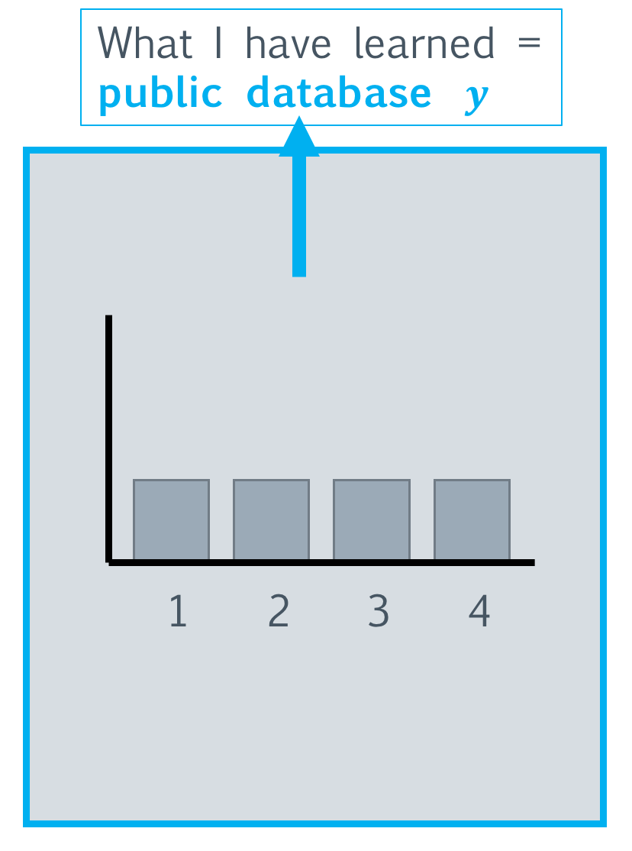

Slide 13
$$f_{1}\left(y\right)>f_{1}(x)$$

Slide 14
$$f_{1}\left(y\right)<f_{1}(x)$$

Slide 15
Private Multiplicative Weights [HR ‘10]
Theorem [HR ‘10]: PMW($x,F,ε,α,β,n$) is $ε$-differentially private and $(α,β)$-accurate for $k$ adaptively chosen queries $F$ for
$α≥{\left(\frac{\log{N\log{(\frac{k}{β})}}}{εn}\right)}^{1/3}$.
Proof relies on potential argument, using potential function:
$RE(x|\left|y\right)=\sum_{i=1}^{N}{x_{i}\log{\frac{x_{i}}{y_{i}}}}$.
Need to show: $RE(x|\left|y\right)$ starts low, decreases quickly, and is bounded below

Slide 16
$RE(x||y)$ starts at $\log{N}$
$RE(x||y)$ decreases by at least $\frac{α^{2}}{4}$ with each HARD query
$RE(x||y)$ bounded below by 0
PMW has at most $\frac{4\log{N}}{α^{2}}$ hard queries
$ε$ loss is small
$$RE(x||y)$$
HARD queries
$$\log{N}$$
$$α^{2}/4$$
$$α^{2}/4$$
$$t$$

Slide 17
What if new data arrive?
$RE(x||y)$ starts at $\log{N}$
$RE(x||y)$ decreases by at least $\frac{α^{2}}{4}$ with each HARD query
$RE(x||y)$ bounded below by 0
Database size n
Database size n+k
$$RE(x||y)$$
HARD queries
$$\log{N}$$
$$α^{2}/4$$
$$α^{2}/4$$
$$t$$

Slide 18
What if new data arrive?
$RE(x||y)$ starts at $\log{N}$ - $RE(x||y)$ changes
$RE(x||y)$ decreases by at least $\frac{α^{2}}{4}$ with each HARD query - YES
$RE(x||y)$ bounded below by 0 - YES
Database size n
Database size n+k
$$RE(x||y)$$
$$\log{N}$$
$$α^{2}/4$$
$$α^{2}/4$$
$$t$$

Slide 19
Database size 2n
$RE(x||y)$ can increase by $\frac{\log{N}}{nα}$
with each new entry
Database size n
$$\frac{\log{N}}{α}$$
$$RE(x||y)$$
$$\log{N}$$
$$α^{2}/4$$
$$α^{2}/4$$
$$t$$

Slide 20
Our fix: Reweight public database $y$ with uniform distribution when new data arrive:
$$y_{i}^{′}= \frac{n}{n+1}y_{i}+\frac{1}{n+1}\frac{1}{N} ∀i$$
Now $RE(x||y)$ increase is only $\frac{\log{N}}{n}$ per new entry
Database size n
Database size n+k
$$RE(x||y)$$
$$\log{N}$$
$$α^{2}/4$$
$$\frac{\log{N}}{n}$$
$$α^{2}/4$$
$$t$$

Slide 21
Main result: PMWG
Theorem: PMWG($X,F,ε,α,β,n$) is $ε$-differentially private and $(α,β)$-accurate for query stream $F$ that respects query budget $Θ(k\exp{\sqrt{t}})$ at each time $t$, for $α≥C{\left(\frac{\log\left(Nn\right)\log{(\frac{kn}{β})}}{nε}\right)}^{1/3}.$
In the paper: extend to $(ε,δ)$-differential privacy
Asymptotically no loss in accuracy relative to static setting!

Slide 22
Outline of results
Adaptive linear queries for growing databases
Background on Private Multiplicative Weights
What goes wrong with growing databases
Our algorithm and results
General transformations of static algorithms to growing setting
Black box reduction to static setting
Application to synthetic data generation
Extensions & application to ERM
Open questions

Slide 23
Part 2: General reduction from dynamic setting to static setting
Assume a private and accurate algorithm in the static setting. How can this be used as a subroutine for solving the same problem in the dynamic setting?

Slide 24
Ideal (easy) data growth
k queries
k queries
k queries
k queries
n datapoints
n datapoints
n datapoints
n datapoints
...

Slide 25
Ideal (easy) data growth
k queries
k queries
k queries
k queries
n datapoints
n datapoints
n datapoints
n datapoints
Run private and accurate
algorithm on current database
...

Slide 26
Realistic data growth
n datapoints
When to run algorithm?
...

Slide 27
Accuracy, revisited
$\left(α,β\right)$-accuracy:
An algorithm $M$ is $\left(α,β\right)$-accurate w.r.t. query class $F$ if for any database $x$, $\left|f\left(x\right)−f\left(M\left(x\right)\right)\right|≤α$ for all $f∈F$ w.p. $1−β$.
$(p,g)$-black box:
An algorithm $M(x,ε,α,β,n)$ is a $(p,g)$-black box for a query class $F$ if it is $ε$-differentially private and $\left(α,β\right)$-accurate w.r.t. $F$ for
$$α=g{\left(\frac{\log{\frac{1}{β}}}{εn}\right)}^{p}.$$

Slide 28
Application: SmallDB [BLR ‘08]
Differentially private algorithm for synthetic data generation
Takes in database $x$ of size $n$ from data universe of size $N$ and query class $F$
Outputs database $y$ of size $\log\left|F\right|/α^{2}$
Samples $y$ with exponential bias towards databases that closely approximate $x$ on all queries in $F$
Theorem [BLR ‘08]: SmallDB($x,F,α,β, ε)$ is $ε$-differentially private and $(α,β)$-accurate for
$$α≥{C\left(\frac{\log{N\log\left|F\right|+\log{1/β}}}{εn}\right)}^{1/3}$$
SmallDB is a (${\frac{1}{3},\left(64\log{N\log{|F|}}\right)}^{1/3}$)-black box.

Slide 29
SmallDB for growing databases (SmallDBG)
Run SmallDB($x_{t_{i}},F,α,β_{i}, ε_{i})$ at times $t_{i}={\left(1+γ\right)}^{i}n$ for some $γ<1$, to produce output stream $\{y_{i}\}$
Use $y_{i}$ to answer all queries that arrive between $t_{i}$ and $t_{i+1}$
Tune $β_{i}, ε_{i}$ in each epoch as a function of database size
Theorem: SmallDBG($x,F,α,β, ε,n)$ is $ε$-differentially private and $(α,β)$-accurate for
$$α≥C{\left(\frac{\log{N\log\left|F\right|+\log{1/β}}}{εn}\right)}^{1/5}$$
Power is 1/3 in static setting, 1/5 in growing setting

Slide 30
Main result: BBScheduler
Running $(p,g)$-black box $M(x_{t_{i}},ε_{i},α_{i},β_{i},n)$ on current database at times $t_{i}={\left(1+γ\right)}^{i+1}n$ for $i=1,2,…$ using parameters:
$γ= g^{1/(2p+1)}{\left(\frac{\log{\frac{1}{β}}}{εn}\right)}^{p/(2p+1)}$
$ε_{i}=\frac{γ^{2}(i+1)}{{\left(1+γ\right)}^{i+2}}ε$
$α_{i}=g{\left(\frac{\log{\frac{1}{β}}}{ε_{i}{\left(1+γ\right)}^{i}n}\right)}^{p}$
$β_{i}= {\left(\frac{β}{1+β}\right)}^{i+1}$
is $(ε,0)$-differentially private and $(α,β)$-accurate for
$$α≥g^{\frac{1}{2p+1}}{\left(\frac{\log{\frac{1}{β}}}{εn}\right)}^{p/(2p+1)}$$
Independent of data growth,
Base of exponent in database size
$∑ε_{i}=ε$ for composition and overall privacy guarantee
Accuracy guarantee of static algorithm at current time
$∑β_{i}=β$ for union bound over failure prob and overall accuracy guarantee
Accuracy loss of $1/(2p+1)$ in power, relative to static setting

Slide 31
Extensions (in the paper)
$(ε,δ)$-differentially private version of BBScheduler
Improved accuracy at cost of weaker privacy guarantee
$(α_{t},β)$-accuracy, where $α_{t}→0$ as $t→∞$
Accuracy guarantee that improves as data accumulate
Better than fixed accuracy guarantee ($α_{t}<α$) once database roughly squares in size ($t≫n^{2}$)
Application to Empirical Risk Minimization
Larger training sample $⟹$ lower empirical risk

Slide 32
Empirical Risk Minimization
Theorem: ERMG is $(ε,δ)$-differentially private and for $d$-dimensional samples, w.p. $1−β$ outputs a classifier $y_{t}$ at every time $t$with excess empirical risk:
$${\hat{R}}_{t}≤\frac{d\log{\frac{1}{β}\sqrt{\log{1/δ}}}}{εt^{1/2}}$$
Theorem [BST ‘14]: Static ERM is $ε$-differentially private and for a static database of size $t$ with $d$-dimensional samples, outputs a classifier $y$ that w.p. $1−β$has excess empirical risk:
$$\hat{R}≤\frac{d\log{\frac{1}{β}}}{εt}$$
In the paper: stronger bounds with more assumptions on loss function.

Slide 33
Outline of results
Adaptive linear queries for growing databases
Background on Private Multiplicative Weights
What goes wrong with growing databases
Our algorithm and results
General transformations of static algorithms to growing setting
Black box reduction to static setting
Application to synthetic data generation
Extensions & application to ERM
Open questions

Slide 34
Open questions for analysis of dynamic data
Improved accuracy guarantees with assumptions on data generation
Data points all sampled iid from fixed distribution
Data points sampled from distribution that changes smoothly over time
Detecting changes in data
Identifying when new data is dramatically different from old data [CKMTZ ‘18]
A/B testing
Other types of dynamic data
Changing/deleting data points
Acquiring new data about the same individuals

Slide 35
Differential Privacy for Growing Databases
Prof. Rachel Cummings, Georgia Tech ISyE
joint work with Sara Krehbiel, Kevin Lai, and Uthaipon (Tao) Tantitongpipat
U.S. Census Bureau – June 12, 2018

