Slide 1
Disclosure Avoidance and
De-identification
95
Simson L. Garfinkel
Center for Disclosure Avoidance Research
October 2, 2017
DISCLAIMER: Specific products and organizations identified in this report were used in order to perform the evaluations described. In no case does such identification imply recommendation or endorsement by the National Institute of Standards and Technology, nor does it imply that identified are necessarily the best available for the purpose.

Slide 2
Outline for today’s talk
De-identification lets us use data while protecting privacy.
De-identified data can be re-identified.
Traditional disclosure avoidance
The push for microdata
Basic de-identification
Famous re-identification controversies
Traditional Disclosure Avoidance at the US Census Bureau

Slide 3
Disclosure Avoidance at the BOC, ca. 1992

Slide 4
Statistical tables can disclose information about individual people and firms.
Sensitive data values: “a data item which a data user could utilize to calculate another individual’s or establishment’s data. Sensitive data values must not be disclosed.”

Slide 5
Cell suppression: “A disclosure avoidance technique in which the sensitive data in the publication is replaced with a ‘(D)’ “

Slide 6
Complementary Suppression: “Suppressions which prevent a user from deriving a sensitive data value from additive table relationships”
(D)
(D)
(D)

Slide 7
This table is not adequately suppressed!

Slide 8
Solution

Slide 9
Primary suppression: “a cell that cannot be published because it fails the n-k rule or the p% rule
n-k rule: “Protects the value of each company from a coalition of (n-1) other companies in the cell.”
p% rule: “protects the largest, and therefore all, company values in a given cell from upper estimation to within p%.”
    T = the total value of a given cell
    L = the value of the largest contributor to the cell
    S = the value of the second largest contributor to the cell
    p = the percentage of protection required
      R = T – L – S = the value of the remaining contributors to the cell
      Suppress if R < (p/100) * L

Slide 10
Other traditional disclosure limitation techniques
Generalization: combine SIC codes, geographies, ages
Top-coding: Report all values over a threshold as > T
Bottom-coding: : Report all values under a threshold as < B.
Swapping: Swap some of the attributes of two-or-more entities.
Statistical Policy Working Paper 22 (second version, 2005) summarizes these techniques and federal statistical policy before the discovery of differential privacy.

Slide 11
Outline for today’s talk
De-identification lets us use data while protecting privacy.
De-identified data can be re-identified.
Traditional disclosure avoidance ✔
The push for microdata
Basic de-identification
Famous re-identification controversies
Traditional Disclosure Avoidance at the US Census Bureau

Slide 12
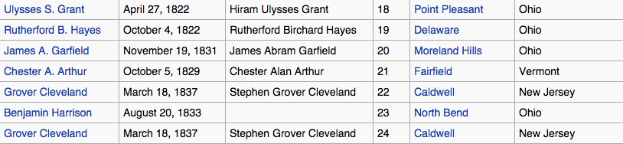
The push for microdata and the need for de-identification.

Slide 13

Why de-identify?
Data Publishing
Controlled Sharing
Oversight
Risk Mitigation
Long-term archiving

Slide 14
De-identification is not a single technique.
    It’s a collection of approaches, algorithms, and tools.
    Different approaches used with different kinds of data.
    Multiple regulations.
De-identification is about results:
    No privacy interest in de-identified data
    (by definition.)
    De-identified data can be shared without permission
    of the data subjects.
https://pixabay.com/en/drill-milling-milling-machine-444484/

Slide 15

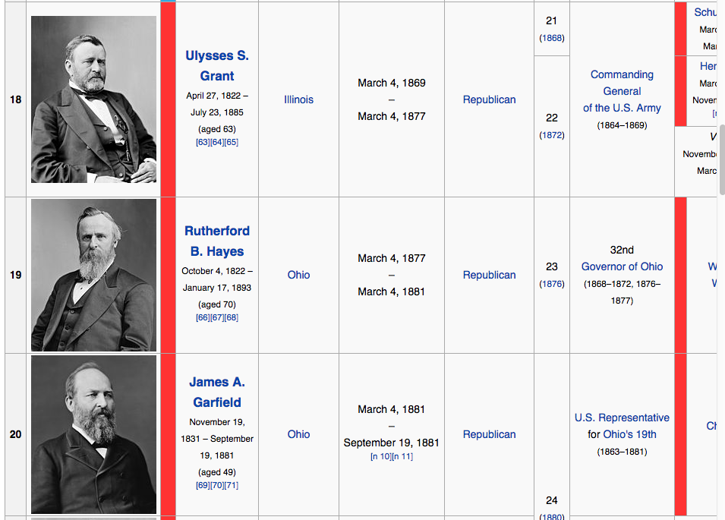
The de-identification problem:
De-identified data can be … re-identified.
Linkage attack:
re-identify data by linking with
another dataset.
Re-identification is rarely 100% certain.

Slide 16
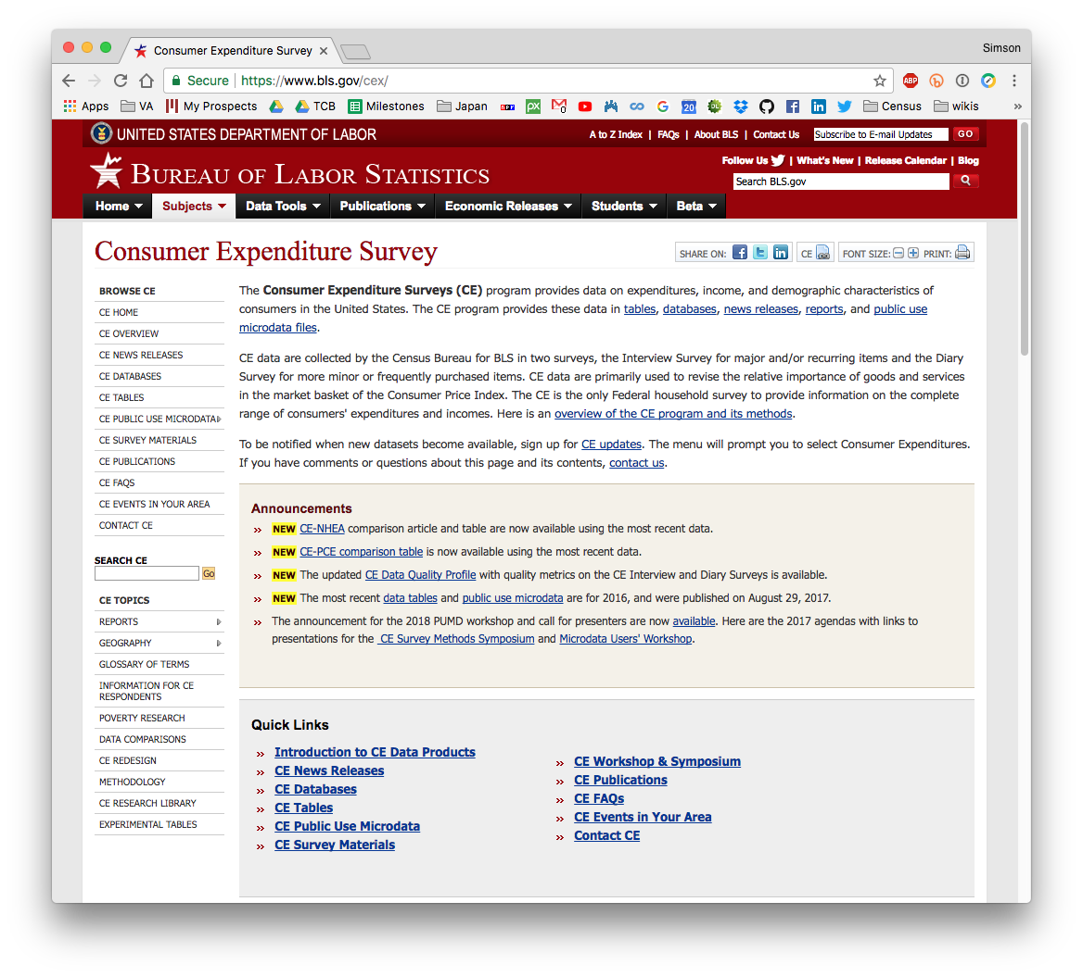
Microdata allows experimenters to perform their own analyses.

Slide 17
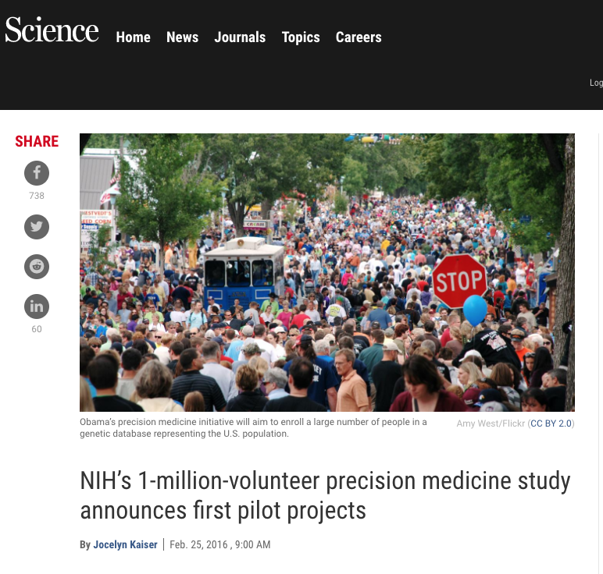
Big-data is the future of medical research.

Slide 18
Using real-time data to avoid the next big thing!
Share de-identified data with other drivers.
Alert authorities.
http://www.cheatsheet.com/automobiles/pothole-detection-is-this-the-next-big-car-technology.html/

Slide 19
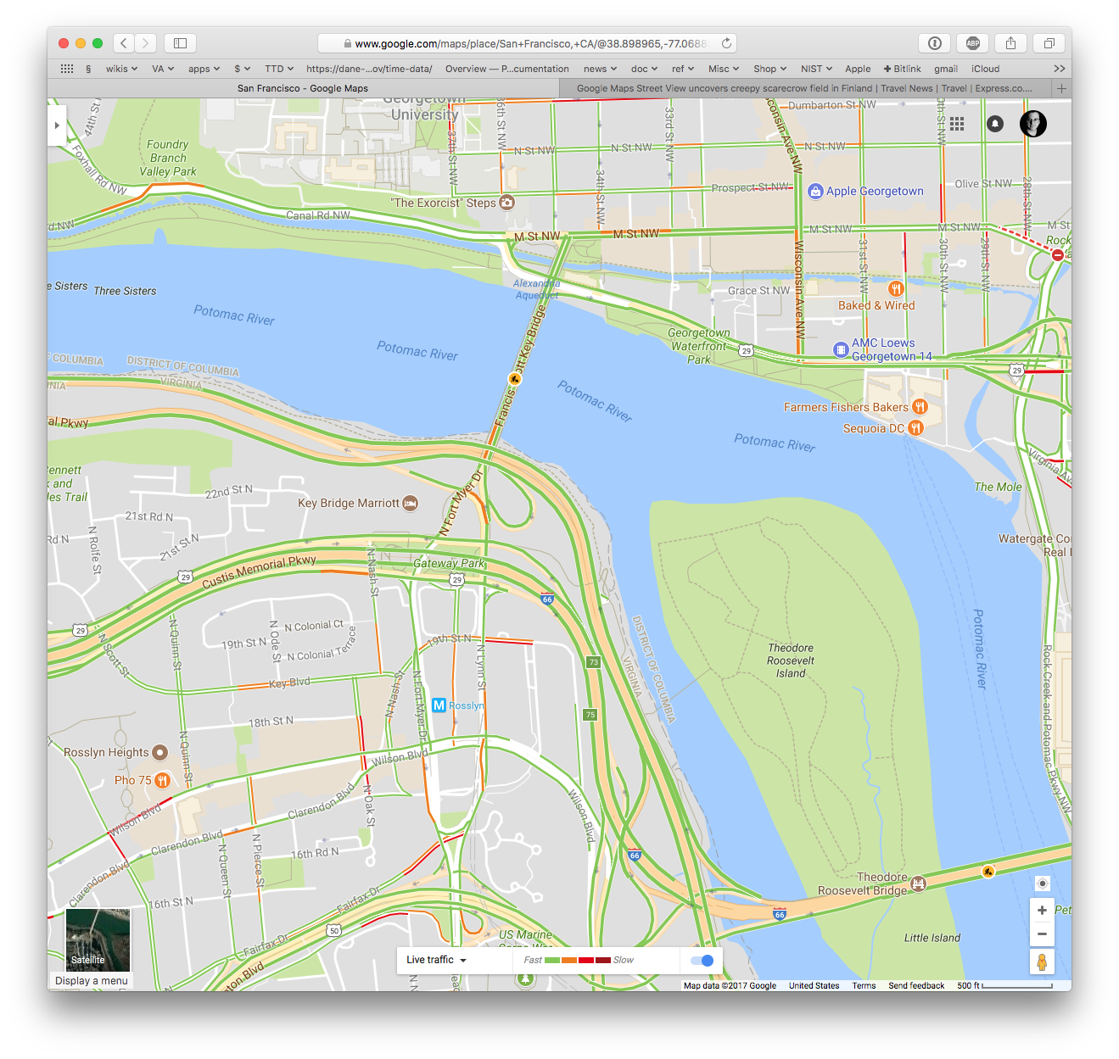
Real-time data is being used today

Slide 20



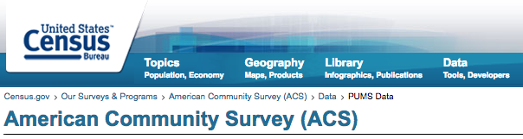
Basic idea of de-identification: remove the identities and you can release the data.
Educational records can be released
if de-identified (FERPA)
Medical records can be released
if de-identified (HIPAA)
Voluntary safety reports submitted to
FAA can be released if the data they
contain are de-identified
Title 13 allows Census to release
microdata if they are de-identified

Slide 21
Our laws assume that perfect de-identification is possible.
Useful data with PII
Useful data without PII
De-ID
The law believes that properly de-identified data cannot be re-identified.

Slide 22
De-identification questions:
How do you know if data are properly de-identified?
What is “anonymized” vs. “de-identified” vs. “pseudonymized?”
What is the privacy/utility trade-off?

Slide 23
Outline for today’s talk
Traditional disclosure avoidance ✔
The push for microdata ✔
Basic de-identification
Famous re-identification controversies
Traditional Disclosure Avoidance at the US Census Bureau

Slide 24
Basic De-Identification
President | Birth | Date of Inauguration | Age at Inauguration
XXXXXX | XXXXXX | XXXXXX | 57 years, 67 days
XXXXXX | XXXXXX | XXXXXX | 61 years, 125 days
XXXXXX | XXXXXX | XXXXXX | 57 years, 325 days
XXXXXX | XXXXXX | XXXXXX | 57 years, 353 days
XXXXXX | XXXXXX | XXXXXX | 58 years, 310 days
XXXXXX | XXXXXX | XXXXXX | 57 years, 236 days
XXXXXX | XXXXXX | XXXXXX | 61 years, 354 days
XXXXXX | XXXXXX | XXXXXX | 54 years, 89 days
William Weld & Latanya Sweeney
Identifiers vs. Quasi-Identifiers
HIPAA Privacy Rule
Testing the HIPAA Privacy Rule

Slide 25
Original approach: remove the “directly identifying” information.
Direct
Identifiers
President | Birth | Date of Inauguration | Age at Inauguration
George Washington | February 22, 1732 | April 30, 1789 | 57 years, 67 days
John Adams | October 30, 1735 | March 4, 1797 | 61 years, 125 days
Thomas Jefferson | April 13, 1743 | March 4, 1801 | 57 years, 325 days
James Madison | March 16, 1751 | March 4, 1809 | 57 years, 353 days
James Monroe | April 28, 1758 | March 4, 1817 | 58 years, 310 days
John Quincy Adams | July 11, 1767 | March 4, 1825 | 57 years, 236 days
Andrew Jackson | March 15, 1767 | March 4, 1829 | 61 years, 354 days
Martin Van Buren | December 5, 1782 | March 4, 1837 | 54 years, 89 days

Slide 26
Original approach: remove the “directly identifying” information.
Direct
Identifiers
President | Birth | Date of Inauguration | Age at Inauguration
XXXXX | February 22, 1732 | April 30, 1789 | 57 years, 67 days
XXXXX | October 30, 1735 | March 4, 1797 | 61 years, 125 days
XXXXX | April 13, 1743 | March 4, 1801 | 57 years, 325 days
XXXXX | March 16, 1751 | March 4, 1809 | 57 years, 353 days
XXXXX | April 28, 1758 | March 4, 1817 | 58 years, 310 days
XXXXX | July 11, 1767 | March 4, 1825 | 57 years, 236 days
XXXXX | March 15, 1767 | March 4, 1829 | 61 years, 354 days
XXXXX | December 5, 1782 | March 4, 1837 | 54 years, 89 days

Slide 27
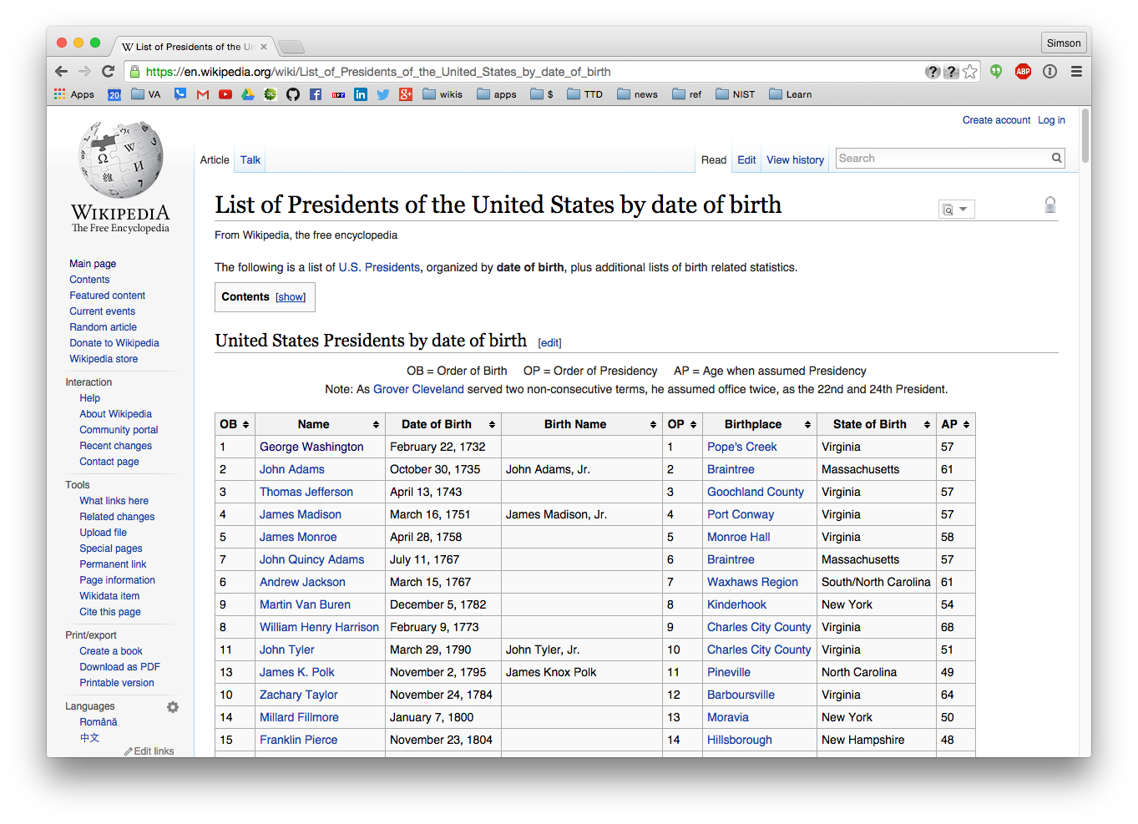
The problem: there may be another database that includes some of the remaining information.

Slide 28
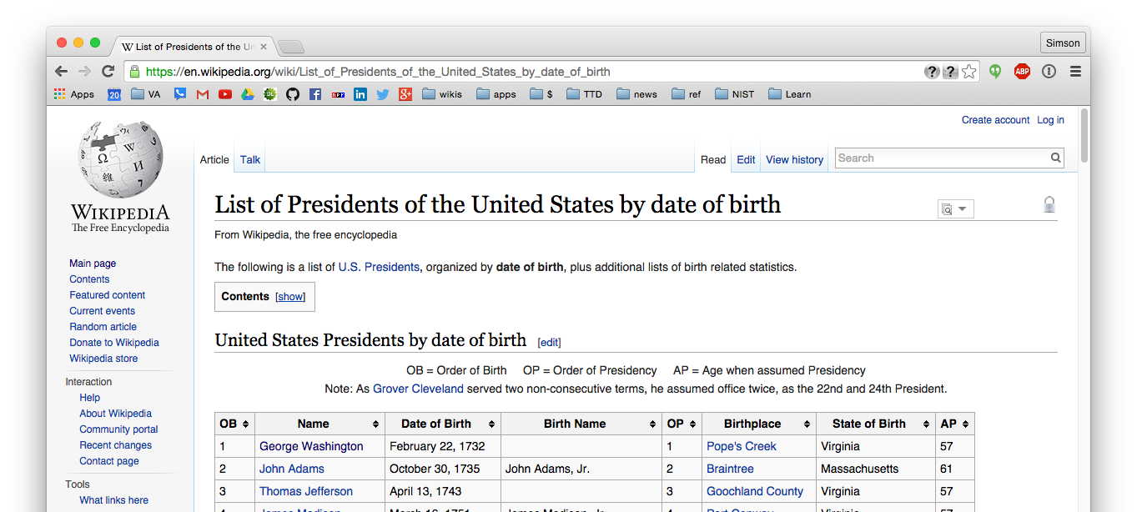
These two databases can be linked.
President | Birth | Date of Inauguration | Favorite Color
XXXXX | February 22, 1732 | April 30, 1789 | Red
XXXXX | October 30, 1735 | March 4, 1797 | Blue
XXXXX | April 13, 1743 | March 4, 1801 | Green
XXXXX | March 16, 1751 | March 4, 1809 | Yellow
XXXXX | April 28, 1758 | March 4, 1817 | Red
XXXXX | July 11, 1767 | March 4, 1825 | Orange
XXXXX | March 15, 1767 | March 4, 1829 | Cyan
XXXXX | December 5, 1782 | March 4, 1837 | Blue
Private Information

Slide 29
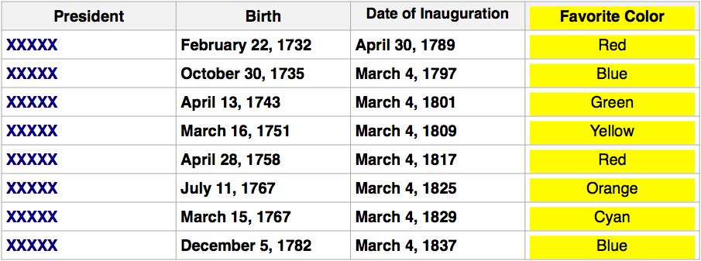
This is called a “linkage attack.”
“Birth date” is an
indirect identifier.
Also called a “quasi Identifier.”

Slide 30
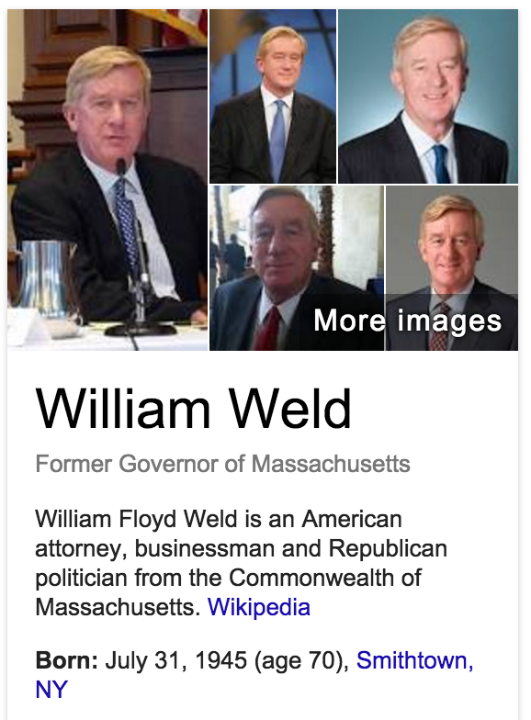
In 2000 Latanya Sweeney demonstrated a linkage attack.
She re-identified MA governor William Weld’s hospital records.
  Weld had fainted in 1996 and was admitted to a hospital.
  State of MA made “de-identified” hospital records of state employees available for research on health care.
    Removed name
    Date of birth, sex, & ZIP remained.

Slide 31
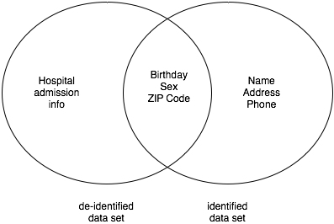
Sweeney purchased voter registration records.
(Cambridge, MA)
Sweeney found a record in each data set with identical birthday, sex & ZIP
  Weld’s records were uniquely identified.
  Sweeney estimated 87% of US population
  were uniquely identified by birthday, sex & ZIP
“Quasi-Identifiers”
“Direct” or “Explicit” identifiers

Slide 32
Basic de-identification with
Direct Identifiers & Quasi-Identifiers
Direct Identifiers — Main function is to identify people.
  Name
  SSN
    Identifiers must be suppressed
Quasi-Identifiers — Useful for analysis, but can also identify.
  Date of Birth
  Physical characteristics — height, weight, hair color, etc.
  History, capabilities, etc.
Options for quasi-identifiers:
  Suppression January 1, 1980 → XXXXXXXX, 1980
  Generalization January 1, 1980 → 1980-1985
  Swapping (between people) January 1, 1980 → February 29, 1984
_

Slide 33
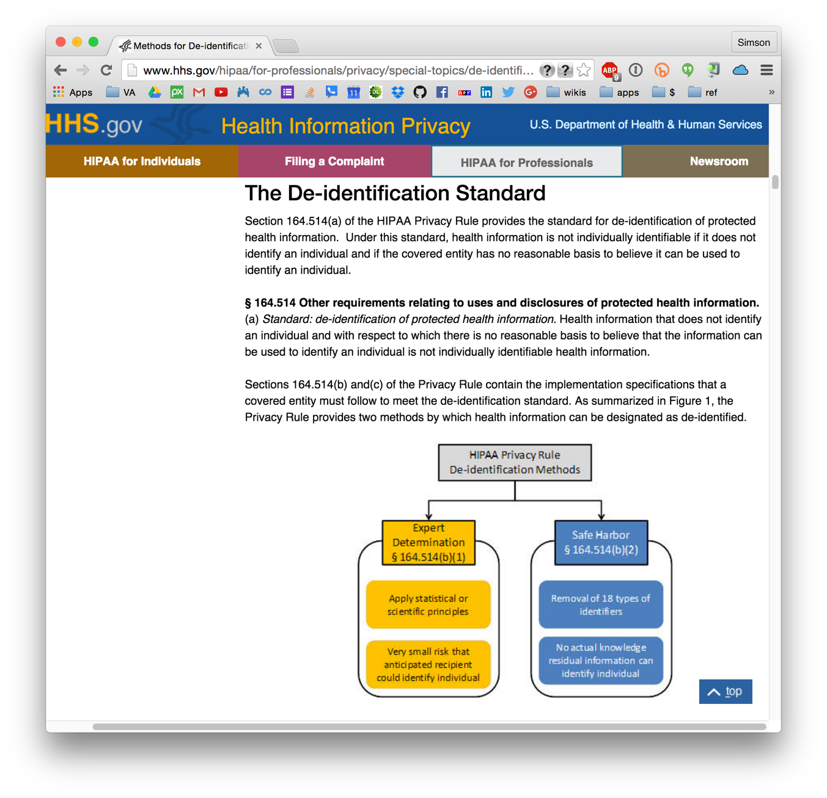
The HIPAA Privacy Rule “Safe Harbor” method is largely based on Sweeney’s findings.
HHS.gov
Health Information Privacy
www.hhs.gov/hipaa/for-professionals/privacy/special-topics/de-identification/

Slide 34
HIPAA “Safe Harbor” rule:
Medical records are de-identified if 18 data elements are removed
Must remove:
    Names
    Geographic subdivisions smaller than a state, except first 3 digits of ZIP, provided the combined ZIP codes contain more than 20,000 people.
    Dates directly related to an individual (except for “age 90 or older”)
    Individual numbers: phone, fax, SSN, medical record, account #s, etc.
    Email addresses, IP address, URLs
    Biometrics: fingerprints, voiceprints, photographs, etc.
    Any other uniquely identifying number, characteristic or code.
Estimated re-identification rate of this rule: 0.01% to 0.25%

Slide 35
HIPAA “Limited Datasets:”
Remove less information / More Useful / Restricted Use.
The same as HIPAA Safe Harbor, except:
    Dates may remain (admission, discharge, service, DOB, DOD)
    City, State, 5-digit ZIP code
    Age in years, months, days, or hours
May be disclosed to an outside party:
    Without a patient’s authorization or notification
    But…
Must have a data use agreement in place:
    Cannot release the data set
    Cannot share with others without a DUA

Slide 36
There is a trade-off between Information Quality and Privacy Protection
Complete
Protection
Bad Decisions /
Bad Science
Ideal Situation
Perfect Information &
Perfect Protection
Not achievable
due to
mathematical
constraints
Disclosure Protection
Poor
Privacy
Protection
No Protection
Information
No Information
Optimal Precision,
Lack of Bias
36

Slide 37
Outline for today’s talk
Traditional disclosure avoidance ✔
The push for microdata ✔
Basic de-identification ✔
Famous re-identification controversies
Traditional Disclosure Avoidance at the US Census Bureau

Slide 38

Famous Re-identification Cases

Slide 39
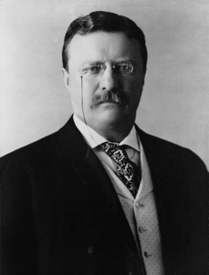
Re-identification is called a “re-identification attack.”
26
    The person doing the re-identification
    is sometimes called a “data intruder.”
    Motivations:
test the de-identification
Commercial
Benefit
gain publicity or professional standing
Harm or embarrass
the de-identifying
organization
Harm the data
subject
Theodore
Roosevelt

Slide 40
De-identified data can result in specific harms.
Identity disclosure
  The attacker can link de-identified data to an individual.
  Causes:
    Insufficient de-identification
    (identifying information remains in the data set)
    Re-identification by linking
    Pseudonym reversal
Attribute disclosure
  The dataset shows that all 20-year-old female patients from Q are left-handed.
    Jane is a 20-year-old female patient from Q.
    ∴Jane is left-handed.
Inferential disclosure
  Data show correlation between home income and purchase price.
  Knowing Jane purchased a house for $X, we can infer Jane’s household income.
De-identification doesn’t
help against these disclosures

Slide 41
Different “release models” can limit opportunities for re-identification.
Release and Forget model
  De-identification data are published on the Internet.
    e.g. American Community Survey PUMS
Data Use Agreement (DUA) model:
  Users assert that they will not attempt to re-identify.
  Required for HIPAA “limited” data sets.
    Census doesn’t do DUAs.
Enclave model:
  Users get access to a computer that has the data.
  Users can run queries, but not download the data.
    e.g. Research Data Centers

Slide 42



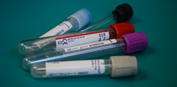

Since 2000, there have been several high-profile incidents in which publicly released de-identified data were re-identified.
Examples include:
  AOL Search Data
  Netflix Prize
  Medical Tests
  Credit Card Transactions —
  Mobility Traces
  Taxi Ride Data —

Slide 43
The AOL Search Log Case of 2006
Goal: Support web information retrieval research
  650k customers, 20 mil. queries, 3 mo. period
  Names replaced with persistent pseudonyms
Pseudonym
1
2
1
Name | Query | Date | Time
John Doe | Books | 1/2/05 | 16:52
Bob Smith | Payscale | 1/4/05 | 23:41
John Doe | Porn | 1/8/05 | 03:15
Name

Slide 44
User Queries
User 3482401
calorie counting
User 2178
foods to avoid when breast feeding
User 7268042
fear that spouse contemplating cheating
User 3505202
depression and medical leave
User 3483689
Time after time
User 47122
Child porno
User 31350
How to kill oneself with gas
User 3483689
Wind beneath my wings

Slide 45
A face exposed for AOL searcher no. 4417749.
New York Times. Aug 9, 2006. (Barbaro & Zeller)
User 4417749 issued hundreds of searches
Hand tremors
Numb fingers
Dog that urinates on everything
60 single men
Landscapers in Lilburn (Georgia)
Last name = “Arnold”
Thelma Arnold
& Dudley
Homes sold in shadow lack subdivision gwinnett county georgia
Nicotine effects on the body
Dry mouth
bipolar

Slide 46

Class Action Law
Suit Filed
AOL CTO resigns
Researcher & Project
Manager dismissed
Sept 2006
Mid-
August 2006
Early
August 2006
Late
August 2006
July 2006
AOL removes dataset
NY Times Article published
Researcher posts search queries of ~650k users to
research.aol.com

Slide 47
The Netflix Challenge (2008-2009)
Netflix published movie selections of ~450,000 pseudonymized subscribers
Re-identification via uniqueness of movie combinations
Name
Location
Extra Movie
Reviews
Extra Movies Watched
Movies
Netflix Challenge
Internet Movie Database
A. Narayanan & V. Shmatikov. IEEE Security and Privacy Conference. 2008.

Slide 48
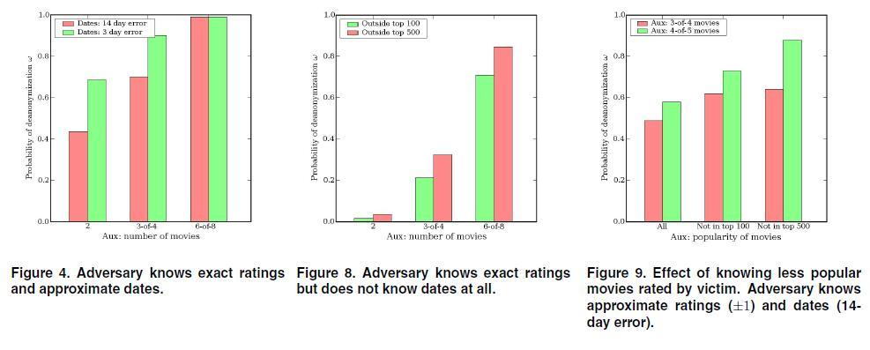
Netflix Prize Reidentification
Notes:
Obscure means outside top 500.
Any four “obscure” movies with rating alone: 84% unique
Any six movies with date (+/- 2 weeks): 99%
Any two movies with date (+/- 3 days) and rating: 68%

Slide 49
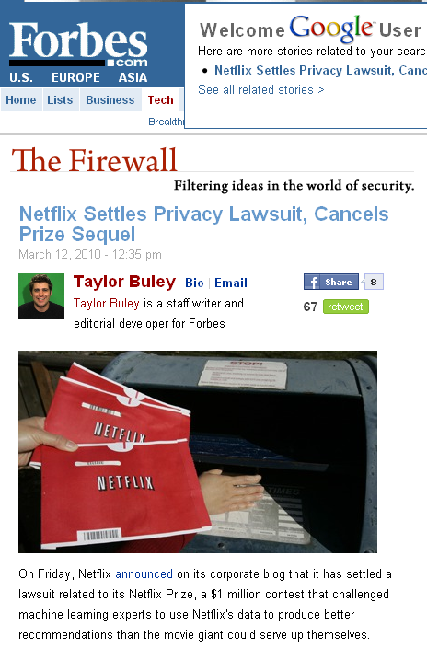

Slide 50
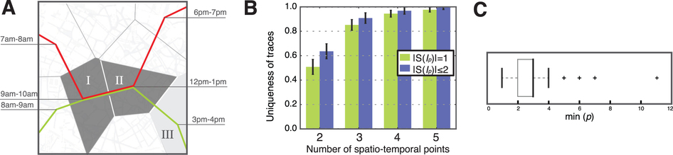
Cell Phone Location:
4 “spatio-temporal points” uniquely identifies a user in the data set.
Yves-Alexandre de Montjoye, César A. Hidalgo, Michel Verleysen & Vincent D. Blondel,
Unique in the Crowd: The Privacy Bounds of Human Mobility,
Nature Scientific Reports, Oct. 1, 2012.
Notes:
Chart B: Green is uniquely identified; Blue is in a group of one or two.
2 points: 50% (green) / 62% (blue)
3 points: 85% (green) / 89% (blue)
Chart C: 11 points, all uniquely identified

Slide 51

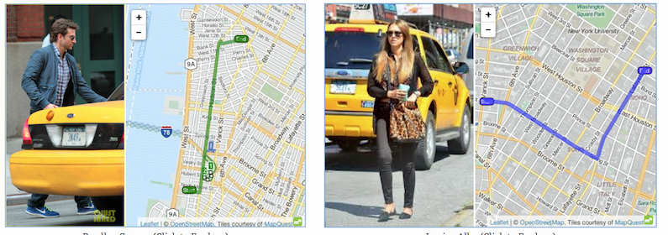
Re-identification by flickr:
2014 NYC Taxi Ride data, NYC Taxi and Licensing Commission
In 2014, NYC TLC released taxi ride dataset with the “MD5” of each taxi as a pseudonym
  MD5(“5C27”) = “0f76c35d4a069e0fe76b21d28f009639”
  Every taxi identifiable with a brute force search
An intern at Neustar re-identified 2 rides by searching for photos for taxi licenses and matching MD5 codes and times.
“5C27”
A journalist at Gawker identified 9 other cab rides.

Slide 52
De-ID Today

Slide 53
De-identified health datasets are widely distributed.
Are they vulnerable?
“A Systematic Review of Re-Identification Attacks on Health Data,” El Emam et al, 2011. PLOS One.
Findings:
14 published attacks
Few attacks involved health data
Most adversaries were researchers
Most re-identification attacks were in the US
Most re-identification attacks were verified
Most re-identified data was not de-identified
according to existing standards.
http://journals.plos.org/plosone/article?id=10.1371/journal.pone.0028071

Slide 54
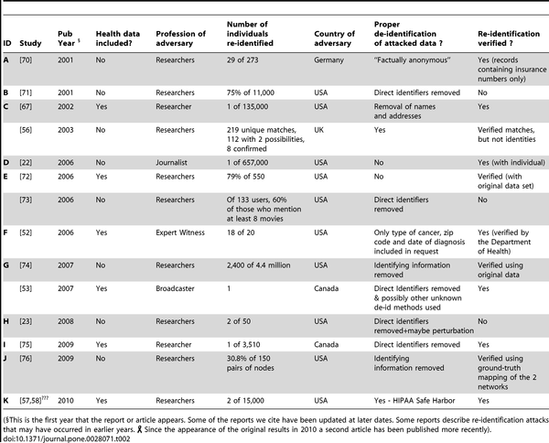

Table 2. A summary of successful re-identification attacks on the evaluation criteria.
El Emam K, Jonker E, Arbuckle L, Malin B (2011) A Systematic Review of Re-Identification Attacks on Health Data. PLoS ONE 6(12): e28071. doi:10.1371/journal.pone.0028071
http://journals.plos.org/plosone/article?id=info:doi/10.1371/journal.pone.0028071

Slide 55
Outline for today’s talk
Traditional Disclosure Avoidance ✔
Why de-identify? ✔
Basic de-identification ✔
Famous re-identification controversies ✔

