Slide 1
Modernizing Disclosure Avoidance: Report on the 2020 Disclosure Avoidance Subsystem as Implemented for the 2018 End-to-End Test (Continued)
Simson L. Garfinkel Chief, Center for Disclosure Avoidance Research U.S. Census Bureau 2017 Census Scientific Advisory Committee Fall Meeting Suitland, MD
11:00AM
September 15, 2017

Slide 2
Acknowledgments
This presentation incorporates work by:
Dan Kifer (Scientific Lead)
John Abowd (Chief Scientist)
Tammy Adams, Robert Ashmead, Aref Dajani, Jason Devine, Michael Hay, Cynthia Hollingsworth, Meriton Ibrahimi, Michael Ikeda, Philip Leclerc, Ashwin Machanavajjhala, Christian Martindale, Gerome Miklau, Brett Moran, Ned Porter, Anne Ross and William Sexton

Slide 3
Outline
Motivation
Differentially private 2020 Disclosure Avoidance System
High-level goals
Flow diagrams
Query examples
Conclusion

Slide 4
Motivation: To protect the privacy of individual survey responses
2010 Census:
5.6 billion independent tabular summaries published.
Based on 308 million person records
Database reconstruction (Dinur and Nissim 2003) is a serious disclosure threat that all statistical tabulation systems from confidential data must acknowledge.
The confidentiality edits applied to the 2010 Census were not designed to defend against this kind of attack.

Slide 5
The Disclosure Avoidance Subsystem (DAS) implements the privacy protections for the decennial Census.
Features of the DAS:
Operates on the edited Census records
Designed to make Census records safe to tabulate
Census Edited File
Disclosure Avoidance System
Hundred percent Detail File
(2000 and 2010)
--
Microdata Detail File (2020)

Slide 6
The 2000 and 2010 Disclosure Avoidance Systems relied on swapping households:
Advantages of swapping:
Easy to understand
Does not affect state counts if swaps are within a state
Can be run state-by-state
Operation is “invisible” to rest of Census processing
Disadvantages:
Does not provide formal privacy guarantees
Does not protect against database reconstruction attacks
Privacy guarantee relies on lack of external data
Town 1
Town 2
State “X”

Slide 7
The 2000 and 2010 Disclosure Avoidance System operated as a filter, on the Census Edited File:
Pre-specified tabular summaries: PL94-171, SF1, SF2 (SF3, SF4, … in 2000)
Enumeration responses, unduplication: Census Unedited File
Edits, imputations: Census Edited File
Confidentiality edits (household swapping), tabulation recodes: Hundred-percent Detail File
Special tabulations and post-census research

Slide 8
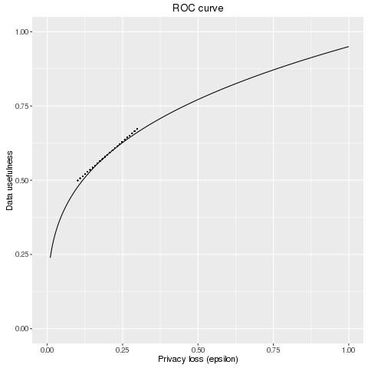
The 2020 Census disclosure avoidance system will use differential privacy to defend against a reconstruction attack,
Differential privacy provides:
Provable bounds on the accuracy of the best possible database reconstruction given the released tabulations.
Algorithms that allow policy makers to decide the trade-off between accuracy and privacy.
Data accuracy
Privacy loss budget (ε)
Pre-Decisional

Slide 9
The 2020 Disclosure Avoidance System also operates as a filter… but it’s much more visible.
Pre-specified tabular summaries:
PL94-171, SF1, SF2…
Enumeration responses, unduplication: Census Unedited File
Edits, imputations: Census Edited File
Global Confidentiality Protection Process
Disclosure Avoidance System
Microdata Detail File
(releasable)
Special tabulations and post-census research
Privacy Budget,
Accuracy Decisions

Slide 10
The 2020 Disclosure Avoidance System relies on infusing formally private noise.
Advantages of noise infusion with formal privacy:
Easy to understand
Provable and tunable privacy guarantees
Privacy guarantees do not depend on external data
Protects against database reconstruction attacks
Privacy operations are composable
Disadvantages:
Entire country must be processed at once for best accuracy
Every use of private data must be tallied in the privacy loss budget
Global Confidentiality Protection Process
Disclosure Avoidance System
ε

Slide 11
Differentially Private Disclosure Avoidance System: Requirements
DAS must be able to read the Census Edited File (CEF):
CEF must be exactly specified and contain all information necessary for all tabulation recodes
CEF must be kept confidential after DAS runs (as it was for historical censuses)
DAS must generate the Microdata Detail File (MDF):
Must contain all information that appears in any publicly released table (e.g. PL94-171, SF1, SF2)
Should not contain any information that does not appear in a publicly released table
May be publicly released (in whole or in part)
Non-functional requirements:
The disclosure avoidance system must provably move information from the CEF to PL94/SF1/SF2 with an adjustable total privacy-loss budget
The source code and parameters for the DAS will be made publicly available
Pre-Decisional

Slide 12
Why generate a differentially private MDF?
Familiar to internal and external stakeholders
Operates with tabulation system to produce PL-94 and SF-1 tabulations
Guarantees population totals (voting age, non-voting age, householder) exact at all levels of geography
Consistency among query answers

Slide 13
Some queries must be privacy preserving. Some queries must be exact (“invariant”)
Specific PL-94 queries must be exact:
Block population
Block voting age population
Block householders & vacancies
—per 2000 Department of Justice letter to the Director, Kenneth Prewitt
Other PL-94 and SF-1 queries will not be exact:
Age distribution under 18
Age distribution 18 and over
Race and ethnicity distribution
Household relationship distribution
Household ownership distribution
Final privacy-loss budget determined by Data Stewardship Executive Policy Committee (DSEP) with recommendation from Disclosure Review Board (DRB)
13

Slide 14
How the 2020 System Works: High-level Overview
The new system is similar to swapping, with key differences:
Every record in the population may be modified
But modifications are bounded by DOJ policy and global privacy budget.
Records in the tabulation data have no exact counterpart in the confidential data
There is no one-to-one mapping between CEF and MDF records.
But there are the same number of records for every block.
Explicitly protected tabulations (PL-94 and SF-1) have provable, public accuracy levels
2020 will publish the algorithms, the parameters and the accuracy of the tabulations.

Slide 15
Proposed “Top-Down” Algorithm
National table with all 500,000 cells filled, structural zeros imposed with accuracy allowed by ε₁
2 x 255 x 17 x 115
National table of US population
2 x 255 x 17 x 115
Spend ε₁ privacy-loss budget
Sex: Male / Female
Race + Hispanic: 255 possible values
Relationship to Householder: 17
Age: 0-114
Reconstruct individual micro-data without geography
325,000,000 records
15

Slide 16
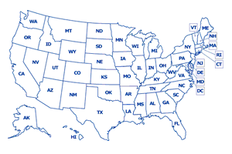
State-level
Reconstruct individual micro-data without geography
325,000,000 records
State-level tables for only certain queries; structural zeros imposed;
dimensions chosen to produce best accuracy for PL-94 and SF-1
Spend ε₂ privacy-loss budget
Target state-level tables required for best accuracy for PL-94 and SF-1
Exact state voting-age, non-voting age, and householder counts as enumerated.
Construct best-fitting individual micro-data with state geography
325,000,000 records now including state identifiers
16

Slide 17
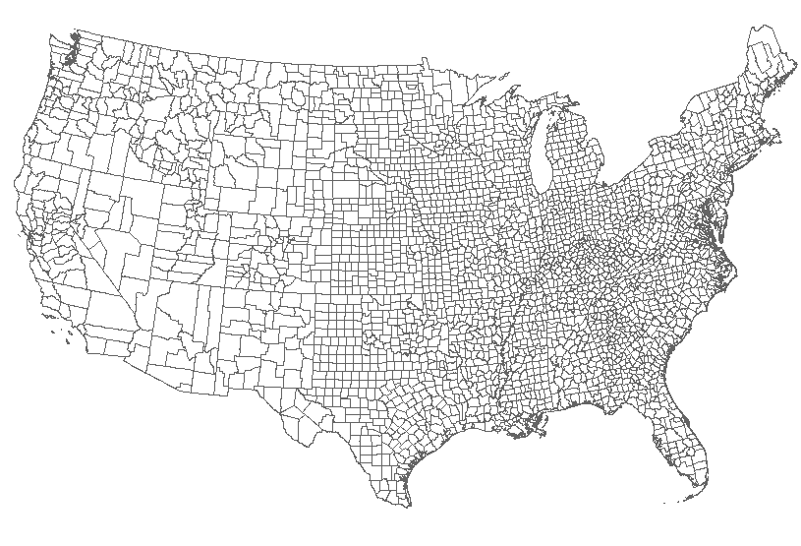
County-level
Construct best-fitting individual micro-data with state geography
325,000,000 records now including state identifiers
County-level tables for only certain queries; structural zeros imposed;
dimensions chosen to produce best accuracy for PL-94 and SF-1
Spend ε₃ privacy-loss budget
Target county-level tables required for best accuracy for PL-94 and SF-1
Exact county voting-age, non-voting age, and householder counts as enumerated.
Construct best-fitting individual micro-data with state and county geography
325,000,000 records now including state and county identifiers
17
Pre-Decisional

Slide 18
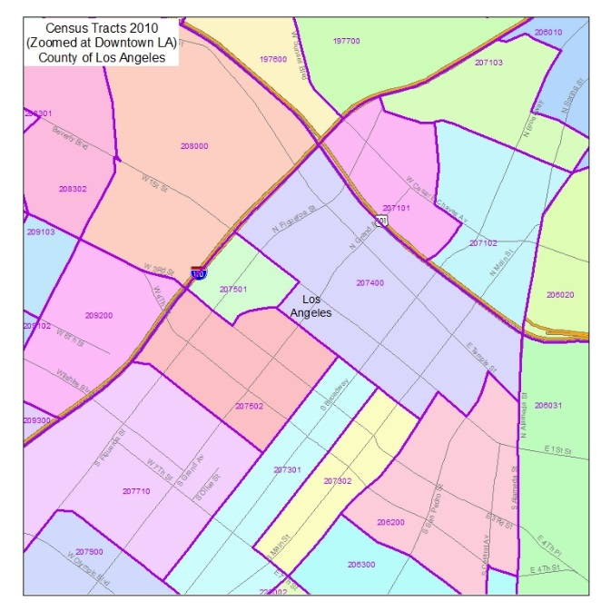
Census tract-level
Construct best-fitting individual micro-data with state and county geography
325,000,000 records now including state and county identifiers
Spend ε₄ privacy-loss budget
Target tract-level tables required for best accuracy for PL-94 and SF-1
Exact tract voting-age, non-voting age, and householder counts as enumerated.
Tract-level tables for only certain queries; structural zeros imposed;
dimensions chosen to produce best accuracy for PL-94 and SF-1
Construct best-fitting individual micro-data with state, county, and tract geography
325,000,000 records now including state, county, and tract identifiers
18

Slide 19
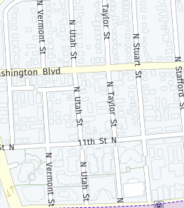
Block-level
Construct best-fitting individual micro-data with state and county geography
325,000,000 records now including state, county and tract identifiers
Spend ε₅ privacy-loss budget
Block tract-level tables required for best accuracy for PL-94 and SF-1
Exact block voting-age, non-voting age, and householder counts as enumerated.
Block-level tables for only certain queries; structural zeros imposed;
dimensions chosen to produce best accuracy for PL-94 and SF-1
Construct best-fitting individual micro-data with state, county, tract and block geography
325,000,000 records now including state, county, tract identifiers
19

Slide 20
MDF for tabulating
Construct best-fitting individual micro-data with state, county, tract and block geography
325,000,000 records now including state, county, tract identifiers
Construct best-fitting individual micro-data with state, county, tract and block geography
325,000,000 records now including state, county, tract, and block identifiers
MDF used for tabulating PL-94, SF-1
20

Slide 21
MDF for tabulating
Construct best-fitting individual micro-data with state, county, tract and block geography
325,000,000 records now including state, county, tract, and block identifiers
How accurate is the MDF?
Disclosure Avoidance Certificate
Certifies that the DAS passed tests
Reports the accuracy of the MDF
Requires ε_{A}
MDF used for tabulating PL-94, SF-1
21

Slide 22
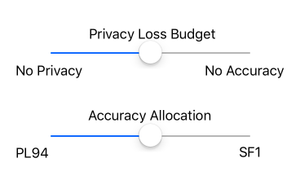
Operational Decisions
Set total privacy loss budget: ε
Ensure that ε₁+ ε₂+ ε₃+ ε₄+ ε₅ + ε_{A} = ε
Within each stage, allocate privacy-loss budget between:
PL-94
Parts of SF-1 not in PL-94
These are policy levers provided by the system.
Levers are set by the Data Stewardship Executive Policy Committee
Pre-Decisional

Slide 23
Inputs Used by the Development Team
Lists of matrices in technical documentation express core queries in the workload
PL94: https://www.census.gov/prod/cen2010/doc/pl94-171.pdf
SF1: https://www.census.gov/prod/cen2010/doc/sf1.pdf
SF2: https://www.census.gov/prod/cen2010/doc/sf2.pdf
Over 1,000 pages of edit specifications for 2010 CEF
Uncurated tabulation recode programs

Slide 24
We are creating
DAS0
A framework for Disclosure Avoidance Systems:
Development & Test Mode
Production Mode
Testing Systems:
DAS0 — 100% accuracy, no privacy
(No disclosure avoidance)
DAS1 — 100% privacy, no accuracy
DAS2 — “bottom-up” engine
Operational System:
DAS3 — “top-down” engine
DAS3
Data accuracy
DAS2
DAS1
Privacy loss budget (ε)
24

Slide 25
Plans for the 2018 End-to-End Test
The 2018 End-to-End test will incorporate differential privacy
Likely DAS2 — Bottom-up algorithm
Only the prototype PL94-171 files will be produced
No decisions yet regarding the privacy-loss budget or accuracy level
Questions?

Slide 26
Reference
Dinur, Irit and Kobbi Nissim (2003). “Revealing information while preserving privacy.” in Proceedings of the twenty-second ACM SIGMOD-SIGACT-SIGART symposium on Principles of database systems (PODS '03). ACM, New York, NY, USA, 202-210. DOI: 10.1145/773153.773173.

