Slide 1
Remembrance of Data Passed
Simson L. Garfinkel • Tech Reunions 2017 • 5PM - 7PM • 3-270 • June 10, 2017

Slide 2
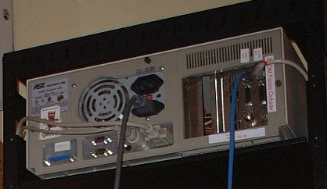
August 1998: 10 used computers purchased from a computer store

Slide 3
1998
#1 — File server from a law firm
#2 — Database of mental health patients
#3 — Financial records from a woman getting a divorce
#4 — Draft manuscript of a novel

Slide 4
Stories of Data Passed…
April 1997
A woman in Pahrump, NV, purchases a used IBM PC and discovers records from 2000 patients who had prescriptions filled at Smitty’s Supermarkets pharmacy in Tempe, AZ.
August 1998
Garfinkel purchases 10 used computers; one computer was a file server of a law firm; another computer had a database used by community organization providing mental health services
August 2001
More than 100 computers from Viant with confidential client data sold at auction by Dovebid.
Spring 2002
Pennsylvania state Department of Labor and Industry sells computers with “thousands of files of information about state employees.”
August 2002
Purdue student purchased used Macintosh computer at equipment exchange; computer contains FileMaker database with names and demographic information of 100 applicants to Entomology Department.

Slide 5
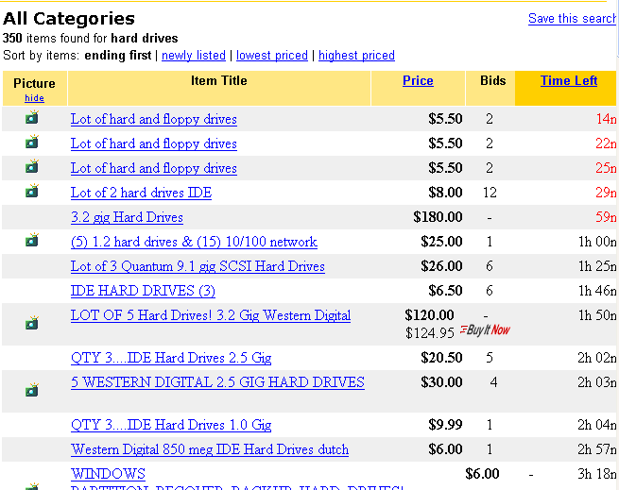
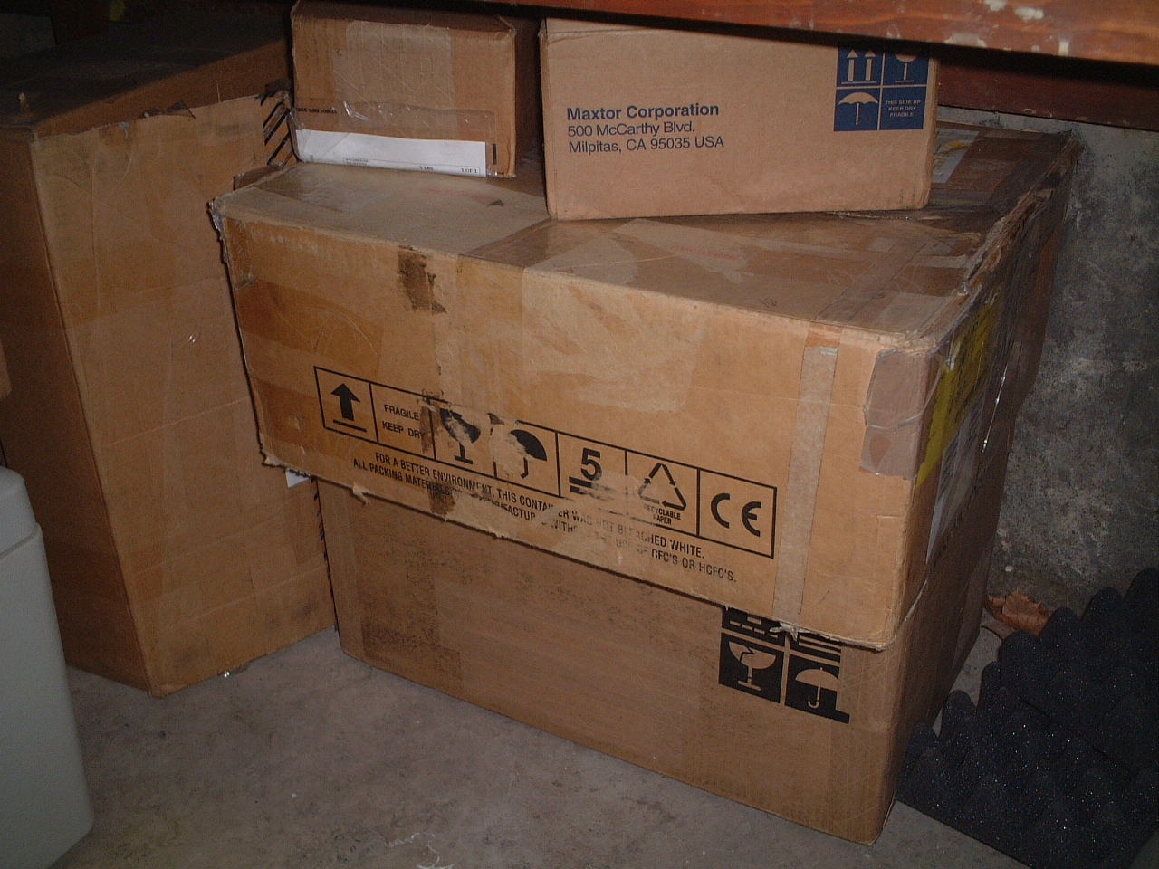
150 drives purchased on eBay

Slide 6
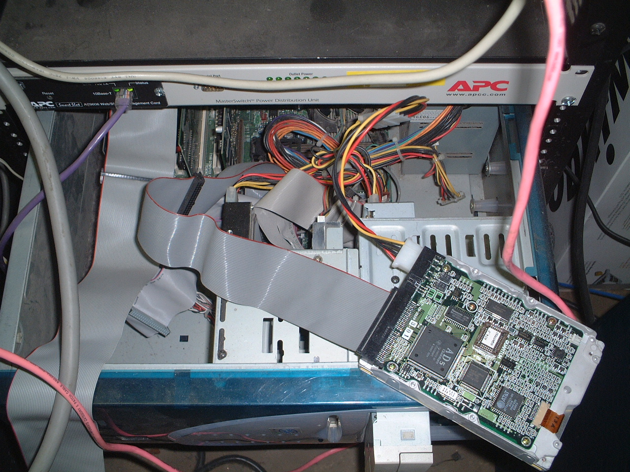
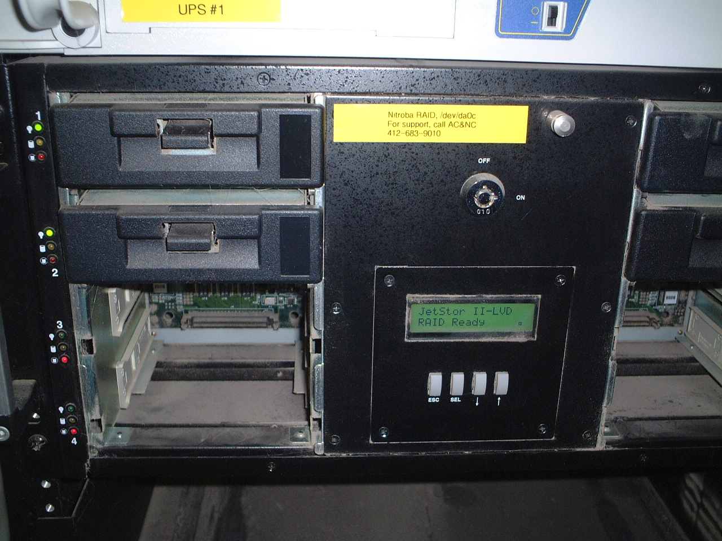
2000-2003

Slide 7
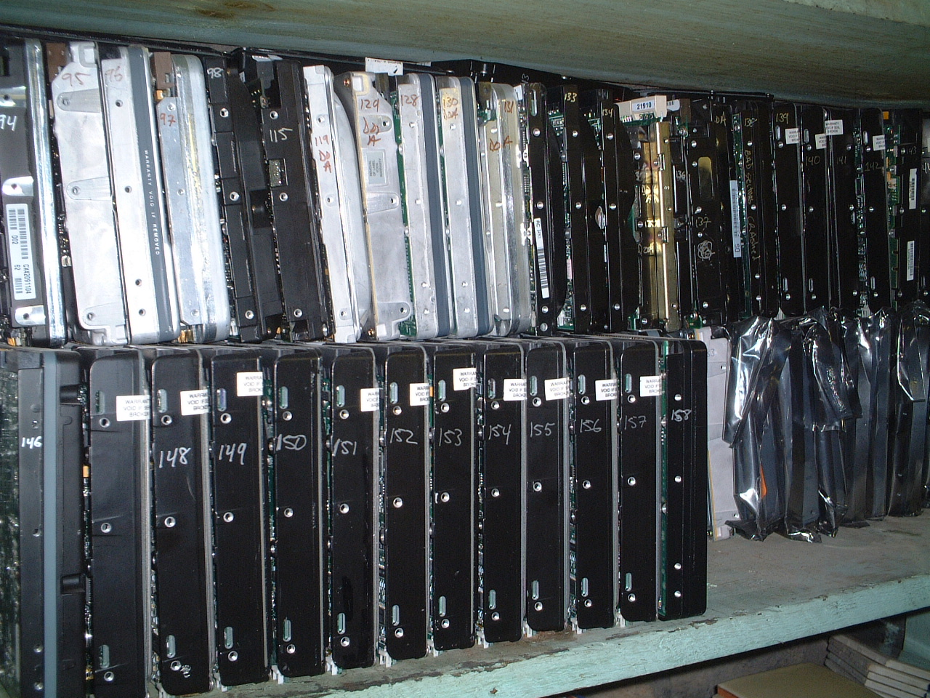
Drives retained in storage
Sept. 2003: First Year MIT PhD program!

Slide 8
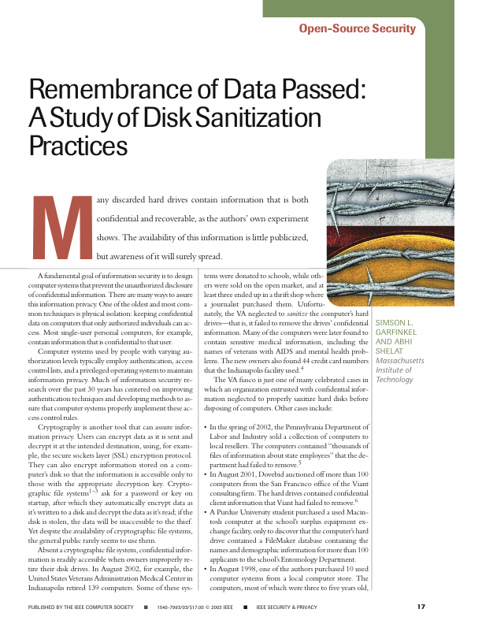
Jan 2002 drives | 150
Jan 2004 drives | 235
Drives DOA | 59
Drives Images | 176
Total files: | 168,459
Total data | 125 GB

Slide 9
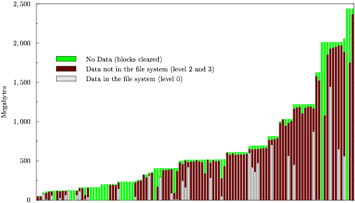

Slide 10
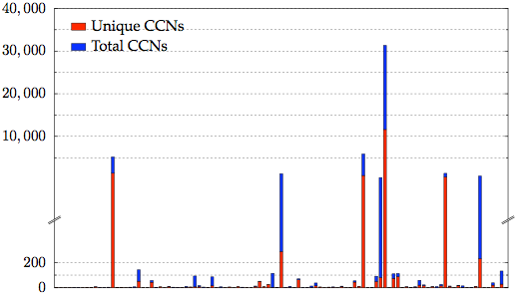
Most drives had just a few,
but some drives had a lot of credit card numbers.

Slide 11
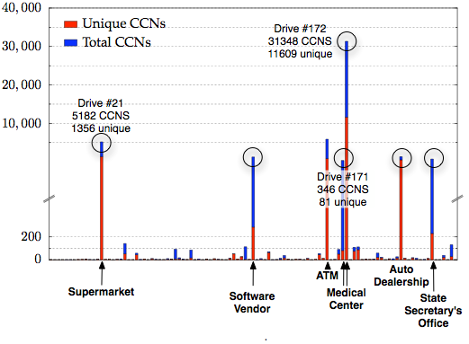
Most drives had just a few,
but some had a lot of credit card numbers.

Slide 12
We traced 20 drives back to their former owners.
While tracing back the drives, we discovered Cross Drive Analysis.

Slide 13
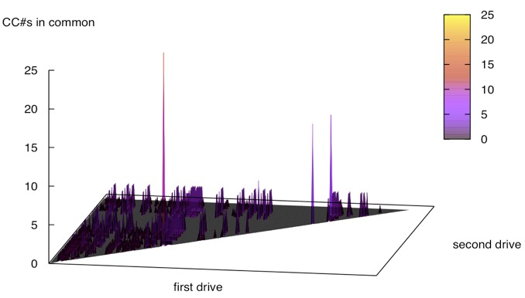
Cross-Drive Correlation

Slide 14
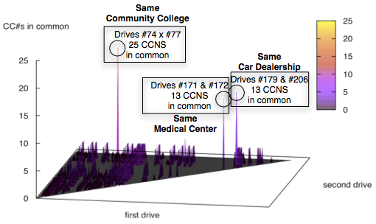
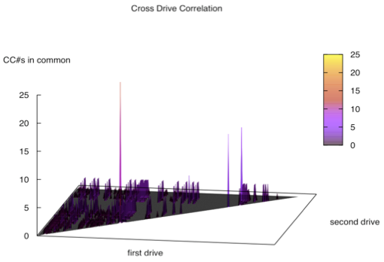
Cross-Drive Correlation

Slide 15
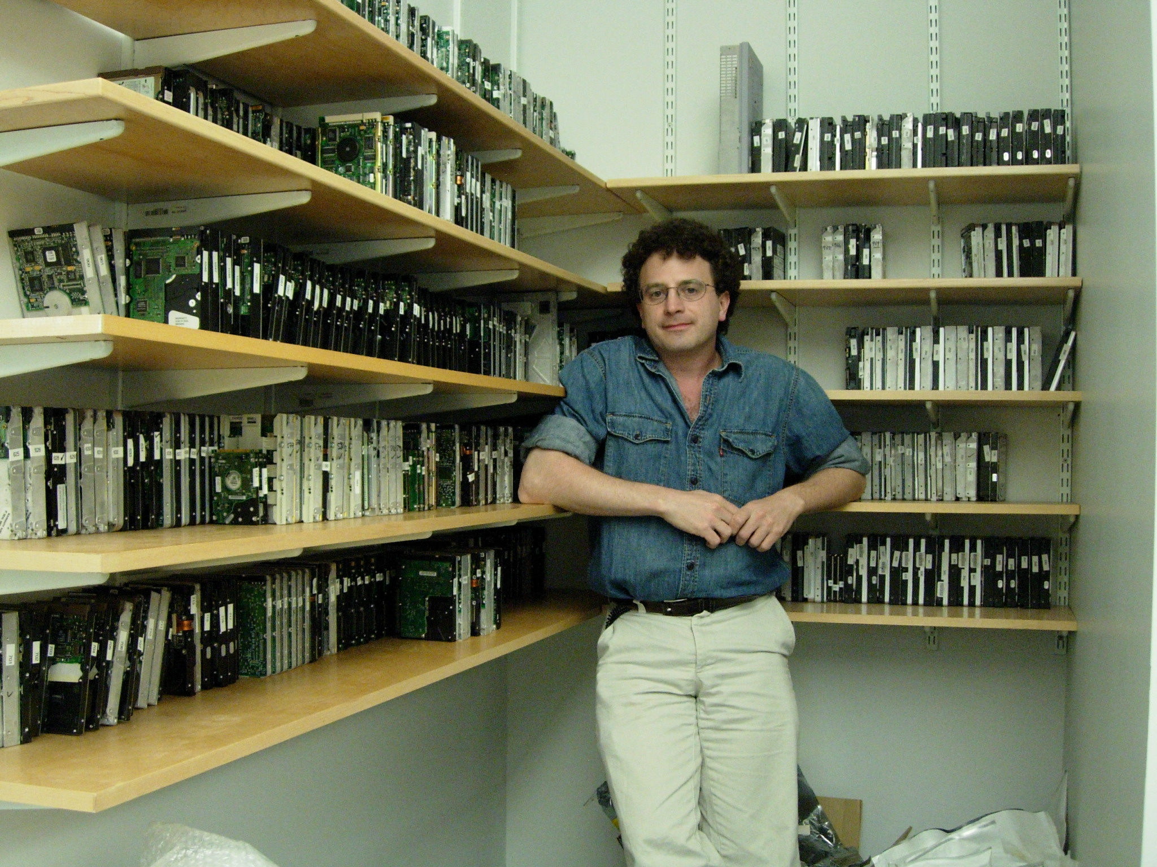
Harvard University, 2005

Slide 16
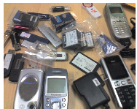
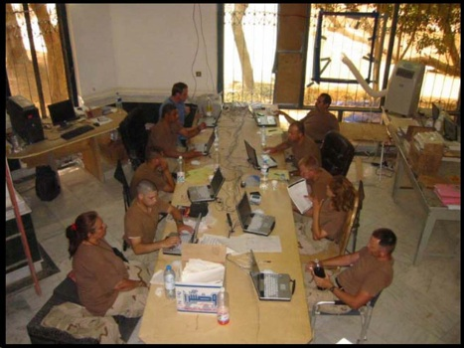
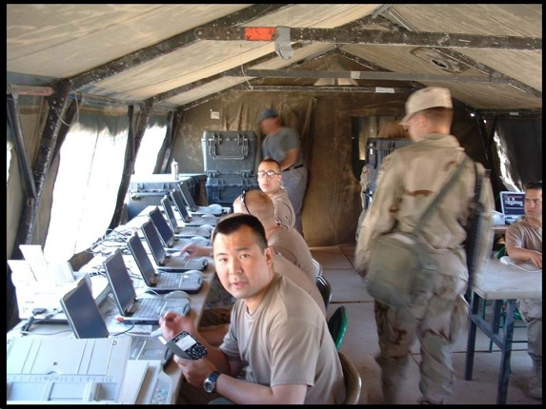
2006-2015: Naval Postgraduate School

Slide 17
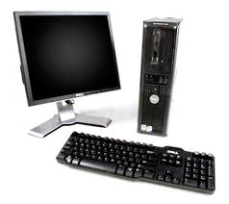
City of San Luis Obispo Police Department, Spring 2010
District Attorney filed charges against two individuals:
Credit Card Fraud
Possession of materials to commit credit card fraud.
Defendants:
Arrested with a computer.
Expected to argue that defends were unsophisticated and lacked knowledge.
Examiner given 250GiB drive the day before preliminary hearing.
Typically, it would take several days to conduct a proper forensic investigation.

Slide 18
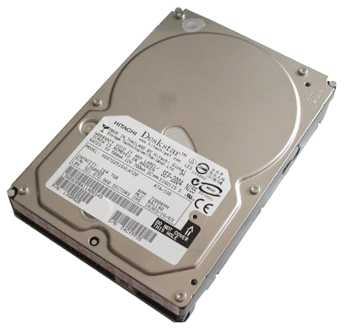
bulk_extractor found actionable evidence in 2.5 hours!
Examiner given 250GiB drive the day before preliminary hearing.
Bulk_extractor found:
Over 10,000 credit card numbers on the HD (1000 unique)
Most common email address belonged to the primary defendant (possession)
The most commonly occurring Internet search engine queries concerned credit card fraud and bank identification numbers (intent)
Most commonly visited websites were in a foreign country whose primary language is spoken fluently by the primary defendant.
Armed with this data, the DA was able to have the defendants held.

Slide 19
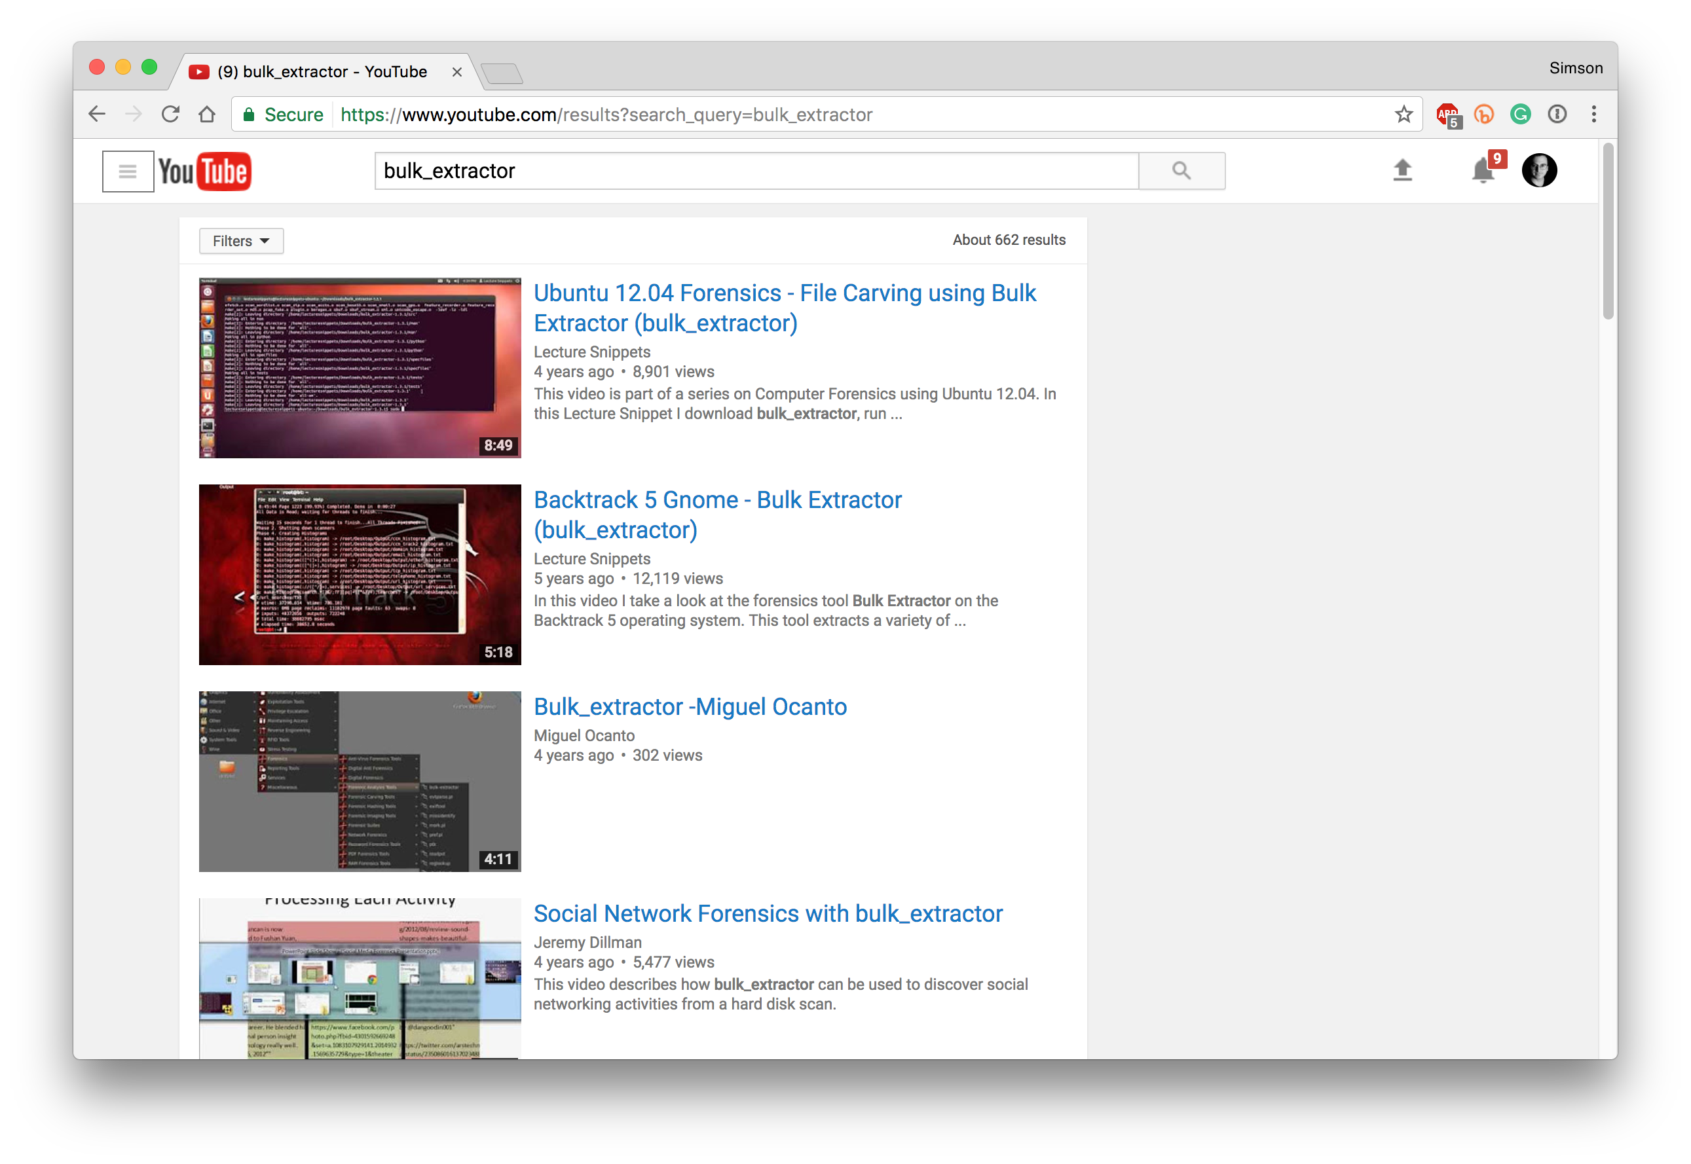
$15M and 8 years later
662 results!

Slide 20
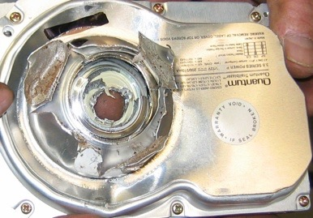
Physical destruction makes forensic recovery impossible.

Slide 21
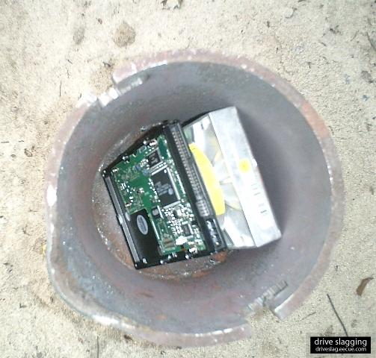
Drive Slagging
Dave Bullock, John Norman, & CHS
http://driveslag.eecue.com/

Slide 22
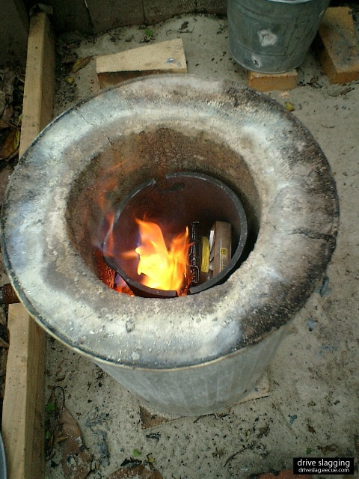
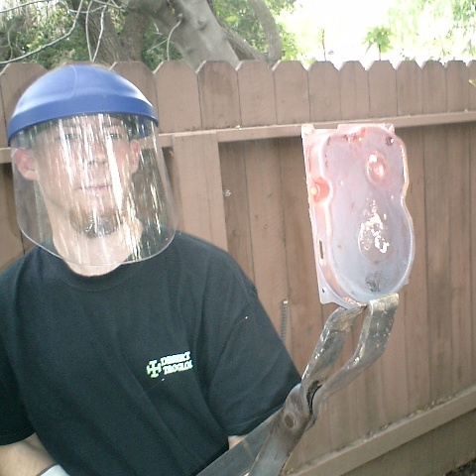
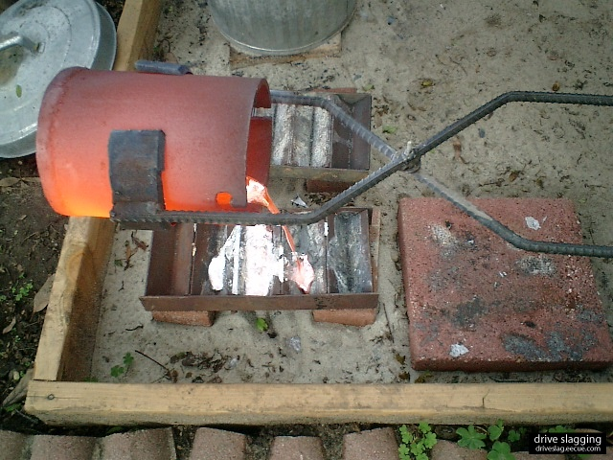
“Good luck removing data from this.”
“Our prognosis: drive slagging is a fool-proof method to prevent data recovery.”

Slide 23
Timeline
1987 — Graduate MIT with degree in chemistry!
1998 — Bought 10 used computers for a startup; found used data.
2002–2005 — Course 6 PhD program
2003 — IEEE S&P Publication
2005 — Cross Drive Analysis
2006–2015 — Naval Postgraduate School
Google: "bulk_extractor"

