Slide 1
Technical Challenges in Disclosure Control
May 4, 2017
Simson L. Garfinkel
Center for Research on Disclosure Avoidance
DISCLAIMER: The views expressed in this presentation are those of the author and do not necessarily reflect the policy of the US Census Bureau, the US Department of Commerce, or the United States Government.

Slide 2
The big picture
“Evidence-based policy making.”
Sensitive data
Public Analytic Product
Public Policy

Slide 3
Goroff & Polonetsky: Privacy Protecting Research
Objectives: Accuracy, Privacy, Efficacy
Approaches:

Slide 4
Sensitive Data:
For example, sensor networks
“Array of Things: A Scientific Research Instrument in the Public Way.”
Aircasting

Slide 5
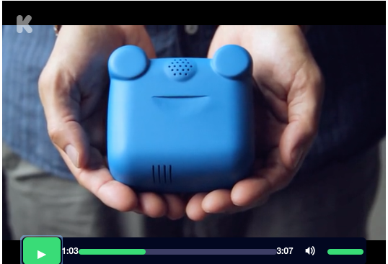
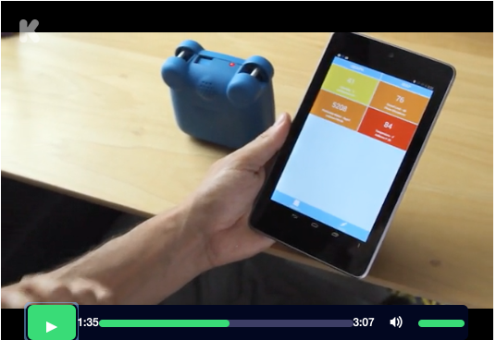
Especially wearable sensors.
Aircasting

Slide 6
Other sources of sensitive data…
Educational records — FERPA
Medical Records — HIPAA
US Census — Title 13
Survey of Income and Program Participation — Title 13
US Internal Revenue Service — Title 26
Commercial Data —
Behavioral Data — Google
http://www.clipartpanda.com/categories/school-house-images
http://www.cooladata.com/blog/behavioral-analytics/

Slide 7
High-quality data can help accelerate empirical research in cancer and other areas.
With high-quality data, we can:
  Perform large-scale retrospective studies.
  Identify drugs that may be highly effective in select populations.
  Discover populations that have been excluded from the benefits of research.
High-quality data requires high-quality privacy protection!
  HIPAA limits the ability to share data with identifiers.
  HIPAA privacy protections may be insufficient for community acceptance.
  There may be additional issues resulting from the Common Rule.

Slide 8
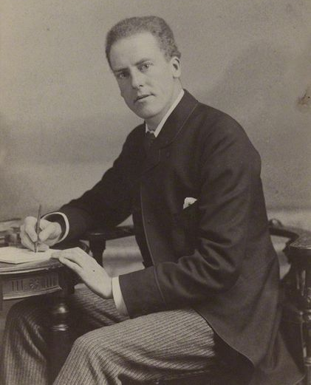
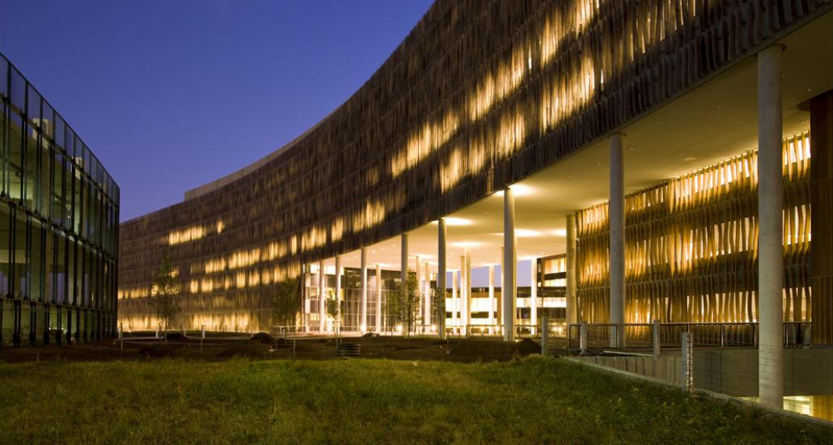
Options for Research on Confidential Data:
Remote Stats
Statistician goes to organization, does research, results are processed with disclosure avoidance and returned.
Karl Pearson
Statisticians who want access to the data
Organization with confidential data
Advantage: Stats run on the real data.
Challenges: Slow; expensive; privileged statisticians — equity issues

Slide 9
Options for Research on Confidential Data: Microdata
Organization publishes de-identified microdata.
Organization with confidential data
Statisticians who want access to the data
Advantage: Statistician can use data at their own offices.
Results do not need disclosure avoidance.
Disadvantage: Accuracy may be insufficient — and you can’t tell what’s not accurate.
De-identified data may still leak sensitive information!

Slide 10
Options for microdata: de-identification
De-identified microdata:
  Direct Identifiers: Remove
  Quasi-Identifiers: Generalize / suppress / infuse noise / swap
  Data accuracy: degrades.
Problems:
  De-identification can be incomplete.
  Impact on accuracy is frequently not released.

Slide 11

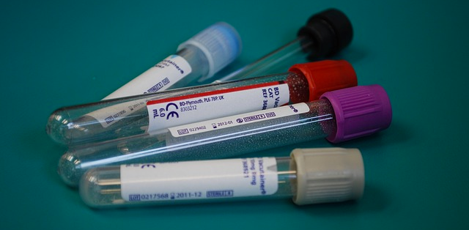
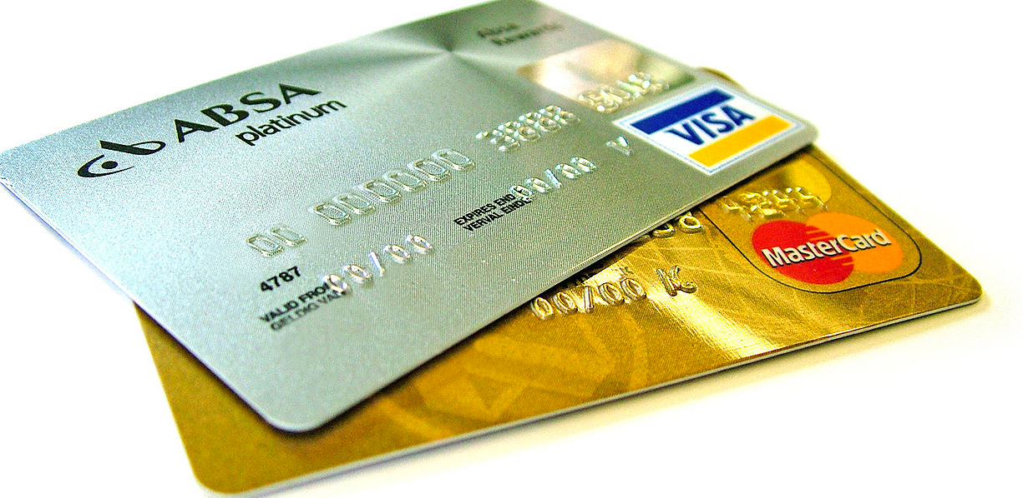
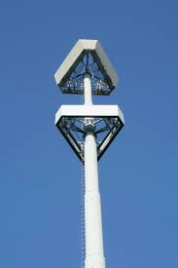
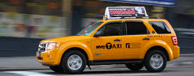
Since 2000, publicly released de-identified data have been re-identified in several high-profile incidents"
Netflix Prize — A few Netflix subscribes were identified using the IMDB rating’s database.
Medical Tests — ≈99% of 61,280 patients were uniquely distinguished by the results of the CHEM7 or CBC blood tests.
Credit Card Transactions — In a data set of 1.1 million people from an unnamed country, 90% were uniquely distinguished by four transactions (merchant, date & transaction size)
Mobility Traces — In a data set of 1.5 million individuals, 95% were uniquely identified with four randomly chosen space-time points (resolution: 1 hour & a cell phone site)
Taxi Ride Data — In a dataset of taxi trips, the drivers and some riders could be identified

Slide 12
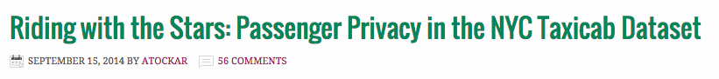
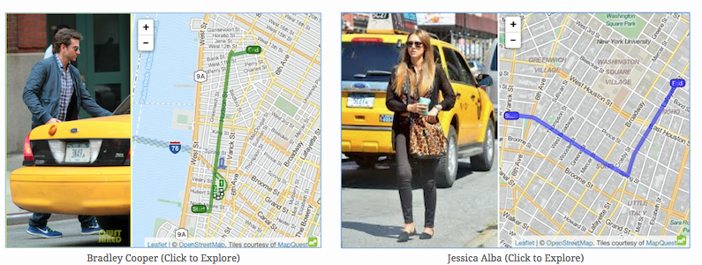
Example: release of 2014 NYC Taxi Ride data by NYC Taxi and Licensing Commission
In 2014, NYC TLC released taxi ride dataset with the “MD5” of each taxi as a pseudonym
  MD5(“5C27”) = “0f76c35d4a069e0fe76b21d28f009639”
  Every taxi identifiable with a brute force search
An intern at Neustar re-identified 2 rides by searching for photos for taxi licenses and matching MD5 codes and times.
“5C27”
A journalist at Gawker identified 9 other cab rides.

Slide 13
The re-identification scenarios help illustrate the risk.
What is the re-identification risk for taxi passengers?
Journalist scenario (to make organization look bad):
  100% — because more than one record was re-identified.
Prosecutor Scenario (to re-identify a specific person)
  0.0000063% — the % of people actually re-identified
  ≧ 0.0000063% — for famous people (likely to be photographed)
NYC Taxi ride database size: | 173 Million
Number of re-identified taxi rides | 11
Percentage re-identified: | 0.0000063%

Slide 14
In general, the risk of re-identification may be over stated.
“A Systematic Review of Re-Identification Attacks on Health Data,” Khaled El Emam, Elizabeth Jonker, Luk Arbuckle, Bradley Malin, PLOS One, Dec. 2, 2011. http://journals.plos.org/plosone/article?id=10.1371/journal.pone.0028071

Slide 15
“The ‘Re-Identification’ of Governor William Weld’s Medical Information: A critical Re-examination of Health Data Identification Risks and Privacy Protections, then and Now,” Daniel Barth-Jones, Working Paper, July 24, 2012
Sweeney stated that 87% of US population could be uniquely identified by date of birth, sex, and 5-digit ZIP. But…

Slide 16
Formal privacy approaches.
De-identification uses ad-hoc approaches to protect privacy.
Formal privacy approaches start with a mathematical definition of privacy, and attempt to develop mechanisms:
Privacy Mechanisms:
De-Identification
Generalization
Top-Coding; Bottom-Coding
Swapping
Privacy Result
Privacy Mechanisms:
Differential Privacy
Homomorphic Encryption
Multi-party computation
Privacy Definition

Slide 17
Options for microdata: synthetic data
Partially synthetic:
Sample an existing dataset and add noise.
  Similar to de-identification
  May not have strong privacy guarantees
Fully synthetic:
create a model, use the model to create the synthetic data.

Slide 18

Fully Synthetic Microdata
Confidential
Data
Model Generation
Model with Privacy Guarantees
Synthetic Data Generation
Formally Private Synthetic Data
Traditional synthetic microdata
  Model can be highly accurate.
  Synthetic data have possibly unknown impact on privacy.
Formally private synthetic microdata
  Model has intentional errors introduced (noise)
  Privacy guarantees can be mathematically established and proven.

Slide 19
Differential privacy: the big idea

Slide 20
https://dennyglee.com/2007/09/24/analyzing-data-while-protecting-privacy-a-case-study/

Slide 21
https://nakedsecurity.sophos.com/2016/06/14/apple-promises-differential-privacy-at-worldwide-developers-conference/

Slide 22
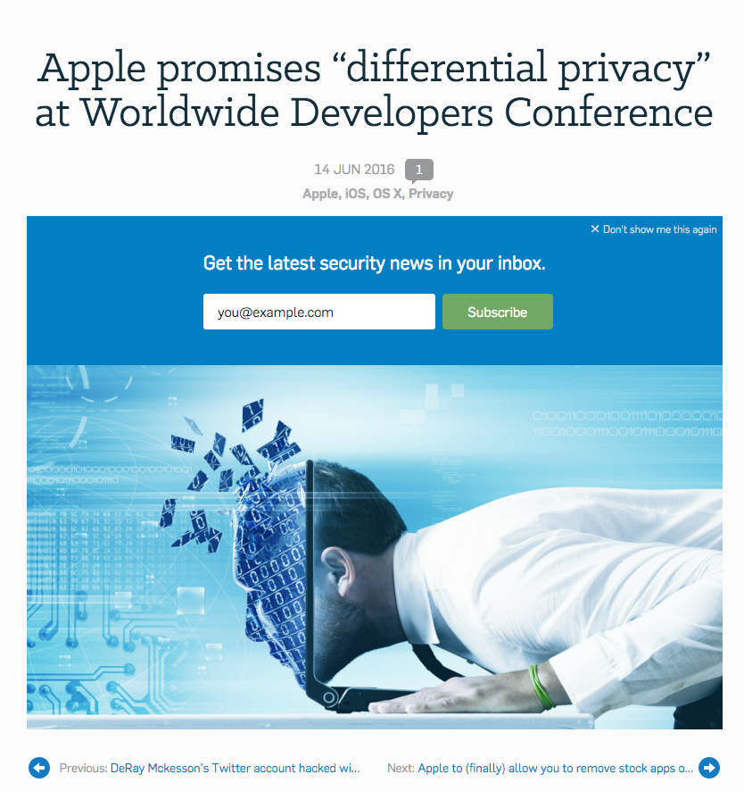

Slide 23
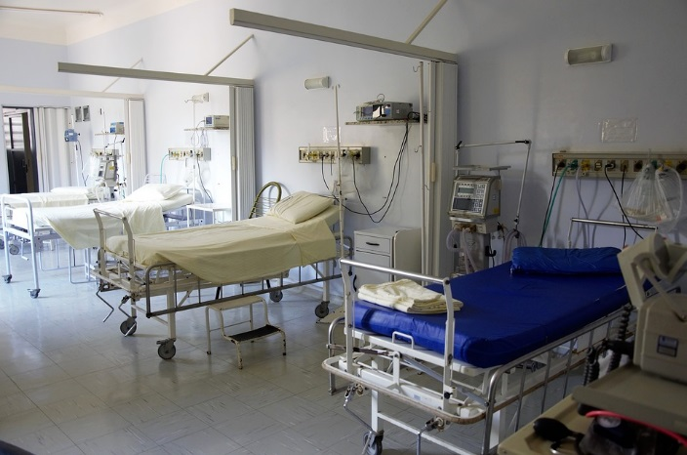
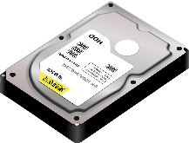
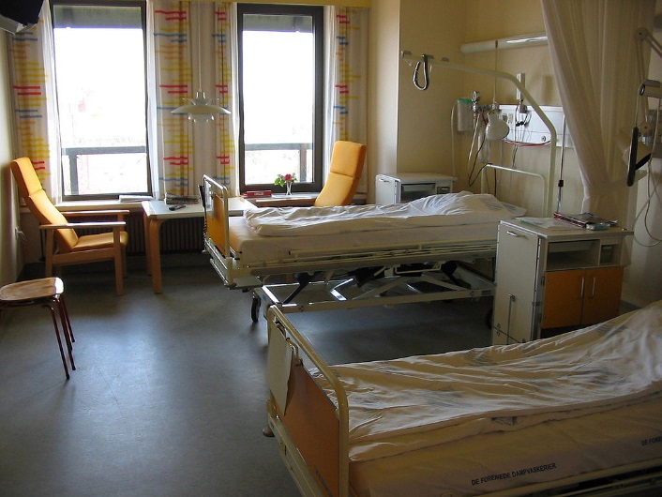
Formally Privacy Synthetic Data (FPSD) Example
Hospital creates FPSD from admissions & outcomes.
Dataset is made available to public—no PHI!
Researchers, students, and the public downloads the dataset and:
  Learn about healthcare utilization costs
  Build statistical models predicting outcomes from treatments.
  Do original research about hospital acquired infections.
https://pixabay.com/en/hospital-bed-doctor-surgery-1802679/
https://commons.wikimedia.org/wiki/Hospitals#/media/File:Hospital_room_ubt.jpeg

Slide 24
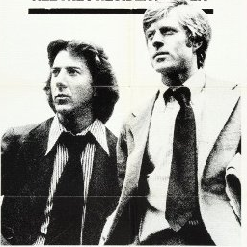
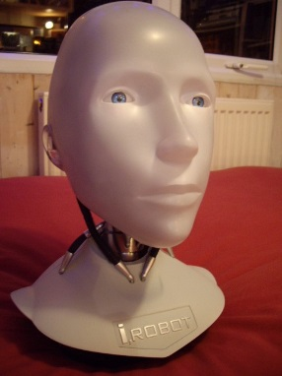
Two journalist downloads the formally private synthetic data!
The journalists:
Identify the hospital has a problem with clostridium difficile (C. diff)
Determine that there are:
  Rooms with high infection rates.
  Nurses and doctors associated with high infection rates.
But:
The actual rooms & staff that the journalists identify don’t exist!
The patients don’t exist either!
Because they’re synthetic!
Images from wikipedia

Slide 25
Formally private synthetic data
Advantages:
  No privacy reason to control release.
  Empowers researchers, students, & community.
Disadvantages:
  FPSD can still cause harm.
  FPSD are less accurate than the confidential data
  Public may not accept FPSD as “open data.”

Slide 26
Verification & Validation Servers help users trust synthetic data.
FPSD
Code
Response
Validation server — Runs code on the actual confidential data, applies disclosure limitation, then releases to public.
Verification Server — Runs code on the actual data, provides a (potentially formally private) statistics on how close the synthetic data are to the confidential data.

Slide 27
Synthetic data is being used today.
US Census Bureau Survey of Income and Program Participation (SIPP) Synthetic Beta (SSB).
  Available with validation servers
US Census Bureau’s Synthetic Longitudinal Business Database (SynLBD) Beta.
  Provides data on 21 million synthetic establishments.
  Covers years 1976-2000
  No geographic or firm-level information.
  Validation servers accept SAS or STATA code.

Slide 28
Issues with synthetic data
Currently, synthetic dataset methods must be created for each confidential dataset.
  We need generic methods that will work on a broader range of datasets.
It is difficult to find meaningful correlations not represented in the model.
  The model must anticipate the analysis that will be done.
  We need better model-building tools.
Users require training to work with synthetic data.

Slide 29
“Technical Challenges in Disclosure Control”
Technical issues identified so far:
  Unclear how to perform disclosure control in some cases (e.g. air casting)
  Improper de-identification.
  Microdata may not be sufficiently rich.
  Synthetic data may not protect privacy.
  Synthetic data may not be accurate.
What else can go wrong?

Slide 30
Differential Privacy:
Floating point math isn’t continuous.
  On Significance of the Least Significant Bits For Differential Privacy, Ilya Mironov, Microsoft Research, October 1, 2012.
  https://www.microsoft.com/en-us/research/publication/on-significance-of-the-least-significant-bits-for-differential-privacy/
  Preserving differential privacy under finite-precision semantics, Ivan Gazeau, Dale Miller, and Catuscia Palamidessi INRIA and LIX, Ecole Polytechnique
  http://www.lix.polytechnique.fr/~dale/papers/qapl-2013.pdf

Slide 31
Mironov 2012

Slide 32
Other potential problems
Trusted computing — Software is buggy.
  Programmers make mistakes.
  Tools have bugs.
Information Assurance — Hackers can steal data
Complex file types — Files can have hidden data

Slide 33
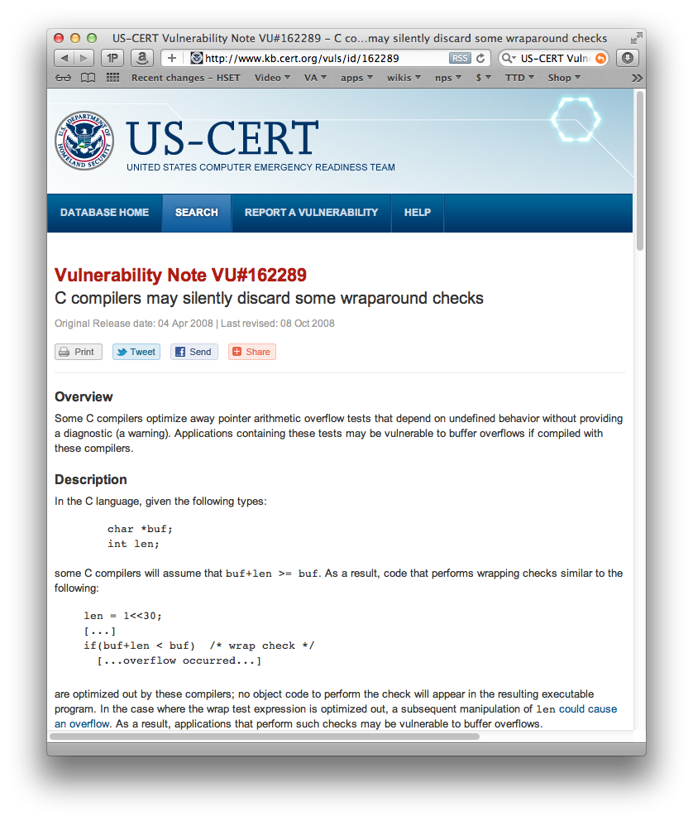
For example...
Compiler bugs are security vulnerabilities!
Compilers are core technology used in software development.
We have seen:
  Optimizations to make programs run faster can become security vulnerabilities
  The same errors are repeatedly made by different programmers
What’s difference between a bug and an attack?
    The programmer’s intent.

Slide 34
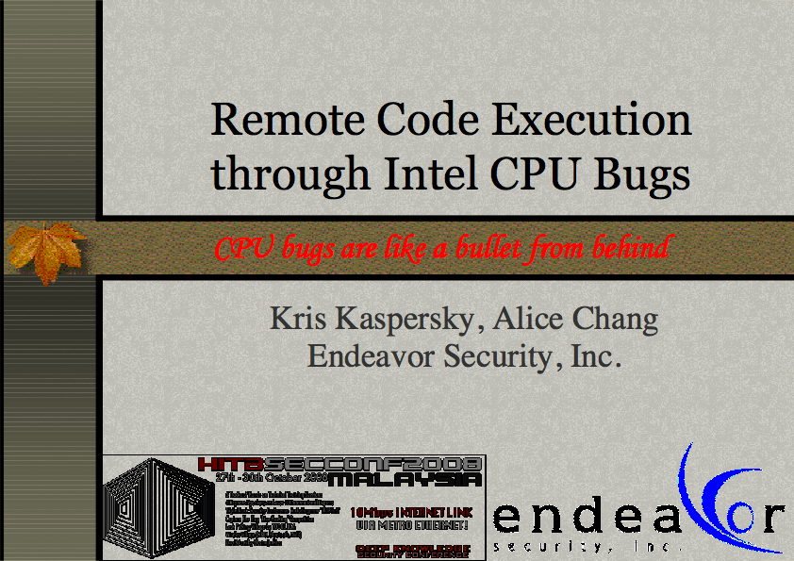
Bugs in CPU silicon are remotely exploitable!
Kaspersky (2010)
This means:
  Programs that are “secure” on one CPU may be vulnerable on another.
  Auditing the code & the compiler isn’t enough.
Kaspersky:
  “Fact: malware that uses CPU bugs really does exist;”
  “not apocalypse, just a new threat;”
www.cs.dartmouth.edu/~sergey/cs258/2010/D2T1 - Kris Kaspersky - Remote Code Execution Through Intel CPU Bugs.pdf

Slide 35
Data hides in complex files
IEEE Security and Privacy
January/February 2014
https://simson.net/clips/academic/2014.IEEE.leaking_pdfs.pdf

Slide 38
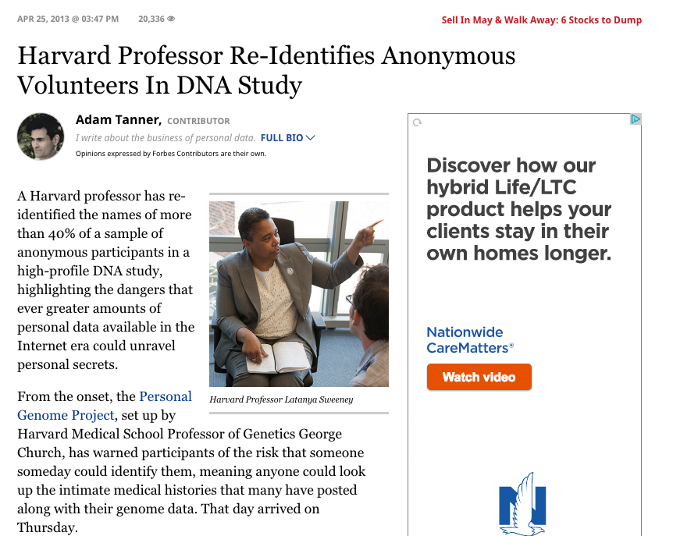

Slide 39
In Summary…

Slide 40
References
Privacy-Preserving Data Analysis for the Federal Statistical Agencies, John Abowd, Lorenzo Alvisi, Cynthia Dwork, Sampath Kannan, Ashwin Machanavajjhala, and Jerome Reiter, January 2017, Computing Community Consortium. https://arxiv.org/pdf/1701.00752.pdf
Ashwin Machanavajjhala, Daniel Kifer, John Abowd, Johannes Gehrke, and Lars Vilhuber. Privacy: From Theory to Practice on the Map. In Proceedings of the 24th IEEE International Conference on Data Engineering (ICDE 2008), Cancun, Mexico, April 2008
Li, H., Xiong, L., Zhang, L., & Jiang, X. (2014). DPSynthesizer: Differentially Private Data Synthesizer for Privacy Preserving Data Sharing. Proceedings of the VLDB Endowment International Conference on Very Large Data Bases, 7(13), 1677–1680. http://doi.org/10.14778/2733004.2733059
Vincent Bindschaedler, Reza Shokri, and Carl A. Gunter. 2017. Plausible deniability for privacy-preserving data synthesis. Proc. VLDB Endow. 10, 5 (January 2017), 481-492. DOI: https://doi.org/10.14778/3055540.3055542

