Slide 1
Formally Private Synthetic Data: Empowering research on confidential data while providing for privacy and security
April 2017
Simson L. Garfinkel
Center for Research on Disclosure Avoidance
DISCLAIMER: The views expressed in this presentation are those of the author and do not necessarily reflect the policy of the US Census Bureau, the US Department of Commerce, or the United States Government.

Slide 2
High-quality data can help accelerate empirical research in cancer and other areas.
With high-quality data, we can:
Perform large-scale retrospective studies.
Identify drugs that may be highly effective in select populations.
Discover populations that have been excluded from the benefits of research.
High-quality data requires high-quality privacy protection!
HIPAA limits the ability to share data with identifiers.
HIPAA privacy protections may be insufficient for community acceptance.
There may be additional issues resulting from the Common Rule.

Slide 3
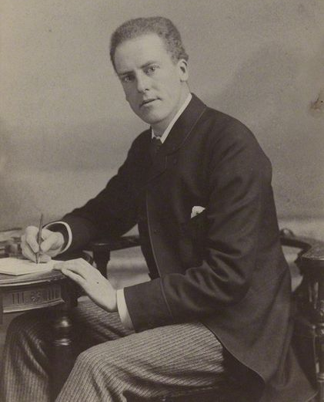
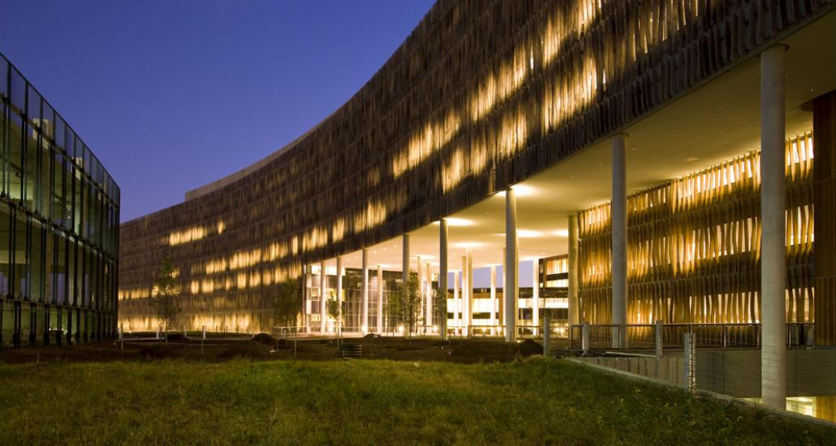
Options for Research on Confidential Data 1 – Remote Stats
Statisticians who want access to the data
Organization with confidential data
Statistician goes to organization, does research, results are processed with disclosure avoidance and returned.
Advantage: Stats run on the real data.
Disadvantage: Slow; expensive; privileged statisticians .

Slide 4
Options for Research on Confidential Data - Microdata
Statisticians who want access to the data
Organization with confidential data
Organization publishes de-identified microdata.
Advantage: Statistician can use data at their own offices. Results do not need disclosure avoidance.
Disadvantage: Accuracy may be insufficient — and you can’t tell what’s not accurate.
De-identified data may still leak sensitive information!

Slide 5
Options for microdata: de-identification
De-identified microdata:
Direct Identifiers: Remove
Quasi-Identifiers: Generalize / suppress / infuse noise / swap
Data accuracy: degrades.
Problems:
De-identification can be incomplete.
Impact on accuracy is frequently not released.

Slide 6
Options for microdata: synthetic data
Partially synthetic: Sample an existing dataset and add noise.
Similar to de-identification
May not have strong privacy guarantees
Fully synthetic: create a model, use the model to create the synthetic data.

Slide 7
Fully Synthetic Microdata
Confidential Data
Model Generation
Model with Privacy Guarantees
Synthetic Data Generation
Formally Private Synthetic Data
Traditional synthetic microdata
Model can be highly accurate.
Synthetic data have possibly unknown impact on privacy.
Formally private synthetic microdata
Model has intentional errors introduced (noise)
Privacy guarantees can be mathematically established and proven.

Slide 8
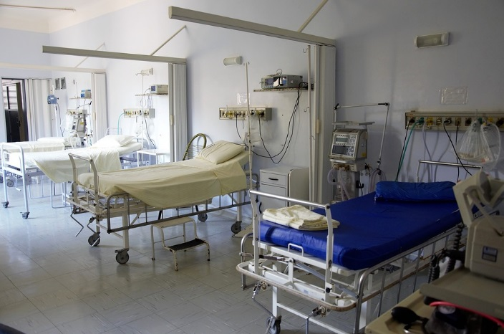
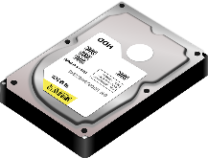
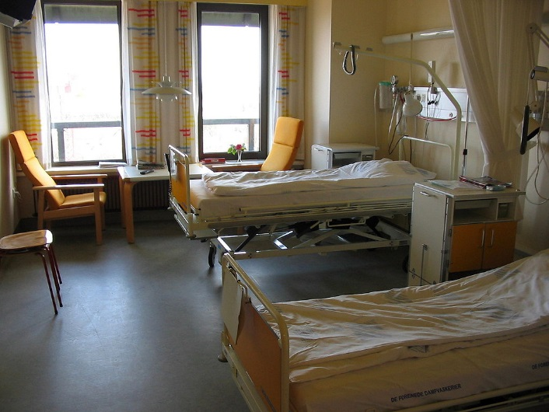
Formally Privacy Synthetic Data (FPSD) Example
Hospital creates FPSD from admissions & outcomes.
Dataset is made available to public—no PHI!
Researchers, students, and the public downloads the dataset and:
Learn about healthcare utilization costs
Build statistical models predicting outcomes from treatments.
Do original research about hospital acquired infections.
https://pixabay.com/en/hospital-bed-doctor-surgery-1802679/
https://commons.wikimedia.org/wiki/Hospitals#/media/File:Hospital_room_ubt.jpeg

Slide 9
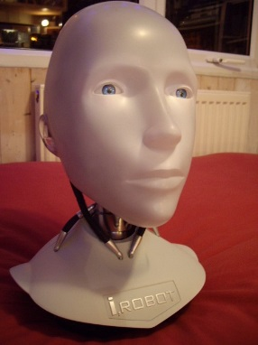
Two journalist downloads the formally private synthetic data!
The journalists:
Identify the hospital has a problem with clostridium difficile (C. diff)
Determine that there are:
Rooms with high infection rates.
Nurses and doctors associated with high infection rates.
But:
The actual rooms & staff that the journalists identify don’t exist!
The patients don’t exist either!
Because they’re synthetic!
Images from wikipedia

Slide 10
Formally private synthetic data
Advantages:
No privacy reason to control release.
Empowers researchers, students, & community.
Disadvantages:
FPSD can still cause harm.
FPSD are less accurate than the confidential data
Public may not accept FPSD as “open data.”

Slide 11
Verification & Validation Servers
FPSD
Code
Response
Validation server — Runs code on the actual confidential data, applies disclosure limitation, then releases to public.
Verification Server — Runs code on the actual data, provides a (potentially formally private) statistics on how close the synthetic data are to the confidential data.

Slide 12
This is not a new idea!
US Census Bureau Survey of Income and Program Participation (SIPP) Synthetic Beta (SSB).
Available with validation servers
US Census Bureau’s Synthetic Longitudinal Business Database (SynLBD) Beta.
Provides data on 21 million synthetic establishments.
Covers years 1976-2000
No geographic or firm-level information.
Validation servers accept SAS or STATA code.

Slide 13
Issues moving forward
Currently, synthetic dataset methods must be created for each confidential dataset.
We need generic methods that will work on a broader range of datasets.
It is difficult to find meaningful correlations not represented in the model.
The model must anticipate the analysis that will be done.
We need better model-building tools.
Users require training to work with synthetic data.
Questions? — Simson.L.Garfinkel@census.gov

Slide 14
References
Privacy-Preserving Data Analysis for the Federal Statistical Agencies, John Abowd, Lorenzo Alvisi, Cynthia Dwork, Sampath Kannan, Ashwin Machanavajjhala, and Jerome Reiter, January 2017, Computing Community Consortium. https://arxiv.org/pdf/1701.00752.pdf
Ashwin Machanavajjhala, Daniel Kifer, John Abowd, Johannes Gehrke, and Lars Vilhuber. Privacy: From Theory to Practice on the Map. In Proceedings of the 24th IEEE International Conference on Data Engineering (ICDE 2008), Cancun, Mexico, April 2008
Li, H., Xiong, L., Zhang, L., & Jiang, X. (2014). DPSynthesizer: Differentially Private Data Synthesizer for Privacy Preserving Data Sharing. Proceedings of the VLDB Endowment International Conference on Very Large Data Bases, 7(13), 1677–1680. http://doi.org/10.14778/2733004.2733059
Vincent Bindschaedler, Reza Shokri, and Carl A. Gunter. 2017. Plausible deniability for privacy-preserving data synthesis. Proc. VLDB Endow. 10, 5 (January 2017), 481-492. DOI: https://doi.org/10.14778/3055540.3055542

