Slide 1
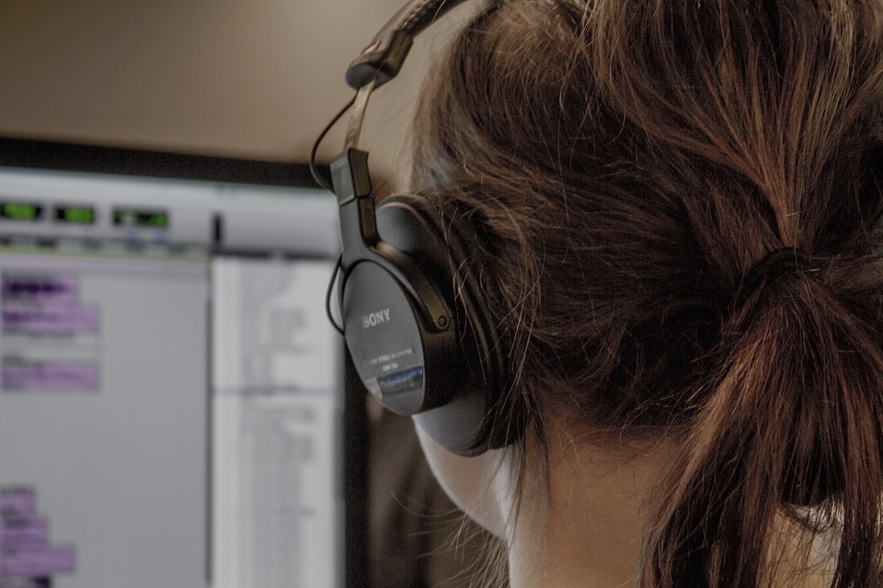
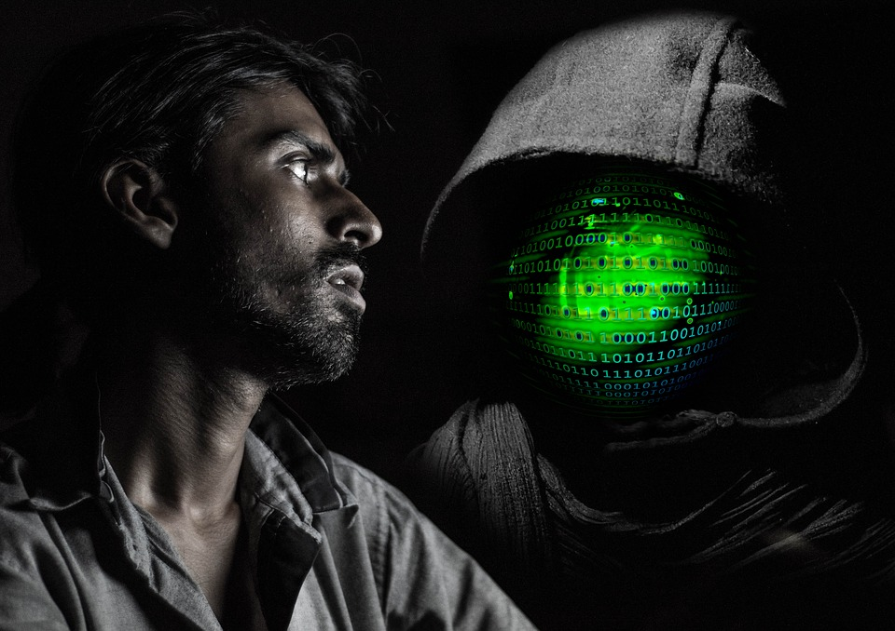

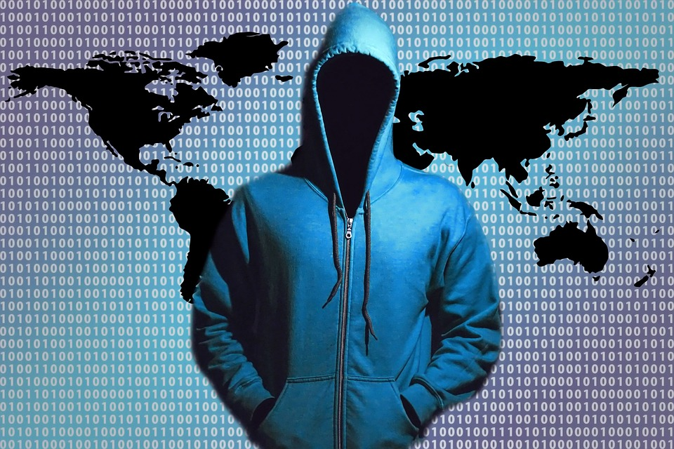

The Cyber Security Mess
Simson L. Garfinkel
April 4, 2018
Spamhause
Photos from https://pixabay.com

Slide 2
The Cybersecurity Mess
Abstract:
Why is it so hard to secure computers? After more than 40 years of concerted effort in network security, why can’t we keep the hackers out?
The problem, I argue, is not the practice of computer security, but its definition, it’s very conception. As we are accepted it, computer security is what social scientists call a "wicked problem” — a poorly defined, high-impact problem for which the solution depends upon satisfying many competing stakeholders and conflicting goals. Solving the cybersecurity mess means addressing both technical factors—factors that dominate the discussion—and nontechnical factors, which reflect deep, divisive political, social, and economic problems without our society as a whole. This problems, which include the decline of the US manufacturing base, the failure of our schools at science, technology, engineering and math (STEM), an inherent power struggle between the makers of information systems and their users, and our inability to frame a coherent immigration policy, are core reasons why we are unable to make technical progress. While it is certainly possible that the need to secure our computers may force us to find a general solution to these problems, such Pollyannish hopes seem unlikely.
This talk follows the history of cybersecurity efforts, showing that while there’s nothing new under the sun, things really are getting worse. And while there are little-used technologies that really can make computers dramatically more secure (such as typesafe languages, formal methods, and provably correct computer systems), these approaches are so expensive that they may never see widespread adoption.
So what’s the solution? I propose that it’s resilience, redundancy, heterogeneity, and regulation. Yes, this talk is designed to leave everyone in the audience both agreeing with the speaker, and angry at the speaker.
Bio: Simson Garfinkel is an adjunct lecturer at Georgetown University’s Graduate School of Data Analytics and the Chief of the Center for Disclosure Avoidance at the US Census Bureau. He was previously a computer scientist at the National Institute of Standards and Technology (2015-2017) and, before that, an Associate Professor of Computer Science at the Naval Postgraduate School (2006-2015). Before earning his PhD in Computer Science from at MIT (2002-2005), he was an award-winning journalist and a serial entrepreneur. In 2012 he was elected a Fellow of the Association for Computing Machinery for his contributions to digital forensics and to computer security eduction.

Slide 3
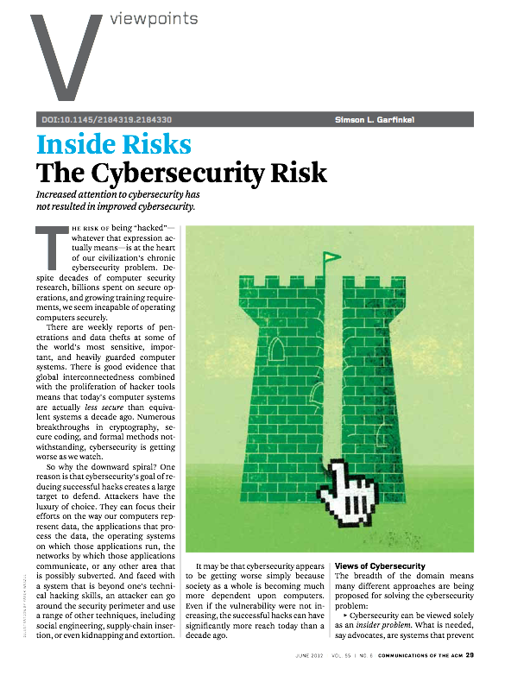
“The Cyber Security Risk”,
Communications of the ACM, June 2012, 55(6)
http://simson.net/clips/academic/2012.CACM.Cybersecurity.pdf

Slide 4
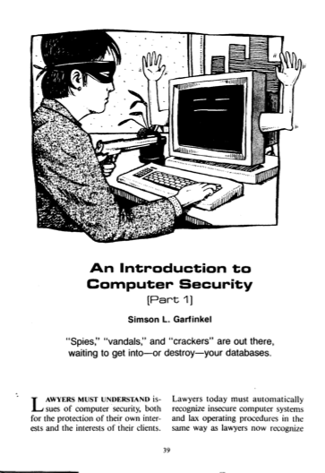
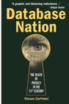
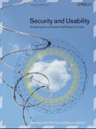
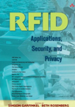
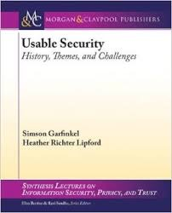
I have spent 29 years trying to secure computers...
System Security
Privacy Policy
1991
2000
Usable Security
Internet of Things
The Practical Lawyer
Sept. 1987
2006
2006
2014

Slide 5
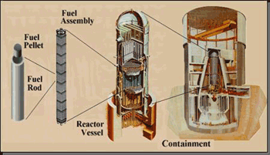
Today’s systems are less secure than those of the 1970s.
The lack of security is inherent in modern information systems.
  Attack is easier and cheaper than defense.
  Cyber “defense in depth” does not work
    a single vulnerability compromises.
It’s easier to break things than to fix them.
Policies, Procedures,
Awareness
Physical
Perimeter
Internal
Network
Application
Defense in depth of nuclear reactors
http://www.nrc.gov/about-nrc/regulatory/research/soar/soarca-accident-progression.html
Data
Cyber can directly target
inner defenses

Slide 6


Slide 7
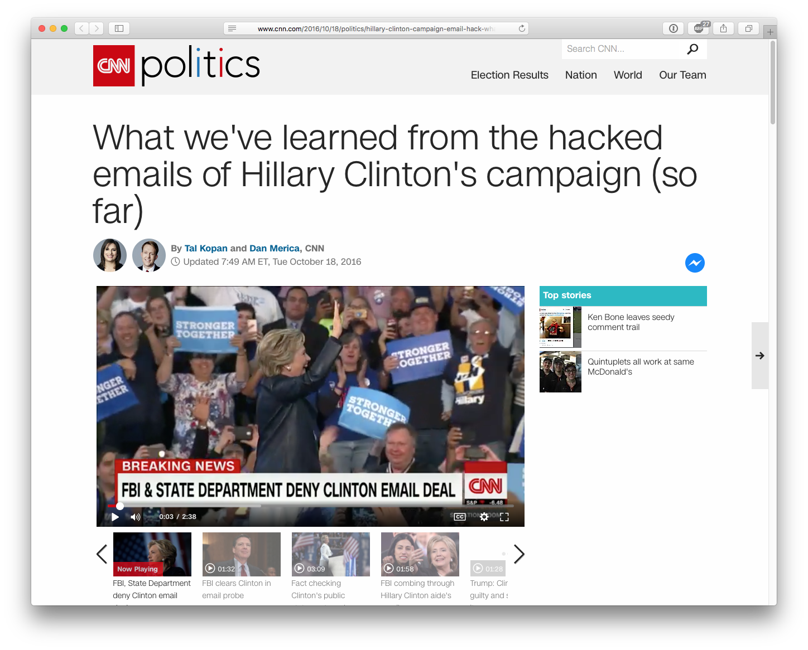
Today we expect computers to crash
We also expect them to be hacked.
The solution is not better security

Slide 8
Cybersecurity impacts the real world.
(Cyber is In Real Life.)
IRL

Slide 9
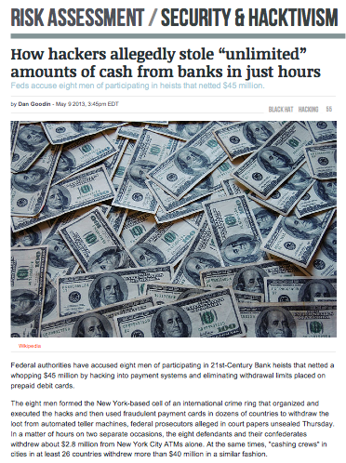
May 2013 —
$45 million stolen from US banks with phony ATM cards
http://arstechnica.com/security/2013/05/how-hackers-allegedly-stole-unlimited-amounts-of-cash-from-banks-in-just-hours/

Slide 10
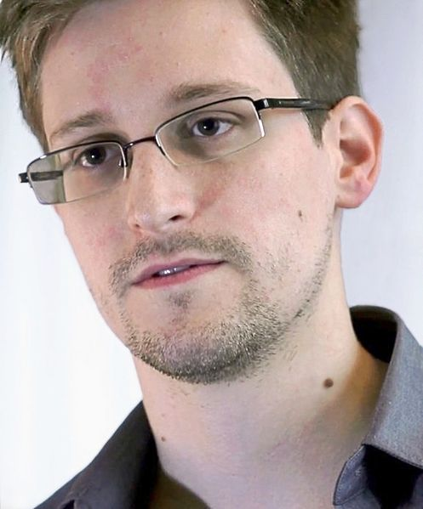
May 2013

Slide 11
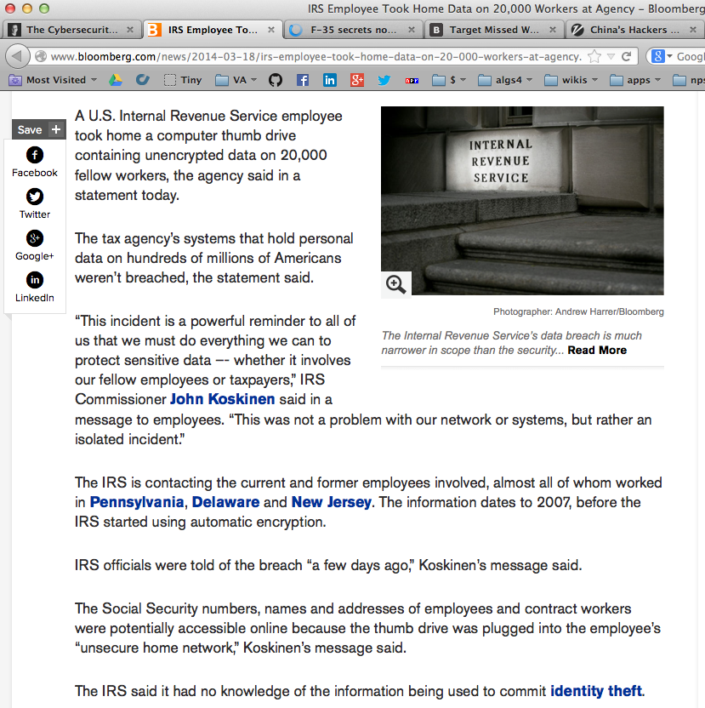
March 2014:
IRS Employee Took Home Data on 20,000 Workers
http://www.bloomberg.com/news/2014-03-18/irs-employee-took-home-data-on-20-000-workers-at-agency.html

Slide 12

March 2014:
Stolen F-35 secrets show up in China’s stealth Fighter

Slide 13
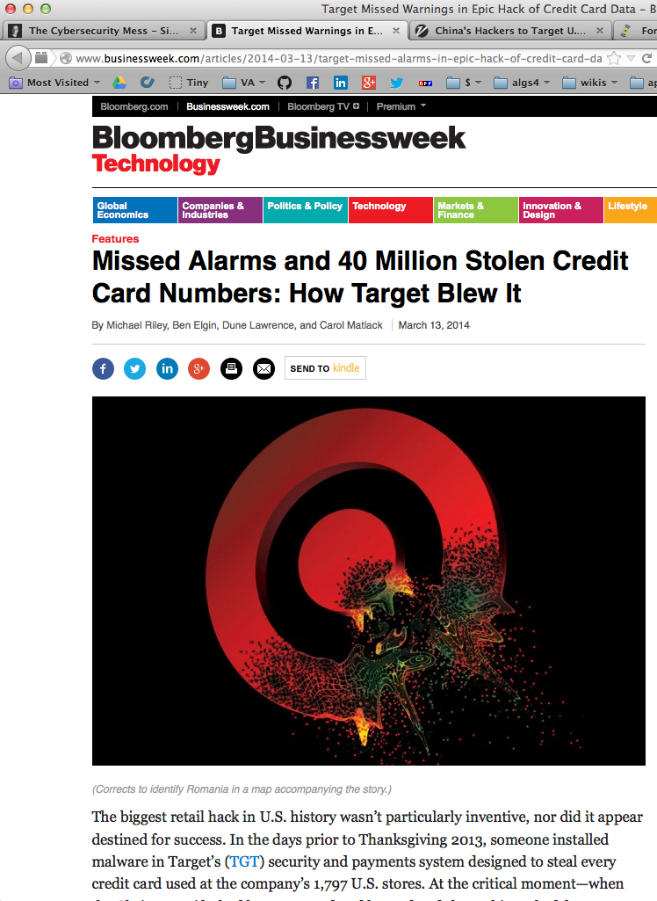
March 2014: Target ignored alarms before hack.

Slide 14
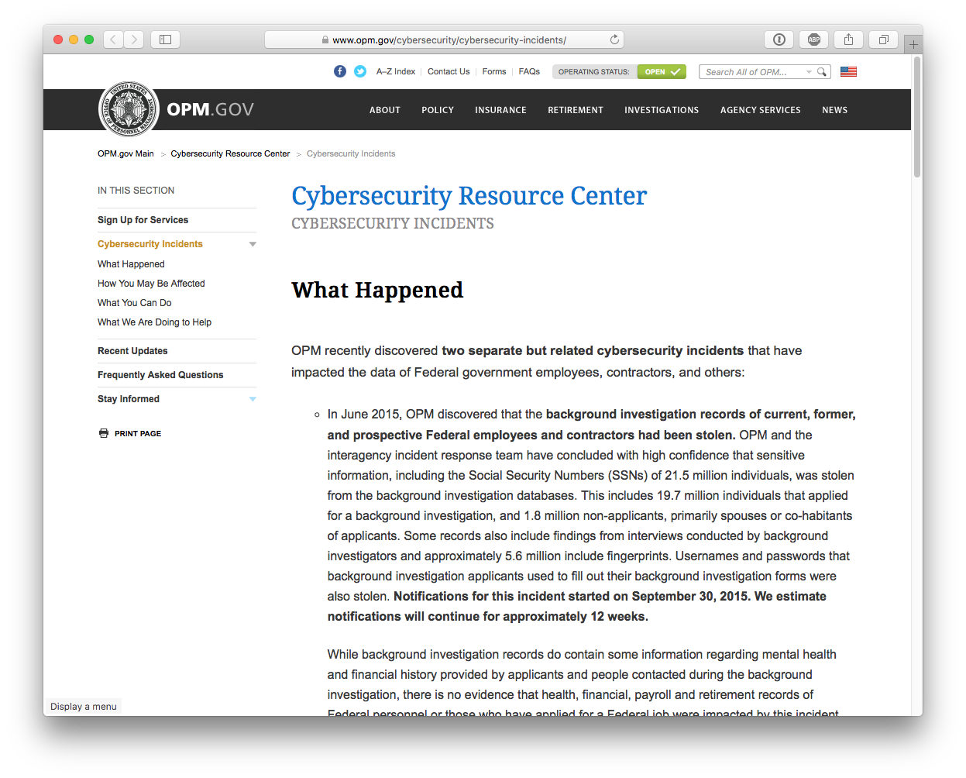
June 2015: OPM Data Breach
19.7 million individuals applying for security clearances

Slide 15
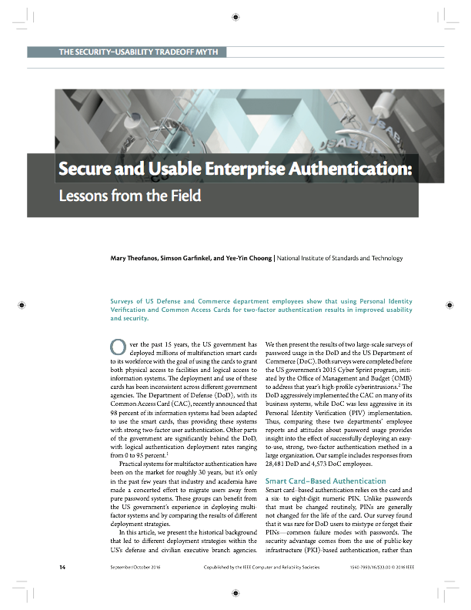
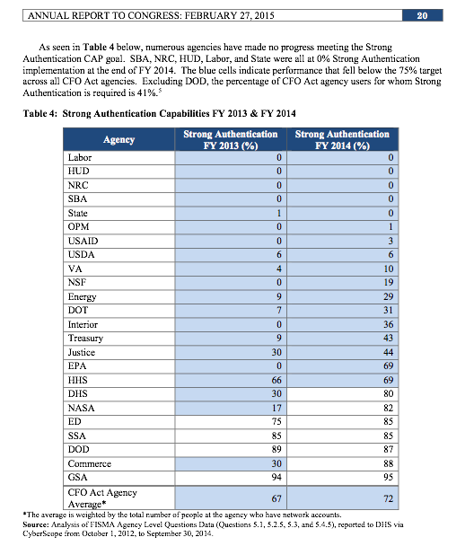
OPM's Strong Authentication Capabilities before hack: 1%
— OMB FISMA Report, Feb. 27, 2015
IEEE Security & Privacy, Sept/Oct 2016

Slide 16
Summer 2016...

Slide 17
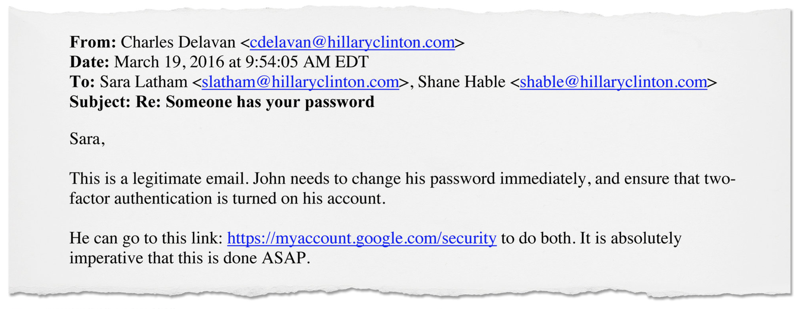
John [Podesta] needs to change his password immediately, and ensure that two-factor authentication is turned on...
The New York Times, December 13, 2016

Slide 18
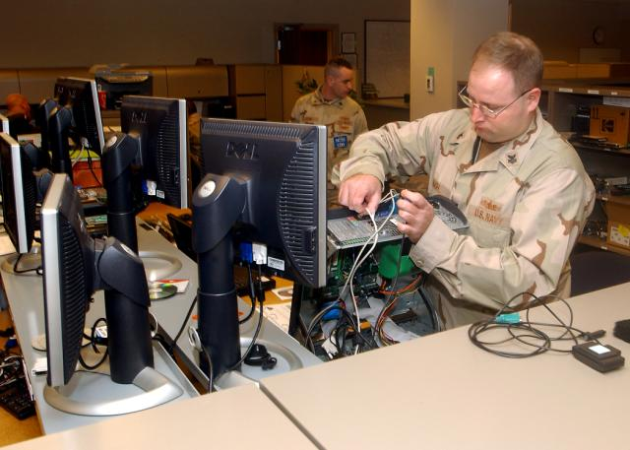
“The cyber” is mess: it’s technical and social.
Most attention is focused on technical issues:
  Malware and anti-viruses
  Access controls, authentication & cryptography
  Supply chain issues
  Cyberspace as a globally connected “domain”
Non-technical issues are at the heart of the cyber security mess.
  Education & career paths
  Immigration
  Manufacturing policy
We will do better when we want to do better.

Slide 19
What do we know about cyber security today?

Slide 20
Cyber Security... is undefined.
“Cybernetics”
“Cyberspace”
X
There is no good definition for “cyber”
  Something having to do with cybernetics
  Computers?
  Computer networks?
  Hacking?
  Using “network security” to secure desktops & servers?
There is no way to measure the security of the “cyber”
  Which OS is more secure?
  Which computer is more secure?
  Is “open source” more secure?
    A system that seems “more secure”
    can suffer a total compromise from a single unknown attack.
Norbert Weiner
1948
William Gibson
1982

Slide 21
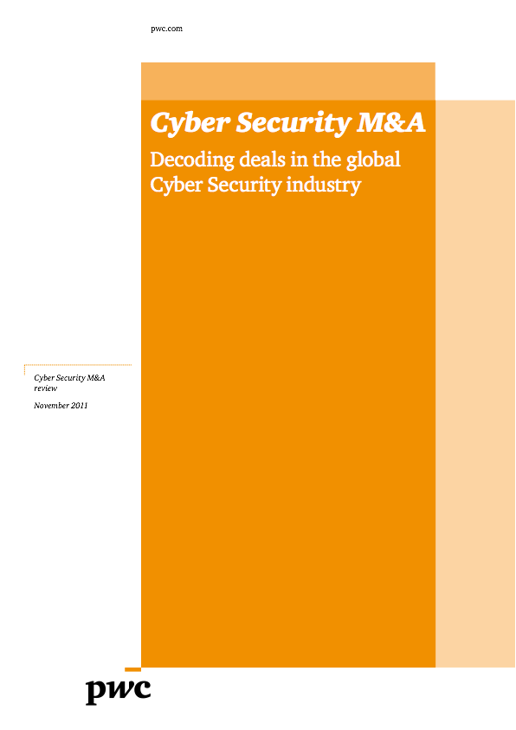
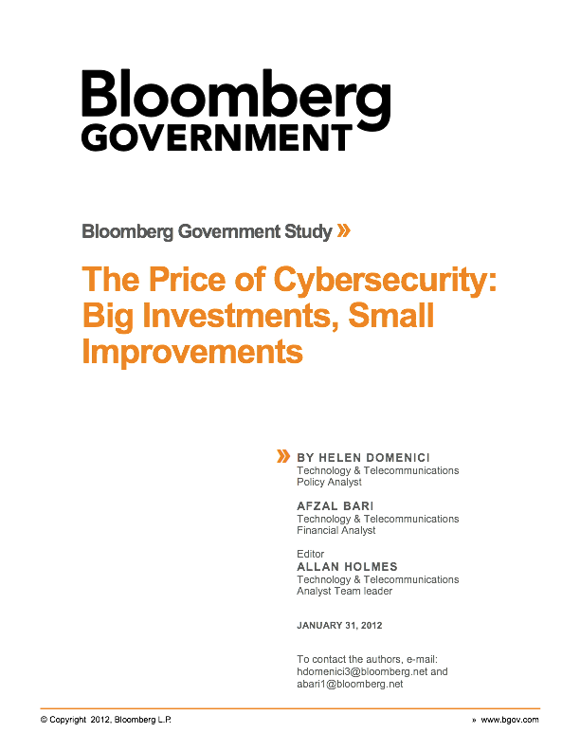
We can measure expenditures.
Cyber Security is expensive.
Global cyber security spending: $60 billion in 2011
  Cyber Security M&A, pwc, 2011
172 Fortune 500 companies surveyed:
  Spending $5.3 billion per year on cyber security.
  Stopping 69% of attacks.
If they raise spending...
  $10.2 billion stops 84%
  $46.67 billion stops 95%
  “highest attainable level”
95% is not good enough.
Spending more money does not make a computer more secure.

Slide 22
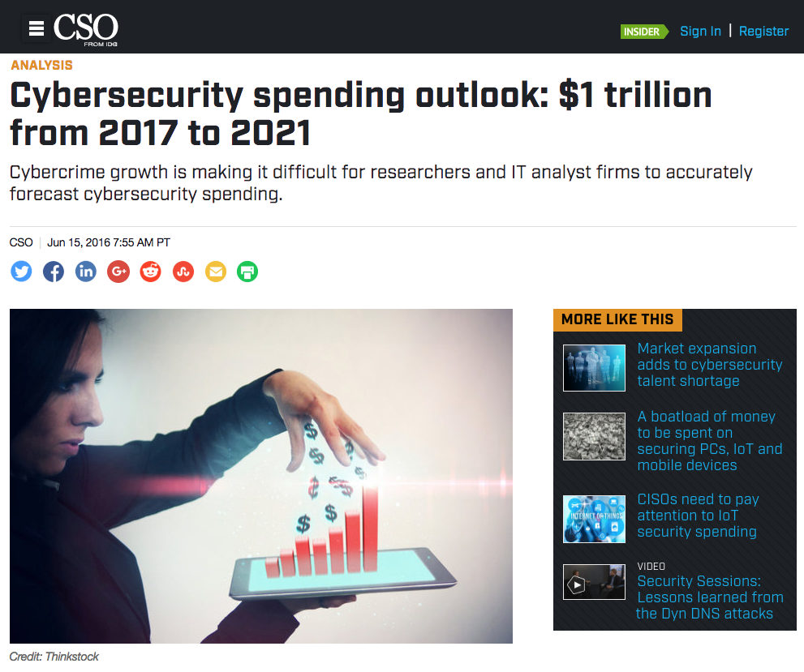
Expenditures are increasing...
$73.7 billion in 2016
    International Data Corporation
    http://fortune.com/2016/10/12/cybersecurity-global-spending/
$1 trillion spent globally from 2015 to 2021 = $200B/year
    Cybersecurity Ventures, http://cybersecurityventures.com/

Slide 23

Paradox:
Cyber security research makes computers less secure!
  Data
  Encoding
  Apps
  OS (programs & patches)
  Network & VPNs
  DNS, DNSSEC
  IPv4 / IPv6
  Embedded Systems
  Human operators
  Hiring process
  Supply chain
  Family members
The more we learn about securing computers,
the better we get at attacking them

Slide 24
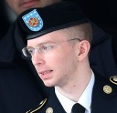

Cyber Security is an “insider problem.”
bad actors
good people with bad instructions
remote access
malware
If we can stop insiders, we might be able to secure cyberspace….
    but we can’t stop insiders.
http://www.flickr.com/photos/shaneglobal/5115134303/
Ames
Hanssen
Manning
Snowden

Slide 25


Cyber Security is a “network security” problem.
We can’t secure the hosts, so secure the network!
  Isolated networks for critical functions.
  Stand-alone hosts for most important functions.
But strong crypto limits visibility into network traffic, and...
http://www.flickr.com/photos/dungkal/2315647839/

Slide 26
... stuxnet shows that there are no isolated hosts.
http://www.npr.org/2013/10/14/232048549/are-irans-centrifuges-just-few-turns-from-a-nuclear-bomb
Iranian President Mahmoud Ahmadinejad
inspects nuclear centrifuges
March 8, 2007

Slide 27
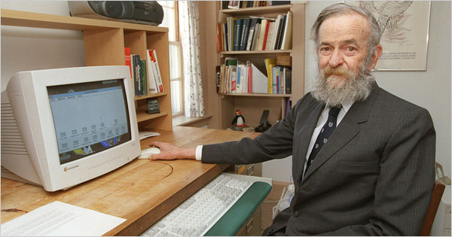
“to a first approximation, every computer in the world is connected to every other computer.” — Dr. Robert Morris
    Robert Morris (1932-2001), to the National Research Council’s Computer Science and Technology Board, Sept. 19, 1988
http://www.nytimes.com/2011/06/30/technology/30morris.html

Slide 28


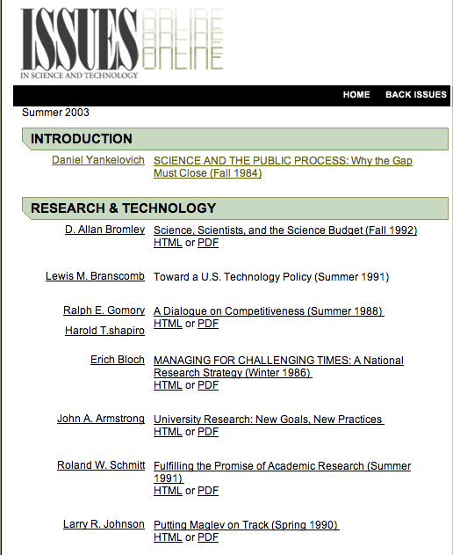
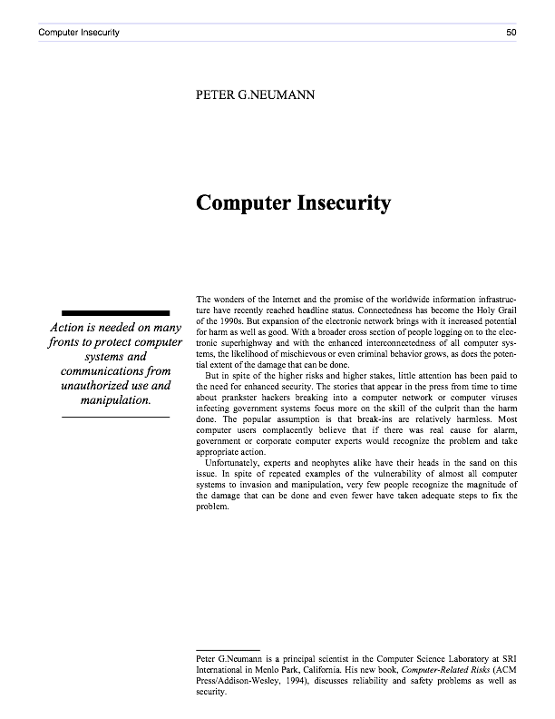
“Action is needed on many fronts to protect computer systems and communications from unauthorized use and manipulation.”
—“Computer Insecurity”, Peter G. Neumann
Issues In Science & Technology, Fall 1994
  http://issues.org/19.4/updated/neumann.html
http://issues.org/19.4/updated/neumann.pdf

Slide 29
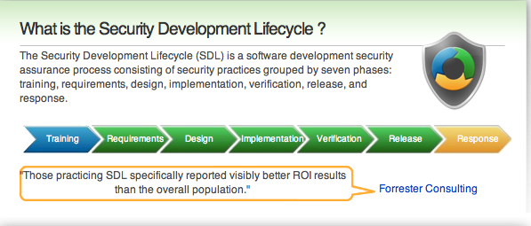
Cyber Security is a “process” problem.
“Security is a process, not a product”
Security encompasses all aspects
of an organization’s IT and HR
operations.
Microsoft Security Development Lifecycle
    Few organizations can afford SDL.
    Windows 7 Windows 8 Windows 10 is still hackable...
http://en.wikipedia.org/wiki/File:Bruce_Schneier_1.jpg

Slide 30
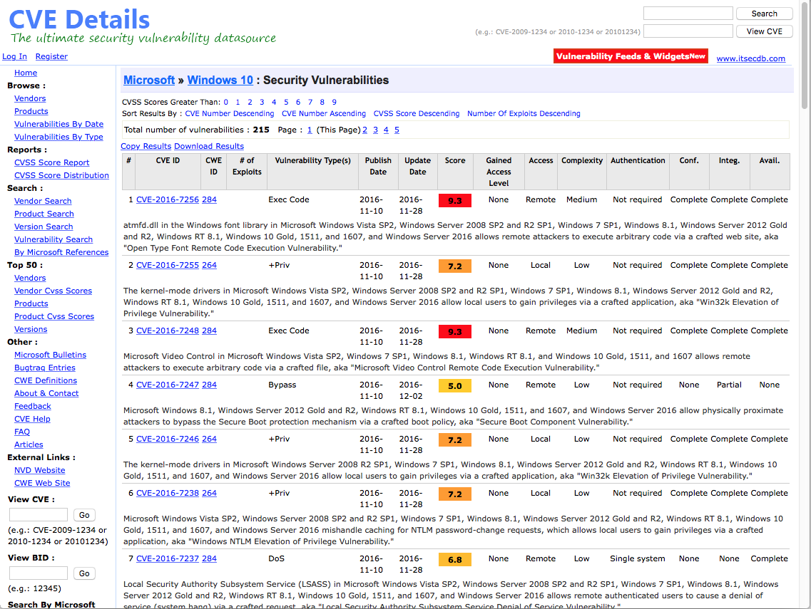
Windows 10: 215 vulnerabilities...

Slide 31
Cyber Security is a money problem.
Security is a cost.....Not an “enabler”
  No ROI
Chief Security Officers are in a no-win situation:
  Security = passwords = frustration
  No reward for spending money to secure the infrastructure
  Money spent on security is “wasted” if there is no attack
    “If you have responsibility for security but have no authority to set rules or punish violators, your own role in the organization is to take the blame when something big goes wrong.”
        Spaf’s first principle of security administration
        Practical Unix Security, 1991

Slide 32
Cyber Security is a “wicked problem”
No clear definition
    You don’t understand the problem until you have a solution.
No “stopping rule”
    The problem can never be solved.
Solutions not right or wrong
    Benefits to one player hurt another — Information security vs. Free speech
Solutions are “one-shot” — no learning by trial and error
    No two systems are the same. The game keeps changing.
Every wicked problem is a symptom of another problem
    Rittel and Webber, “Dilemmas in a General Theory of Planning,” 1973
    Dave Clement, “Cyber Security as a Wicked Problem,” Chatham House, 2011
Chatham House • Oct. 2011
Cyber Security
As a Wicked Problem

Slide 33
Is it the technology?
Why is the cyber so hard?

Slide 34
Cyber Security has an active, malicious adversary.
The adversary...
    Turns your bugs into exploits
    Adapts to your defenses
    Waits until you make a mistake
    Attacks your employees when your systems are secure
It will get on all your disks
It will infiltrate your chips
Yes, it's Cloner!
It will stick to you like glue
It will modify RAM too
Send in the Cloner!
Elk Cloner, 1982
(Rich Skrenta, age 15)

Slide 35
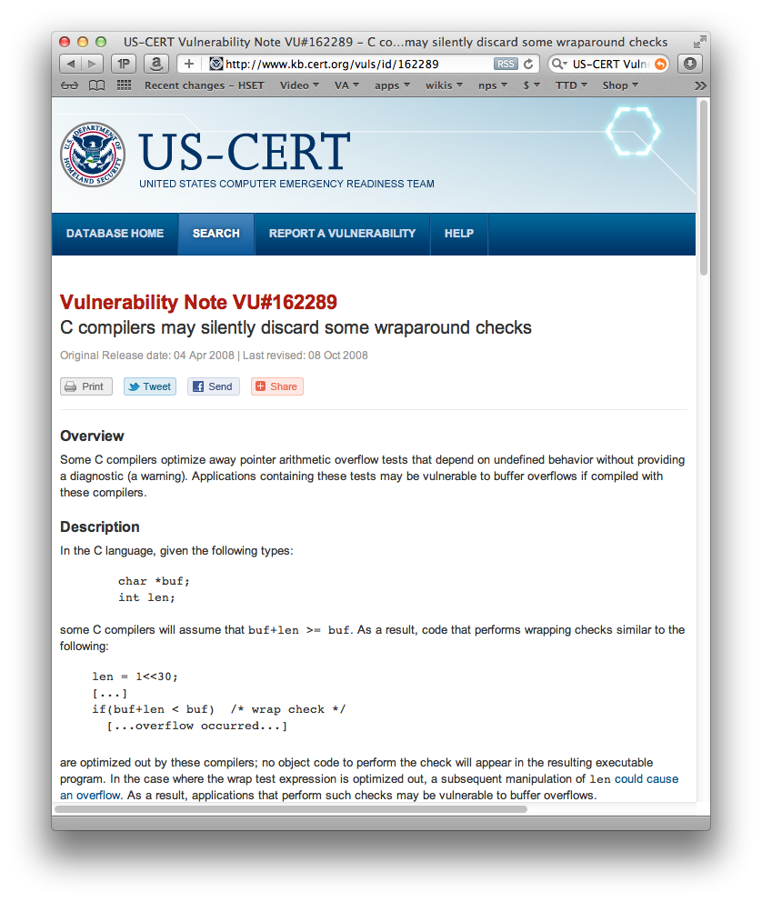
For example...
Compiler bugs are security vulnerabilities!
Compilers are core technology used in software development.
We have seen:
  Optimizations to make programs run faster can become security vulnerabilities
  The same errors are repeatedly made by different programmers
What’s difference between a bug and an attack?
    The programmer’s intent.

Slide 36
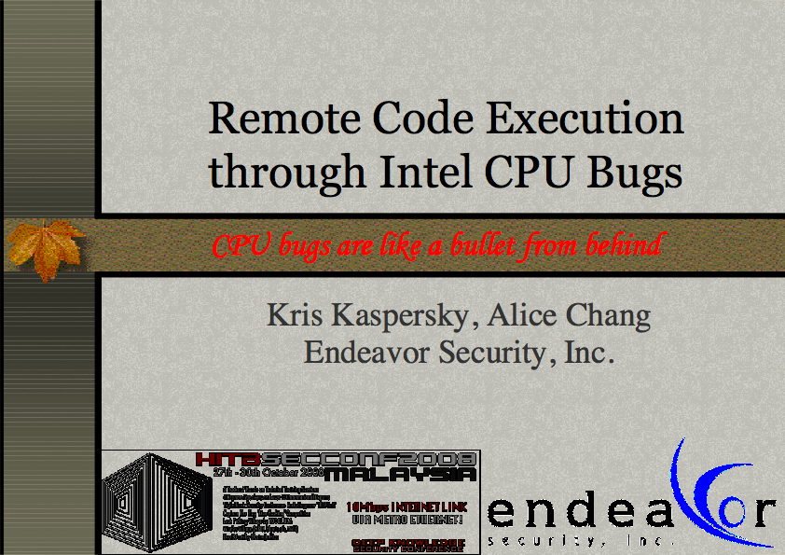
Bugs in CPU silicon are remotely exploitable!
Kaspersky (2010)
This means:
  Programs that are “secure” on one CPU may be vulnerable on another.
  Auditing the code & the compiler isn’t enough.
Kaspersky:
  “Fact: malware that uses CPU bugs really does exist;”
  “not apocalypse, just a new threat;”
www.cs.dartmouth.edu/~sergey/cs258/2010/D2T1 - Kris Kaspersky - Remote Code Execution Through Intel CPU Bugs.pdf

Slide 37
The supply chain creates numerous security vulnerabilities
App
Developers
3rd Party
Kits
Apps
Open
Source
iOS
Apple
Developers
CPU
Wireless
Carrier

Slide 38
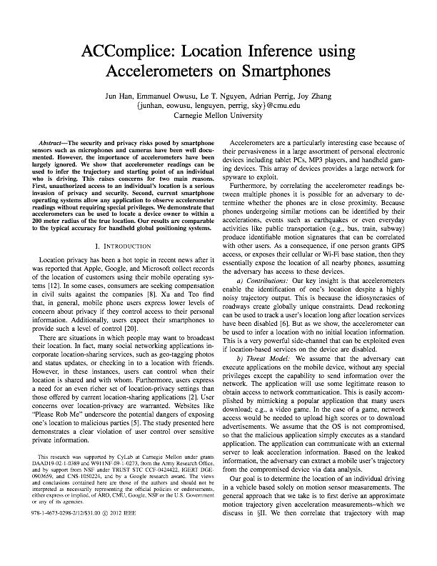
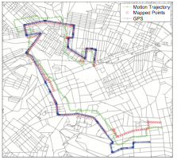
There are more attackers than defenders, they are smarter,
and they have the time to find really good attacks.
Smartphone designers were sure that there was no privacy leakage in accelerometers. We now know they can:
  Reveal your position
  Reveal your PIN
6 accelerometers
no privacy
https://sparrow.ece.cmu.edu/group/pub/han_ACComplice_comsnets12.pdf
Jun Han, Emmanuel Owusu, Thanh-Le Nguyen, Adrian Perrig, and Joy Zhang "ACComplice: Location Inference using Accelerometers on Smartphones" In Proceedings of the 4th International Conference on Communication Systems and Networks (COMSNETS 2012), Bangalore, India, January 3-7, 2012.

Slide 39
Many people liken cyber security to the flu.
DHS calls for “cyber hygiene”
  install anti-virus
  update your OS
  back up key files
    “STOP, THINK, CONNECT”

Slide 40
Another model is obesity....
Making people fat is good business:
  Farm subsidies
  Restaurants
  Healthcare and medical utilization
  Weight loss plans
    Few make money when Americans stay
    trim and healthy.
Lax security is also good business:
  Cheaper cost of deploying software
  Private information for marketing
  Selling anti-virus & security products
  Cleaning up incidents
    Few benefit from secure computers

Slide 41

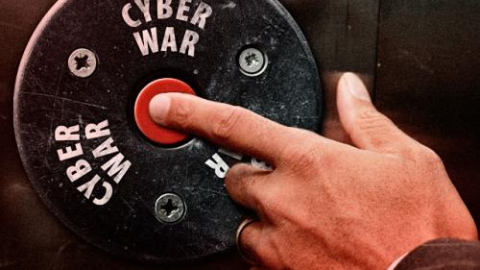
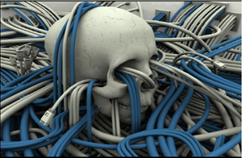
Some people say that cyber war is like nuclear war.
http://www.acus.org/new_atlanticist/mind-cyber-gap-deterrence-cyberspace
http://www.beyondnuclear.org/security/

Slide 42
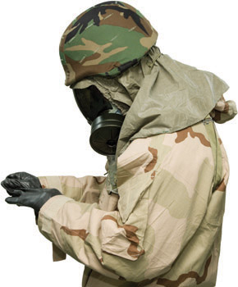
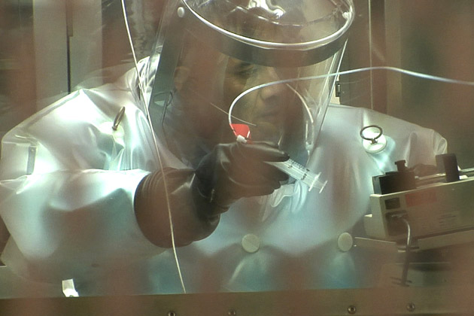
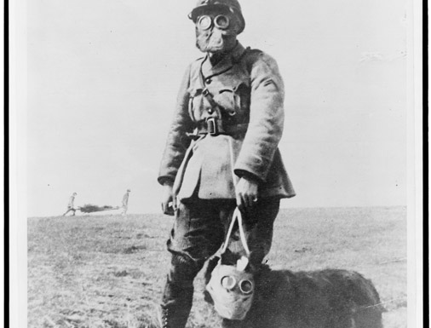

Biowar may be a better model for cyberwar.
    Cheap to produce
    Easy to attack
    Hard to control
    Hard to defend
    No clear end

Slide 43
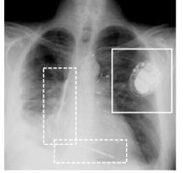
Security problems are bad for society as a whole...
… because [wireless] computers are everywhere.
50 microprocessors
per average car
2008: demonstrated wireless
attack on implantable pacemakers
2012: demonstrated wireless
attack on insulin pump
  http://www.autosec.org/
      Comprehensive Experimental Analysis of Automotive Attack Surfaces (2011)
      Experimental Security Analysis of a Modern Automobile (2010)
Remote take-over of EVERY safety-critical system from ANY wired or wireless interface
DDoS the endocrine system!

Slide 44

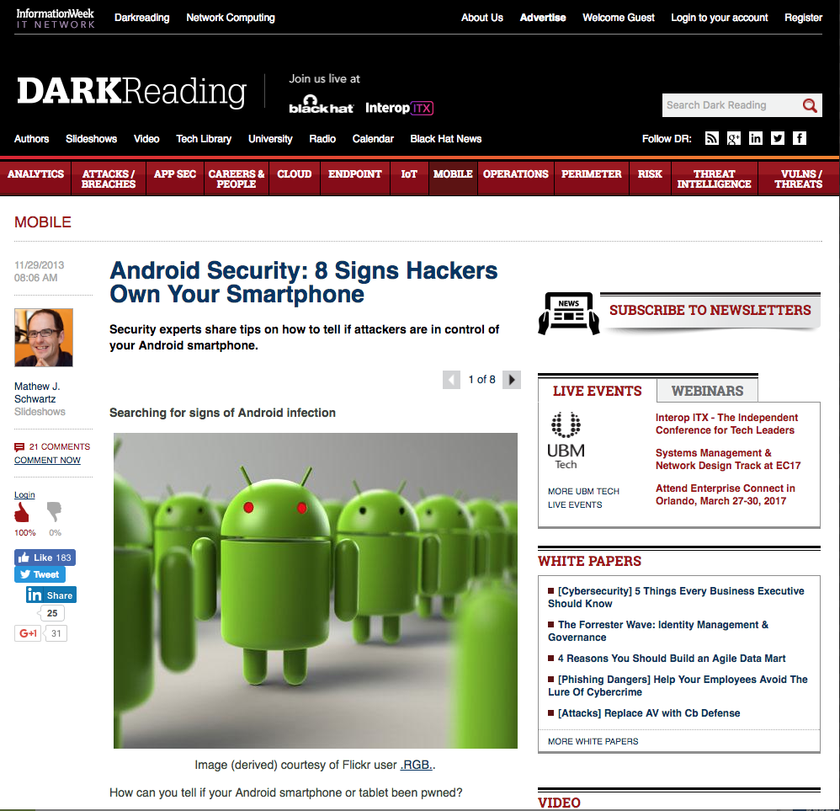
[Android] Cell phones cannot have not be[en] secured.
Cell phones have:
  Wireless networks, microphone, camera, & batteries
  Downloaded apps
  Bad crypto
Cell phones can be used for:
  Tracking individuals
  Wiretapping rooms
  Personal data

Slide 45
How do we address the cybersecurity challenge?
1. Deploy technology that works.
2. Address the non-technical issues.

Slide 46
We have made major advances in cyber security.
Major security breakthroughs since 1980:
  Public key cryptography (RSA with certificates to distribute public keys)
  Fast symmetric cryptography (AES)
  Fast public key cryptography (elliptic curves)
  Easy-to-use cryptography (SSL/TLS)
  Sandboxing (Java, C# and virtualization)
  Firewalls
  BAN logic
  Fuzzing.
None of these breakthroughs has been a “silver bullet,”
but they have all helped.
    “Why Cryptosystems Fail,” Ross Anderson,
    1st Conference on Computer and Communications Security, 1993.
    http://www.cl.cam.ac.uk/~rja14/Papers/wcf.pdf

Slide 47
We must continue to deploy technology that works, because adversaries are not all powerful.
Adversaries are impacted by:
    Economic factors
    Attention span
    Other opportunities
You don’t have to run faster than the bear….
http://forums.corvetteforum.com/off-topic/2824193-i-only-have-to-outrun-you-polar-bear-tag.html

Slide 48
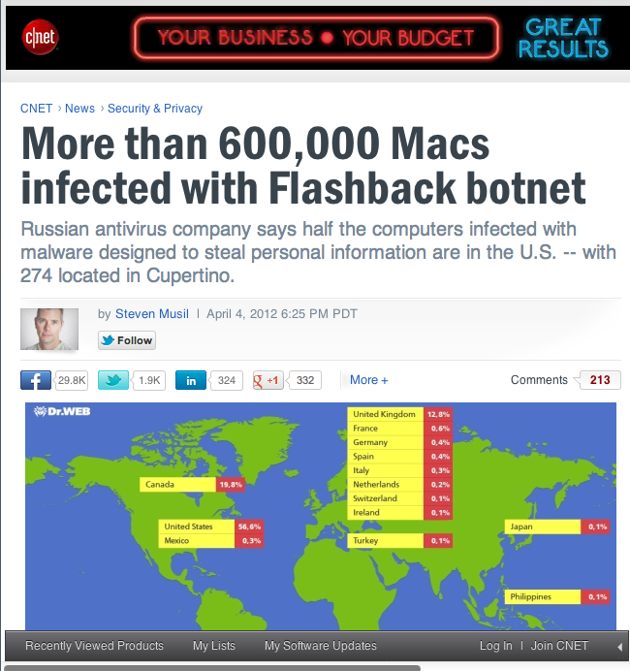


There are solutions to many cyber security problems...
We should use them!
8.63% of the desktop computers still run Windows XP
    http://netmarketshare.com/
  Support was ended in 2014!
Apple users don’t run anti-virus.
  Yes, Apple tries to fix bugs, but
Most “SSL” websites only use it for logging in.
DNSSEC lags
Smart Cards aren’t

Slide 49
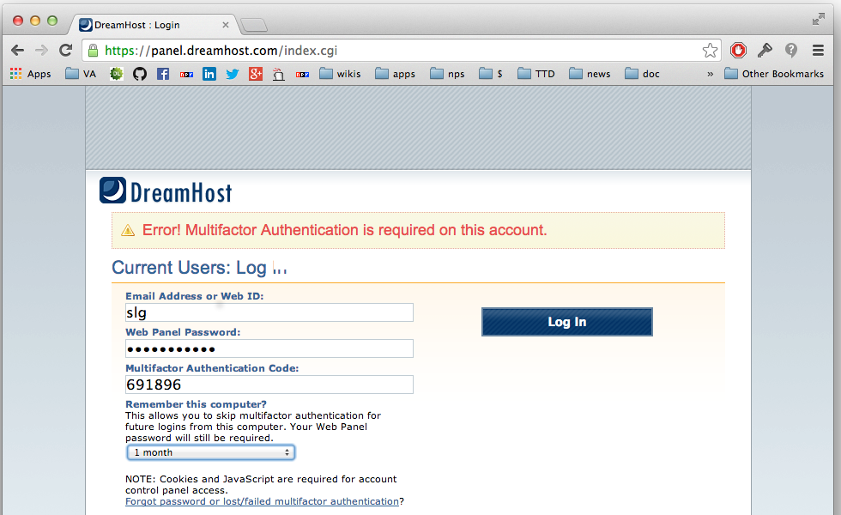
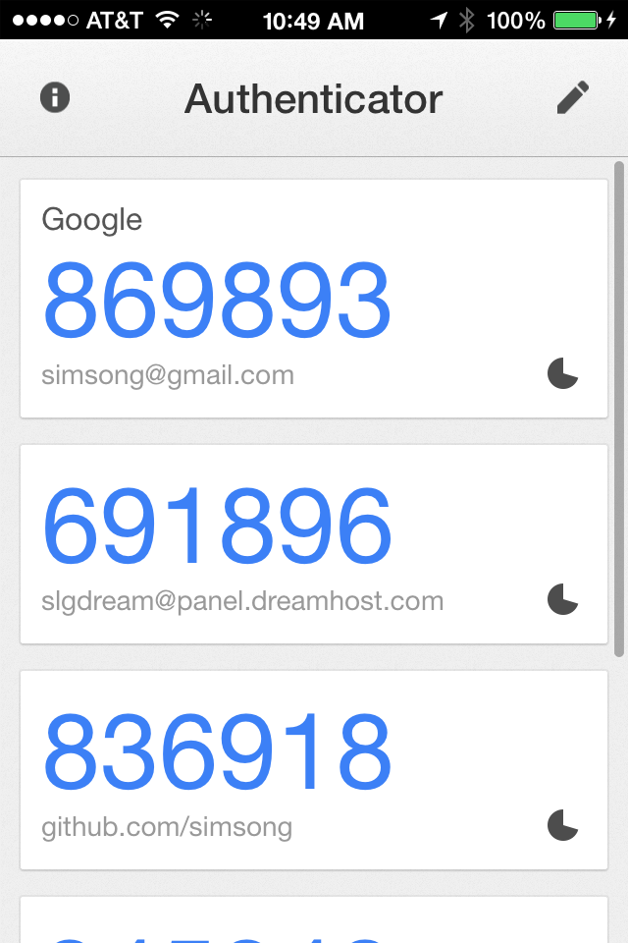
Example: Google Authenticator’s 2-factor authentication protections against password stealing.

Slide 50
Universal Second Factor (2UF)

Slide 51
We must address non-technical factors that impact cyber.
These factors reflect deep divisions within our society.
  Shortened development cycles
  Education: Not enough CS graduates; not enough security in CS.
  Labor:
    Immigration Policy: Foreign students; H1B Visa
    HR: Inability to attract and retain the best workers
  Manufacturing Policy: Where we are building our computers.
Solving the cyber security mess requires addressing these issues.

Slide 52
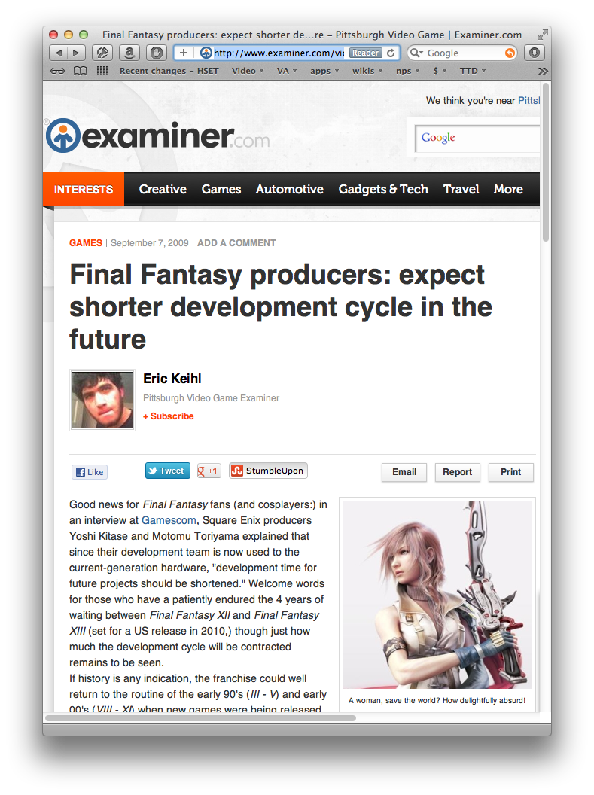

Short development cycles
Insufficient planning:
  Security not “baked in” to most products
  Few or no security reviews
  Little Usable Security
Insufficient testing:
  Testing does not uncover security flaws
  No time to retest after fixing
Poor deployment:
  Little monitoring for security problems
  Difficult to fix current system when new
  system is under development
Address institutionalized harassment of women

Slide 53
Education is not supplying enough security engineers.
Software engineers don’t learn enough about security.
Security HR Pipeline
  High School → College → Graduate School → Career
It takes years to master security...
  Many professional programmers learn their craft in college
  College English graduates: 16 years’ instruction in writing
  College CS graduates: 4 years’ instruction in programming
    Is it any wonder their code has security vulnerabilities?

Slide 54
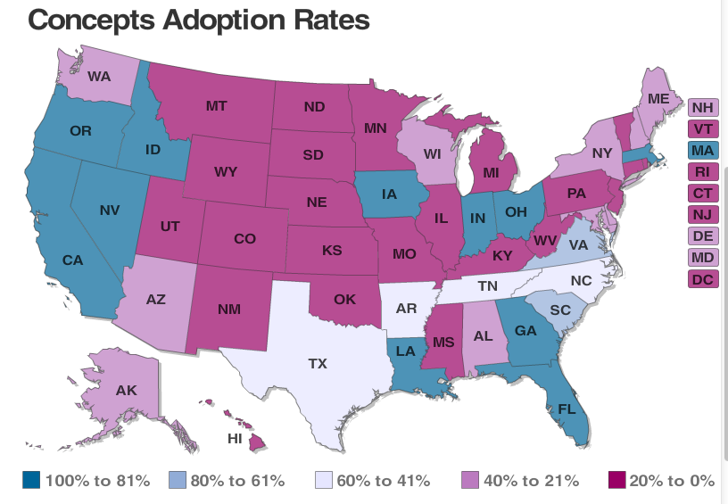
73% of states require computer “skills” for graduation.
Only 37% require CS “concepts”
CS teachers are paid far less than CS engineers.

Slide 55
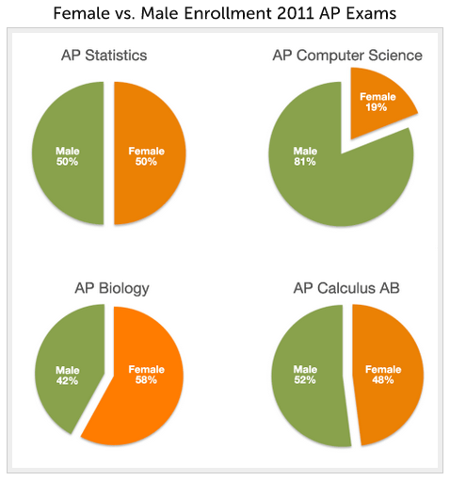
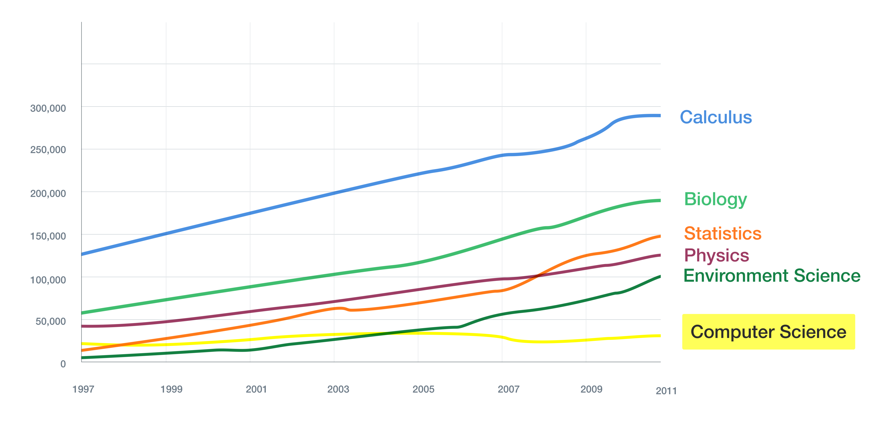
High school students are not taking AP computer science!
AP Exams 1997 -2011
Source: College Board, Advanced Placement (AP)
Exam Data 2011, available at
http://professionals.collegeboard.com/data-reports-research/ap/data

Slide 56
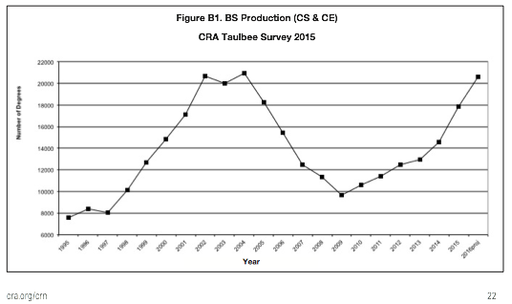
Good news:
Computer Science BS production is once again at its peak!

Slide 57
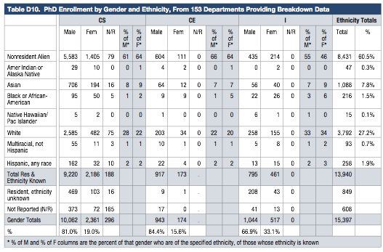
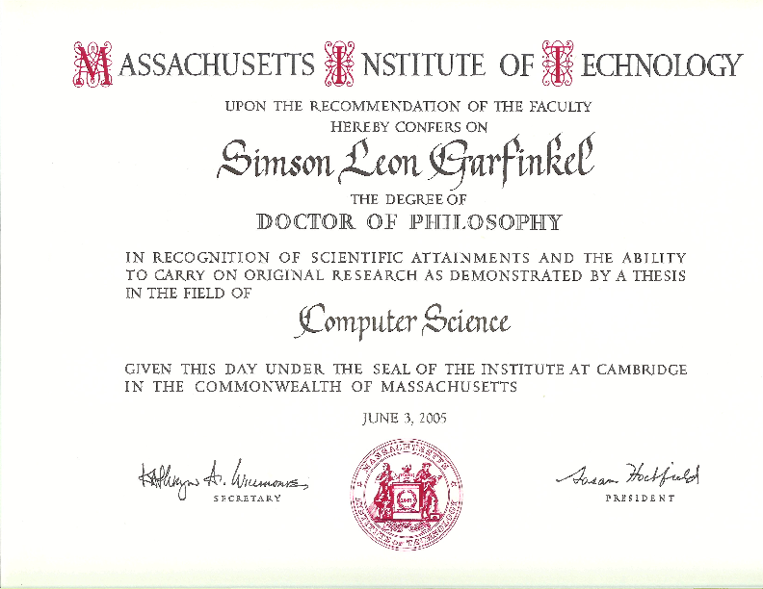

60.5% of PhDs awarded in 2015 to nonresident aliens
    We did not train Russia’s weapons scientists in Boston during the Cold War.
Clip a green card
to every PhD diploma

Slide 58




Just 67 / 1275 (5%) PhDs went into Information Assurance
21 professors & postdocs; 41 to industry & government
Security should be taught to everyone, but we need specialists

Slide 59

Bureau of Labor Statistics puts CS as 12th highest paying profession, after...
Highest paying occupations:
  Physicians and surgeons > $187K
  Family practitioners: $184K
  CEOs: $175K
  Nurse anesthetists: $157K
  Dentists: $153K
  Architectural and engineering
  managers: $133K
  Computer and information
  systems managers: $131K

Slide 60

Computer scientists make less than MIS managers...

Slide 61

Manufacturing policy —
The US did not buy WW2 aircraft from Germany
Boeing Whichata B-29 Assembly Line, 1944
http://en.wikipedia.org/wiki/File:Boeing-Whichata_B-29_Assembly_Line_-_1944.jpg

Slide 62


But we buy nearly all of our computers from China.
It’s easy to put backdoors in hardware and software.

Slide 63
We need to bring computer security to K-12
K-12 education that:
  Integrates data, communications & computation across the curricula
  Graduating programmers should have 10 years’ experience before writing code that can steal you credit card numbers!
Policies that accomplish their stated goals.
  16 character passwords are no more secure than 12 character passwords

Slide 64
There is no obvious way to secure cyberspace.
We trust computers…
    but we cannot make them trustworthy.
    (A “trusted” system is a computer that can violate your security policy.)
We know a lot about building secure computers...
    but we do not use this information when building and deploying them.
We know about usable security…
    but we can’t make any progress on usernames and passwords
We should design with the assumption that computers will fail…
    but it is cheaper to design without redundancy or resiliency.
Despite the new found attention to cyber security,
our systems seem to be growing more vulnerable every year.
Thank you!

Slide 65
Backup Slides:
HCI-SEC

Slide 66
Major Themes in HCI-SEC Academic Research
UserAuthentication
  Text Passwords
  Graphical Authentication
  Biometrics
  Token-based Authentication
  CAPTCHAs
Email Security and PKI
  Automatic,Transparent Encryption
Anti-PhishingTechnology
Password Managers
Device Pairing
Web Privacy
Policy Specification and Interaction
Security Experts
Mobile Security and Privacy
  Location Privacy
  Application platforms
  Mobile authentication
Social Media Privacy

Slide 67
HCI-SEC Lessons and Challenges
Lessons Learned:
  Users need better information, not more information
  To make good decisions, users require clear context
  Plain Language Works,Even if it is less precise
  Where Possible, Reduce Decisions and Configuration Options
  Education Works, but cannot overcome economics
Research Challenges
  Authentication Challenges
  Administration Challenges
  Privacy Challenges
  Challenge of Modelling the Adversary
  The Challenge of Social Media and Social Computing
  Teaching Challenges

Slide 68
HCI-SEC Conclusion: The Next 10 years
More HCI-SEC Research Centers
More HCI-SEC ResearchTargets
Increased Researching on Nudges and Pusuasion
Increased Emphasis on Offensive Work
Increased demand for HCI-SEC from non-technical sectors

Slide 69
Backup Slides:
Insider Threat

Slide 70






DETECTING THREATENING INSIDERS WITH LIGHTWEIGHT MEDIA FORENSICS
Naval Postgraduate School &
The University of Texas at San Antonio
Dr. Simson Garfinkel (NPS) & Dr. Nicole Beebe (UTSA)
8am, Wednesday November 13th, 2013

Slide 71

Team Profile
Naval Postgraduate School
  Simson L. Garfinkel
  Assoc. Prof
  Computer Science
    simsong@acm.org
    +1.202.649.0029
The University of Texas at San Antonio
  N. Beebe, Asst. Prof.
  Info Systems/Cyber Security
    Nicole.Beebe@utsa.edu
    +1.210.269.5647

Slide 72
The current approaches for finding hostile insiders are based on “signatures.”
Sample signature to find a problem employee:
These signatures are typically hand written.
    Brittle
    Don’t scale
    Miss new patterns
(CERT 2011)
• if the mail is from a departing insider
• and the message was sent in last 30 days
• and the recipient is not in organization’s domain
• and the total bytes summed by day is more than X,
➜ send an alert to security operator

Slide 73






We propose a new approach for finding threatening insiders—storage profile anomalies.
Hypothesis 1:
Some insiders hoard before exfiltration
  Manning
  Snowden

Slide 74


We also want to detect other kinds of illegal employee activity.
Hypothesis 2:
Some illegal activity has storage indicators:
  Contraband software (hacking tools) and data
  Large amount of:
    graphics
    PII; PHI; account numbers
    Encrypted data
  Stolen documents
Illegal employee activity is:
  Bad for business
  Exploitation threat
  Fraud risk

Slide 75

Our plan: look for storage devices that are different than their peers.
We build a “storage profile” from features:
  # of credit card numbers, phone #s; SSNs, DOBs, etc.
  % pictures; %video
  % Doc files; %PDFs;
“Different” relative to:
  User’s history
  User’s organization
  Others in role.
Garfinkel, S. and Shelat, A., "Remembrance of Data Passed: A Study of Disk Sanitization Practices," IEEE Security & Privacy, January/February 2003.

Slide 76

Our approach:
Collect “storage profiles” and look for outliers.
We profile storage on the hard drive/storage device:
  Allocated & “deleted” files; Unallocated space (file fragments)
Statistical profile is collected:
  Frequently, at “random” times
  Securely — by going to raw media
  Centrally — at management console

Slide 77


We cluster the storage profiles to find “outliers.”
What’s an outlier?
  Something that’s different from its peers
  Something different from its own history
Outliers Matter
“Normal” Storage Profile

Slide 78

Outlier detection should have significant benefits:
  Not signature based
  Not reliant on access patterns
  Not reliant on policy definition, discovery, auditing
Design constraints:
  Agent must be scalable and cannot interfer with operations
    Desktop: background process, samples disk data
    Network load: small, aggregated data transfer
    Management console: scalable algorithms used
  Must work with isolated systems
  Must be OS agnostic
  Must includes deleted data in collection/analysis

Slide 79
Competing Alternatives (sample)
SIEM Appliances (Security Information & Event Management)
  Various commercial tools
  Disadvantages
    Relies on fusion of system data & event logs
    Not data/content focused
    No analysis of deleted data
Signature-based extrusion detection systems
  Example: ELICIT (from MITRE)
  Disadvantages
    Presumes attacks follow a known signature
    Policy discovery and measurement challenges

Slide 80





Our system has three parts:
1. Sample disk to collect desired data
  bulk_extractor
    a lightweight media forensics tool
2. Client-server, enterprise response framework
  Google Rapid Response (GRR)
3. Anomaly detection agent
  Univariate and multivariate outlier detection
Garfinkel, Simson, Digital media triage with bulk data analysis and bulk_extractor. Computers and Security 32: 56-72 (2013)

Slide 81



Random sampling is a great way to analyze data.
Simple random sampling can determine % free space
Data characterization can determine the kind of stored data
Sector hashing can identify specific target files
.
.
.
.
.
.
.
.
.
.
.
.
.
Garfinkel, Simson, Vassil Roussev, Alex Nelson and Douglas White, Using purpose-built functions and block hashes to enable small block and sub-file forensics, DFRWS 2010, Portland, OR
.
.
Young J., Foster, K., Garfinkel, S., and Fairbanks, K., Distinct sector hashes for target file detection, IEEE Computer, December 2012
.
.
.
.
.
.
.
.
.
.
.

Slide 82
It takes 3.5 hours to read a 1TB hard drive.
In 5 minutes you can read:
  36 GB in one strip
  100,000 randomly chosen 64KiB strips (assuming 3 msec/seek)
Minutes | 208 | 5 | 5
Data | 1 TB | 36 GB | 6.5 GB
# Seeks | 1 | 1 | 100,000
% of data | 100% | 3.6% | 0.65%

Slide 83

The statistics of a randomly chosen sample
predict the statistics of a population.
US elections can be predicted by sampling thousands of households:
  Hard drive contents can be predicted by sampling thousands of sectors:
  The challenge is identifying
  likely voters.
  The challenge is identifying the sector content that is sampled.

Slide 84

We think of computers as devices with files.

Slide 85
This heatmap of anomalies let an analyst easily identify clusters and outliers.

Slide 86
Current status —
bulk_extractor updated v1.4 just released
  Added features & GRR integration preparation
Sceadan data type classifier updated v1.2 released
Extraction, transformation, loading of datesets
  M57 Patents (digitalcorpora.org) case
Progress on anomaly detection algorithm
  Real Data Corpus extraction, translation and loading near complete
  Theoretical development
  Empirical data descriptive analyses (test assumptions)
  Univariate anomaly detection performing well on synthetic data set

Slide 87
We are in year 1 of a 3-year effort.
 | NPS Lead | UTSA Lead
Year 1 | bulk_extractor upgrades | Outlier detection algorithm Synthetic data experimentation Real Data Corpus experimentation
Year 2 | Integrate GRR Develop/test management console | Develop/test data outlier detection Develop/test visualization component
Year 3 | Large-scale testing on partner net | Final dev. of outlier detection algorithm Final dev. of visualization agent

Slide 88
Many challenges remain.
“Anomalous” suggests “normal” exists
  Large, diverse, dislocated organizations
  High fluidity and variety in workforce
  Remote, mobile, multi-device access requirements
  Uninterruptible, critical computational operations
Clustering algorithm selection/development
  Accuracy and speed trade-off of extant algorithms
  Develop combinatorial algorithm to improve accuracy
  Need for automated parameter selection amidst noise
  Feature selection
Engineering of visualization component

Slide 89

In conclusion, we are developing a system that uses “lightweight media forensics” to find hostile insiders.
We use random sampling to build a storage profile of media
We collect these profiles on a central server
We cluster & data mine to find outliers.
Contact:
  Simson L. Garfinkel simsong@acm.org
  Nicole Beebe Nicole.Beebe@utsa.edu

Slide 90


Security problems reflect deep societal problems.
We need to fix our society.
Follow the money.
IEEE Security & Privacy
Florêncio and Herley, Dec. 2012
  Emptying accounts is hard
  Mules, not victims, lose money
  Passwords are not the bottleneck
  Underground markets are not thriving
  Credential Stealing is a terrible business
Supporting slides:
    https://www.usenix.org/sites/default/files/conference/protected-files/woot_herley.pdf
Video
    https://www.usenix.org/conference/woot12/keynote-tba (1 hour, 25 minutes)

